Slide 1
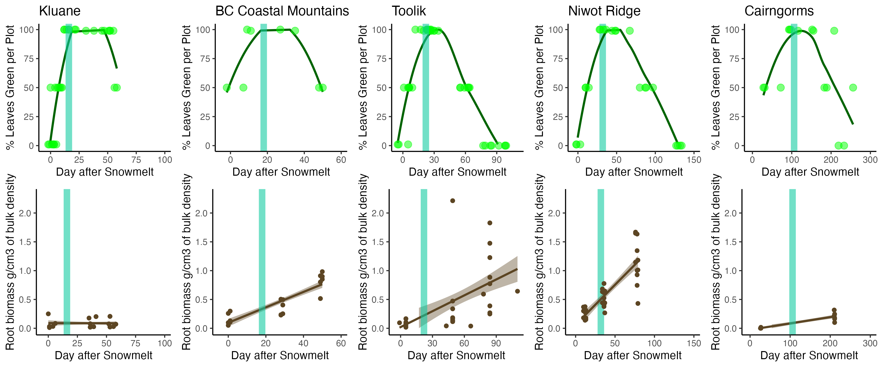

Slide 2
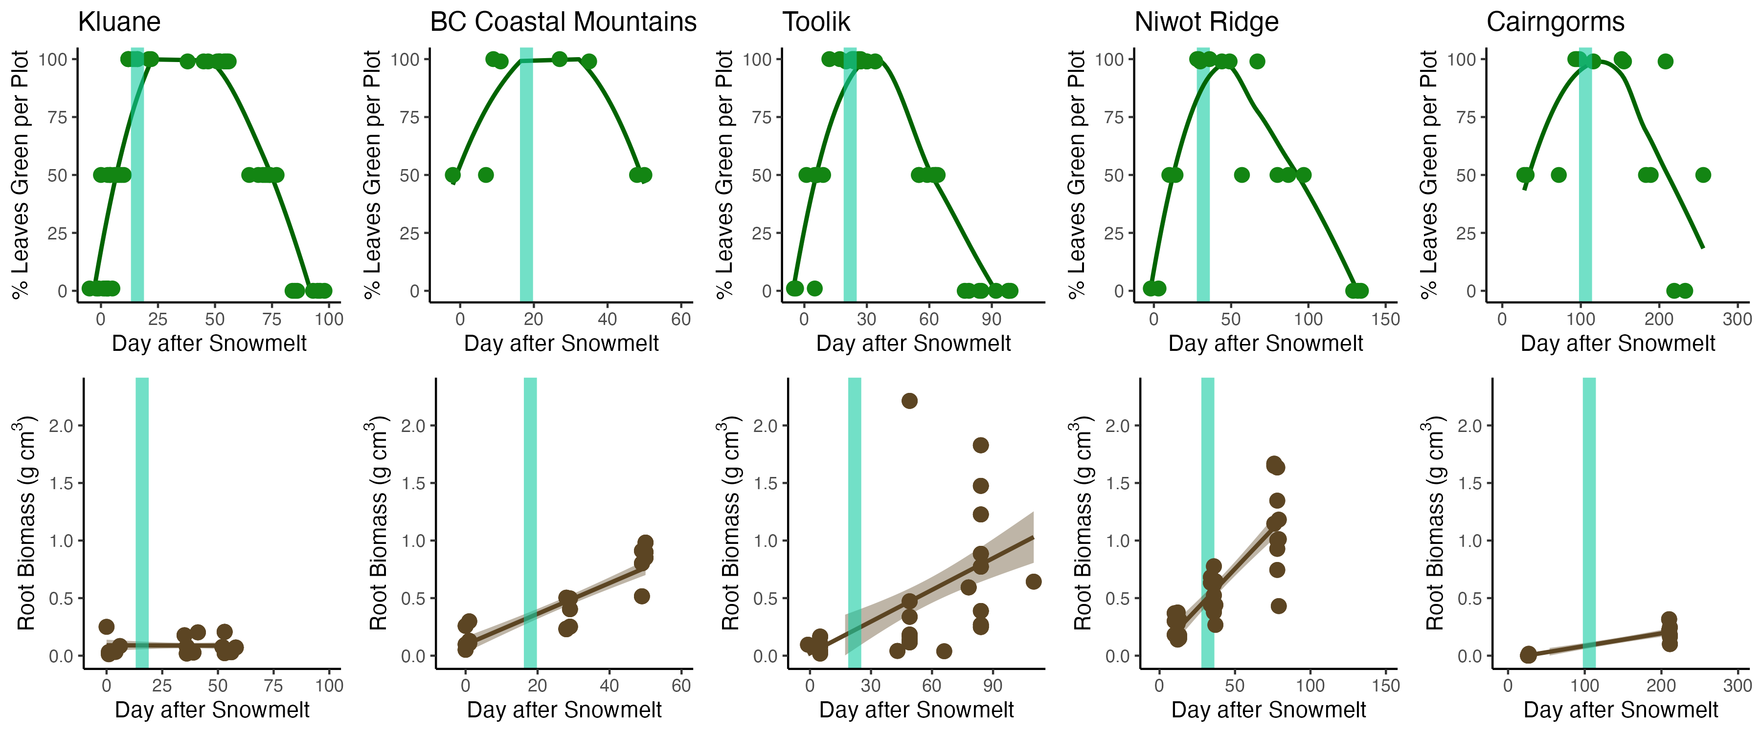
32
62
47
101
x = Number of days of observed root growth after the date of peak aboveground growth

