Slide 1
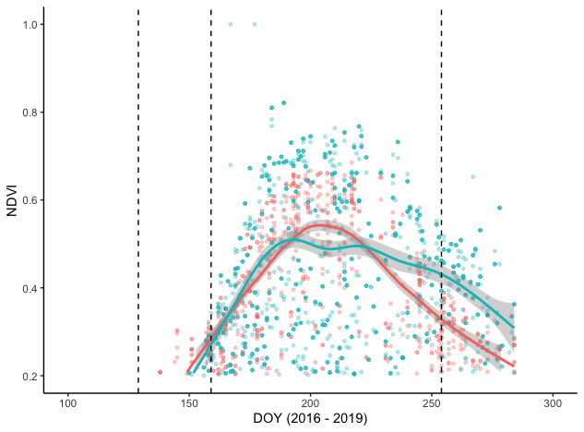
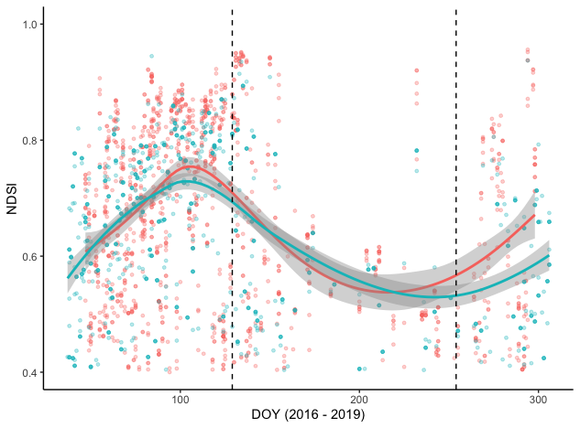

a)
b)
Average snow-free date (phenocams)
Average senescence date (phenocams)
Average green-up date (phenocams)
Average senescence date (phenocams)
Average green-up date (phenocams)

