Slide 1
Team 17
A2: Team Presentation
Would your friends describe you as normal?
Link to video presentation:
https://youtu.be/wURu7Q4em1c
R

Slide 2
Context
In order to better understand our customers, we conducted interviews with 5 questions regarding different aspects of their life and personalities, and a final binary question regarding their ‘normality’. Due to Covid circumstances, the interviews were conducted over Zoom, and otter.ai was used to transcribe the responses. We conducted over 30 interviews, and this dashboard will go through some key analysis we have conducted on our data to generate insights.
Questions
1. If you were arrested with no explanation, what would your friends and family assume you had done? 2. What is your spirit animal and why? 3. Who is your craziest family member and why? 4. What is the dumbest way you hurt yourself? 5. What is your most unusual talent? 6. Would your friends describe you as normal? (Y/N)
Limitations
Low number of responses collected limits the generalization of insights
Quality of transcription software distorted responses and may mask key words
R

Slide 3
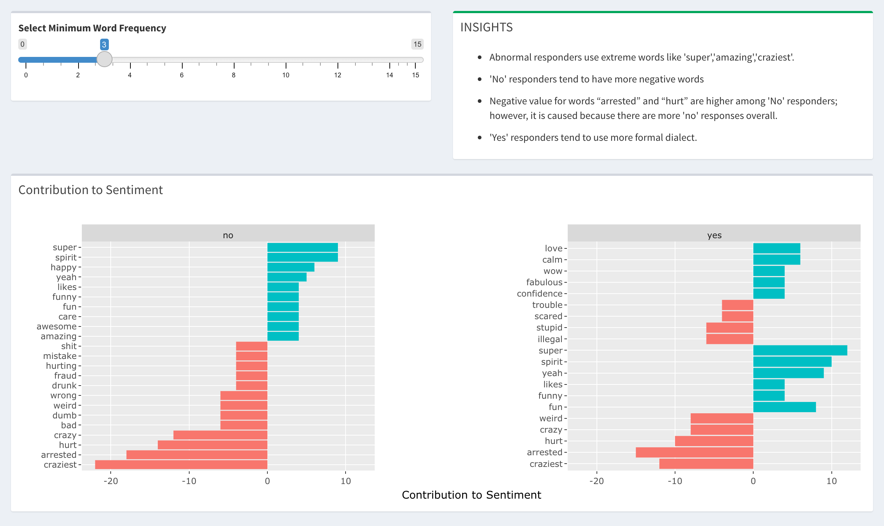
Sentiment Analysis
R

Slide 4
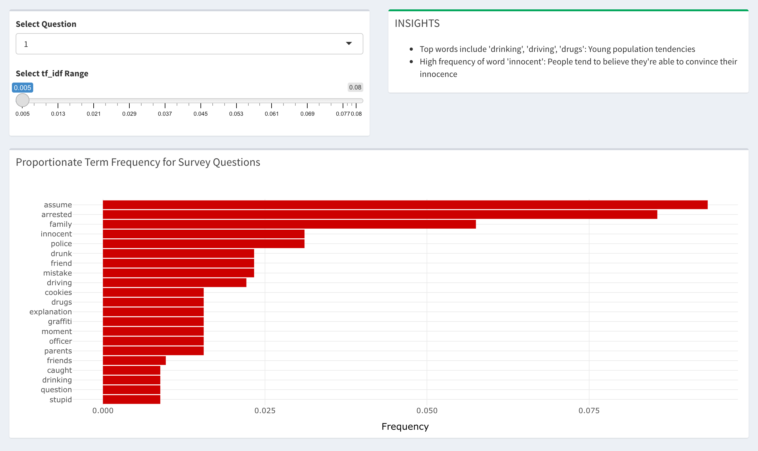
Relative Term Frequency
R

Slide 5
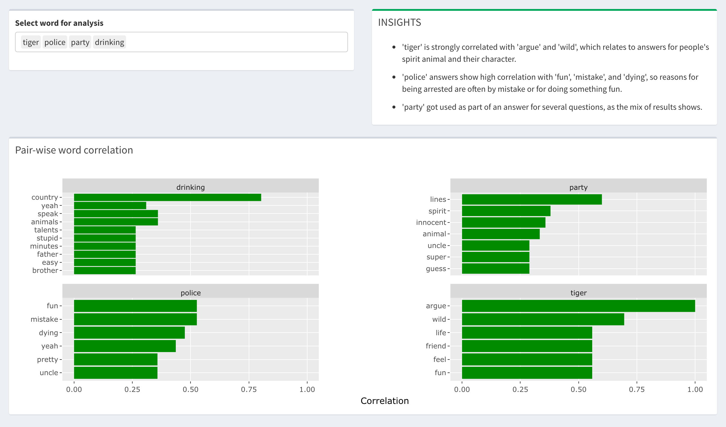
Pair Wise Correlation
R

Slide 6
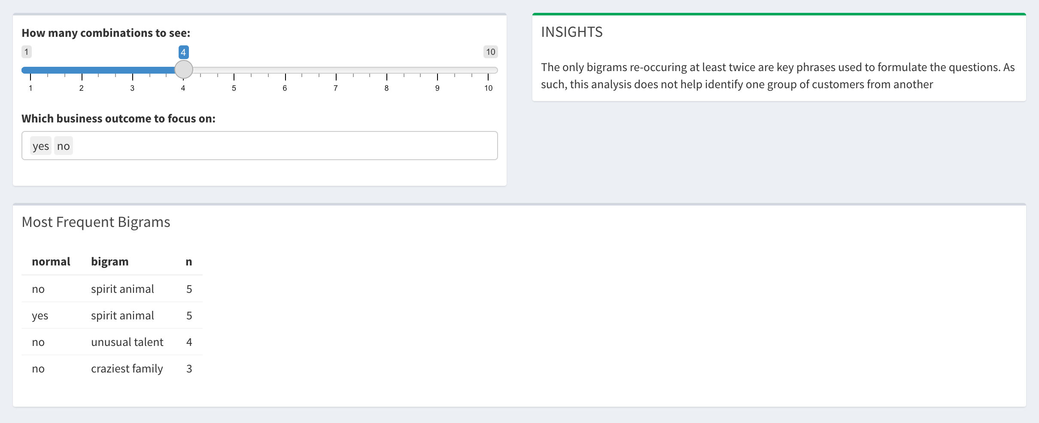
N-Grams
R

Slide 7
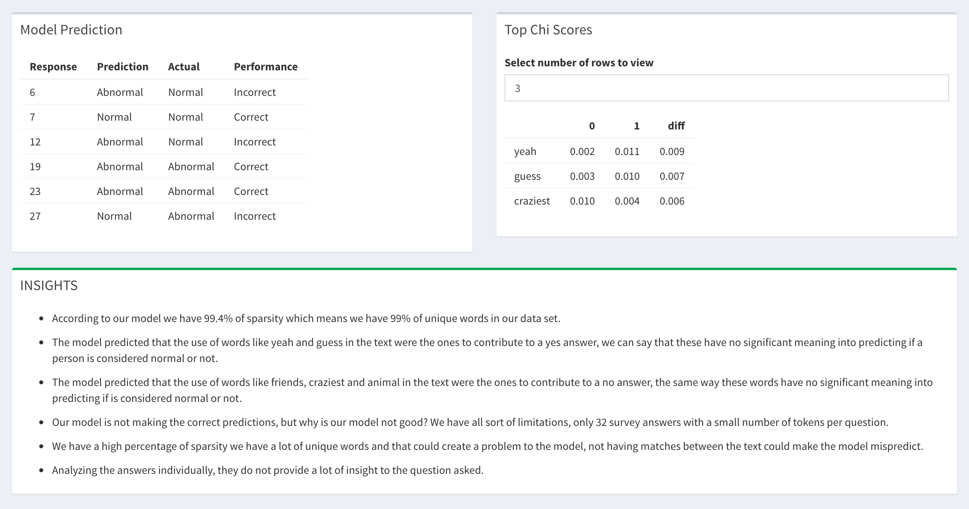
Prediction
R

