Slide 1
COVID 19 PRECONDITION ANALYSIS
Rows:
500 000 rows
1 row = one patient – no duplicates
Columns :
Categorial datas about chronical deseases, gender
Numerical datas: age, symptome dates, death dates, hospital entry dates
Data Cleaning:
Recode with true or false on the patient condition
Compute symptomes duration and time from symptom to death
Withdraw patient with « not specified » / « awaiting result » (= N/A value)
68K row left split in two data set to test the results

Slide 2
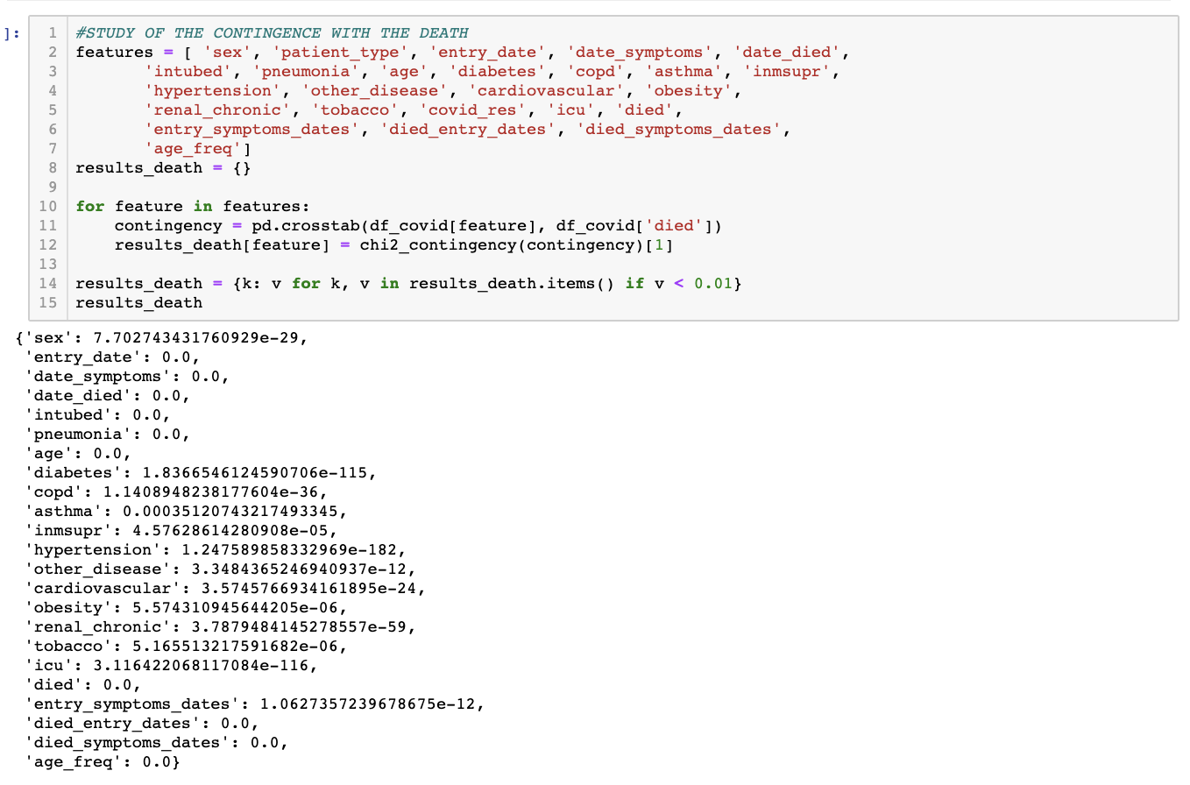
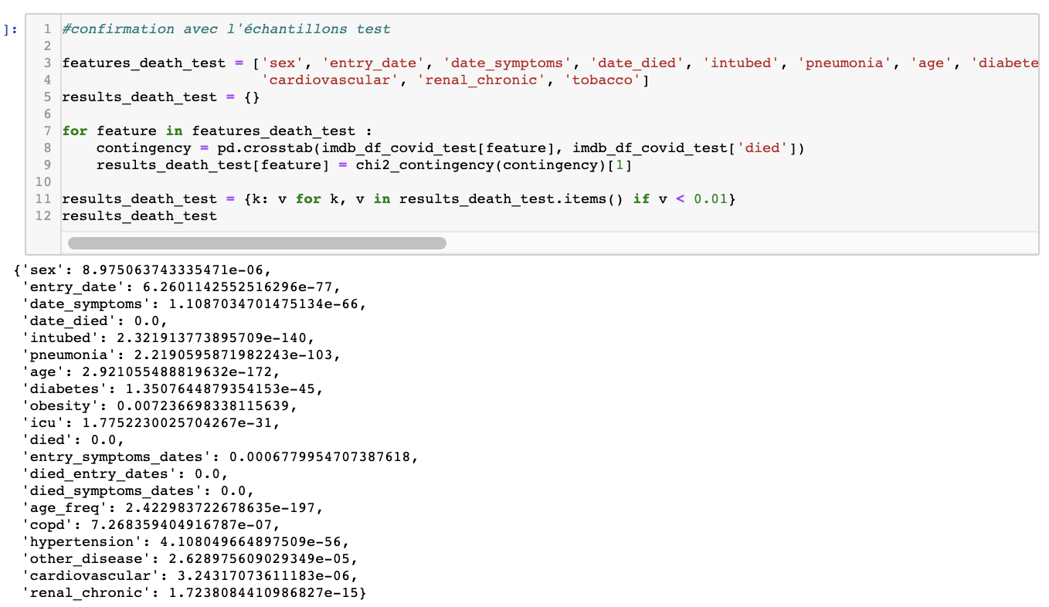
CONTINGENCY TEST ON DEATH
80% SAMPLE TEST
20% SAMPLE TEST
['asthma', 'inmsupr', 'tobacco’] did not pass the sample test

Slide 3
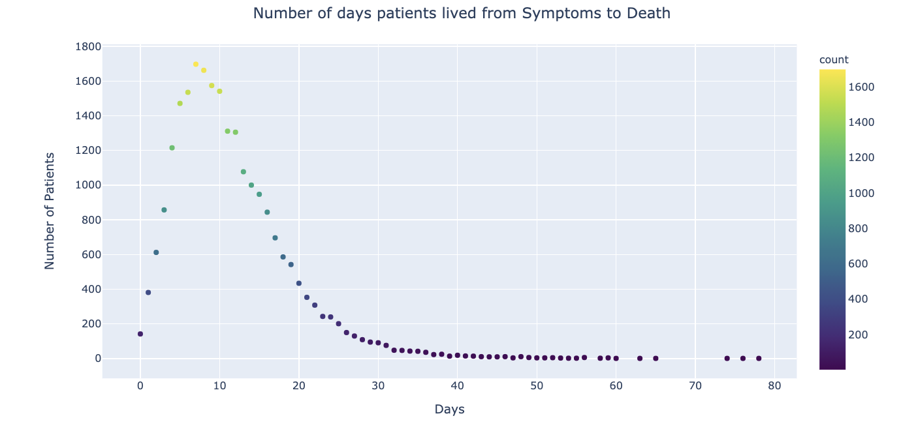
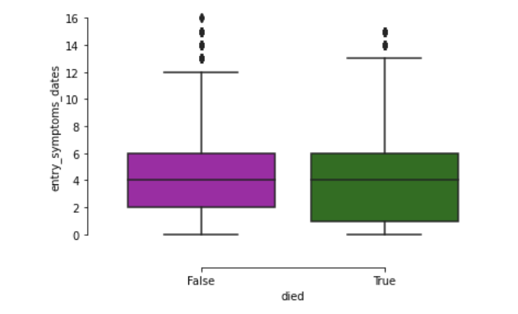
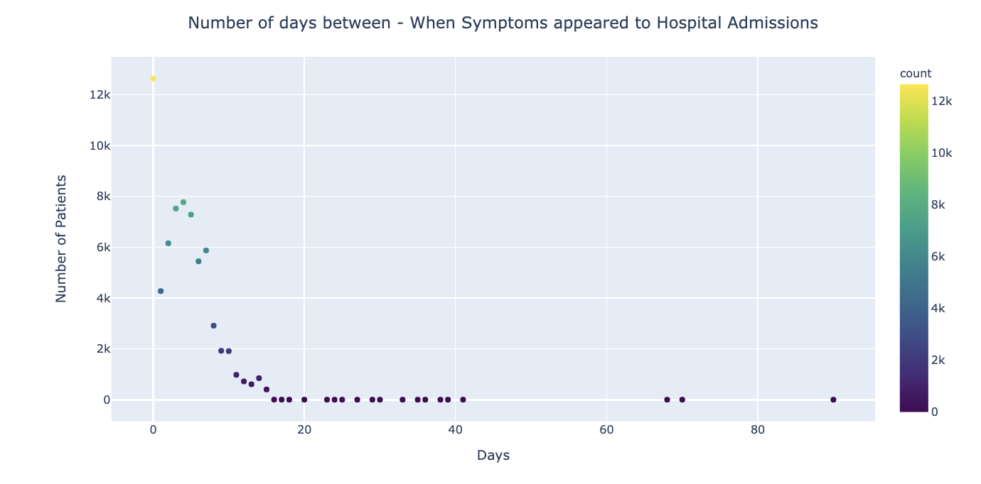
ANALYSIS ON SYMPTOMES, HOSPITALISATION & DEATH

Slide 4
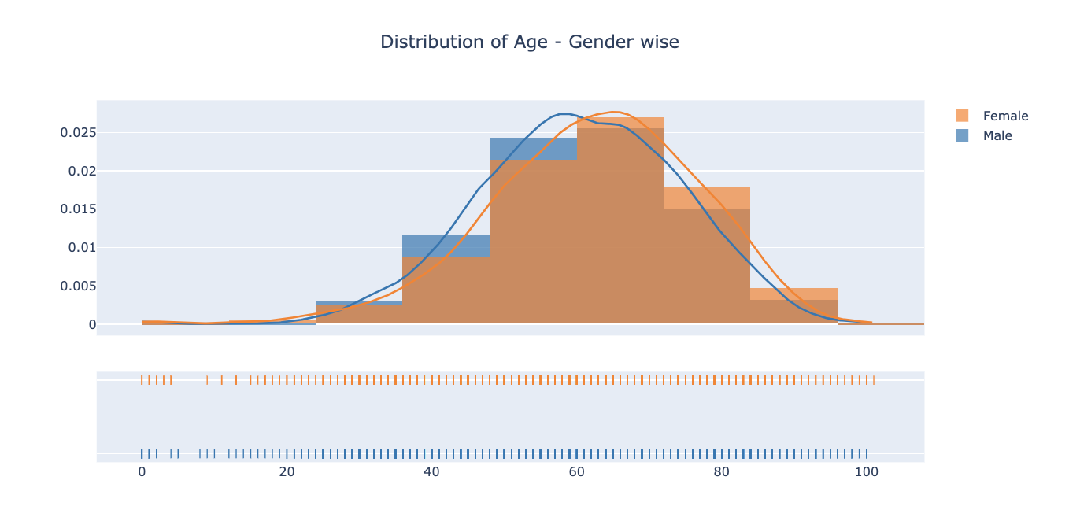
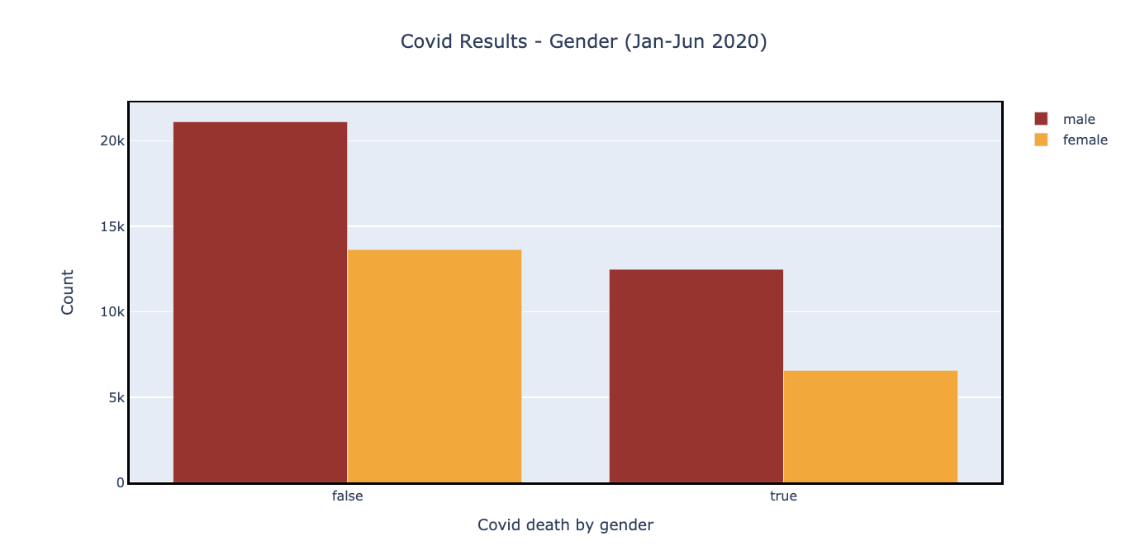
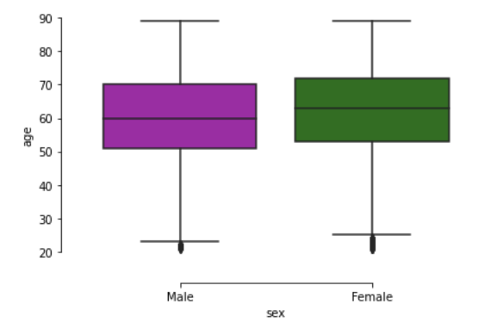
ANALYSIS ON DEATH FOR GENDER & AGES
62%
68%
38%
32%

Slide 5
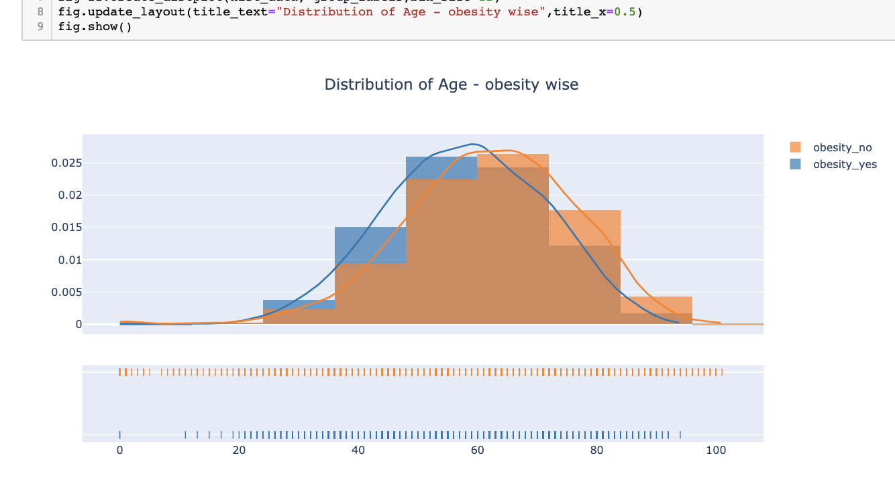
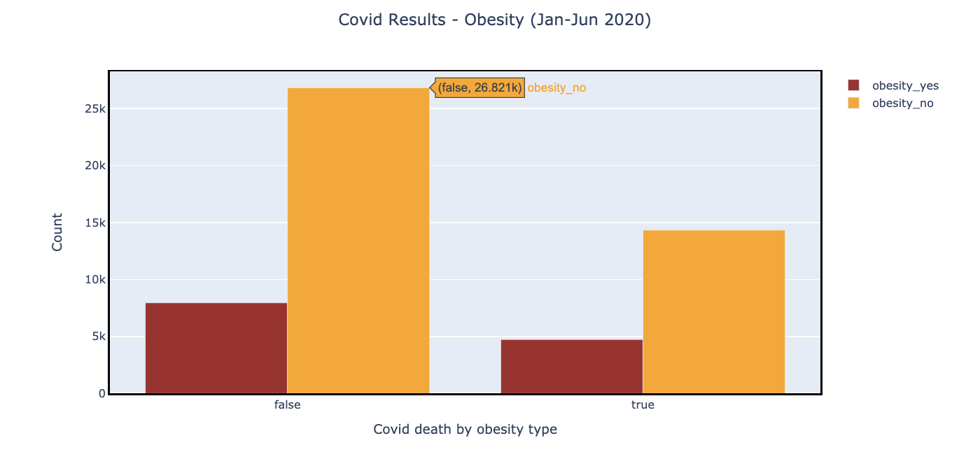
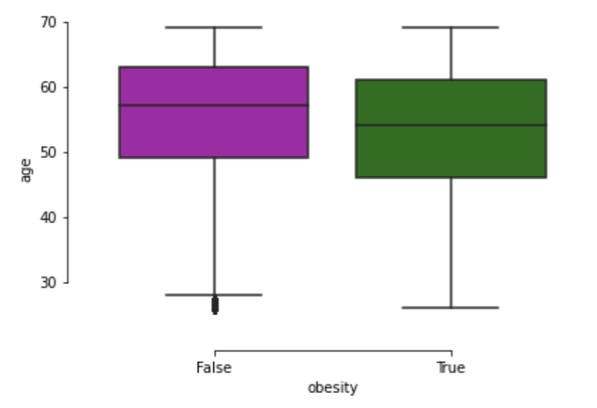
ANALYSIS ON OBESITY
65%
35%
62%
38%

Slide 6
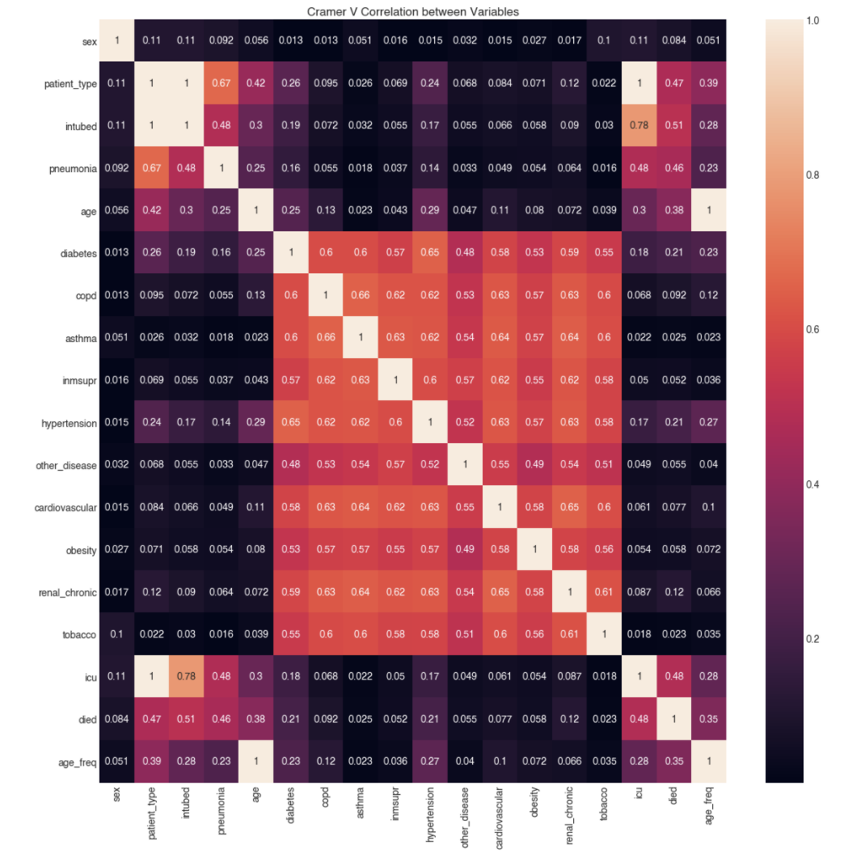
CRAMER MATRIX

