Slide 1
读者写者问题

Slide 2
Classical Problems of Synchronization:
Readers-Writers Problem
进程通信
Readers-writers problem
  One data object is to be shared by two kinds of processes.
  Reader processes may want only to read the shared object.
  Writer processes may want to update (that is, to read and write) the shared object.
Synchronization requirement for
  A writer and some other processes may not access the shared object simultaneously.
  More than one reader process can access the shared object simultaneously.

Slide 3
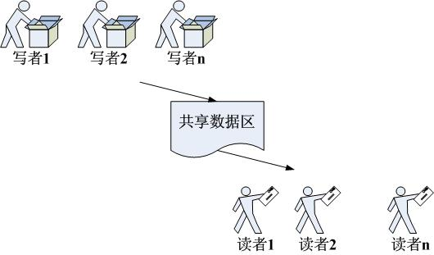

Slide 4
Readers first读者优先
No reader will be kept waiting unless a writer has already obtained permission to use the shared object.
如果读者来：
  无读者、写者，新读者可以读
  有写者等待，但有其他读者正在读，新读者可以读
  有写者写，新读者等
如果写者来：
  无读者，新写者可以写
  有读者，新写者等待
  有其他写者，新写者等待

Slide 5
读者：
While(true){
P(mutex);
readcount++;
if(readcount==1)
P(w);
V(mutex);
读
P(mutex);
readcount--;
if(readcount==0)
V(w);
V(mutex);
}
写者：
While(true){
P(w);
写
V(w);
}

Slide 6
写者优先
第二类读者写者问题：
写者优先
条件：
1）多个读者可以同时进行读
2）写者必须互斥（只允许一个写者写，也不能读者写者同时进行）
3）写者优先于读者（一旦有写者，则后续读者必须等待，唤醒时优先考虑写者）

Slide 7

readcount=0; writecount=0； S=mutex=w=wmutex=1
读者：
while (true) {
P(S);
P(mutex);
readcount ++;
if (readcount==1)
P (w);
V(mutex);
V(S);
读
P(mutex);
readcount --;
if (readcount==0)
V(w);
V(mutex);
};
写者：
while (true) {
P(wmutex);
writecount++;
if(writecount==1)
P(S);
V(wmutex);
P(w);
写
V(w);
P(wmutex);
writecount--;
if(writecount=0)
V(S);
V(wmutex);
};

Slide 8
分析
S的意义？
上面代表的情形
能否继续对写者进行提前？

Slide 9
readcount=0; writecount=0；S=mutex=w=wmutex=m=1
读者：
while (true) {
P(m);
P(S);
P(mutex);
readcount ++;
if (readcount==1)
P (w);
V(mutex);
V(S);
V(m);
读
P(mutex);
readcount --;
if (readcount==0)
V(w);
V(mutex);
};
写者：
while (true) {
P(wmutex);
writecount++;
if(writecount==1)
P(S);
V(wmutex);
P(w);
写
V(w);
P(wmutex);
writecount--;
if(writecount=0)
V(S);
V(wmutex);
};

Slide 10
继续
在实际应用中，写优先非常重要，因为写代表的是对数据的更新。而我们希望读到的是最新的消息。因此继续进行改进，就要考虑，如果写者到来，可以让正在读的读者让路，先让写者写。

Slide 11
理发师问题
理发店理有一位理发师、一把理发椅和n把供等候理发的顾客坐的椅子
如果没有顾客，理发师便在理发椅上睡觉
一个顾客到来时，它必须叫醒理发师
如果理发师正在理发时又有顾客来到，则如果有空椅子可坐，就坐下来等待，否则就离开

Slide 12
设置整形变量 waiting /*等候理发的顾客数*/
CHAIRS /*为顾客准备的椅子数*/
信号量 customers顾客数, barbers空着的理发师数，mutex
customers = 0; barbers = 0; waiting = 0; mutex = 1;
Procedure barber;
while(TRUE){ /*理完一人,还有顾客吗?*/
P(cutomers); /*若无顾客,理发师睡眠*/
P(mutex); /*进程互斥*/
waiting = waiting – 1; /*等候顾客数少一个*/
V(barbers); /*理发师去为一个顾客理发*/
V(mutex); /*开放临界区*/
cut-hair( ); /*正在理发*/
}
procedure customer
{
P(mutex); /*进程互斥*/
if waiting<CHAIRS{ /*看看有没有空椅子*/
waiting = waiting+1; /* 等候顾客数加1*/
V(customers); /*必要的话唤醒理发师*/
V(mutex); /*开放临界区*/
P(barbers); /*无理发师, 顾客坐着养神*/
get-haircut( ); /*理发*/
}
else V(mutex); /*人满了,走吧!*/
}

