Slide 1
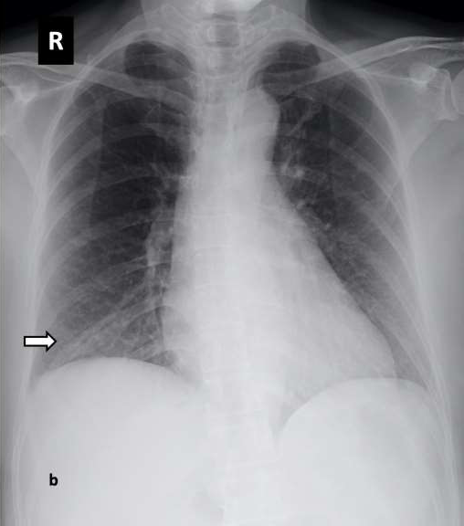
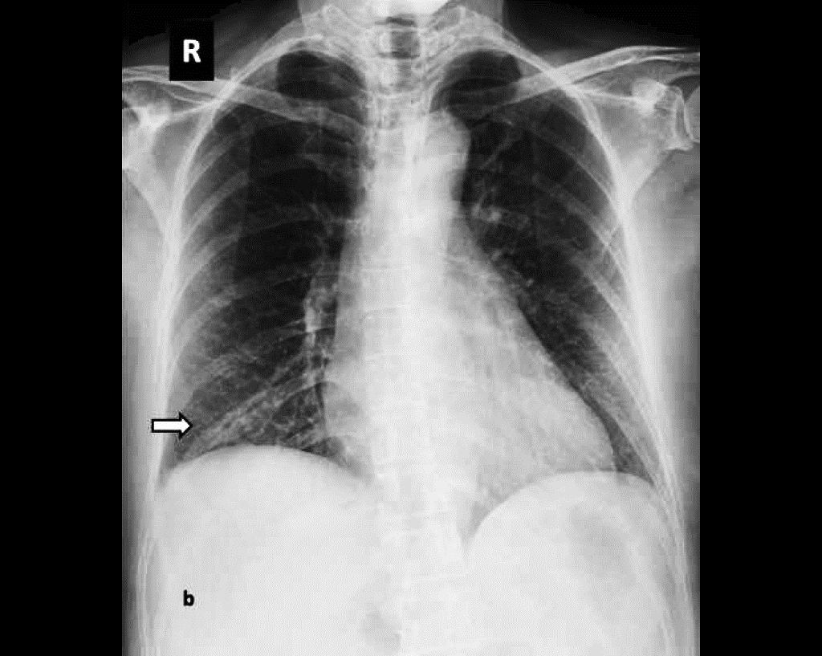
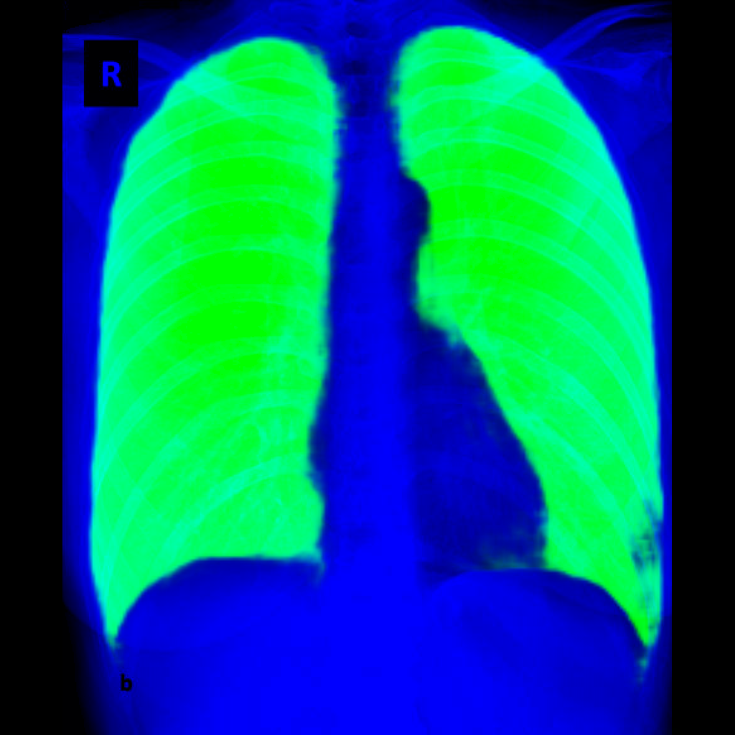
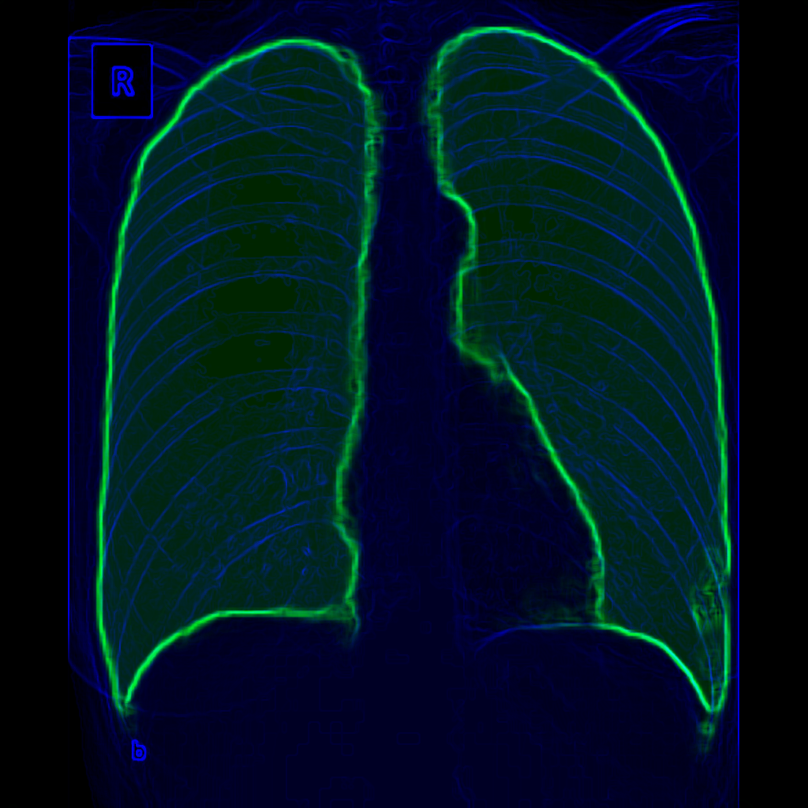
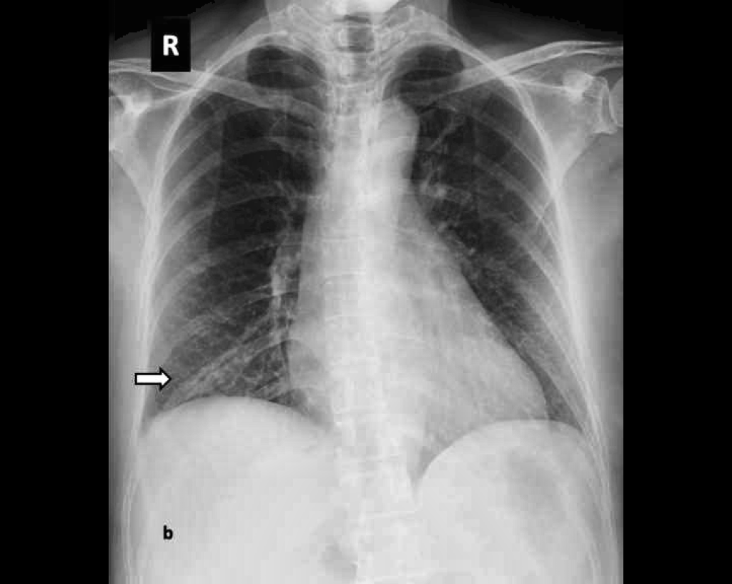
PRE PROCESSOR DATA FLOW
Normalization
Combined Image
Image Set
INPUT IMAGE(S)
Segmentation
Augmentation
Unification & Filtering
Add Augmentation Data
META DATA
Offline Statistical Analysis

Slide 2
UNIFIED META DATA

