Slide 1

FireFly
Kenenth Chin
Shane Casiano
Jack Donelson
Shafin Haque
Christopher Lopez
Elisha Shmalo
Yaodong Qiu

Slide 2
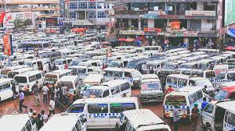
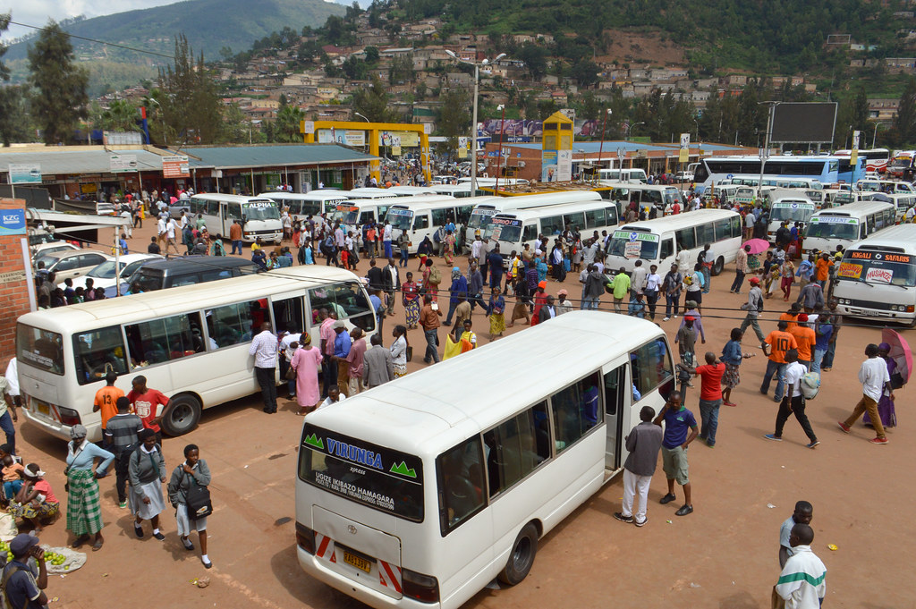
Problem
Transportation is expensive
Transportation is difficult to access
Lack of transportation = Lack of opportunity
Transportation infrastructure is almost non-existent in many third-world countries
How do we stimulate the increase of transportation in third-world countries

Slide 3


Solution
Stimulate the increase in transportation in two major components:
Data driven component: An A.I. to determine how many resources (drivers and cars) should be sent to a location.
Front-end component: A public transportation subscription platform (think Netflix but for PT).
Work with government entities or public transportation sectors to provide a model
Built on data collected from companies, governments, and possible users.
This data allows for the allocation of vehicles and other infrastructure based closely to the assumed need.
Overall jobs will be created through the drivers. And the transportation will provide more opportunities for citizens.

Slide 4




Architecture
Built as much as possible on cloud infrastructure provided by AWS, Google Cloud, or Azure
Front-end:
Built primarily on PHP
Connected to SQL database
Back-end:
SQL connector to machine-learning data
Machine Learning:
Data can be gathered from several sources:
Governmental assistance.
Other transportation services in the area.
Data analysis/manipulation will be handled in Python using NumPy and Pandas.
We will use GCP's AI Infrastructure to train the AI model

Slide 5


Financial
Cost analysis (things someone will need to pay for):
The actual vehicles.
Background checks on the (if necessary).
Upkeep of the servers.
Income:
Potential Government funding.
Donations and Investments.
Payment for Subscription (The more we get from the others, the cheaper this has to be).
Advertisements

Slide 6



Competitors
Possible competitors would depend on implementation:
If we provide the service as its own company, than local governments and transportation agencies would directly compete
If we provide the service simply as the data collection and handling portion, there would realistically be no competition with exception to a possible companies own implementation of transportation allocation.
The flexibility of our model allows for multiple ways to implement the same core service
But we don’t really know who the competitors will be

Slide 7


Support
Decreasing the cost of transportation by allocating resources where they are needed most
Improving the availability of work based on additional needs for the transportation services
Better overall control over public transportation that can be scaled from small areas to multiple countries
Potential to become a global transportation allocation system

Slide 8

Questions?

