Slide 1

Testing Windows Code integrity from Software
Muhammed Tariq Ali Razvi
Supervised by Tom Chothia
MSc Cyber Security

Slide 2
Testing Windows Code integrity from Software
Muhammed Tariq Ali Razvi
Supervised by Tom Chothia
MSc Cyber Security

Slide 3
1. Background and Motivation
where did this project come from and why I choose it
2. Aim and Objective
What have I accomplished and how
2. The Approach
Pipeline of its work
Background and Motivation
Windows defends itself with signed code.
Drivers must carry a Microsoft issued signature to load
Obscurity isn't a security property.
It just makes the claim hard to check.
So:
how much of it is "secure" survives being looked at directly?

Slide 4
Aim and Objectives
Establish how much the “signed by Microsoft” actually protects, when an attacker can read and write physical memory from software alone.
Try and break into drivers code in a way that is undetected
Make proof of concept of each stage
Verify memory aliasing is possible
Work towards results that can be applied to Raw physical memory

Slide 5
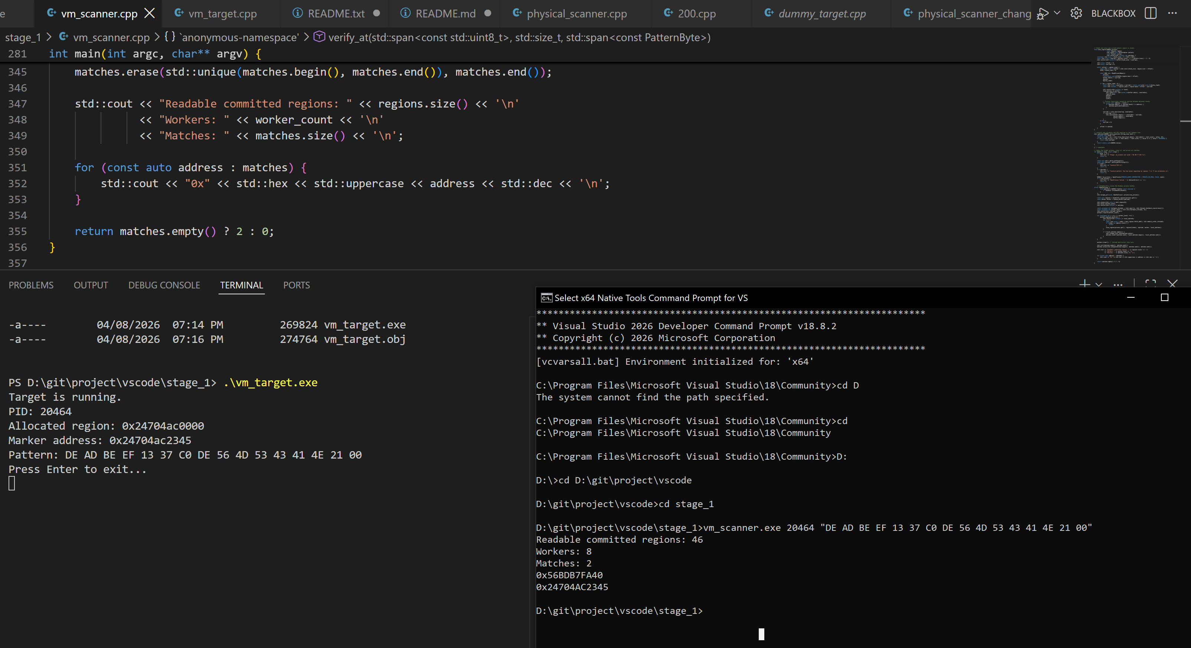

Slide 6
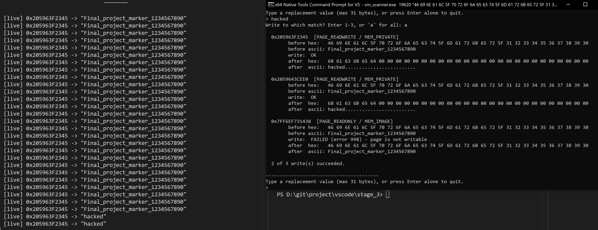

Slide 7
The Core Idea
Prove It in Virtual, Then Go Physical
Started in virtual memory by finding known marker (player name) in a CS2, then overwrite it
Multiple matches, copies of the same string, the live one is the one that reflects the patch
Confirmed: values in a running process are findable and writable, with no third-party tooling
Then moved to physical. Same search logic but the source changed
  Virtual -> a PID or a raw VM image
  Physical-> the WinPmem device, \\.\pmem
Change/read values over physical memory so the Windows/anticheats or antiviruses don’t detect it
Progress
Five stages result
Scan a dummy Process’s virtual memory and overwrite it.
2. Scan a live Process’s virtual memory and try to overwrite it.
3. Scan a dummy physical image which is a Live RAM capture of a dummy process in VM.
4. Scan live physical memory via WinPmem, a validly signed driver.
5. Established a valid pattern to scan for a known bytes in live process
6. Tried to change the resulting physical memory using WinPmem. (resulted in system crash)
Read off the value resulting from the scanner to make a basic cheat working (ESP wall hack)
8. Game updated its values so changed, offset changed, couldn’t make the hack or the code work ☹

Slide 8
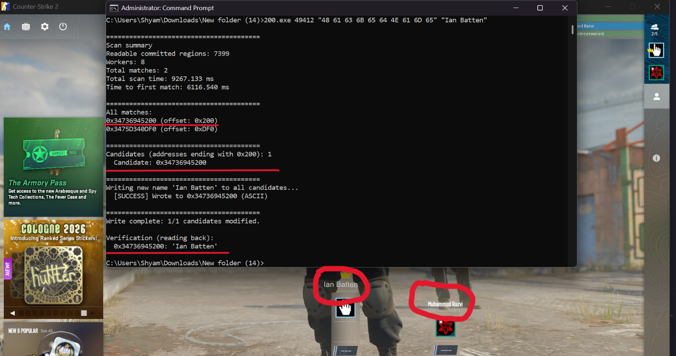

Slide 9
The Core Idea
Prove It in Virtual, Then Go Physical
Started in virtual memory by finding known marker (player name) in a CS2, then overwrite it
Multiple matchs, copies of the same string, the live one is the one that reflects the patch
Confirmed: values in a running process are findable and writable, with no third party tooling
Then moved to physical. Same search logic but the source changed
  Virtual -> a PID or a raw VM image
  Physical-> the WinPmem device, \\.\pmem
Change/read values over physical memory so the drivers/Windows/anticheats or antiviruses don’t detect it
Progress
Five stages result
Scan a dummy Process’s virtual memory and overwrite it.
2. Scan a live Process’s virtual memory and try to overwrite it.
3. Scan a dummy physical image which is a Live RAM capture of a dummy process in VM.
4. Scan live physical memory via WinPmem, a validly signed driver.
5. Established a valid pattern to scan for a known bytes in live process
6. Tried to change the resulting physical memory using WinPmem. (resulted in system crash)
Read off the value resulting from the scanner to make a basic cheat working (ESP wall hack)
8. Game updated its values so changed, offset changed, couldn’t make the hack or the code work ☹

Slide 10
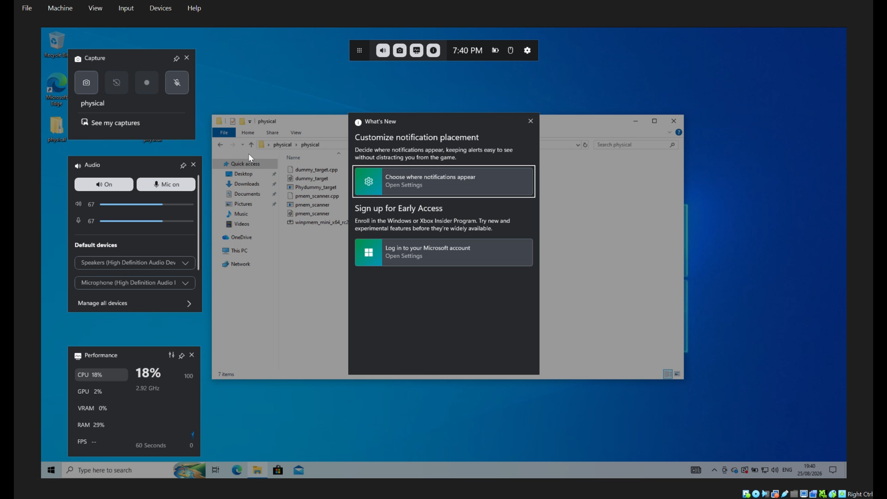

Slide 11
What’s Next
Limitation
Game update rendered my attack/research senseless.
Need to find new and better patterns for the needed values.
Refine the offsets for needed values.
Rework and recreat the memory aliases
Access Raw physical memory
Patch
Boot up windows again
Run the program or programs
Memory aliasing works only on older version of windows
The result is as good as the pattern you set
Overwriting the physical memory causes system crash most of the time
Game/Program update can moves values offsets and render the program useless
Scaning physical memory could take some GPU power
Choice of values is limited, most values could be server side

Slide 12
Conclusion
Windows internals aren’t as documented as it leads us to believe.
Obscurity isn't a security property.
Drivers aren’t secured just because they are checked and signed by Microsoft.
Signed drivers itself can be used against other signed drivers.
Notes:
This ppt is more of a UI design than Presentation -Shyam

