Slide 1
Efficient Mamba-Based Accelerator Architecture for Massive-MIMO Indoor Localization Using the LuViRA Dataset
CHENXI ZHANG Shengjie Chen

Slide 2
Contents
1. Architechture
Board-level deployment
Pipeline and fine-grained parallelism
2. Linear Layers
Reuse of in-proj, dt-proj and out-proj
Weight banking and memory access
3. Non-linear Layers
RMSNorm
Sigmoid
3. Quantisation
Workflow
Hardware implementation
4. Results

Slide 3
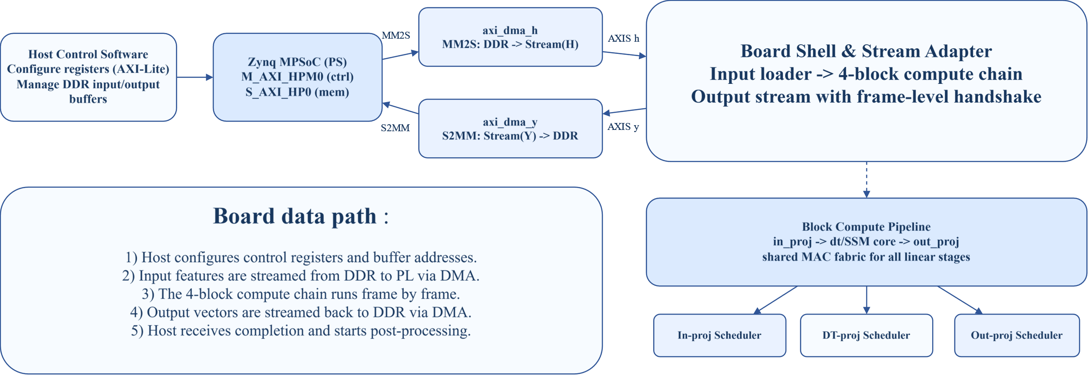
Architecture - Board-level deployment

Slide 4
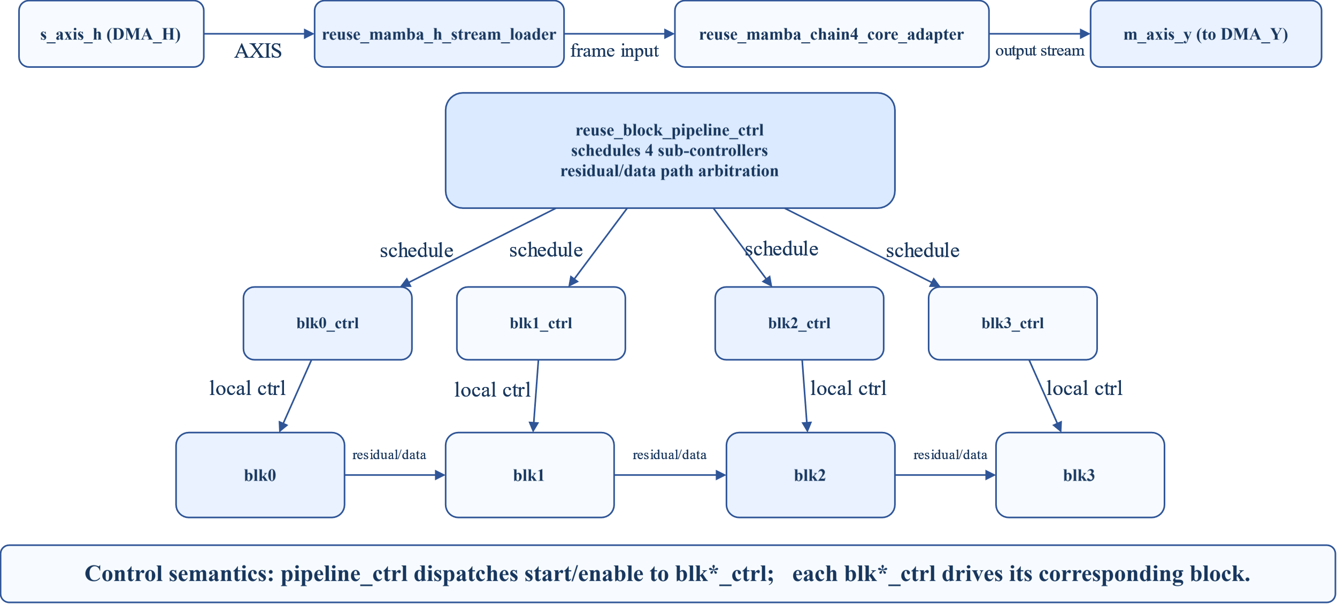
Architecture - Pipeline and fine-grained parallelism
Shell Input Flow and 4-Block Control Pipeline

Slide 5
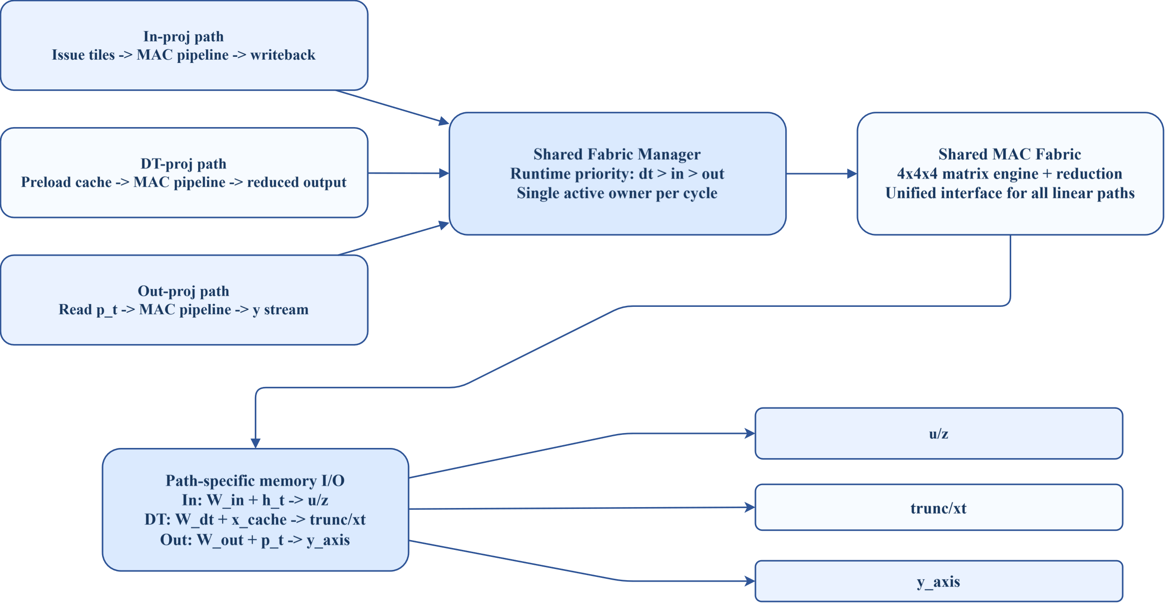
Architecture - Pipeline and fine-grained parallelism
Linear Layer Reuse Dataflow (in / dt / out)

Slide 6
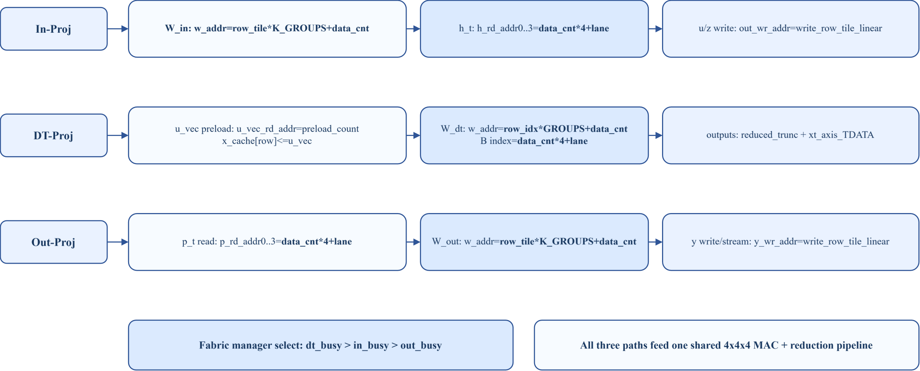
Architecture - Pipeline and fine-grained parallelism
Memory Access Mapping from RTL (In / DT / Out Proj)

Slide 7
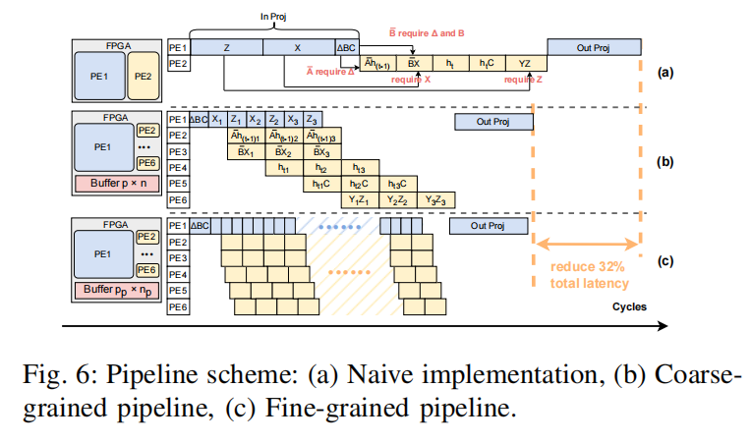
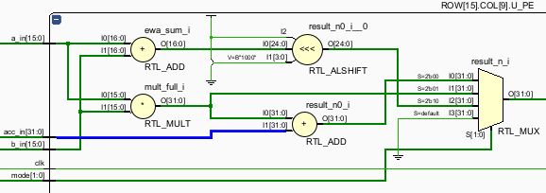
Trade Off : Reconfigurable vs. Fine-grained pipeline
mode Calculation
00 MAC (A*B+acc_in)
01 MUL (A*B)
10 ADD (A+B)
Case A: wait for all MAC tiles, then run Sigmoid/EW
T_A = 29N
Case B: stream each tile to Sigmoid/EW as soon as MAC finishes
T_B = 22N + 7
Latency saving
For N = 64
T_A = 1856 cycles
T_B = 1415 cycles
Saving = 441 cycles
Saving ratio ≈ 23.8%
Add 12 DSPs
use 64 DSPs
wait for all MACs (64 tiles) to finish and then goes to next layer.
R. Wei et al., "LightMamba: Efficient Mamba Acceleration on FPGA with Quantization and Hardware Co-design," 2025 Design, Automation & Test in Europe Conference (DATE), Lyon, France, 2025, pp. 1-7, doi: 10.23919/DATE64628.2025.10993079.

Slide 8
Architecture - Pipeline and fine-grained parallelism
Memory Access Comparison ：Interleaving vs Pre-distrubuted
Synthesis results: ulti, power...

Slide 9
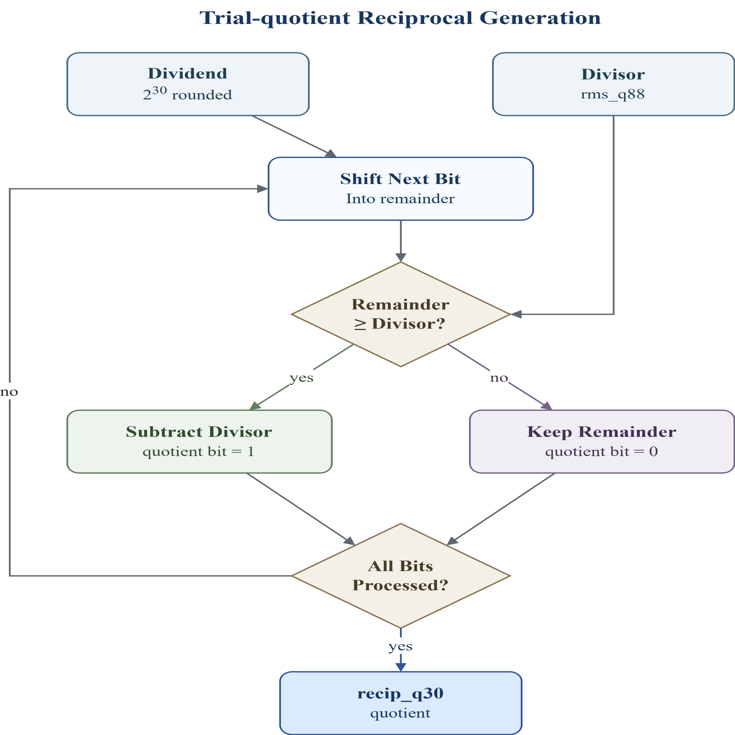
Nonlinear layer - RMSNorm
RMSNorm: y_i = x_i / RMS(x) * gamma_i
Trial-quotient
method
Iterative
method
weight
Division：
Goal: replace division with one reciprocal value, recip_q30 = round(2^30 / rms_q88)
2^30 is the scaling factor for the fixed-point reciprocal. recip_q30 stores 1 / rms_q88 with 30 fractional bits.
More fractional bits give higher reciprocal precision, reducing RMSNorm output error.

Slide 10
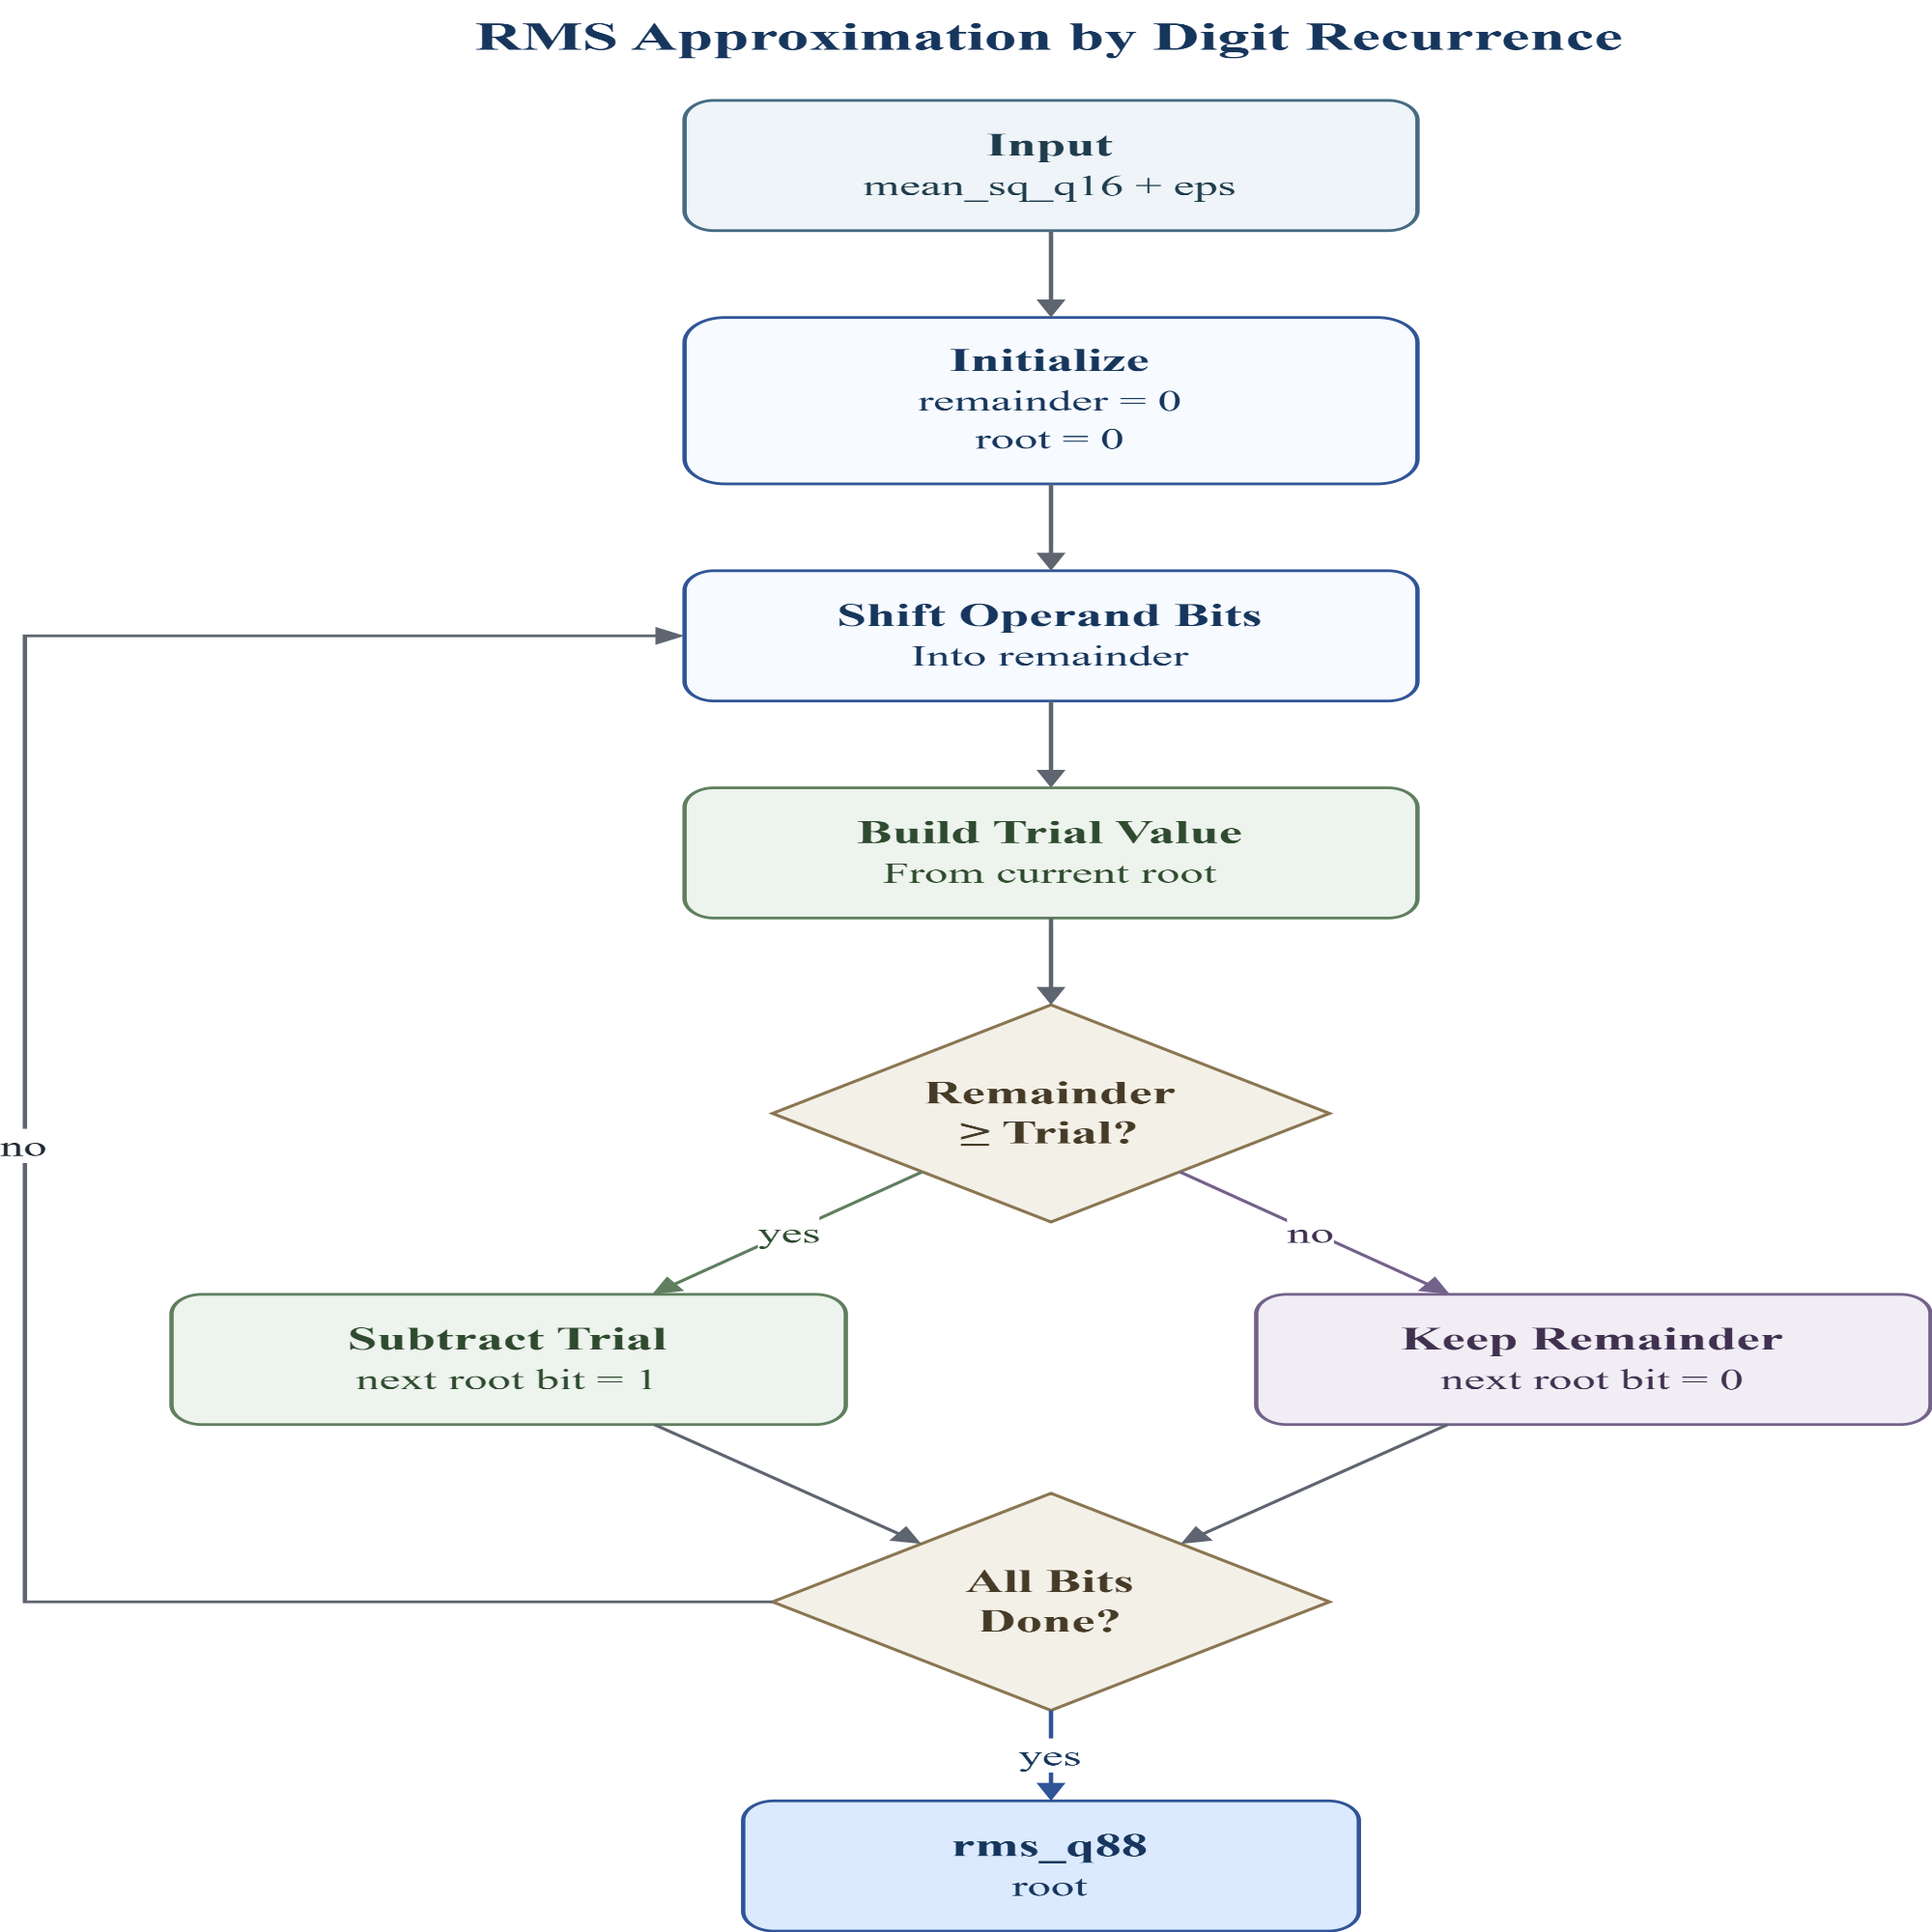
Nonlinear layer - RMSNorm
RMSNorm: y_i = x_i / RMS(x) * gamma_i
Trial-quotient
method
Iterative
method
weight
RMS Approximation：
Goal: compute RMS without floating-point sqrt: rms_q88 = isqrt(mean_sq_q16 + eps)
root: current partial square-root result; one new bit is decided each cycle.
remainder: the remaining part of the input that has not been explained by the current root.
trial value: a test value used to check whether the next root bit can be set to 1.
root_shift = {isqrt_root, 1'b0};
trial = {32'd0, root_shift, 1'b1};

Slide 11
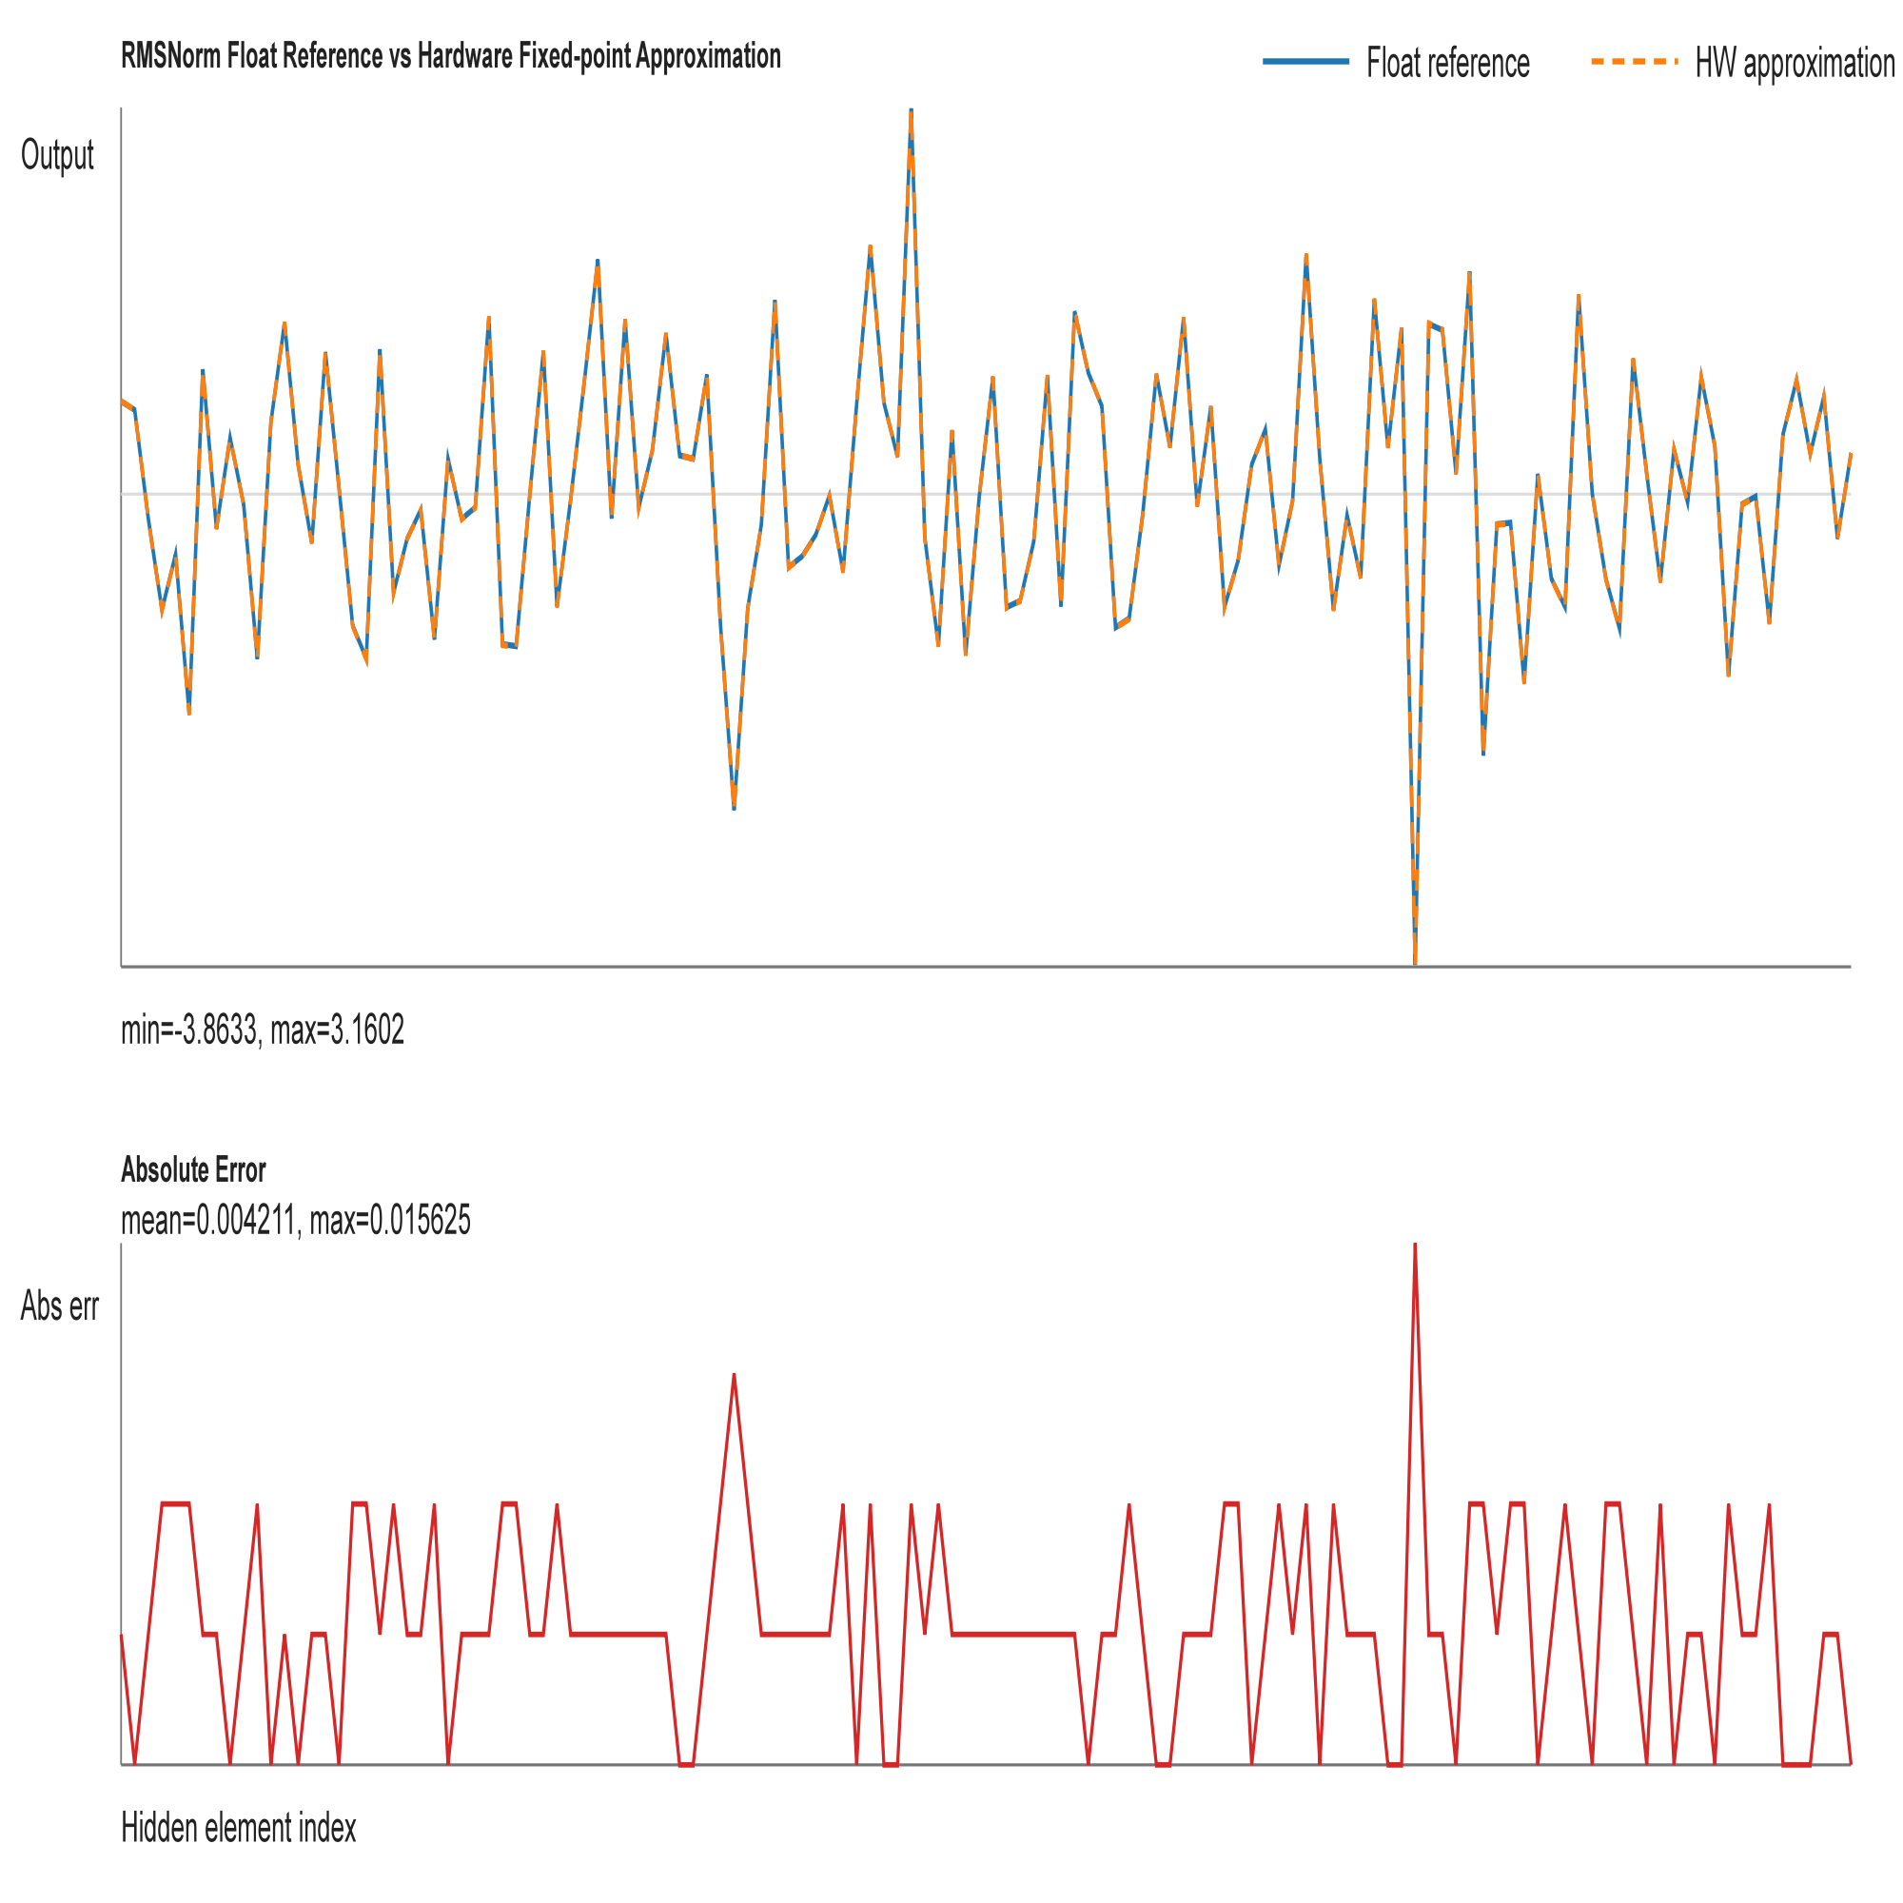
Nonlinear layer - RMSNorm
max_abs_error_real = 0.015625
mean_abs_error_real = 0.004211

Slide 12
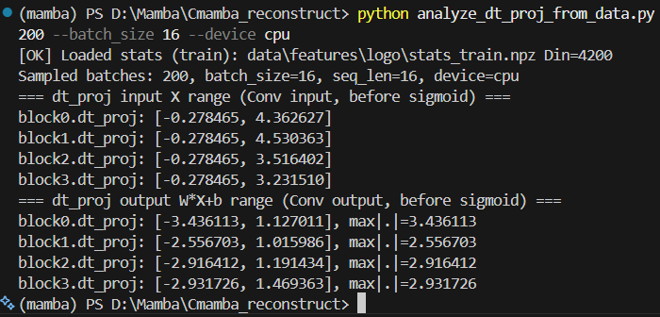
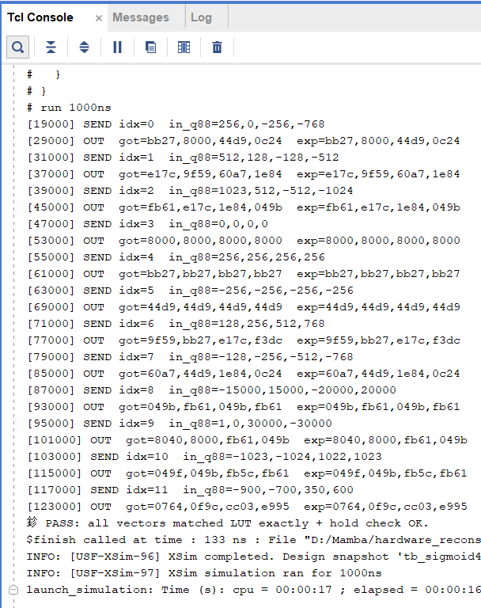


Nonlinear layer - Sigmoid
clamp x to [-4, +4)
LUT: 2048 sigmoid outputs

Slide 13
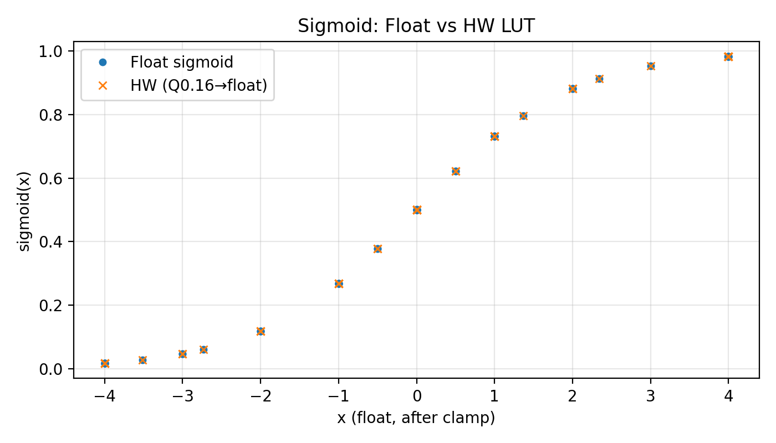
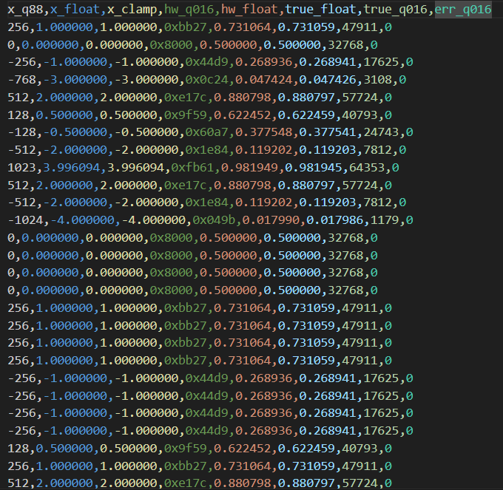
Nonlinear layer - Sigmoid
error < 0.02%

Slide 14
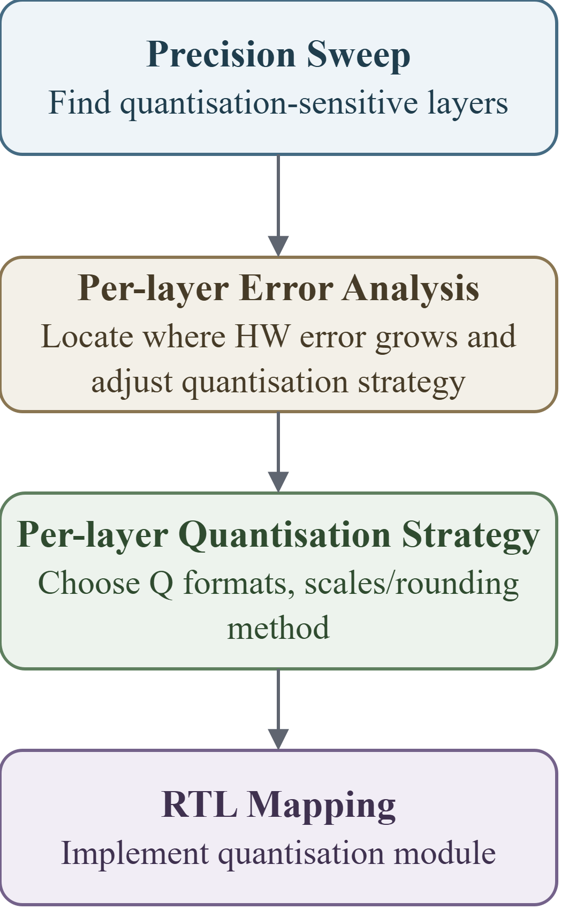
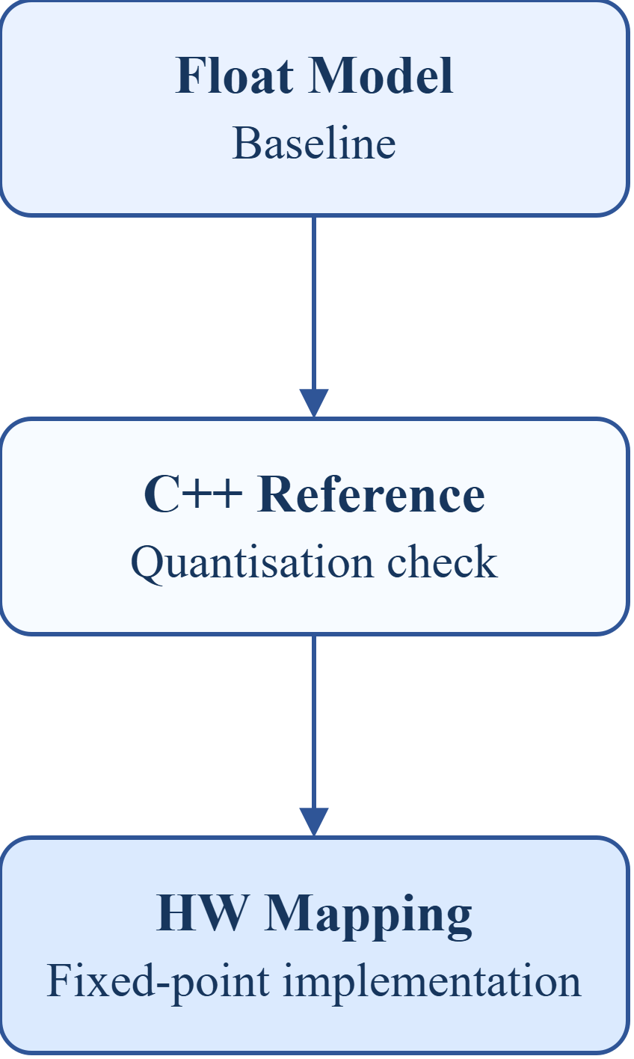
Quantisation: Workflow
Layer-wise Precision Sweep
label | mode | overrides | mean_err (m)
fake | fake |  | 0.13695
all_int16 | int16 | ssm_state=int16, gate=int16 | 0.13520
mixed_candidate | int16 | dt_proj=int8, ssm_state=int8, gate=int8 | 0.13519
inproj_i8_on_i16 | int16 | in_proj=int8, ssm_state=int16, gate=int16 | 0.76520
outproj_i8_on_i16 | int16 | out_proj=int8, ssm_state=int16, gate=int16 | 0.24352
int16 quantisation is safe.
dt_proj, ssm_state, and gate can be reduced to int8 with negligible accuracy loss.
in_proj and out_proj are precision-sensitive and should remain at higher precision.
Metrics - MAE (Mean Absolute Error)：
cpp vs float quantisation loss
hw_like vs cpp hardware mapping error

Slide 15
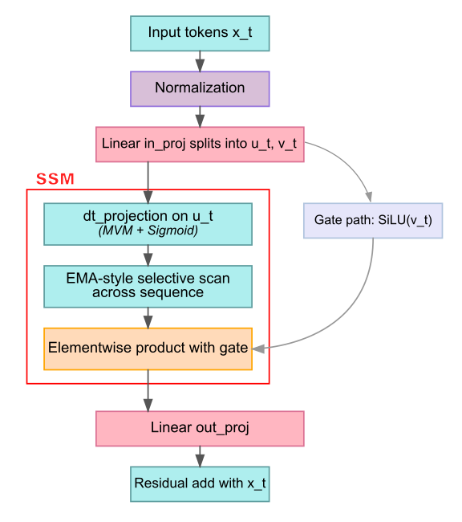
Quantisation: Workflow
Analyse per-layer quantisation error
Stage | Fixed scale MAE | Dynamic Scale MAE
norm | 0.004498 | 0.004498
inproj_u | 0.010917 | 0.010917
inproj_z | 0.011069 | 0.011069
silu_u | 0.006183 | 0.006183
silu_gate | 0.005931 | 0.005931
dtproj | 0.010139 | 0.010139
dt_sigmoid | 0.002118 | 0.002118
selective_scan | 0.127090 | 0.085484
ewm_gating | 0.033001 | 0.029827
outproj | 0.032225 | 0.031243
block_output | 0.032426 | 0.031332
Fixed scale: for Q8.8, every value uses the same scale 1/256, so real value = int16 / 256.
Dynamic scale: scale is computed from the channel range, so real value = int16 × scale.

Slide 16
Quantisation: Workflow
Per-layer quantisation strategy
Scale and Q-Format
Rounding
Main rule: round-to-nearest-even.
Used after MAC, Q-format conversion, state update, and scale multiplication.
Reduces long-term bias compared with truncation.
Saturation / Clamp
Final Q8.8 values are clamped to signed int16:
[-32768, 32767] -> about [-128, 127.996]
Prevents overflow and wrong sign after multiplication, accumulation, or residual add.
Scale | Q Format | Layer
1/256 | signed int16 Q8.8 | RMSNorm output, in_proj, dt_proj, out_proj, gate_y
1/65536 | unsigned Q0.16 | sigmoid LUT output, SiLU sigmoid path, dt lambda
1/32768 | signed Q1.15 | selective scan lambda
Dynamic scale | scaled signed int16 | selective scan state SRAM
Final quantisation evaluation (34,505 samples)
in selective scan we need to calculate 1-lamda
s_new = lambda * s_prev + (1 - lambda) * u
Q1.15: s_new = ((lam_q15 * s_prev) + ((32768 - lam_q15) * u_scaled)) >> 15
hw vs float mae = 0.02081
Mean error = 0.14103m (float=0.13695m)

Slide 17
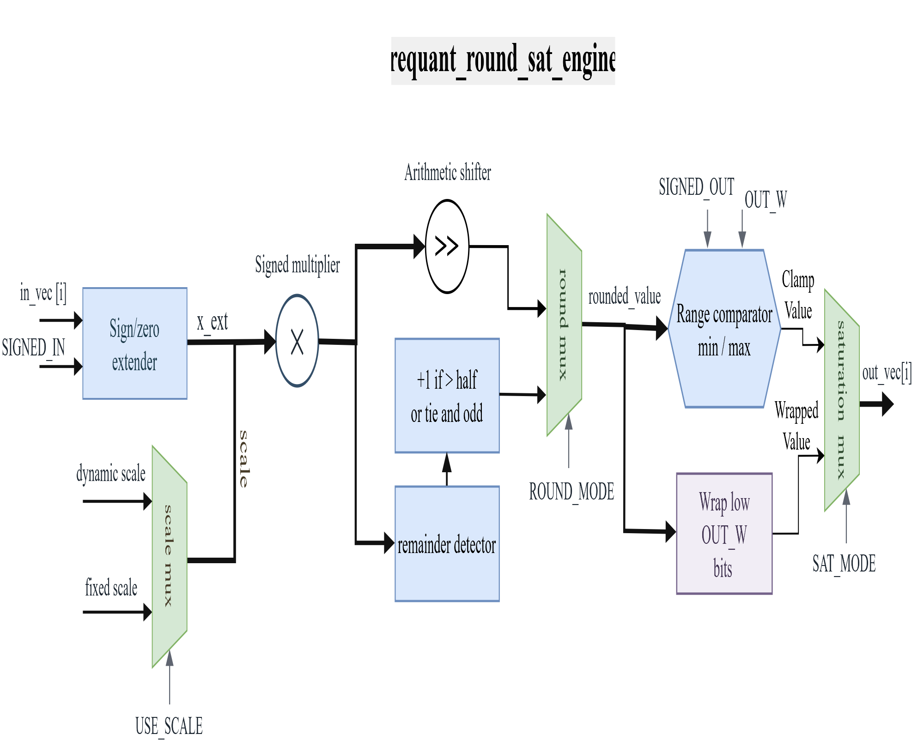
Quantisation: Hardware implemetation
A Configurable Quantisation Module - requant_round_sat_engine
• USE_SCALE selects fixed identity scale or external per-lane scale.
• ROUND_MODE selects truncation or round-to-nearest-even.
• SAT_MODE selects wrap cast or clamp to the target output range.

Slide 18
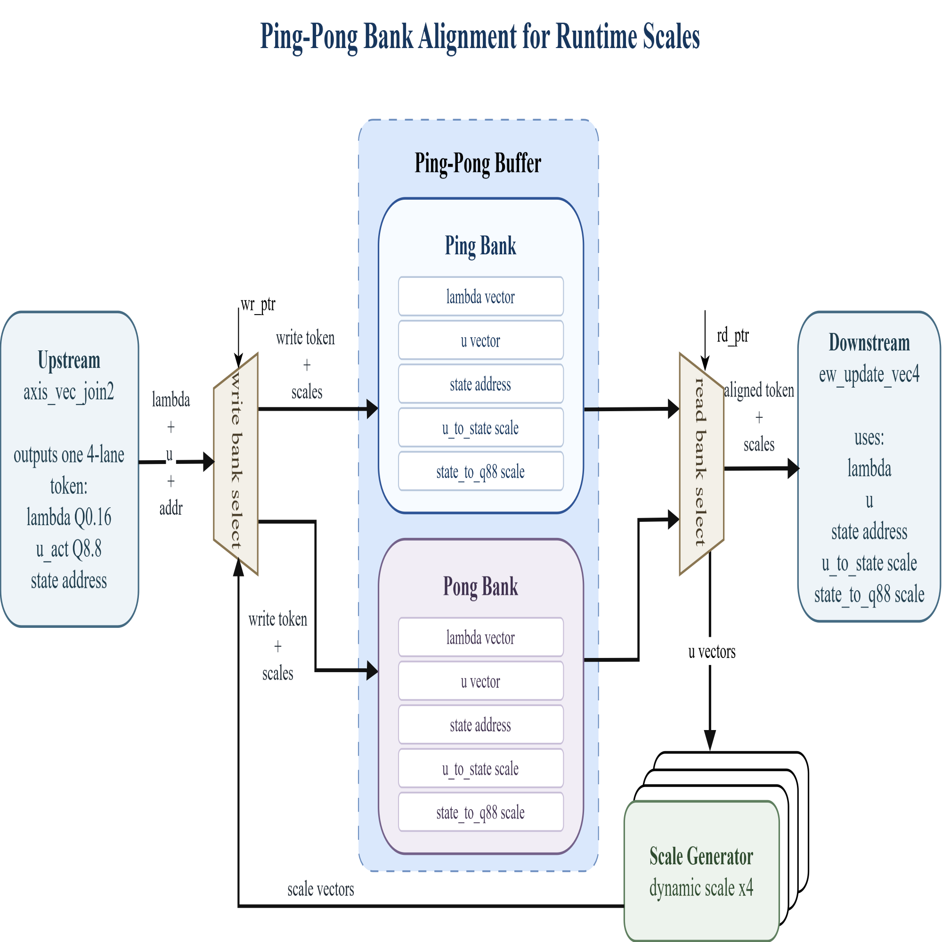
Quantisation: Hardware implemetation
Dynamic scale for selective scan
While one bank feeds ew_update_vec4, the other bank can prepare the next toke, keeps data and scale values aligned before the state update.
Scale generator computes per-lane u_to_state and state_to_q88 scales from u_act.

Slide 19
Results
Requirement : 100 frames per sec
Achieved(100MHz): 471 frames per sec
Key takeaways
Power (On-chip)
Timing closed @ 100 MHz
Low utilization
Total Power
Dynamic
Static
Freq. using 100 MHz on Board
4.292 W
3.562 W
0.729 W
On-chip
83%
17%
Key driver: PS= 2.622 W (74% of Dynamic)
Resource utilization (Post-synth @ 100 MHz)
Latency(per block)
Resource
Used
Available
Util.
Category
Clcck Cycles
Share
LUT
60868
274080
22.21%
RMSNorm
134cc
2.5%
FF
77345
548160
14.11%
In_projection
2305cc
47.25%
Ping-pong buffer
199 cc
3.75%
BRAM (Tiles)
279
912
30.59%
ssm
1828 cc
34.48%
DSP
496
2520
19.68%
out_projection
833 cc
15.71%
I/O (Bonded IOB)
0
328
0%
total
5301cc
100%

Slide 20
Next step optimazation for the paper
Refine pipeline granularity
Current design mainly uses module-level reuse scheduling to reduce hardware cost.
Next step is to split critical compute paths into finer pipeline stages.
Compare current reuse-based architecture with fine-grained pipelined architecture.
Goal: shorten combinational delay, improve timing closure, and further increase maximum clock frequency.
Add output heading
Add a dedicated output head after the final feature stage.
Directly generate target lacation from hardware output.
Avoid extra software-side output post-processing.
Make the accelerator output more application-ready for engineering deployment.

