Slide 1
Efficient Mamba-Based Accelerator Architecture for Massive-MIMO Indoor Localization Using the LuViRA Dataset
CHENXI ZHANG Shengjie Chen

Slide 2
Contents
1. Architechture
Board-level dataflow
Pipeline and fine-grained parallelism
2. Linear Layers
Reuse of in-proj, dt-proj and out-proj
Weight banking and memory access
3. Non-linear Layers
RMSNorm
Sigmoid
3. Quantisation
Workflow
Hardware implementation
4. Results

Slide 3
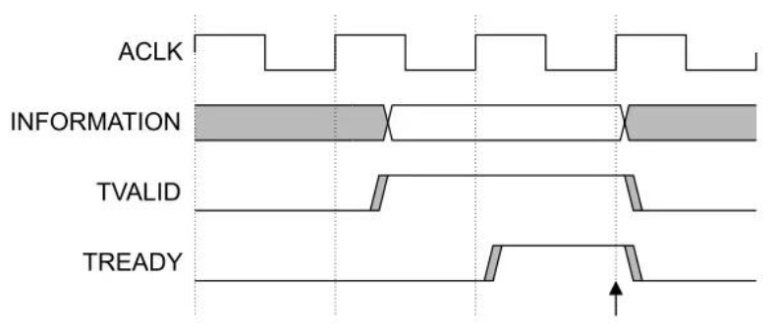
SSM Control: AXI-Stream + FIFO
Master
TVALID
Slave
TDATA
TREADY
// AXI-Stream interface signals
input logic s_axis_TVALID,
output logic s_axis_TREADY,
input logic [DATA_W-1:0] s_axis_TDATA,
output logic m_axis_TVALID,
input logic m_axis_TREADY,
output logic [DATA_W-1:0] m_axis_TDATA
MAC
(dt_proj)
TVALID
FIFO
TVALID
Sigmoid
TDATA(Δ_raw)
TDATA(Δ_raw)
TREADY
TREADY
Each FIFO acts as an AXI-Stream bridge ensuring smooth data flow across modules.
Provides intermediate buffering, rate matching, and timing decoupling, ensuring stable pipeline flow.

Slide 4
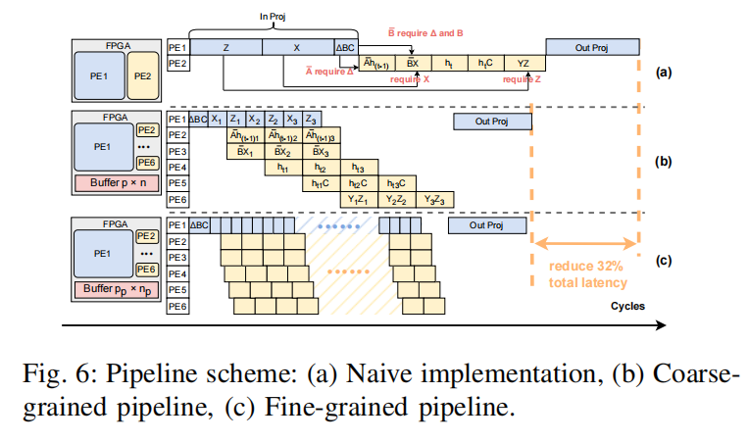
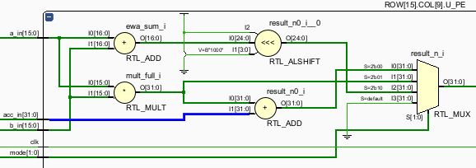
Trade Off : Reconfigurable vs. Fine-grained pipeline
mode Calculation
00 MAC (A*B+acc_in)
01 MUL (A*B)
10 ADD (A+B)
Case A: wait for all MAC tiles, then run Sigmoid/EW
T_A = 29N
Case B: stream each tile to Sigmoid/EW as soon as MAC finishes
T_B = 22N + 7
Latency saving
For N = 64
T_A = 1856 cycles
T_B = 1415 cycles
Saving = 441 cycles
Saving ratio ≈ 23.8%
Add 12 DSPs
use 64 DSPs
wait for all MACs (64 tiles) to finish and then goes to next layer.
R. Wei et al., "LightMamba: Efficient Mamba Acceleration on FPGA with Quantization and Hardware Co-design," 2025 Design, Automation & Test in Europe Conference (DATE), Lyon, France, 2025, pp. 1-7, doi: 10.23919/DATE64628.2025.10993079.

Slide 5
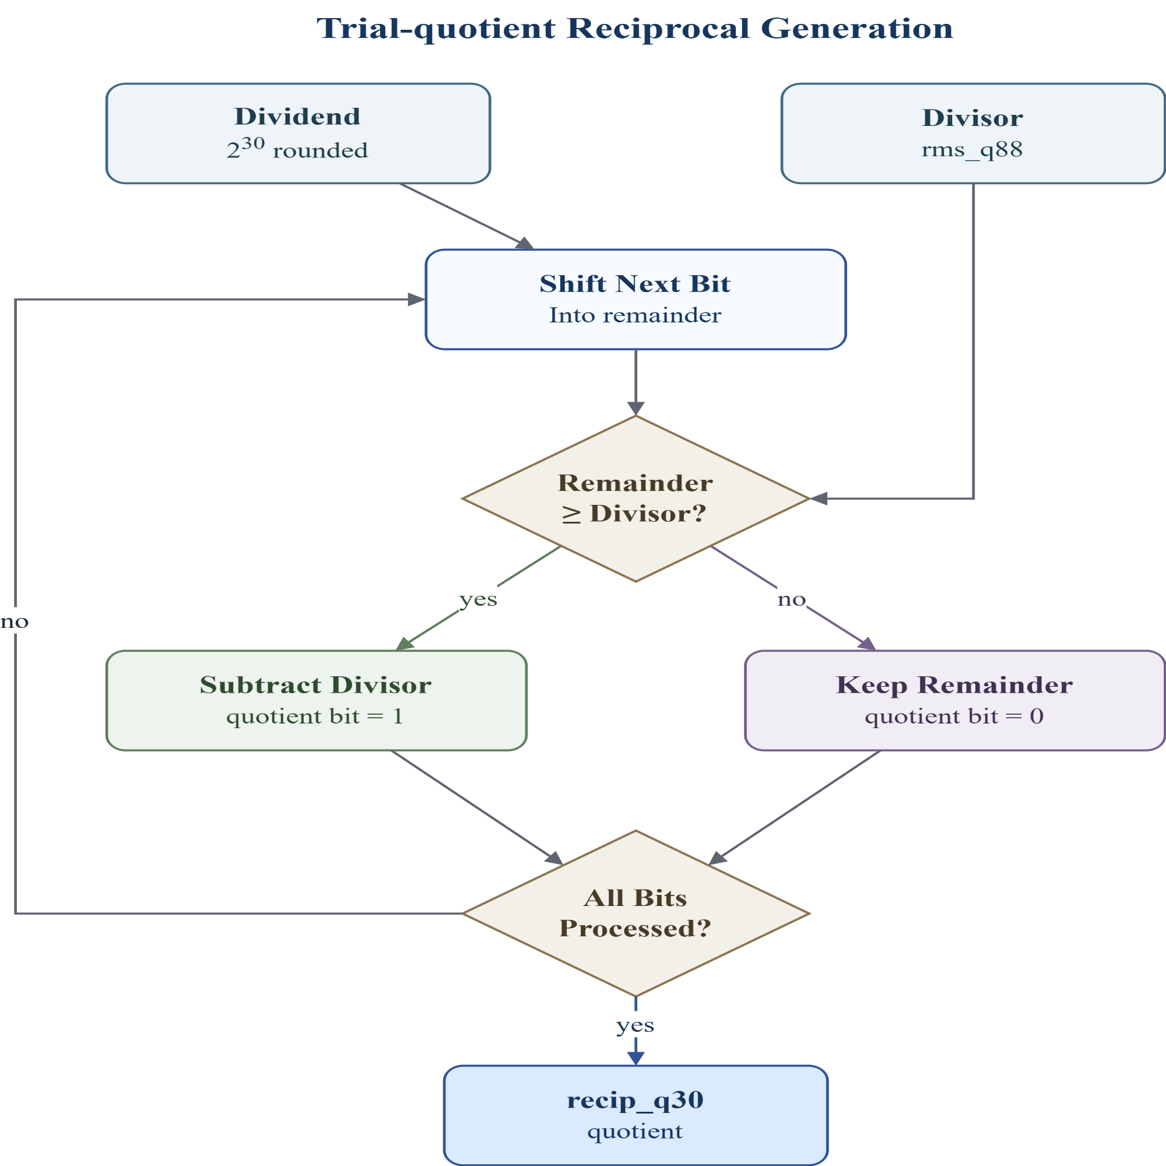
Nonlinear layer - RMSNorm
RMSNorm: y_i = x_i / RMS(x) * gamma_i
Trial-quotient
method
Iterative
method
weight
Division：
Goal: replace division by RMS with one reciprocal value, recip_q30 = round(2^30 / rms_q88)
2^30 is the scaling factor for the fixed-point reciprocal. recip_q30 stores 1 / rms_q88 with 30 fractional bits.
More fractional bits give higher reciprocal precision, reducing RMSNorm output error.

Slide 6
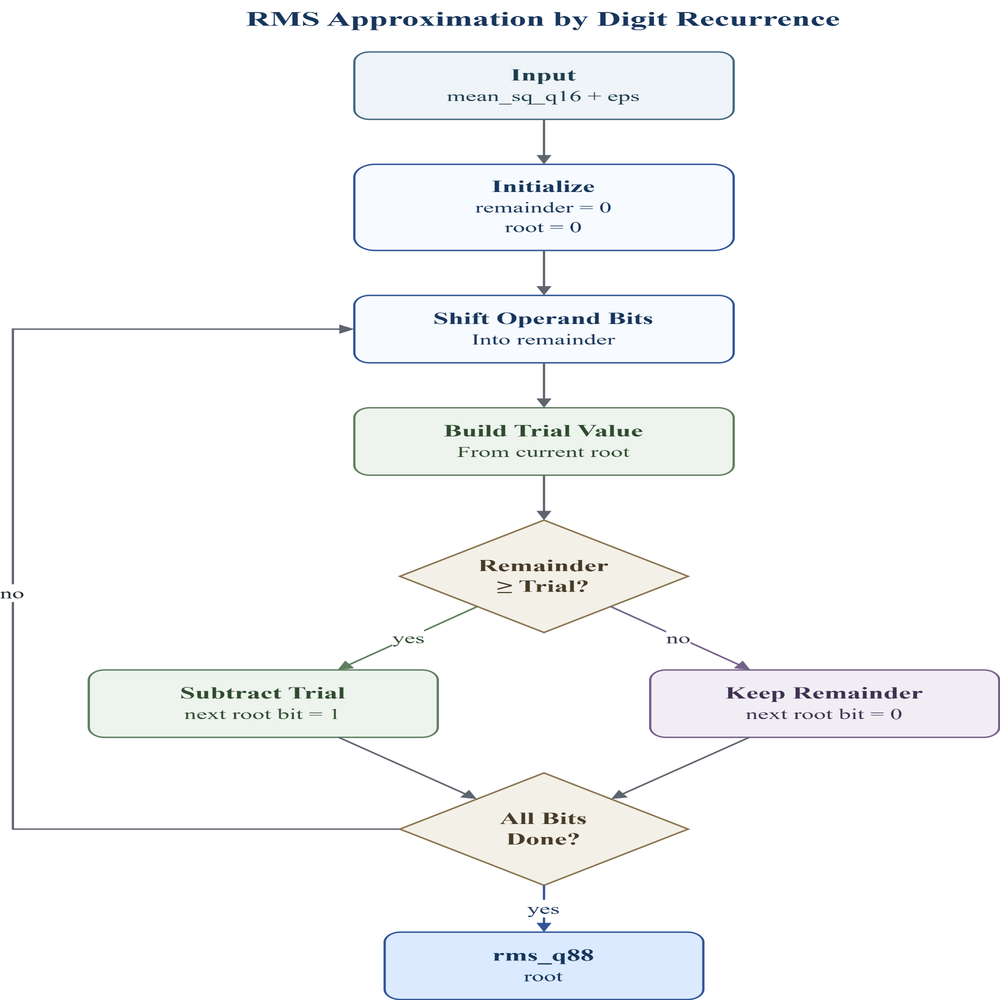
Nonlinear layer - RMSNorm
RMSNorm: y_i = x_i / RMS(x) * gamma_i
Trial-quotient
method
Iterative
method
weight
RMS Approximation：
Goal: compute RMS without floating-point sqrt: rms_q88 = isqrt(mean_sq_q16 + eps)
root: current partial square-root result; one new bit is decided each cycle.
remainder: the remaining part of the input that has not been explained by the current root.
trial value: a test value used to check whether the next root bit can be set to 1.
root_shift = {isqrt_root, 1'b0};
trial = {32'd0, root_shift, 1'b1};

Slide 7

Nonlinear layer - RMSNorm
RMSNorm: y_i = x_i / RMS(x) * gamma_i
Trial-quotient
method
Iterative
method
weight
RMS Approximation：
Goal: compute RMS without floating-point sqrt: rms_q88 = isqrt(mean_sq_q16 + eps)
root: current partial square-root result; one new bit is decided each cycle.
remainder: the remaining part of the input that has not been explained by the current root.
trial value: a test value used to check whether the next root bit can be set to 1.
root_shift = {isqrt_root, 1'b0};
trial = {32'd0, root_shift, 1'b1};

Slide 8
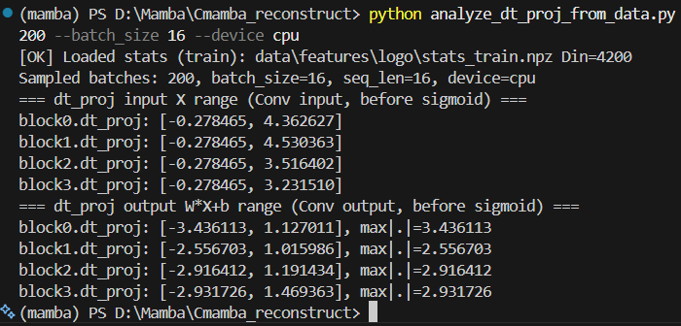
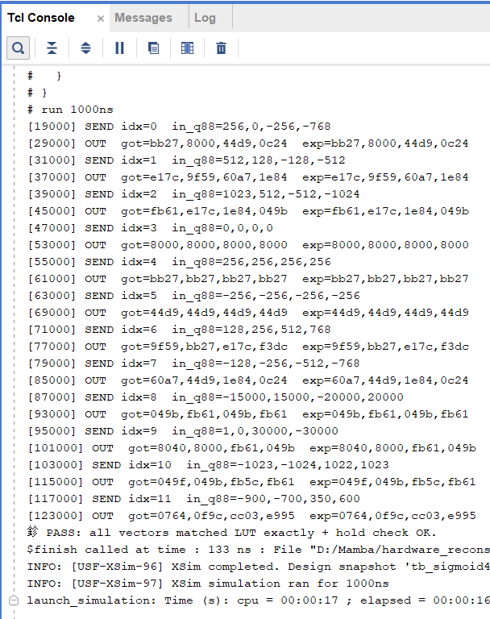


Nonlinear layer - Sigmoid
clamp x to [-4, +4)
LUT: 2048 sigmoid outputs

Slide 9
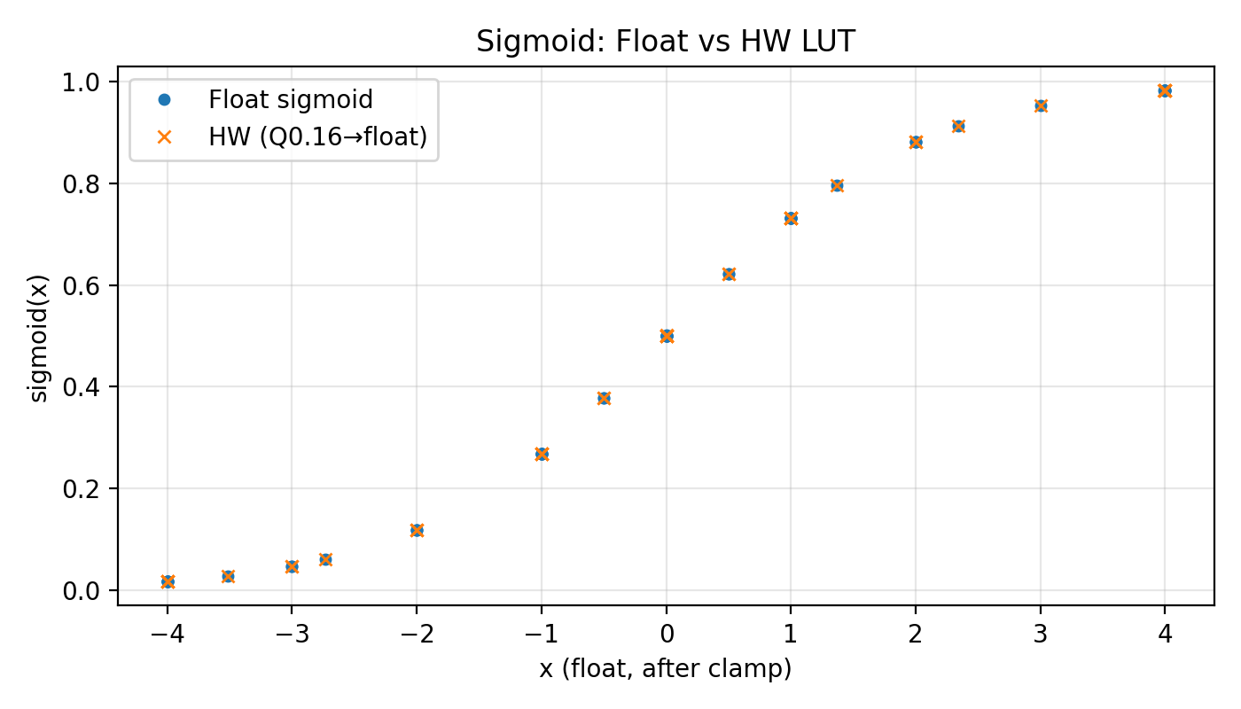
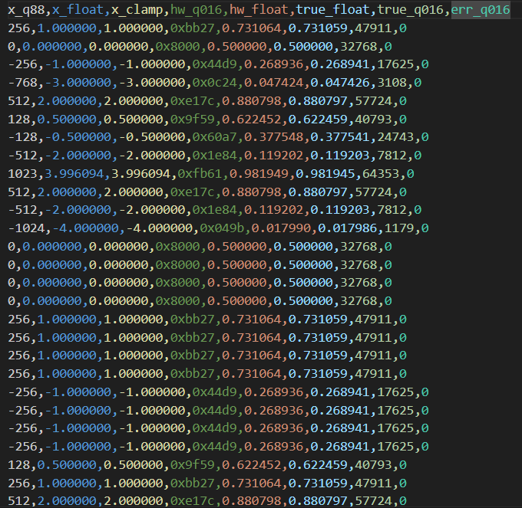
Nonlinear layer - Sigmoid
error < 0.02%

Slide 10
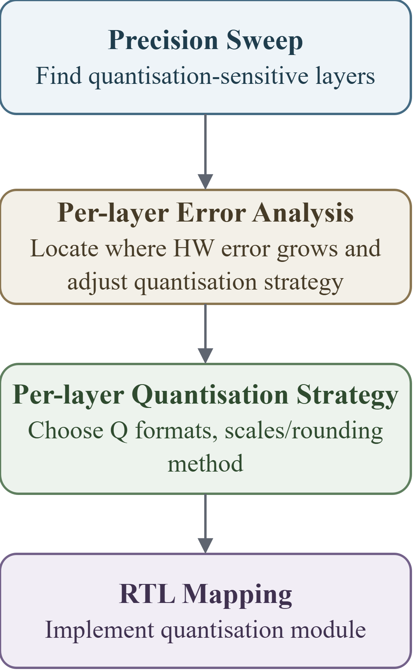
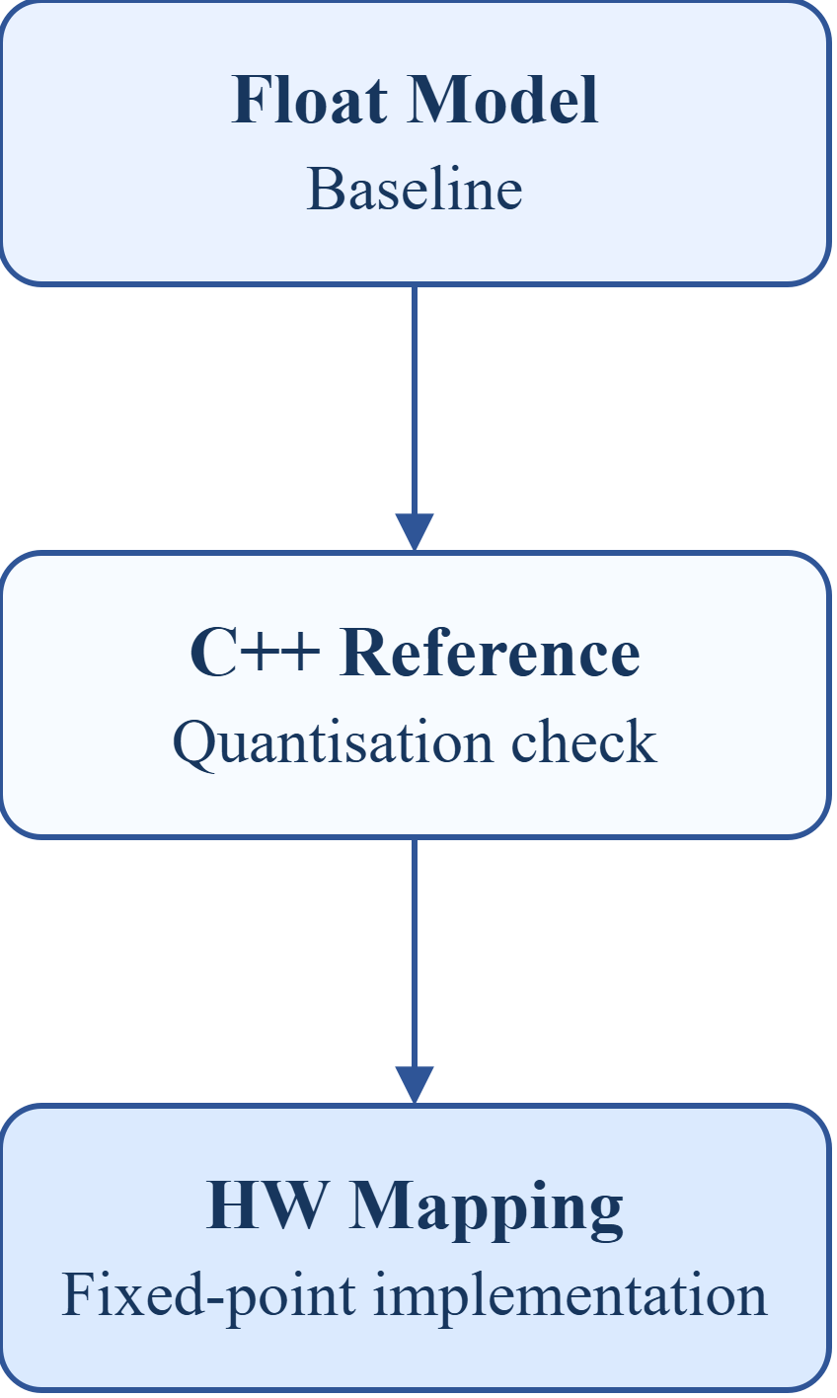
Quantisation: Workflow
Layer-wise Precision Sweep
label | mode | overrides | mean_err (m)
fake | fake |  | 0.13695
all_int16 | int16 | ssm_state=int16, gate=int16 | 0.13520
mixed_candidate | int16 | dt_proj=int8, ssm_state=int8, gate=int8 | 0.13519
inproj_i8_on_i16 | int16 | in_proj=int8, ssm_state=int16, gate=int16 | 0.76520
outproj_i8_on_i16 | int16 | out_proj=int8, ssm_state=int16, gate=int16 | 0.24352
int16 quantisation is safe.
dt_proj, ssm_state, and gate can be reduced to int8 with negligible accuracy loss.
in_proj and out_proj are precision-sensitive and should remain at higher precision.
Metrics - MAE (Mean Absolute Error)：
cpp vs float quantisation loss
hw_like vs cpp hardware mapping error

Slide 11
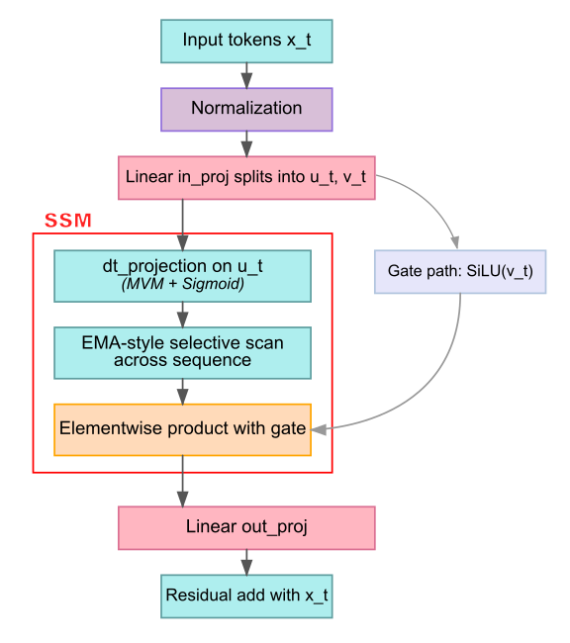
Quantisation: Workflow
Analyse per-layer quantisation error
Stage | Fixed scale MAE | Dynamic Scale MAE
norm | 0.004498 | 0.004498
inproj_u | 0.010917 | 0.010917
inproj_z | 0.011069 | 0.011069
silu_u | 0.006183 | 0.006183
silu_gate | 0.005931 | 0.005931
dtproj | 0.010139 | 0.010139
dt_sigmoid | 0.002118 | 0.002118
selective_scan | 0.127090 | 0.085484
ewm_gating | 0.033001 | 0.029827
outproj | 0.032225 | 0.031243
block_output | 0.032426 | 0.031332
Fixed scale: for Q8.8, every value uses the same scale 1/256, so real value = int16 / 256.
Dynamic scale: scale is computed from the channel range, so real value = int16 × scale.

Slide 12
Quantisation: Workflow
Per-layer quantisation strategy
Scale and Q-Format
Rounding
Main rule: round-to-nearest-even.
Used after MAC, Q-format conversion, state update, and scale multiplication.
Reduces long-term bias compared with truncation.
Saturation / Clamp
Final Q8.8 values are clamped to signed int16:
[-32768, 32767] -> about [-128, 127.996]
Prevents overflow and wrong sign after multiplication, accumulation, or residual add.
Scale | Q Format | Layer
1/256 | signed int16 Q8.8 | RMSNorm output, in_proj, dt_proj, out_proj, gate_y
1/65536 | unsigned Q0.16 | sigmoid LUT output, SiLU sigmoid path, dt lambda
1/32768 | signed Q1.15 | selective scan lambda
Dynamic scale | scaled signed int16 | selective scan state SRAM
Final quantisation evaluation (34,505 samples)
in selective scan we need to calculate 1-lamda
s_new = lambda * s_prev + (1 - lambda) * u
Q1.15: s_new = ((lam_q15 * s_prev) + ((32768 - lam_q15) * u_scaled)) >> 15
hw vs float mae = 0.02081
Mean error = 0.14103m (float=0.13695m)

Slide 13
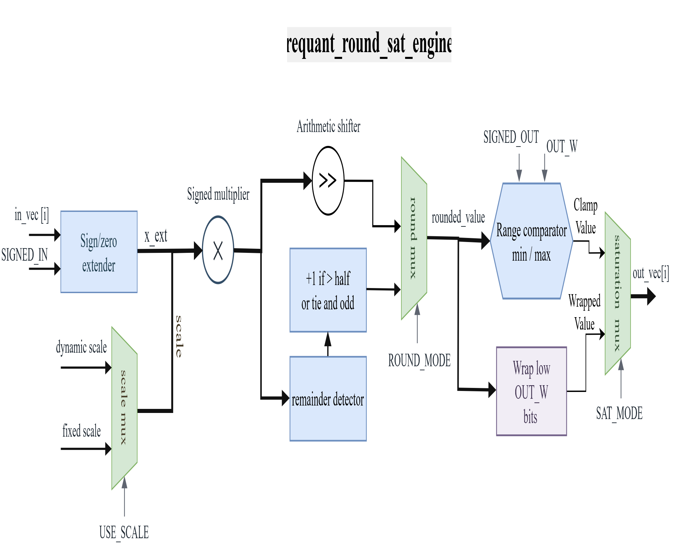
Quantisation: Hardware implemetation
A Configurable Quantisation Module - requant_round_sat_engine
• USE_SCALE selects fixed identity scale or external per-lane scale.
• ROUND_MODE selects truncation or round-to-nearest-even.
• SAT_MODE selects wrap cast or clamp to the target output range.

Slide 14
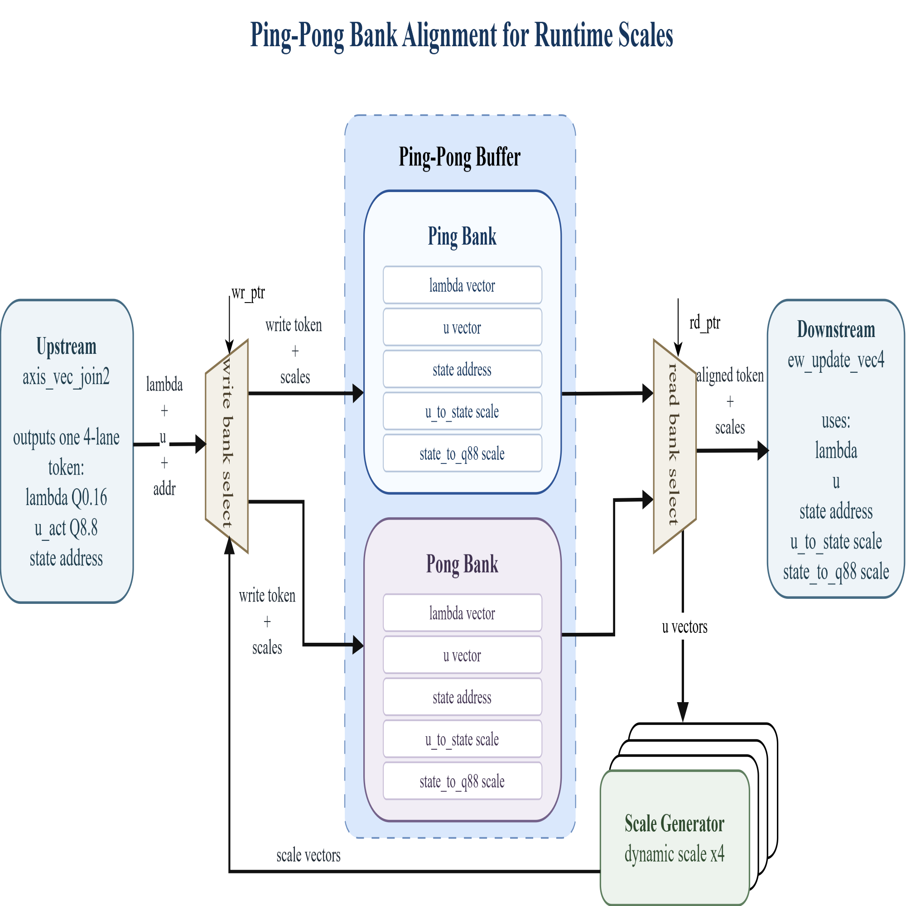
Quantisation: Hardware implemetation
Dynamic scale for selective scan
While one bank feeds ew_update_vec4, the other bank can prepare the next toke, keeps data and scale values aligned before the state update.
Scale generator computes per-lane u_to_state and state_to_q88 scales from u_act.

Slide 15
Results
FastMamba (Xilinx Virtex-7): 250MHz
HCSAs(28nm post-layout): 400MHz
Key takeaways
Power (On-chip)
Timing closed @ 400 MHz
Low utilization
I/O dominates dynamic power (54% of Dynamic)
Total Power
Dynamic
Static
400 MHz
1.442 W
0.817 W
0.625 W
On-chip
57%
43%
Key driver: I/O = 0.443 W (54% of Dynamic)
Resource utilization (Post-synth @ 400 MHz)
Dynamic breakdown
Resource
Used
Available
Util.
Category
Power
Share of Dynamic
LUT
6244
274080
2.28%
I/O
0.443 W
54%
FF
4928
548160
0.90%
BRAM
0.089 W
11%
Signals
0.081 W
10%
BRAM (Tiles)
52
912
5.70%
Clocks
0.078 W
10%
DSP
76
2520
3.02%
Logic
0.073 W
9%
I/O (Bonded IOB)
136
328
41.46%
DSP
0.053 W
6%
[1] A. Wang, H. Shao, S. Ma, and Z. Wang, “Fastmamba: A high-speed and efficient mamba accelerator on fpga with accurate quantization,” arXiv preprint arXiv:2505.18975, 2025.
[2] X. Jin, H. Zheng, M. Nie, J. Wang, and C.-J. R. Shi, “Hcsas: Hybrid computing systolic arrays for accelerating mamba models with unified state space buffers and energy-efficient dataflow,” in Proceedings of the Great Lakes Symposium on VLSI 2025, 2025, pp. 457–462.

