Slide 1
Efficient Mamba-Based Accelerator Architecture for Massive-MIMO Indoor Localization Using the LuViRA Dataset
CHENXI ZHANG Shengjie Chen

Slide 2
Contents
01
Background
02
Architecture
03
Methodology & Experimental Design
04
Results, Discussion & Conclusions
Notes:
This master’s thesis builds upon the coursework we completed last semester, so I will begin with a brief overview of the relevant background and a summary of the course content we have already covered.

Slide 3
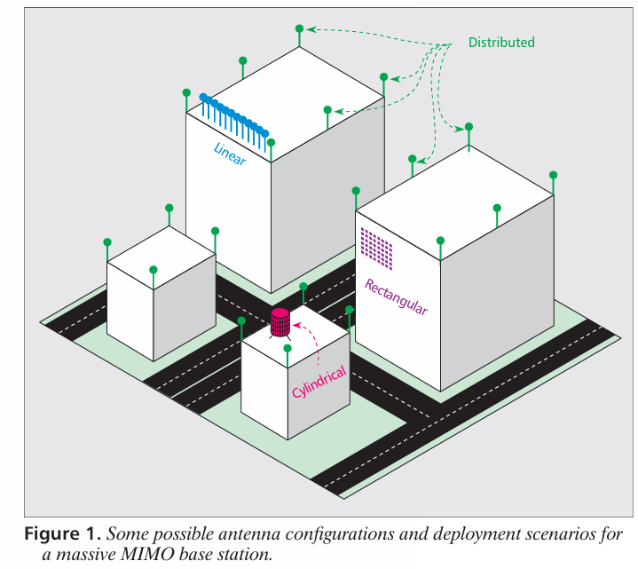
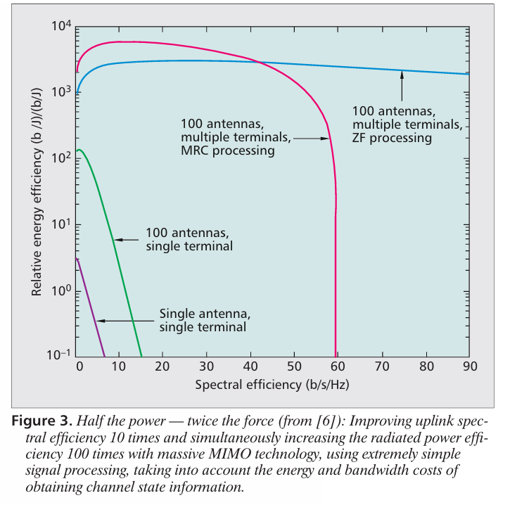
Background & Task: Massive MIMO
What is Massive MIMO?
E. G. Larsson, O. Edfors, F. Tufvesson and T. L. Marzetta, "Massive MIMO for next generation wireless systems," in IEEE Communications Magazine, vol. 52, no. 2, pp. 186-195, February 2014, doi: 10.1109/MCOM.2014.6736761.
Notes:
Massive MIMO means that the base station uses a large excess of antennas relative to the number of active terminals. The key benefit is spatial resolution: with many antennas, the system can separate users and propagation paths much more clearly in space. In communication, this improves throughput and energy efficiency. In our context, it also means that the received channel contains much richer spatial information than a conventional small-array system

Slide 4
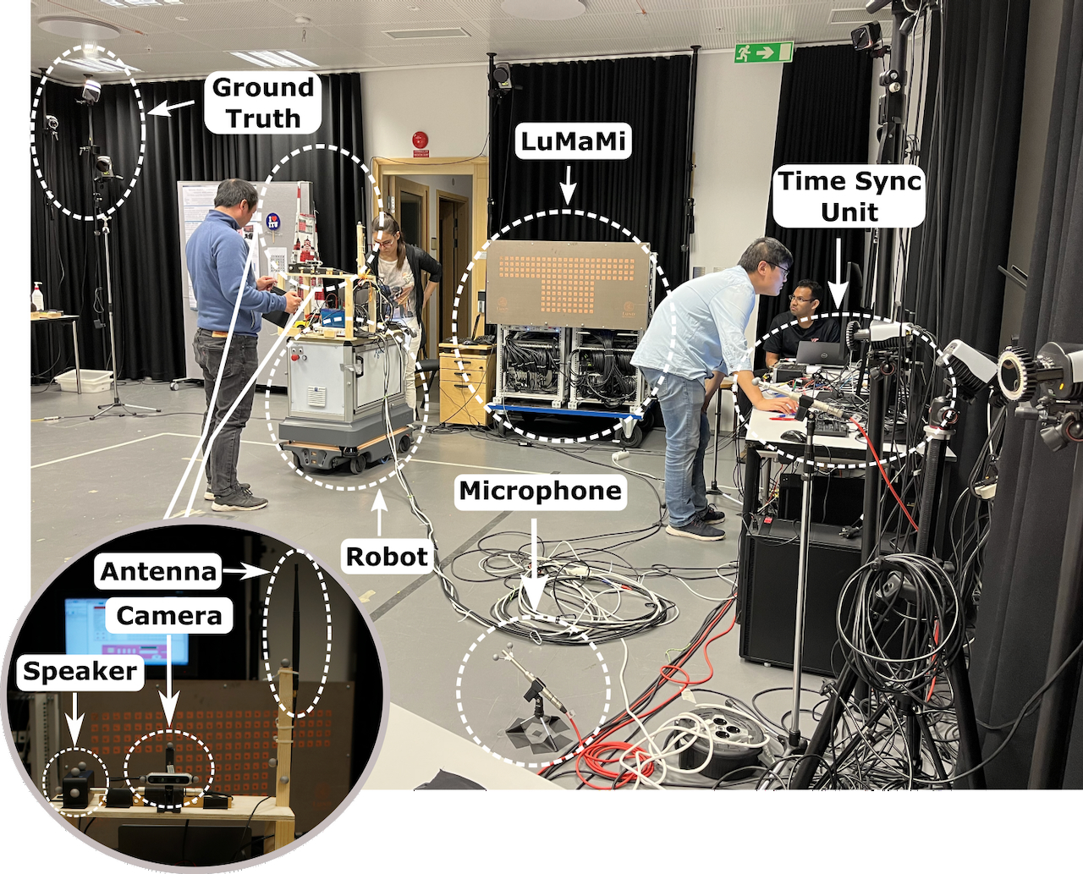
Background & Task: Massive MIMO
Lund University Vision, Radio, and Audio (LuViRA) Dataset Overview
70 spatial grids covering the operational environment
100 fps temporal resolution for high‑fidelity signal capture
4,700+ annotated frames with ground‑truth (x, y) positions
100 antennas, each containing 100 subcarriers, with a center frequency of 3.7 GHz and a bandwidth of 20 MHz.
Objective
Estimate precise (x, y) coordinates from temporal wireless signal sequences, enabling accurate indoor localization for positioning applications.
G. Tian, I. Yaman, M. Sandra, X. Cai, L. Liu and F. Tufvesson, "Deep-Learning-Based High-Precision Localization With Massive MIMO," in IEEE Transactions on Machine Learning in Communications and Networking, vol. 2, pp. 19-33, 2024, doi: 10.1109/TMLCN.2023.3334712.
Notes:
This master’s thesis builds upon the coursework we completed last semester, so I will begin with a brief overview of the relevant background and a summary of the course content we have already covered.

Slide 5
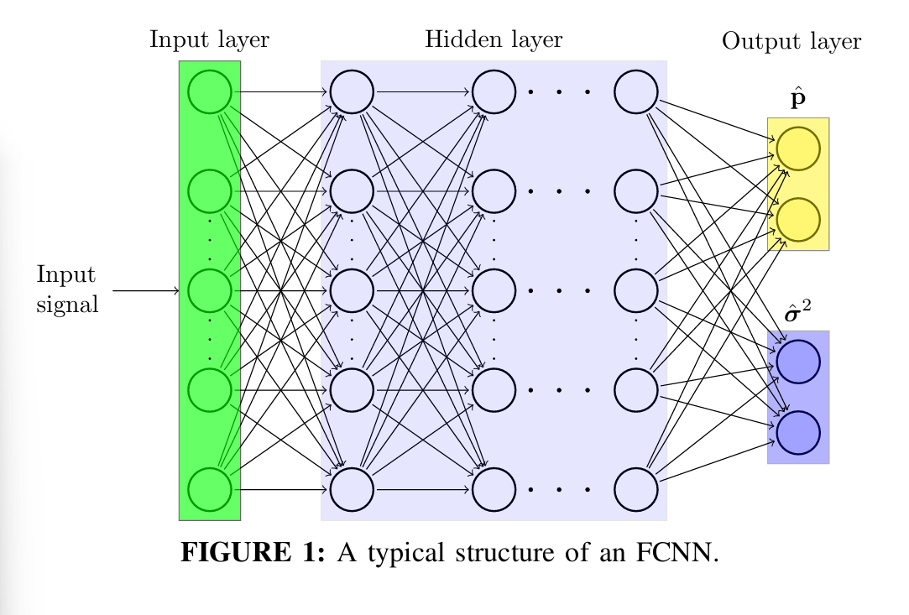
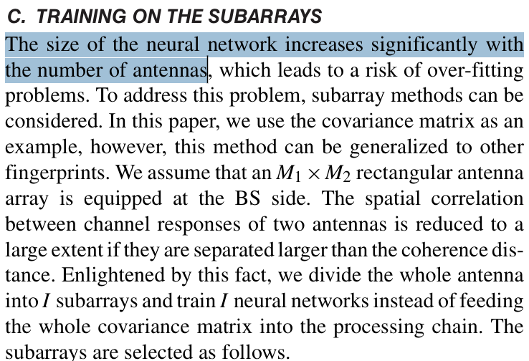
Background – Previous works
FCNN: Fully Connected Neural Network
localization as a static nonlinear regression problem via FCNN, without explicit temporal memory
G. Tian, I. Yaman, M. Sandra, X. Cai, L. Liu and F. Tufvesson, "Deep-Learning-Based High-Precision Localization With Massive MIMO," in IEEE Transactions on Machine Learning in Communications and Networking, vol. 2, pp. 19-33, 2024, doi: 10.1109/TMLCN.2023.3334712.
Notes:
In their previous work, they used an FCNN model for indoor positioning, but this approach presented a major challenge: the model size increased rapidly as the number of antennas grew, and there was a risk of overfitting. Therefore, we turned our attention to other possible models. Furthermore, since the short-term memory window is likely to retain useful information in indoor localization tasks, we turned to the Mamba model. I will begin by introducing this model starting with the state space.

Slide 6
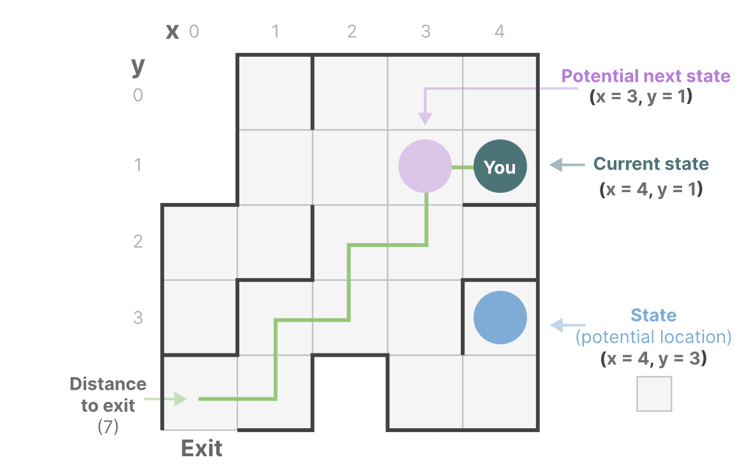
Background - Why use Mamba
State Space Model
A State Space contains the minimum number of variables that fully describe a system. It mathematically represent a problem by defining a system’s possible states.
Grootendorst, M. (2024). A Visual Guide to Mamba and State Space Models.
Notes:
Here presents the basic definition of a state space. A state space model uses states to describe a system ,such as in this picture ,all the potential positions are states

Slide 7
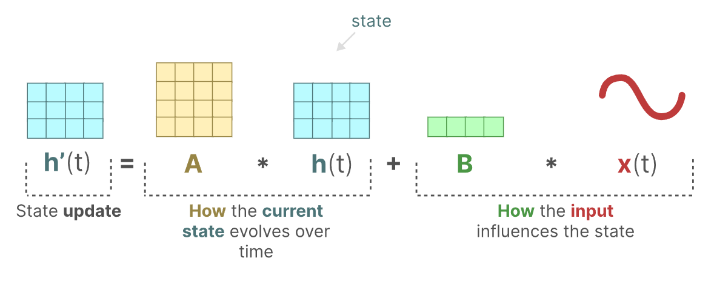
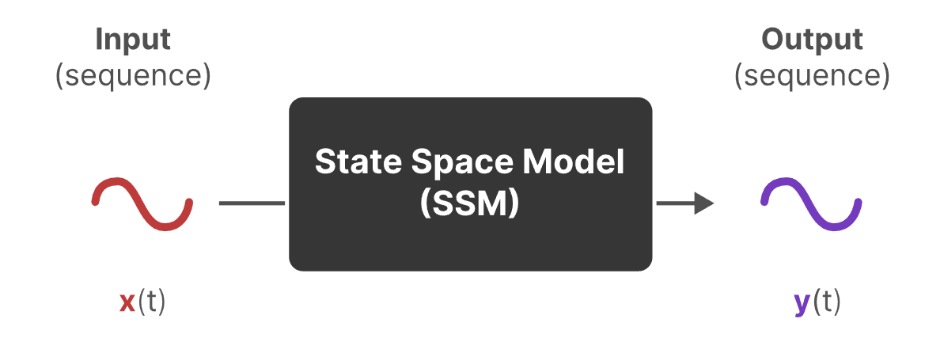
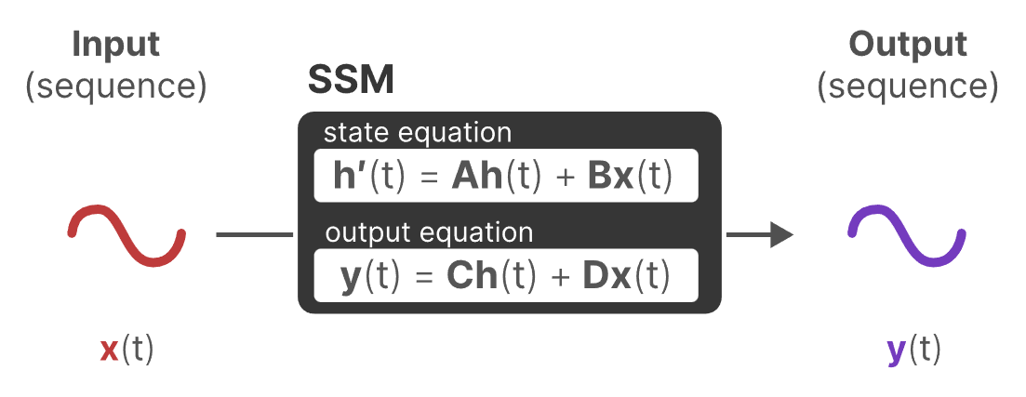
Background - Why use Mamba
State Space Model
SSMs are models used to describe and make predictions of these state, which is well suited for positioning tasks.
Traditionally, at time t, SSMs:
map an input sequence x(t) — (e.g., moved left and down in the maze)
to a latent state h(t) — (e.g., distance to exit or x/y)
and derive a predicted output sequence y(t) — (e.g., predict move left again)
SSMs assume that dynamic systems, such as an object moving in 3D space, can be predicted from its state at time t through two equations.
D = 0 for positioning tasks
Grootendorst, M. (2024). A Visual Guide to Mamba and State Space Models.
Notes:
And here u can see the first equation illustrates how the state changes, the second shows how the state connected with output

Slide 8
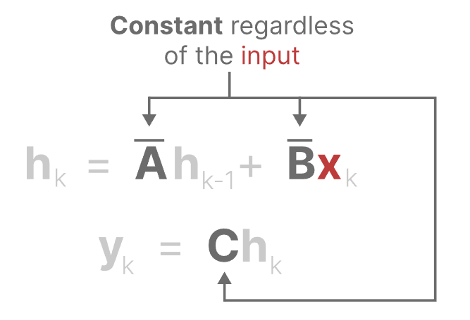
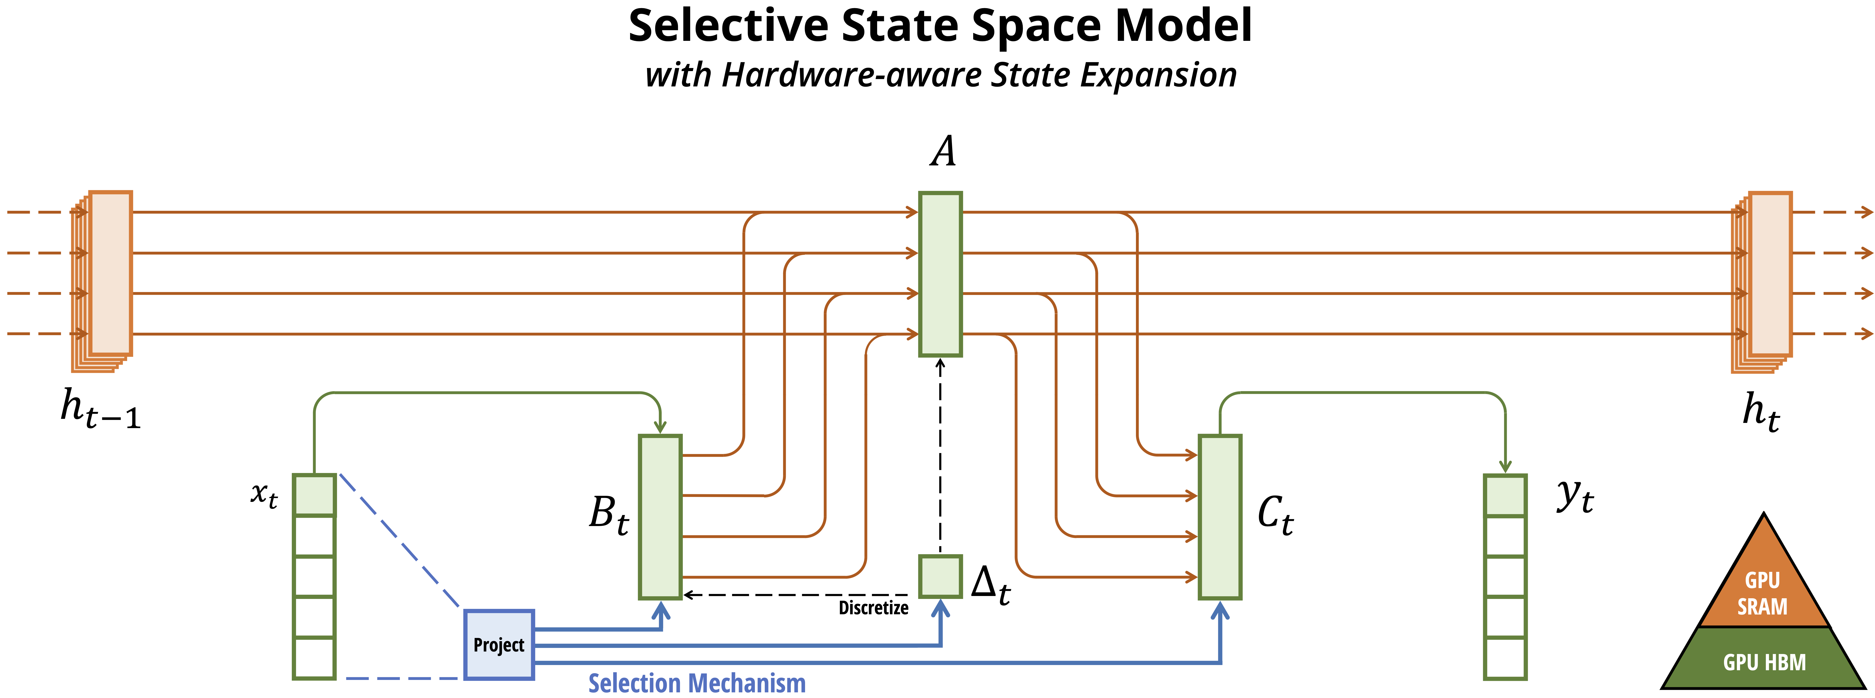
Background - Why use Mamba
Mamba is a State Space Model but more hardware-efficient
Using hidden states to store historical information and process sequences with recursive updates.
SSM
Grootendorst, M. (2024). A Visual Guide to Mamba and State Space Models.

Slide 9
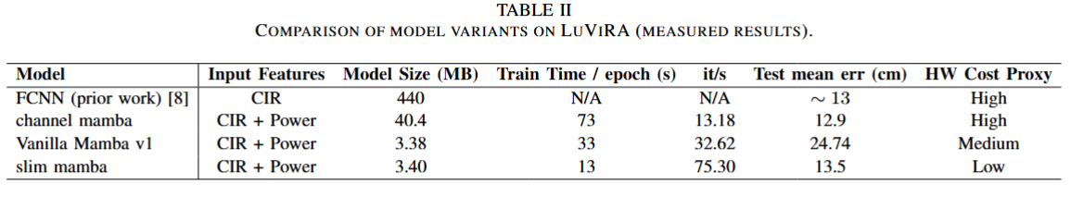
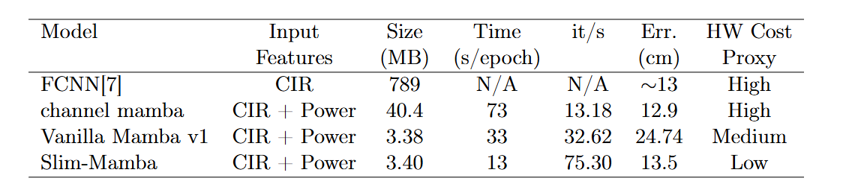
Background – Previous works
FCNN: Fully Connected Neural Network
All variant models using Mamba architecture exhibit significantly smaller parameters.
Notes:
After deciding to use the Mamba model, we tried various variants of the Mamba model and trained them using the same dataset split. The table shows the results. As can be seen, all Mamba variants exhibit a lower number of parameters. Among these, the “slim mamba” is the Mamba architecture that we determined, through ablation experiments, to be best suited for this indoor localization task. It achieves the optimal balance between maximum accuracy and model size, hardware resource consumption, and training time.

Slide 10
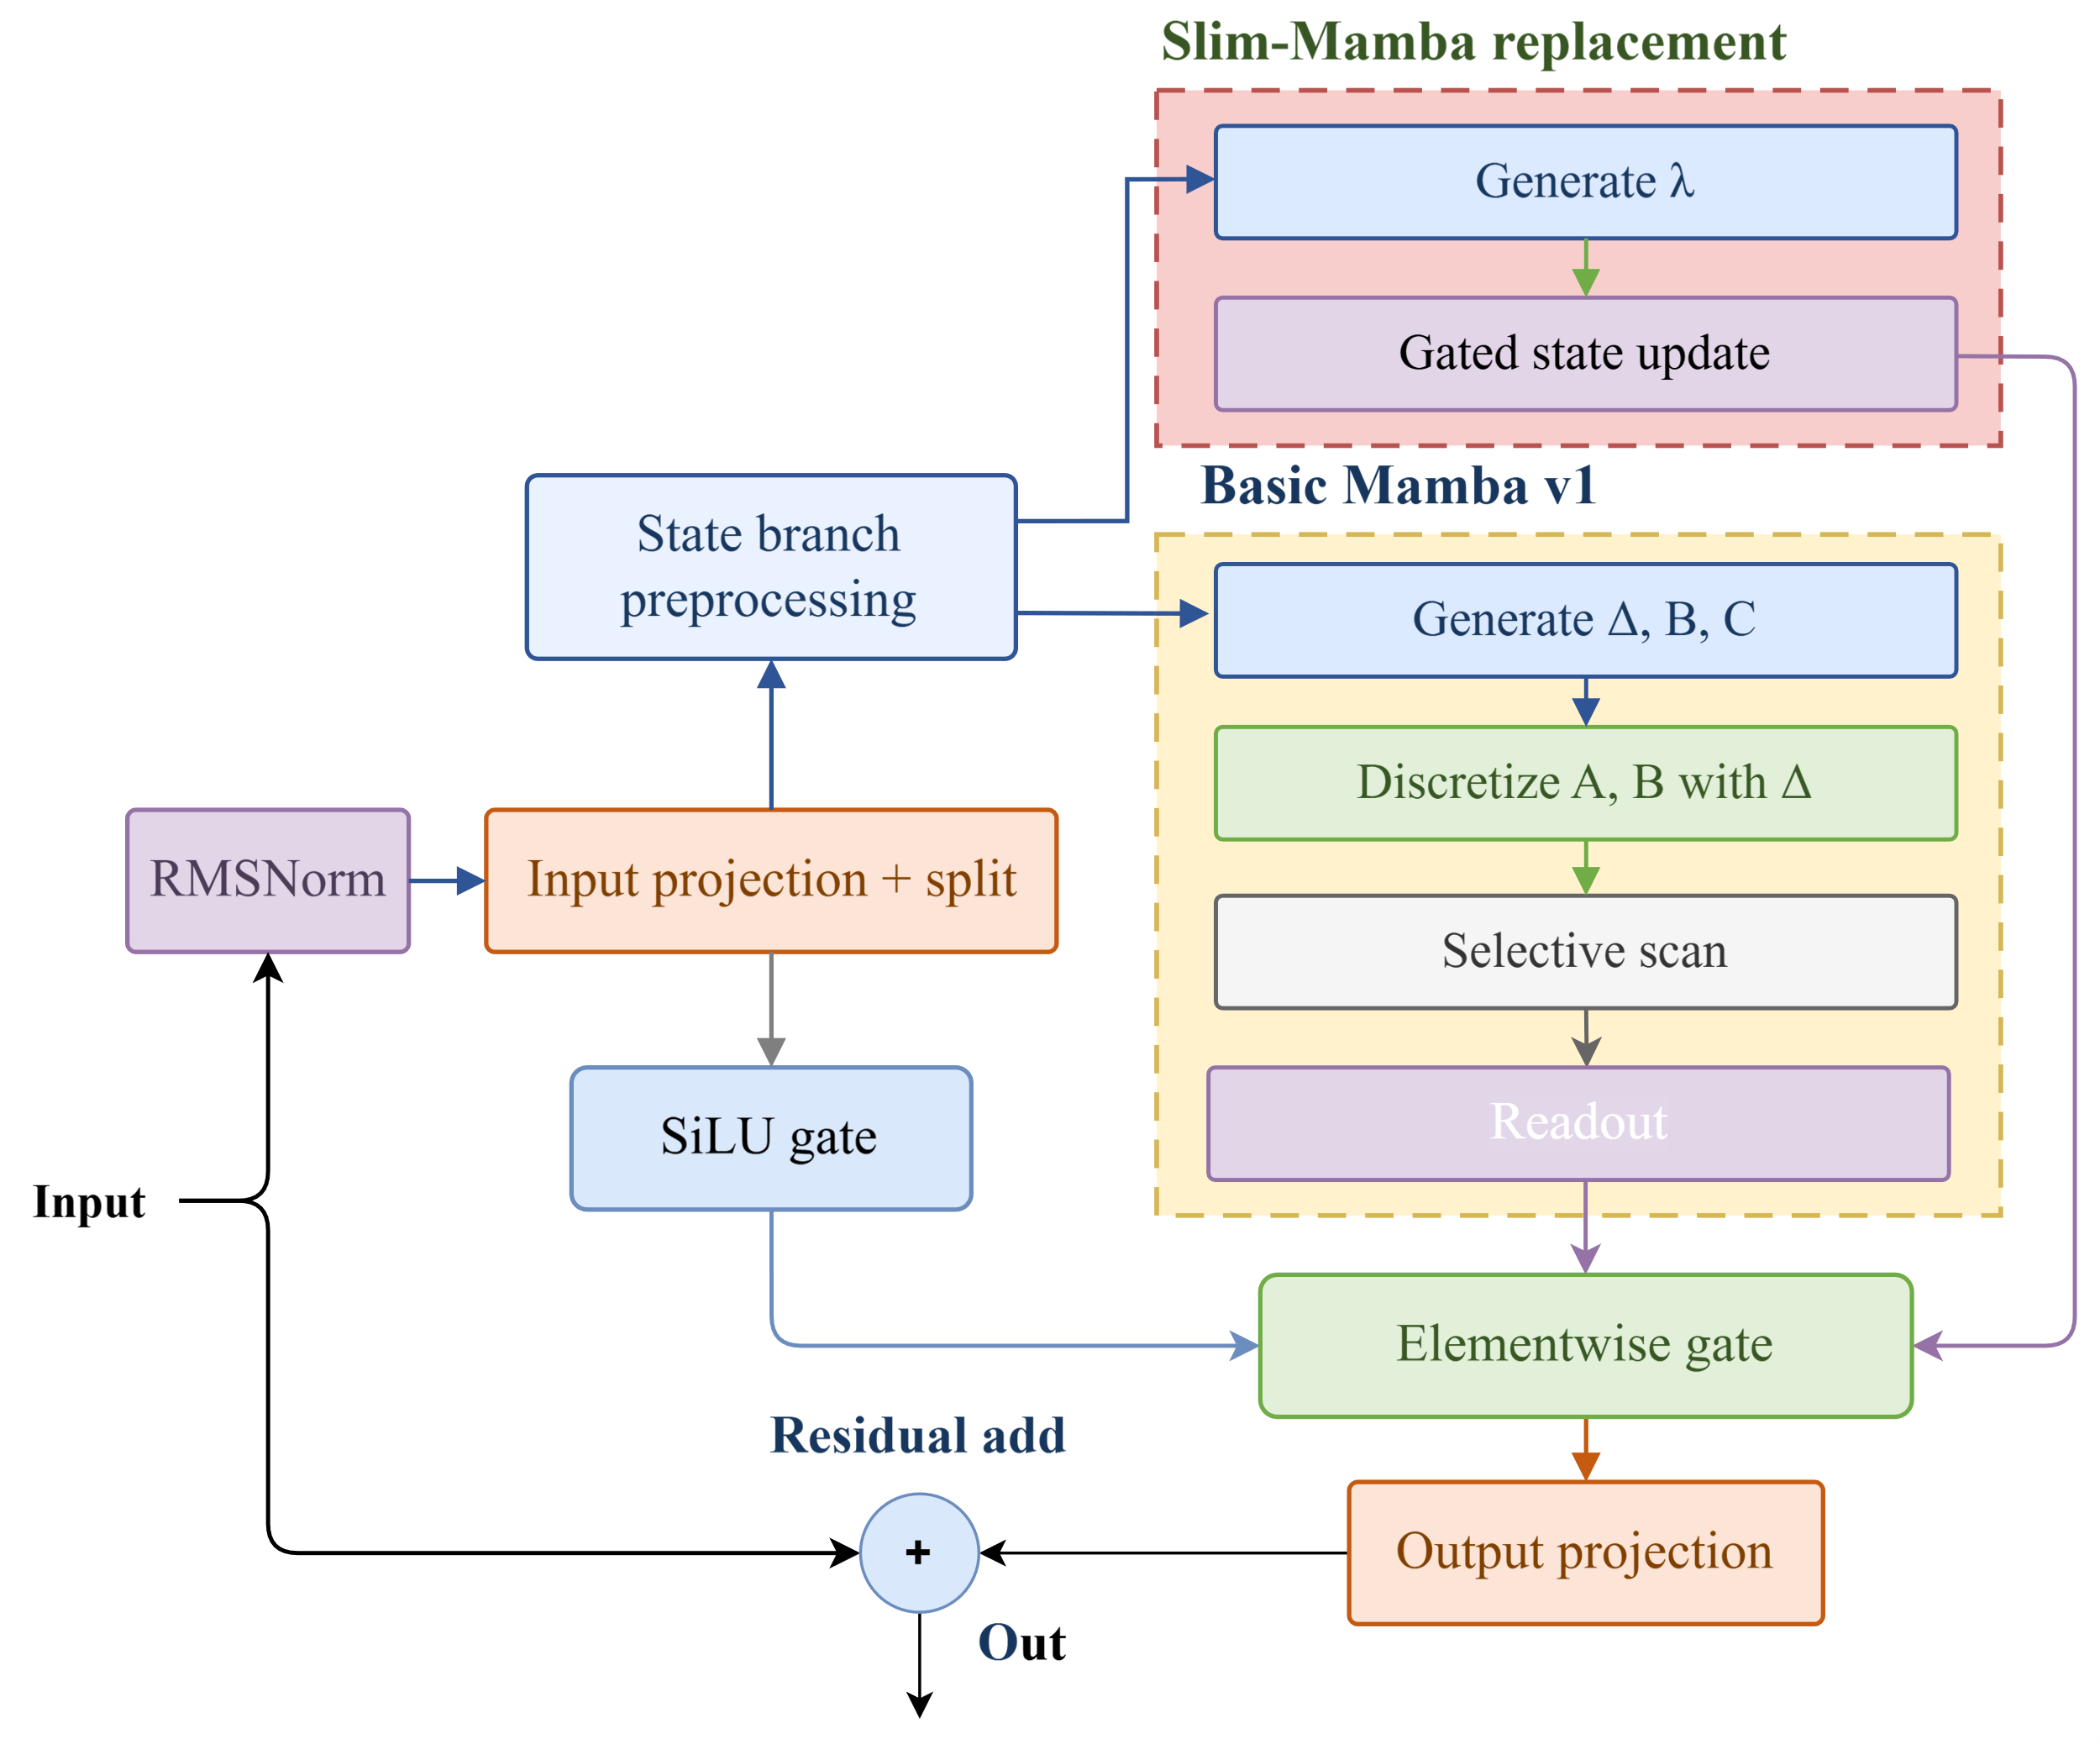
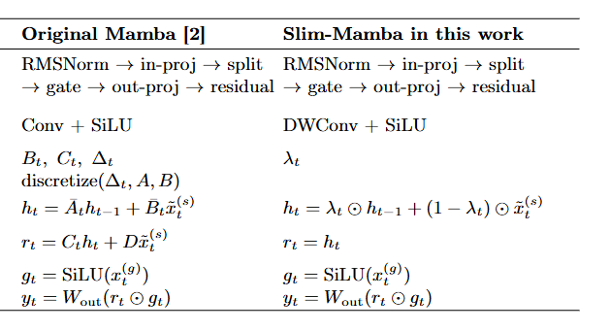
Architecture
Notes:
Below is the structure of our modified Slim Mamba algorithm. The main changes are concentrated in the recursive section; we have removed the complex time-domain and frequency-domain discretization and replaced it with a relatively simple direct discrete-time update. Once the model architecture has been determined, our primary task is first to quantize the model, measure the quantization error, and identify the layer most sensitive to quantization. My teammates will explain these details later.

Slide 11
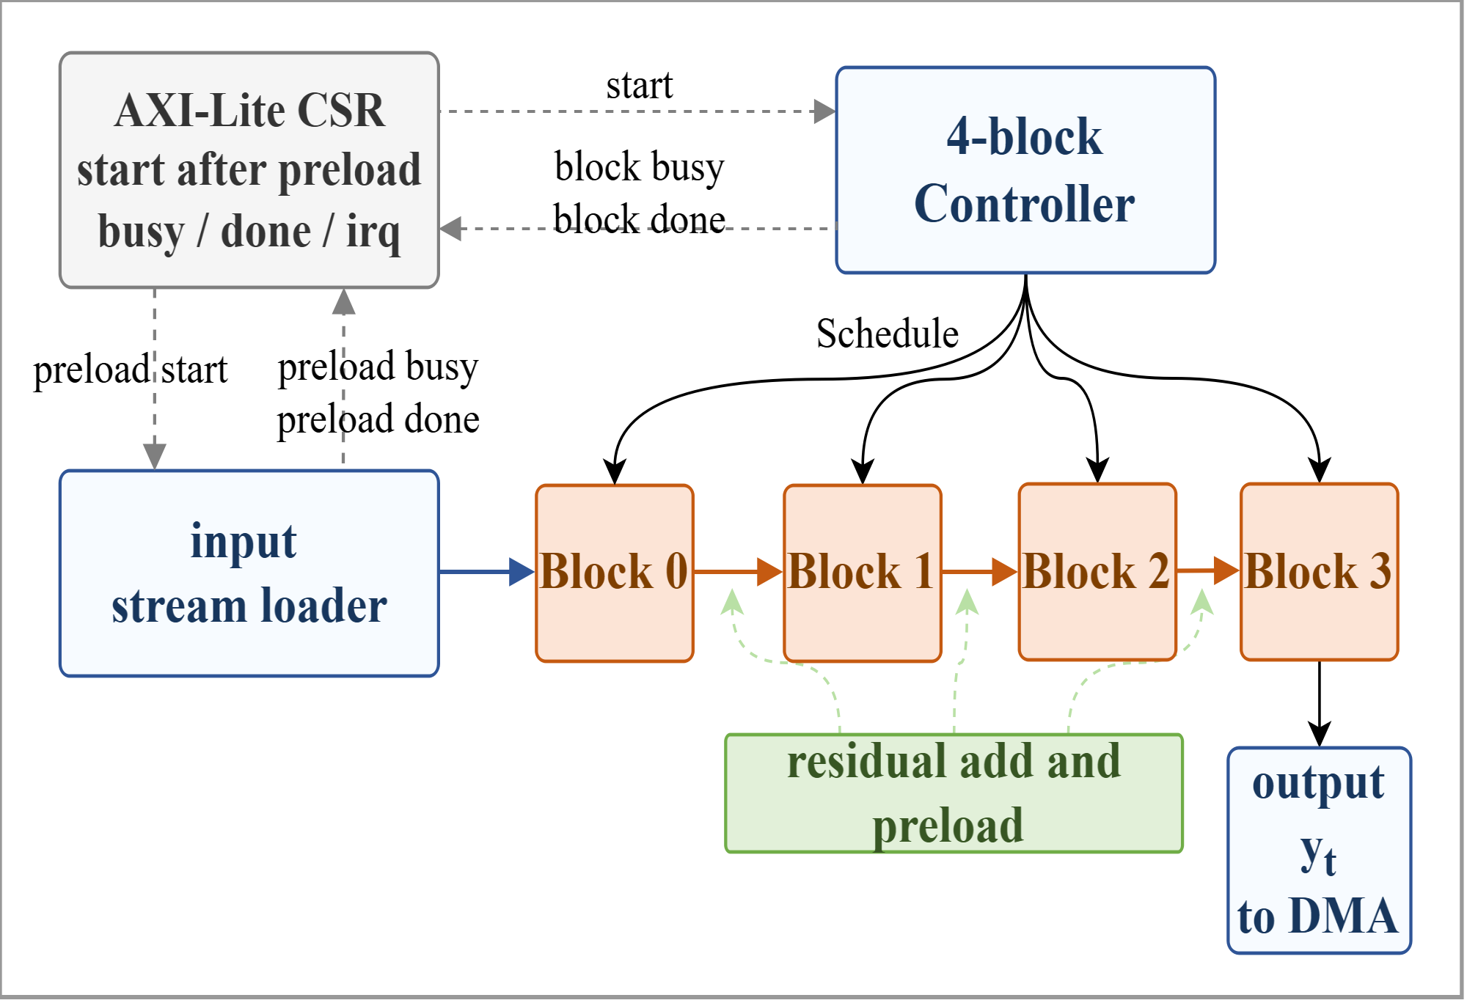
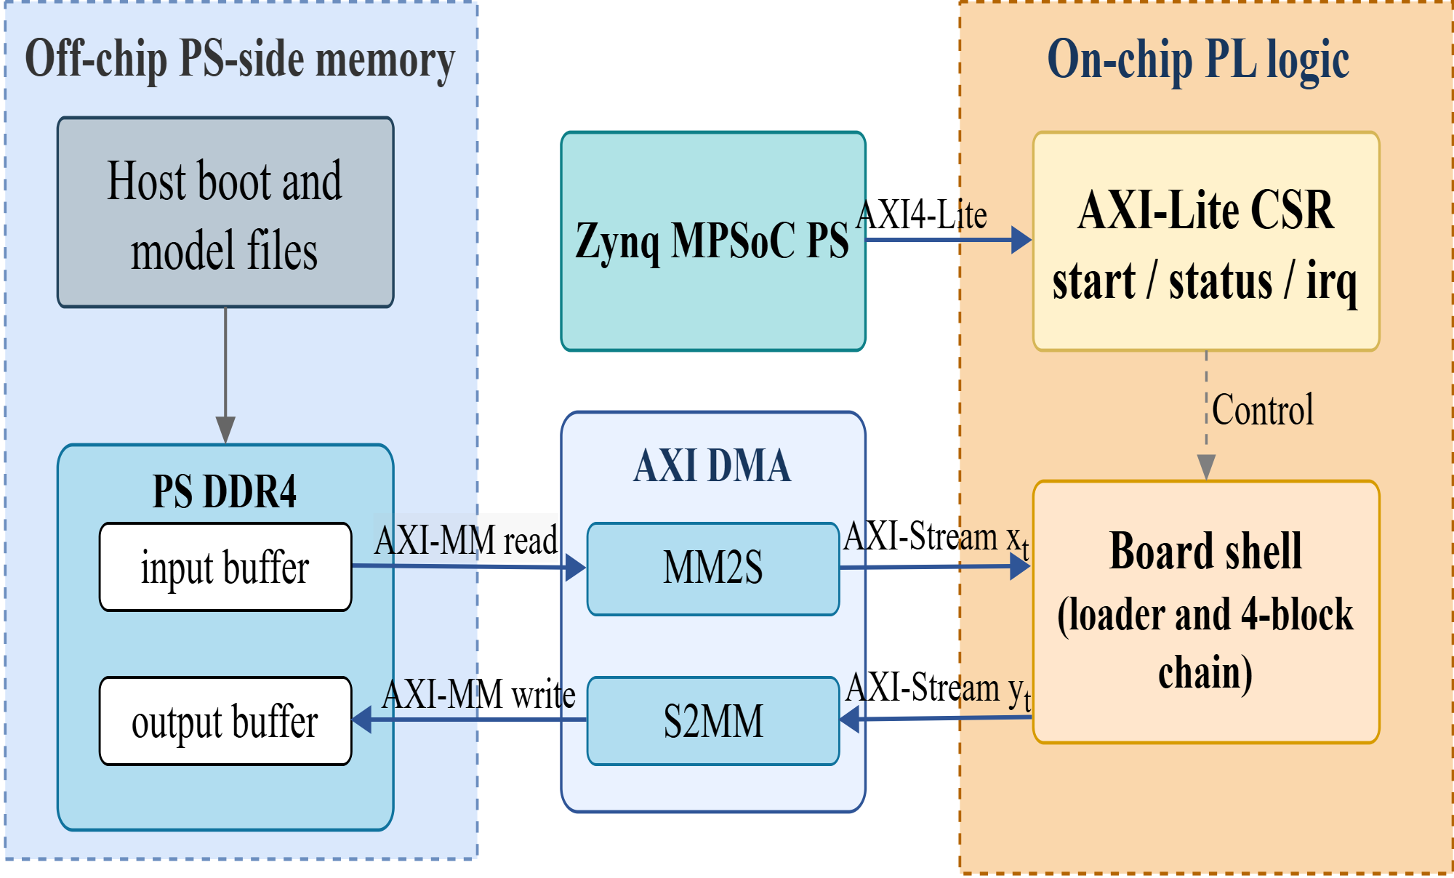
Architecture
Notes:
This is the board-level architecture of our project deployed on FPGA. First, we store the data to be processed in the memory of the processing system, then preload it into the onboard DDR4 memory (Double Data Rate Fourth Generation Synchronous Dynamic Random Access Memory). Next, we transfer the data from the DDR4 memory to the board shell—that is, our acceleration core—by AXI DMA. The following diagram shows the internal structure of our accelerator within the programming logic. We use AXI Lite control and status registers to monitor the accelerator’s operating status and then control data transfer. These state flags are generated directly by the controller's FSM. As you can see, here are four blocks, all of which are identical Slim Mamba blocks in the pipeline. This means that when we update the model—for example, by training a new three-block or five-block model for a smaller or larger dataset—we can achieve this simply by changing the instantiation and making minor modifications to the controller, while ensuring that inference speed remains unchanged.

Slide 12
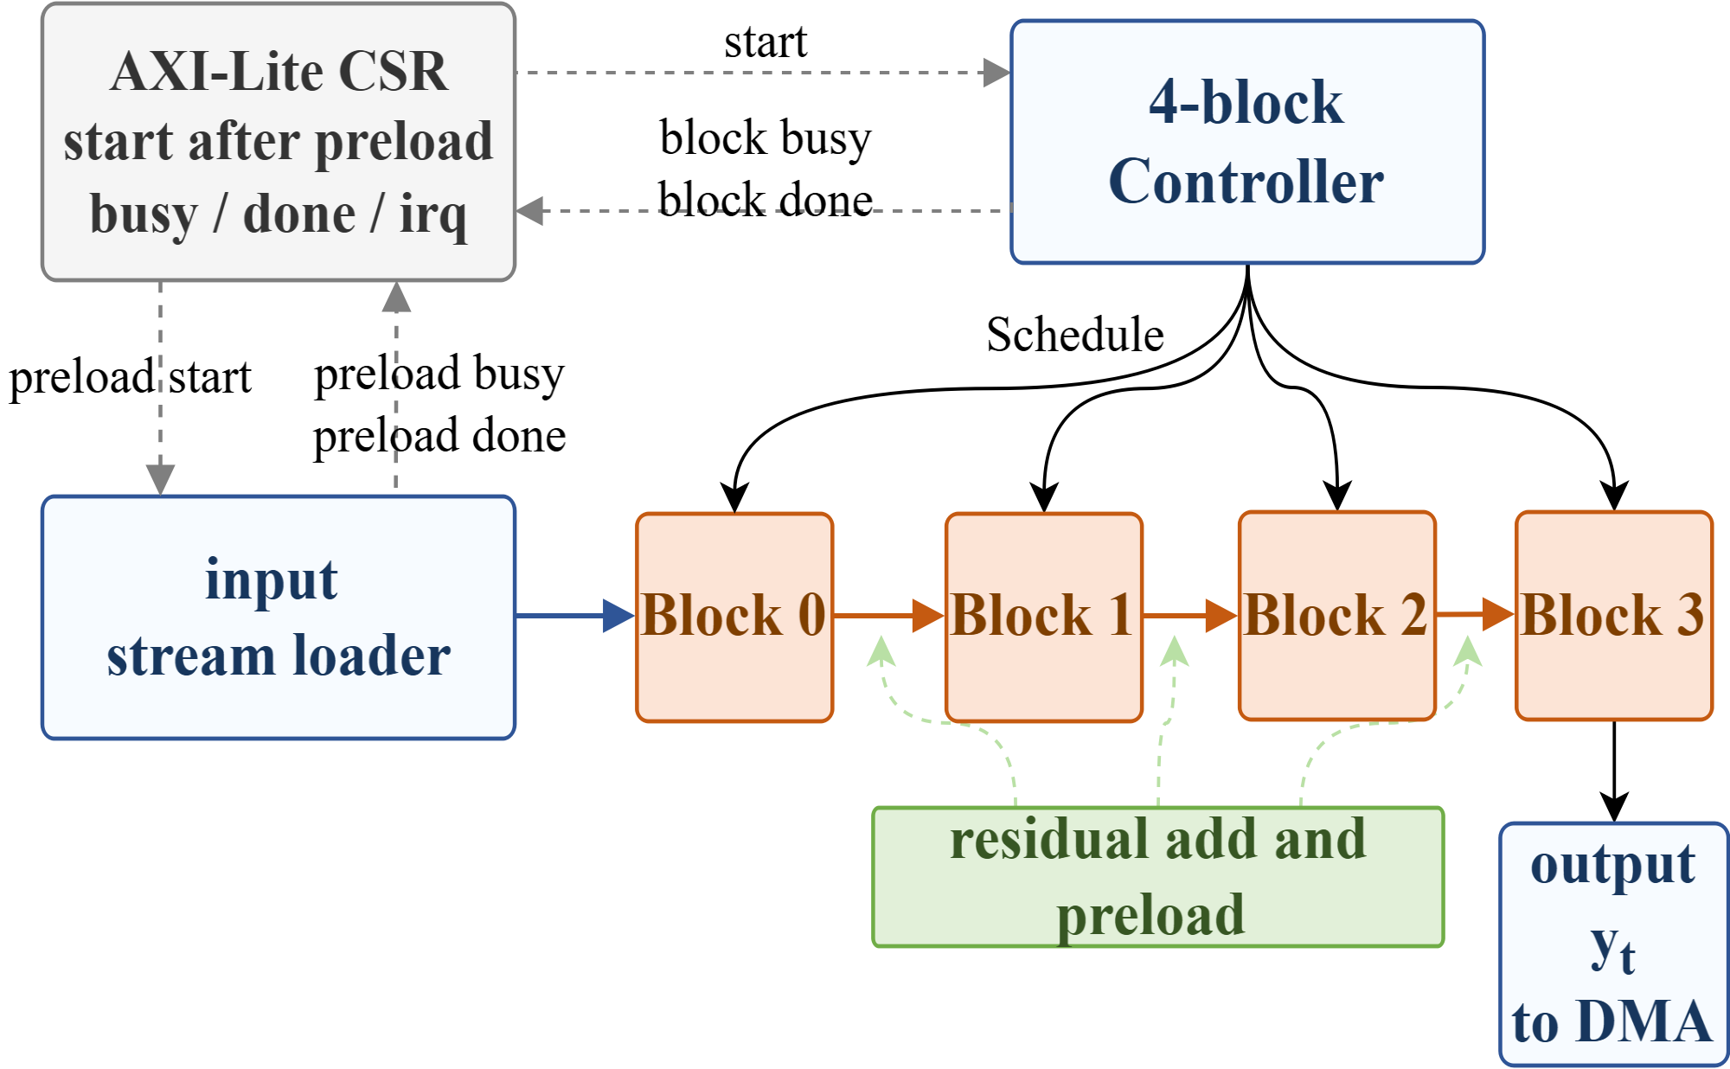
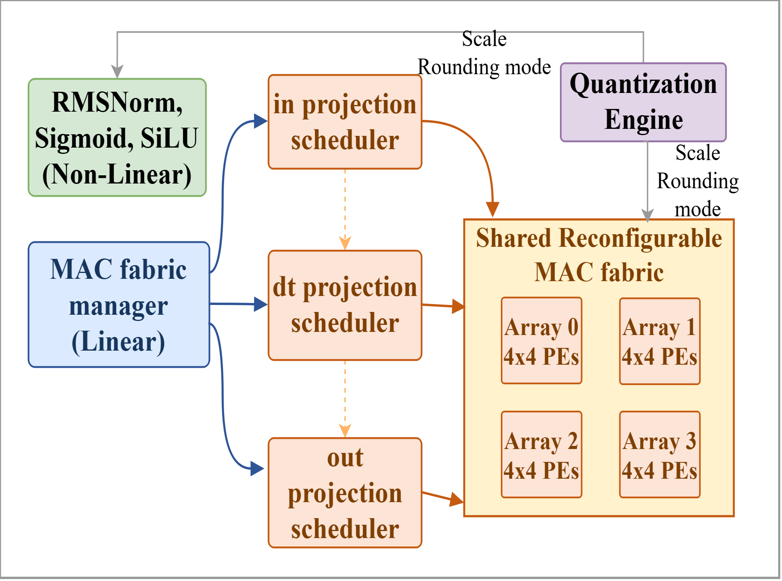
Architecture
Notes:
To ensure maintainability and reusability, we have implemented several measures. For example, within each block, all linear layers share the same MAC (multiply-accumulate) unit, and a manager is used to allocate missions. Additionally, all modules are instantiated using the same quantization engine, which allows us to easily modify the quantization target for any individual operation—such as switching between int8 and int16—without affecting the rest of the design. We designed the entire project using a unified interface, which ensures that future algorithm updates will not require a complete rewrite of the hardware. Additionally, after careful calculation, we adopted a shared MAC, which significantly reduces hardware utilization while maintaining the target frame rate. My teammate Shengjie will now walk you through the details of hardware.

Slide 13
Contents
1. Architecture
2. Linear Layers
Trade Off 1: MAC Architecture Selection
Trade Off 2: Reconfigurable vs. Fine-grained pipeline
3. Non-linear Layers
RMSNorm
Sigmoid
3. Quantisation
Workflow
Hardware implementation
4. Results

Slide 14
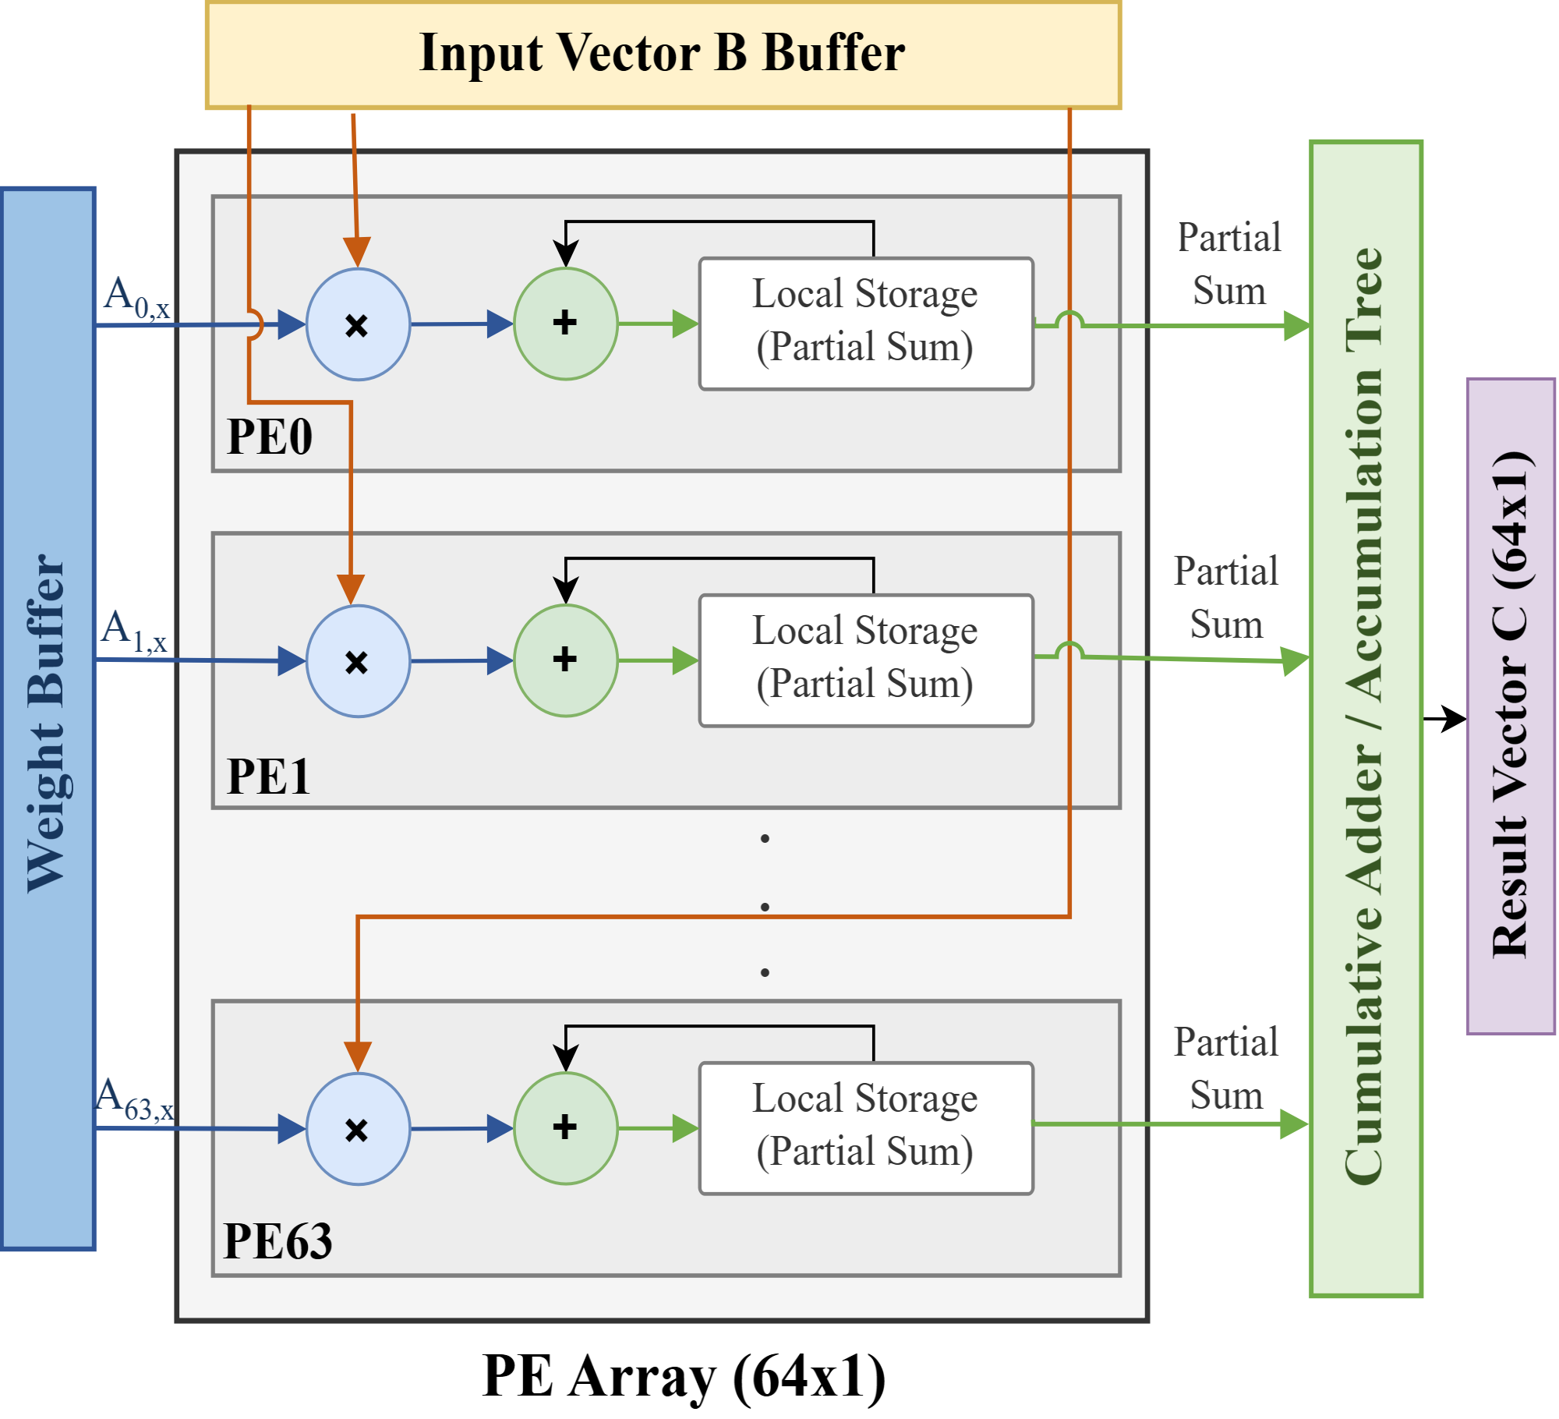
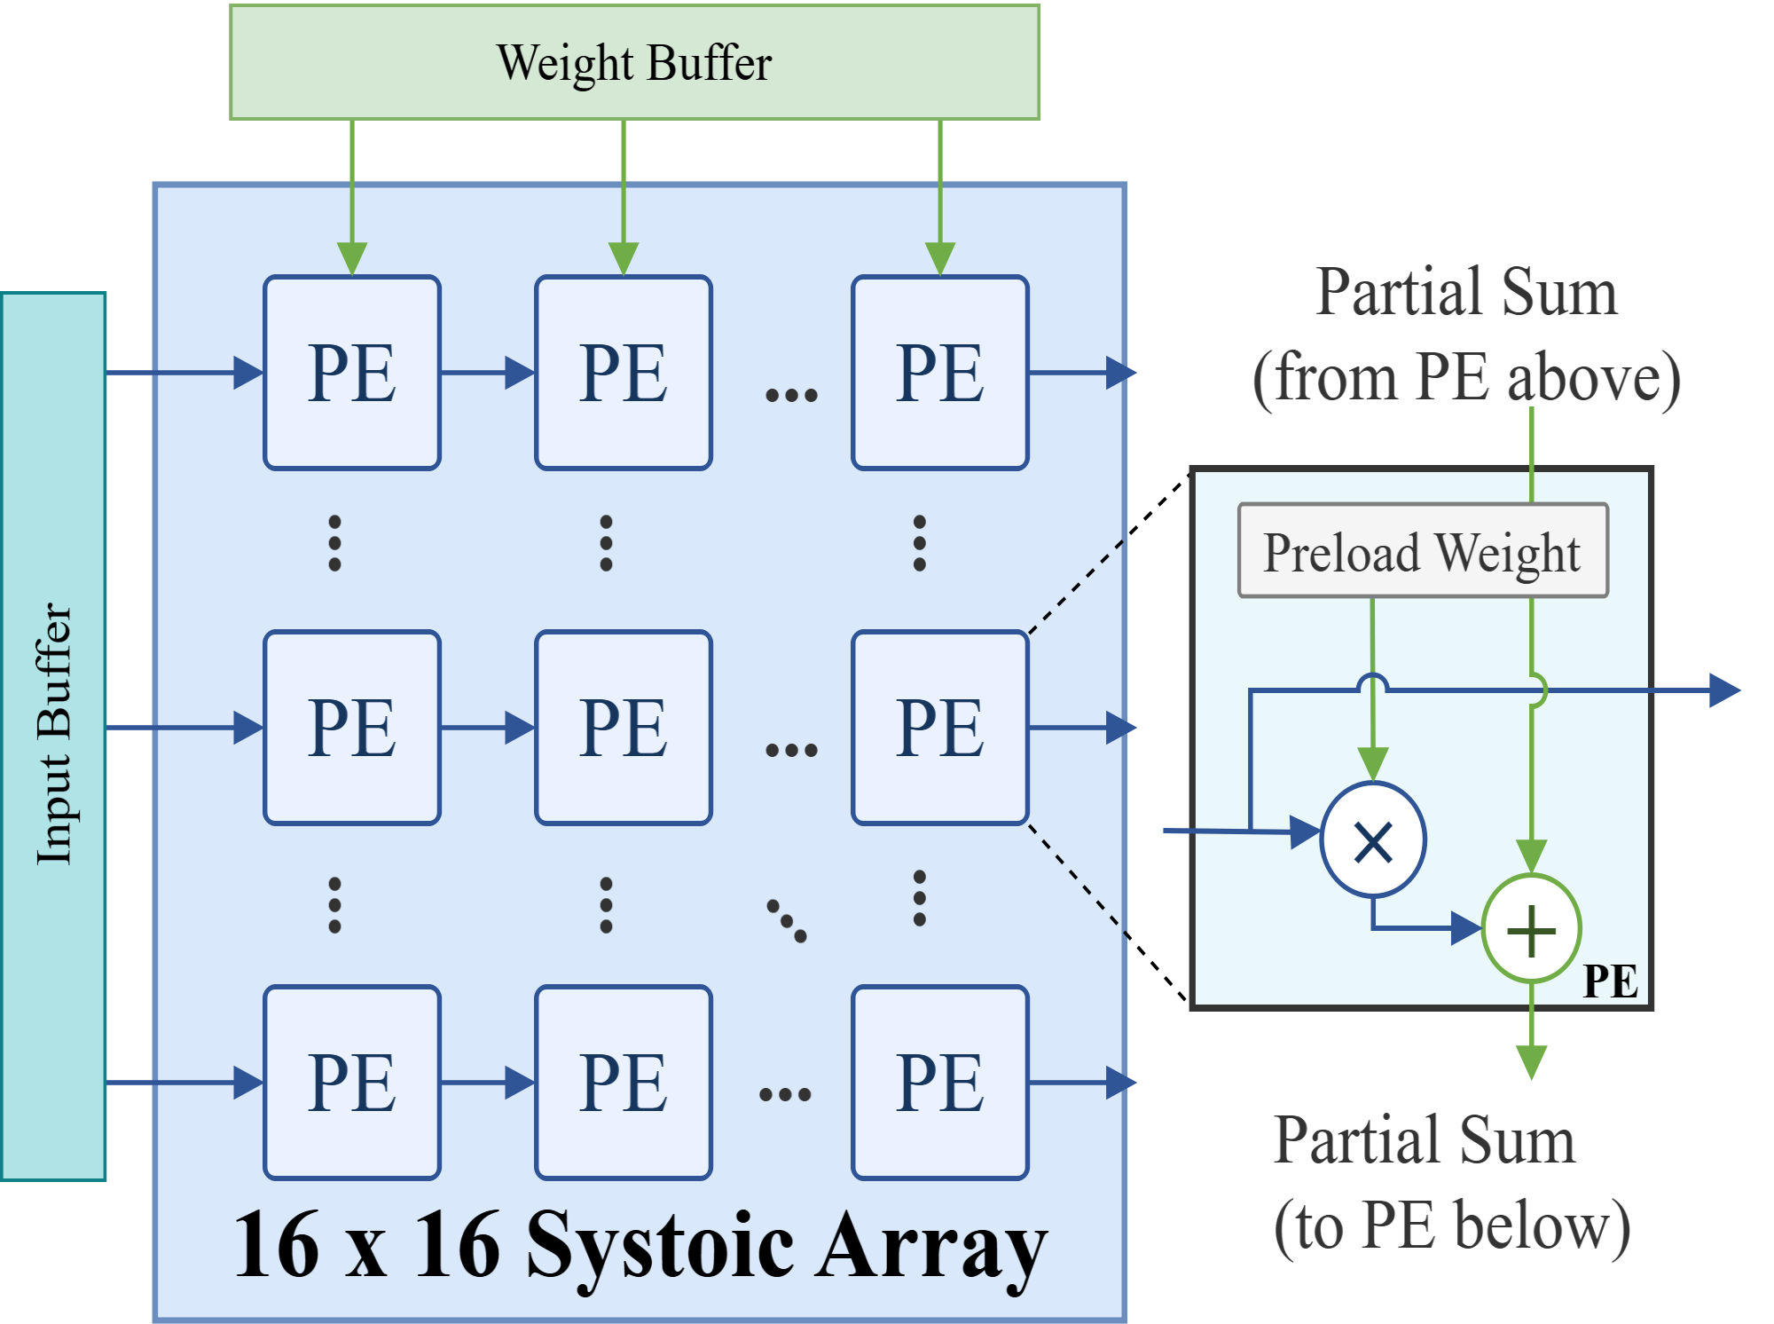
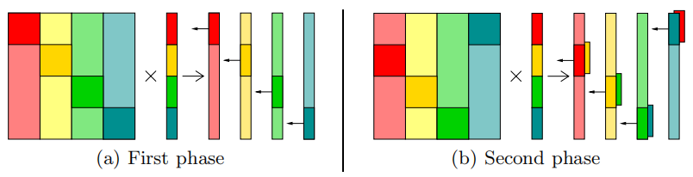
Linear Layers - MAC array design
Goal: (256,256) * (256,1) MVM - Total MACs=256×256=65536
Method 1: 16 x 16 Systolic Array
fit for Matrix, bad for Matrix-Vector
Method 2: 64 x 1 MV Unit
fit for Matrix-Vector
Method 3: 4 x 4 x 4 pipeline
compromise solution
Min. latency In theory: 1024 ccs
Bandwidth: 64 w/cycle
Min. latency In theory: 256 ccs
Bandwidth: 256 w/cycle
(stuck when run implementation)
Min. latency In theory: 1024 ccs
Bandwidth: 64 w/cycle
(works well for mvm, limited Reusability )
K. B. Theobald et al., "Landing CG on EARTH: A Case Study of Fine-Grained Multithreading on an Evolutionary Path," SC '00: Proceedings of the 2000 ACM/IEEE Conference on Supercomputing, Dallas, TX, USA, 2000, pp. 4-4, doi: 10.1109/SC.2000.10011.

Slide 15

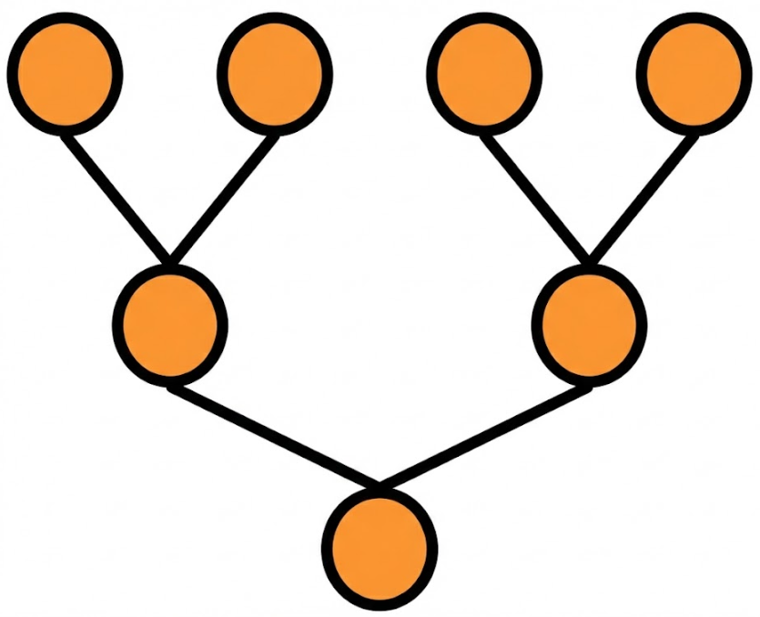
Linear Layers - MAC array design
Method 3: small parallel array (4*4) + pipeline
Weight Matrix
Goal: (256,256) * (256,1) MVM
Result: (256,1) Vector
B: 4*4 block
 | ARRAY1 | ARRAY2 | ARRAY3 | ARRAY4
cycle1 | B1
cycle2 | B5 | B2+B1
cycle3 | B9 | B6+B5 | B3+B2+B1
cycle4 | B13 | B10+B9 | B7+B6+B5 | B4+B3+B2+B1
cycle5 | B17 | B14+B13 | B11+B10+B9 | B8+B7+B6+B5
cycle6 | ... | ... | B15+B14+B13 | B12+B11+B10+B9
cycle7 | ... | ... | ... | B16+B15+B14+B13
... | ... | ... | ... | ...
... | ... | ... | ... | ...
... | ... | ... | ... | ...
cycle19 | ... | ... | ... | B64+B63+B62+B61
reduction unit
cost 3 cycles
cycle19
cycle20
cycle21
cycle22
Min. latency In theory: 1024 ccs
(3ccs filling pipeline + 3ccs reduction)
In total: 64*16+3+3=1030 ccs
Bandwidth: 64 w/cycle
at cycle 19 first 4 rows of (256,256) is completed!
at cycle 22 first tile compete, generating first 4 output!

Slide 16
Trade Off 1: MAC Architecture Selection
 | 16*16, Systolic | 64*1, MV Unit | 4*4*4, pipeline
DSPs | 256 | 64 | 64
BW (Weights/cycle) | 256 | 64 | 64
Clock Cycles (256,256) MVM | 256 | 1024 | 1030
Mem. access | in oder | in oder | interleaving
choose the 4×4×4 pipelined array because :
achieves the same 1024-cycle latency and 64 weights/cycle bandwidth as the 64×1 GEMV design, while providing much higher reusability across GEMV/GEMM/EW kernels
better timing/routing scalability than a monolithic 16×16 systolic array
Pre-distribute the weight data according to access pattern.

Slide 17
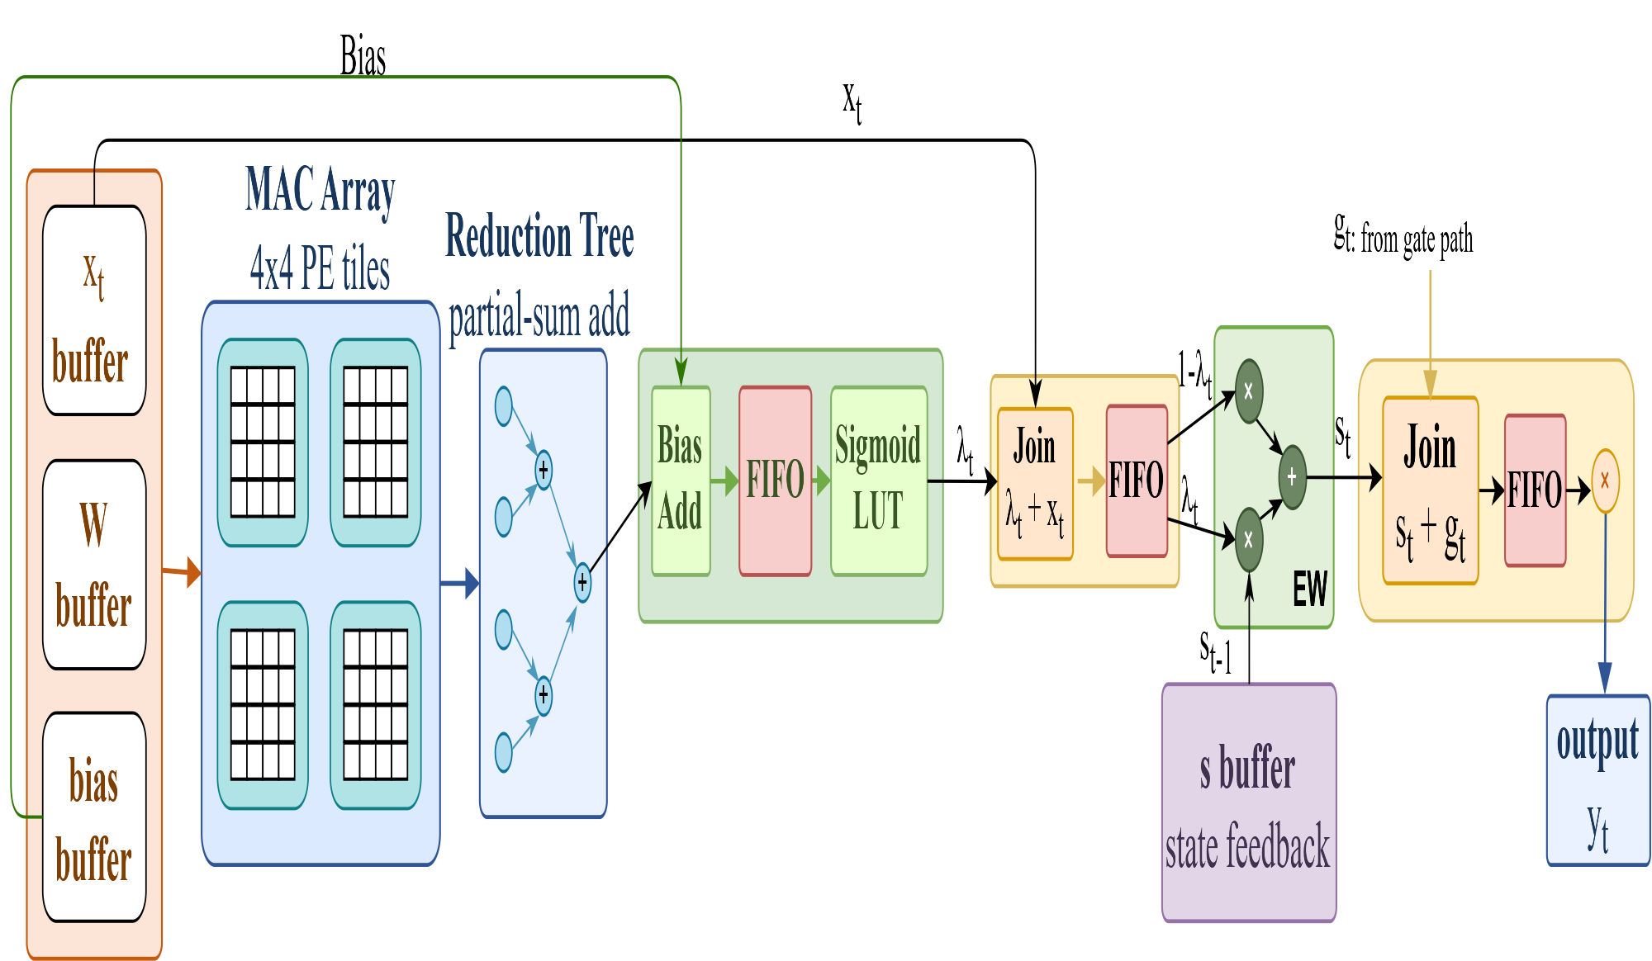
Linear Layers - Control Method
Take SSM for example:
output gating：
yt = st ⊙ gt
dt_proj :
λt = Sigmoid(Wdt · ut + b)
state update：
st = λt ⊙ st−1 + (1 − λt) ⊙ ut

Slide 18
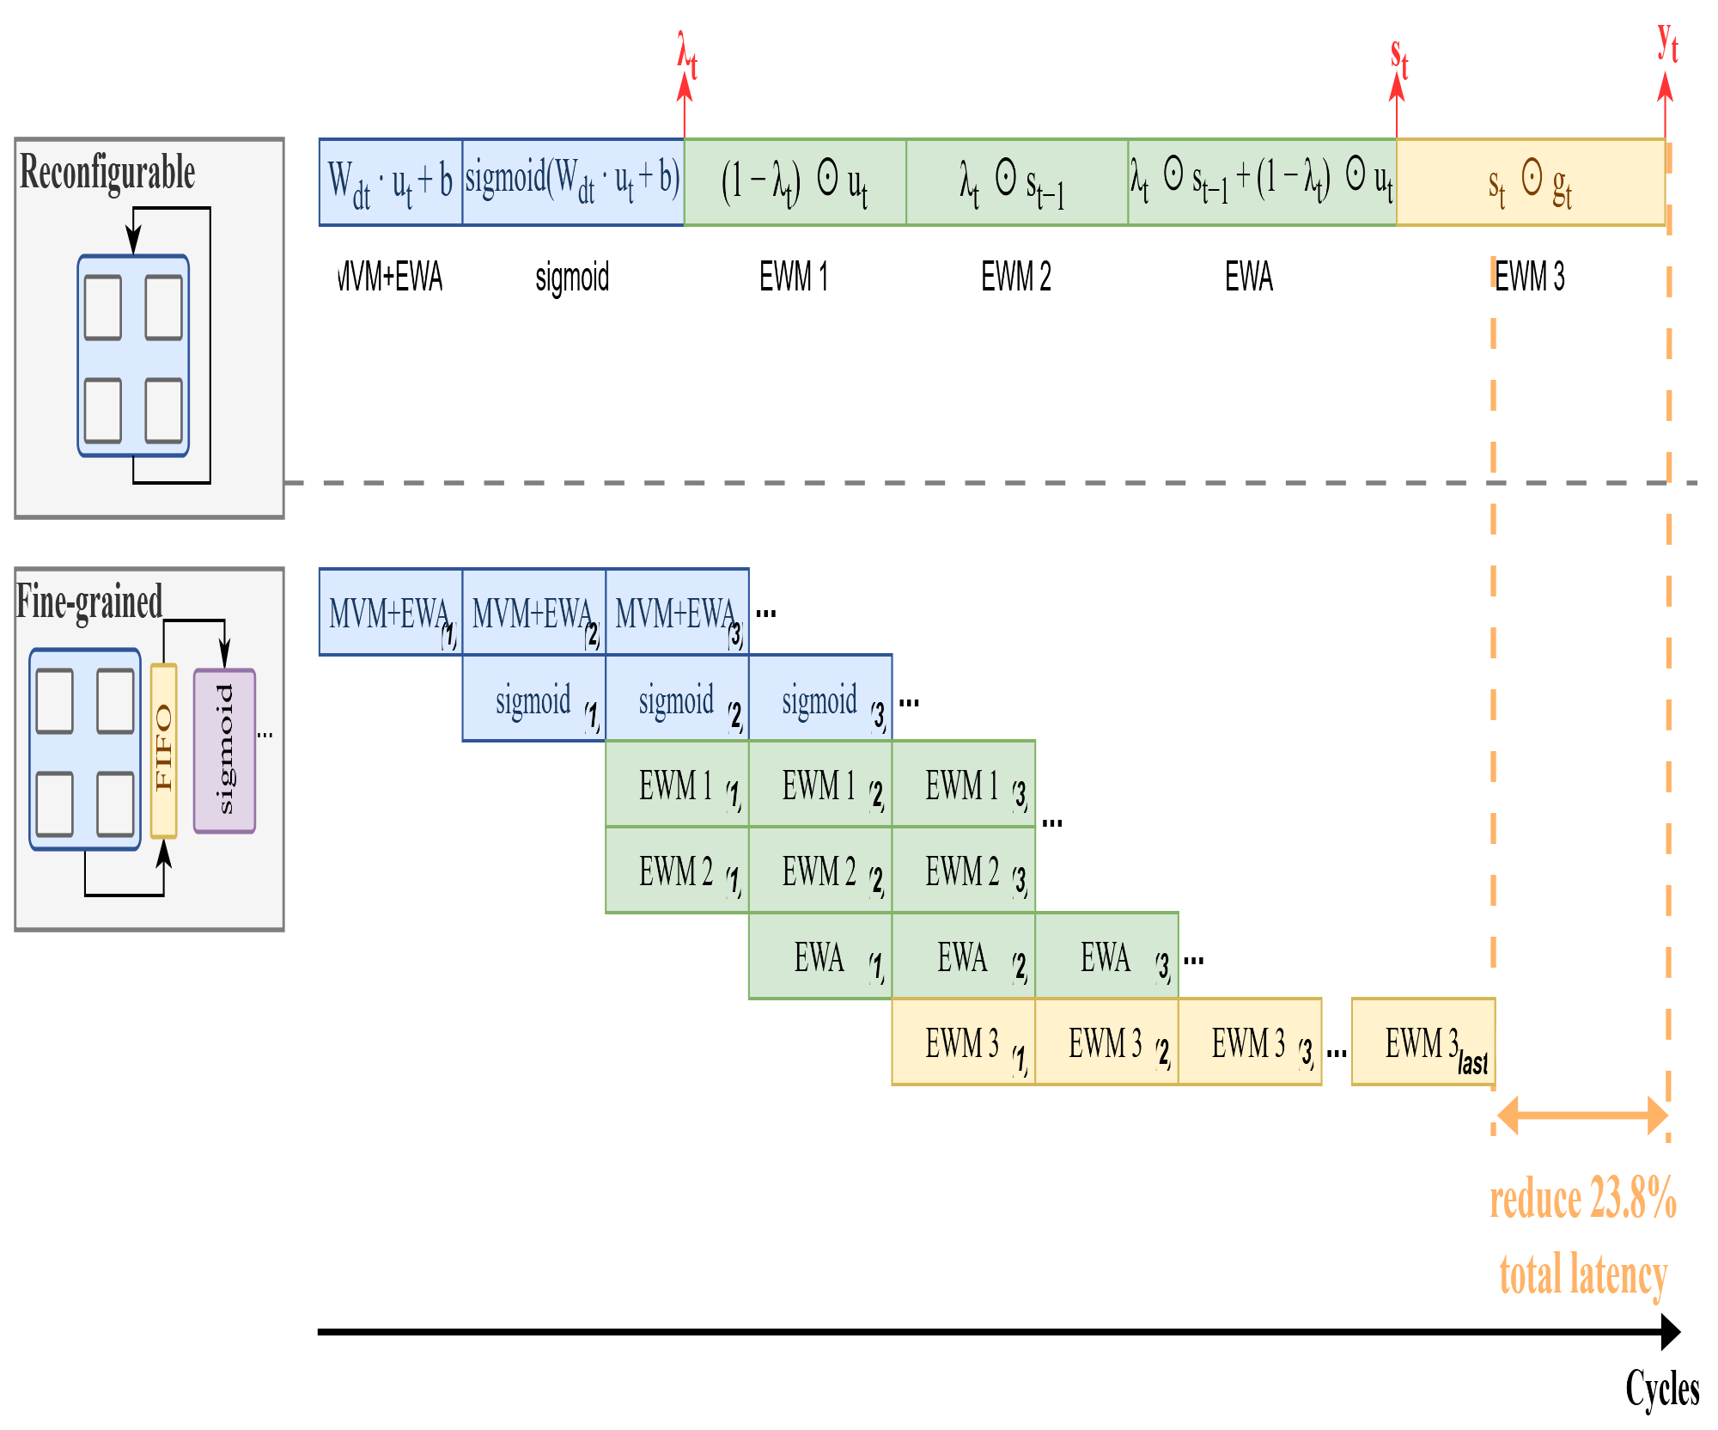
Trade Off 2 : Reconfigurable vs. Fine-grained pipeline
Case A: wait for all MAC tiles, then run Sigmoid/EW
T_A = 29N
Case B: stream each tile to Sigmoid/EW as soon as MAC finishes
T_B = 22N + 7
Latency saving
For N = 64
T_A = 1856 cycles
T_B = 1415 cycles
Saving = 441 cycles
Saving ratio ≈ 23.8%
Add 12 DSPs
mode Calculation
00 MAC (A*B+acc_in)
01 MUL (A*B)
10 ADD (A+B)
use 64 DSPs
wait for all MACs (64 tiles) to finish and then goes to next layer.
R. Wei et al., "LightMamba: Efficient Mamba Acceleration on FPGA with Quantization and Hardware Co-design," 2025 Design, Automation & Test in Europe Conference (DATE), Lyon, France, 2025, pp. 1-7, doi: 10.23919/DATE64628.2025.10993079.

Slide 19
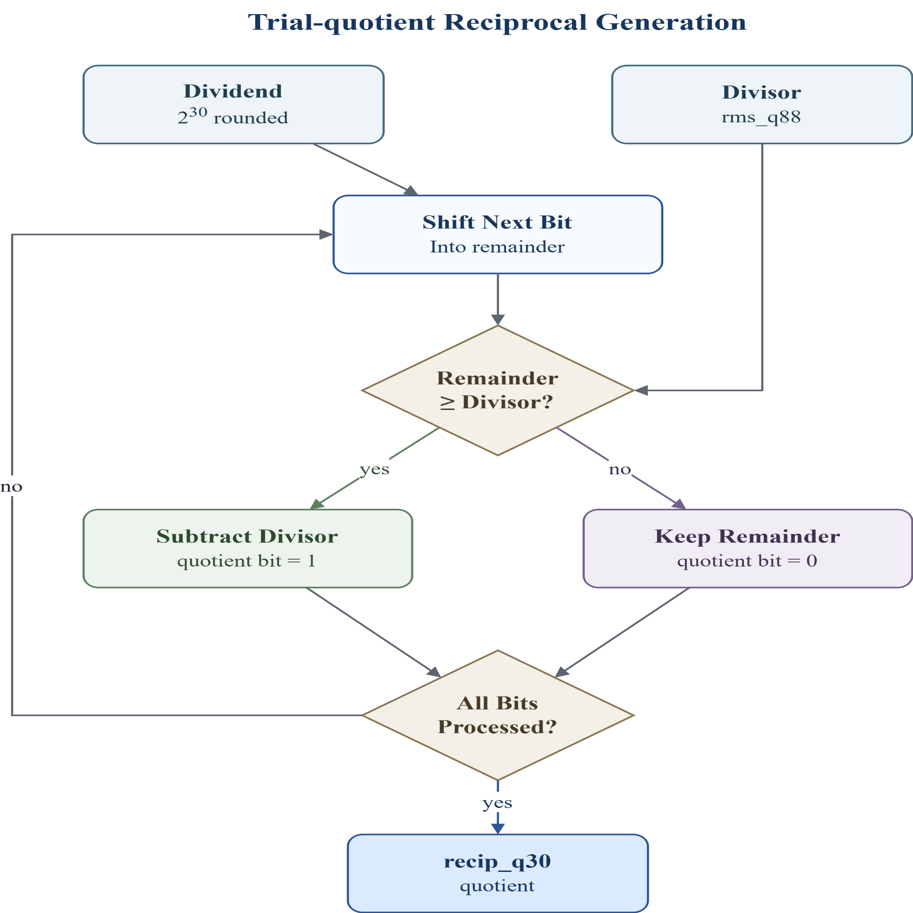
Nonlinear layer - RMSNorm
RMSNorm: y_i = x_i / RMS(x) * gamma_i
Trial-quotient
method
Iterative
method
weight
Division：
Goal: replace division with one reciprocal value, recip_q30 = round(2^30 / rms_q88)
2^30 is the scaling factor for the fixed-point reciprocal. recip_q30 stores 1 / rms_q88 with 30 fractional bits.
More fractional bits give higher reciprocal precision, reducing RMSNorm output error.

Slide 20
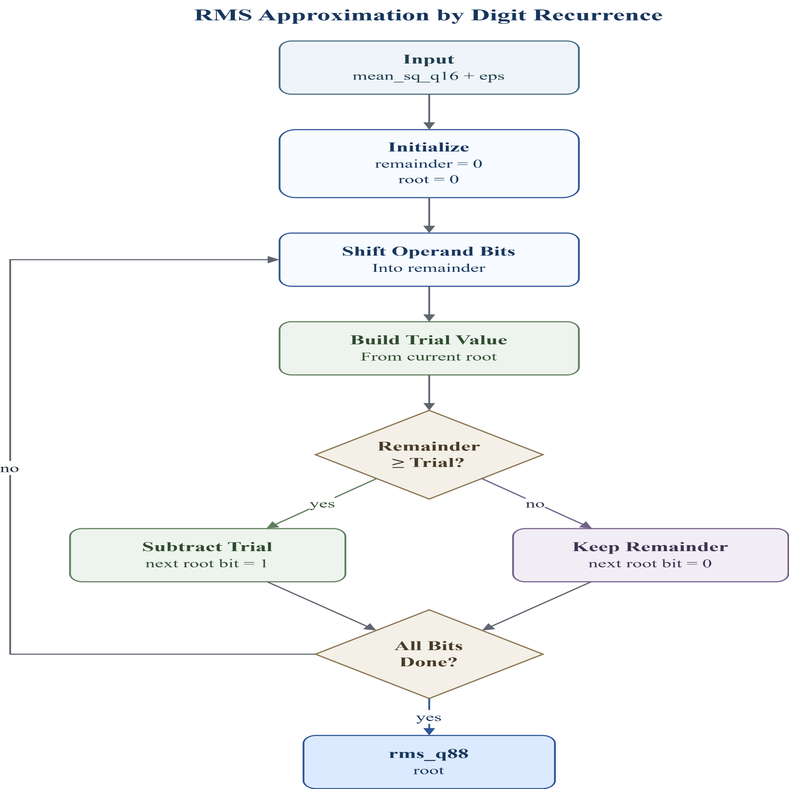
Nonlinear layer - RMSNorm
RMSNorm: y_i = x_i / RMS(x) * gamma_i
Trial-quotient
method
Iterative
method
weight
RMS Approximation：
Goal: compute RMS without floating-point sqrt: rms_q88 = isqrt(mean_sq_q16 + eps)
root: current partial square-root result; one new bit is decided each cycle.
remainder: the remaining part of the input that has not been explained by the current root.
trial value: a test value used to check whether the next root bit can be set to 1.
root_shift = {isqrt_root, 1'b0};
trial = {32'd0, root_shift, 1'b1};

Slide 21
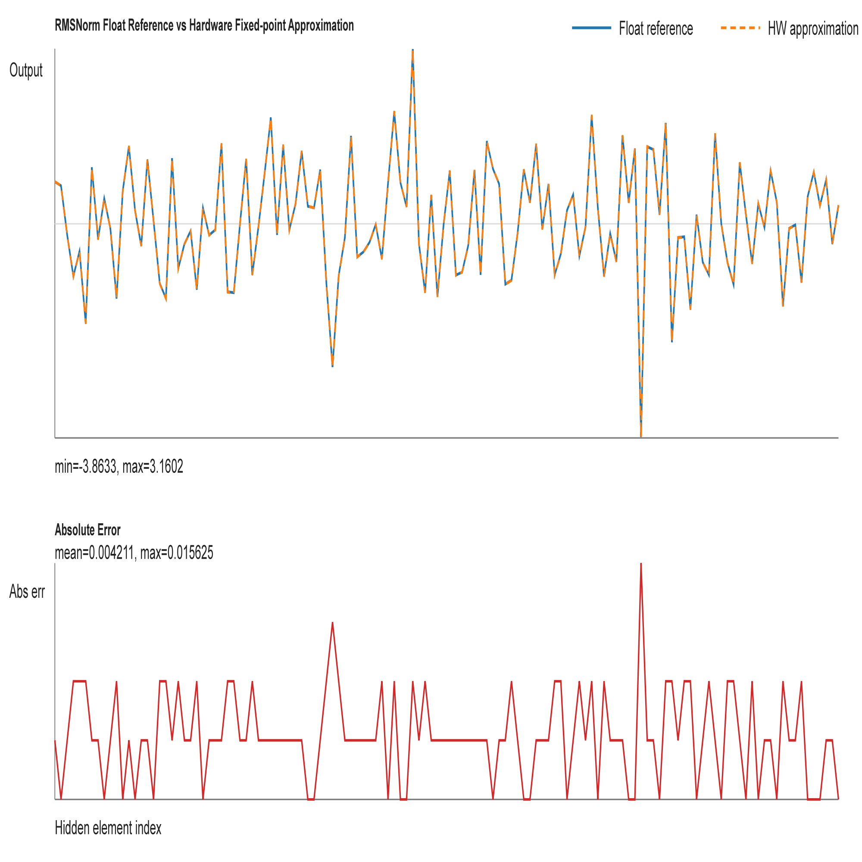
Nonlinear layer - RMSNorm
max abs. error= 0.015625
mean abs. error = 0.004211

Slide 22
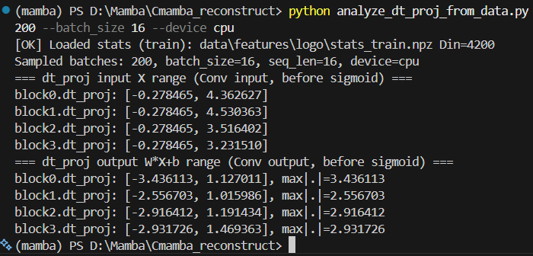
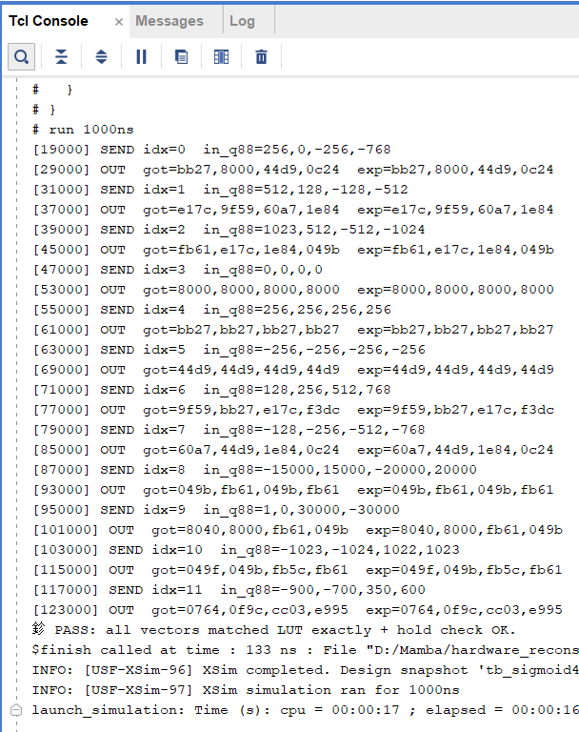


Nonlinear layer - Sigmoid
clamp x to [-4, +4)
LUT: 2048 sigmoid outputs

Slide 23
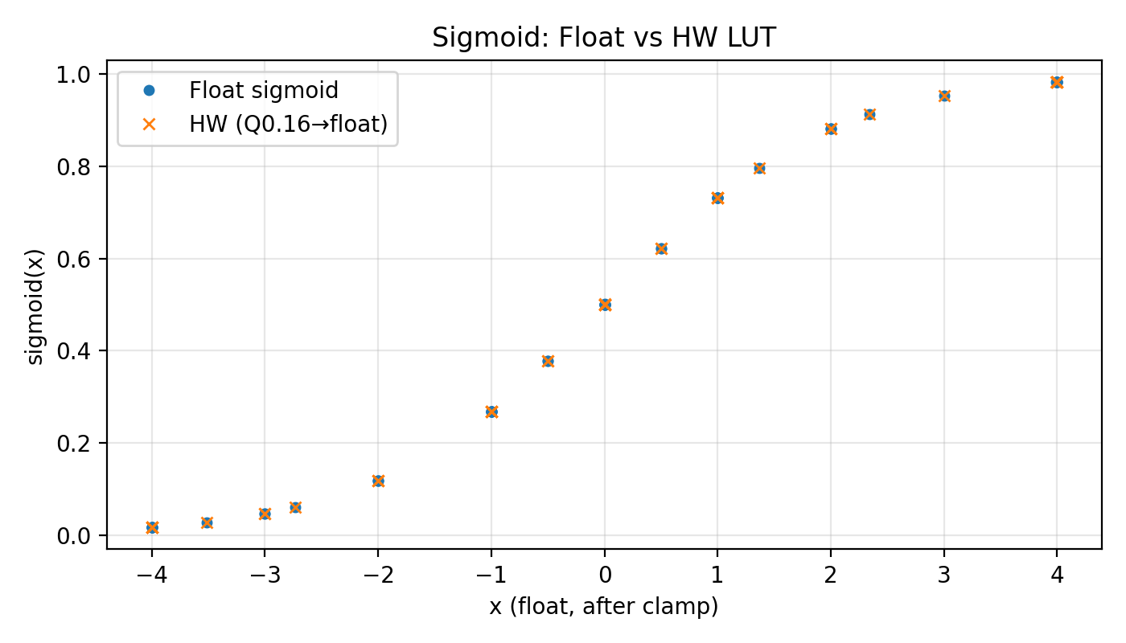
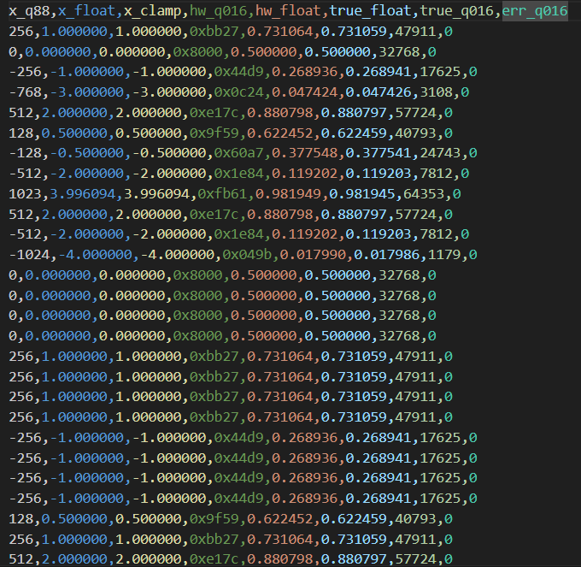
Nonlinear layer - Sigmoid
error < 0.02%

Slide 24
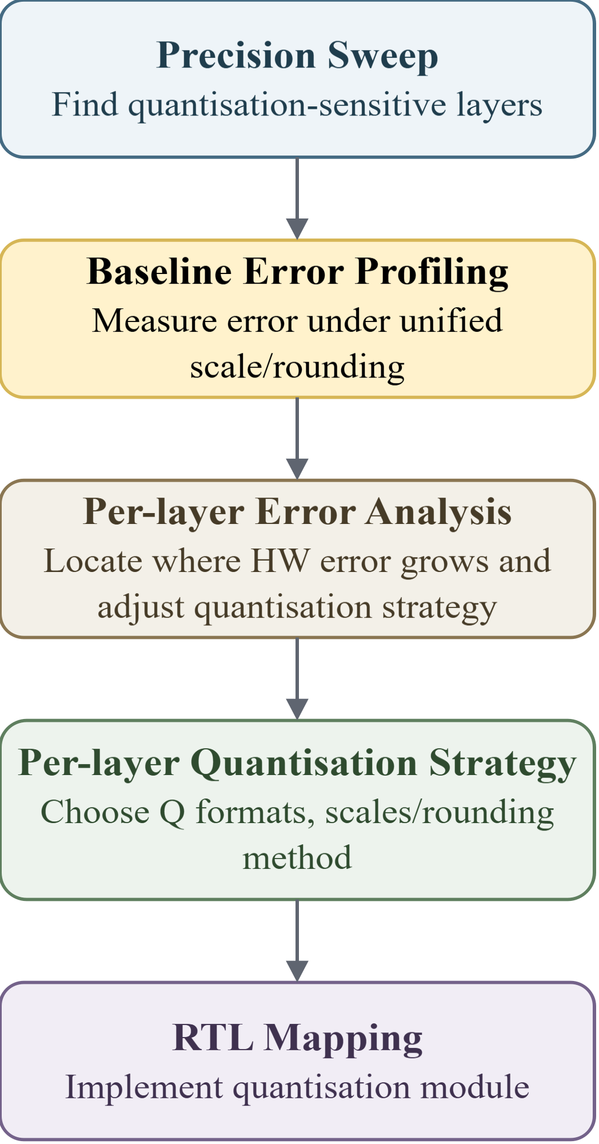
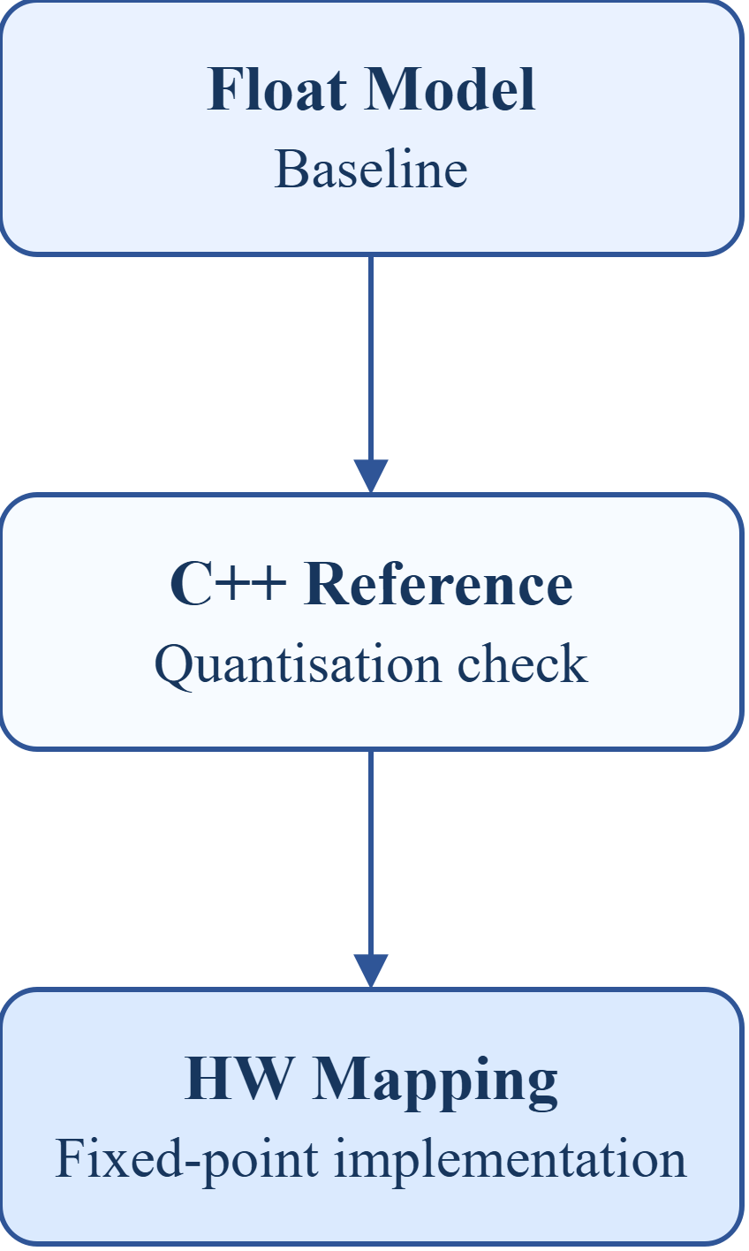
Quantisation: Workflow
Layer-wise Precision Sweep
label | mode | overrides | mean_err (m)
golden | - |  | 0.13695
all_int16 | int16 | ssm_state=int16, gate=int16 | 0.13520
mixed_candidate | int16 | dt_proj=int8, ssm_state=int8, gate=int8 | 0.13519
inproj_i8_on_i16 | int16 | in_proj=int8, ssm_state=int16, gate=int16 | 0.76520
outproj_i8_on_i16 | int16 | out_proj=int8, ssm_state=int16, gate=int16 | 0.24352
int16 quantisation is safe.
dt_proj, ssm_state, and gate can be reduced to int8 with negligible accuracy loss.
in_proj and out_proj are precision-sensitive and should remain at higher precision.
Metrics - MAE ：
cpp vs float quantisation loss
hw vs cpp
hardware mapping error

Slide 25
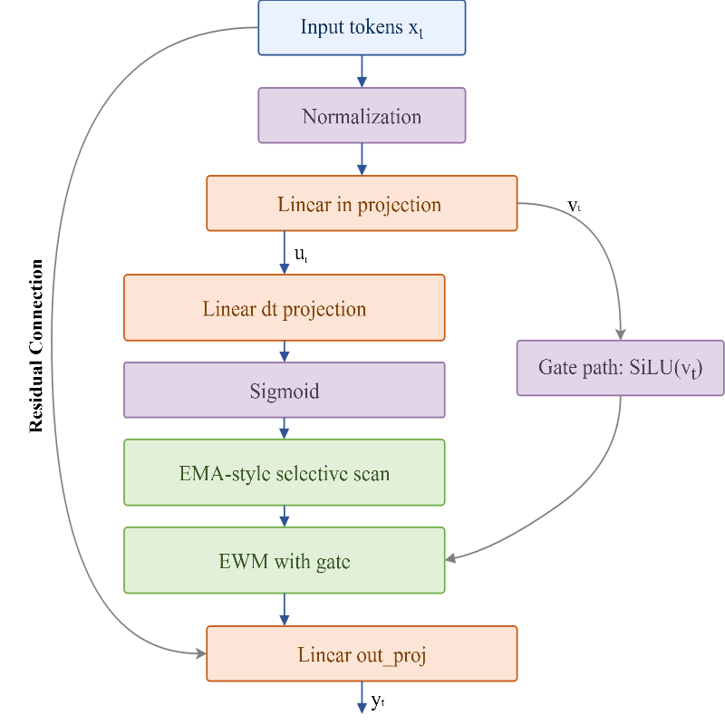
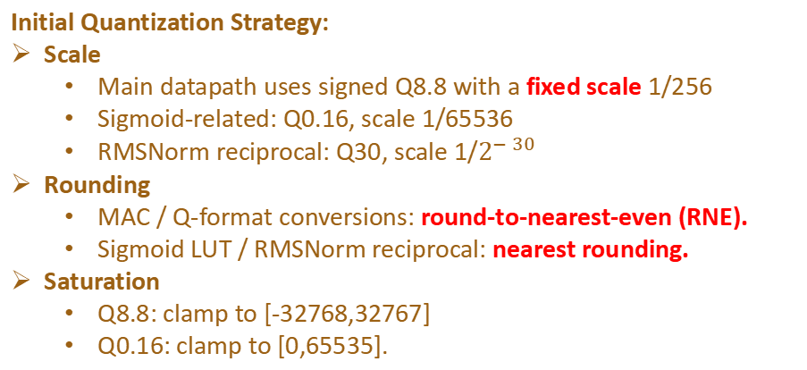
Quantisation: Workflow
Analyse per-layer quantisation error
Mismatch!
Evaluation | HW vs. float MAE | Mean localization error (m)
unified | 0.17987 | 0.35543
golden | - | 0.13695
Initial Quantization Strategy:
Scale
Main datapath uses signed Q8.8 with a fixed scale 1/256
Sigmoid-related: Q0.16, scale 1/65536
RMSNorm reciprocal: Q30, scale 1/$2^{−30}$
Rounding
MAC / Q-format conversions: round-to-nearest-even (RNE).
Sigmoid LUT / RMSNorm reciprocal: nearest rounding.
Saturation
Q8.8: clamp to [-32768,32767]
Q0.16: clamp to [0,65535].

Slide 26

Quantisation: Workflow
Analyse per-layer quantisation error
Stage | Fixed scale MAE | Dynamic Scale MAE
norm | 0.004498 | 0.004498
inproj_u | 0.010917 | 0.010917
inproj_z | 0.011069 | 0.011069
silu_u | 0.006183 | 0.006183
silu_gate | 0.005931 | 0.005931
dtproj | 0.010139 | 0.010139
dt_sigmoid | 0.002118 | 0.002118
selective_scan | 0.127090 | 0.085484
ewm_gating | 0.033001 | 0.029827
outproj | 0.032225 | 0.031243
block_output | 0.032426 | 0.031332
Fixed scale: for Q8.8, every value uses the same scale 1/256, so real value = int16 / 256.
Dynamic scale: scale is computed from the channel range, so real value = int16 × scale.

Slide 27
Quantisation: Workflow
Per-layer quantisation strategy
Scale and Q-Format
Rounding
Main rule: round-to-nearest-even.
Used after MAC, Q-format conversion, state update, and scale multiplication.
Reduces long-term bias compared with truncation.
Saturation / Clamp
Final Q8.8 values are clamped to signed int16:
[-32768, 32767]
Prevents overflow and wrong sign after multiplication, accumulation, or residual add.
Stage | Scale | Q format | Rounding | Saturation
RMSNorm output | 1/256 | Q8.8 | RNE | [-32768, 32767]
RMSNorm reciprocal | 1/2^30 | Q30 | NR | [-32768, 32767]
in_proj | 1/256 | Q8.8 | RNE | [-32768, 32767]
dt_proj | 1/256 | Q8.8 | RNE | [-32768, 32767]
out_proj | 1/256 | Q8.8 | RNE | [-32768, 32767]
gate_y | 1/256 | Q8.8 | RNE | [-32768, 32767]
Sigmoid LUT output | 1/65536 | Q0.16 | NR | [0, 65535]
SiLU sigmoid path | 1/65536 | Q0.16 | NR | [0, 65535]
dt_lambda | 1/65536 | Q0.16 | NR | [0, 65535]
Selective-scan lambda | 1/32768 | Q1.15 | No rounding, Shift | [0, 1]
Selective-scan state | Dynamic | Q8.8 | RNE | [-32768, 32767]
Final quantisation evaluation (34,505 samples)
hw vs. float mae = 0.02081
Mean error = 0.14103m (float=0.13695m)

Slide 28
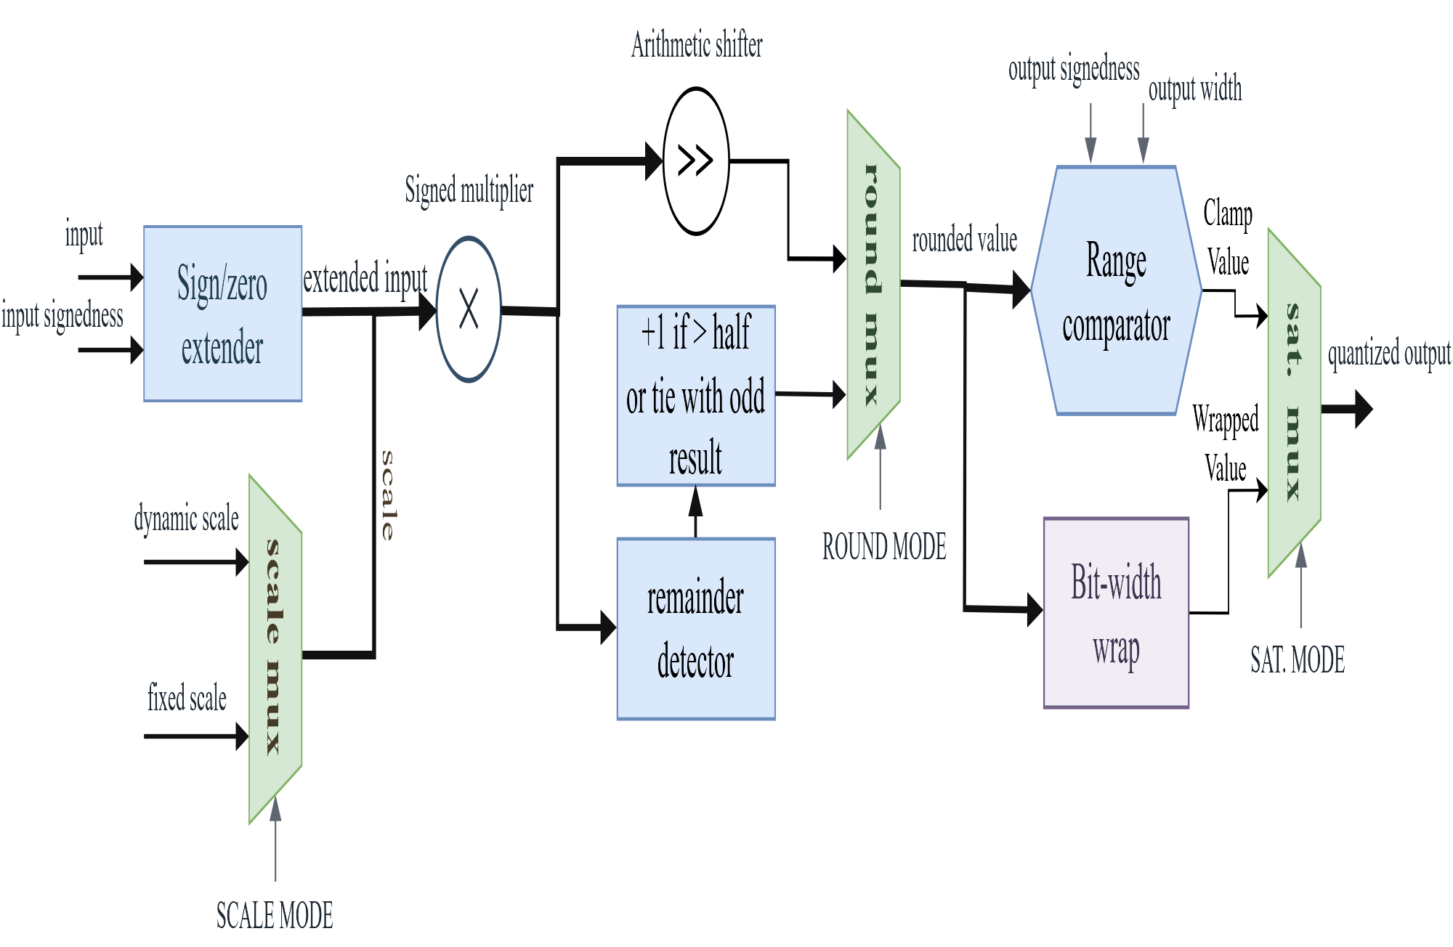
Quantisation: Hardware implemetation
A Configurable Quantisation Module - requant_round_sat_engine
• USE_SCALE selects fixed identity scale or external per-lane scale.
• ROUND_MODE selects truncation or round-to-nearest-even.
• SAT_MODE selects wrap cast or clamp to the target output range.

Slide 29
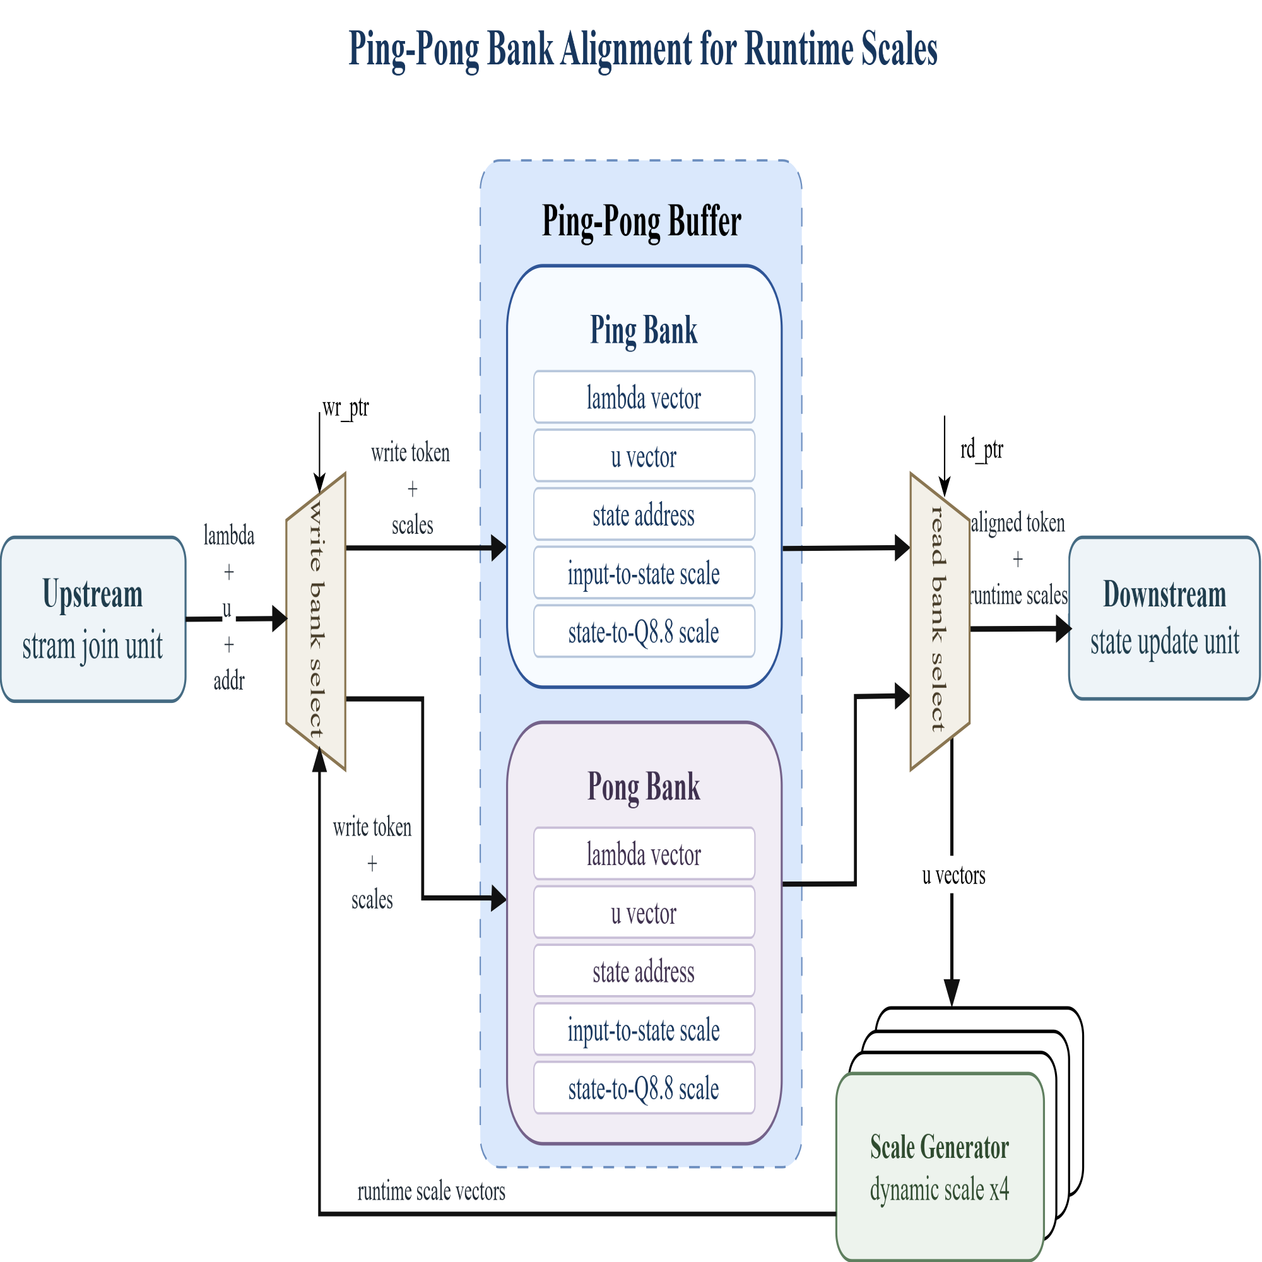
Quantisation: Hardware implemetation
Dynamic scale for selective scan
While one bank feeds downstream, the other bank can prepare the next toke, keeps data and scale values aligned before the state update.
Scale generator computes per-lane scales from actual input.

Slide 30
Results
Requirement : 100 frames per sec
Achieved(100MHz): 471 frames per sec
Key takeaways
Power (On-chip)
Timing closed @ 100 MHz
Low utilization
Total Power
Dynamic
Static
Freq. using 100 MHz on Board
4.292 W
3.562 W
0.729 W
On-chip
83%
17%
Key driver: PS= 2.622 W (74% of Dynamic)
Resource utilization (Post-synth @ 100 MHz)
Latency(per block)
Resource
Used
Available
Util.
Category
Clcck Cycles
Share
LUT
60868
274080
22.21%
RMSNorm
134cc
2.5%
FF
77345
548160
14.11%
In_projection
2305cc
47.25%
Ping-pong buffer
199 cc
3.75%
BRAM (Tiles)
279
912
30.59%
ssm
1828 cc
34.48%
DSP
496
2520
19.68%
out_projection
833 cc
15.71%
I/O (Bonded IOB)
0
328
0%
total
5301cc
100%

