Slide 1
Efficient Mamba-Based Accelerator Architecture for Massive-MIMO Indoor Localization Using the LuViRA Dataset
CHENXI ZHANG Shengjie Chen

Slide 2
Contents
1. Architechture
Board-level deployment
Pipeline and fine-grained parallelism
2. Linear Layers
Reuse of in-proj, dt-proj and out-proj
Weight banking and memory access
3. Non-linear Layers
RMSNorm
Sigmoid
3. Quantisation
Workflow
Hardware implementation
4. Results

Slide 3
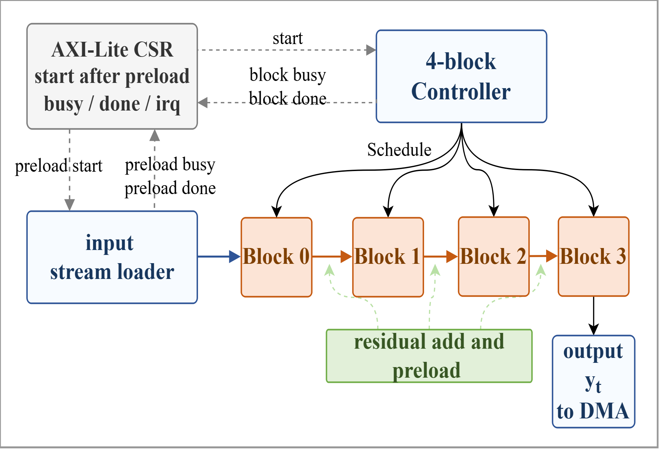
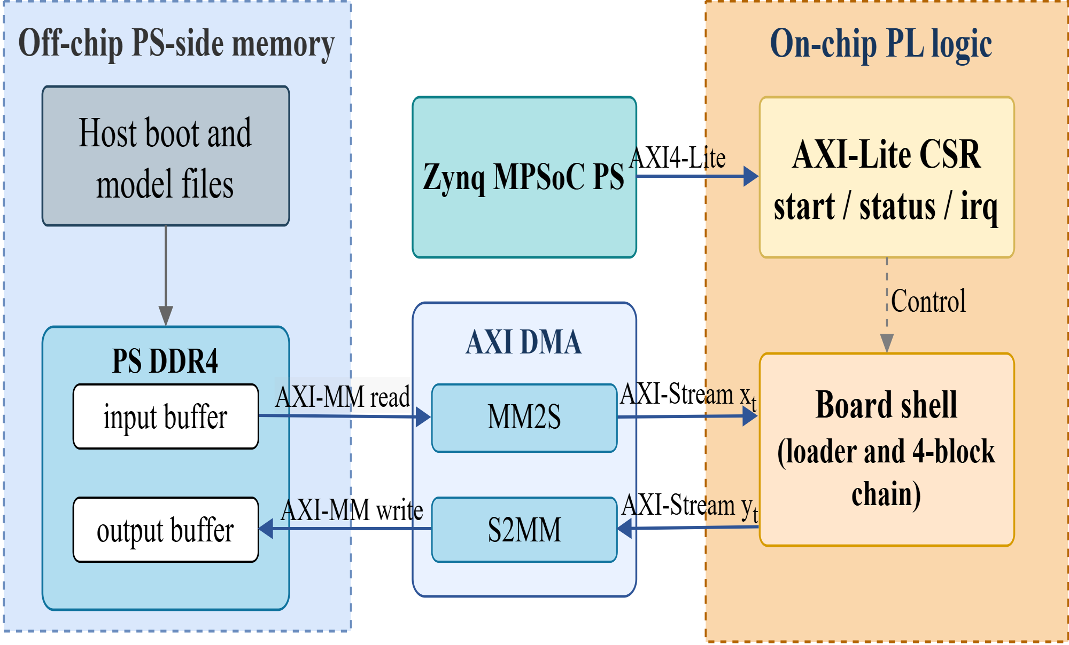
Architecture

Slide 4
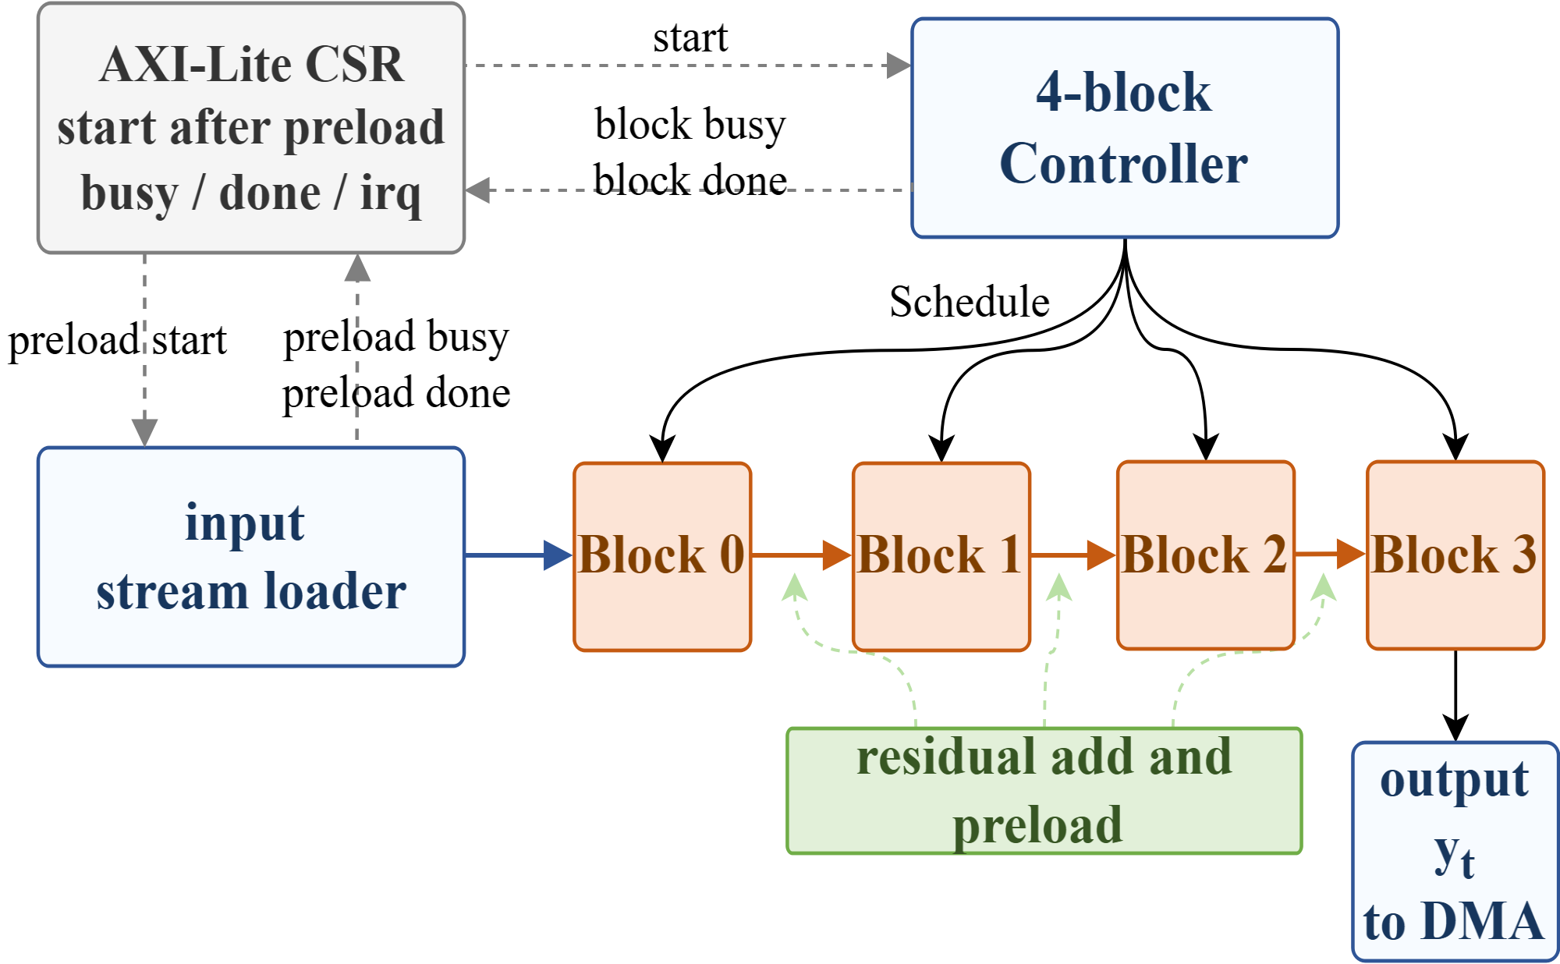
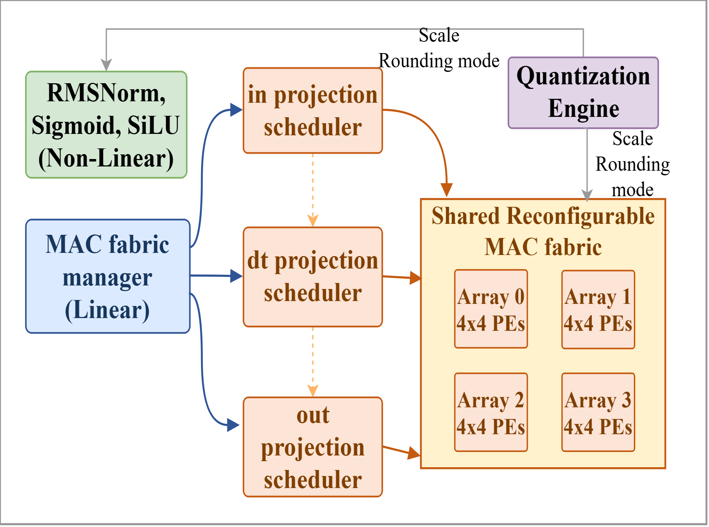
Architecture

Slide 5
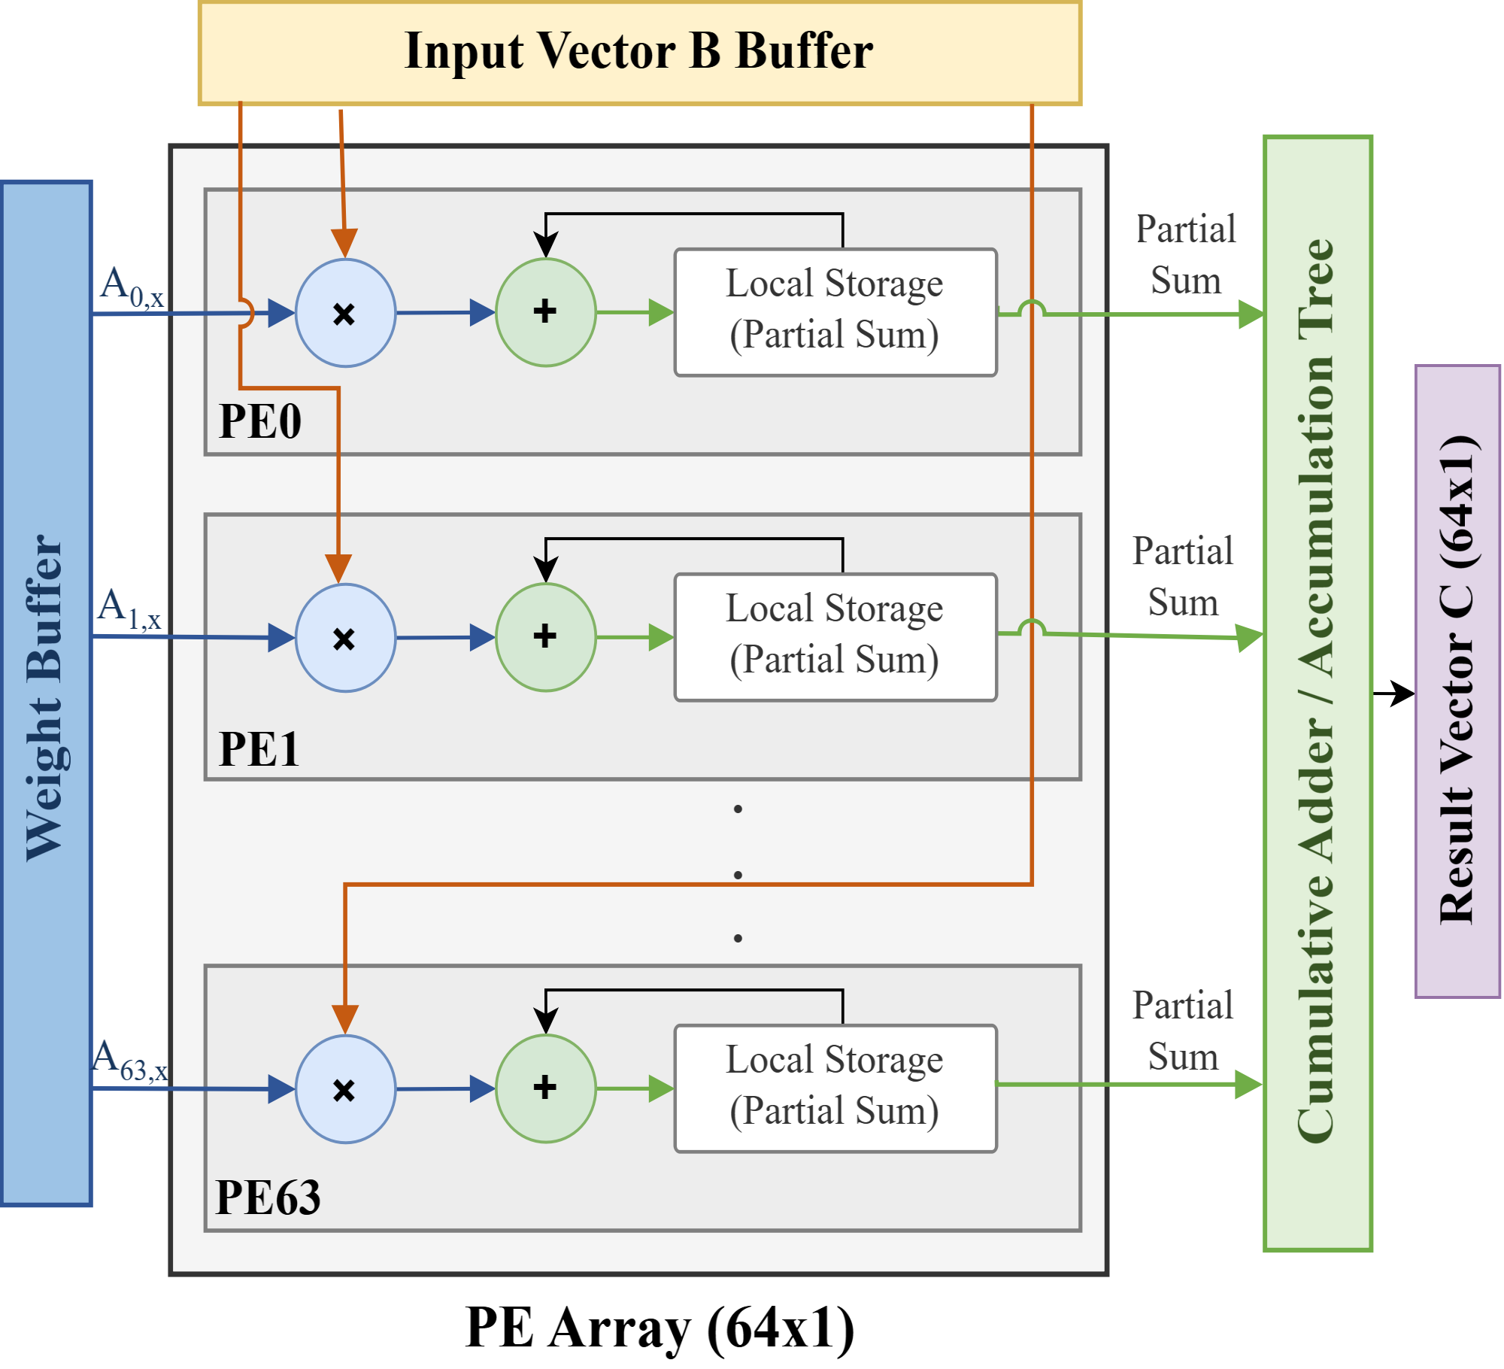
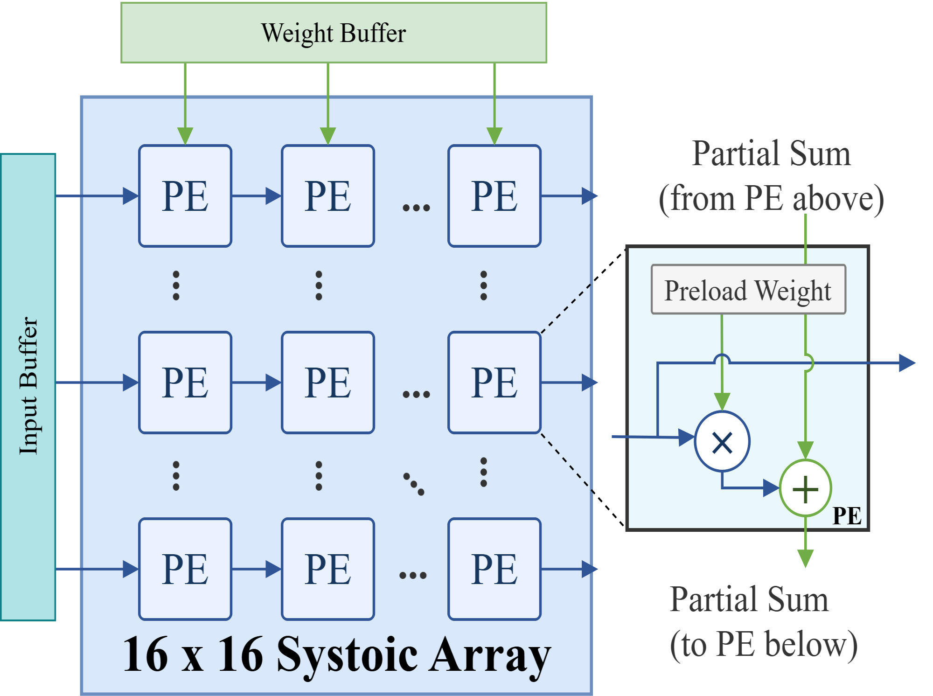
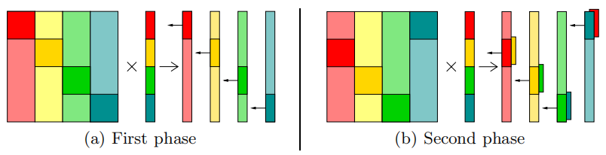
Linear Layers - MAC array design
Goal: (256,256) * (256,1) MVM - Total MACs=256×256=65536
Method 1: 16 x 16 Systolic Array
fit for Matrix, bad for Matrix-Vector
Method 2: 64 x 1 MV Unit
fit for Matrix-Vector
Method 3: 4 x 4 x 4 pipeline
compromise solution
Min. latency In theory: 1024 ccs
Bandwidth: 64 w/cycle
Min. latency In theory: 256 ccs
Bandwidth: 256 w/cycle
(stuck when run implementation)
Min. latency In theory: 1024 ccs
Bandwidth: 64 w/cycle
(works well for mvm, limited Reusability )
K. B. Theobald et al., "Landing CG on EARTH: A Case Study of Fine-Grained Multithreading on an Evolutionary Path," SC '00: Proceedings of the 2000 ACM/IEEE Conference on Supercomputing, Dallas, TX, USA, 2000, pp. 4-4, doi: 10.1109/SC.2000.10011.

Slide 6

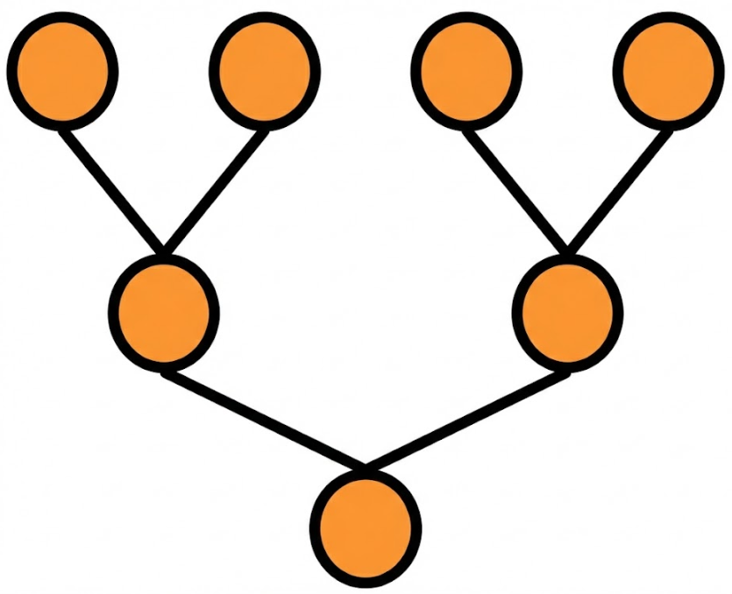
Linear Layers - MAC array design
Method 3: small parallel array (4*4) + pipeline
Weight Matrix
Goal: (256,256) * (256,1) MVM
Result: (256,1) Vector
B: 4*4 block
 | ARRAY1 | ARRAY2 | ARRAY3 | ARRAY4
cycle1 | B1
cycle2 | B5 | B2+B1
cycle3 | B9 | B6+B5 | B3+B2+B1
cycle4 | B13 | B10+B9 | B7+B6+B5 | B4+B3+B2+B1
cycle5 | B17 | B14+B13 | B11+B10+B9 | B8+B7+B6+B5
cycle6 | ... | ... | B15+B14+B13 | B12+B11+B10+B9
cycle7 | ... | ... | ... | B16+B15+B14+B13
... | ... | ... | ... | ...
... | ... | ... | ... | ...
... | ... | ... | ... | ...
cycle19 | ... | ... | ... | B64+B63+B62+B61
reduction unit
cost 3 cycles
cycle19
cycle20
cycle21
cycle22
Min. latency In theory: 1024 ccs
(3ccs filling pipeline + 3ccs reduction)
In total: 64*16+3+3=1030 ccs
Bandwidth: 64 w/cycle
at cycle 19 first 4 rows of (256,256) is completed!
at cycle 22 first tile compete, generating first 4 output!

Slide 7
Trade Off 1: MAC Architecture Selection
 | 16*16, Systolic | 64*1, MV Unit | 4*4*4, pipeline
DSPs | 256 | 64 | 64
BW (Weights/cycle) | 256 | 64 | 64
Clock Cycles (256,256) MVM | 256 | 1024 | 1030
Mem. access | in oder | in oder | interleaving
choose the 4×4×4 pipelined array because :
achieves the same 1024-cycle latency and 64 weights/cycle bandwidth as the 64×1 GEMV design, while providing much higher reusability across GEMV/GEMM/EW kernels
better timing/routing scalability than a monolithic 16×16 systolic array
Pre-distribute the weight data according to access pattern.

Slide 8
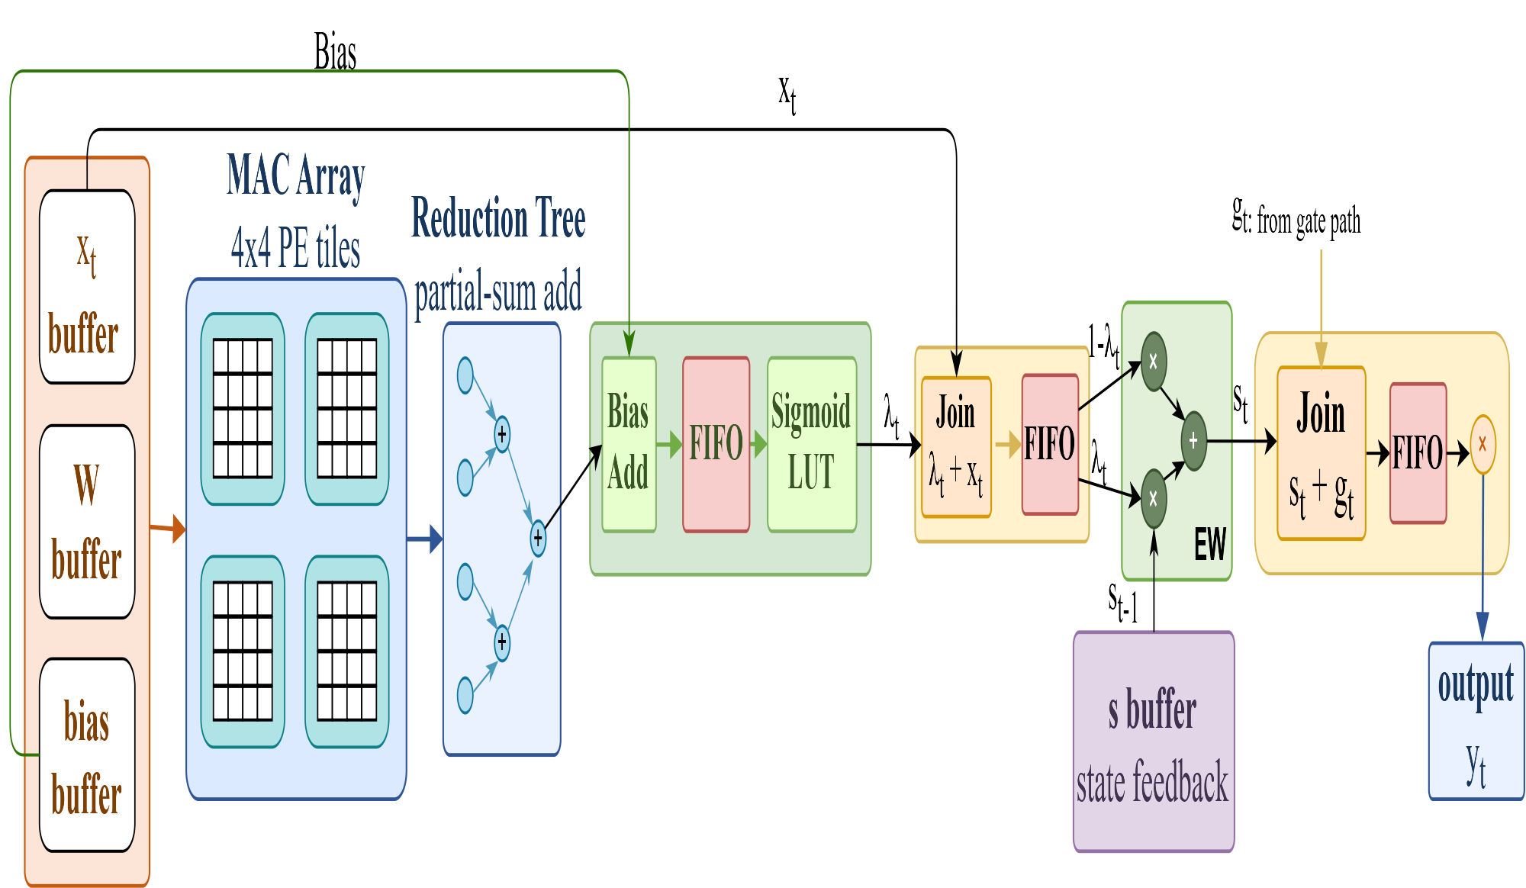
Linear Layers - Control Method
Take SSM for example:
output gating：
yt = st ⊙ gt
dt_proj :
λt = Sigmoid(Wdt · ut + b)
state update：
st = λt ⊙ st−1 + (1 − λt) ⊙ ut

Slide 9
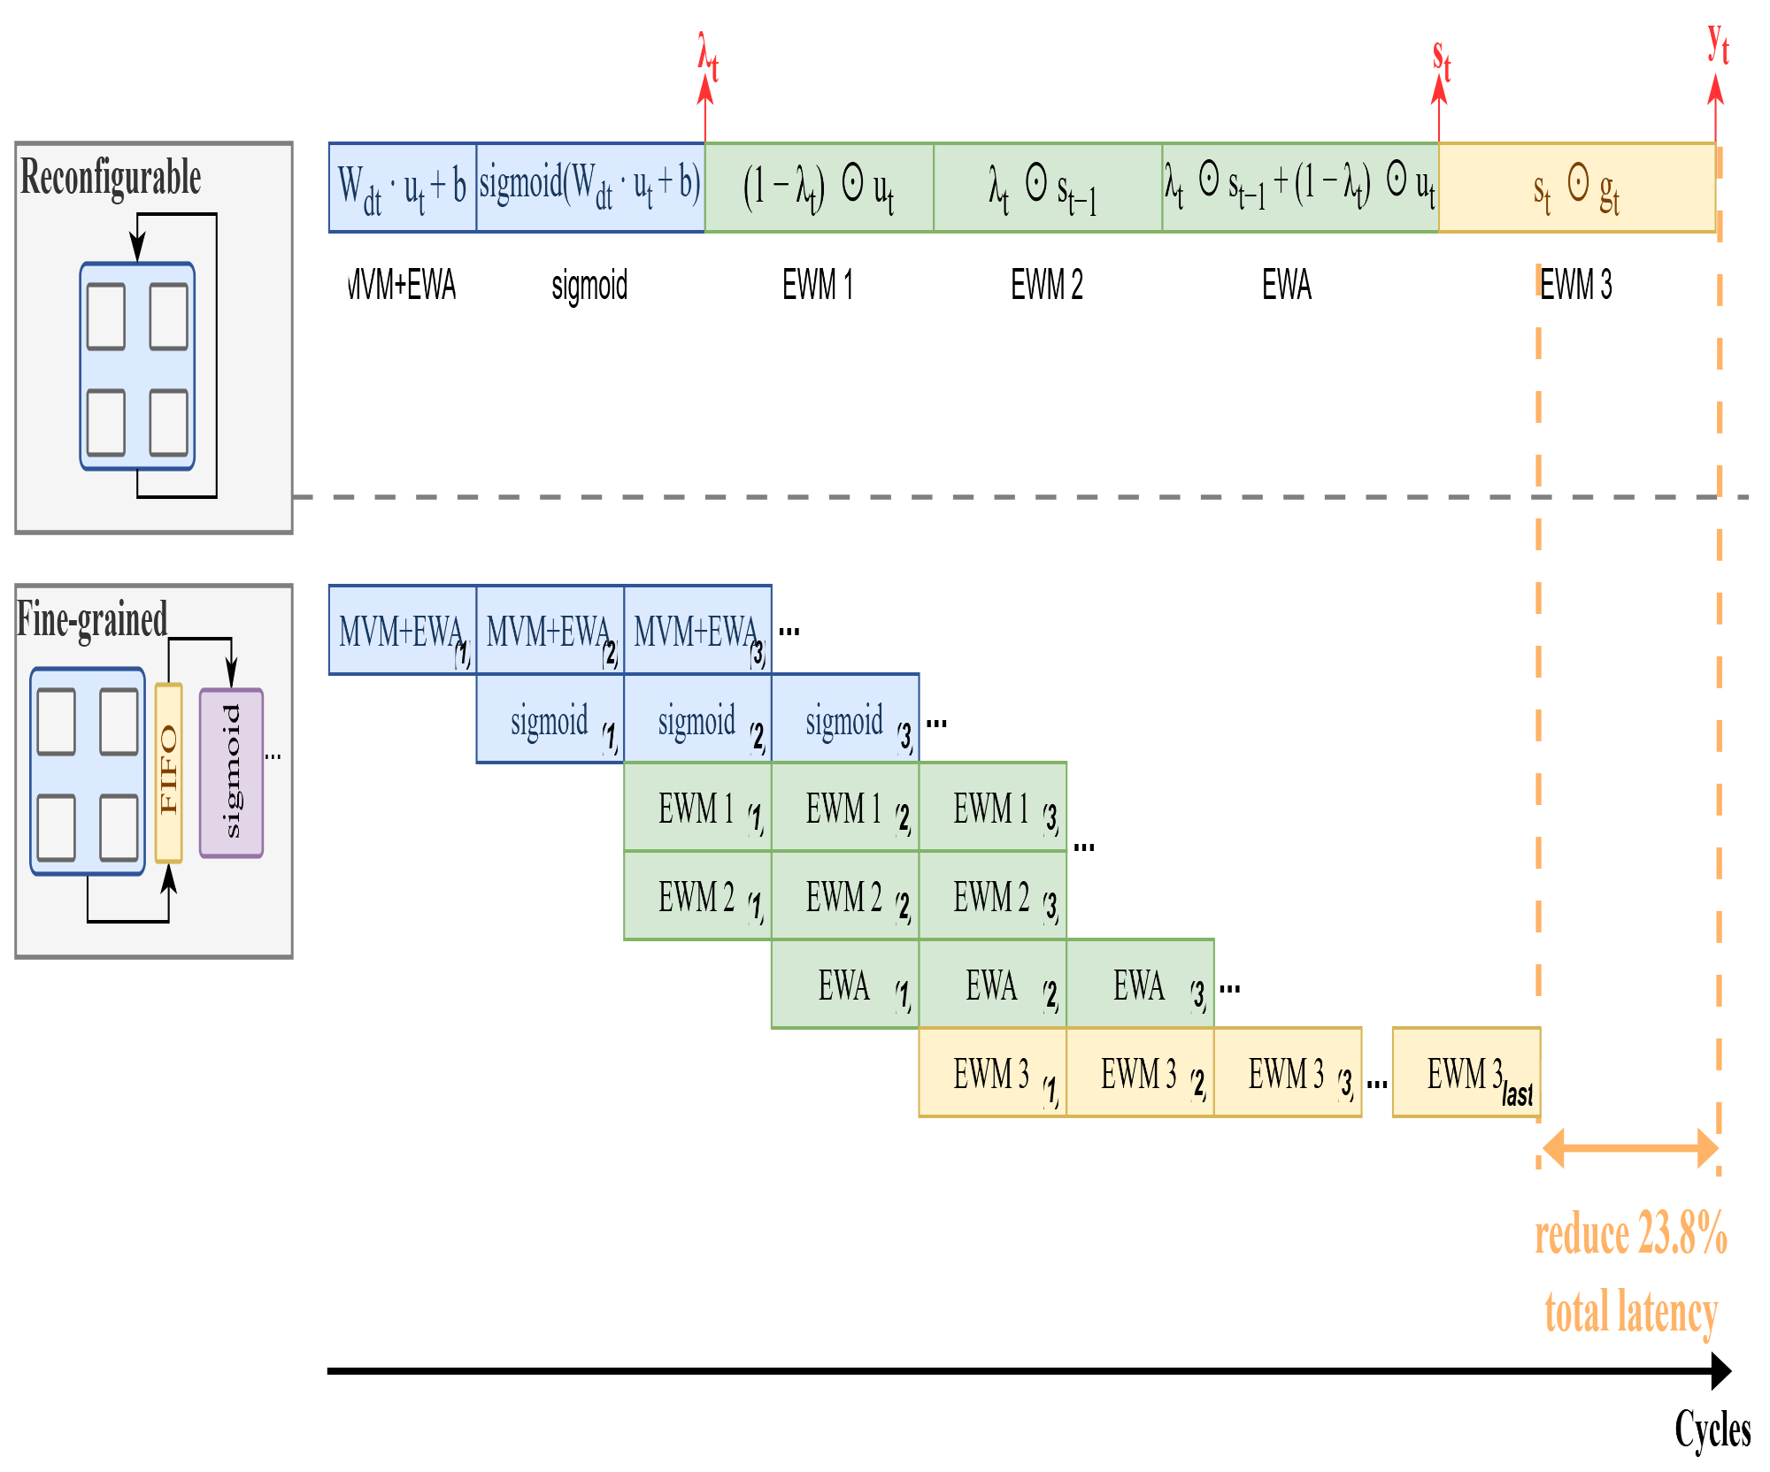
Trade Off 2 : Reconfigurable vs. Fine-grained pipeline
Case A: wait for all MAC tiles, then run Sigmoid/EW
T_A = 29N
Case B: stream each tile to Sigmoid/EW as soon as MAC finishes
T_B = 22N + 7
Latency saving
For N = 64
T_A = 1856 cycles
T_B = 1415 cycles
Saving = 441 cycles
Saving ratio ≈ 23.8%
Add 12 DSPs
mode Calculation
00 MAC (A*B+acc_in)
01 MUL (A*B)
10 ADD (A+B)
use 64 DSPs
wait for all MACs (64 tiles) to finish and then goes to next layer.
R. Wei et al., "LightMamba: Efficient Mamba Acceleration on FPGA with Quantization and Hardware Co-design," 2025 Design, Automation & Test in Europe Conference (DATE), Lyon, France, 2025, pp. 1-7, doi: 10.23919/DATE64628.2025.10993079.

Slide 10
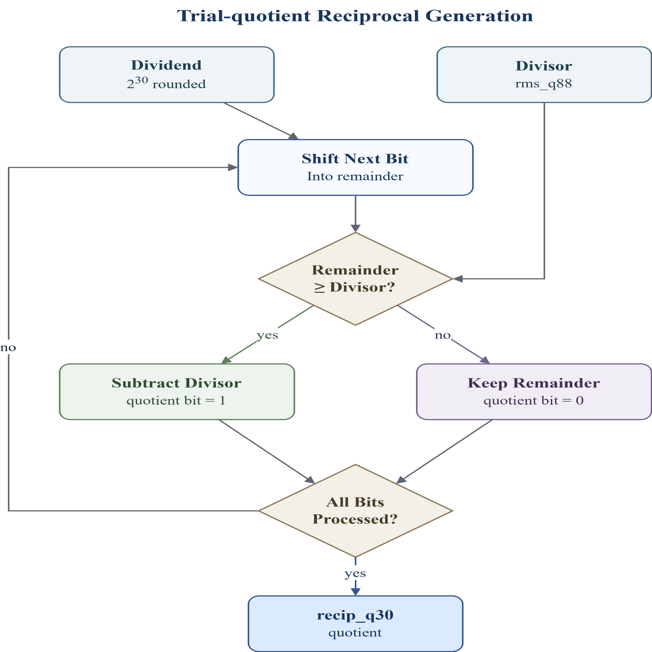
Nonlinear layer - RMSNorm
RMSNorm: y_i = x_i / RMS(x) * gamma_i
Trial-quotient
method
Iterative
method
weight
Division：
Goal: replace division with one reciprocal value, recip_q30 = round(2^30 / rms_q88)
2^30 is the scaling factor for the fixed-point reciprocal. recip_q30 stores 1 / rms_q88 with 30 fractional bits.
More fractional bits give higher reciprocal precision, reducing RMSNorm output error.

Slide 11
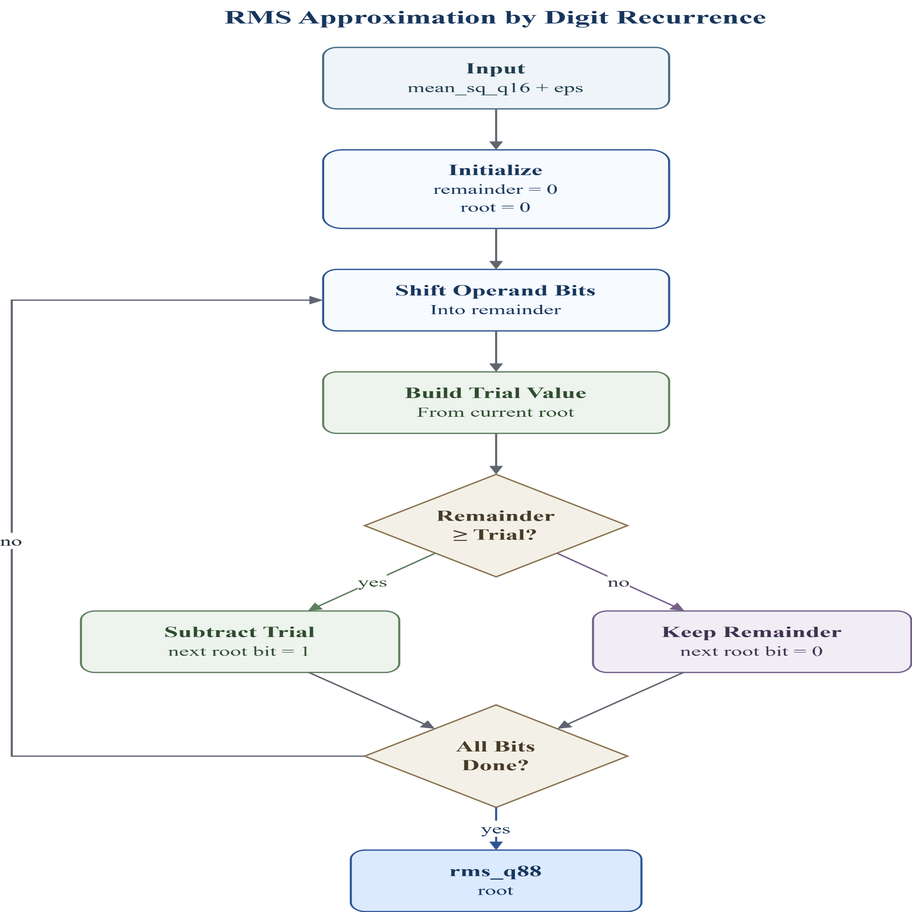
Nonlinear layer - RMSNorm
RMSNorm: y_i = x_i / RMS(x) * gamma_i
Trial-quotient
method
Iterative
method
weight
RMS Approximation：
Goal: compute RMS without floating-point sqrt: rms_q88 = isqrt(mean_sq_q16 + eps)
root: current partial square-root result; one new bit is decided each cycle.
remainder: the remaining part of the input that has not been explained by the current root.
trial value: a test value used to check whether the next root bit can be set to 1.
root_shift = {isqrt_root, 1'b0};
trial = {32'd0, root_shift, 1'b1};

Slide 12
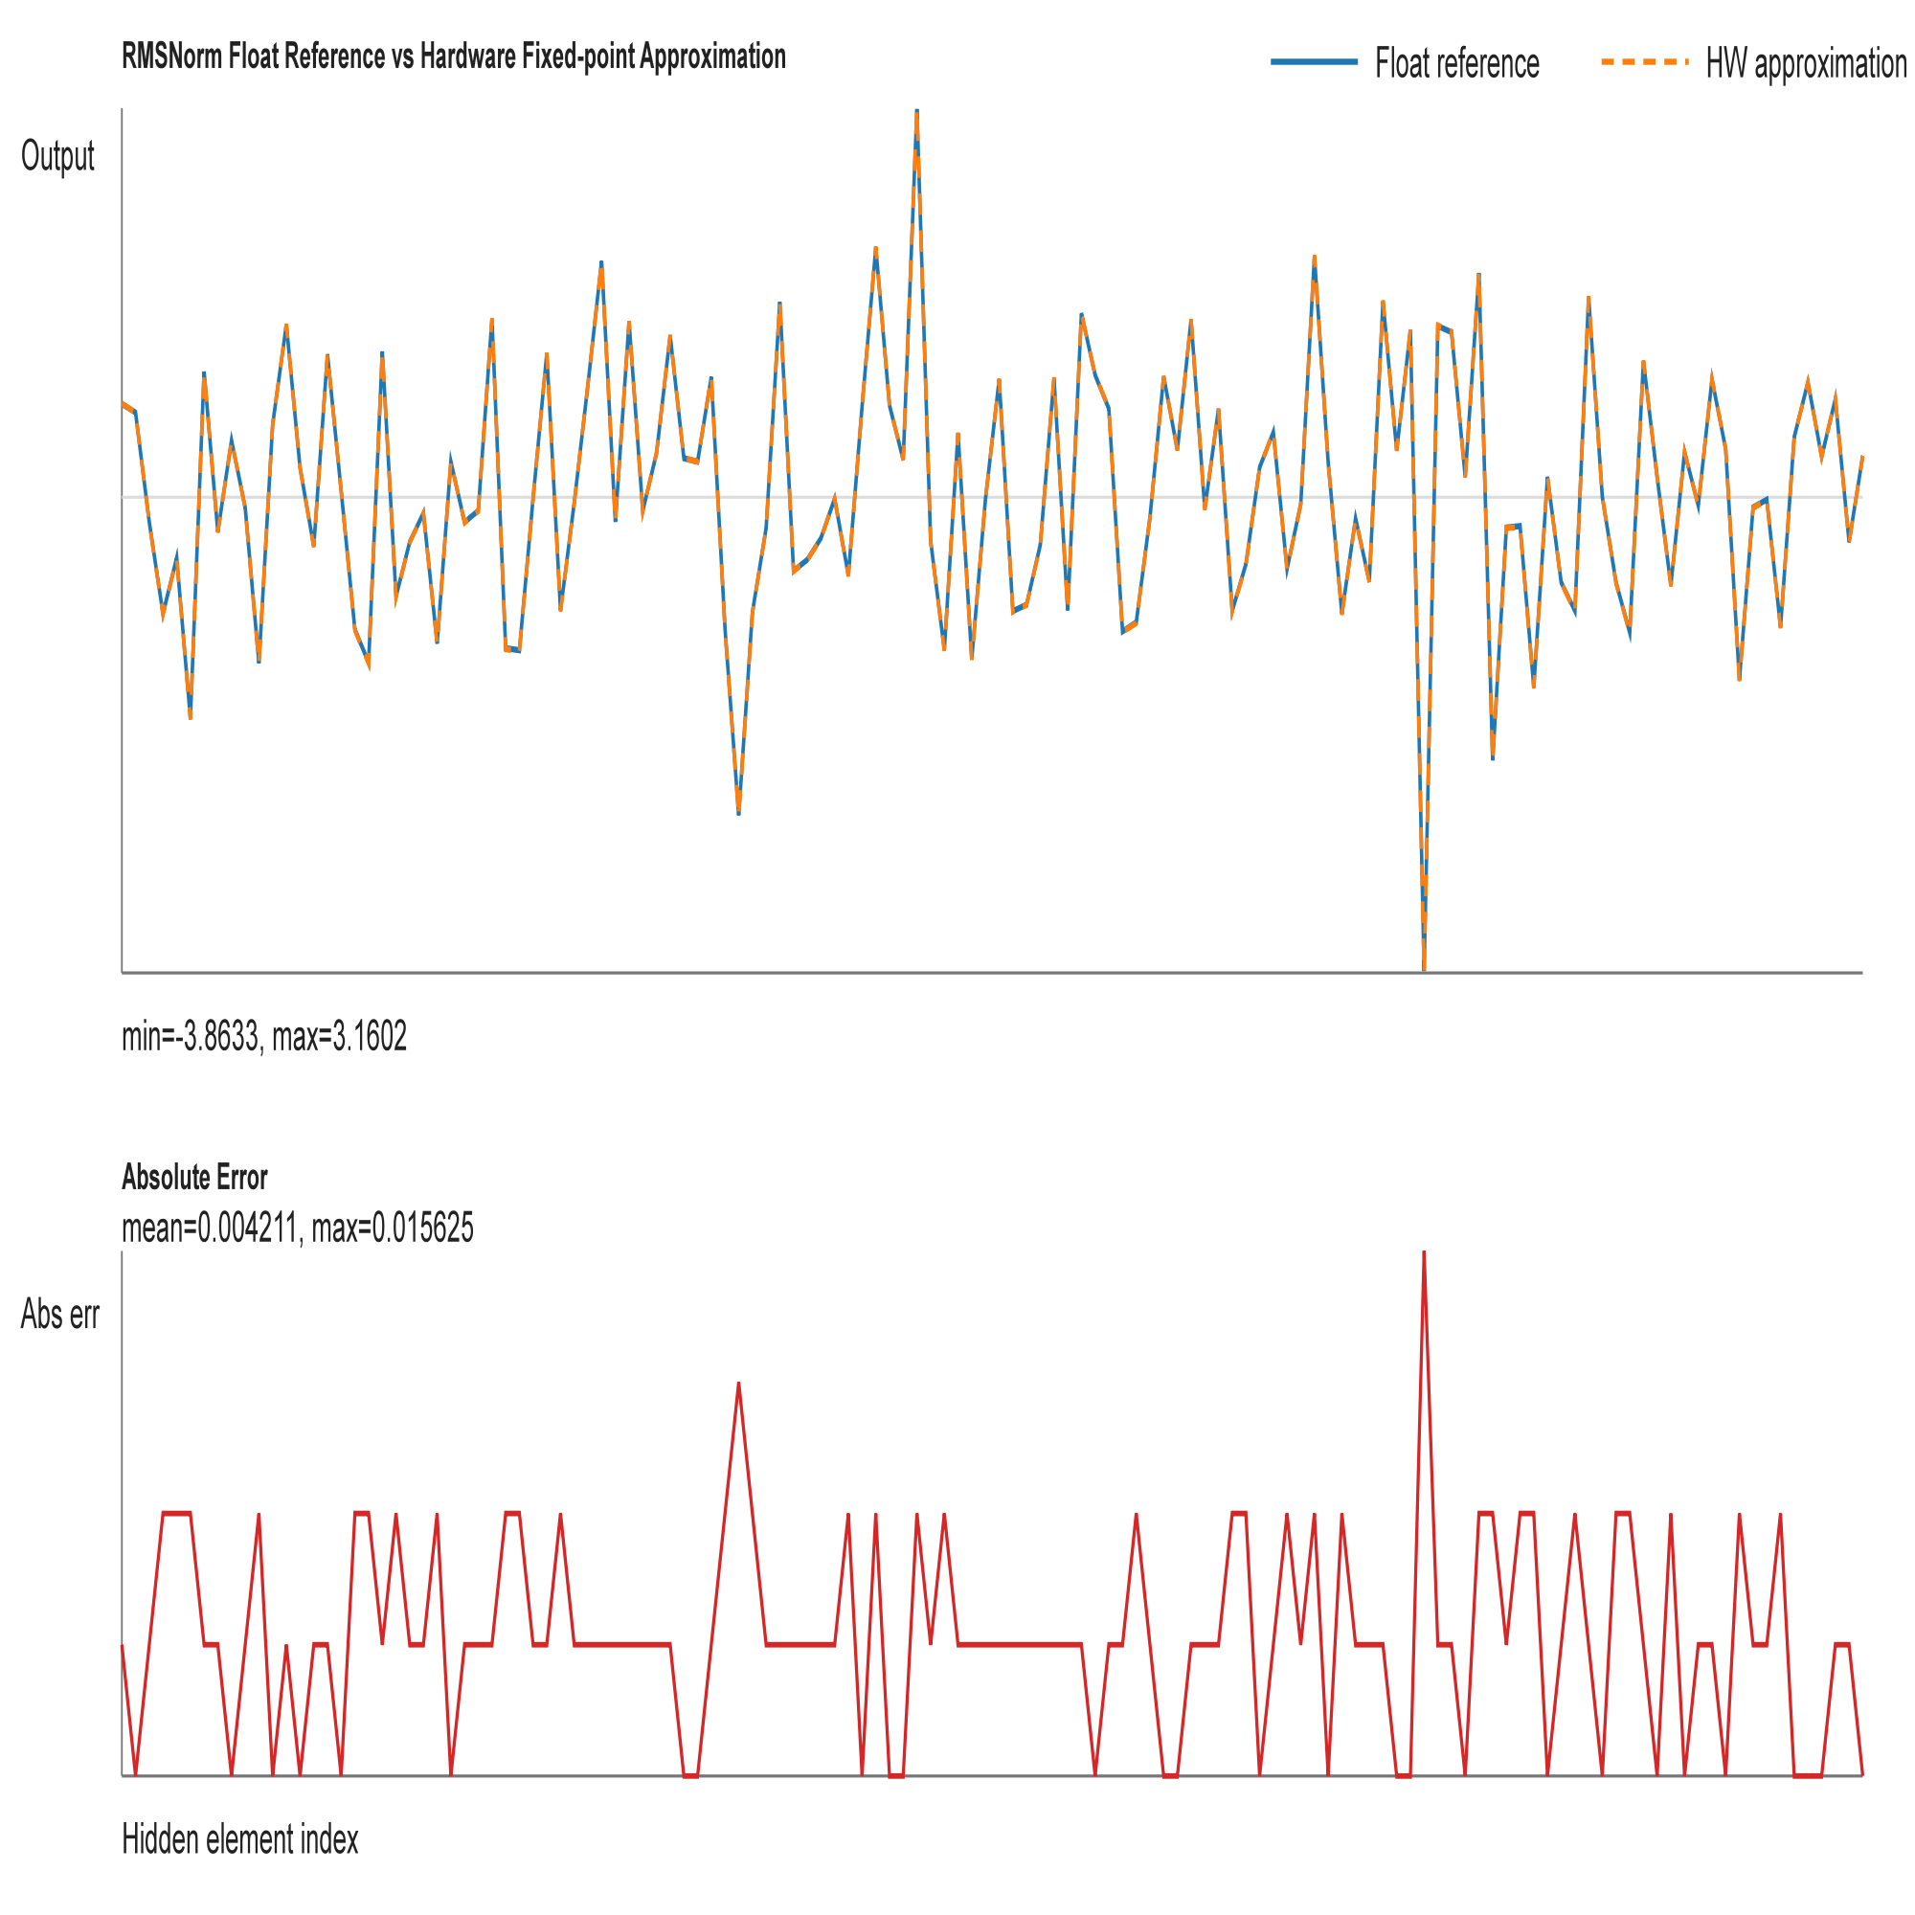
Nonlinear layer - RMSNorm
max abs. error= 0.015625
mean abs. error = 0.004211

Slide 13
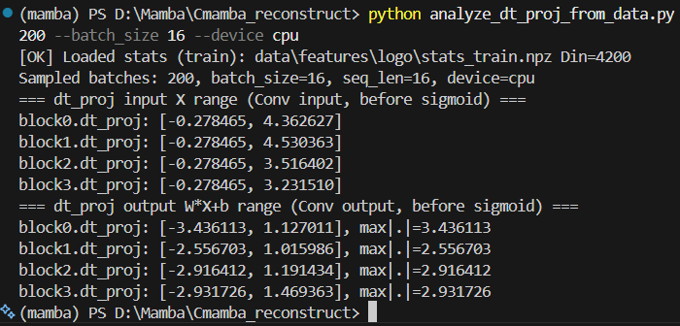
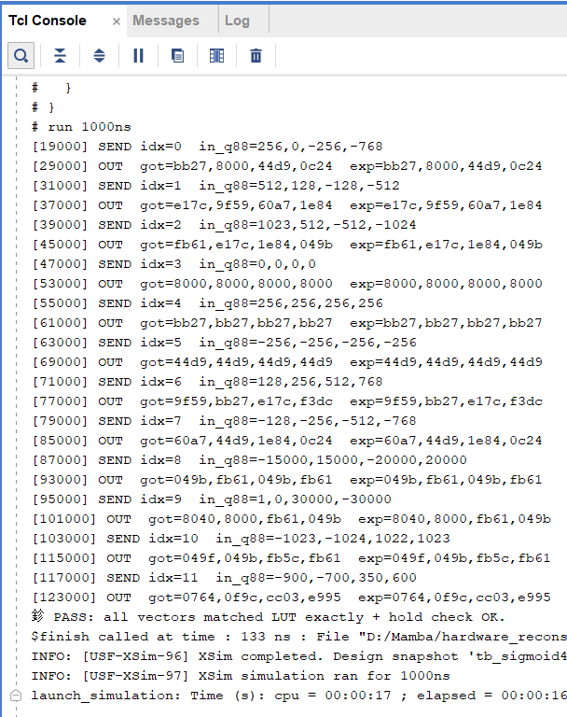


Nonlinear layer - Sigmoid
clamp x to [-4, +4)
LUT: 2048 sigmoid outputs

Slide 14
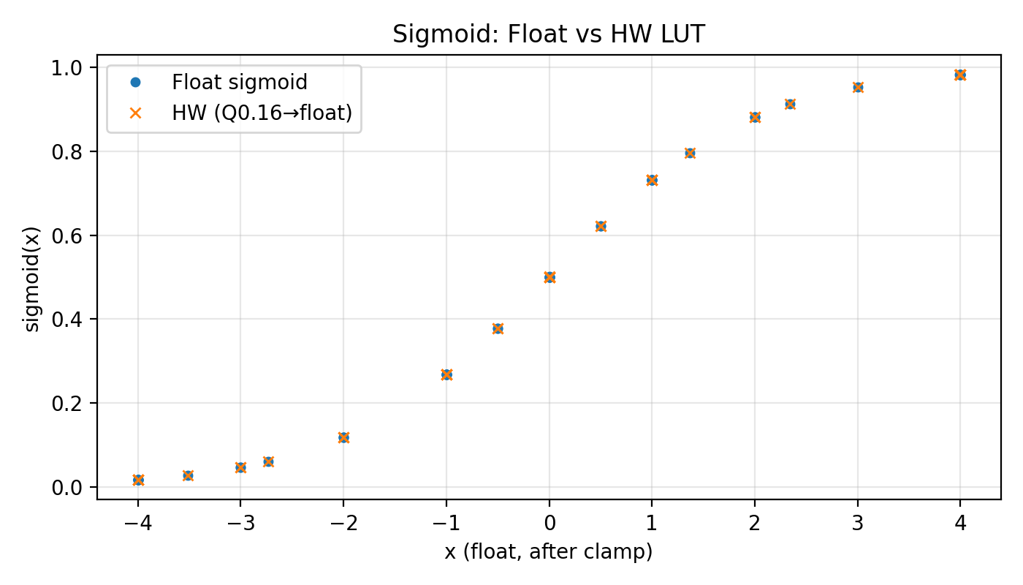
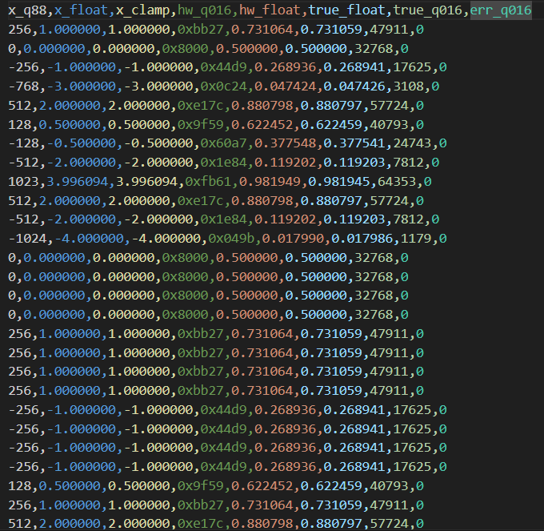
Nonlinear layer - Sigmoid
error < 0.02%

Slide 15
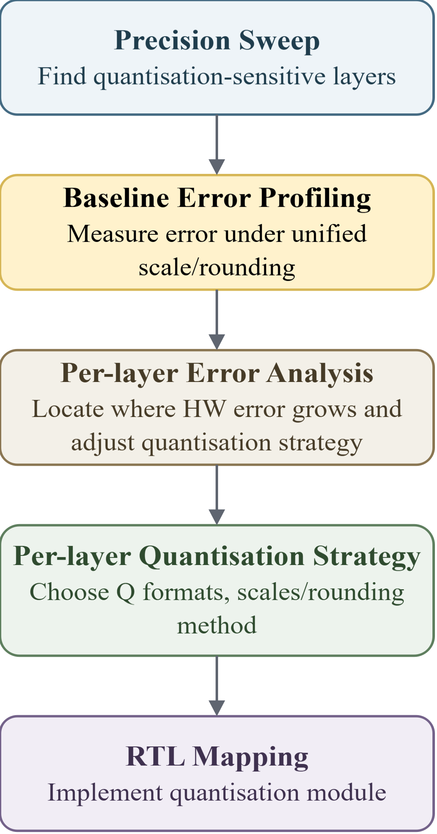
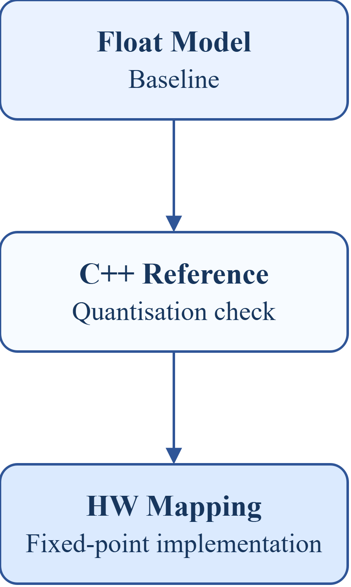
Quantisation: Workflow
Layer-wise Precision Sweep
label | mode | overrides | mean_err (m)
golden | - |  | 0.13695
all_int16 | int16 | ssm_state=int16, gate=int16 | 0.13520
mixed_candidate | int16 | dt_proj=int8, ssm_state=int8, gate=int8 | 0.13519
inproj_i8_on_i16 | int16 | in_proj=int8, ssm_state=int16, gate=int16 | 0.76520
outproj_i8_on_i16 | int16 | out_proj=int8, ssm_state=int16, gate=int16 | 0.24352
int16 quantisation is safe.
dt_proj, ssm_state, and gate can be reduced to int8 with negligible accuracy loss.
in_proj and out_proj are precision-sensitive and should remain at higher precision.
Metrics - MAE ：
cpp vs float quantisation loss
hw vs cpp
hardware mapping error

Slide 16
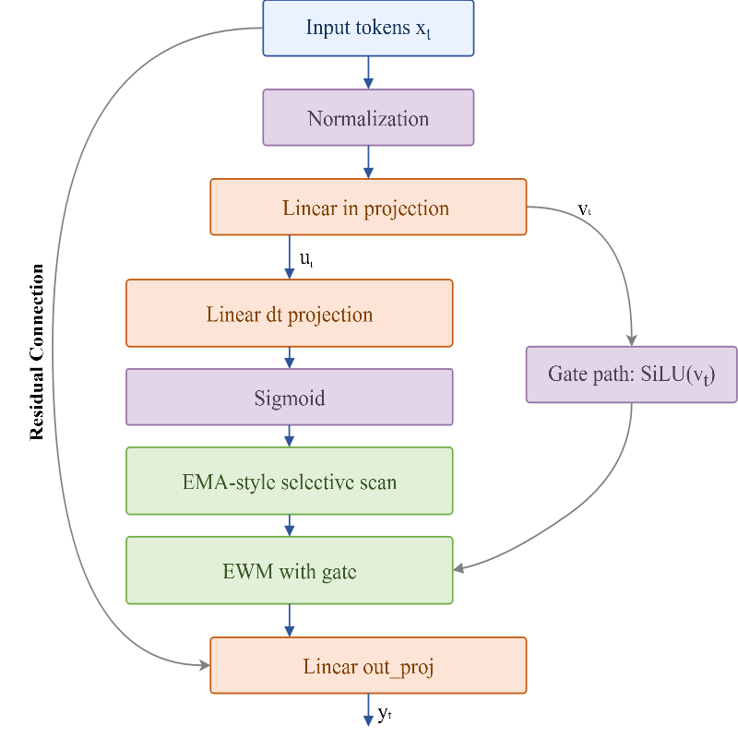
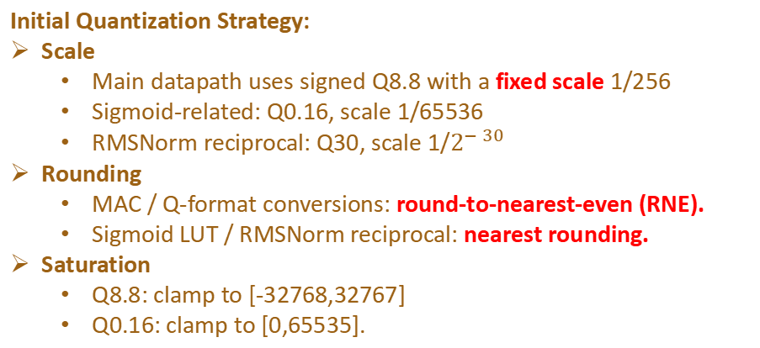
Quantisation: Workflow
Analyse per-layer quantisation error
Mismatch!
Evaluation | HW vs. float MAE | Mean localization error (m)
unified | 0.17987 | 0.35543
golden | - | 0.13695
Initial Quantization Strategy:
Scale
Main datapath uses signed Q8.8 with a fixed scale 1/256
Sigmoid-related: Q0.16, scale 1/65536
RMSNorm reciprocal: Q30, scale 1/$2^{−30}$
Rounding
MAC / Q-format conversions: round-to-nearest-even (RNE).
Sigmoid LUT / RMSNorm reciprocal: nearest rounding.
Saturation
Q8.8: clamp to [-32768,32767]
Q0.16: clamp to [0,65535].

Slide 17

Quantisation: Workflow
Analyse per-layer quantisation error
Stage | Fixed scale MAE | Dynamic Scale MAE
norm | 0.004498 | 0.004498
inproj_u | 0.010917 | 0.010917
inproj_z | 0.011069 | 0.011069
silu_u | 0.006183 | 0.006183
silu_gate | 0.005931 | 0.005931
dtproj | 0.010139 | 0.010139
dt_sigmoid | 0.002118 | 0.002118
selective_scan | 0.127090 | 0.085484
ewm_gating | 0.033001 | 0.029827
outproj | 0.032225 | 0.031243
block_output | 0.032426 | 0.031332
Fixed scale: for Q8.8, every value uses the same scale 1/256, so real value = int16 / 256.
Dynamic scale: scale is computed from the channel range, so real value = int16 × scale.

Slide 18
Quantisation: Workflow
Table 4.8: Final layer-wise quantization strategy.
Stage | Scale | Q format | Rounding | Saturation
RMSNorm output | 1/256 | Q8.8 | RNE | [-32768, 32767]
RMSNorm reciprocal | 1/2^30 | Q30 | NR | [-32768, 32767]
in_proj | 1/256 | Q8.8 | RNE | [-32768, 32767]
dt_proj | 1/256 | Q8.8 | RNE | [-32768, 32767]
out_proj | 1/256 | Q8.8 | RNE | [-32768, 32767]
gate_y | 1/256 | Q8.8 | RNE | [-32768, 32767]
Sigmoid LUT output | 1/65536 | Q0.16 | NR | [0, 65535]
SiLU sigmoid path | 1/65536 | Q0.16 | NR | [0, 65535]
dt_lambda | 1/65536 | Q0.16 | NR | [0, 65535]
Selective-scan lambda | 1/32768 | Q1.15 | No rounding, Shift | [0, 1]
Selective-scan state | Dynamic | Q8.8 | RNE | [-32768, 32767]
Rounding
Main rule: round-to-nearest-even.
Used after MAC, Q-format conversion, state update, and scale multiplication.
Reduces long-term bias compared with truncation.
Saturation / Clamp
Final Q8.8 values are clamped to signed int16:
[-32768, 32767] -> about [-128, 127.996]
Prevents overflow and wrong sign after multiplication, accumulation, or residual add.
Final quantisation evaluation (34,505 samples)
in selective scan we need to calculate 1-lamda
s_new = lambda * s_prev + (1 - lambda) * u
Q1.15: s_new = ((lam_q15 * s_prev) + ((32768 - lam_q15) * u_scaled)) >> 15
hw vs float mae = 0.02081
Mean error = 0.14103m (float=0.13695m)

Slide 19
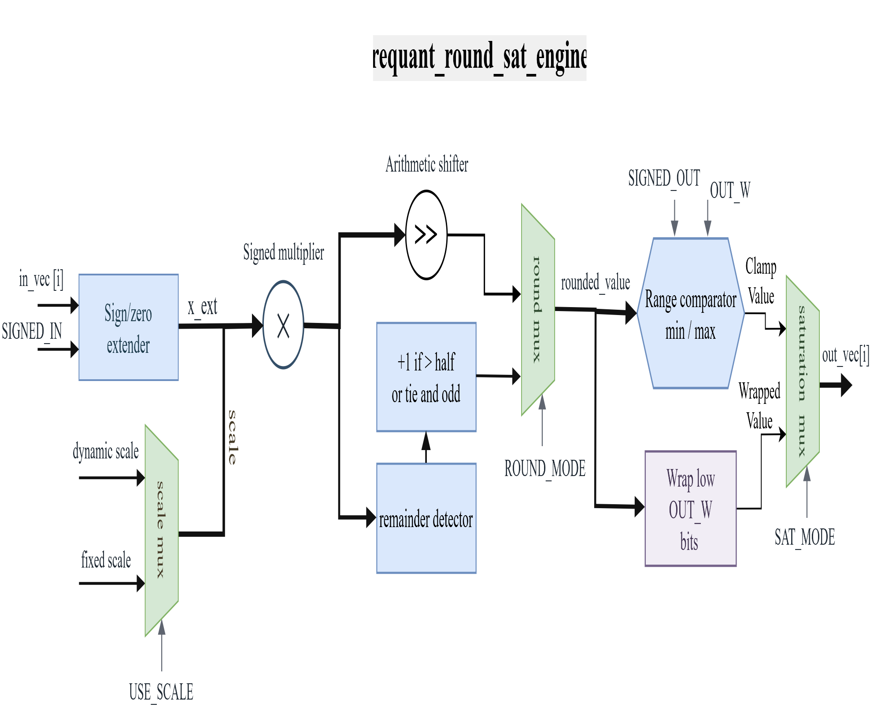
Quantisation: Hardware implemetation
A Configurable Quantisation Module - requant_round_sat_engine
• USE_SCALE selects fixed identity scale or external per-lane scale.
• ROUND_MODE selects truncation or round-to-nearest-even.
• SAT_MODE selects wrap cast or clamp to the target output range.

Slide 20
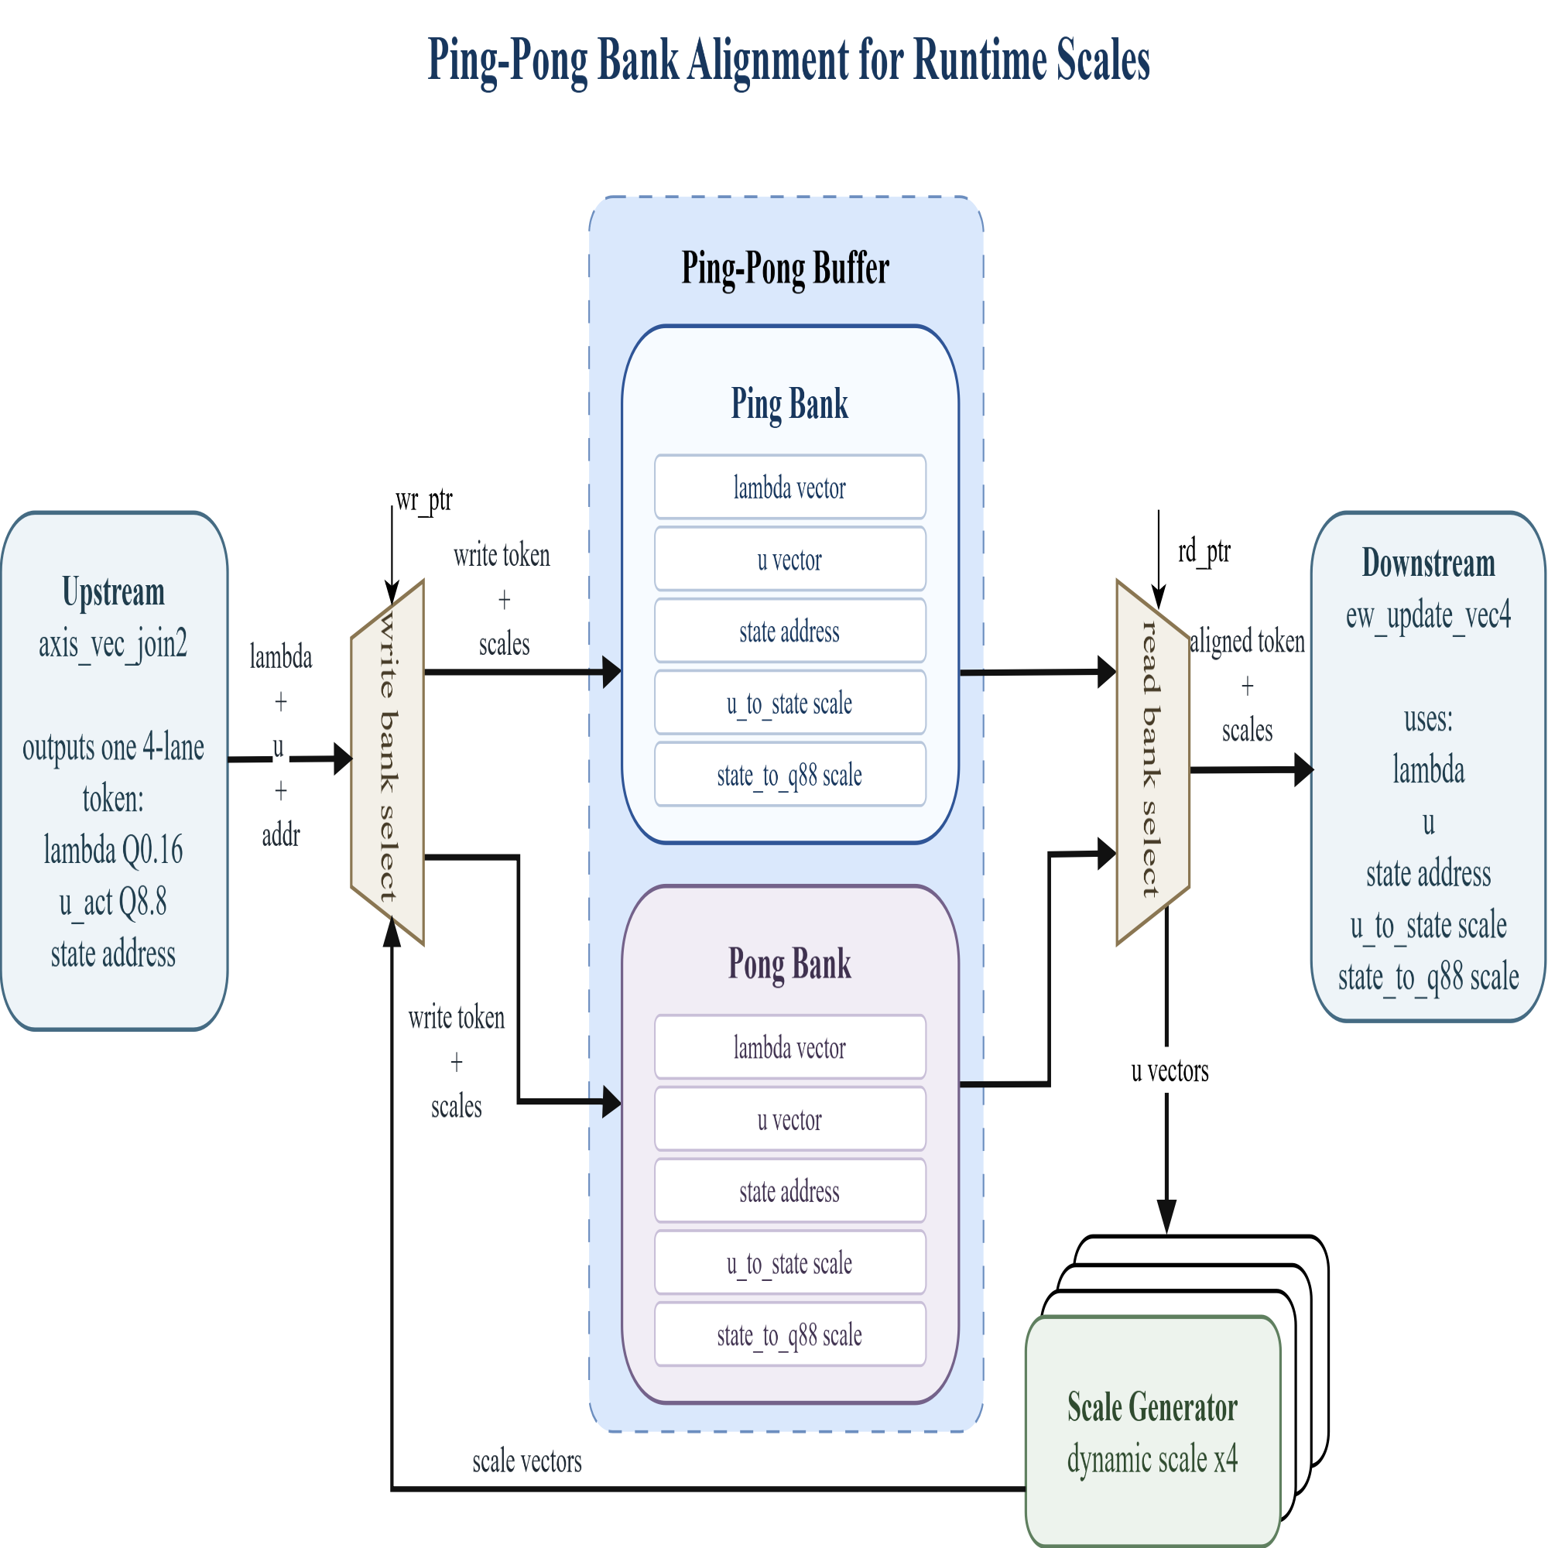
Quantisation: Hardware implemetation
Dynamic scale for selective scan
While one bank feeds ew_update_vec4, the other bank can prepare the next toke, keeps data and scale values aligned before the state update.
Scale generator computes per-lane u_to_state and state_to_q88 scales from u_act.

Slide 21
Results
Requirement : 100 frames per sec
Achieved(100MHz): 471 frames per sec
Key takeaways
Power (On-chip)
Timing closed @ 100 MHz
Low utilization
Total Power
Dynamic
Static
Freq. using 100 MHz on Board
4.292 W
3.562 W
0.729 W
On-chip
83%
17%
Key driver: PS= 2.622 W (74% of Dynamic)
Resource utilization (Post-synth @ 100 MHz)
Latency(per block)
Resource
Used
Available
Util.
Category
Clcck Cycles
Share
LUT
60868
274080
22.21%
RMSNorm
134cc
2.5%
FF
77345
548160
14.11%
In_projection
2305cc
47.25%
Ping-pong buffer
199 cc
3.75%
BRAM (Tiles)
279
912
30.59%
ssm
1828 cc
34.48%
DSP
496
2520
19.68%
out_projection
833 cc
15.71%
I/O (Bonded IOB)
0
328
0%
total
5301cc
100%

Slide 22
Next step optimazation for the paper
Refine pipeline granularity
Current design mainly uses module-level reuse scheduling to reduce hardware cost.
Next step is to split critical compute paths into finer pipeline stages.
Compare current reuse-based architecture with fine-grained pipelined architecture.
Goal: shorten combinational delay, improve timing closure, and further increase maximum clock frequency.
Add output heading
Add a dedicated output head after the final feature stage.
Directly generate target lacation from hardware output.
Avoid extra software-side output post-processing.
Make the accelerator output more application-ready for engineering deployment.

