Slide 1
Design and Analysis and of Algorithms

Slide 2
Agenda – session 10
What is greedy method
Fractional knapsack problem (Algorithm, example problem, analysis)
Hauffman Coding
Task scheduling Algorithm, sample problem, analysis
MST
What is MST
Prim's (algorithm and analysis) example problem.
Kruskal(algorithm and analysis) example Problem
Dijkstra's shortest path algorithm, analysis example Problem
Problems

Slide 3
What is a greedy algorithm?
Greedy algorithm: “an algorithm always makes the choice that looks best at the moment”
Human beings use greedy algorithms a lot
How to maximize your final grade of this class?
How to become a rich man?
How does a cashier minimize the number of coins to make a change?

Slide 4
Example - Counting Coins
This problem is to count to a desired value by choosing the least possible coins.
For the currency system, where we have coins of 1, 7, 10 value, Discuss Greedy approach for counting coins for value 18 and for 15 ?

Slide 5
The knapsack problem
n objects, each with a weight w_{i} > 0
a profit p_{i} > 0
capacity of knapsack: M
Maximize
Subject to
0 ≤ x_{i} ≤ 1, 1 ≤ i ≤ n

Slide 6
The knapsack algorithm
The greedy algorithm:
Step 1: Sort p_{i}/w_{i} into nonincreasing order.
Step 2: Put the objects into the knapsack according
to the sorted sequence as possible as we can.
e. g.
n = 3, M = 20, (p₁, p₂, p₃) = (25, 24, 15)
(w₁, w₂, w₃) = (18, 15, 10)
Sol: p₁/w₁ = 25/18 = 1.39
p₂/w₂ = 24/15 = 1.6
p₃/w₃ = 15/10 = 1.5
Optimal solution: x₁ = 0, x₂ = 1, x₃ = 1/2

Slide 7
Algorithm: Greedy-Fractional-Knapsack (w[1..n], p[1..n], W)
for i = 1 to n
do x[i] = 0
weight = 0
for i = 1 to n
if weight + w[i] ≤ W then
x[i] = 1
weight = weight + w[i]
else
x[i] = (W - weight) / w[i]
weight = W
break
return x
Time Complexity-
While solving the problem, The main time taking step is the sorting of all items in the decreasing order of their value / weight ratios.
If the items are already arranged in the required order, the while loop takes O(n) time.
Quick sort’s average time complexity is O(nlogn), therefore total time taken including the sort is O(nlogn).

Slide 8
Coding Problem
Coding: assignment of bit strings to alphabet characters
Codewords: bit strings assigned for characters of alphabet
Two types of codes:
fixed-length encoding (e.g., ASCII)
variable-length encoding (e,g., Morse code)
Prefix-free codes: no codeword is a prefix of another codeword
Problem: If frequencies of the character occurrences are
known, what is the best binary prefix-free code?

Slide 9
Huffman codes
Any binary tree with edges labeled with 0’s and 1’s yields a prefix-free code of characters assigned to its leaves
Optimal binary tree minimizing the expected (weighted average) length of a codeword can be constructed as follows
Huffman’s algorithm
Initialize n one-node trees with alphabet characters and the tree weights with their frequencies.
Repeat the following step n-1 times: join two binary trees with smallest weights into one (as left and right subtrees) and make its weight equal the sum of the weights of the two trees.
Mark edges leading to left and right subtrees with 0’s and 1’s, respectively.

Slide 10
Example
character A B C D _
frequency 0.35 0.1 0.2 0.2 0.15
codeword 11 100 00 01 101
average bits per character: 2.25
for fixed-length encoding: 3
compression ratio: (3-2.25)/3*100% = 25%

Slide 11
Job Sequencing Problem with Deadline
This problem consists of n jobs each associated with a deadline and profit and our objective is to earn maximum profit. We will earn profit only when job is completed on or before deadline. We assume that each job will take 1 unit time to complete.

Slide 12
Points to remember
In this problem we have n jobs j1, j2, … jn each has an associated deadline d1, d2, … dn and profit p1, p2, ... pn.
Profit will only be awarded or earned if the job is completed on or before the deadline.
We assume that each job takes unit time to complete.
The objective is to earn maximum profit when only one job can be scheduled or processed at any given time.

Slide 13
Problem
Consider the following 5 jobs and their associated deadline and profit.
index | 1 | 2 | 3 | 4 | 5
JOB | j1 | j2 | j3 | j4 | j5
DEADLINE | 2 | 1 | 3 | 2 | 1
PROFIT | 60 | 100 | 20 | 40 | 20

Slide 14
Sort the jobs according to their profit in descending order
Note! If two or more jobs are having the same profit then sort them as per their entry in the job list.
index | 1 | 2 | 3 | 4 | 5
JOB | j2 | j1 | j4 | j3 | j5
DEADLINE | 1 | 2 | 2 | 3 | 1
PROFIT | 100 | 60 | 40 | 20 | 20

Slide 15
Find the maximum deadline value
Looking at the jobs we can say the max deadline value is 3. So, dmax = 3
As dmax = 3 so we will have THREE slots to keep track of free time slots. Set the time slot status to EMPTY
time slot | 1 | 2 | 3
status | EMPTY | EMPTY | EMPTY

Slide 16
Total number of jobs is 5. So we can write n = 5
Note!
If we look at job j2, it has a deadline 1. This means we have to complete job j2 in time slot 1 if we want to earn its profit.
Similarly, if we look at job j1 it has a deadline 2. This means we have to complete job j1 on or before time slot 2 in order to earn its profit.
Similarly, if we look at job j3 it has a deadline 3. This means we have to complete job j3 on or before time slot 3 in order to earn its profit.
Our objective is to select jobs that will give us higher profit.
time slot | 1 | 2 | 3
status | j2 | j1 | j3

Slide 17
Job sequencing with deadlines
Problem: n jobs, S={1, 2, …, n}, each job i has a deadline d_{i} ≥ 0 and a profit p_{i} ≥ 0. We need one unit of time to process each job and we can do at most one job each time. We can earn the profit p_{i} if job i is completed by its deadline.
The optimal solution = {1, 2, 4}.
The total profit = 20 + 15 + 5 = 40.
i | 1 | 2 | 3 | 4 | 5
p_{i} | 20 | 15 | 10 | 5 | 1
d_{i} | 2 | 2 | 1 | 3 | 3

Slide 18
Algorithm:
Step 1: Sort p_{i} into nonincreasing order. After sorting p₁ ≥ p₂ ≥ p₃ ≥ … ≥ p_{n}.
Step 2: Add the next job i to the solution set if i can be completed by its deadline. Assign i to time slot [r-1, r], where r is the largest integer such that 1 ≤ r ≤ d_{i} and [r-1, r] is free.
Step 3: Stop if all jobs are examined. Otherwise, go to step 2.
Time complexity: ?
O(n²)

Slide 19
e.g.
solution = {1, 2, 4}
total profit = 20 + 15 + 5 = 40
i | p_{i} | d_{i}
1 | 20 | 2 | assign to [1, 2]
2 | 15 | 2 | assign to [0, 1]
3 | 10 | 1 | reject
4 | 5 | 3 | assign to [2, 3]
5 | 1 | 3 | reject

Slide 20
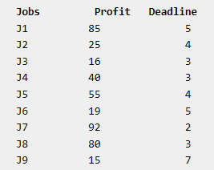
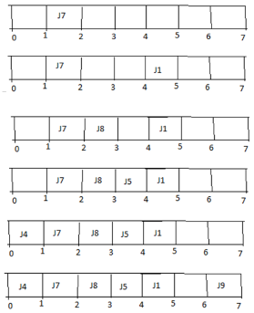

Slide 21
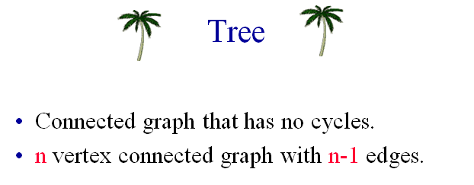

Slide 22
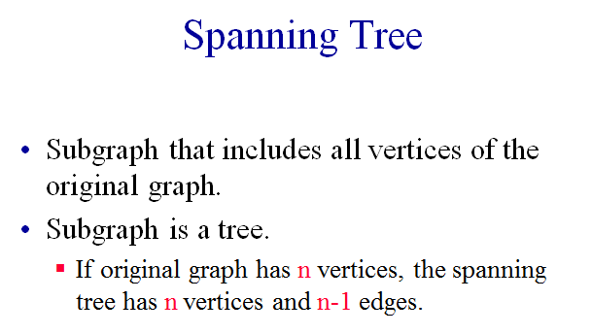

Slide 23
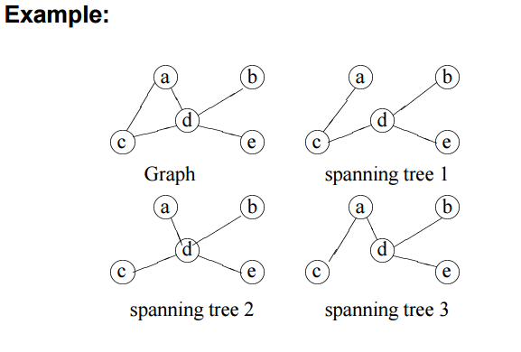

Slide 24
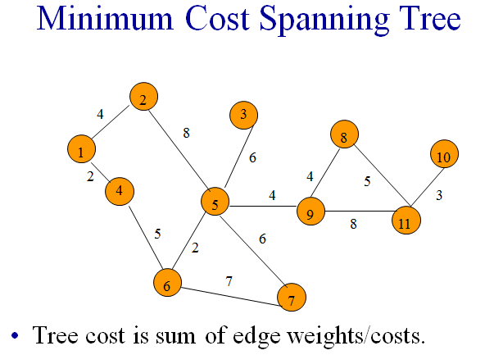

Slide 25
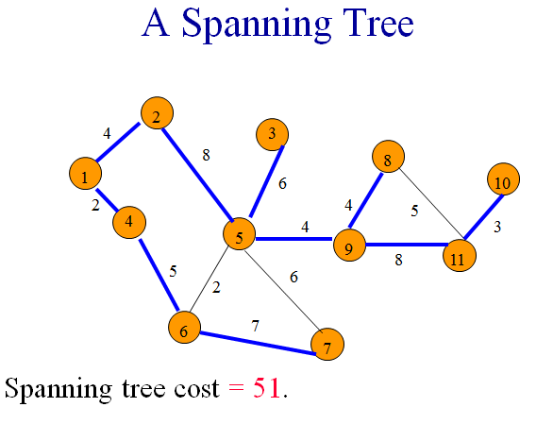

Slide 26
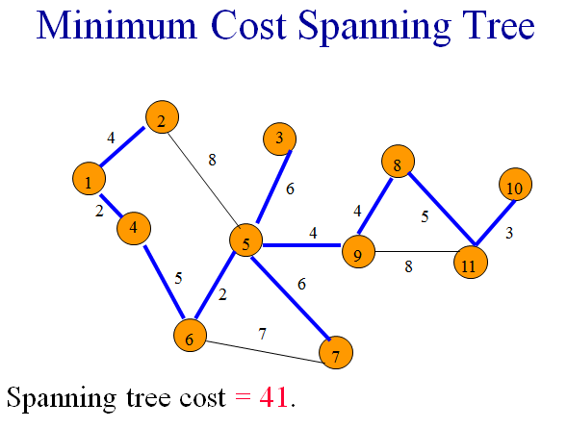

Slide 27
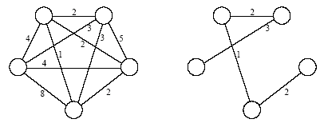
Minimum Cost Spanning Tree

Slide 28
The Algorithms of Kruskal and Prim
Both algorithms use a specific rule to:
Determine a safe-edge in the Generic MST algoritm.
In Kruskal’s algorithm, the set A is a forest
The Safe-Edge is always a Least-Weight edge in the graph
that connects two distinct components (trees).
In Prim’s algorithm, the set A forms a single tree
The Safe-Edge is always a Least-Weight edge in the graph that connects the tree to a vertex not in tree.

Slide 29
Kruskal’s Algorithm
Kruskal’s algorithm is based directly on the Generic-MST
It finds a Safe-Edge to add to the growing forest, by finding an edge (u,v) of Least-Weight of all edges that connect any two trees in the forest
Let C₁ & C₂ denote two trees that are connected by (u,v)
Since (u,v) must be a light-edge connecting C₁ to some other tree, the Corollary implies that (u,v) is a Safe-Edge for C₁.

Slide 30
Kruskal’s Algorithm
Kruskal’s algorithm is a greedy algorithm
Because at each step it adds to the forest an edge of least possible weight.

Slide 31
The Execution of Kruskal’s Algorithm
(a)
b
8
c
7
d
4
9
2
a
11
i
4
14
e
7
6
8
10
h
g
f
1
2

Slide 32
The Execution of Kruskal’s Algorithm
(b)
b
8
c
7
d
4
9
2
a
11
i
4
14
e
7
6
8
10
h
g
f
1
2

Slide 33
The Execution of Kruskal’s Algorithm
(c)
b
8
c
7
d
4
9
2
a
11
i
4
14
e
7
6
8
10
h
g
f
1
2

Slide 34
The Execution of Kruskal’s Algorithm
(d)
b
8
c
7
d
4
9
2
a
11
i
4
14
e
7
6
8
10
h
g
f
1
2

Slide 35
The Execution of Kruskal’s Algorithm
(e)
b
8
c
7
d
4
9
2
a
11
i
4
14
e
7
6
8
10
h
g
f
1
2

Slide 36
The Execution of Kruskal’s Algorithm
(f)
b
8
c
7
d
4
9
2
a
11
i
4
14
e
7
6
8
10
h
g
f
1
2
(g,i) discarded

Slide 37
The Execution of Kruskal’s Algorithm
(g)
b
8
c
7
d
4
9
2
a
11
i
4
14
e
7
6
8
10
h
g
f
1
2

Slide 38
The Execution of Kruskal’s Algorithm
(h)
b
8
c
7
d
4
9
2
a
11
i
4
14
e
7
6
8
10
h
g
f
1
2
(h,i) discarded

Slide 39
The Execution of Kruskal’s Algorithm
(i)
b
8
c
7
d
4
9
2
a
11
i
4
14
e
7
6
8
10
h
g
f
1
2

Slide 40
The Execution of Kruskal’s Algorithm
(j)
b
8
c
7
d
4
9
2
a
11
i
4
14
e
7
6
8
10
h
g
f
1
2
(b,c) discarded

Slide 41
The Execution of Kruskal’s Algorithm
(k)
b
8
c
7
d
4
9
2
a
11
i
4
14
e
7
6
8
10
h
g
f
1
2

Slide 42
The Execution of Kruskal’s Algorithm
(l)
b
8
c
7
d
4
9
2
a
11
i
4
14
e
7
6
8
10
h
g
f
1
2
(e,f) discarded

Slide 43
The Execution of Kruskal’s Algorithm
(m)
8
c
7
d
b
4
9
2
a
11
i
4
14
e
7
6
8
10
h
g
f
1
2
(b,h) discarded

Slide 44
The Execution of Kruskal’s Algorithm
(n)
b
8
c
7
d
4
9
2
a
11
i
4
14
e
7
6
8
10
h
g
f
1
2
(d,f) discarded

Slide 45
Prim’s Algorithm
Prim’s algorithm is also a special case of Generic-MST algorithm
The edges in the set A always form a single tree
The tree starts from an arbitrary vertex v and grows until the tree spans all the vertices in V
At each step, a light-edge connecting a vertex in A to a vertex in V-A is added to the tree A
Hence, the Corollary implies that Prim’s algorithm adds safe-edges to A at each step.

Slide 46
Prim’s Algorithm
This strategy is greedy since
The tree is augmented at each step with an edge that contributes the minimum amount possible to the tree’s weight.
The key to implementing Prim’s algorithm efficiently is to make it easy to select a new edge to be added to A
All vertices that are not in the tree reside in a priority queue Q based on a key field.
For each vertex v, key[v] is the minimum weight of any edge connecting v to a vertex in the tree
key[v] = ∞ if there is no such edge.

Slide 47
The Execution of Prim’s Algorithm
4*
∞
∞
(a)
8
7
b
c
d
4
9
∞
2
a
11
i
4
14
e
∞
7
6
8
10
h
g
f
1
2
∞
∞
8*

Slide 48
The Execution of Prim’s Algorithm
8*
∞
(b)
8
7
b
c
d
4
9
∞
2
a
11
i
4
14
e
∞
7
6
8
10
h
g
f
1
2
∞
∞
8*

Slide 49
The Execution of Prim’s Algorithm
7
(c)
8
7
b
c
d
4
9
2*
2
a
11
i
4
14
e
∞
7
6
8
10
h
g
f
1
2
∞
4
8

Slide 50
The Execution of Prim’s Algorithm
7
(d)
8
7
b
c
d
4
9
2
a
11
i
4
14
e
∞
7
6
8
10
h
g
f
1
2
6
4*
7

Slide 51
The Execution of Prim’s Algorithm
7
(e)
8
7
b
c
d
4
9
2
a
11
i
4
14
e
10
7
6
8
10
h
g
f
1
2
7
2*

Slide 52
The Execution of Prim’s Algorithm
(f)
8
7
b
c
d
4
9
2
a
11
i
4
14
e
7
6
8
10
h
g
f
1
2

Slide 53
The Execution of Prim’s Algorithm
(g)
8
7
b
c
d
4
9
2
a
11
i
4
14
e
7
6
8
10
h
g
f
1
2

Slide 54
The Execution of Prim’s Algorithm
(h)
8
7
b
c
d
4
9
2
a
11
i
4
14
e
7
6
8
10
h
g
f
1
2

Slide 55
The Execution of Prim’s Algorithm
(i)
8
7
b
c
d
4
9
2
a
11
i
4
14
e
7
6
8
10
h
g
f
1
2

Slide 56
Graph Traversing
Single-source shortest path problems (SSSPP):
Given a source vertex s, find distances and shortest paths from s to all other vertices
BFS works on unweighted graphs
Dijkstra’s algorithm for weighted graphs:
Each node is labeled with its distance from the source node along the best known path
Initially, all nodes are labeled with infinity
As the algorithm proceeds, labels may change
Label can be:
Non-permanent
Permanent
Initially, all labels are non-permanent
When label represents the shortest possible path from the source to that node, make it permanent
56

Slide 57
Graph Traversing
Dijkstra’s Shortest Path Algorithm
Step 1: initially all nodes are “non-permament”
Step 2: set the source node (A) as permanent
A is at the same time the “current node”
Step 3:
Examine all non-permanent nodes i adjacent to the current node
Fore each i, calculate the cumulative distance from the source node to i via the current node
Relabel i with the newly computed distance
But if i already has a shorter cumulative distance than the calculated one, then to NOT relabel.
Also, label i with the name of the current node (as predecessor)
Compare labels (distances) of all non-permanent nodes and choose the one with the smallest value. Change the node to permanent and set it as the current node.
Repeat step 3 until all nodes become permanent.

Slide 58
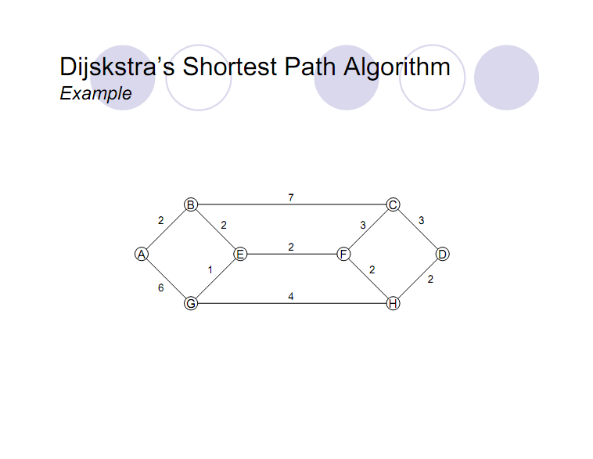
Graph Traversing
58

Slide 59
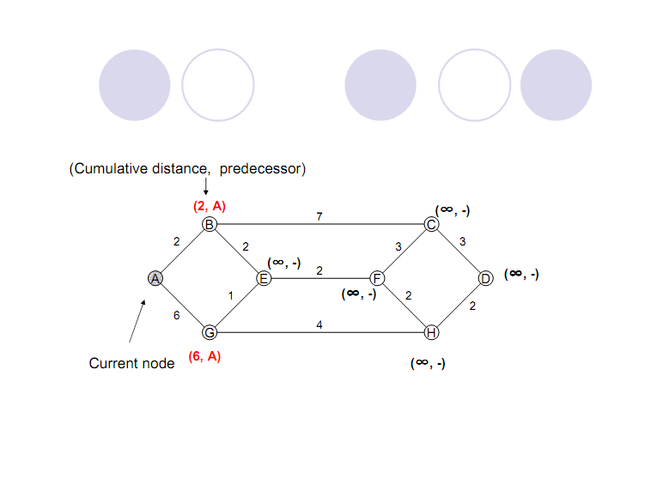
Graph Traversing
Dijkstra’s Shortest Path Algorithm
Example
59
59

Slide 60
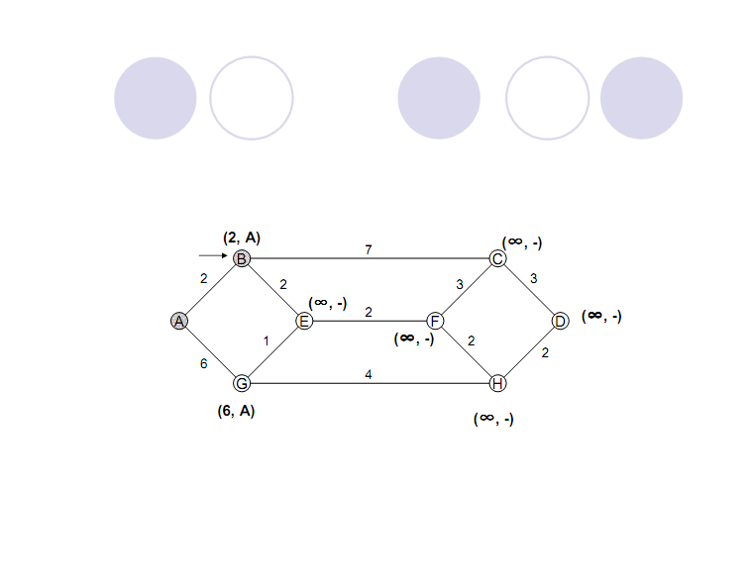
Graph Traversing
Dijkstra’s Shortest Path Algorithm
Example
60
60
60

Slide 61
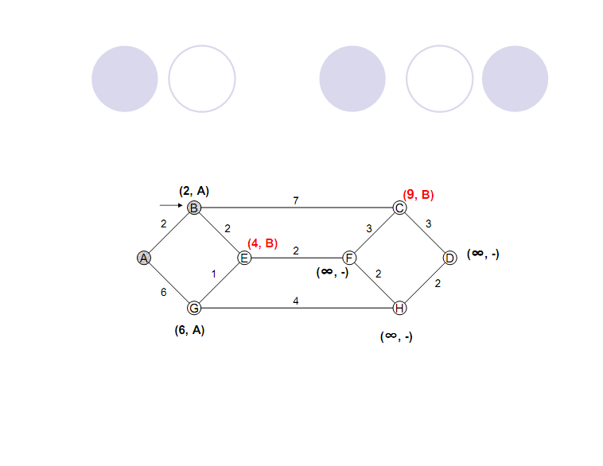
Graph Traversing
Dijkstra’s Shortest Path Algorithm
Example
61
61
61

Slide 62
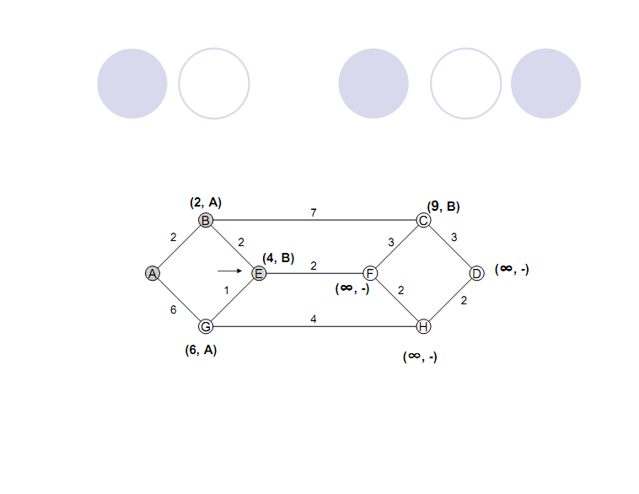
Graph Traversing
Dijkstra’s Shortest Path Algorithm
Example
62
62
62

Slide 63
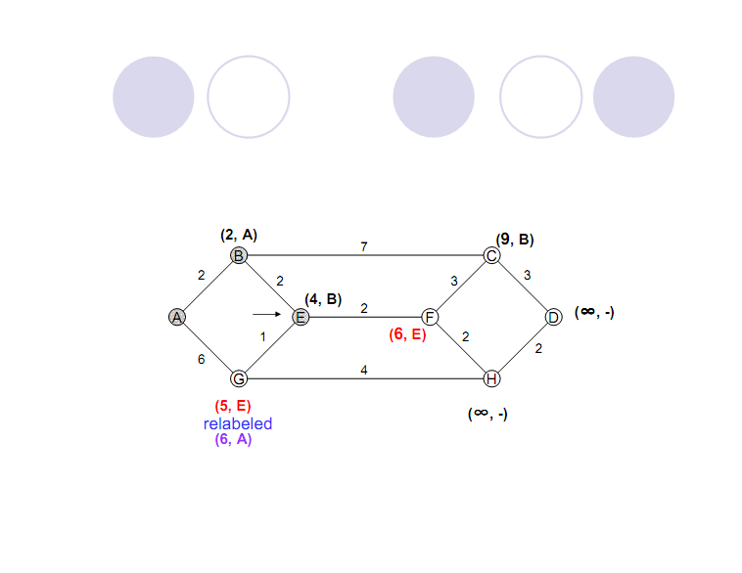
Graph Traversing
Dijkstra’s Shortest Path Algorithm
Example
63
63
63

Slide 64

Graph Traversing
Dijkstra’s Shortest Path Algorithm
Example
64
64
64

Slide 65
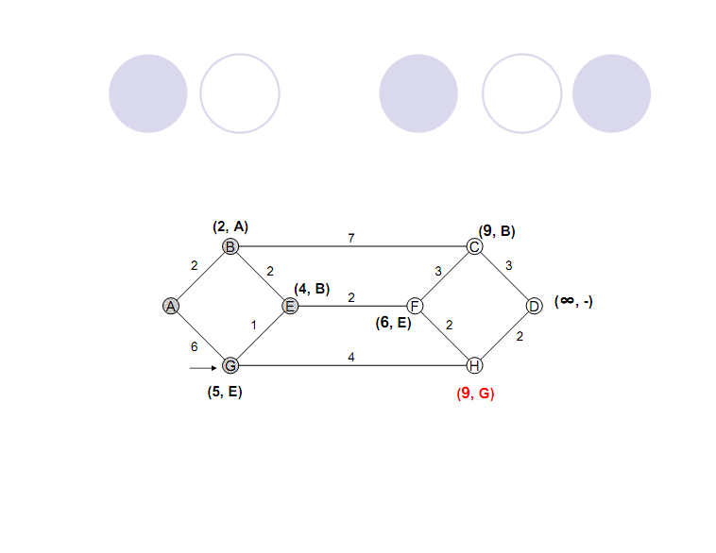
Graph Traversing
Dijkstra’s Shortest Path Algorithm
Example
65
65
65

Slide 66
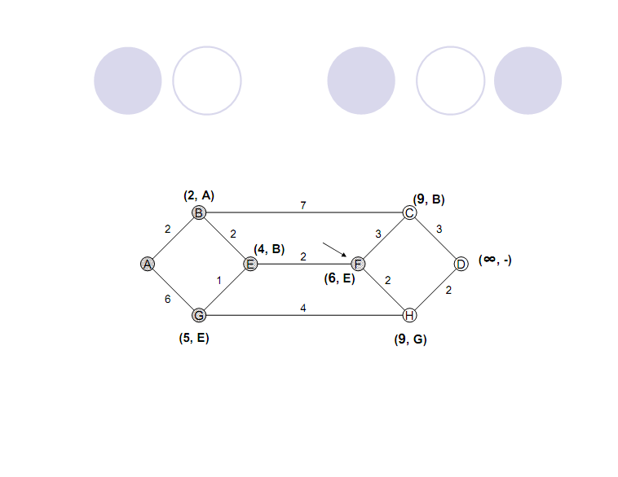
Graph Traversing
Dijkstra’s Shortest Path Algorithm
Example
66
66
66

Slide 67
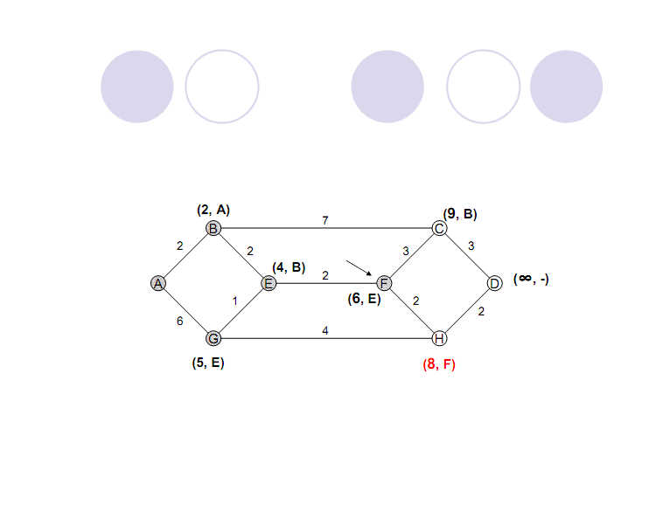
Graph Traversing
Dijkstra’s Shortest Path Algorithm
Example
67
67
67

Slide 68
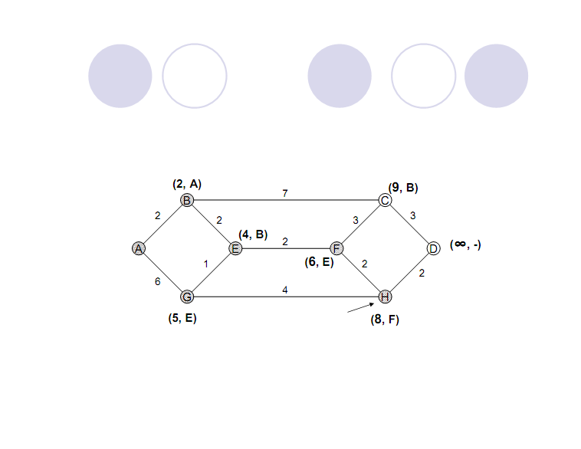
Graph Traversing
Dijkstra’s Shortest Path Algorithm
Example
68
68
68

Slide 69
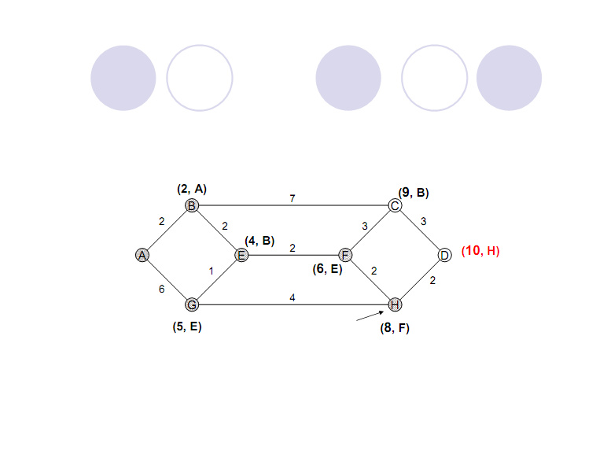
Graph Traversing
Dijkstra’s Shortest Path Algorithm
Example
69
69
69

Slide 70
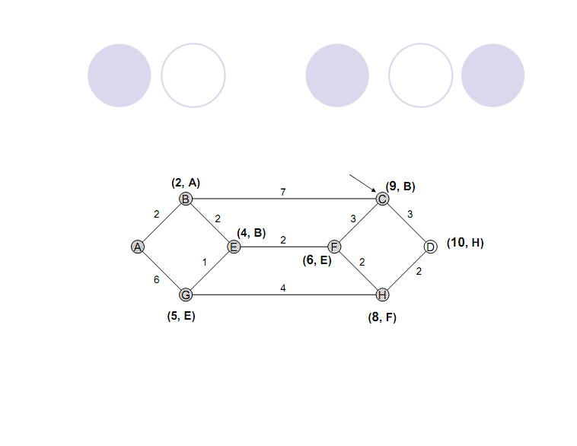
Graph Traversing
Dijkstra’s Shortest Path Algorithm
Example
70
70
70

Slide 71
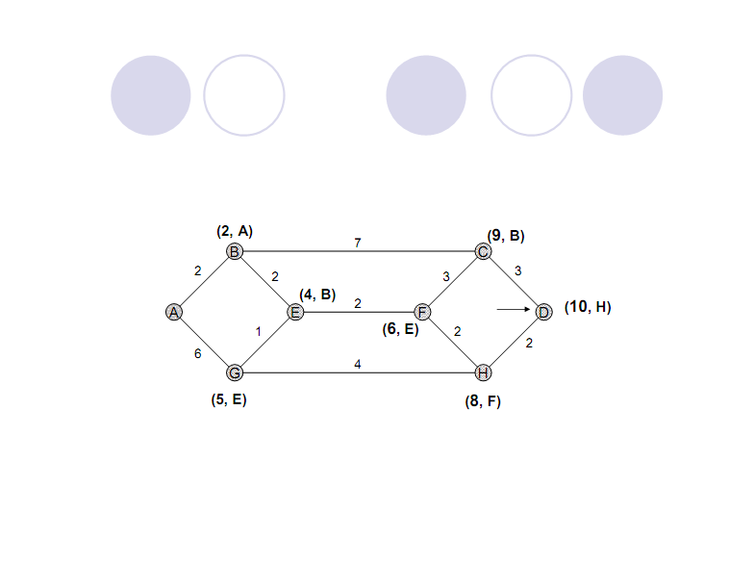
Graph Traversing
Dijkstra’s Shortest Path Algorithm
Example
71
71
71

Slide 72
Thanks!!!
Queries?

