Slide 1
Design and Analysis and of Algorithms

Slide 2
Agenda – session 11
Divide and Conquer Algorithms
Divide and Conquer - Design Principles and Strategy,
Analyzing Divide and Conquer Algorithms
Sorting Problem - Merge Sort Algorithm, Quick Sort Algorithm.
Searching Problem and Binary Search Algorithm
Integer Multiplication Problem

Slide 3
Divide-and-Conquer
The most-well known algorithm design strategy:
Divide instance of problem into two or more smaller instances
Solve smaller instances recursively
Obtain solution to original (larger) instance by combining these solutions

Slide 4
Divide-and-Conquer Technique (cont.)
a problem of size n
(instance)
subproblem 1
of size n/2
subproblem 2
of size n/2
a solution to
subproblem 1
a solution to
subproblem 2
a solution to
the original problem
It generally leads to a recursive algorithm!

Slide 5
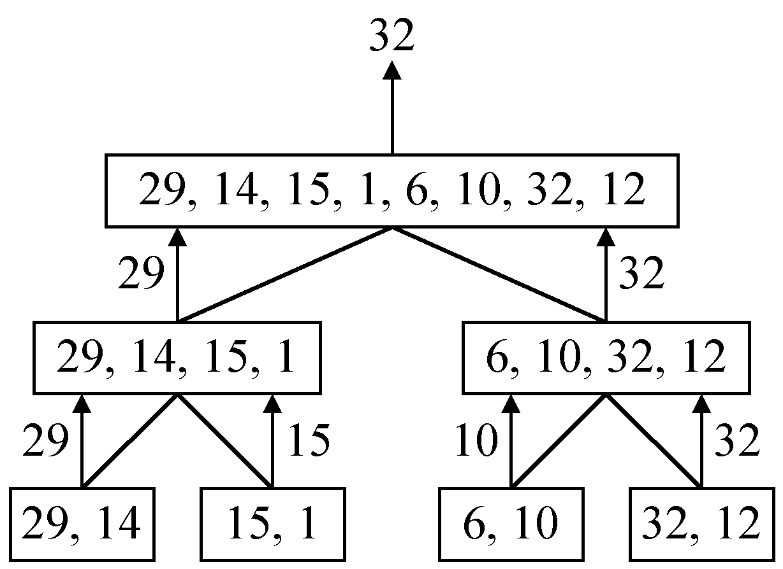
A simple example
finding the maximum of a set S of n numbers

Slide 6
Time complexity
Time complexity:
Calculation of T(n):
Assume n = 2^{k},
T(n) = 2T(n/2)+1
= 2(2T(n/4)+1)+1
= 4T(n/4)+2+1
:
=2^{k-1}T(2)+2^{k-2}+…+4+2+1
=2^{k-1}+2^{k-2}+…+4+2+1
=2^{k}-1 = n-1

Slide 7
Divide-and-Conquer
Divide-and conquer is a general algorithm design paradigm:
Divide: divide the input data S in two or more disjoint subsets S₁, S₂, …
Recur: solve the subproblems recursively
Conquer: combine the solutions for S₁, S₂, …, into a solution for S
The base case for the recursion are subproblems of constant size
Analysis can be done using recurrence equations

Slide 8
Algorithms - Divide & Conquer
Recurrences: as we saw, the Divide and Conquer approach leads to Recurrence Formulae to represent its time costs:
for low values of n (1 is typical, but we could have n larger) T(n) = Θ(1).
for large(r) values of n, T(n) = a T(n/b) + f(n), where f(n) represents the costs of dividing and those of recombining the solutions.

Slide 9
Algorithms - Divide & Conquer
The substitution method: essentially, guess the solution and prove the guess to be correct by mathematical induction. This will work well in all cases. Slight difficulty: you have to guess right – and that is not easy in most cases…
The recursion-tree method: convert the recurrence into a tree (as in MERGESORT) and add up all the costs of each level, and then add up the costs of all the levels. Slight difficulty: unless the costs at each level are easy to compute, you may have some difficult bounds to cook up.
The Master Method: there is a theorem... Basically, find out which set of hypotheses hold in your special case, and read off the conclusion. Slight difficulty: sometimes you will have trouble proving that the hypotheses you need (or any relevant hypotheses) are actually satisfied.

Slide 10
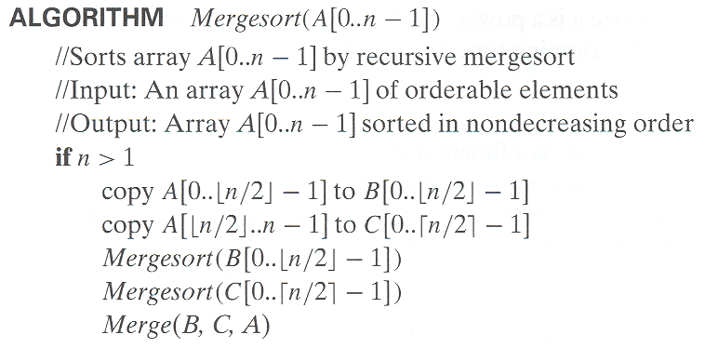
Merge-Sort
Merge-sort on an input sequence S with n elements consists of three steps:
Divide: partition S into two sequences S₁ and S₂ of about n/2 elements each
Recur: recursively sort S₁ and S₂
Conquer: merge S₁ and S₂ into a unique sorted sequence

Slide 11
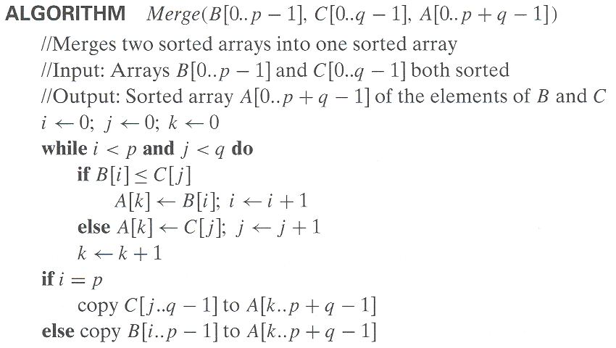

Slide 13
Recurrence Equation Analysis
The conquer step of merge-sort consists of merging two sorted sequences, each with n/2 elements, takes at most bn steps, for some constant b.
Likewise, the basis case (n < 2) will take at b most steps.
Therefore, if we let T(n) denote the running time of merge-sort:

Slide 14
Iterative Substitution
In the iterative substitution, or “plug-and-chug,” technique, we iteratively apply the recurrence equation to itself and see if we can find a pattern:
Note that base, T(n)=b, case occurs when 2^{i}=n. That is, i = log n.
So,
Thus, T(n) is O(n log n).

Slide 15
The Recursion Tree
Draw the recursion tree for the recurrence relation and look for a pattern:
depth | T’s | size
0 | 1 | n
1 | 2 | n/2
i | 2^{i} | n/2^{i}
… | … | …
time
bn
bn
bn
…
Total time = bn + bn log n
(last level plus all previous levels)

Slide 16
Master Theorem
Let T(n) be a monotonically increasing function that satisfies
T(n) = a T(n/b) + f(n)
T(1) = c
where a ≥ 1, b ≥ 2, c>0. If f(n) is Θ(n^{d}) where d ≥ 0 then
 |  | if a < b^{d}
T(n) = |  | If a = b^{d}
 |  | if a > b^{d}
Notes:
In mathematics, a monotonic function (or monotone function) is a function between ordered sets that preserves or reverses the given order. This concept first arose in calculus, and was later generalized to the more abstract setting of order theory.
In mathematics, a polynomial is an expression consisting of variables (or indeterminates) and coefficients, that involves only the operations of addition, subtraction, multiplication, and non-negative integer exponents. An example of a polynomial of a single indeterminate x is x² − 4x + 7. An example in three variables is x³ + 2xyz² − yz + 1.

Slide 17

The master theorem concerns recurrence relations of the form:
In the application to the analysis of a recursive algorithm, the constants and function take on the following significance:
n is the size of the problem.
a is the number of subproblems in the recursion.
n/b is the size of each subproblem.
(Here it is assumed that all subproblems are essentially the same size.)
f (n) is the cost of the work done outside the recursive calls, which includes the cost of dividing the problem and the cost of merging the solutions to the subproblems.

Slide 18
Master Theorem: Example 1
Let T(n) = T(n/2) + ½ n² + n. What are the parameters?
a =
b =
d =
Therefore, which condition applies?
1
2
2
1 < 2², case 1 applies
We conclude that
T(n) ∈ Θ(n^{d}) = Θ (n²)

Slide 19
Master Theorem: Example 2
Let T(n)= 2 T(n/4) + √n + 42. What are the parameters?
a =
b =
d =
Therefore, which condition applies?
2
4
1/2
2 = 4^{1/2}, case 2 applies
We conclude that

Slide 20
Master Theorem: Example 3
Let T(n)= 3 T(n/2) + 3/4n + 1. What are the parameters?
a =
b =
d =
Therefore, which condition applies?
3
2
1
3 > 2¹, case 3 applies
We conclude that
Note that log₂3≈1.584…, can we say that T(n) ∈ Θ (n^{1.584})
No, because log₂3≈1.5849… and n^{1.584} ∉ Θ (n^{1.5849})

Slide 21
General Divide-and-Conquer Recurrence
T(n) = aT(n/b) + f (n) where f(n) ∈ Θ(n^{d}), d ≥ 0
Master Theorem: If a < b^{d}, T(n) ∈ Θ(n^{d})
If a = b^{d}, T(n) ∈ Θ(n^{d} log n)
If a > b^{d}, T(n) ∈ Θ(n^{log b a} )
Note: The same results hold with O instead of Θ.
Examples: T(n) = 4T(n/2) + n ⇒ T(n) ∈ ?
T(n) = 4T(n/2) + n² ⇒ T(n) ∈ ?
T(n) = 4T(n/2) + n³ ⇒ T(n) ∈ ?

Slide 22
Trace of QuickSort Algorithm

Slide 23
quickSort(array, lower, upper)
{
// Base Case
if (lower >= upper)
{
we’re done
}
else
{
partition array around pivot value array[lower]
pos contains the new location of pivot value
quickSort array up to pos: quickSort(array,lower,pos)
quickSort array after pos: quickSort(array,pos+1,upper)
}
}

Slide 24
partition(array, lower, upper)
{
pivot is array[lower]
while (true)
{
scan from right to left using index called RIGHT
STOP when locate an element that should be left of pivot
scan from left to right using index called LEFT
stop when locate an element that should be right of pivot
swap array[RIGHT] and array[LEFT]
if (RIGHT and LEFT cross)
pos = location where LEFT/RIGHT cross
swap pivot and array[pos]
all values left of pivot are <= pivot
all values right of pivot are >= pivot
return pos
end pos
}
}

Slide 25
0
1
2
3
4
5
quickSort(arr,0,5)
6
5
9
12
3
4

Slide 26
quickSort(arr,0,5)
0
1
2
3
4
5
partition(arr,0,5)
6
5
9
12
3
4

Slide 27
quickSort(arr,0,5)
0
1
2
3
4
5
partition(arr,0,5)
6
5
9
12
3
4
pivot= ?
Partition Initialization...

Slide 28
quickSort(arr,0,5)
0
1
2
3
4
5
partition(arr,0,5)
6
5
9
12
3
4
pivot=6
Partition Initialization...

Slide 29
quickSort(arr,0,5)
0
1
2
3
4
5
partition(arr,0,5)
6
5
9
12
3
4
pivot=6
left
Partition Initialization...

Slide 30
quickSort(arr,0,5)
0
1
2
3
4
5
partition(arr,0,5)
6
5
9
12
3
4
pivot=6
left
right
Partition Initialization...

Slide 31
quickSort(arr,0,5)
0
1
2
3
4
5
partition(arr,0,5)
6
5
9
12
3
4
pivot=6
left
right
right moves to the left until
value that should be to left
of pivot...

Slide 32
quickSort(arr,0,5)
0
1
2
3
4
5
partition(arr,0,5)
6
5
9
12
3
4
pivot=6
left
right

Slide 33
quickSort(arr,0,5)
0
1
2
3
4
5
partition(arr,0,5)
6
5
9
12
3
4
pivot=6
left
right
left moves to the right until
value that should be to right
of pivot...

Slide 34
quickSort(arr,0,5)
0
1
2
3
4
5
partition(arr,0,5)
6
5
9
12
3
4
pivot=6
left
right

Slide 35
quickSort(arr,0,5)
0
1
2
3
4
5
partition(arr,0,5)
6
5
9
12
3
4
pivot=6
left
right

Slide 36
quickSort(arr,0,5)
0
1
2
3
4
5
partition(arr,0,5)
6
5
9
12
3
4
pivot=6
left
right
swap arr[left] and arr[right]

Slide 37
quickSort(arr,0,5)
0
1
2
3
4
5
partition(arr,0,5)
6
5
4
12
3
9
pivot=6
left
right
repeat right/left scan
UNTIL left & right cross

Slide 38
quickSort(arr,0,5)
0
1
2
3
4
5
partition(arr,0,5)
6
5
4
12
3
9
pivot=6
left
right
right moves to the left until
value that should be to left
of pivot...

Slide 39
quickSort(arr,0,5)
0
1
2
3
4
5
partition(arr,0,5)
6
5
4
12
3
9
pivot=6
left
right

Slide 40
quickSort(arr,0,5)
0
1
2
3
4
5
partition(arr,0,5)
6
5
4
12
3
9
pivot=6
left
right
left moves to the right until
value that should be to right
of pivot...

Slide 41
quickSort(arr,0,5)
0
1
2
3
4
5
partition(arr,0,5)
6
5
4
12
3
9
pivot=6
left
right

Slide 42
quickSort(arr,0,5)
0
1
2
3
4
5
partition(arr,0,5)
6
5
4
12
3
9
pivot=6
left
right
swap arr[left] and arr[right]

Slide 43
quickSort(arr,0,5)
0
1
2
3
4
5
partition(arr,0,5)
6
5
4
3
12
9
pivot=6
left
right
swap arr[left] and arr[right]

Slide 44
quickSort(arr,0,5)
0
1
2
3
4
5
partition(arr,0,5)
6
5
4
3
12
9
pivot=6
left
right
repeat right/left scan
UNTIL left & right cross

Slide 45
quickSort(arr,0,5)
0
1
2
3
4
5
partition(arr,0,5)
6
5
4
3
12
9
pivot=6
left
right
right moves to the left until
value that should be to left
of pivot...

Slide 46
quickSort(arr,0,5)
0
1
2
3
4
5
partition(arr,0,5)
6
5
4
3
12
9
pivot=6
left
right

Slide 47
quickSort(arr,0,5)
0
1
2
3
4
5
partition(arr,0,5)
6
5
4
3
12
9
pivot=6
left
right
right & left CROSS!!!

Slide 48
quickSort(arr,0,5)
0
1
2
3
4
5
partition(arr,0,5)
6
5
4
3
12
9
pivot=6
left
right
right & left CROSS!!!
1 - Swap pivot and arr[right]

Slide 49
quickSort(arr,0,5)
0
1
2
3
4
5
partition(arr,0,5)
3
5
4
6
12
9
pivot=6
left
right
right & left CROSS!!!
1 - Swap pivot and arr[right]

Slide 50
quickSort(arr,0,5)
0
1
2
3
4
5
partition(arr,0,5)
3
5
4
6
12
9
pivot=6
left
right
right & left CROSS!!!
1 - Swap pivot and arr[right]
2 - Return new location of pivot to caller
return 3

Slide 51
0
1
2
3
4
5
quickSort(arr,0,5)
3
5
4
6
12
9
pivot
position
Recursive calls to quickSort()
using partitioned array...

Slide 52
quickSort(arr,0,5)
0
1
2
3
4
5
3
5
4
6
12
9
quickSort(arr,0,3)
quickSort(arr,4,5)
0
1
2
3
4
5
3
5
4
6
12
9

Slide 53
quickSort(arr,0,5)
quickSort(arr,0,3)
quickSort(arr,4,5)
partition(arr,0,3)
0
1
2
3
4
5
3
5
4
6
12
9

Slide 54
quickSort(arr,0,5)
quickSort(arr,0,3)
quickSort(arr,4,5)
partition(arr,0,3)
0
1
2
3
4
5
3
5
4
6
12
9
Partition Initialization...

Slide 55
quickSort(arr,0,5)
quickSort(arr,0,3)
quickSort(arr,4,5)
partition(arr,0,3)
0
1
2
3
4
5
3
5
4
6
12
9
Partition Initialization...

Slide 56
quickSort(arr,0,5)
quickSort(arr,0,3)
quickSort(arr,4,5)
partition(arr,0,3)
0
1
2
3
4
5
3
5
4
6
12
9
left
Partition Initialization...

Slide 57
quickSort(arr,0,5)
quickSort(arr,0,3)
quickSort(arr,4,5)
partition(arr,0,3)
0
1
2
3
4
5
3
5
4
6
12
9
left
right
Partition Initialization...

Slide 58
quickSort(arr,0,5)
quickSort(arr,0,3)
quickSort(arr,4,5)
partition(arr,0,3)
0
1
2
3
4
5
3
5
4
6
12
9
left
right
right moves to the left until
value that should be to left
of pivot...

Slide 59
quickSort(arr,0,5)
quickSort(arr,0,3)
quickSort(arr,4,5)
partition(arr,0,3)
0
1
2
3
4
5
3
5
4
6
12
9
left
right

Slide 60
quickSort(arr,0,5)
quickSort(arr,0,3)
quickSort(arr,4,5)
partition(arr,0,3)
0
1
2
3
4
5
3
5
4
6
12
9
left
right

Slide 61
quickSort(arr,0,5)
quickSort(arr,0,3)
quickSort(arr,4,5)
partition(arr,0,3)
0
1
2
3
4
5
3
5
4
6
12
9
left
right

Slide 62
quickSort(arr,0,5)
quickSort(arr,0,3)
quickSort(arr,4,5)
partition(arr,0,3)
0
1
2
3
4
5
3
5
4
6
12
9
left
right
right & left CROSS!!!

Slide 63
quickSort(arr,0,5)
quickSort(arr,0,3)
quickSort(arr,4,5)
partition(arr,0,3)
0
1
2
3
4
5
3
5
4
6
12
9
left
right
right & left CROSS!!!
1 - Swap pivot and arr[right]

Slide 64
quickSort(arr,0,5)
quickSort(arr,0,3)
quickSort(arr,4,5)
partition(arr,0,3)
0
1
2
3
4
5
3
5
4
6
12
9
left
right
right & left CROSS!!!
1 - Swap pivot and arr[right]
2 - Return new location of pivot to caller
right & left CROSS!!!
1 - Swap pivot and arr[right]
return 0

Slide 65
quickSort(arr,0,5)
quickSort(arr,0,3)
quickSort(arr,4,5)
0
1
2
3
4
5
3
5
4
6
12
9
Recursive calls to quickSort()
using partitioned array...

Slide 66
quickSort(arr,0,5)
quickSort(arr,0,3)
quickSort(arr,4,5)
quickSort(arr,0,0)
quickSort(arr,1,3)
4
5
12
9
0
1
2
3
3
5
4
6

Slide 67
quickSort(arr,0,5)
quickSort(arr,0,3)
quickSort(arr,4,5)
quickSort(arr,0,0)
quickSort(arr,1,3)
4
5
12
9
0
1
2
3
3
5
4
6
Base case triggered...
halting recursion.

Slide 68
quickSort(arr,0,5)
quickSort(arr,0,3)
quickSort(arr,4,5)
quickSort(arr,0,0)
quickSort(arr,1,3)
4
5
12
9
0
1
2
3
3
5
4
6
Base Case: Return

Slide 69
quickSort(arr,0,5)
quickSort(arr,0,3)
quickSort(arr,4,5)
quickSort(arr,0,0)
quickSort(arr,1,3)
4
5
partition(arr,1,3)
12
9
0
1
2
3
3
5
4
6
Partition Initialization...

Slide 70
quickSort(arr,0,5)
quickSort(arr,0,3)
quickSort(arr,4,5)
quickSort(arr,0,0)
quickSort(arr,1,3)
4
5
partition(arr,1,3)
12
9
0
1
2
3
3
5
4
6
Partition Initialization...

Slide 71
quickSort(arr,0,5)
quickSort(arr,0,3)
quickSort(arr,4,5)
quickSort(arr,0,0)
quickSort(arr,1,3)
4
5
partition(arr,1,3)
12
9
0
1
2
3
3
5
4
6
left
Partition Initialization...

Slide 72
quickSort(arr,0,5)
quickSort(arr,0,3)
quickSort(arr,4,5)
quickSort(arr,0,0)
quickSort(arr,1,3)
4
5
partition(arr,1,3)
12
9
0
1
2
3
3
5
4
6
left
right
right moves to the left until
value that should be to left
of pivot...

Slide 73
quickSort(arr,0,5)
quickSort(arr,0,3)
quickSort(arr,4,5)
quickSort(arr,0,0)
quickSort(arr,1,3)
4
5
partition(arr,1,3)
12
9
0
1
2
3
3
5
4
6
left
right

Slide 74
quickSort(arr,0,5)
quickSort(arr,0,3)
quickSort(arr,4,5)
quickSort(arr,0,0)
quickSort(arr,1,3)
4
5
partition(arr,1,3)
12
9
0
1
2
3
3
5
4
6
left
right
left moves to the right until
value that should be to right
of pivot...

Slide 75
quickSort(arr,0,5)
quickSort(arr,0,3)
quickSort(arr,4,5)
quickSort(arr,0,0)
quickSort(arr,1,3)
4
5
partition(arr,1,3)
12
9
0
1
2
3
3
5
4
6
right
left

Slide 76
quickSort(arr,0,5)
quickSort(arr,0,3)
quickSort(arr,4,5)
quickSort(arr,0,0)
quickSort(arr,1,3)
4
5
partition(arr,1,3)
12
9
0
1
2
3
3
5
4
6
right
left
right & left CROSS!

Slide 77
quickSort(arr,0,5)
quickSort(arr,0,3)
quickSort(arr,4,5)
quickSort(arr,0,0)
quickSort(arr,1,3)
4
5
partition(arr,1,3)
12
9
0
1
2
3
3
5
4
6
right
left
right & left CROSS!
1- swap pivot and arr[right]

Slide 78
quickSort(arr,0,5)
quickSort(arr,0,3)
quickSort(arr,4,5)
quickSort(arr,0,0)
quickSort(arr,1,3)
4
5
partition(arr,1,3)
12
9
0
1
2
3
3
4
5
6
right
left
right & left CROSS!
1- swap pivot and arr[right]

Slide 79
quickSort(arr,0,5)
quickSort(arr,0,3)
quickSort(arr,4,5)
quickSort(arr,0,0)
quickSort(arr,1,3)
4
5
partition(arr,1,3)
12
9
0
1
2
3
3
4
5
6
right
left
right & left CROSS!
1- swap pivot and arr[right]
2 – return new position of pivot
return 2

Slide 80
quickSort(arr,0,5)
quickSort(arr,0,3)
quickSort(arr,4,5)
quickSort(arr,0,0)
quickSort(arr,1,3)
4
5
12
9
0
3
quickSort(arr,1,2)
quickSort(arr,3,3)
1
2
3
4
5
6

Slide 81
quickSort(arr,0,5)
quickSort(arr,0,3)
quickSort(arr,4,5)
quickSort(arr,0,0)
quickSort(arr,1,3)
4
5
12
9
0
3
quickSort(arr,1,2)
quickSort(arr,3,3)
partition(arr,1,2)
1
2
3
4
5
6

Slide 82
quickSort(arr,0,5)
quickSort(arr,0,3)
quickSort(arr,4,5)
quickSort(arr,0,0)
quickSort(arr,1,3)
4
5
12
9
0
3
quickSort(arr,1,2)
quickSort(arr,3,3)
1
2
3
4
5
6

Slide 83
quickSort(arr,0,5)
quickSort(arr,0,3)
quickSort(arr,4,5)
quickSort(arr,0,0)
quickSort(arr,1,3)
4
5
12
9
0
3
quickSort(arr,1,2)
quickSort(arr,3,3)
3
6
quickSort(arr,1,1)
quickSort(arr,2,2)
1
2
4
5

Slide 84
quickSort(arr,0,5)
quickSort(arr,0,3)
quickSort(arr,4,5)
partition(arr,4,5)
quickSort(arr,0,0)
quickSort(arr,1,3)
4
5
12
9
0
3
quickSort(arr,1,2)
quickSort(arr,3,3)
3
6
quickSort(arr,1,1)
quickSort(arr,2,2)
1
2
4
5

Slide 85
quickSort(arr,0,5)
quickSort(arr,0,3)
quickSort(arr,4,5)
partition(arr,4,5)
quickSort(arr,0,0)
quickSort(arr,1,3)
4
5
9
12
0
3
quickSort(arr,1,2)
quickSort(arr,3,3)
3
6
quickSort(arr,1,1)
quickSort(arr,2,2)
1
2
4
5

Slide 86
quickSort(arr,0,5)
quickSort(arr,0,3)
quickSort(arr,4,5)
quickSort(arr,6,5)
quickSort(arr,0,0)
quickSort(arr,1,3)
quickSort(arr,4,5)
0
4
5
3
9
12
quickSort(arr,1,2)
quickSort(arr,3,3)
3
6
quickSort(arr,1,1)
quickSort(arr,2,2)
1
2
4
5

Slide 87
quickSort(arr,0,5)
quickSort(arr,0,3)
quickSort(arr,4,5)
quickSort(arr,6,5)
quickSort(arr,0,0)
quickSort(arr,1,3)
quickSort(arr,4,5)
partition(arr,4,5)
0
4
5
3
9
12
quickSort(arr,1,2)
quickSort(arr,3,3)
3
6
quickSort(arr,1,1)
quickSort(arr,2,2)
1
2
4
5

Slide 88
quickSort(arr,0,5)
quickSort(arr,0,3)
quickSort(arr,4,5)
quickSort(arr,6,5)
quickSort(arr,0,0)
quickSort(arr,1,3)
quickSort(arr,4,5)
0
4
5
3
9
12
quickSort(arr,1,2)
quickSort(arr,3,3)
3
6
quickSort(arr,1,1)
quickSort(arr,2,2)
1
2
4
5

Slide 89
quickSort(arr,0,5)
quickSort(arr,0,3)
quickSort(arr,4,5)
quickSort(arr,6,5)
quickSort(arr,0,0)
quickSort(arr,1,3)
quickSort(arr,4,5)
0
3
quickSort(arr,1,2)
quickSort(arr,3,3)
3
quickSort(arr,4,4)
6
4
9
quickSort(arr,1,1)
quickSort(arr,2,2)
quickSort(arr,5,5)
1
2
5
4
5
12

Slide 90
Algorithm Quicksort
Input: A set S of n elements.
Output: The sorted sequence of the inputs in nondecreasing order.
Step 1: If |S|≤2, solve it directly.
Step 2: (Partition step) Use a pivot to scan all elements in S. Put the smaller elements in S₁, and the larger elements in S₂.
Step 3: Recursively solve S₁ and S₂.

Slide 91
Quicksort Analysis
Partition can be done in O(n) time, where n is the size of the array
Let T(n) be the number of comparisons required by Quicksort
If the pivot ends up at position k, then we have
T(n) =T(n−k) + T(k −1) + n
To determine best-, worst-, and average-case complexity we need to determine the values of k that correspond to these cases.

Slide 92
Best-Case Complexity
The best case is clearly when the pivot always partitions the array equally.
Intuitively, this would lead to a recursive depth of at most lg n calls
We can actually prove this. In this case
T(n) ≈T(n/2) + T(n/2) + n ⇒ Θ(n lg n)

Slide 93
Worst-Case and Average-Case Complexity
The worst-case is when the pivot always ends up in the first or last element. That is, partitions the array as unequally as possible.
In this case
T(n) =?

Slide 94
Worst-Case and Average-Case Complexity
The worst-case is when the pivot always ends up in the first or last element. That is, partitions the array as unequally as possible.
In this case
T(n) = T(n−1) + T(1−1) + n = T(n−1) + n
= n + (n−1) + … + 1
= n(n + 1)/2 ⇒ Ο(n²)
Average case is rather complex, hence by applying Master Theorem :

Slide 95
Summary of Quicksort
Best case: split in the middle — Θ( n log n)
Worst case: sorted array! — Θ( n²)
Average case: random arrays — Θ( n log n)
Considered as the method of choice for internal sorting for large files (n ≥ 10000)
Improvements:
better pivot selection: median of three partitioning avoids worst case in sorted files
switch to insertion sort on small subfiles
elimination of recursion
these combine to 20-25% improvement

Slide 96
What is the solution to Worst Case - Quick sort?
Randomized Quicksort

Slide 97
Multiplication of Large Integers
Consider the problem of multiplying two (large) n-digit integers represented by arrays of their digits such as: A = 12345678901357986429 B = 87654321284820912836 The grade-school algorithm:
a₁ a₂ … a_{n} b₁ b₂ … b_{n}
(d₁₀) d₁₁d₁₂ … d_{1n}
(d₂₀) d₂₁d₂₂ … d_{2n}
… … … … … … …
(d_{n0}) d_{n1}d_{n2} … d_{nn}
Efficiency: Θ(n²) single-digit multiplications

Slide 98
First Divide-and-Conquer Algorithm
A small example: A ∗ B where A = 2135 and B = 4014
A = (21·10² + 35), B = (40 ·10² + 14)
So, A ∗ B = (21 ·10² + 35) ∗ (40 ·10² + 14)
= 21 ∗ 40 ·10⁴ + (21 ∗ 14 + 35 ∗ 40) ·10² + 35 ∗ 14
In general, if A = A₁A₂ and B = B₁B₂ (where A and B are n-digit,
A₁, A₂, B₁, B₂ are n/2-digit numbers),
A ∗ B = A₁ ∗ B₁·10^{n} + (A₁ ∗ B₂ + A₂ ∗ B₁) ·10^{n/2} + A₂ ∗ B₂
Recurrence for the number of one-digit multiplications M(n):
M(n) = 4M(n/2) + constant, M(1) = 1 Solution: M(n) = n²

Slide 99
Explore few other algorithms that may reduce number of multiplications for multiplying 2 large integers

Slide 100
Multiplication of large integers
a , b are both n-digit integers
If we use the brute-force approach to compute c = a * b, what is the time efficiency?

Slide 101
Multiplication of large integers (divide-conquer recursive algorithm I ]
a = a₁a₀ and b = b₁b₀
c = a * b
= (a₁10^{n/2} + a₀) * (b₁10^{n/2} + b₀)
=(a₁ * b₁)10^{n} + (a₁ * b₀ + a₀ * b₁)10^{n/2} + (a₀ * b₀)
For instance: a = 123456, b = 117933:
Then c = a * b = (123*10³+456)*(117*10³+933)
=(123 * 117)10⁶ + (123 * 933 + 456 * 117)10³ + (456 * 933)

Slide 102
Multiplication of large integers
a = a₁a₀ and b = b₁b₀
a, b: n-digit integers
a₁, a₀, b₁, b₀: n/2-digit integers
c = a * b
=(a₁ * b₁)10^{n} + (a₁ * b₀ + a₀ * b₁)10^{n/2} + (a₀ * b₀)
How many single-digit multiplications are needed to compute a*b, if we ignore the shifting operations required for multiplying 10^{n} and 10^{n/2}?

Slide 103
Multiplication of large integers (divide-conquer recursive algorithm II ]
a = a₁a₀ and b = b₁b₀
c = a * b
=(a₁ * b₁)10^{n} + (a₁ * b₀ + a₀ * b₁)10^{n/2} + (a₀ * b₀)
=c₂10^{n} + c₁10^{n/2} + c₀,
where
c₂ = a₁ * b₁ is the product of their first halves
c₀ = a₀ * b₀ is the product of their second halves
c₁ = (a₁ + a₀) * (b₁ + b₀) – (c₂ + c₀) is the product of the sum of the a’s halves and the sum of the b’s halves minus the sum of c₂ and c₀.

Slide 104
Multiplication of large integers
c =c₂10^{n} + c₁10^{n/2} + c₀,
where
c₂ = a₁ * b₁
c₀ = a₀ * b₀
c₁ = (a₁ + a₀) * (b₁ + b₀) – (c₂ + c₀)
How many single-digit multiplications are needed to compute a*b, if we ignore the shifting operations required for multiplying 10^{n} and 10^{n/2}?

Slide 105
Multiplication of large integers
c =c₂10^{n} + c₁10^{n/2} + c₀,
where
c₂ = a₁ * b₁
c₀ = a₀ * b₀
c₁ = (a₁ + a₀) * (b₁ + b₀) – (c₂ + c₀)
Multiplication of n-digit numbers requires three multiplications of n/2-digit numbers

Slide 106
Multiplication of large integers
M(n) = 3M(n/2) + constant for n>1, M(1) = 1

Slide 107
Multiplication of large integers
M(n) = 3M(n/2) + constant for n>1, M(1) = 1
M(n) ≈ n^{1.585}

Slide 108
Thanks!!!
Queries?

