Slide 1
Design and Analysis and of Algorithms

Slide 2
Agenda – session 12
Dynamic Programming - Design Principles and Strategy

Slide 3
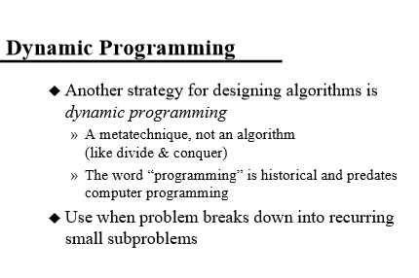

Slide 4
Dynamic programming is an effective and efficient way to solve a particular paradigm of programming problems. Such problems exhibits following two properties:
Optimal Substructure
Overlapping subproblems

Slide 5
A problem has optimal substructure if the complete problem can be optimally solved by combining the solution of its various subproblems. In other words, if the problem can be written down in some sort of recurrence relation / dependency equation consisting of smaller subproblems, then the problem contains optimal substructure. To understand it better, let us pick up a fairly common program - Fibonacci Series. Fibonacci series goes like this - 0, 1, 1, 2, 3, 5, 8, 13, 21, 34, ... To see if this problem contains optimal substructure or not, we need to figure out if we can divide the problem into subproblems and whether solving those subproblems will give us the optimal solution.

Slide 6
Let us consider F(n) to be the nth Fibonacci number. Consider F(1) = 0 and F(2) = 1 as the exceptions (let us call them base cases). Rest all follows the following recurrence relation:
F(n) = F(n-1) + F(n-2) F(3) = F(2) + F(1) = 1 + 0 = 1 F(4) = F(3) + F(2) = 1 + 1 = 2 F(5) = F(4) + F(3) = 2 + 1 = 3 F(6) = F(5) + F(4) = 3 + 2 = 5 F(7) = F(6) + F(5) = 5 + 3 = 8 F(8) = F(7) + F(6) = 8 + 5 = 13 F(9) = F(8) + F(7) = 13 + 8 = 21 F(10) = F(9) + F(8) = 21 + 13 = 34

Slide 7
So, it is quite evident that nth term of the series can easily be calculated from the results of (n-1)th and (n-2)th terms. Which is a perfect example of optimal substructure where in to solve a particular problem we can use the solutions for smaller subproblems. The natural way to solve such problems is to use recursion:
int fib(int n) { if (n < 0) return 0; if (n < 2) return n; return fib(n - 1) + fib(n - 2); }

Slide 8
Now, let us try to understand what is meant by a problem having overlapping subproblems and how Dynamic Programming can help us in such situations. Again, let us head back to our previous example of Fibonacci series. If you observe closely, you will find that in recursive solution, we end up solving the same subproblem multiple number of times. For example, we evaluate F(2) while we evaluate F(3), F(4). We evaluate F(3) while we evaluate F(4) and F(5) and so on. Which means a lot of recursive function calls for the same subproblem again and again. If we look at it from performance angle, it isn't optimized by any means. See the following figure for reference:

Slide 9
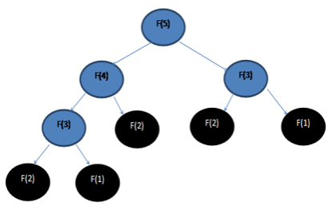
This is what is exactly meant by overlapping subproblems and is the perfect example where we should apply Dynamic Programming to find an optimal solution. Dynamic programming takes care of overlapping subproblems in two ways:
Top down and Bottom up approaches.

Slide 10
Evaluate the trade-offs between a top-down solution and bottom-up solution for a given problem using DP approach
Lets take fibonacci series as an example
1,1,2,3,5,8,13,21....
first number: 1
Second number: 1
Third Number: 2
Another way to put it,
Bottom(first) number: 1
Top (Eighth) number on the given sequence: 21
In case of first five fibonacci number
Bottom(first) number :1
Top (fifth) number: 5

Slide 11
Now lets take a look of recursive Fibonacci series algorithm as an example
public int rcursive(int n)
{
if ((n == 1) || (n == 2))
{
return 1;
}
else
{
return rcursive(n - 1) + rcursive(n - 2); }
}
Now if we execute this program with following commands
rcursive(5);
if we closely look into the algorithm, in-order to generate fifth number it requires 3rd and 4th numbers. So my recursion actually start from top(5) and then goes all the way to bottom/lower numbers. This approach is actually top-down approach.
To avoid doing same calculation multiple times we use Dynamic Programming techniques. We store previously computed value and reuse it. This technique is called memoization. There are more to Dynamic programming other then memoization which is not needed to discuss current problem.
Notes:
In computing, memoization or memoisation is an optimization technique used primarily to speed up computer programs by storing the results of expensive function calls and returning the cached result when the same inputs occur again.

Slide 12
Top-Down
Lets rewrite our original algorithm and add memoized techniques.
public int memoized(int n, int[] memo) {
if (n <= 2)
{
return 1;
} else if (memo[n] != -1) {
return memo[n];
} else {
memo[n] = memoized(n - 1, memo) + memoized(n - 2, memo);
}
return memo[n];
}
And we execute this method like following
int n = 5;
int[] memo = new int[n + 1];
Arrays.fill(memo, -1);
memoized(n, memo);
This solution is still top-down as algorithm start from top value and go to bottom each step to get our top value.

Slide 13
Bottom-Up
But, question is, can we start from bottom, like from first fibonacci number then walk our way to up. Lets rewrite it using this techniques,
public int dp(int n) {
int[] output = new int[n + 1];
output[1] = 1;
output[2] = 1;
for (int i = 3; i <= n; i++) {
output[i] = output[i - 1] + output[i - 2];
}
return output[n];
}
Now if we look into this algorithm it actually start from lower values then go to top. If i need 5th fibonacci number i am actually calculating 1st, then second then third all the way to up 5th number. This techniques actually called bottom-up techniques.
Last two, algorithms full-fill dynamic programming requirements. But one is top-down and another one is bottom-up. Both algorithm has similar space and time complexity.

Slide 14
Floyd’s Algorithm: All pairs shortest paths
Problem: In a weighted (di)graph, find shortest paths between every pair of vertices
Same idea: construct solution through series of matrices D⁽⁰⁾, …, D ^{(n)} using increasing subsets of the vertices allowed as intermediate
Example:
4
3
1
1
6
1
5
4
2
3

Slide 15
Floyd’s Algorithm (matrix generation)
On the k-th iteration, the algorithm determines shortest paths between every pair of vertices i, j that use only vertices among 1,…,k as intermediate
D^{(k)}[i,j] = min {D^{(k-1)}[i,j], D^{(k-1)}[i,k] + D^{(k-1)}[k,j]}
D^{(k-1)}[i,k]
k
i
D^{(k-1)}[k,j]
D^{(k-1)}[i,j]
j

Slide 16
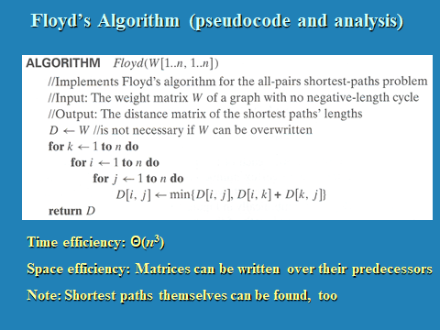

Slide 17
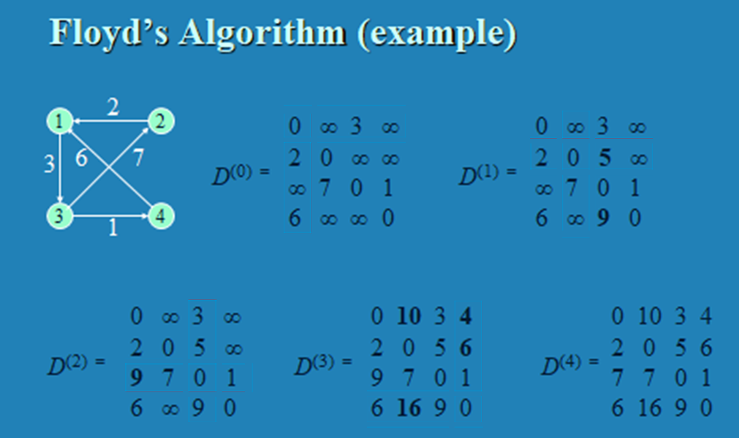


Slide 18
Knapsack problem
Given some items, pack the knapsack to get
the maximum total value. Each item has some
weight and some value. Total weight that we can
carry is no more than some fixed number W.
So we must consider weights of items as well as
their values.
Item # Weight Value
1 1 8
2 3 6
3 5 5

Slide 19
Knapsack problem
There are two versions of the problem:
“0-1 knapsack problem”
Items are indivisible; you either take an item or not. Some special instances can be solved with dynamic programming
“Fractional knapsack problem” (Discussed during Greedy Techniques)
Items are divisible: you can take any fraction of an item

Slide 20
0-1 Knapsack problem
Given a knapsack with maximum capacity W, and a set S consisting of n items
Each item i has some weight w_{i} and benefit value b_{i} (all w_{i} and W are integer values)
Problem: How to pack the knapsack to achieve maximum total value of packed items?

Slide 21
0-1 Knapsack problem
Problem, in other words, is to find
The problem is called a “0-1” problem, because each item must be entirely accepted or rejected.

Slide 22
0-1 Knapsack problem: brute-force approach
Let’s first solve this problem with a straightforward algorithm
Since there are n items, there are 2^{n} possible combinations of items.
We go through all combinations and find the one with maximum value and with total weight less or equal to W
Running time will be O(2^{n})

Slide 23
0-1 Knapsack problem: dynamic programming approach
We can do better with an algorithm based on dynamic programming
We need to carefully identify the subproblems

Slide 24
Defining a Subproblem
Given a knapsack with maximum capacity W, and a set S consisting of n items
Each item i has some weight w_{i} and benefit value b_{i} (all w_{i} and W are integer values)
Problem: How to pack the knapsack to achieve maximum total value of packed items?

Slide 25
Defining a Subproblem
We can do better with an algorithm based on dynamic programming
We need to carefully identify the subproblems
Let’s try this:
If items are labeled 1..n, then a subproblem
would be to find an optimal solution for
S_{k} = {items labeled 1, 2, .. k}

Slide 26
Defining a Subproblem
If items are labeled 1..n, then a subproblem would be to find an optimal solution for S_{k} = {items labeled 1, 2, .. k}
This is a reasonable subproblem definition.
The question is: can we describe the final solution (S_{n} ) in terms of subproblems (S_{k})?
Unfortunately, we can’t do that.

Slide 27
Defining a Subproblem
Given a knapsack with maximum capacity W, and a set S consisting of n items
Each item i has some weight w_{i} and benefit value b_{i} (all w_{i} and W are integer values)
Problem: How to pack the knapsack to achieve maximum total value of packed items?

Slide 28
Defining a Subproblem
Let’s add another parameter: w, which will represent the maximum weight for each subset of items
The subproblem then will be to compute V[k,w], i.e., to find an optimal solution for S_{k} = {items labeled 1, 2, .. k} in a knapsack of size w

Slide 29
Recursive Formula for subproblems
The subproblem will then be to compute V[k,w], i.e., to find an optimal solution for S_{k} = {items labeled 1, 2, .. k} in a knapsack of size w
Assuming knowing V[i, j], where i=0,1, 2, … k-1, j=0,1,2, …w, how to derive V[k,w]?

Slide 30
Recursive Formula for subproblems (continued)
Recursive formula for subproblems:
It means, that the best subset of S_{k} that has total weight w is:
1) the best subset of S_{k-1} that has total weight ≤ w, or
2) the best subset of S_{k-1} that has total weight ≤ w-w_{k} plus the item k

Slide 31
Recursive Formula
The best subset of S_{k} that has the total weight ≤ w, either contains item k or not.
First case: w_{k}>w. Item k can’t be part of the solution, since if it was, the total weight would be > w, which is unacceptable.
Second case: w_{k} ≤ w. Then the item k can be in the solution, and we choose the case with greater value.

Slide 32
0-1 Knapsack Algorithm
for w = 0 to W
V[0,w] = 0
for i = 1 to n
V[i,0] = 0
for i = 1 to n
for w = 0 to W
if w_{i} <= w // item i can be part of the solution
if b_{i} + V[i-1,w-w_{i}] > V[i-1,w]
V[i,w] = b_{i} + V[i-1,w- w_{i}]
else
V[i,w] = V[i-1,w]
else V[i,w] = V[i-1,w] // w_{i} > w

Slide 33
Running time
for w = 0 to W
V[0,w] = 0
for i = 1 to n
V[i,0] = 0
for i = 1 to n
for w = 0 to W
< the rest of the code >
O(W)
Repeat n times
O(W)
What is the running time of this algorithm?
O(n*W)
Remember that the brute-force algorithm
takes O(2^{n})

Slide 34
Example
Let’s run our algorithm on the
following data:
n = 4 (# of elements)
W = 5 (max weight)
Elements (weight, benefit):
(2,3), (3,4), (4,5), (5,6)

Slide 35
Example (2)
i\W
0
1
2
3
4
5
0
0
0
0
0
0
0
1
2
3
4
for w = 0 to W
V[0,w] = 0

Slide 36
Example (3)
i\W
0
1
2
3
4
5
0
0
0
0
0
0
0
1
0
2
0
3
0
4
0
for i = 1 to n
V[i,0] = 0

Slide 37
Example (4)
Items:
1: (2,3)
2: (3,4)
3: (4,5)
4: (5,6)
i\W
0
1
2
3
4
5
i=1
b_{i}=3
w_{i}=2
w=1
w-w_{i} =-1
0
0
0
0
0
0
0
1
0
0
2
0
3
0
4
0
if w_{i} <= w // item i can be part of the solution
if b_{i} + V[i-1,w-w_{i}] > V[i-1,w]
V[i,w] = b_{i} + V[i-1,w- w_{i}]
else
V[i,w] = V[i-1,w]
else V[i,w] = V[i-1,w] // w_{i} > w

Slide 38
Example (5)
Items:
1: (2,3)
2: (3,4)
3: (4,5)
4: (5,6)
i\W
0
1
2
3
4
5
i=1
b_{i}=3
w_{i}=2
w=2
w-w_{i} =0
0
0
0
0
0
0
0
1
0
0
3
2
0
3
0
4
0
if w_{i} <= w // item i can be part of the solution
if b_{i} + V[i-1,w-w_{i}] > V[i-1,w]
V[i,w] = b_{i} + V[i-1,w- w_{i}]
else
V[i,w] = V[i-1,w]
else V[i,w] = V[i-1,w] // w_{i} > w

Slide 39
Example (6)
Items:
1: (2,3)
2: (3,4)
3: (4,5)
4: (5,6)
i\W
0
1
2
3
4
5
i=1
b_{i}=3
w_{i}=2
w=3
w-w_{i} =1
0
0
0
0
0
0
0
1
0
0
3
3
2
0
3
0
4
0
if w_{i} <= w // item i can be part of the solution
if b_{i} + V[i-1,w-w_{i}] > V[i-1,w]
V[i,w] = b_{i} + V[i-1,w- w_{i}]
else
V[i,w] = V[i-1,w]
else V[i,w] = V[i-1,w] // w_{i} > w

Slide 40
Example (7)
Items:
1: (2,3)
2: (3,4)
3: (4,5)
4: (5,6)
i\W
0
1
2
3
4
5
i=1
b_{i}=3
w_{i}=2
w=4
w-w_{i} =2
0
0
0
0
0
0
0
1
0
0
3
3
3
2
0
3
0
4
0
if w_{i} <= w // item i can be part of the solution
if b_{i} + V[i-1,w-w_{i}] > V[i-1,w]
V[i,w] = b_{i} + V[i-1,w- w_{i}]
else
V[i,w] = V[i-1,w]
else V[i,w] = V[i-1,w] // w_{i} > w

Slide 41
Example (8)
Items:
1: (2,3)
2: (3,4)
3: (4,5)
4: (5,6)
i\W
0
1
2
3
4
5
i=1
b_{i}=3
w_{i}=2
w=5
w-w_{i} =3
0
0
0
0
0
0
0
1
0
0
3
3
3
3
2
0
3
0
4
0
if w_{i} <= w // item i can be part of the solution
if b_{i} + V[i-1,w-w_{i}] > V[i-1,w]
V[i,w] = b_{i} + V[i-1,w- w_{i}]
else
V[i,w] = V[i-1,w]
else V[i,w] = V[i-1,w] // w_{i} > w

Slide 42
Example (9)
Items:
1: (2,3)
2: (3,4)
3: (4,5)
4: (5,6)
i\W
0
1
2
3
4
5
i=2
b_{i}=4
w_{i}=3
w=1
w-w_{i} =-2
0
0
0
0
0
0
0
1
0
0
3
3
3
3
2
0
0
3
0
4
0
if w_{i} <= w // item i can be part of the solution
if b_{i} + V[i-1,w-w_{i}] > V[i-1,w]
V[i,w] = b_{i} + V[i-1,w- w_{i}]
else
V[i,w] = V[i-1,w]
else V[i,w] = V[i-1,w] // w_{i} > w

Slide 43
Example (10)
Items:
1: (2,3)
2: (3,4)
3: (4,5)
4: (5,6)
i\W
0
1
2
3
4
5
i=2
b_{i}=4
w_{i}=3
w=2
w-w_{i} =-1
0
0
0
0
0
0
0
1
0
0
3
3
3
3
2
0
0
3
3
0
4
0
if w_{i} <= w // item i can be part of the solution
if b_{i} + V[i-1,w-w_{i}] > V[i-1,w]
V[i,w] = b_{i} + V[i-1,w- w_{i}]
else
V[i,w] = V[i-1,w]
else V[i,w] = V[i-1,w] // w_{i} > w

Slide 44
Example (11)
Items:
1: (2,3)
2: (3,4)
3: (4,5)
4: (5,6)
i\W
0
1
2
3
4
5
i=2
b_{i}=4
w_{i}=3
w=3
w-w_{i} =0
0
0
0
0
0
0
0
1
0
0
3
3
3
3
2
0
0
3
4
3
0
4
0
if w_{i} <= w // item i can be part of the solution
if b_{i} + V[i-1,w-w_{i}] > V[i-1,w]
V[i,w] = b_{i} + V[i-1,w- w_{i}]
else
V[i,w] = V[i-1,w]
else V[i,w] = V[i-1,w] // w_{i} > w

Slide 45
Example (12)
Items:
1: (2,3)
2: (3,4)
3: (4,5)
4: (5,6)
i\W
0
1
2
3
4
5
i=2
b_{i}=4
w_{i}=3
w=4
w-w_{i} =1
0
0
0
0
0
0
0
1
0
0
3
3
3
3
2
0
0
3
4
4
3
0
4
0
if w_{i} <= w // item i can be part of the solution
if b_{i} + V[i-1,w-w_{i}] > V[i-1,w]
V[i,w] = b_{i} + V[i-1,w- w_{i}]
else
V[i,w] = V[i-1,w]
else V[i,w] = V[i-1,w] // w_{i} > w

Slide 46
Example (13)
Items:
1: (2,3)
2: (3,4)
3: (4,5)
4: (5,6)
i\W
0
1
2
3
4
5
i=2
b_{i}=4
w_{i}=3
w=5
w-w_{i} =2
0
0
0
0
0
0
0
1
0
0
3
3
3
3
2
0
0
3
4
4
7
3
0
4
0
if w_{i} <= w // item i can be part of the solution
if b_{i} + V[i-1,w-w_{i}] > V[i-1,w]
V[i,w] = b_{i} + V[i-1,w- w_{i}]
else
V[i,w] = V[i-1,w]
else V[i,w] = V[i-1,w] // w_{i} > w

Slide 47
Example (14)
Items:
1: (2,3)
2: (3,4)
3: (4,5)
4: (5,6)
i\W
0
1
2
3
4
5
i=3
b_{i}=5
w_{i}=4
w= 1..3
0
0
0
0
0
0
0
1
0
0
3
3
3
3
2
0
0
3
4
4
7
3
0
0
3
4
4
0
if w_{i} <= w // item i can be part of the solution
if b_{i} + V[i-1,w-w_{i}] > V[i-1,w]
V[i,w] = b_{i} + V[i-1,w- w_{i}]
else
V[i,w] = V[i-1,w]
else V[i,w] = V[i-1,w] // w_{i} > w

Slide 48
Example (15)
Items:
1: (2,3)
2: (3,4)
3: (4,5)
4: (5,6)
i\W
0
1
2
3
4
5
i=3
b_{i}=5
w_{i}=4
w= 4
w- w_{i}=0
0
0
0
0
0
0
0
1
0
0
3
3
3
3
2
0
0
3
4
4
7
3
0
0
3
4
5
4
0
if w_{i} <= w // item i can be part of the solution
if b_{i} + V[i-1,w-w_{i}] > V[i-1,w]
V[i,w] = b_{i} + V[i-1,w- w_{i}]
else
V[i,w] = V[i-1,w]
else V[i,w] = V[i-1,w] // w_{i} > w

Slide 49
Example (16)
Items:
1: (2,3)
2: (3,4)
3: (4,5)
4: (5,6)
i\W
0
1
2
3
4
5
i=3
b_{i}=5
w_{i}=4
w= 5
w- w_{i}=1
0
0
0
0
0
0
0
1
0
0
3
3
3
3
2
0
0
3
4
4
7
3
0
0
3
4
5
7
4
0
if w_{i} <= w // item i can be part of the solution
if b_{i} + V[i-1,w-w_{i}] > V[i-1,w]
V[i,w] = b_{i} + V[i-1,w- w_{i}]
else
V[i,w] = V[i-1,w]
else V[i,w] = V[i-1,w] // w_{i} > w

Slide 50
Example (17)
Items:
1: (2,3)
2: (3,4)
3: (4,5)
4: (5,6)
i\W
0
1
2
3
4
5
i=4
b_{i}=6
w_{i}=5
w= 1..4
0
0
0
0
0
0
0
1
0
0
3
3
3
3
2
0
0
3
4
4
7
3
0
0
3
4
5
7
4
0
0
3
4
5
if w_{i} <= w // item i can be part of the solution
if b_{i} + V[i-1,w-w_{i}] > V[i-1,w]
V[i,w] = b_{i} + V[i-1,w- w_{i}]
else
V[i,w] = V[i-1,w]
else V[i,w] = V[i-1,w] // w_{i} > w

Slide 51
Example (18)
Items:
1: (2,3)
2: (3,4)
3: (4,5)
4: (5,6)
i\W
0
1
2
3
4
5
i=4
b_{i}=6
w_{i}=5
w= 5
w- w_{i}=0
0
0
0
0
0
0
0
1
0
0
3
3
3
3
2
0
0
3
4
4
7
3
0
0
3
4
5
7
4
0
0
3
4
5
7
if w_{i} <= w // item i can be part of the solution
if b_{i} + V[i-1,w-w_{i}] > V[i-1,w]
V[i,w] = b_{i} + V[i-1,w- w_{i}]
else
V[i,w] = V[i-1,w]
else V[i,w] = V[i-1,w] // w_{i} > w

Slide 52
Comments
This algorithm only finds the max possible value that can be carried in the knapsack
i.e., the value in V[n,W]
To know the items that make this maximum value, an addition to this algorithm is necessary

Slide 53
How to find actual Knapsack Items
All of the information we need is in the table.
V[n,W] is the maximal value of items that can be placed in the Knapsack.
Let i=n and k=W
if V[i,k] ≠ V[i−1,k] then
mark the i^{th} item as in the knapsack
i = i−1, k = k-w_{i}
else
i = i−1 // Assume the i^{th} item is not in the knapsack
// Could it be in the optimally packed knapsack?

Slide 54
Finding the Items
Items:
1: (2,3)
2: (3,4)
3: (4,5)
4: (5,6)
i\W
0
1
2
3
4
5
i=4
k= 5
b_{i}=6
w_{i}=5
V[i,k] = 7
V[i−1,k] =7
0
0
0
0
0
0
0
1
0
0
3
3
3
3
2
0
0
3
4
4
7
3
0
0
3
4
5
7
4
0
0
3
4
5
7
i=n, k=W
while i,k > 0
if V[i,k] ≠ V[i−1,k] then
mark the i^{th} item as in the knapsack
i = i−1, k = k-w_{i}
else
i = i−1

Slide 55
Finding the Items (2)
Items:
1: (2,3)
2: (3,4)
3: (4,5)
4: (5,6)
i\W
0
1
2
3
4
5
i=4
k= 5
b_{i}=6
w_{i}=5
V[i,k] = 7
V[i−1,k] =7
0
0
0
0
0
0
0
1
0
0
3
3
3
3
2
0
0
3
4
4
7
3
0
0
3
4
5
7
4
0
0
3
4
5
7
i=n, k=W
while i,k > 0
if V[i,k] ≠ V[i−1,k] then
mark the i^{th} item as in the knapsack
i = i−1, k = k-w_{i}
else
i = i−1

Slide 56
Finding the Items (3)
Items:
1: (2,3)
2: (3,4)
3: (4,5)
4: (5,6)
i\W
0
1
2
3
4
5
i=3
k= 5
b_{i}=5
w_{i}=4
V[i,k] = 7
V[i−1,k] =7
0
0
0
0
0
0
0
1
0
0
3
3
3
3
2
0
0
3
4
4
7
3
0
0
3
4
5
7
4
0
0
3
4
5
7
i=n, k=W
while i,k > 0
if V[i,k] ≠ V[i−1,k] then
mark the i^{th} item as in the knapsack
i = i−1, k = k-w_{i}
else
i = i−1

Slide 57
Finding the Items (4)
Items:
1: (2,3)
2: (3,4)
3: (4,5)
4: (5,6)
i\W
0
1
2
3
4
5
i=2
k= 5
b_{i}=4
w_{i}=3
V[i,k] = 7
V[i−1,k] =3
k − w_{i}=2
0
0
0
0
0
0
0
1
0
0
3
3
3
3
2
0
0
3
4
4
7
7
3
0
0
3
4
5
7
4
0
0
3
4
5
7
i=n, k=W
while i,k > 0
if V[i,k] ≠ V[i−1,k] then
mark the i^{th} item as in the knapsack
i = i−1, k = k-w_{i}
else
i = i−1

Slide 58
Finding the Items (5)
Items:
1: (2,3)
2: (3,4)
3: (4,5)
4: (5,6)
i\W
0
1
2
3
4
5
i=1
k= 2
b_{i}=3
w_{i}=2
V[i,k] = 3
V[i−1,k] =0
k − w_{i}=0
0
0
0
0
0
0
0
1
0
0
3
3
3
3
3
2
0
0
3
4
4
7
3
0
0
3
4
5
7
4
0
0
3
4
5
7
i=n, k=W
while i,k > 0
if V[i,k] ≠ V[i−1,k] then
mark the i^{th} item as in the knapsack
i = i−1, k = k-w_{i}
else
i = i−1

Slide 59
Finding the Items (6)
Items:
1: (2,3)
2: (3,4)
3: (4,5)
4: (5,6)
i\W
0
1
2
3
4
5
i=0
k= 0
0
0
0
0
0
0
0
1
0
0
3
3
3
3
2
0
0
3
4
4
7
3
0
0
3
4
5
7
The optimal knapsack should contain {1, 2}
4
0
0
3
4
5
7
i=n, k=W
while i,k > 0
if V[i,k] ≠ V[i−1,k] then
mark the n^{th} item as in the knapsack
i = i−1, k = k-w_{i}
else
i = i−1

Slide 60
Finding the Items (7)
Items:
1: (2,3)
2: (3,4)
3: (4,5)
4: (5,6)
i\W
0
1
2
3
4
5
0
0
0
0
0
0
0
1
0
0
3
3
3
3
3
2
0
0
3
4
4
7
7
3
0
0
3
4
5
7
The optimal knapsack should contain {1, 2}
4
0
0
3
4
5
7
i=n, k=W
while i,k > 0
if V[i,k] ≠ V[i−1,k] then
mark the n^{th} item as in the knapsack
i = i−1, k = k-w_{i}
else
i = i−1

Slide 61
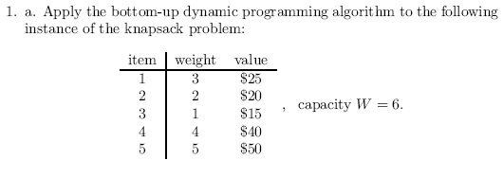
Exercise
P303 8.2.1 (a).
How to find out which items are in the optimal subset?

Slide 62
Matrix Chain multiplication Basics
Matrix Chain Multiplication Example

