Slide 1
Design and Analysis and of Algorithms

Slide 2
Agenda – session 8
Ordered Dictionary: ADT, Applications
Bloom Filters –
Motivation, Properties and Operations
Types of Bloom Filters, Applications

Slide 3
The Dictionary ADT
Definition A dictionary is an ordered or unordered list of key-element pairs,
where keys are used to locate elements in the list.
Example: consider a data structure that stores bank accounts; it can be viewed as a dictionary, where account numbers serve as keys for identification of account objects.
Operations (methods) on dictionaries:
size () Returns the size of the dictionary
empty () Returns true is the dictionary is empty
findItem (key) Locates the item with the specified key. If
no such key exists, sentinel value NO_SUCH_KEY is returned. If more
than one item with the specified key exists, an arbitrary item is returned.
findAllItems (key) Locates all items with the specified key. If
no such key exists, sentinel value NO_SUCH_KEY is returned.
removeItem (key) Removes the item with the specified key
removeAllItems (key) Removes all items with the specified key
insertItem (key, element) Inserts a new key-element pair

Slide 4
Additional methods for ordered dictionaries
closestKeyBefore (key) Returns the key of the item with largest key
less than or equal to key
closestElemBefore (key) Returns the element for the item with largest
key less than or equal to key
closestKeyAfter (key) Returns the key of the item with smallest
key greater than or equal to key
closestElemAfter (key) Returns the element for the item with smallest
key greater than or equal to key
Sentinel value NO_SUCH_KEY is always returned if no item in the dictionary
satisfies the query.
Note Java has a built-in abstract class java.util.Dictionary In this class,
however, having two items with the same key is not allowed. If an application
assumes more than one item with the same key, an extended version of the
Dictionary class is required.

Slide 5
Example of unordered dictionary
Consider an empty unordered dictionary and the following set of operations:
Operation Dictionary Output
insertItem(5,A) {(5,A)}
insertItem(7,B) {(5,A), (7,B)}
insertItem(2,C) {(5,A), (7,B), (2,C)}
insertItem(8,D) {(5,A), (7,B), (2,C), (8,D)}
insertItem(2,E) {(5,A), (7,B), (2,C), (8,D), (2,E)}
findItem(7) {(5,A), (7,B), (2,C), (8,D), (2,E)} B
findItem(4) {(5,A), (7,B), (2,C), (8,D), (2,E)} NO_SUCH_KEY
findItem(2) {(5,A), (7,B), (2,C), (8,D), (2,E)} C
findAllItems(2) {(5,A), (7,B), (2,C), (8,D), (2,E)} C, E
size() {(5,A), (7,B), (2,C), (8,D), (2,E)} 5
removeItem(5) {(7,B), (2,C), (8,D), (2,E)} A
removeAllItems(2) {(7,B), (8,D)} C, E
findItem(4) {(7,B), (8,D)} NO_SUCH_KEY

Slide 6
Example of ordered dictionary
Consider an empty ordered dictionary and the following set of operations:
Operation Dictionary Output
insertItem(5,A) {(5,A)}
insertItem(7,B) {(5,A), (7,B)}
insertItem(2,C) {(2,C), (5,A), (7,B)}
insertItem(8,D) {(2,C), (5,A), (7,B), (8,D)}
insertItem(2,E) {(2,C), (2,E), (5,A), (7,B), (8,D)}
findItem(7) {(2,C), (2,E), (5,A), (7,B), (8,D)} B
findItem(4) {(2,C), (2,E), (5,A), (7,B), (8,D)} NO_SUCH_KEY
findItem(2) {(2,C), (2,E), (5,A), (7,B), (8,D)} C
findAllItems(2) {(2,C), (2,E), (5,A), (7,B), (8,D)} C, E
size() {(2,C), (2,E), (5,A), (7,B), (8,D)} 5
removeItem(5) {(2,C), (2,E), (7,B), (8,D)} A
removeAllItems(2) {(7,B), (8,D)} C, E
findItem(4) {(7,B), (8,D)} NO_SUCH_KEY

Slide 7
Implementations of the Dictionary ADT
Dictionaries are ordered or unordered lists. The easiest way to implement a list is by means of an ordered or unordered sequence.
Unordered sequence implementation Items are added to the initially empty dictionary as they arrive. insertItem(key, element) method is O(1) no matter whether the new item is added at the beginning or at the end of the dictionary. findItem(key), findAllItems(key), removeItem(key) and removeAllItems(key) methods, however, have O(n) efficiency. Therefore, this implementation is appropriate in applications where the number of insertions is very large in comparison to the number of searches and removals.
Ordered sequence implementation Items are added to the initially empty dictionary in nondecreasing order of their keys. insertItem(key, element) method is O(n), because a search for the proper place of the item is required. If the sequence is implemented as an ordered array, removeItem(key) and removeAllItems(key) take O(n) time, because all items following the item removed must be shifted to fill in the gap. If the sequence is implemented as a doubly linked list , all methods involving search also take O(n) time.
Therefore, this implementation is inferior compared to unordered sequence implementation. However, the efficiency of the search operation can be considerably improved, in which case an ordered sequence implementation will become a better choice.

Slide 8
Implementations of the Dictionary ADT (contd.)
Array-based ranked sequence implementation A search for an item in a sequence by its rank takes O(1) time. We can improve search efficiency in an ordered dictionary by using binary search; thus improving the run time efficiency of insertItem(key, element), removeItem(key) and removeAllItems(key) to O(log n).
More efficient implementations of an ordered dictionary are binary search trees and AVL trees which are binary search trees of a special type. The best way to implement an unordered dictionary is by means of a hash table.

Slide 9

Recall Arrays …
Unordered array
searching and removing takes O(n) time
inserting takes O(1) time
applications to log files (frequent insertions, rare searches and removals)
Note: though a hash table is generally O(1), the actual situation may show that a O(log N) structure can outperform it, or even in some select cases a O(N) structure could outperform all.

Slide 10
More Arrays
Ordered array
searching takes O(log n) time (binary search)
inserting and removing takes O(n) time
application to look-up tables (frequent searches, rare insertions and removals)
Apply binary search

Slide 11
Binary Searches
narrow down the search range in stages
“high-low” game
findElement(22)

Slide 12
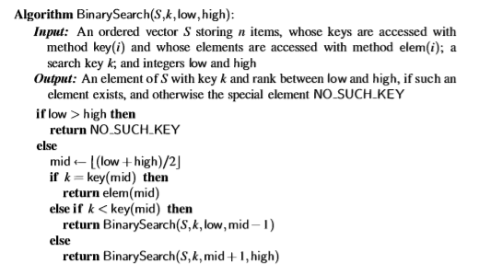

Slide 13
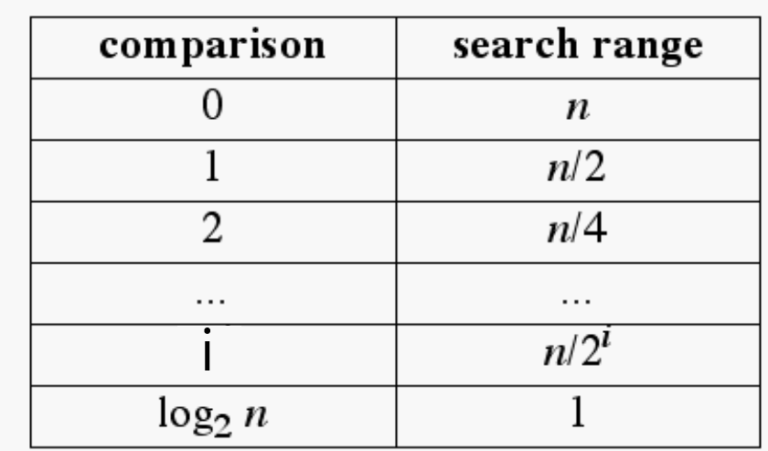
Running Time of Binary Search
The range of candidate items to be searched is halved after each comparison

Slide 14
Bloom Filters –
Motivation, Properties and Operations
Types of Bloom Filters, Applications

Slide 15
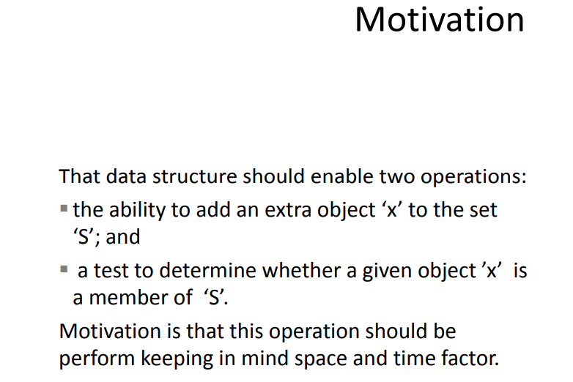

Slide 16
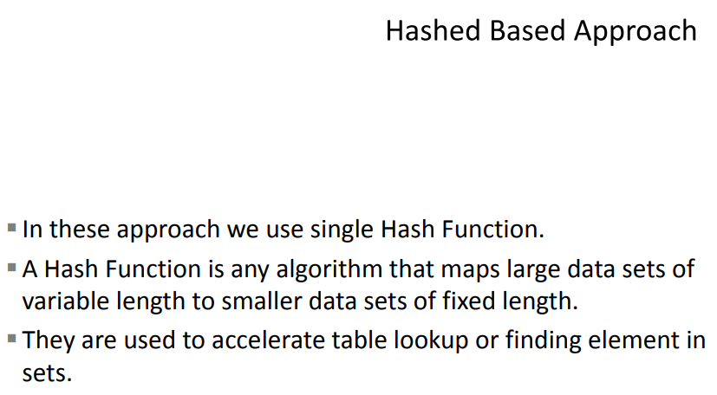

Slide 17
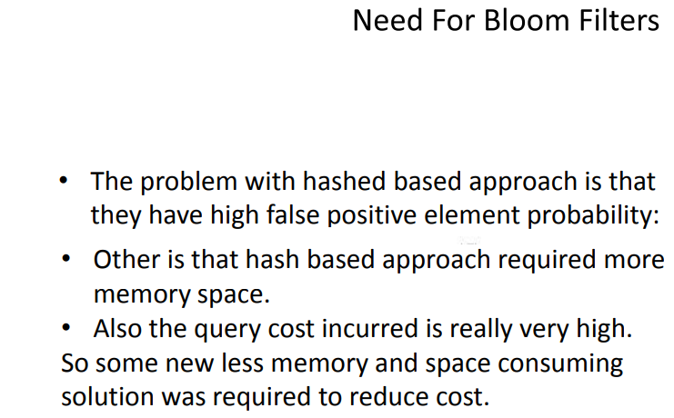

Slide 18
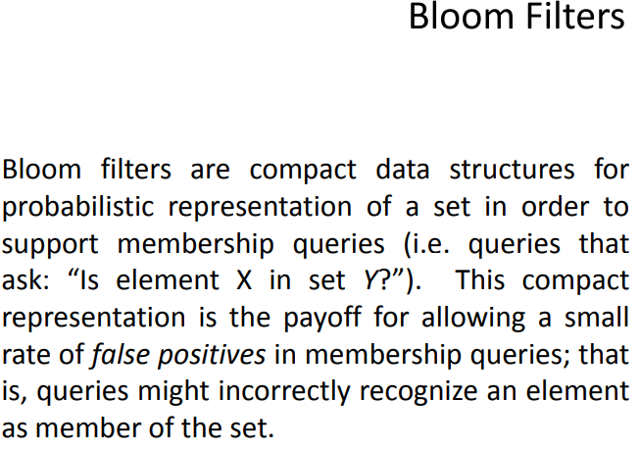

Slide 19
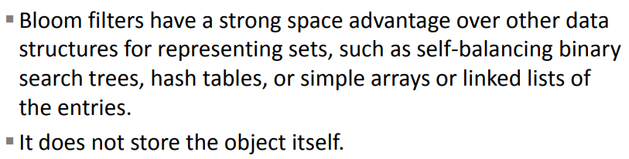

Slide 20
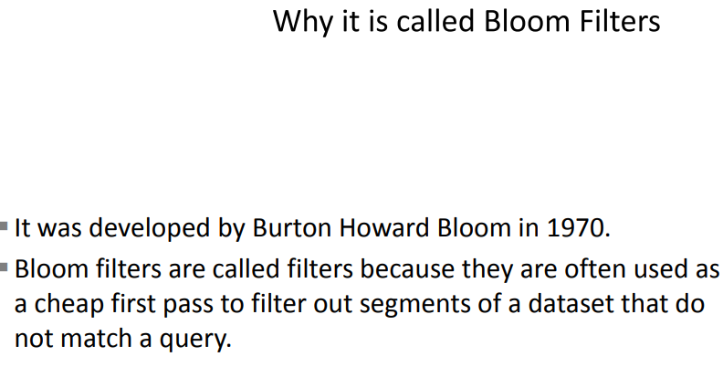

Slide 21
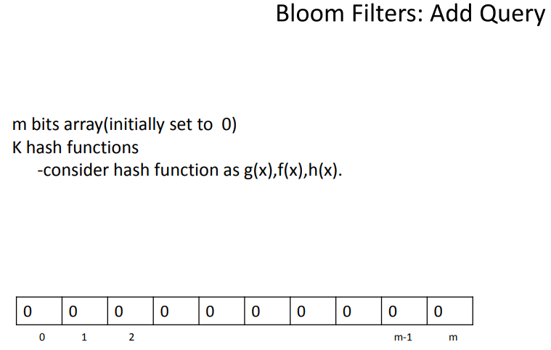

Slide 22
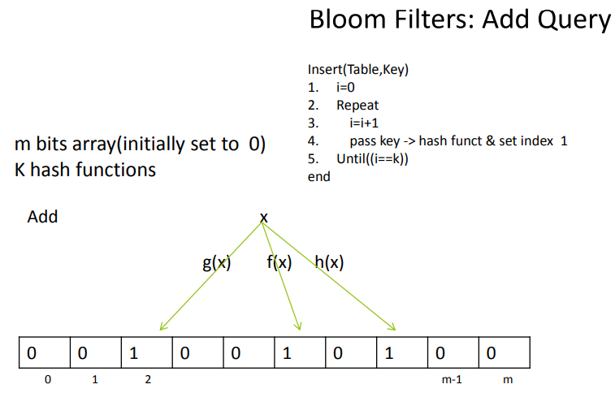

Slide 23
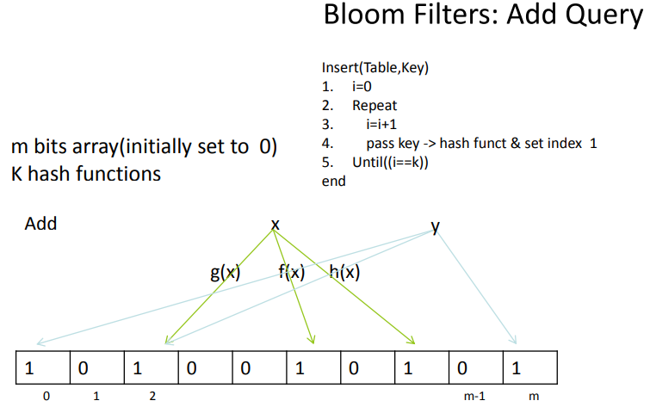

Slide 24
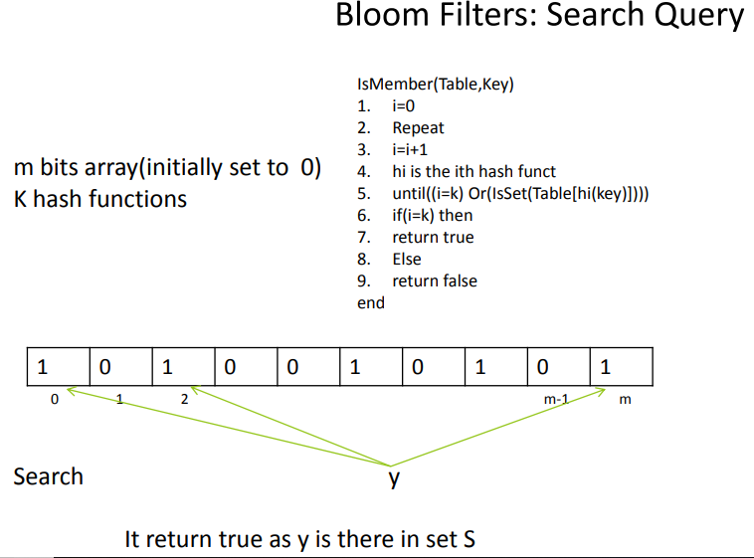

Slide 25
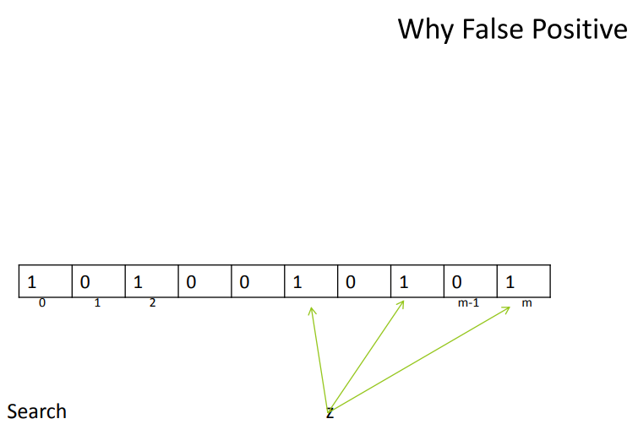

Slide 26
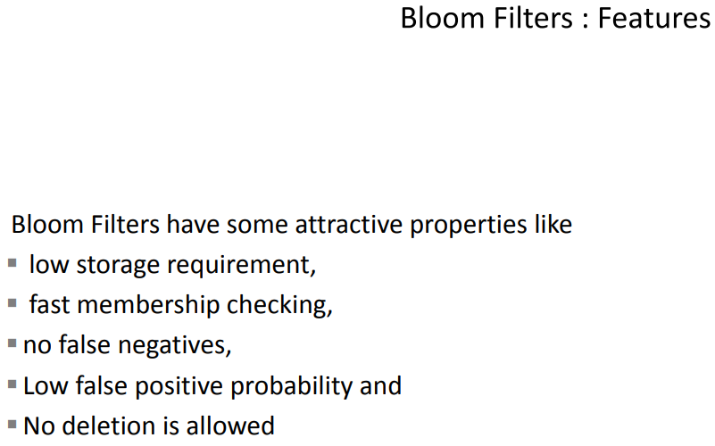

Slide 27
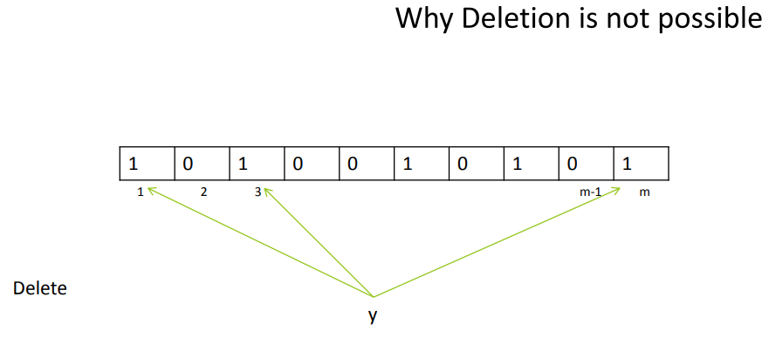

Slide 28
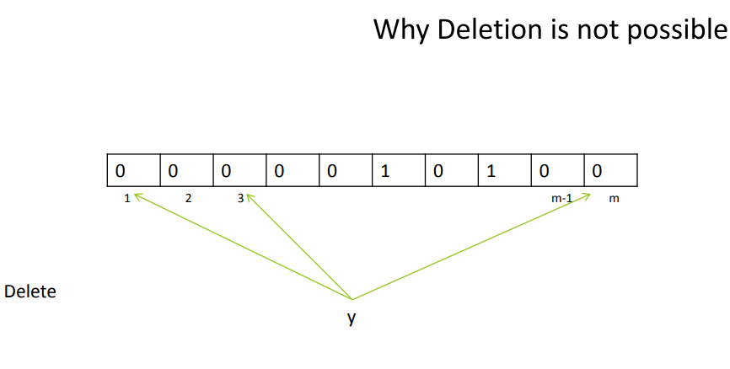

Slide 29
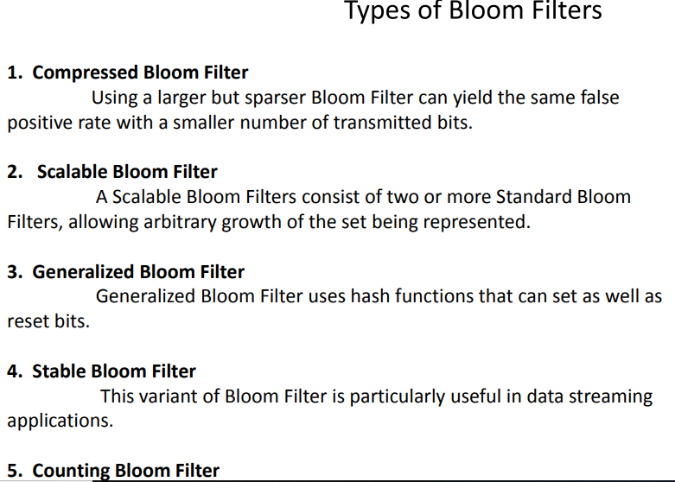

Slide 30
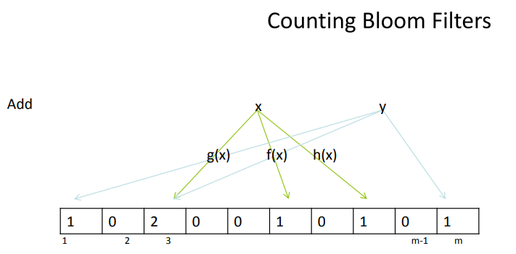

Slide 31
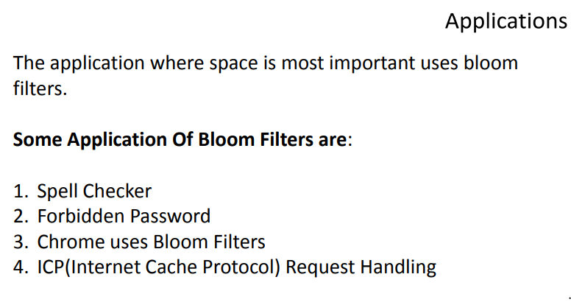

Slide 32
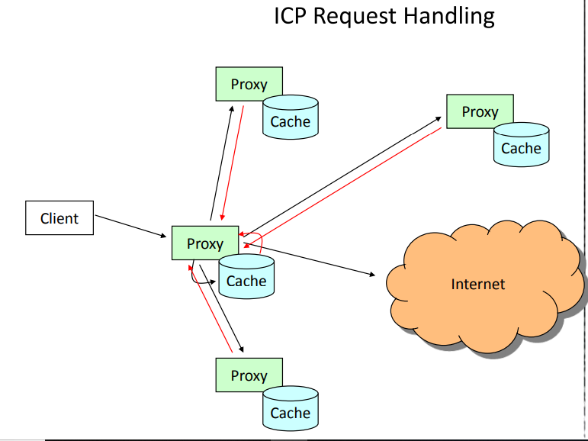

Slide 33
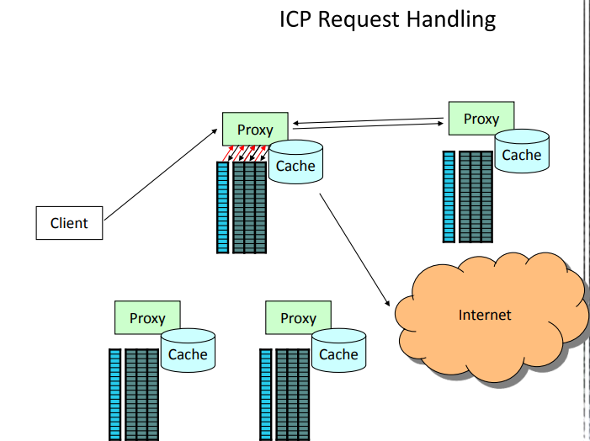

Slide 34
Thanks!!!
Queries?

