Slide 1
Data Structures and Algorithm Design

Slide 2
Agenda – session 9
What is BST
BST-Search(Algorithm -analysis)
BST-Insertion(Algorithm -analysis)
BST-Deletion(Algorithm -analysis)
Balanced Tree
Rank,Find k-th smallest element in BST
Range query
Range Search – Example
BST-Few applications
k-d Trees

Slide 3
Quick Revision

Slide 4
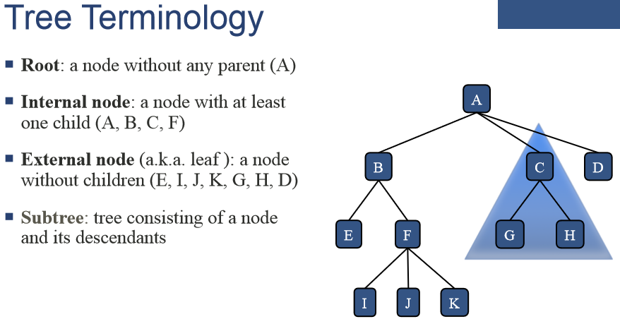

Slide 5
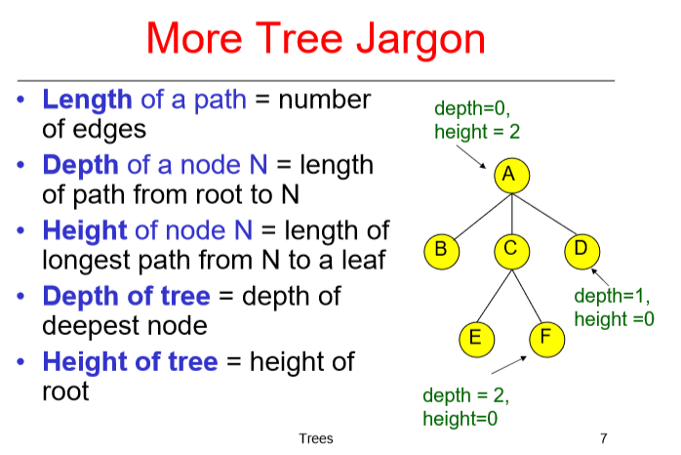

Slide 6
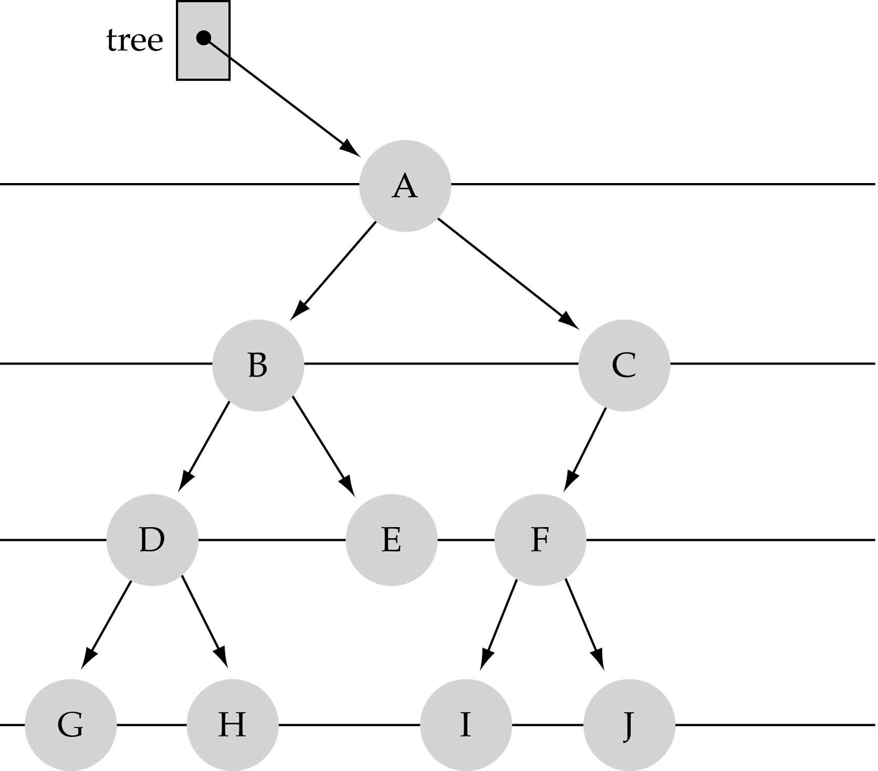
What is a Binary Tree?
Each node can have up to two successor nodes.

Slide 7
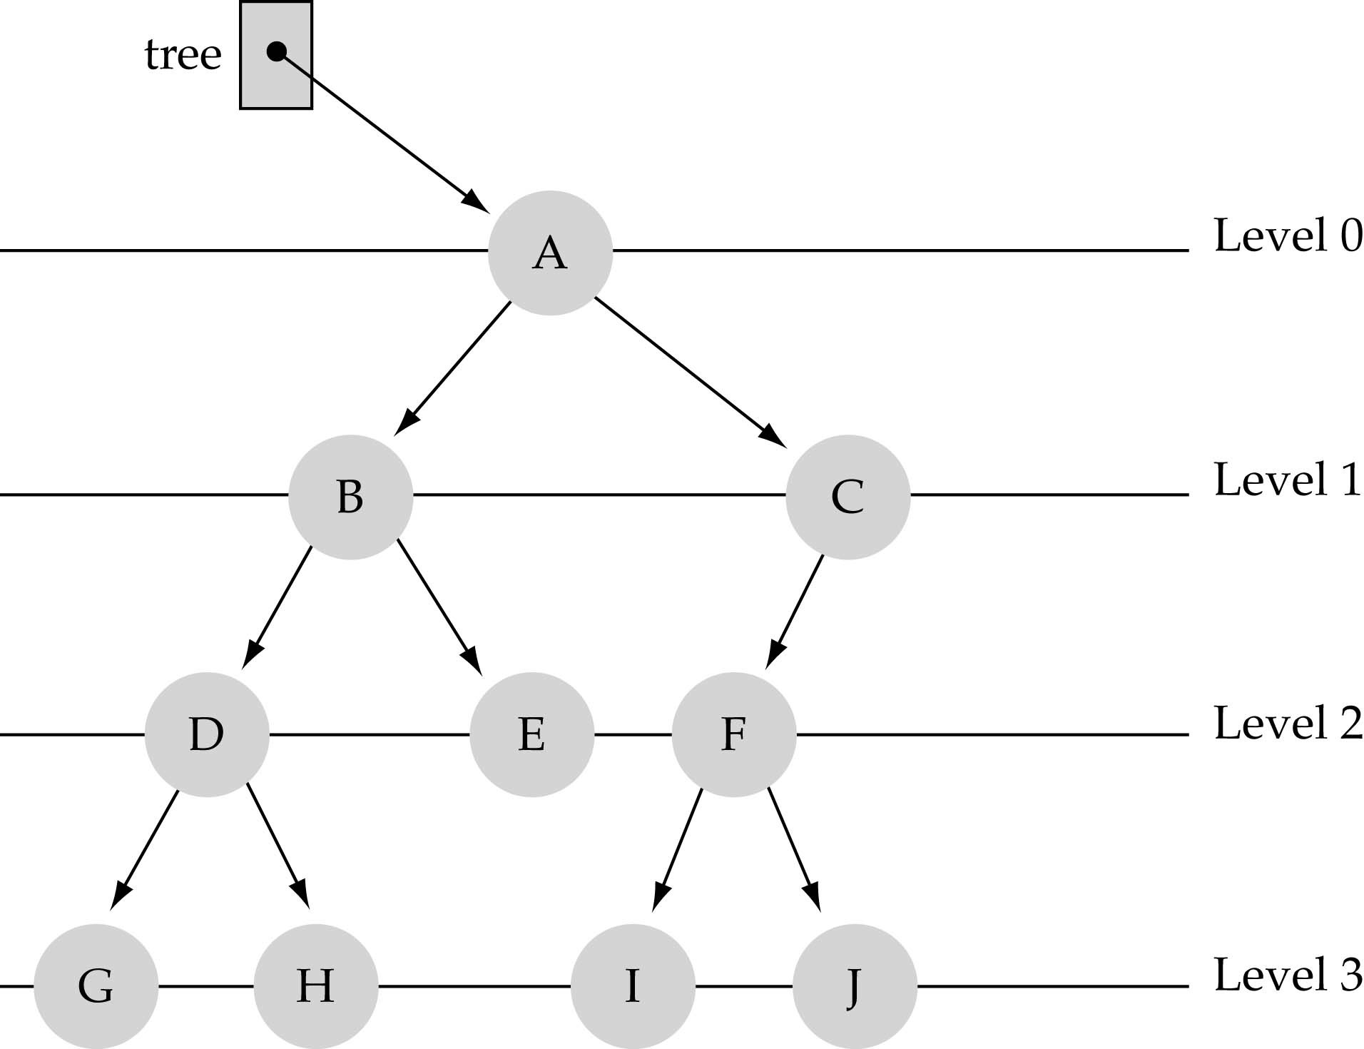
Basic Terminology
Nodes are organized in levels (indexed from 0).
Level (or depth) of a node: number of edges in the path from the root to that node.
not full!

Slide 8

There is a difference between a STRICT, COMPLETE and FULL BINARY TREE.
FULL BINARY TREE: A binary tree of height h that contains exactly (2^{h+1})-1 elements is called a full binary tree.
or in other words
In a FULL BINARY TREE each node has exactly 0 or 2 children and all leaf nodes are on the same level.
For Example: The following is a FULL BINARY TREE:

Slide 9


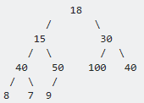
2) STRICT BINARY TREE: Each node has exactly 0 or 2 children.
For example: The following is a STRICT BINARY TREE:
3) COMPLETE BINARY TREE: A Binary Tree is complete Binary Tree if all levels are completely filled except possibly the last level and the last level has all keys as left as possible.
For Example: The following is a COMPLETE BINARY TREE:

Slide 10
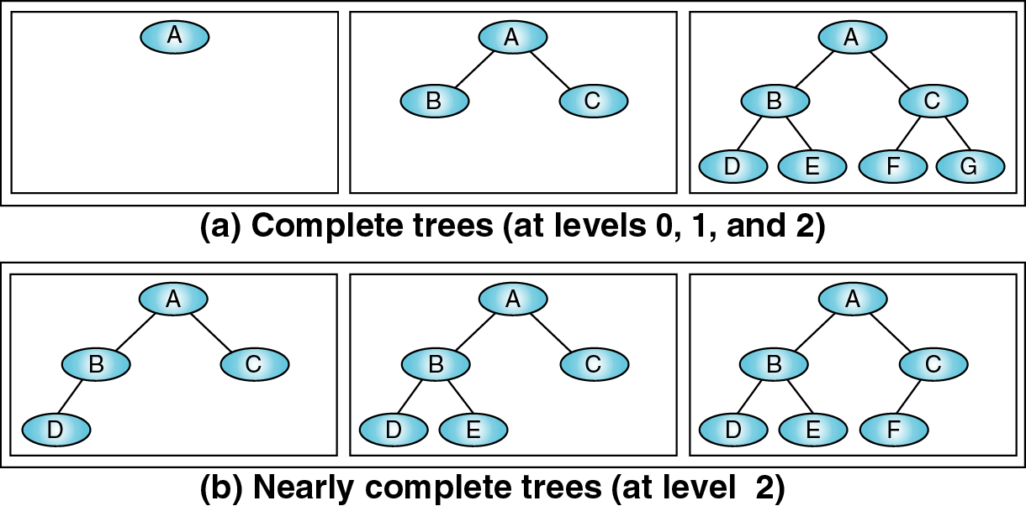
Binary Trees
A complete tree has the maximum number of entries for its height. N_{max} = 2^{H}-1 (H- Height of the tree +1)
The distance of a node from the root determines how efficiently it can be located.
The “balance factor” show that the balance of the tree.
B = H_{L} – H_{R}
If B = 0, 1 or -1; the tree is balanced.

Slide 11
What is the height H
of a full tree with N nodes?
₂H
−1 = N
⇒ 2^{H} = N + 1
⇒ H = log(N + 1) → O(log N )

Slide 12
Why is h important?
The Tree operations like insert, delete, retrieve etc. are typically expressed in terms of the height of the tree h.
So, it can be stated that the tree height h determines running time!

Slide 13
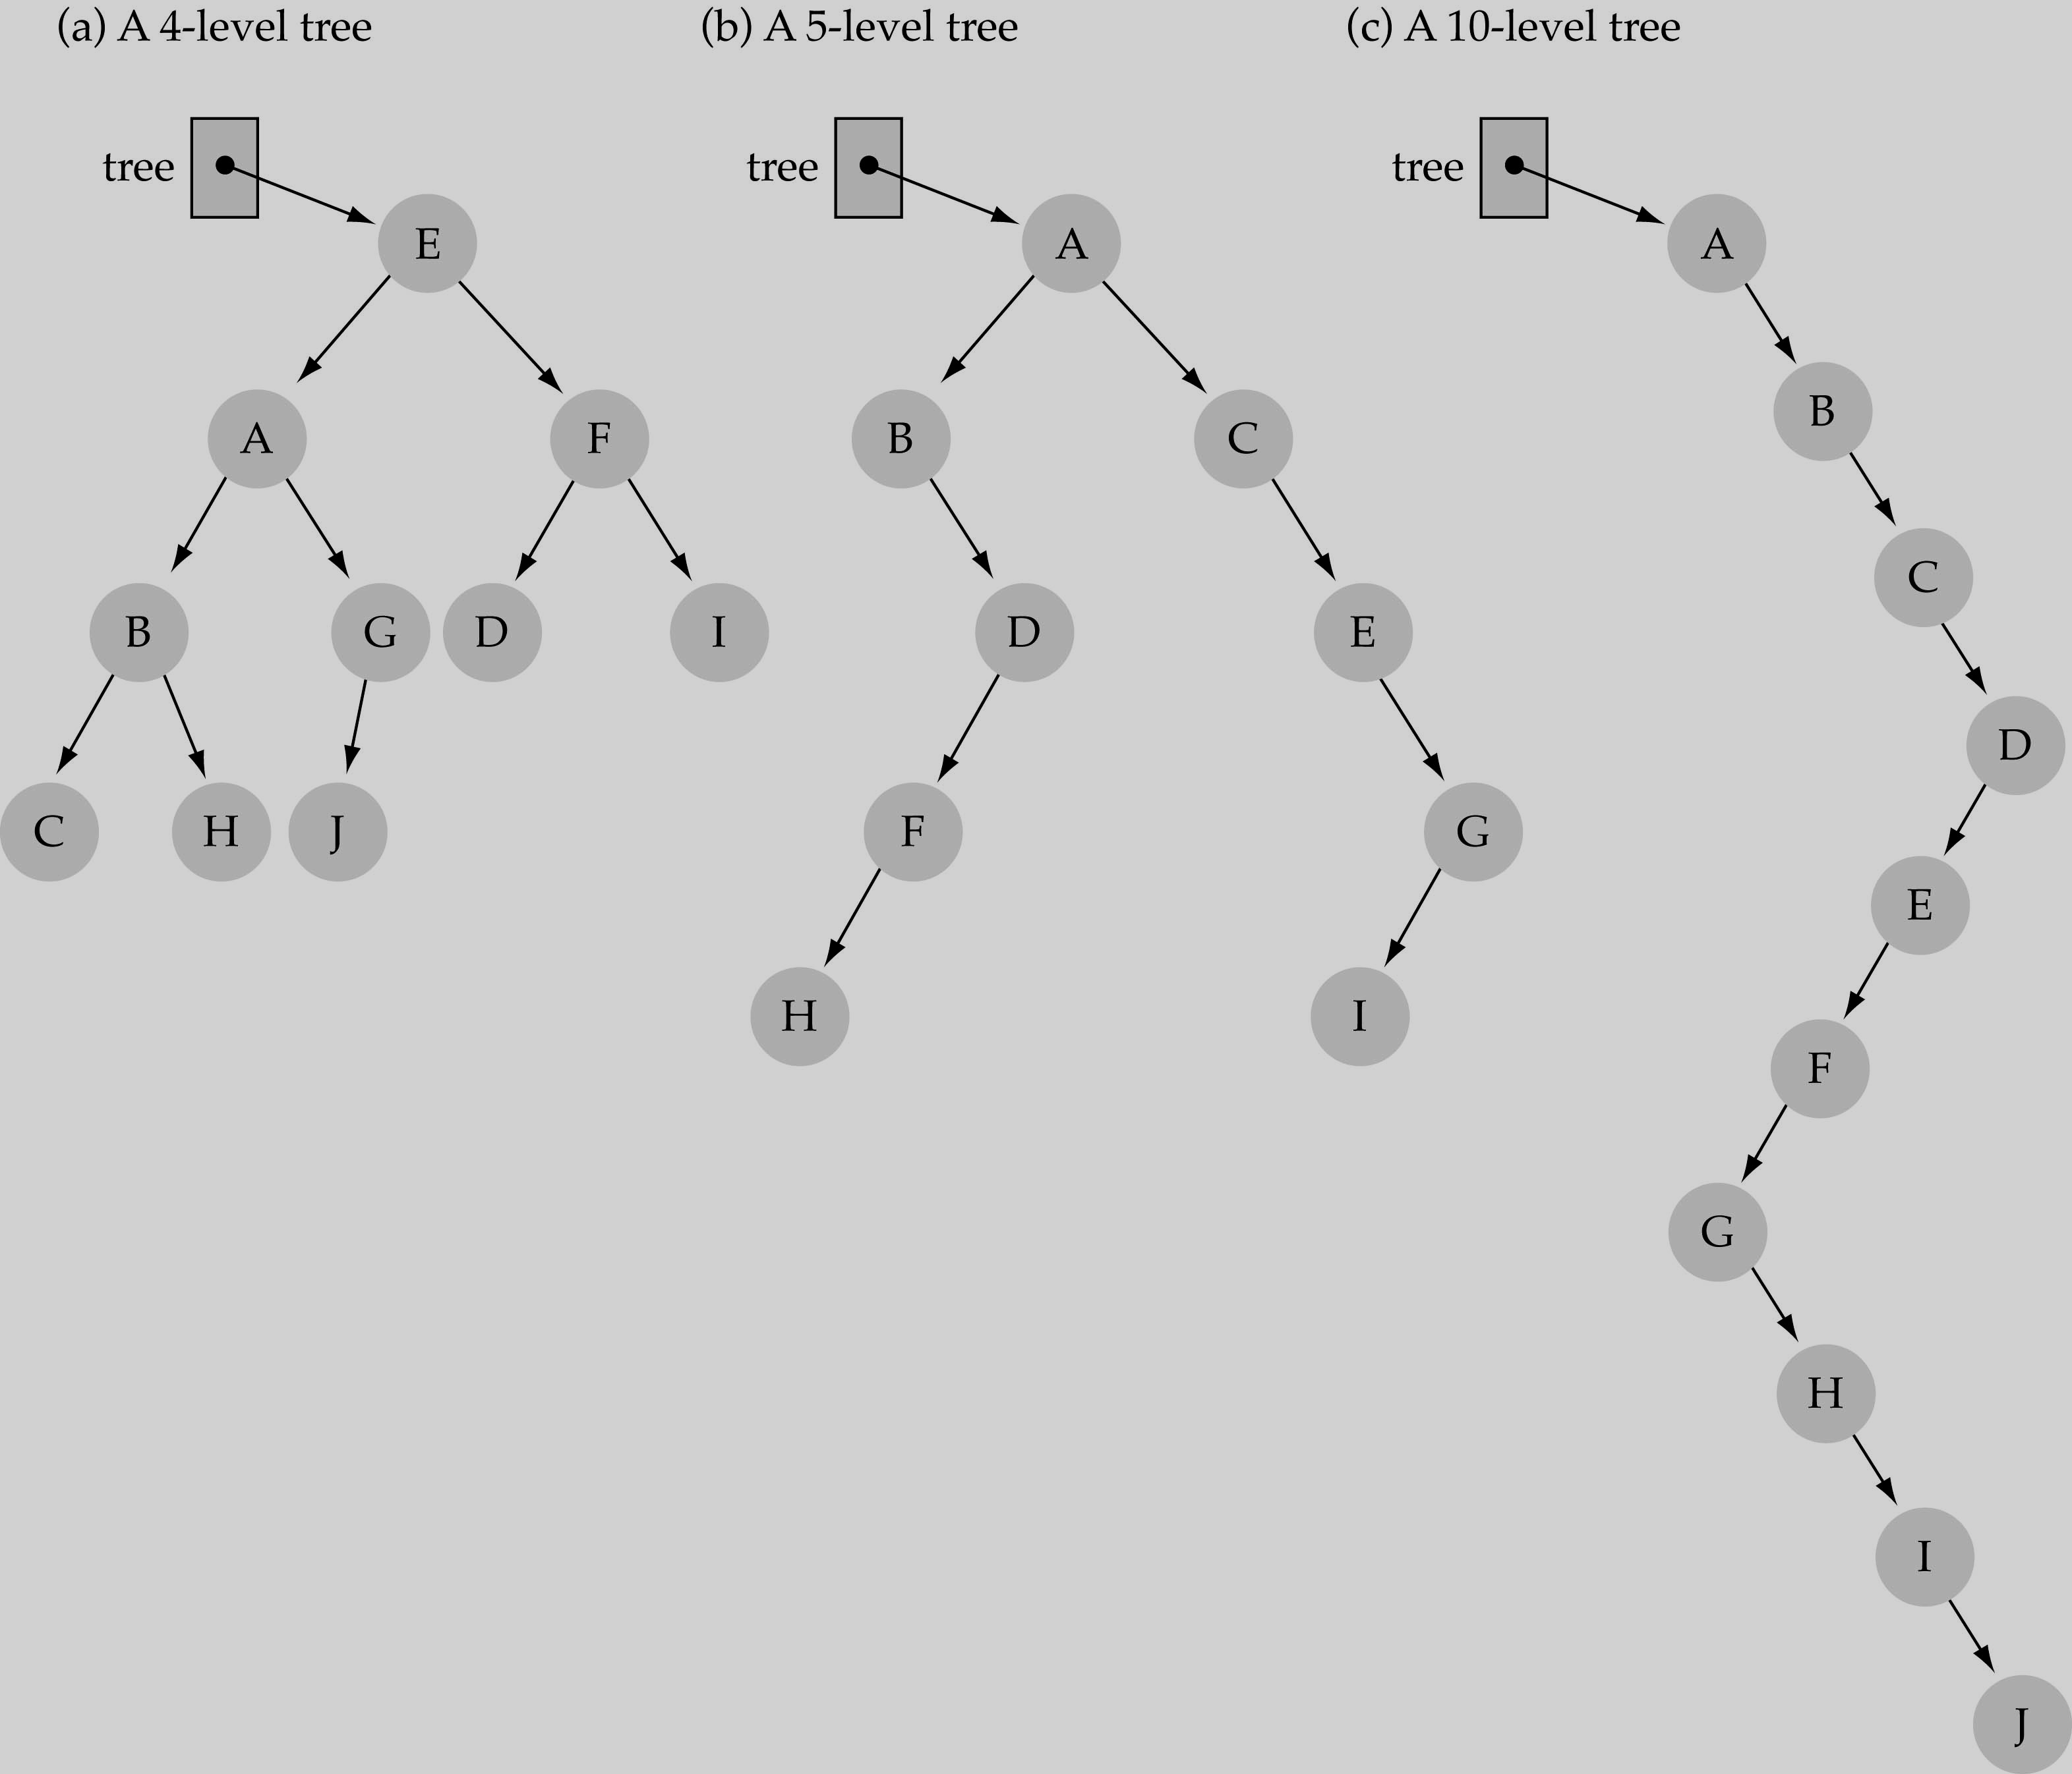
What is the max height of a tree with N nodes?
N (same as a linked list)
What is the min height of a tree with N nodes?
log(N)

Slide 14
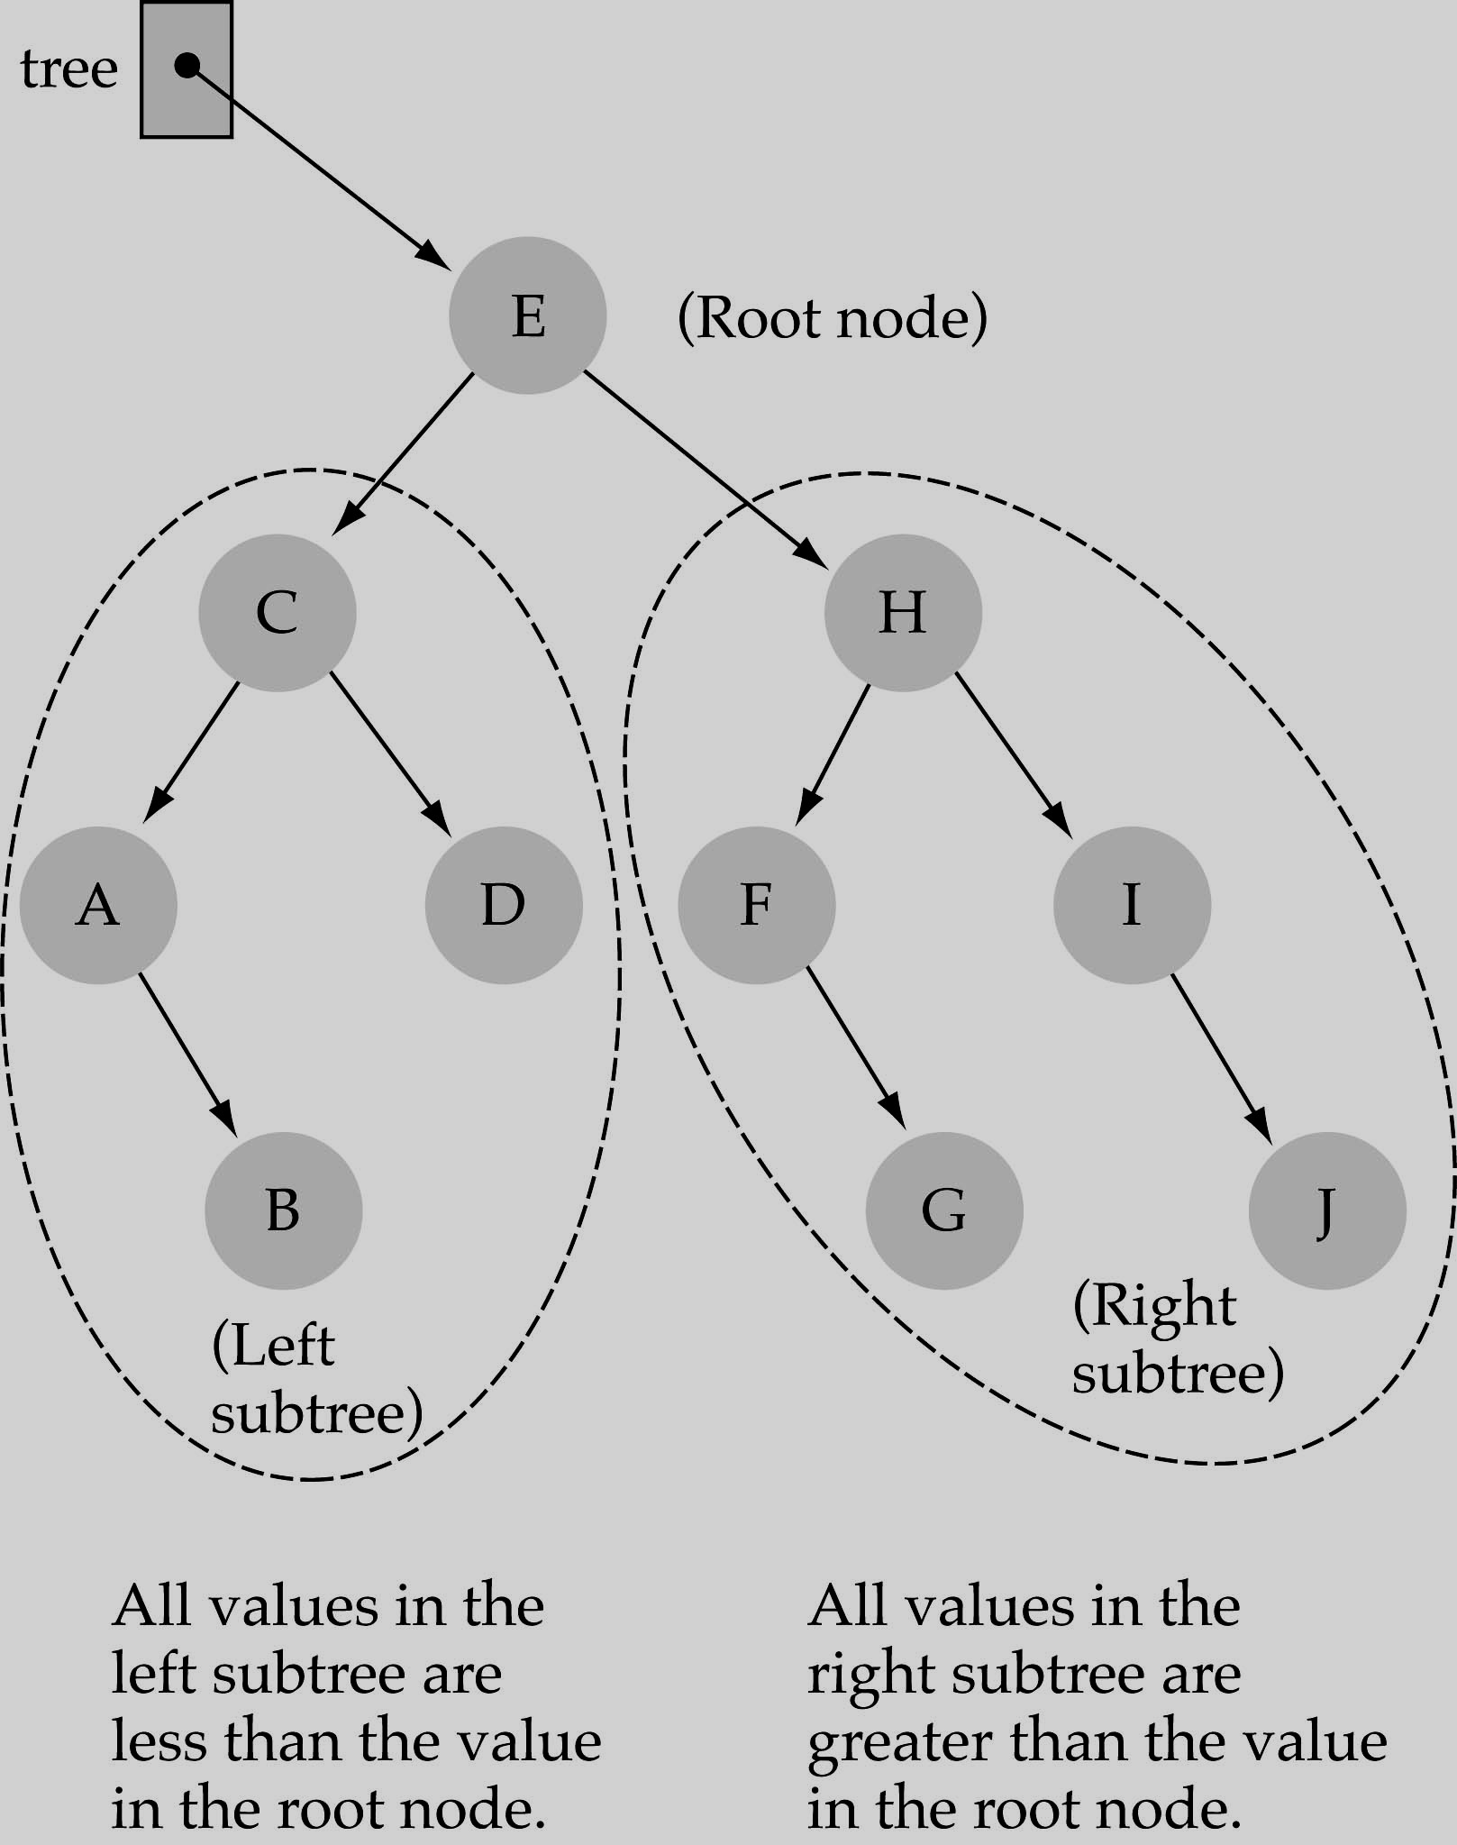
Binary Search Trees
♣ Binary Search Tree Property:
The value stored at
a node is greater than the value stored at its
left child and less than the value stored at its
right child

Slide 15
Binary Search Trees
♣
In a BST, the value stored at the root of a subtree is greater than any value in its left subtree and less than any value in its right subtree!

Slide 16
Binary Search Trees
Where is the smallest element?
Ans: leftmost element
Where is the largest element?
Ans: rightmost element

Slide 17
How to search a binary search tree?
Start at the root
Compare the value of the item you are searching for with the value stored at the root
If the values are equal, then item found; otherwise, if it is a leaf node, then not found

Slide 18
How to search a binary search tree?
If it is less than the value stored at the root, then search the left subtree
If it is greater than the value stored at the root, then search the right subtree
Repeat steps 2-6 for the root of the subtree chosen in the previous step 4 or 5

Slide 19
How to search a binary search tree?
Is this better than searching a linked list?
Yes !! ◊ ◊ O(logN)

Slide 20
Difference between BT and BST
A binary tree is simply a tree in which each node can have at most two children.
A binary search tree is a binary tree in which the nodes are assigned values, with the following restrictions :
No duplicate values.
The left subtree of a node can only have values less than the node
The right subtree of a node can only have values greater than the node and recursively defined
The left subtree of a node is a binary search tree.
The right subtree of a node is a binary search tree.

Slide 21
Binary Tree Search Algorithm
Let x be a node in a binary search tree and k is the value, we are supposed to search.
Then according to the binary search tree property we know that: if y is a node in the left subtree of x, then y.key <= x.key. If y is a node in the right subtree of x, then y.key>=x.key. (x.key denotes the value at node x)
To search the location of given data k, the binary search tree algorithm begins its search at the root and traces the path downward in the tree.
For each node x it compares the value k with x.key. If the values are equal then the search terminates and x is the desired node.

Slide 22
Binary Tree Search Algorithm
If k is smaller than x.key, then the search continues in the left subtree of x, since the binary search tree property implies that k could not be in the right subtree.
Symmetrically, if k is larger than x.key, then the search continues in the right subtree.
The nodes encountered during the recursion form a simple path downward from the root of the tree, and thus the running time of TREE-SEARCH is O(h), where h is the height of the tree.

Slide 23
Binary Tree Search Algorithm
TREE-SEARCH(x,k)
If x==NIL or k==x.key
return x
If k < x.key
4. return TREE-SEARCH(x.left,k) 5.else return TREE-SEARCH(x.right,k)

Slide 24
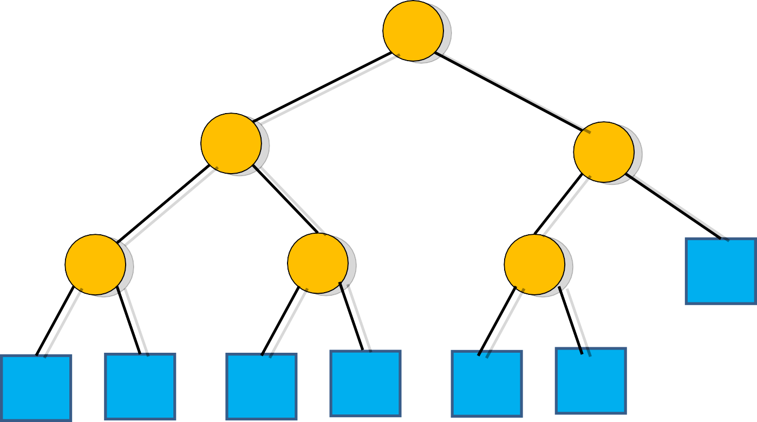
Binary Tree Search Algorithm
Example: key =4 then find(4)
6
Call TREE-SEARCH(x,k)
2
9
1
4
8

Slide 25
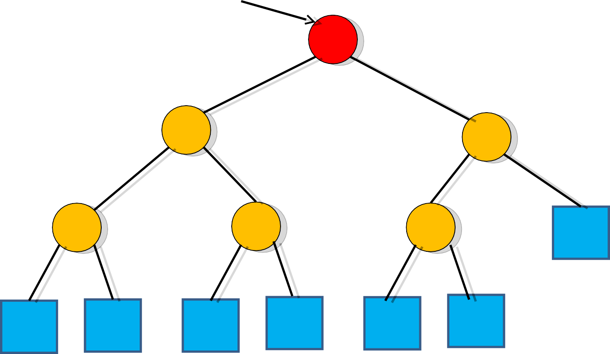
Binary Tree Search Algorithm
x=root
Example: k =4 and x=root
Call TREE-SEARCH(root,4) Now x.key=6 then k<x.key
So call TREE-SEARCH(x.left,k)
9
6
2
1
4
8

Slide 26
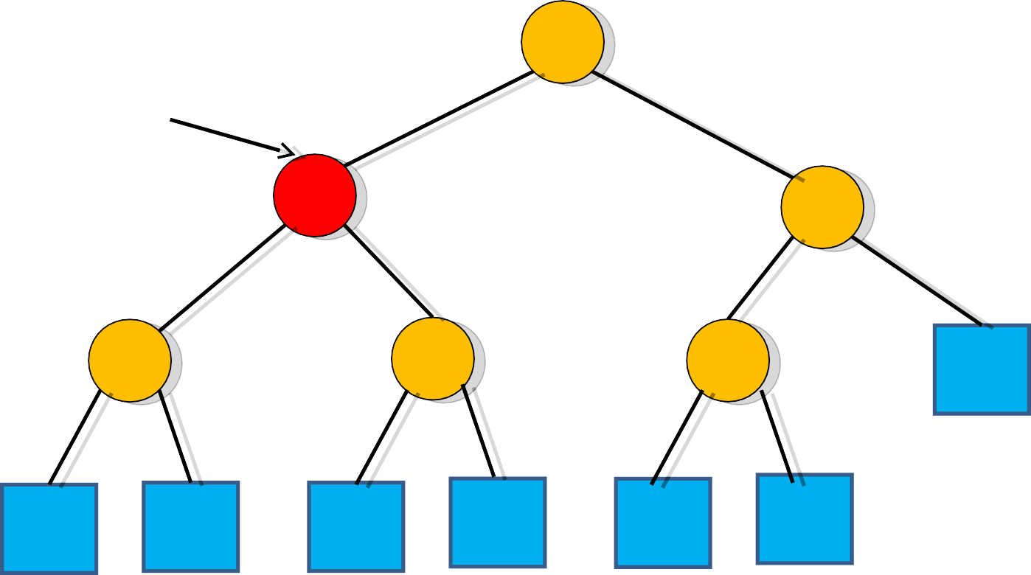
Binary Tree Search Algorithm
Example: k =4 and x=root.left Call TREE-SEARCH(x,4)
6
x=root.left
Now x.key=2 then k>x.key TREE-SEARCH(x.right,k)
9
2
1
4
8

Slide 27
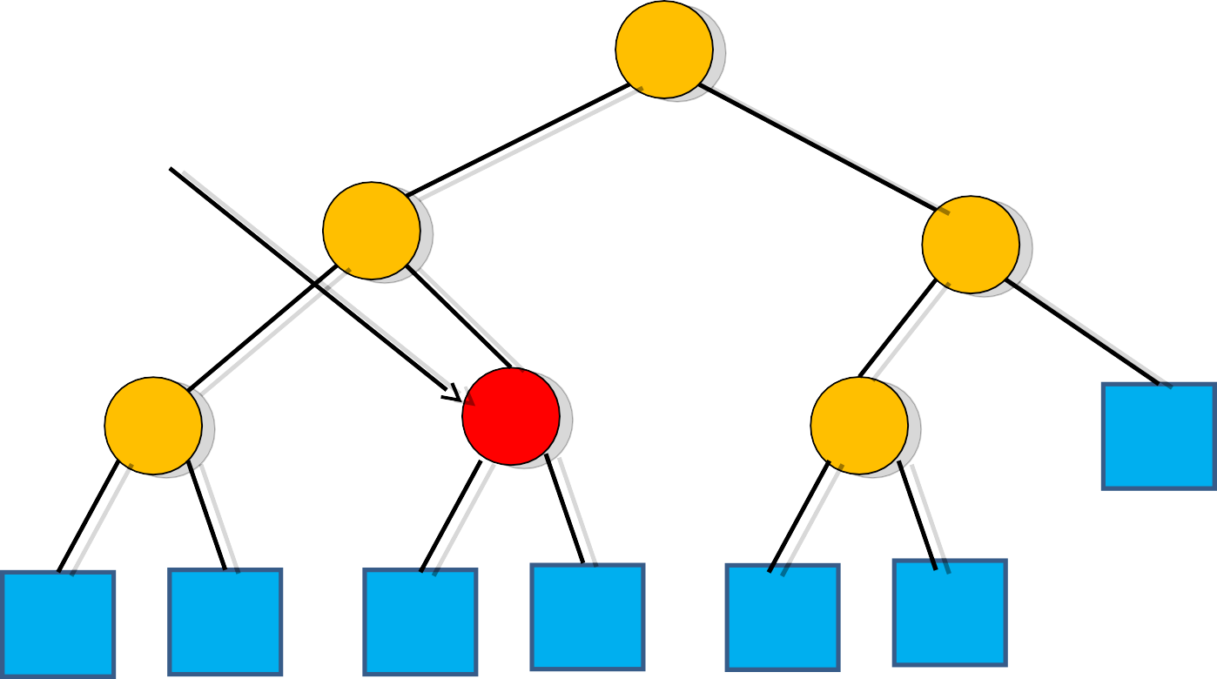
Binary Tree Search Algorithm
Example: k =4 and x=root.left.right Call TREE-SEARCH(x,4)
6
x=root.left.right
2
Now x.key=4 then k=x.key Search terminates
9
1
4
8

Slide 28
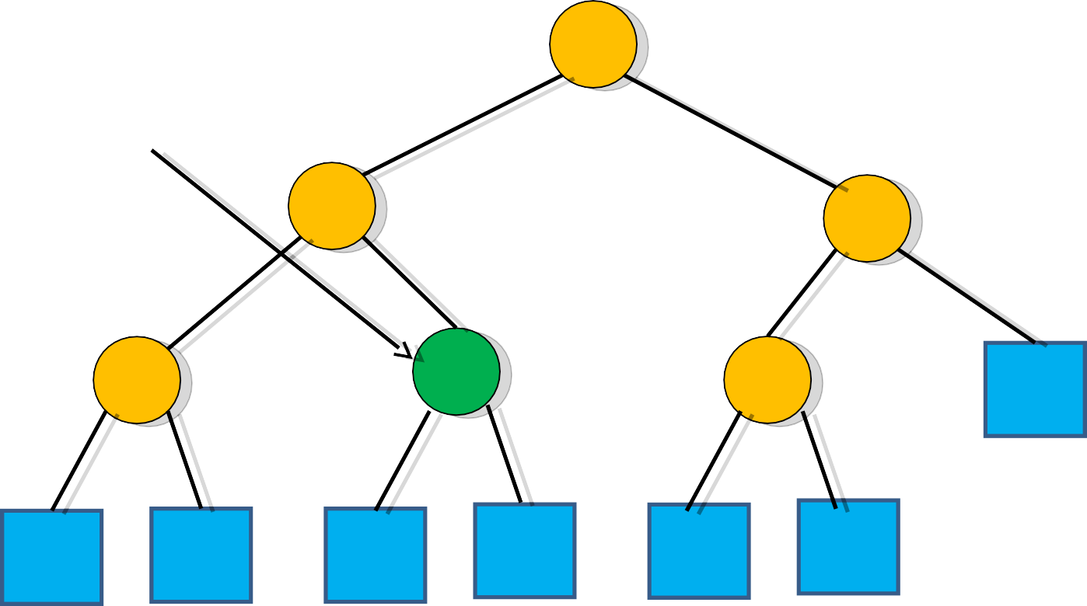
Binary Tree Search Algorithm
Example: k =4 and x=root.left.right Now x.key=4 then k=x.key
6
x=root.left.right
2
Search terminates and x=root.left.right is the desired
node or location
9
1
4
8

Slide 29
BST – algorithm
if the tree is empty
return NULL
else if the key value in the node(root) equals the target return the node value
else if the key value in the node is greater than the target return the result of searching the left subtree
else if the key value in the node is smaller than the target return the result of searching the right subtree

Slide 30
Minimum Key or Element
We can always find an element in a binary search tree whose key is minimum by following the left children from the root until we encounter a NIL.
Otherwise if a node x has no left subtree then the value x.key contained in root x is the minimum key or element. The procedure for finding the minimum key:
TREE-MINIMUM(x)
while x.left ≠ NIL
x = x.left
return x

Slide 31
Maximum Key or Element
We can always find an element in a binary search tree whose key is maximum by following the right children from the root until we encounter a NIL.
Otherwise if a node x has no right subtree then the value x.key contained in root x is the maximum key or element. The procedure for finding the maximum key:
TREE-MAXIMUM(x)
while x.right ≠ NIL
x = x.right
return x

Slide 32
Insert a value into the BST
To insert a new value v into a binary search tree T, we use the procedure TREE-INSERT.
The procedure takes a node z for which z.key=v , z.left=NIL and z.right=NIL.
It modifies T and some of the attributes of z in such a way that it inserts z into an appropriate position in the tree

Slide 33
Insert a value into the BST
♣ Suppose v is the value we want to insert and z is the node (New or NIL) we are supposed to find to insert the value v.
z.p denotes the parent of z.
X is a pointer that traces a simple path downward the tree and y is the trailing pointer as the parent of x. T.root denote the root of the tree.
Now the intention is to find a new or NIL node that will satisfy the BST property after placing the value v. The procedure first consider x as the root of the tree thus the parent of the root y=NIL.
In steps 3 to 7 the procedure causes the two pointer y and x to move down the tree, going left or right depending on the comparison of z.key with x.key, until x becomes NIL.

Slide 34
Insert a value into the BST
Now this NIL occupies the position z, where we wish to place the input item.
At this time we need y the parent of the desired node. This is why at step four we always storing the parent of current node x while moving downward. At the end of step 7 (in step 8) we make this node the parent of z (z.p).
From steps 9 to 11:
Now if tree is empty (y==NIL) then create a root node with the new key(T.root=z)
If the value v is less than the value of the parent(z.key<y.key) then make it as the left-child of the parent(y.left=z)
If the value v is greater than the value of the parent(z.key>y.key) then make it as the right-child of the parent(y.right=z)

Slide 35
Insert a value into the BST
TREE-INSERT(T , z)
y=NIL
x= T.root
While x ≠ NIL
4.
5.
6.
7.
8. z.p=y
y=x
if z.key<x.key x=x.left
else x=x.right
if y== NIL
T.root = z
elseif z.key < y.key
12. y.left=z
13. else y.right = z

Slide 36
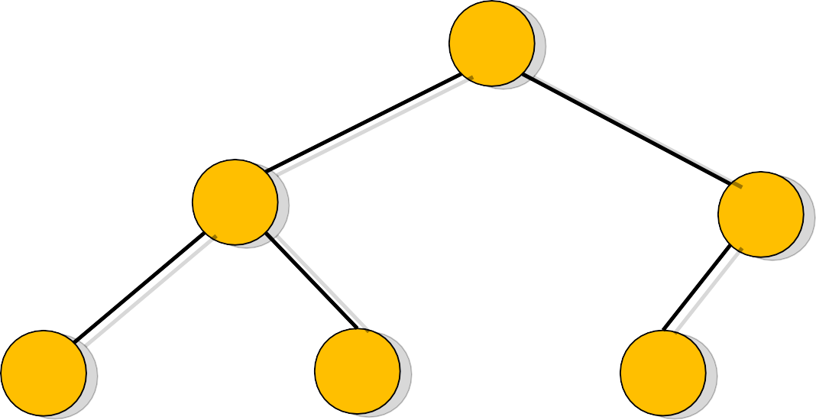
BST Insertion Algorithm
We are supposed to insert
6
an item value 5 and find an appropriate node z for it
9
2
11
4
8

Slide 37
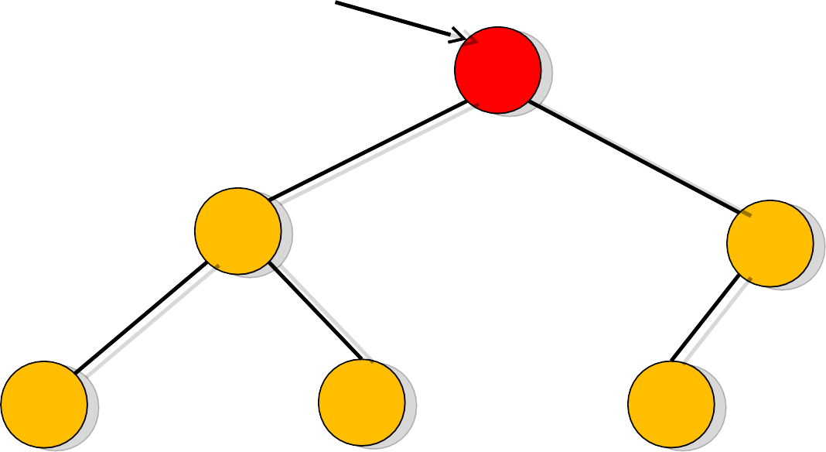
BST Insertion Algorithm
x=T.root
Y=NIL and x=T.root
6
2
9
11
4
8

Slide 38
BST Insertion Algorithm
x=T.root
Now x≠NIL and z.key<x.key
6
That is [5<6]
2
9
11
4
8

Slide 39
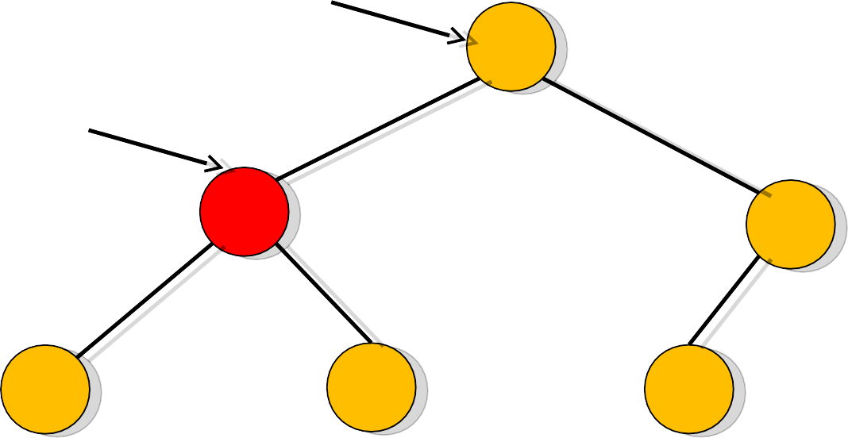
BST Insertion Algorithm
y
Y=T.root and x=T.root.left And z.key>x.key[5>2]
6
x
2
9
1
4
8

Slide 40
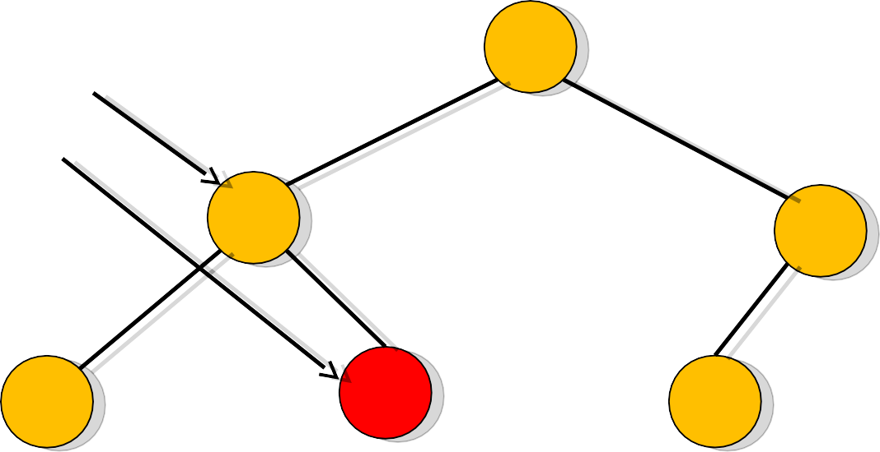
BST Insertion Algorithm
Y=T.root.left and
y x
6
x=T.root.left.right And z.key>x.key[5>4]
9
2
1
4
8

Slide 41
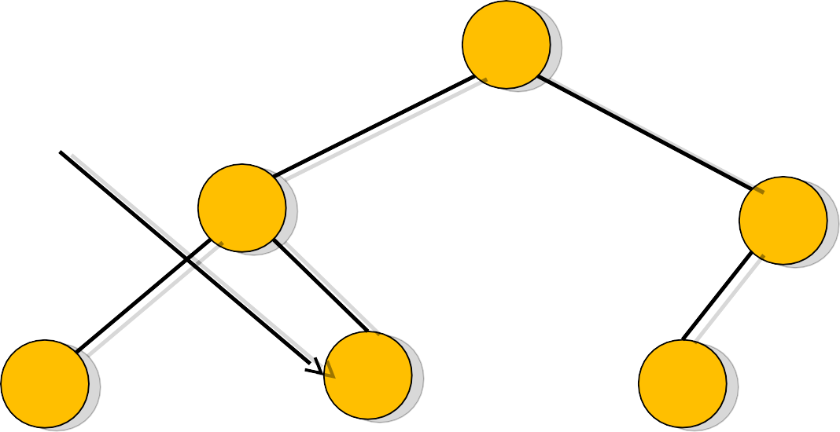
BST Insertion Algorithm
Y=T.root.left.right and x=NIL
6
Then z.p=T.root.left.right
y
2
9
1
4
8

Slide 42
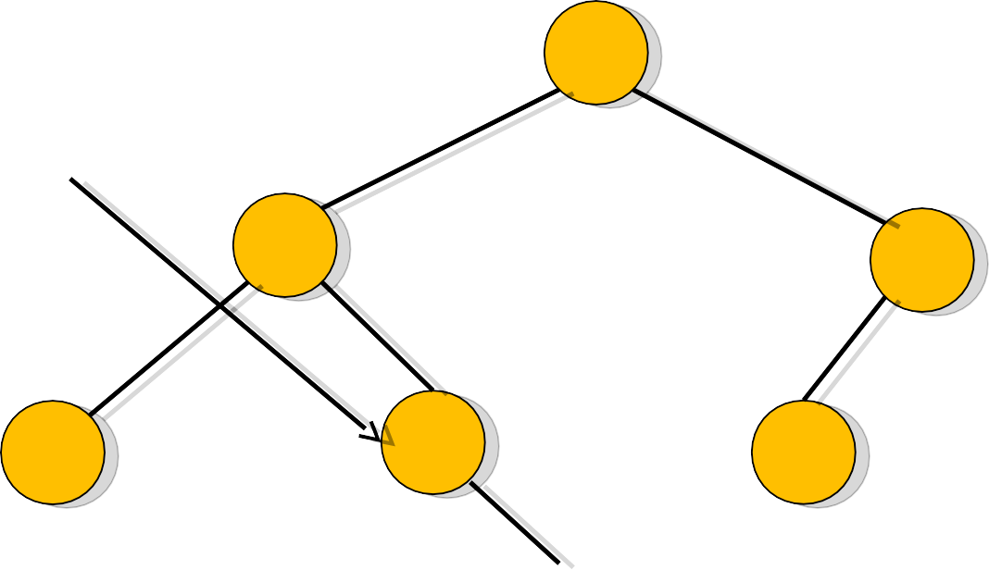
BST Insertion Algorithm
Y=T.root.left.right [y ≠ NIL] And z.key>y.key [5>4]
6
So y.right=z that is T.root.left.right.right=z
9
y
2
1
z
4
8
5

Slide 43
Insertion in BST - Algorithm
if tree is empty
create a root node with the new key else
compare key with the top node if key = node key
replace the node with the new value else if key > node key
compare key with the right subtree:
if subtree is empty create a leaf node else add key in right subtree
else key < node key
compare key with the left subtree:
if the subtree is empty create a leaf node else add key to the left subtree

Slide 44
Delete a value from the BST
♣
Removing a node from a BST is a bit more complex, since we do not want to create any "holes" in the tree. The intention is to remove the specified item from the BST and adjusts the tree
The binary search algorithm is used to locate the target item: starting at the root it probes down the tree till it finds the target or reaches a leaf node (target not in the tree)
If the node has one child then the child is spliced to the parent of the node. If the node has two children then its successor has no left child; copy the successor into the node and delete the successor instead TREE-DELETE (T, z) removes the node pointed to by z from the tree T. IT returns a pointer to the node removed so that the node can be put on a free-node list
The overall strategy for deleting a node or item from a binary search tree can be described through some cases.
♣
♣
♣

Slide 45
Delete a value from the BST
Experimenting the cases:
if the tree is empty return false
else Attempt to locate the node containing the target using the binary search algorithm:
if the target is not found return false
else the target is found, then remove its node. Now while removing the node four cases may happen

Slide 46
Delete a value from the BST
Case 1: if the node has 2 empty subtrees
- replace the link in the parent with null
Case 2: if the node has a left and a right subtree
replace the node's value with the max value in the left subtree
delete the max node in the left subtree
Case 3: if the node has no left child
link the parent of the node to the right (non-empty) subtree
Case 4: if the node has no right child
link the parent of the target to the left (non-empty) subtree

Slide 47
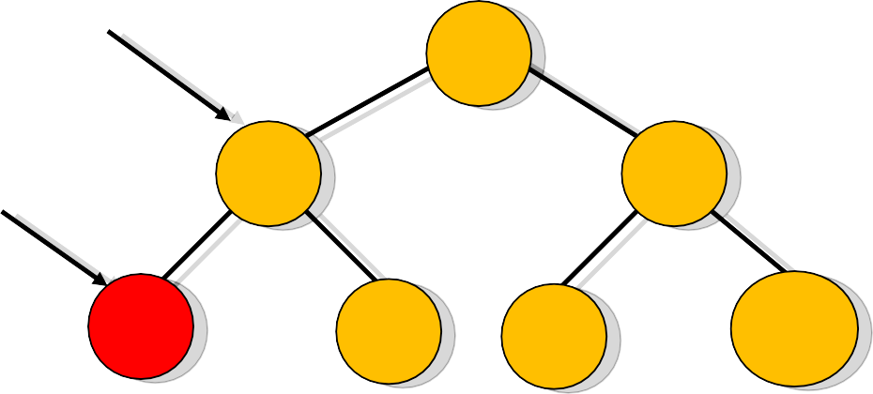
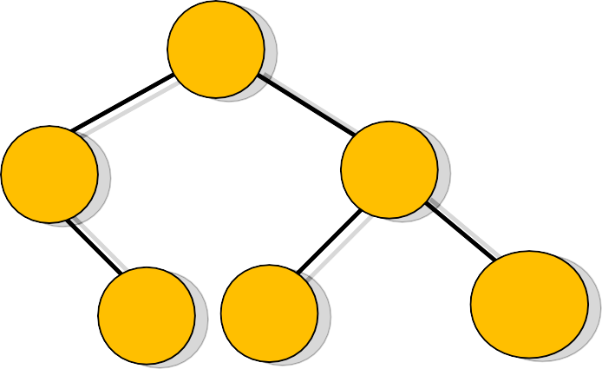
Delete a value from the BST
Case 1: removing a node with 2 EMPTY SUBTREES
-replace the link in the parent with null
Removing 4
Parent
7
7
5 9
5
9
Z
4
6
8
10
6
8
10

Slide 48
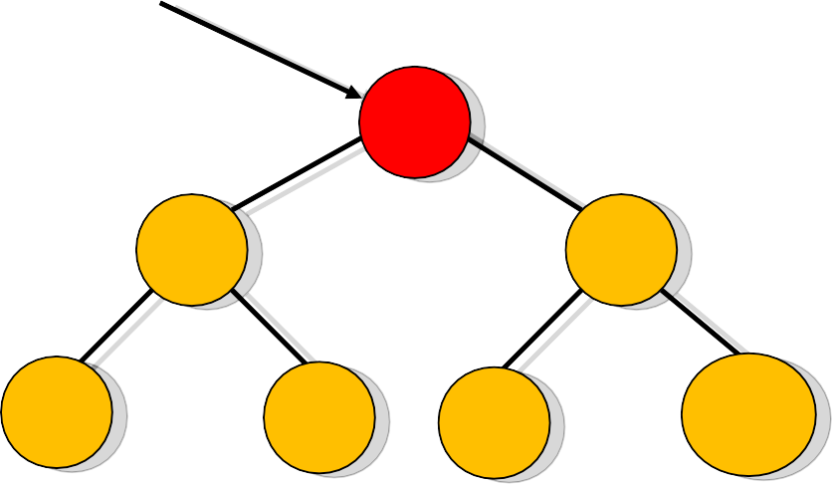
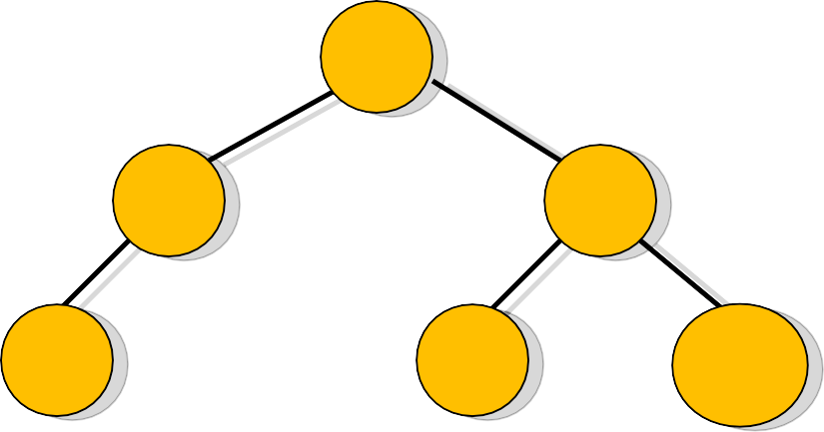
Delete a value from the BST
Case 2: removing a node with 2 SUBTREES
replace the node's value with the max value in the left subtree
delete the max node in the left subtree
Z
Removing 7
7
6
5
9
5
9
4
6
8
10
4
8
10

Slide 49
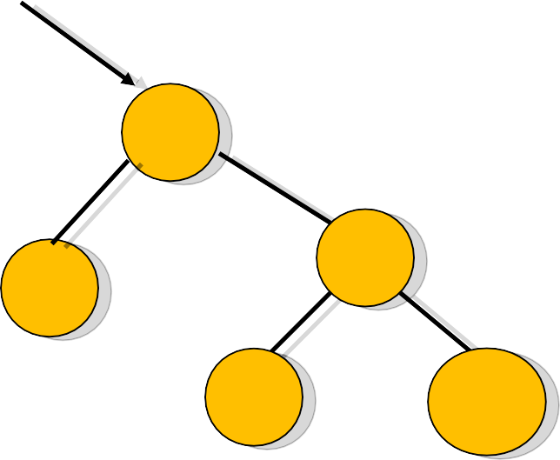
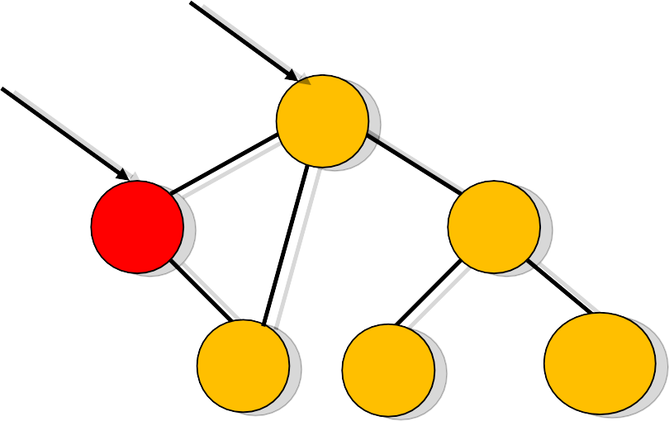
Delete a value from the BST
Case 3: if the node has no left child
- link the parent of the node to the right (non-empty) subtree
Parent
Removing 5
Parent
Z
7
7
5
9
9
6
6
8
10
8
10

Slide 50
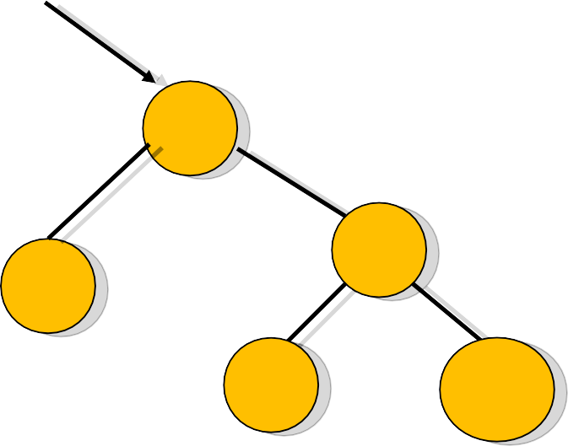
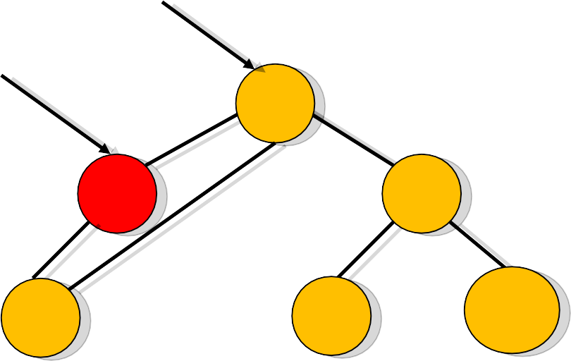
Delete a value from the BST
Case 4: if the node has no right child
- link the parent of the node to the left (non-empty) subtree
Parent
Removing 5
Parent
Z
7
7
5
9
9
4
4
8
10
8
10

Slide 51
BST Deletion Algorithm
•
if left [z] = NIL .OR. right[z] = NIL
then y ← z
else y ← TREE-SUCCESSOR (z)
if left [y] ≠ NIL
then x ← left[y]
else x ← right [y]
if x ≠ NIL
then p[x] ← p[y]
if p[y] = NIL
then root [T] ← x
else if y = left [p[y]]
then left [p[y]] ← x
else right [p[y]] ← x
TREE-DELETE (T, z)
if y ≠ z
then key [z] ← key [y]
if y has other field, copy them, too
return y

Slide 52
Analysis of BST Operations
The complexity of operations search, insert and
remove in BST is O(h) , where h is the height.
When the tree is balanced then it is O(log n). The updating operations cause the tree to become unbalanced.
The tree can degenerate to a linear shape and the operations will become O (n)

Slide 53
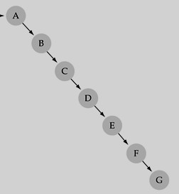
What is a Degenerate BST?
♣ A degenerate binary search tree is one where most or all of the nodes contain only one sub node.
♣ | It is unbalanced degrades to tha | rmance
♣ | If your add no then you can ea feeding it data t | balancingee by
and, in the worst case, perfo
t of a linked list.
de function does not handle re sily construct a degenerate tr hat is already sorted.

Slide 54
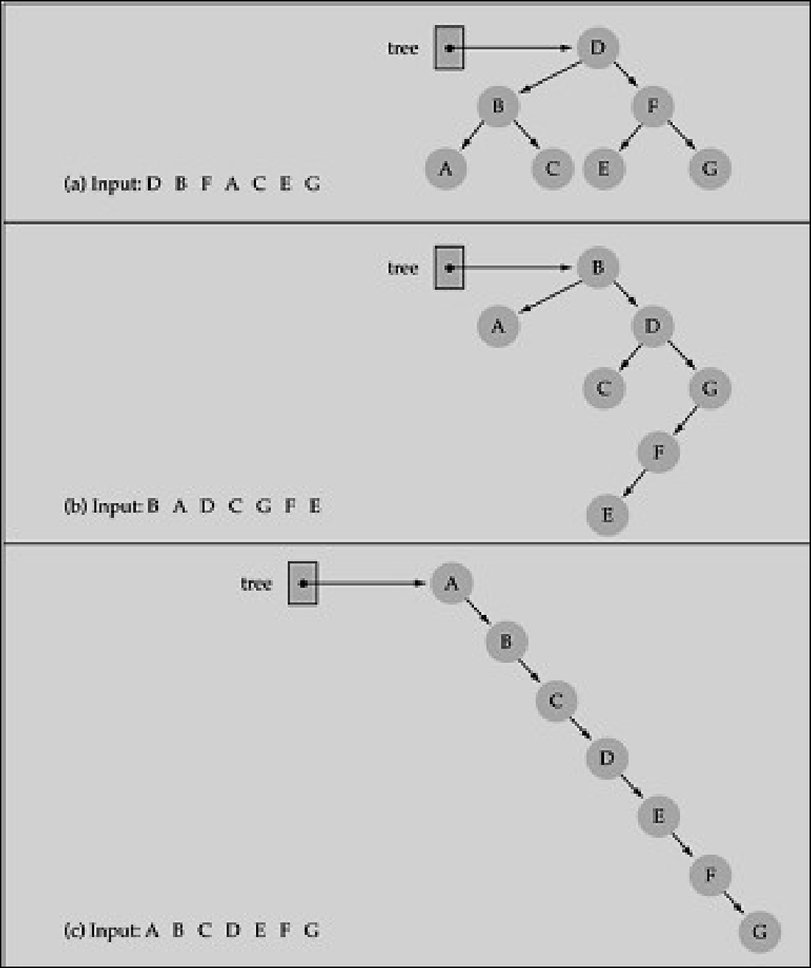
Does the order of inserting elements into a tree matter?

Slide 55
Does the order of inserting elements into a tree matter?
Yes, certain orders might produce very unbalanced trees or degenerated trees!
Unbalanced trees are not desirable because search time increases!
♣
Advanced tree structures, such as red-black trees, AVL trees, guarantee balanced trees.

Slide 56
Better Search Trees
Prevent the degeneration of the BST :
A BST can be set up to maintain balance during updating operations (insertions and removals)
Types of ST which maintain the optimal performance in other words balanced trees:
splay trees
AVL trees
2-4 Trees
Red-Black trees
B-trees

Slide 57
Minimize The Search Time of Binary Search Tree In Dynamic Situation
From the previous few examples, we know that the average and maximum search time will be minimized if the binary search tree is maintained as a complete binary search tree at all times.
However, to achieve this in a dynamic situation, we have to pay a high price to restructure the tree to be a complete binary tree all the time.
In 1962, Adelson-Velskii and Landis introduced a binary tree structure that is balanced with respect to the heights of subtrees. As a result of the balanced nature of this type of tree, dynamic retrievals can be performed in O(log n) time if the tree has n nodes. The resulting tree remains height-balanced. This is called an AVL tree.

Slide 58
Balancing BST – (AVL Tree)
Click Reference (lab6ASD.pdf)
Last Topic – CTS – Session 9

Slide 59
Indexed Binary Search Trees
Definition
Binary search tree.
Each node has an additional field ‘LeftSize’.
Support search and delete operations by rank as well as all the binary search tree operations.
LeftSize
the number of elements in its left subtree
the rank of an element with respect to the elements in its subtree (e.g., the fourth element in sorted order)

Slide 60
Indexed Binary Search Tree Example
7
20
4
10
3
40
1
6
0
15
1
30
0
1
0
0
0
2
8
18
25
35
0
7
What is the Leftsize for each node?
LeftSize values are in red.

Slide 61
LeftSize and Rank
Rank of an element is its position in inorder (inorder = ascending key order).
[2,6,7,8,10,15,18,20,25,30,35,40]
rank(2)=0
rank(15)=5
rank(20)=7
LeftSize(x) = rank(x) with respect to elements in the subtree rooted at x

Slide 62
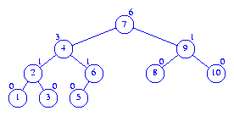
Exercise

Slide 63
Indexed Binary Search Tree – Search & Delete
IndexSearch(rank) returns the rank^{th} element
IndexDelete(rank) deletes the rank^{th} element
If rank = x.LeftSize, desired element is x.element.
If rank < x.LeftSize, desired element is rank^{th} element in left subtree of x.
If rank > x.LeftSize, desired element is (rank-(x.LeftSize+1))^{th} element in right subtree of x.

Slide 64
Indexed Binary Search Example
7
20
4
10
3
40
1
6
0
15
1
30
0
1
0
0
0
2
8
18
25
35
0
7
What is the 3rd element in this IndexedBST?
What is the 9th element in this IndexedBST?

Slide 65
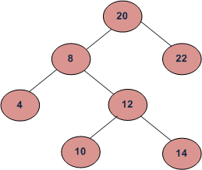
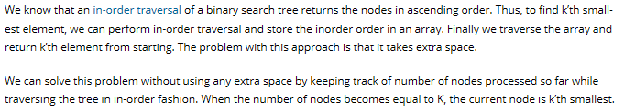
Find k-th smallest element in BST
Given root of binary search tree and K as input, find K-th smallest element in BST.
For example, in the following BST, if k = 3, then output should be 10, and if k = 5, then output should be 14.

Slide 66
Exercise:
Find k-th Largest element in BST

Slide 67
Range queries
A range query on a range tree reports the set of points that lie inside a given interval. To report the points that lie in the interval [x₁, x₂], we start by searching for x₁ and x₂

Slide 68
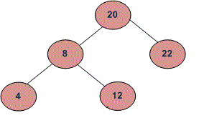
Print BST keys in the given range
Given two values k1 and k2 (where k1 < k2) and a root pointer to a Binary Search Tree. Print all the keys of tree in range k1 to k2. i.e. print all x such that k1<=x<=k2 and x is a key of given BST. Print all the keys in increasing order.
For example, if k1 = 10 and k2 = 22, then your function should print 12, 20 and 22.
Approach - ???
Algorithm: 1) If value of root’s key is greater than k1, then recursively call in left subtree. 2) If value of root’s key is in range, then print the root’s key. 3) If value of root’s key is smaller than k2, then recursively call in right subtree.

Slide 69
Uses for Binary Search Trees
Use for storing and retrieving information n Insert, delete, and search faster than with a linked list
Take advantage of logn height
Idea: Store information in an ordered way (keys)

Slide 70
Thanks!!!
Queries?

