Slide 1
Data Structure and Algorithms

Slide 2
Agenda – session 7
Hash Tables
Hash - functions, collision, collision handling.
Collision Resolution Schemes
Separate Chaining
Linear Probing
Quadratic Probing
Double Hashing
Additional Topic - Design of Hash Functions

Slide 3
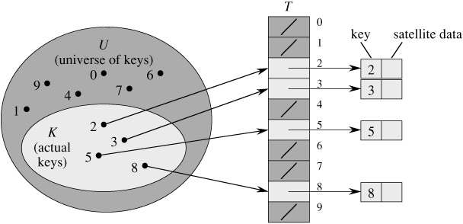
Direct-Address Table

Slide 4
Direct-address Tables
Direct-Address-Search( T, k )
return T[k]
Direct-Address-Insert( T, x )
T[ key[ x ] ] ⬅ x
Direct-Address-Delete( T, x )
T[ key[ x ] ] ⬅ NIL
We could use a direct-address table to implement caller-id, with the phone numbers as keys.
Time Analysis:
Space Analysis:

Slide 5
Dictionaries
A dictionary consists of key/element pairs in which the key is used to look up the element.
Ordered Dictionary: Elements stored in sorted order by key
Unordered Dictionary: Elements not stored in sorted order
Example | Key | Element
English Dictionary | Word | Definition
Student Records | Student Number | Rest of record: Name, …
Symbol Table in Compiler | Variable Name | Variable’s Address in Memory
Lottery Tickets | Ticket Number | Name & Phone Number

Slide 6
Dictionary as a Function
Given a key, return an element
Key Element
(domain: (range:
type of the keys) type of the elements)

Slide 7
Unordered Dictionary Best Implementation: Hash Table
0
1
2
3
4
5
6
7
8
9
5336666 | “Sara Li”
Space: O(n)
Time: O(1) average-case
Key/Element Pairs
5336666
“Sara Li”
5661111
“Lea Ross”
Hash Function

Slide 8
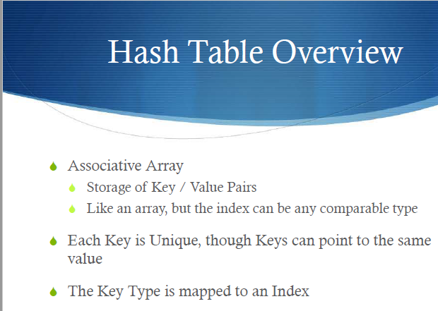
Notes:
A comparable object is capable of comparing itself with another object

Slide 9
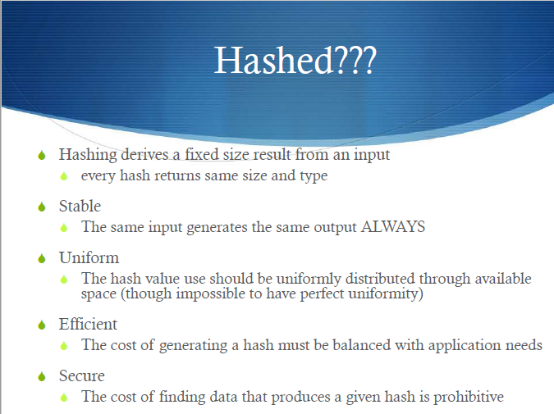

Slide 10
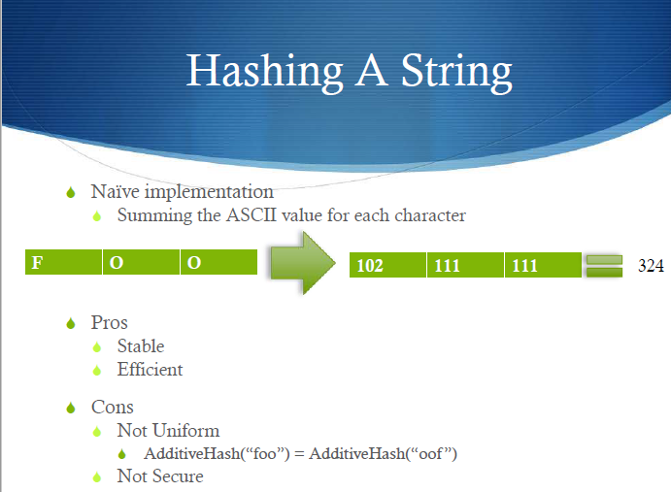

Slide 11
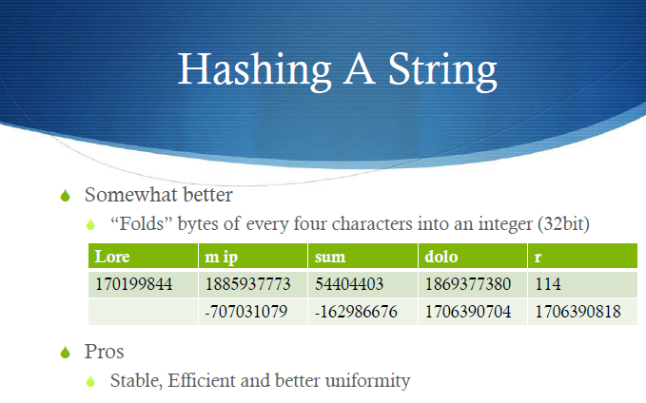
Notes:
Lore = 01001100 01101111 01110010 01100101 = 1282372197

Slide 12
Designing a hash table
Hash function: establishing a key with an indexed location in a hash table.
Index = hash(key) % table_size;
Resolve conflicts:
Need to handle multiple keys that may be mapped to the same index.
Two representative solutions
Linear probe open addressing (will discuss more later)
Chaining with separate lists.

Slide 13


Slide 14
Example Hash Function
h( k )
return k mod m
where k is the key and m is the size of the table

Slide 15
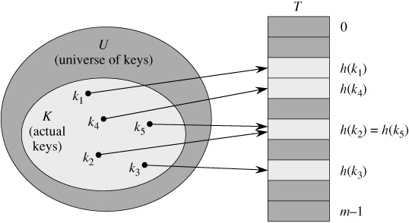
Hash Table with Collision

Slide 16
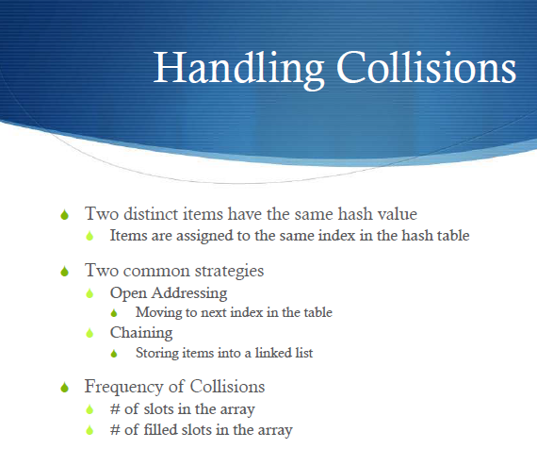

Slide 17
Collision Resolution Schemes: Chaining
The hash table is an array of linked lists
Insert Keys: 0, 1, 4, 9, 16, 25, 36, 49, 64, 81
Notes:
As before, elements would be associated with the keys
We’re using the hash function h(k) = k mod m
0
1
2
3
4
5
6
7
8
9
0
81
1
64
4
25
36
16
49
9

Slide 18
Chaining Algorithms
Chained-Hash-Insert( T, x )
insert x at the head of list T[ h( key[x] ) ]
Chained-Hash-Search( T, k )
search for an element with key k
in list T[ h(k) ]
Chained-Hash-Delete( T, x )
delete x from the list T[ h( key[x] ) ]

Slide 19
Worst-case Analysis of Chaining
Let n = number of elements in hash table
Let m = hash table size
Let λ = n / m ( the load factor, i.e, the average number of elements stored in a chain )
What is the worst-case?
Unsuccessful Search:
Successful Search:

Slide 20
Average-Case Analysis of Chaining for an Unsuccessful Search
Let n = number of elements in hash table
Let m = hash table size
Let λ = n / m ( the load factor, i.e, the average number of elements stored in a chain )
In unsuccessful search, one of the linked lists in the table must be exhaustively searched, and the average length of a linked list in the table is λ . So the average number of comparisons for unsuccessful find with separate chaining is λ.

Slide 21
Average-Case Analysis of Chaining for a Successful Search
Let n = number of elements in hash table
Let m = hash table size
Let λ = n / m ( the load factor, i.e, the average number of elements stored in a chain )
In successful find, the linked list containing the target key will be searched. There are on average λ keys in that list besides the target key; on average half of them will be searched before finding the target. So the average number of comparisons for successful find with separate chaining is -- 1 + λ / 2

Slide 22
Questions to Ask When Analyzing Resolution Schemes
Are we guaranteed to find an empty cell if there is one?
Are we guaranteed we won’t be checking the same cell twice during one insertion?
What should the load factor be to obtain O(1) average-case insert, search, and delete?
Answers for Chaining:
1.
2.
3.

Slide 23
Hash Tables Without Chaining
Try to avoid buckets with separate lists
How ➔ use Probing Hash Tables
If collision occurs, try another cell in the hash table.
More formally, try cells h₀(x), h₁(x), h₂(x), h₃(x)… in succession until a free cell is found.
h_{i}(x) = (hash(x) + f(i))
And f(0) = 0

Slide 24
Collision Resolution Strategies: Open Addressing
All elements stored in the hash table itself (the array). If a collision occurs, try alternate cells until empty cell is found.
Three Resolution Strategies:
Linear Probing
Quadratic Probing
Double Hashing
All these try cells h(k,0), h(k,1), h(k,2), …, h(k, m-1)
where h(k,i) = ( h′(k) + f(i) ) mod m, with f(0) = 0
The function f is the collision resolution strategy and the function h′ is the original (now auxiliary) hash function.

Slide 25
Linear Probing
Function f is linear. Typically, f(i) = i
So, h( k, i ) = ( h′(k) + i ) mod m
Offsets: 0, 1, 2, …, m-1
With H = h′( k ), we try the following cells with wraparound:
H, H + 1, H + 2, H + 3, …
0
1
2
3
4
5
6
7
8
9
What does the table look like after the following insertions?
Insert Keys: 0, 1, 4, 9, 16, 25, 36, 49, 64, 81

Slide 26
General Open Addressing Insertion Algorithm
Hash-Insert( T, k )
i ⬅ 0
repeat
j ⬅ h( k, i )
if T[ j ] = NIL
then T[ j ] ⬅ k
return j
else i ⬅ i + 1
until i = m
error “hash table overflow”

Slide 27
General Open Addressing Search Algorithm
Hash-Search( T, k )
i ⬅ 0
repeat
j ⬅ h( k, i )
if T[ j ] = k
then return j
i ⬅ i + 1
until T[ j ] = NIL or i = m
return NIL

Slide 28
Linear Probing: Delete
Can be tricky ...
How to maintain the consistency of the hash table
What is the simplest deletion strategy you can think of?

Slide 29
Linear Probing Deletion
How do we delete 9?
How do we find 49 after deleting 9?
0
1
2
3
4
5
6
7
8
9
0
1
49
4
25
16
36
64
9

Slide 30
Lazy Deletion
Empty: Null reference
Active: A
Deleted: D
0
1
2
3
4
5
6
7
8
9
0
1
49
4
25
16
36
64
9

Slide 31
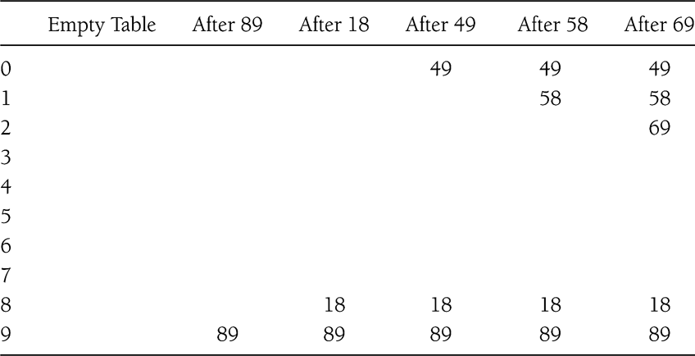
Linear Probing Example 2
Insert 89, 18, 49, 58, 69

Slide 32
Questions to Ask When Analyzing Resolution Schemes
Are we guaranteed to find an empty cell if there is one?
Are we guaranteed we won’t be checking the same cell twice during one insertion?
What should the load factor be to obtain O(1) average-case insert, search, and delete?
Answers for Linear Probing:
1.
2.
3.

Slide 33
Primary Clustering
Linear Probing is easy to implement, but it suffers from the problem of primary clustering:
Hashing several times in one area results in a cluster of occupied spaces in that area. Long runs of occupied spaces build up and the average search time increases.

Slide 34
Assignment Exercise - Collision Resolution Comparison
 | Advantages? | Disadvantages?
Chaining
Linear Probing

Slide 35
Rehashing
Hash Table may get full
No more insertions possible
Hash table may get too full
Insertions, deletions, search take longer time
Solution: Rehash
Build another table that is twice as big and has a new hash function
Move all elements from smaller table to bigger table
Cost of Rehashing = O(N)
But happens only when table is close to full
Close to full = table is X percent full, where X is a tunable parameter

Slide 36
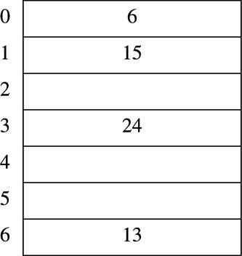
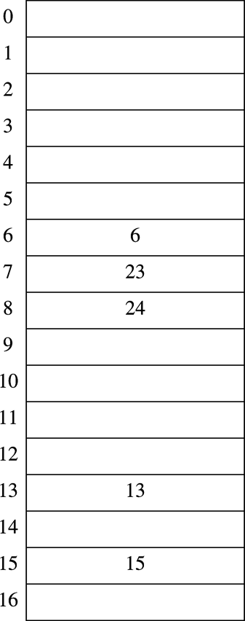
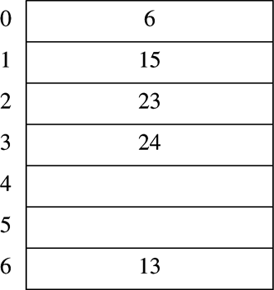
Rehashing Example
Original Hash Table
After Rehashing
After Inserting 23

Slide 37
Quadratic Probing
Function f is quadratic. Typically, f(i) = i²
So, h( k, i ) = ( h′(k) + i² ) mod m
Offsets: 0, 1, 4, …
With H = h′( k ), we try the following cells with wraparound:
H, H + 1², H + 2², H + 3² …
Insert Keys: 10, 23, 14, 9, 16, 25, 36, 44, 33
0
1
2
3
4
5
6
7
8
9

Slide 38
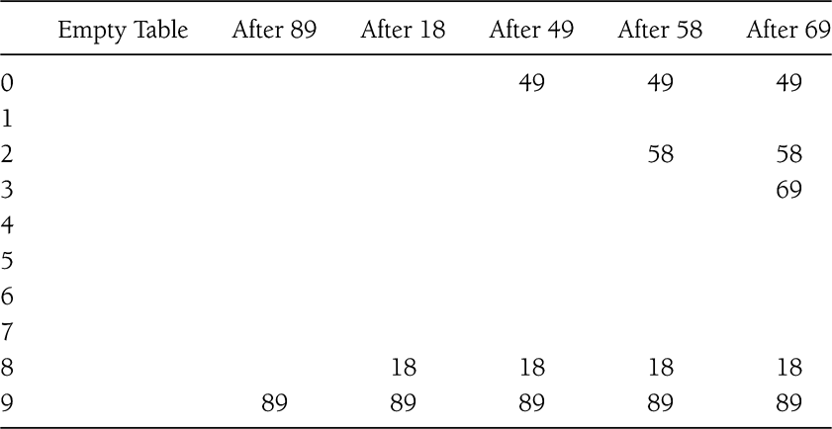
Quadratic Probing Example 2
f(i) = i²

Slide 39
Questions to Ask When Analyzing Resolution Schemes
Are we guaranteed to find an empty cell if there is one?
Are we guaranteed we won’t be checking the same cell twice during one insertion?
What should the load factor be to obtain O(1) average-case insert, search, and delete?
Answers for Quadratic Probing:
1.
2.
3.

Slide 40
Secondary Clustering
Quadratic Probing suffers from a milder form of clustering called secondary clustering:
As with linear probing, if two keys have the same initial probe position, then their probe sequences are the same, since h(k₁,0) = h(k₂,0) implies h(k₁,1) = h(k₂,1). So only m distinct probes are used.
Therefore, clustering can occur around the probe sequences.

Slide 41
Practice Exercise - Advantages/Disadvantages of Quadratic Probing?

Slide 42
Double Hashing
If a collision occurs when inserting, apply a second auxiliary hash function, h₂(k), and probe at a distance h₂(k), 2 * h₂(k), 3 * h₂(k), etc. until find empty position.
So, f(i) = i * h₂(k) and we have two auxiliary functions:
h( k, i ) = ( h₁(k) + i * h₂(k) ) mod m
With H = h₁( k ), we try the following cells in sequence with wraparound:
H
H + h₂(k)
H + 2 * h₂(k)
H + 3 * h₂(k)
…

Slide 43
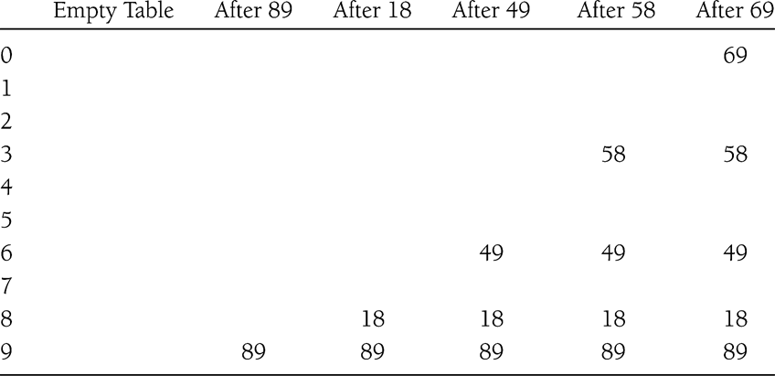
Double Hashing Method 2
f(i) = i*hash₂(x)
E.g.: hash₂(x) = 7 – (x % 7)
Try this - if hash₂(x) == 0 for some x?

Slide 44
Double Hashing
In order for the entire table to be searched, the value of the second hash function, h₂(k), must be relatively prime to the table size m.
One of the best methods available for open addressing because the permutations produced have many of the characteristics of randomly chosen permutations

Slide 45
Practice Exercise - Advantages/Disadvantages of Double Hashing?

Slide 46
Assignment - Collision Resolution Comparison: Expected Number of Probes in Searches
Let λ = n / m (load factor)
 | Unsuccessful Search | Successful Search
Chaining | λ (average number of elements in chain) | 1 + λ/2 (1 + average number before element in chain)
Open Addressing ( assuming uniform hashing ) | 1 / (1 – λ) | 1 ln 1 λ 1- λ

Slide 47
Expected Number of Probes vs. Load Factor
Number of Probes
Unsuccessful
Linear Probing
Successful
Double Hashing
Chaining
1.0
Load Factor
0.5
1.0

Slide 48
Collision Resolution Comparison
Let λ = n / m (load factor)
 | Recommended Load Factor
Chaining | λ ≤ 1.0
Linear or Quadratic Probing | λ ≤ 0.5 (half full)
Double Hashing | λ ≤ 0.5 (half full)
Note: If a table using quadratic probing is more than half full, it is not guaranteed that an empty cell will be found

Slide 49
Practice Exercise - Collision Resolution Comparison
 | Advantages? | Disadvantages?
Chaining
Linear Probing
Quadratic Probing
Double Hashing

Slide 50
Choosing Hash Functions
A good hash function must be O(1) and must distribute keys evenly.
Division Method Hash Function for Integer Keys:
h(k) = k mod m
Hash Function for String Keys?

Slide 51
Hash Functions for String Keys (assume English words as keys)
Option 1: Use all letters of key
h(k) = (sum of ASCII values in Key) mod m
So,
h( k ) =
keysize -1
( ∑ (int)k[ i ] ) mod m
i=0
Good hash function?

Slide 52
Hash Functions for String Keys (assume English keys)
Option 2: Use first three letters of a key & multiplier
h( k ) =
( (int) k[0] +
(int) k[1] * 27 +
(int) k[2] * 729 ) mod m
Note: 27 is number of letters in English + blank
729 is 27²
Using 3 letters, so 26³ = 17, 576 possible combos, not including blanks
Good hash function?

Slide 53
Hash Functions for String Keys (assume English keys)
Option 3: Use all letters of a key & multiplier
h( k ) =
keysize -1
( ∑ (int)k[ i ] * 128^{i} ) mod m
i=0
Good hash function?

Slide 54
Requirement: Prime Table Size for Division Method Hash Functions
If the table is not prime, the number of alternative locations can be severely reduced, since the hash position is a value mod the table size
Example: Table Size 16, with Quadratic Probing
h′(k) + Offset
0 + 1 mod 16 = 1
4 mod 16 = 4
9 mod 16 = 9
16 mod 16 = 0
25 mod 16 = 9
36 mod 16 = 4
49 mod 16 = 1
…

Slide 55
Important Factors When Designing Hash Tables
To Minimize Collisions:
Distribute the elements evenly.
Use a hash function that distributes keys evenly
Make the table size, m, a prime number not near a power of two if using a division method hash function
Use a load factor, λ = n / m, that’s appropriate for the implementation.
1.0 or less for chaining ( i.e., n ≤ m ).
0.5 or less for linear or quadratic probing or double hashing ( i.e., n ≤ m / 2 )

Slide 56
Applications
Associative arrays: Hash tables are commonly used to implement many types of in-memory tables. They are used to implement associative arrays (arrays whose indices are arbitrary strings or other complicated objects).
Database indexing: Hash tables may also be used as disk-based data structures and database indices (such as in dbm).
Caches: Hash tables can be used to implement caches i.e. auxiliary data tables that are used to speed up the access to data, which is primarily stored in slower media.
Object representation: Several dynamic languages, such as Perl, Python, JavaScript, and Ruby use hash tables to implement objects.
Hash Functions are used in various algorithms to make their computing faster

Slide 57
Thanks!!!
Queries?

