Slide 1
Data Structures Algorithm and Design DSELZG519
<number>
Notes:
<number>

Slide 2
Introduction to tree
<number>

Slide 3
CONTACT SESSION 4 -PLAN
Contact Sessions(#) | List of Topic Title
4 | Trees: Terms and Definition, Tree ADT, Applications. Binary Trees : Terms and Definition, Properties, Properties. Representations (Vector Based and Linked), Binary Tree traversal (In Order, Pre Order, Post Order), Applications
Page <number>

Slide 4
Linear data structures
Here are some of the data structures we have studied so far:
Arrays
Singly-linked lists and doubly-linked lists
Stacks and queues
These all have the property that their elements can be adequately displayed in a straight line
How to obtain data structures for data that have nonlinear relationships
<number>

Slide 5
How should one decide which data structure to use ?
What need to be stored
Cost of operations
Memory use
Ease of implementation ☺
<number>

Slide 6
Trees
Linear access time of linked lists is expensive
Does there exist any simple data structure for which the running time of most operations (search, insert, delete) is O(log N)?
Trees
Basic concepts
Tree traversal
Binary tree
Binary search tree and its operations
Notes:
<number>

Slide 7

Nature View of a Tree
leaves
branches
root
<number>

Slide 8

Computer Scientist’s View
root
leaves
branches
nodes
<number>

Slide 9
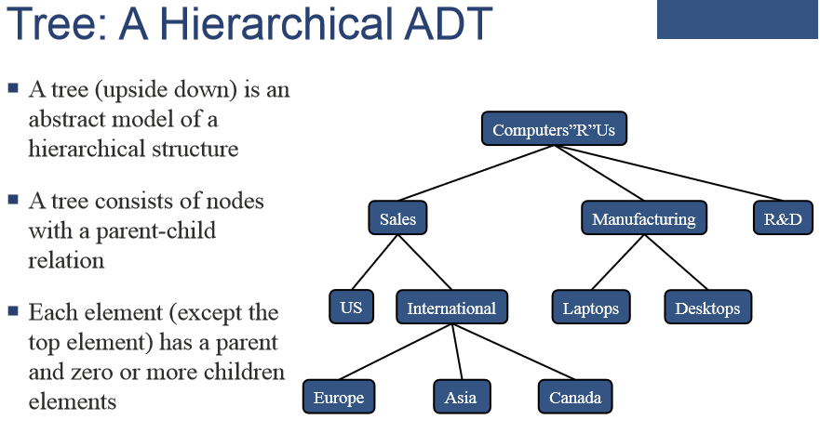

Slide 10
Tree
A tree is a finite nonempty set of elements.
It is an abstract model of a hierarchical structure.
consists of nodes with a parent-child relation.
Applications:
Organization data
File systems /storing naturally
Trie -dictionary
Network routing algorithm.
Programming environments
Compiler Design/Text processing (syntax analysis & to display the structure of a sentence in a language)
Searching Algorithms and sorting
Evaluating a mathematical expression.
Computers”R”Us
Sales
Manufacturing
R&D
US
International
Laptops
Desktops
Europe
Asia
Canada
<number>

Slide 11
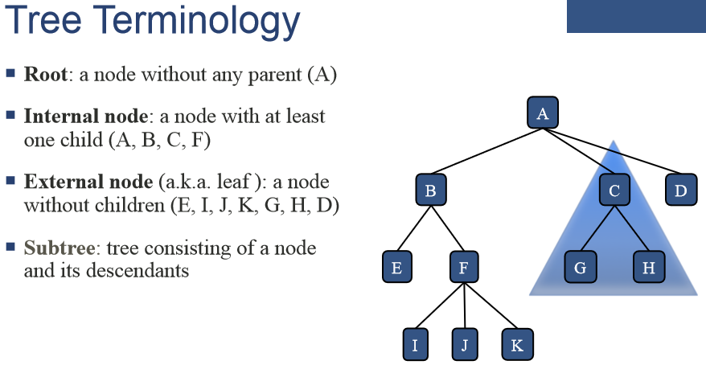

Slide 12
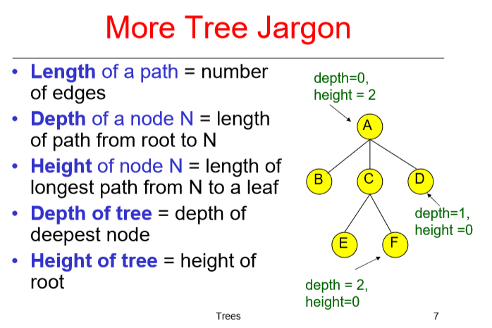

Slide 13
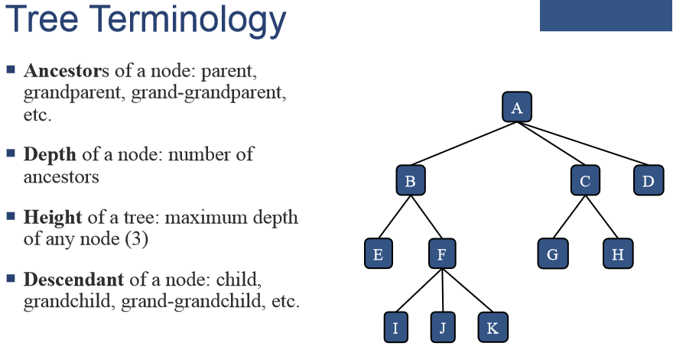

Slide 14
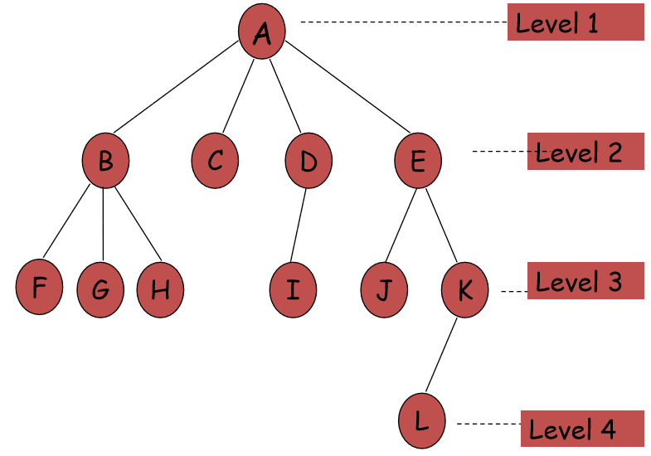

Slide 15
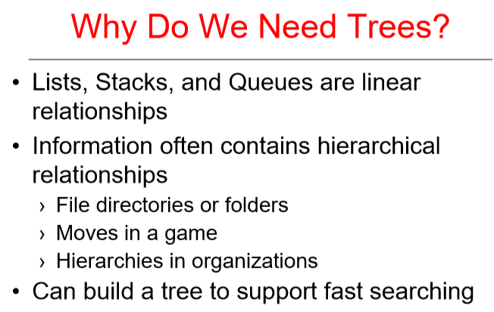

Slide 16
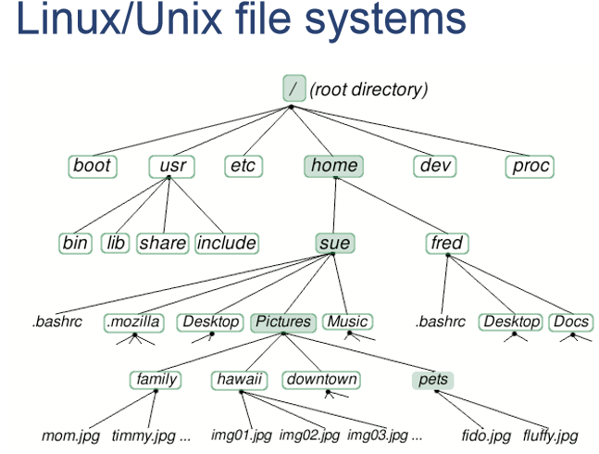

Slide 17
Tree Applications Can represent an outline as a tree

Slide 18
Tree Applications
An organizational chart is a tree

Slide 19
Tree Applications
Can represent an arithmetic expression as a tree
((12 / 3) * 2) + (5 - 1)

Slide 20
Tree Applications
Many compilers represent programs as trees
if (x == y)
{
return;
}

Slide 21
TREE ADT
We use positions to abstract nodes
Generic methods:
integer size():Retum the number of nodes in the tree. boolean isEmpty()
ObjectIterator elements():Return an iterator of all the elements
stored at nodes of the tree.
positionIterator positions():Return an iterator of all the nodes of the tree
Accessor methods:
position root():Return the root of the tree
position parent(p):Return the parent of node v; error if v is root. positionIterator children(p):Return an iterator of the children of node v.
Page <number>

Slide 22
TREE ADT
Query methods:
boolean isInternal(p):Test whether node v is internal.
boolean isExternal(p):Test whether node v is external
boolean isRoot(p):Test whether node v is the root.
Update methods:
swapElements(v, w):Swap the elements stored at the nodes v and w.
object replaceElement(v, e):Replace with e and return the element
stored at node v
Page <number>

Slide 23
TREE ADT-Depth and Height
Let v be a node of a tree T.
The depth of v is the number of ancestors of v, excluding v itself
If v is the root, then the depth of v is 0.
Otherwise, the depth of v is one plus the depth of the parent of v.
Algorithm depth(T, v):
if T. isRoot(v) then return 0
else
return 1 + depth (T, T. parent(v))
The running time of algorithm depth ( T, v) is O( 1 + d_{v}), where d_{v}
denotes the depth of the node v in the tree T.
In the worst case, the depth algorithm runs in O (n) time, where n is the total number of nodes in the tree T
Page <number>

Slide 24
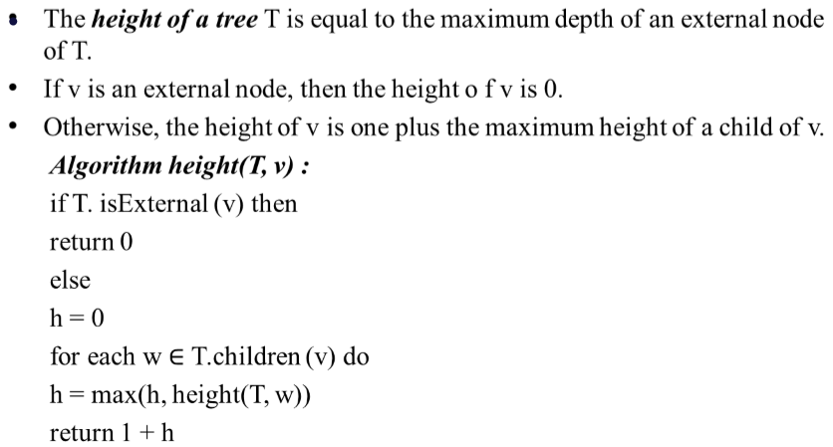
TREE ADT-Depth and Height
Page <number>

Slide 25
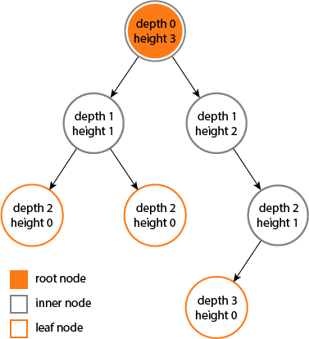
TREE ADT-Depth and Height
Page <number>

Slide 26
Binary Tree
Each node can have at most 2 –child
This is also binary tree
<number>
What about this ?

Slide 27
Strict/proper binary tree
Each node can have either 2 or 0 children.
<number>

Slide 28
Complete Binary tree
L0
All levels except possibly the last are completely filled and all nodes are as left as possible.
L1
L2
L3
Max no of nodes at level i = 2^{i}
This is not the left as possible
<number>

Slide 29
Complete Binary tree[cont..,]
All levels except possibly the last are completely filled and all nodes are as left as possible.
<number>

Slide 30
Complete Binary tree [cont..,]
L0
All levels except possibly the last are completely filled and all nodes are as left as possible.
L1
L2
L3
This is the left as possible
<number>

Slide 31
Perfect binary tree
Maximum no of nodes in a binary tree with height h
= 2⁰ + 2¹ + ….. + 2^{h}
= 2^{h+1} - 1
= 2^{(no of levels)} – 1
n = 2^{h+1} – 1
In perfect binary all levels will be complete filled.
<number>
Notes:
log₂(1) = 0
<number>

Slide 32
Now you can find the height of a tree, with n
n = 2^{h+1} – 1
2^{h+1} = n+1
h = log₂(n+1) – 1
Height of complete binary tree h = floor (log₂n)
<number>

Slide 33
Min and max height of a binary tree
L0
Min-height of n- nodes = floor (log₂n)
L1
L2
Max-height of n- nodes = n-1
<number>

Slide 34
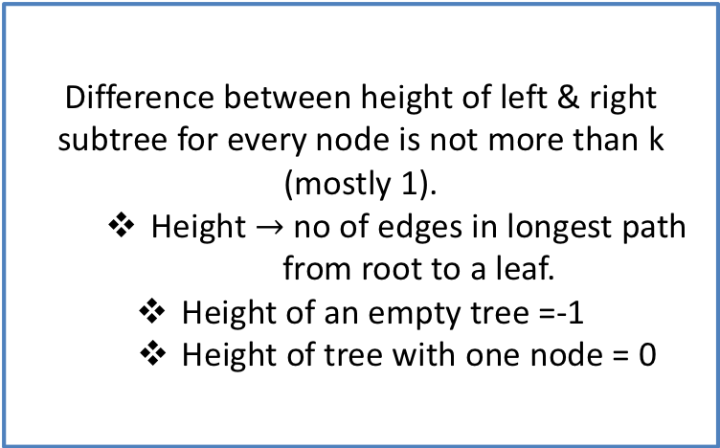
Balanced binary tree
Difference between height of left & right subtree for every node is not more than k (mostly 1).
Height no of edges in longest path from root to a leaf.
Height of an empty tree =-1
Height of tree with one node = 0
<number>

Slide 35
Binary tree implementation
We can implement binary tree using
Dynamically created nodes
Arrays [ this will only happen to complete binary tree]
<number>

Slide 36
Complete Binary Trees: Array Representation
Complete Binary Trees can be represented in
memory with the use of an array A so that all
nodes can be accessed in O(1) time:
Label nodes sequentially top-to-bottom and left-to-right
Left child of A[i] is at position A[2i]
Right child of A[i] is at position A[2i + 1]
Parent of A[i] is at A[i/2]
<number>

Slide 37
Complete Binary Trees: Array Representation
1
Left child of A[i] is at position A[2i]
Right child of A[i] is at position A[2i + 1]
14
2
3
10
16
4
5
6
7
8
12
15
18
8
9
10
11
7
9
11
13
14 | 10 | 16 | 8 | 12 | 15 | 18 | 7 | 9 | 11 | 13
<number>

Slide 38
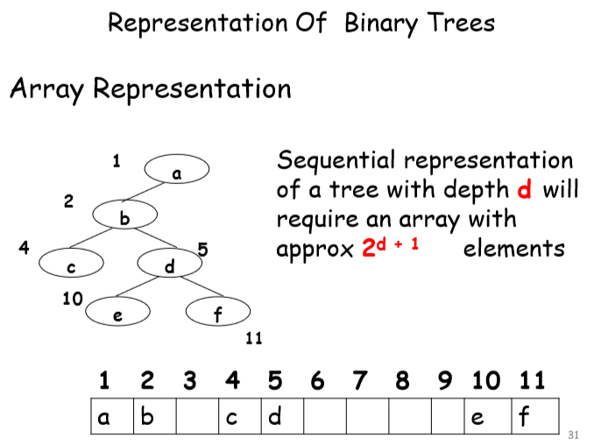

Slide 39
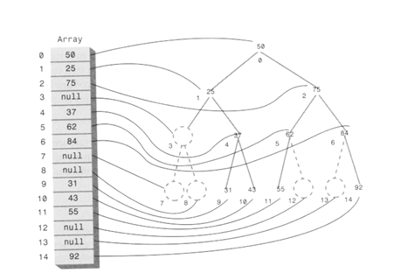

Slide 40
Binary Trees: Linked List Representation
A Binary tree is a linked data structure. Each node contains data (including a key and satellite data), and pointers left, right and p.
Left points to the left child of the node.
Right points to the right child of the node.
p points to the parent of the node.
If a child is missing, the pointer is NIL.
If a parent is missing, p is NIL.
The root of the tree is the only node for which p is NIL.
Nodes for which both left and right are NIL are leaves.
<number>

Slide 41
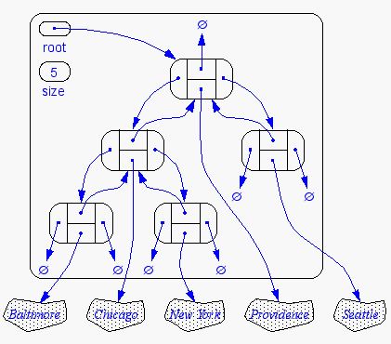
Binary Trees: Linked List Representation
<number>

Slide 42
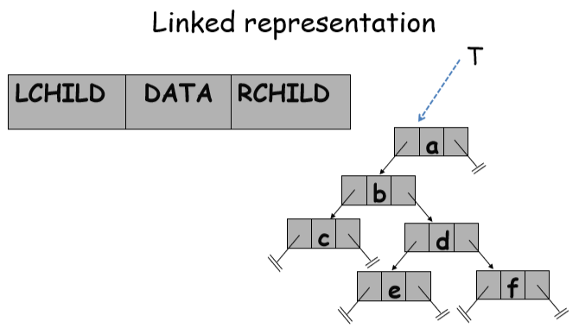

Slide 43
Binary Tree Traversals
A binary tree is defined recursively: it consists of a root, a left subtree and a right subtree
To traverse (or walk) the binary tree is to visit each node in the binary tree exactly once.
Tree traversals are naturally recursive.
Since a binary tree has three parts, these are the possible ways to traverse the binary tree:
root, left, right : preorder (root, right, left)
left, root, right: inorder (right, root, left)
left, right, root: postorder (right, left, root)
<number>

Slide 44
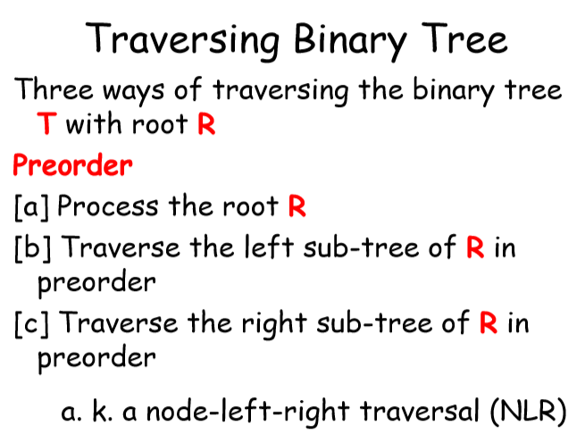

Slide 45
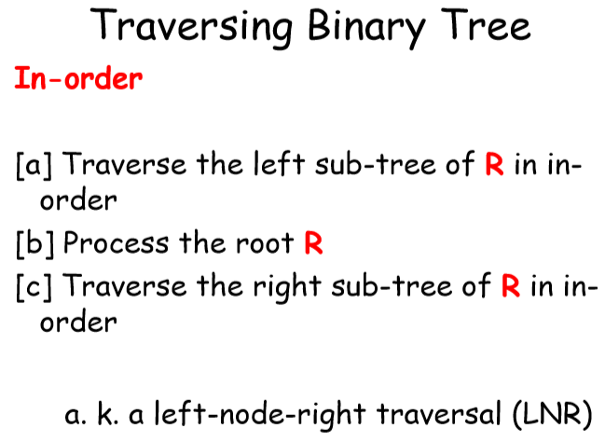

Slide 46
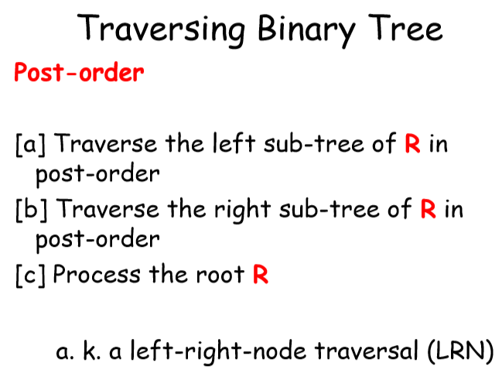

Slide 47
Binary Tree Traversals
1
preorder: 1 2 3
inorder: 2 1 3
postorder: 2 3 1
2
3
<number>

Slide 48
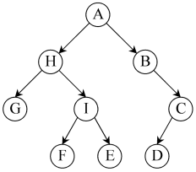
Tree Traversal: examples
Preorder (DLR) traversal yields: A, H, G, I, F, E, B, C, D
Postorder (LRD) traversal yields: G, F, E, I, H, D, C, B,A
In-order (LDR) traversal yields: G, H, F, I, E, A, B, D, C
<number>

Slide 49
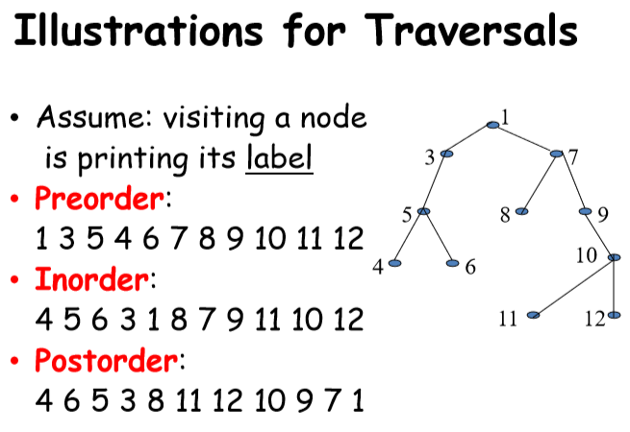

Slide 50
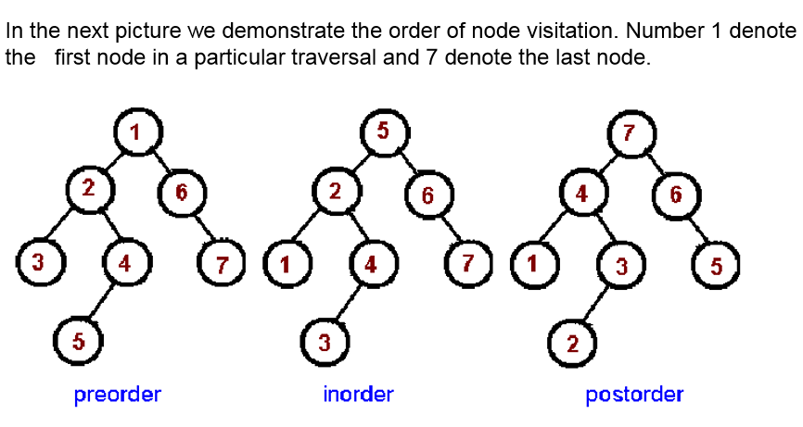

Slide 51
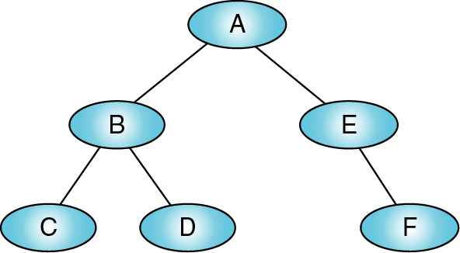
Binary Tree Traversals
Preorder = ?
Inorder = ?
Postorder = ?

Slide 52
Application of Binary Trees
Data Base indexing
BSP (Binary space partitioning)in video games
Path finding algorithms in AI applications
Huffman Coding
Heaps
Set and Map in C++
Syntax tree.
<number>

Slide 53
Heaps - Definition and Properties,
Representations (Vector Based and Linked),
Insertion and deletion of elements
Heap implementation of priority queue, Heap sort
Notes:
<number>

Slide 54
Heap
A (binary) heap data structure is an array object that can be viewed as a complete binary tree
Each node of the tree corresponds to an element of the array that stores the value in the node
Leaf nodes are nodes without children.
⇓ Interior node
⇓ Leaf node
Edge ◊

Slide 55
Heaps
Complete binary tree– if not full, then the only unfilled level is filled in from left to right.
1
1
2 2
3
3
4
⁵ 6 7 ⁴
9 10 11 12 13 7
5
6
8
8 9
10 11
12
Parent(i)
return ⎣i/2⎦
Left(i)
return 2i
Right(i)
return 2i + 1

Slide 56
Heap Representation - ??????????????
Class should Answer.

Slide 57
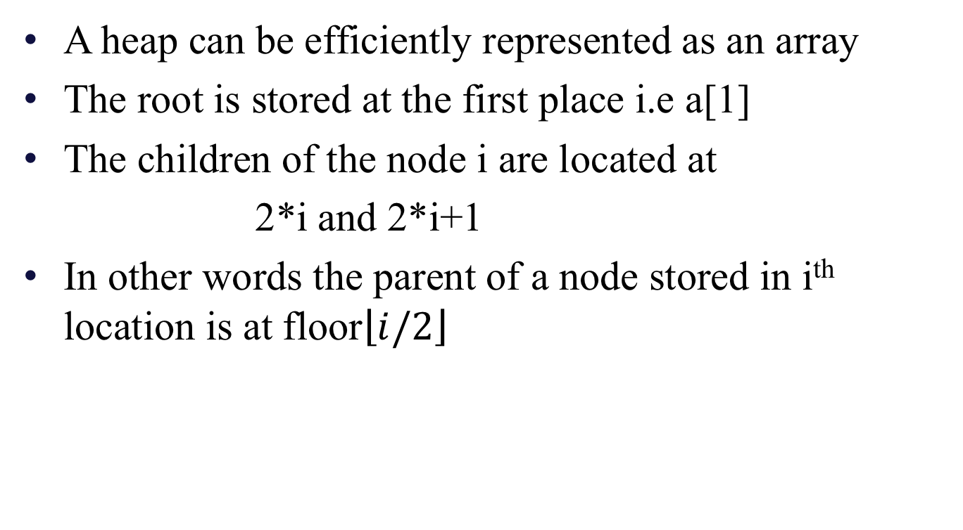
Heap Representation
A heap can be efficiently represented as an array
The root is stored at the first place i.e a[1]
The children of the node i are located at
2*i and 2*i+1
In other words the parent of a node stored in i^{th} location is at floor
<number>

Slide 58
Heap Representation(Cont..,)
25
22
17
19
22
14
15
18
14
21
3
9
11
1 2 3 4 5 6 7 8 9 10 11 12 13
25
22
17
19
22
14
15
18
14
21
3
9
11
Notice:
The left child of index i is at index 2*i
The right child of index i is at index 2*i+1
Example: the children of node 3 (19) are 7 (18) and 8 (14)
<number>

Slide 59
Heaps
The heap property of a tree is a condition that must be true for the tree to be considered a heap.
Min-heap property: for min-heaps, requires A[parent(i)] ≤ A[i]
So, the root of any sub-tree holds the least value in that sub-tree.
Max-heap property: for max-heaps, requires A[parent(i)] ≥ A[i]
The root of any sub-tree holds the greatest value in the sub-tree.

Slide 60
Heaps
Looks like a max heap, but max-heap property is violated at indices 11 and 12. Why?
because those nodes’ parents have smaller values than their children.
1
9
2
3
8
8
4
8
5
7
6
8
7
1
8
6
9
7
10
5
11
8
12
9

Slide 61
Thank You!!
<number>

