Slide 1
Data Structure and Algorithms

Slide 2
Agenda – session 1
Algorithms and it’s Specification
Random Access Machine Model
Counting Primitive Operations
Notion of best case, average case and worst case.
Use of asymptotic notation, Big-Oh, Little-Oh, Omega and Theta Notations.
Correctness of Algorithms.

Slide 3
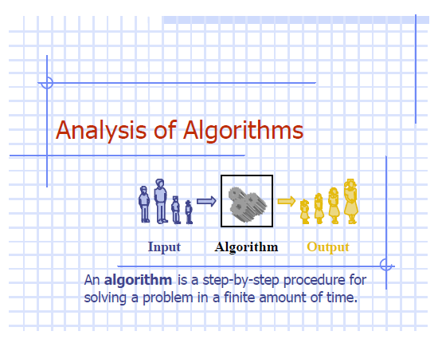

Slide 4
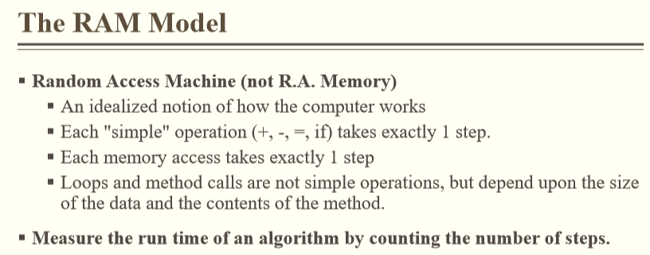

Slide 5
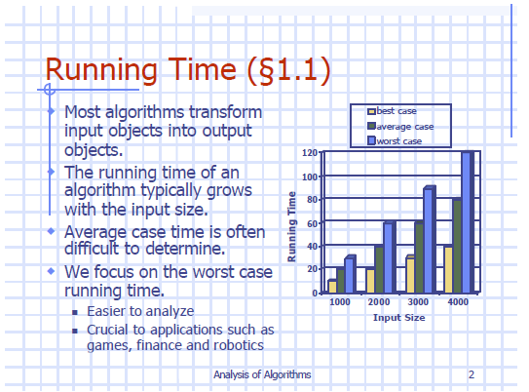

Slide 6
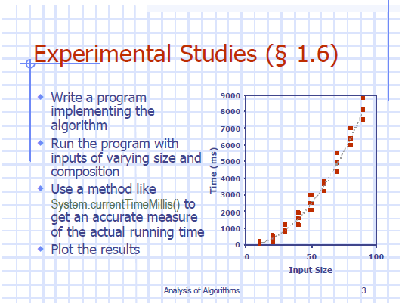

Slide 7
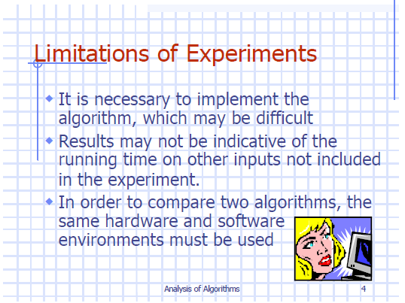

Slide 8
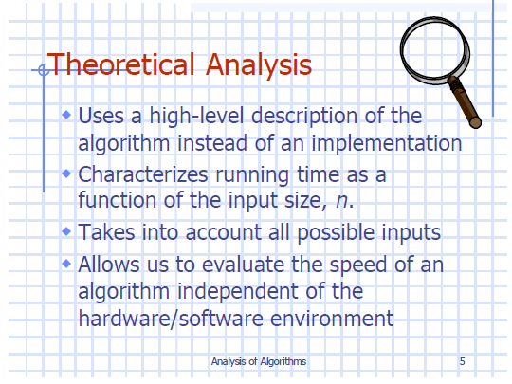

Slide 9
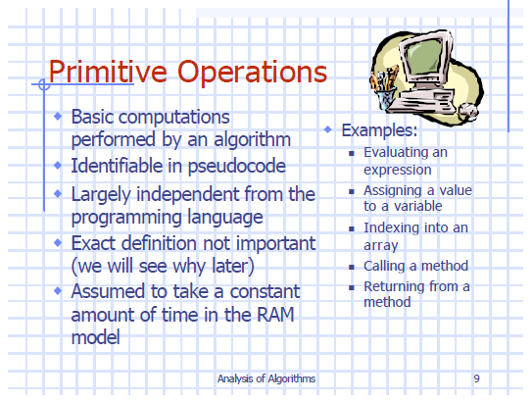

Slide 10
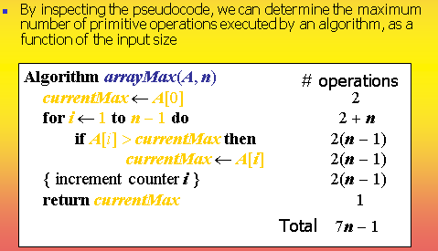

Slide 11
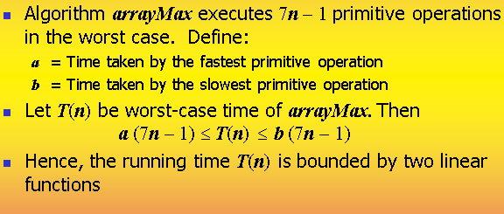

Slide 12
Counting primitive operations
Algorithm ArrayMax(A, n) | #Operations | Remarks
CurrentMax = A [0] i = 1 while (i<n) if A[i] > CurrentMax CurrentMax = A[i] i = i + 1 return CurrentMax | 2 1 n 2 (n-1) 2 (n-1) 2 (n-1) 1 | Indexing , Assignment Assignment Comparison (n-1) times indexing and comparison (n-1) times indexing and assignment [ assume if condition is true always ] (n-1) times addition and assignment returning
Max Total Primitive Operations = 2+1+n+ 6(n-1) +1 = 4 + n + 6n + 6 = 7n -2

Slide 13
Counting primitive operations
Algorithm ArrayMax(A, n) | #Operations | Remarks
CurrentMax = A [0] i = 1 while (i<n) if A[i] > CurrentMax CurrentMax = A[i] i = i + 1 return CurrentMax | 2 1 n 2 (n-1) 0 2 (n-1) 1 | Indexing , Assignment Assignment Comparison (n-1) times indexing and comparison [ assume if condition is false always ] (n-1) times addition and assignment returning
Min Total Primitive Operations = 2+1+n+ 4(n-1) +1 = 4 + n + 4n - 4 = 5n

Slide 14
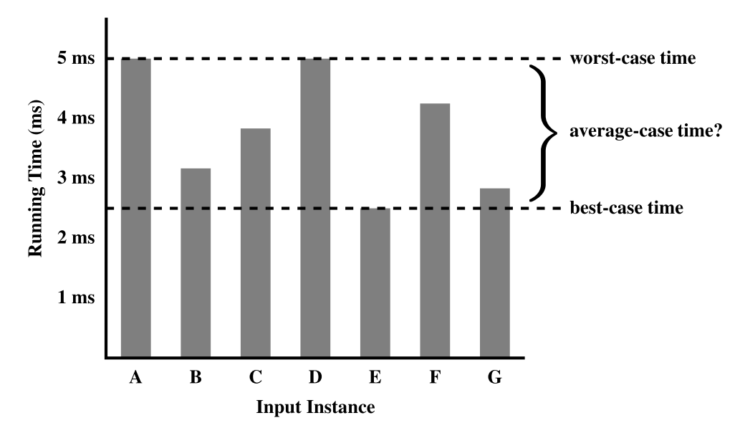
Estimating run time for ArrayMax
Max Total Primitive Operations = 7n -2
Min Total Primitive Operations = 5n
Let the time taken by ArrayMax on any input of size n is T(n).
Then, T(n) is bounded as below
5n <=T(n) <= 7n-2

Slide 15
Estimating run time for ArrayMax
Max Total Primitive Operations = 7n -2
Min Total Primitive Operations = 5n
Let the time taken by ArrayMax on any input of size n is T(n).
Then, T(n) is bounded as below
5n <=T(n) <= 7n-2

Slide 16
Ex-1 : Characterize runtime as a function of primitive operations
Algorithm Sum(a, b)
return a+b

Slide 17
Ex-2 : Characterize runtime as a function of primitive operations
Algorithm Compute1 (array a, int N)
j = 0;
while (j < N) do
a[j] = a[j] * a[j];
b[j] = a[j] + j;
j = j + 1;
endwhile;

Slide 18
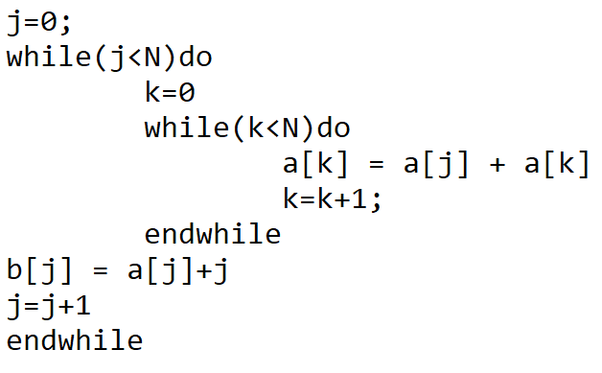
Ex-3 : Characterize runtime as a function of primitive operations
Algorithm Compute2 (array a, int N)

Slide 19
Ex-4 : Characterize runtime as a function of primitive operations
Algorithm Compute3 (array a, int N)
j = 0;
while (j < N) do
k = 0;
while (k < N) do
a[k] = a[j] + a[k];
k = k + 1;
endwhile;
b[j] = a[j] + j;
j = j + 1;
endwhile;

Slide 20
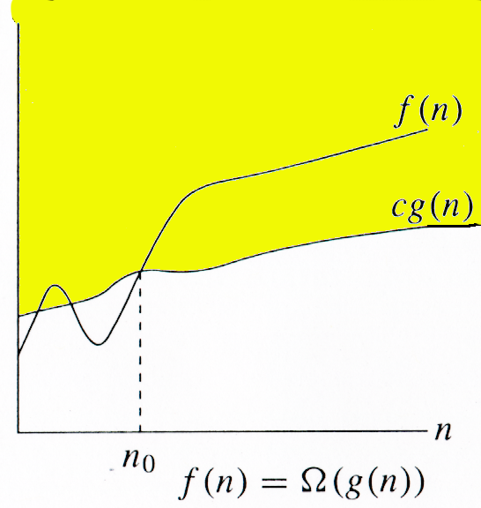
Ω -notation
For function f(n), we define Ω(g(n)), big-Omega of n, as the set:
Ω(g(n)) = {f(n) : ∃ positive constants c and n_{0,} such that ∀n ≥ n₀,
we have 0 ≤ cg(n) ≤ f(n)}
Intuitively: Set of all functions whose rate of growth is the same as or higher than that of g(n).
g(n) is an asymptotic lower bound for f(n).

Slide 21
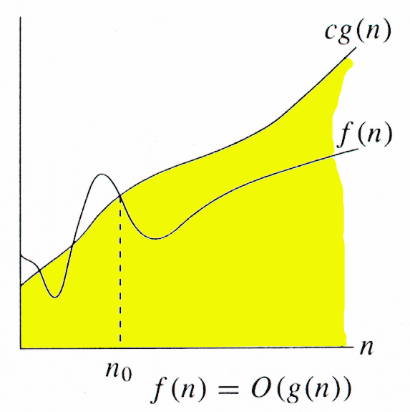
O-notation
For function f(n), we define O(g(n)), big-O of n, as the set:
O(g(n)) = {f(n) : ∃ positive constants c and n_{0,} such that ∀n ≥ n₀,
we have 0 ≤ f(n) ≤ cg(n) }
Intuitively: Set of all functions whose rate of growth is the same as or lower than that of g(n).
g(n) is an asymptotic upper bound for f(n).

Slide 22
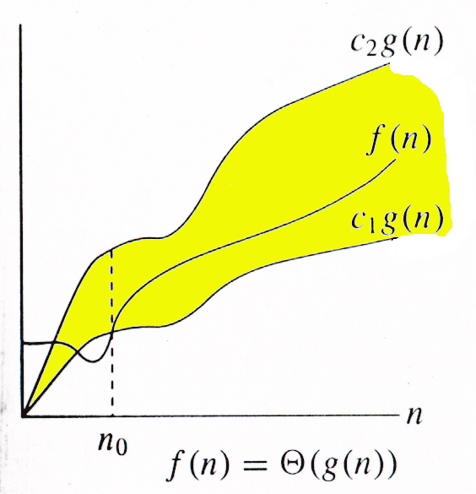
Θ-notation
For function f(n), we define Θ(g(n)), big-Theta of n, as the set:
Θ(g(n)) = {f(n) : ∃ positive constants c₁, c₂, and n_{0,} such that ∀n ≥ n₀,
we have 0 ≤ c₁g(n) ≤ f(n) ≤ c₂g(n)
}
Intuitively: Set of all functions that
have the same rate of growth as g(n).
g(n) is an asymptotically tight bound for f(n).
Notes:
∃ (a backwards E) or existential quantification, the symbol for "there exists...", in predicate logic; ∃! meaning "there exists only one" (or "there exists exactly one")

Slide 23
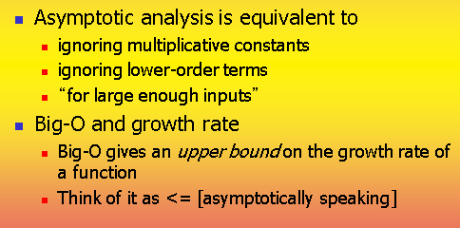

Slide 24
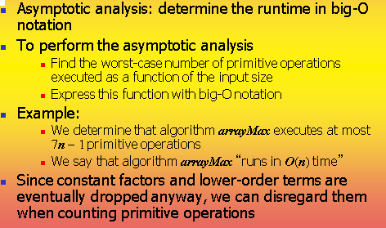

Slide 25
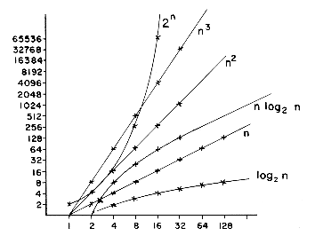

Slide 26
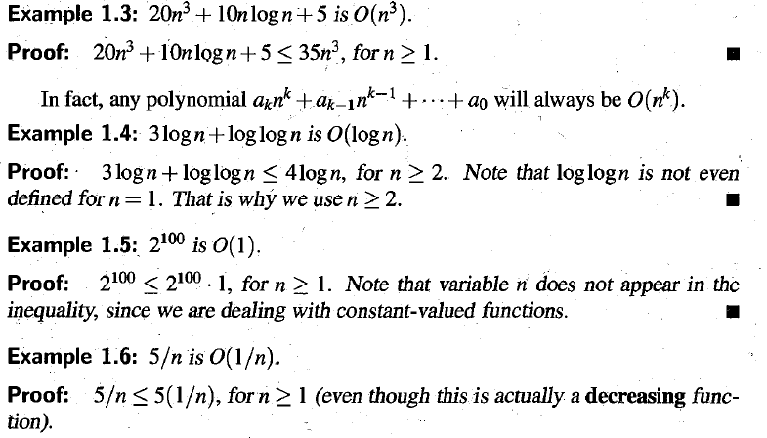

Slide 27
Correctness of an algorithm
It is said that the algorithm is correct with respect to a specification means it refers to the input-output behavior of the algorithm (i.e., for each input it produces the expected output)
There are different ways to check the correctness of the Algorithm. (Will discuss later)

