Slide 1
Data Structures Algorithm and Design DSECLZG519
Session-2

Slide 2
Analyzing Algorithms - Session 2

Slide 3
Recap..
Introduction to Algorithms
Characteristic of good algorithms
Need for RAM
How to analyze algorithms?
Pseudocode
Counting primitive operations
Asymptotic analysis
Asymptotic notations – Big O, Omega and Theta

Slide 4
Session plan
General Rules
Logarithmic functions
Complexity definitions
Recursive algorithm
Recurrence relations
Substitution methods
Master Methods (introduction)

Slide 5
Time Complexity

Slide 6
Asymptotic Algorithm Analysis - Quick glance
The asymptotic analysis of an algorithm determines the running time in big-Oh notation
To perform the asymptotic analysis
We find the worst-case number of primitive operations executed as a function of the input size
We express this function with big-Oh notation
Example:
We determine that algorithm arrayMax executes at most 7n − 1 primitive operations
We say that algorithm arrayMax “runs in O(n) time”
Since constant factors and lower-order terms are eventually dropped anyhow, we can disregard them when counting primitive operations

Slide 7
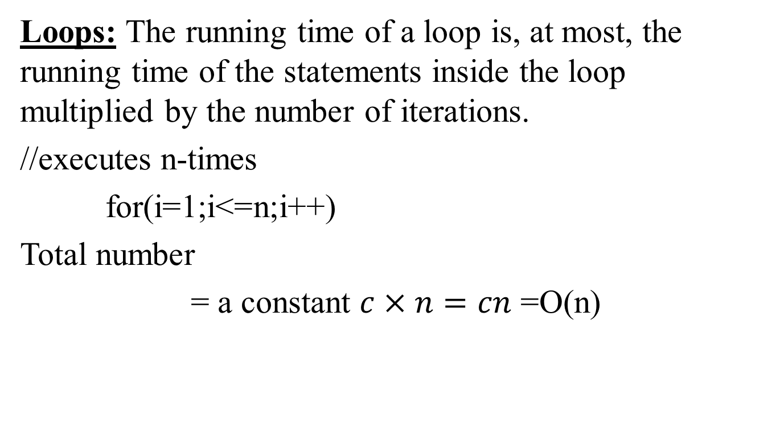
General rules to determine running time of algorithm

Slide 8
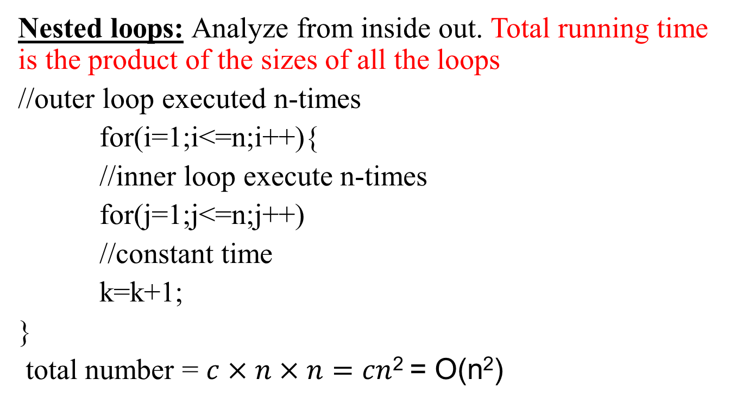
General rules to determine running time of algorithm (Cont..,)

Slide 9
General rules to determine running time of algorithm (Cont..,)
Consecutive statements: Add the time complexities of each statement.
//constant time
x=x+1;
//executed n-times
for(i=1;i<=n;i++)
//constant time
m=m+2;
//outer loop executed n-times
for(i=1;i<=n;i++){
//inner loop executed n-times
for(j=1;j<=n;j++)
//constant time
k= k+1;
}
Total time = c₀ + c₁n + c₂n² = O(n²)

Slide 10
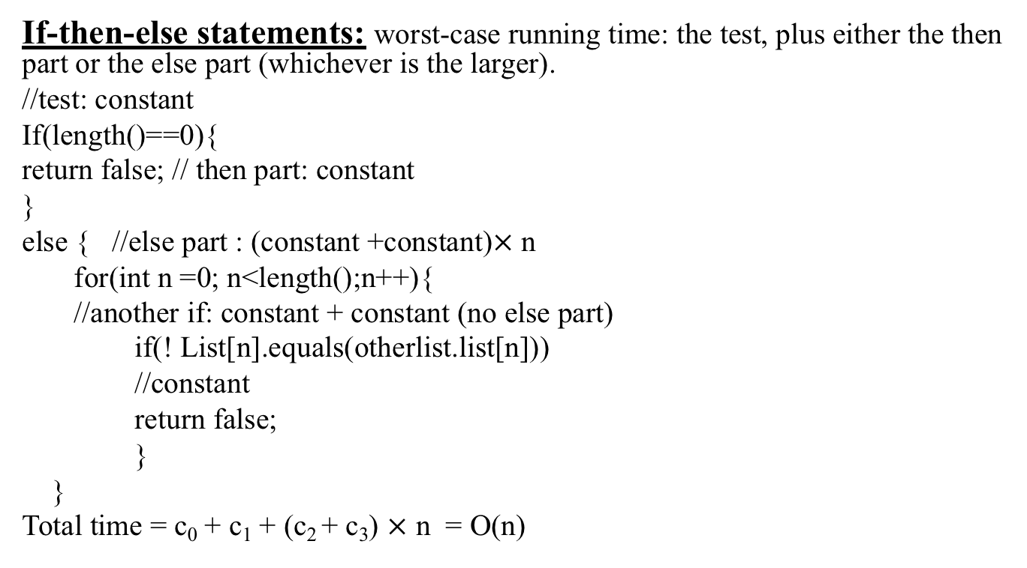
General rules to determine running time of algorithm (Cont..,)

Slide 11
Logarithmic function
Logarithmic functions are the inverse of exponential functions.
If a is b to the power c, i.e. b pow c = a, we also say that c is the logarithm of a to the base b (meaning c is the power to which we have to raise b in order to get a), and we write logb a = c.
For example:
log₁₀ 100 = 2 (since 10 pow 2 = 100 i.e., 10² = 100)
log₂ 8 = 3 (since 2 pow 3 = 8 i.e., 2³ = 8)

Slide 12
General rules to determine running time of algorithm (Cont..,)
Logarithmic complexity: an algorithm is O(logn) if it takes constant time to cut the problem size by a fraction (usually by ½)
As an example let us consider the following program
for(i=1; i<=n;)
i=i*2;
If we observe carefully, the value of i is doubling every time initially i=1, in next step i=2, and in subsequent steps i = 4,8 and soon.
Let us assume that the loop is executing some k-times.
At k^{th} step 2^{k}=n and we come out of loop
Taking logarithm on both sides, gives
log(2^{k}) = log n
klog2 = log n
k = log n // if we assume base ~ 2.
Total number = O(logn)
Notes:
An algorithm, would take a logarithm of complexity, it cut the problems I size by a fraction of time and usually by 1 by 2. For an instance if you consider the following program where there is an increment happens by multiplying I into 2 and if you observe carefully the value of I is doubling every time that means initially I use one then the next step I becomes two and then in the subsequent steps 48 and so on let us assume that you know the loop executes 4K times select this step we can write something like this it is 2 to the power of K equal to young it means every time in the iteration it is incrementing in terms of two to the power of key now if you apply the mathematics update log at the boot site so it becomes K log to log in K log to base two is equal to 1 so it becomes K log in or I would say it is or log in in big of log in

Slide 13
Problem-1
What is the complexity of the program given below
void function (int n){
//outer loop executes n/2- times
for (i =n/2; i<=n; i++)
//middle loop executes n/2
for (j=1;j+n/2<=n;j=j++)
//loop execute logn times
for (k=1;k<=n;k=k*2)
count++;
}
Time complexity of the above function is O(n²logn)

Slide 14
Problem-2
function (int n){
//constant time
if(n==1) return;
//outer loop execute n times
for (int i =1;i<=n;i++){
// inner loop executes only time due to break statement
for (int j =1;j<=n;j++){
printf(“*”);
break;
}
}
}
Time complexity of the above function is?

Slide 15
Complexity Definition
Linear Complexity: Processing time or storage space is directly proportional to the number of input elements to be processed.
Quadratic complexity: An algorithm is of quadratic complexity if the processing time is proportional to the square of the number of input elements.
Cubic complexity: In the case of cubic complexity, the processing time of an algorithm is proportional to the cube of the input elements.
Logarithmic complexity: An algorithm is of logarithmic complexity if the processing time is proportional to the logarithm of the input elements. The logarithm base is typically 2

Slide 16
Recursive Algorithm

Slide 17
Analyzing Recursive Algorithms
Recursive calls:-A procedure P calling itself-calls to P are for
solving sub problems of smaller size.
Recursive procedure call should always define a base case.
Base case-small enough that it can be solved directly without
using recursion.
11/5/2018
Data Structures and Algorithms Design
Page 3

Slide 18
Analyzing Recursive Algorithms
Algorithm recursiveMax(A,n)
// Input : An array A storing n>=1 integers
//Output: The maximum element in A if n = 1 then
return A[0]
return max{ recursiveMax(A,n-1),A[n-1]}
11/5/2018
Data Structures and Algorithms Design
Page 4

Slide 19
Analyzing Recursive Algorithms
A recurrence is an equation or inequality that describes a function in terms of its value on smaller inputs.
Recurrence equation: defines mathematical statements that the running time of a recursive algorithm must satisfy
Analysis of recursiveMax
– T(n)-Running time of algorithm on an input size n
T(n) =
3
T(n-1) + 7
if n=1
otherwise
11/5/2018
Data Structures and Algorithms Design
Page 5

Slide 20
Analyzing Recursive Algorithms
General Plan
Identify the parameter to be considered based on the size of the input.
Identify the basic operation in the algorithm
Obtain the number of times the basic operation is executed.
Obtain an initial condition-base case
Obtain a recurrence relation
Solve the recurrence relation and obtain the order of growth and
express using asymptotic notations.
11/5/2018
Data Structures and Algorithms Design
Page 6

Slide 21
Analyzing Recursive Algorithms- Example 1:-Factorial of a number
– Algorithm fact(n)
//Purpose: Computes factorial of n
//Input: A positive integer n
//Output: factorial of n If(n=0)
return 1
return n*fact(n-1)
11/5/2018
Data Structures and Algorithms Design
Page 7

Slide 22
Analyzing Recursive Algorithms- Example 1:-Factorial of a number
Analysis
Parameter to be considered –n
Basic operation –Multiplication
– T(n) =
0
1+T(n-1)
if n=0
Otherwise
Time taken to compute fact(n-1)
Time to multiply n*fact(n-1)
11/5/2018
Data Structures and Algorithms Design
Page 8

Slide 23
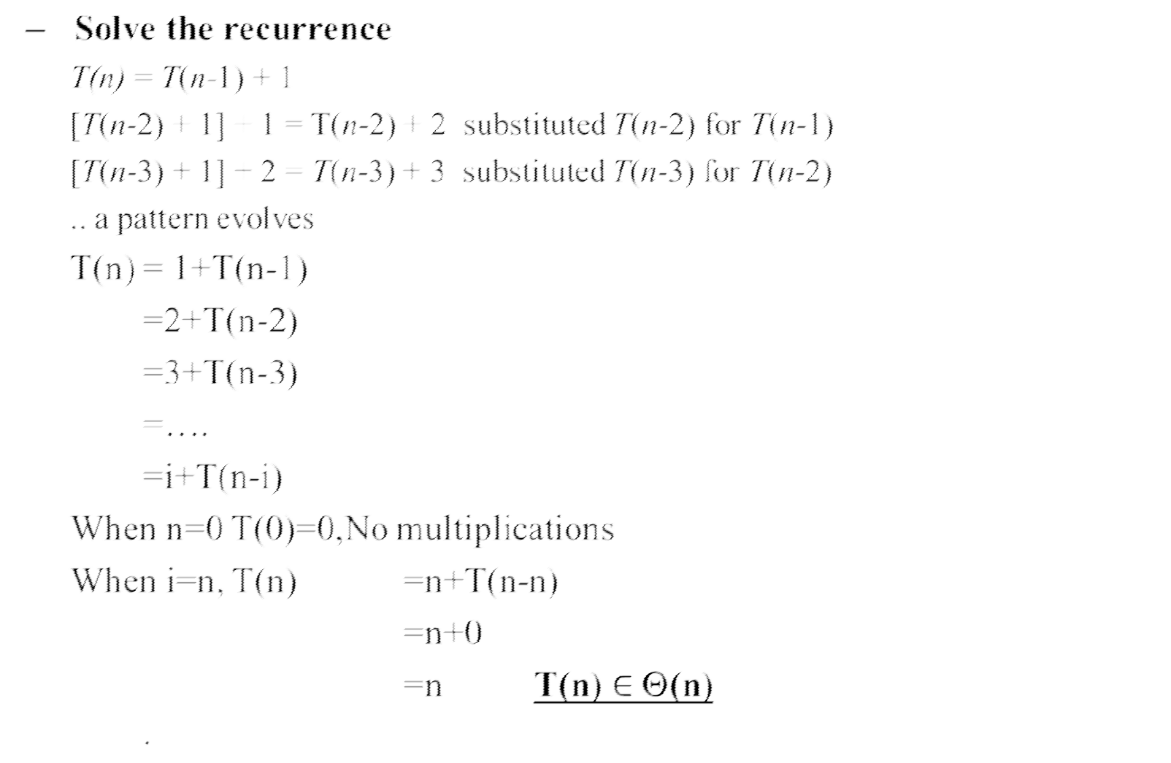
Analyzing Recursive Algorithms- Example 1:-Factorial of a number
•
Even if we stop recursion at n=1, then
i+T(n-i)
= (n-1) +T(n-(n-1))
= n - 1 +T(n - n +1)
= n - 1 +T(1)
= n – 1 + 1
= n
11/5/2018
Data Structures and Algorithms Design
Page 9

Slide 24
Assignment - Practice Problem Analyzing Recursive Algorithms- Example 2:-Tower of hanoi
Step 1 − Move n-1 disks from source to temp Step 2 − Move n^{th} disk from source to dest Step 3 − Move n-1 disks from temp to dest Algorithm Hanoi(n, source, dest, temp)
//Input: n :number of disks
//Output :All n disks on dest If disk = 1
move disk from source to dest
Hanoi(n - 1, source, temp, dest) // Step 1 move nth disk from source to dest // Step 2 Hanoi(n - 1, temp, dest, source) // Step 3
11/5/2018
Data Structures and Algorithms Design
Page 10

Slide 25
Assignment - Practice Problem Analyzing Recursive Algorithms- Example 2:-Tower of hanoi
Problem size is n, the number of discs
The basic operation is moving a disc from rod to another
Base case M(1) = 1
Recursive relation for moving n discs
M(n) = M(n-1) + 1 + M(n-1) = 2M(n-1) + 1
11/5/2018
Data Structures and Algorithms Design
Page 11

Slide 26
Assignment - Practice Problem Analyzing Recursive Algorithms- Example 2:-Tower of hanoi
Solve using backward substitution
M(n)
= 2M(n-1) + 1
= 2[2M(n-2) + 1] +1 = 2²M(n-2) + 2+1
=2²[2M(n-3) +1] + 2+1
= 2³M(n-3) + 2² + 2 + 1
...
= 2^{i}M(n-i) + 2^i-1+2^i-2+….+2^3+2^2+2^1+2^0
M(n)
M(n)
= 2^{i}M(n-i) + (2^i-1)/(2-1) It’s a GP with a=1,r=2,n=i
= 2^{i}M(n-i) + 2^i-1
11/5/2018
Data Structures and Algorithms Design
Page 12
Notes:
A geometric progression is a sequence in which each term is derived by multiplying or dividing the preceding term by a fixed number called the common ratio. ... The general form of a GP is a, ar, ar², ar³ and so on.
The nth term of a GP series is T_{n} = ar^{n-1}, where a = first term and r = common ratio = T_{n}/T_{n-1}) .
The formula applied to calculate sum of first n terms of a GP: a (r^{n} – 1)/ (r- 1)

Slide 27
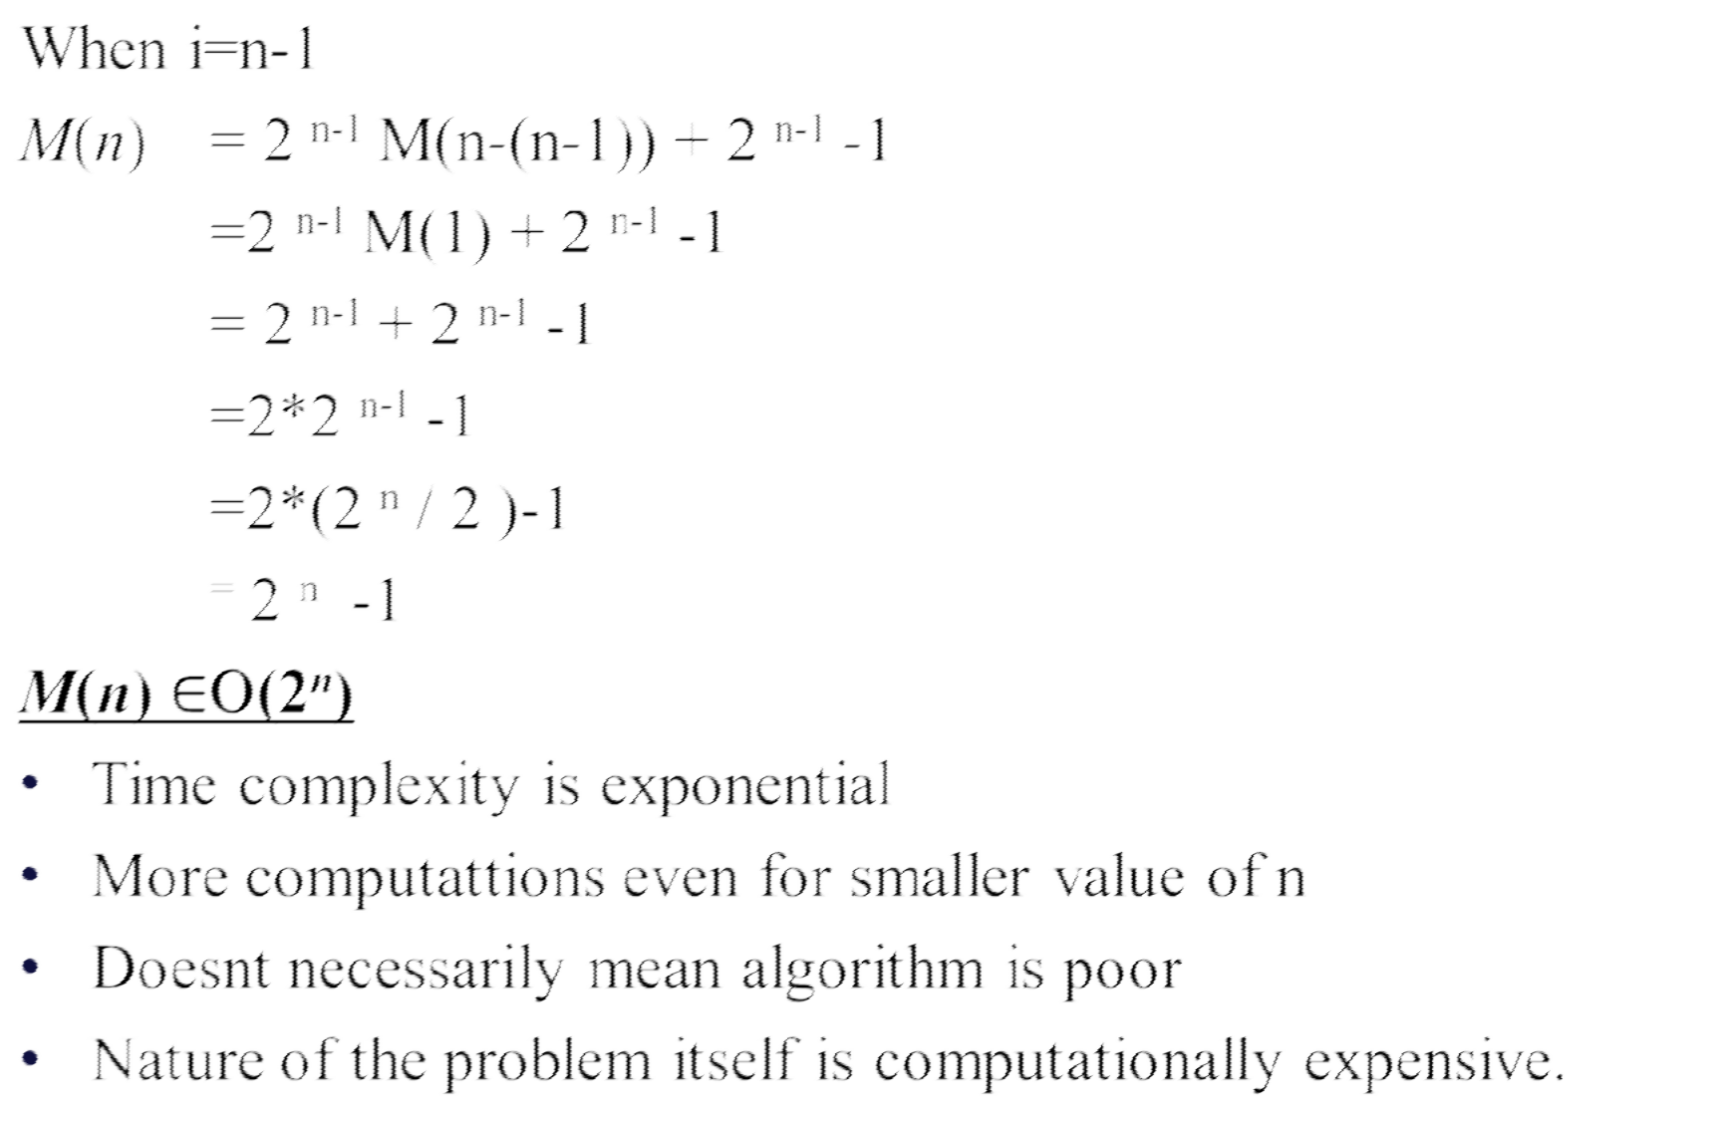
Assignment - Practice Problem Analyzing Recursive Algorithms- Example 2:-Tower of hanoi
•
11/5/2018
Data Structures and Algorithms Design
Page 13
Notes:
The formula applied to calculate sum of first n terms of a GP: a (r^{n} – 1)/ (r- 1)

Slide 28
Analyzing Recursive Algorithms-Example 3:Exercise
ALGORITHM BinRec(n)
//Input: A positive decimal integer n
//Output: The number of binary digits in n’s binary representation
if n = 1 return 1
else return BinRec(n/2) + 1
Let us set up a recurrence and an initial condition for the number of additions A(n) made by the algorithm. The number of additions made in computing
BinRec(n/2) is A(n/2), plus one more addition is made by the algorithm to increase the returned value by 1. This leads to the recurrence
A(n) = A(n/2) + 1 for n > 1.
A(1)=0

Slide 29
Analyzing Recursive Algorithms-Example 3:Exercise
Base condition A(1)= 0
A(n)=2A(n/2)+1
The presence of n/2 in the function’s argument makes the method of backward substitutions stumble on values of n that are not powers of 2. Therefore, the standard approach to solving such a recurrence is to solve it only for n = 2^{k} and then take advantage of the theorem called the smoothness rule, which claims that under very broad assumptions the order of growth observed for n = 2^{k} gives a correct answer about the order of growth for all values of n.

Slide 30
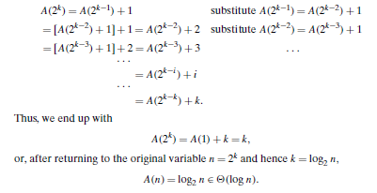
Analyzing Recursive Algorithms-Example 3:Exercise
A(2^{k}) = A(2 ^{k−1}) + 1 for k > 0,
A(2⁰) = 0.

Slide 31
Assignment - Practice Problem Analyzing Recursive Algorithms- Example 3:Exercise
Solve the recurrence
Base condition T(1)= 0
T(n)=2T(n/2)+cn
11/5/2018
Data Structures and Algorithms Design
Page 14

Slide 32
Solving recurrences : Substitution Method
11/5/2018
Data Structures and Algorithms Design
Page 15

Slide 33
Solving recurrences : Substitution Metho
The most general method
Guess the form of the solution.
Use mathematical induction to find the constants and show that the solution works.
We must be able to guess the form of the answer in order to
apply it.
11/5/2018
Data Structures and Algorithms Design
Page 16

Slide 34
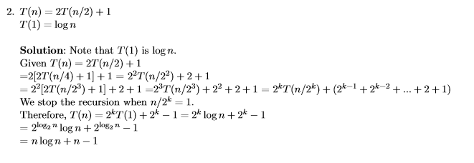
Solving recurrences : Substitution Method
11/5/2018
Data Structures and Algorithms Design
Page 17

Slide 35
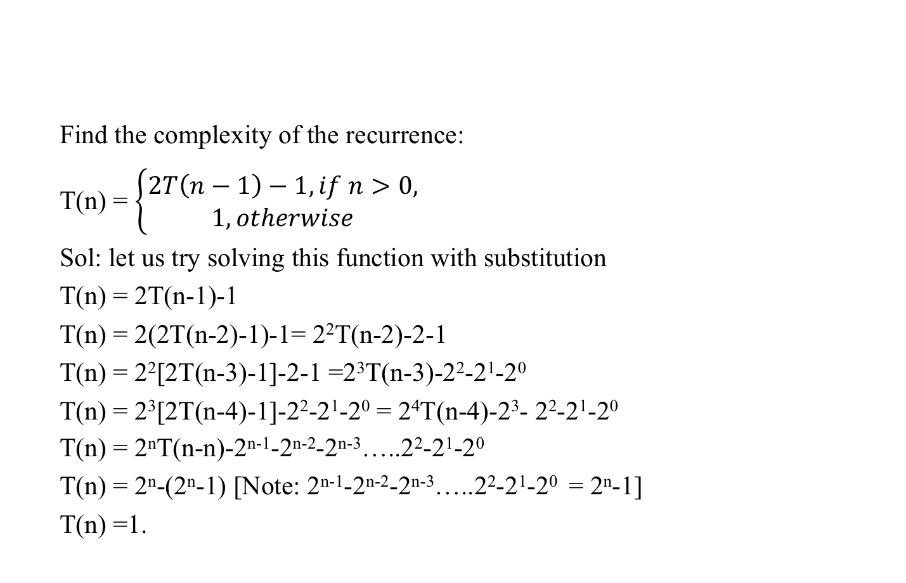
Assignment Practice - Problem-2
Find the complexity of the recurrence:
T(n) = $\left\{\begin{aligned}2T\left(n−1\right)−1, if n>0, \\ 1, otherwise\end{aligned}\right.$
Sol: let us try solving this function with substitution
T(n) = 2T(n-1)-1
T(n) = 2(2T(n-2)-1)-1= 2²T(n-2)-2-1
T(n) = 2²[2T(n-3)-1]-2-1 =2³T(n-3)-2²-2¹-2⁰
T(n) = 2³[2T(n-4)-1]-2²-2¹-2⁰ = 2⁴T(n-4)-2³- 2²-2¹-2⁰
T(n) = 2^{n}T(n-n)-2^{n-1}-2^{n-2}-2^{n-3}…..2²-2¹-2⁰
T(n) = 2^{n}-(2^{n}-1) [Note: 2^{n-1}-2^{n-2}-2^{n-3}…..2²-2¹-2⁰ = 2^{n}-1]
T(n) =1.

Slide 36
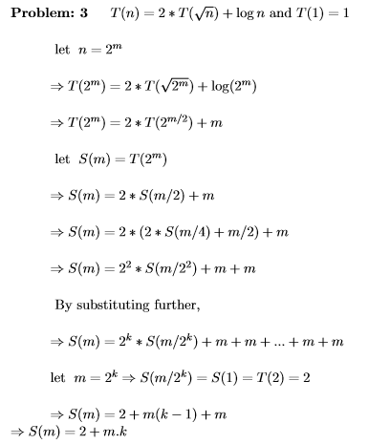
Assignment - Practice Problem

Slide 37
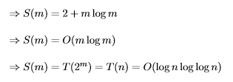

Slide 38
Solving recurrences: Master method
The master method applies to recurrences of the form
T(n) = a T(n/b) + f (n) ,
where a ≥ 1, b > 1, and f is asymptotically positive.
(f(n)>0 for n>=n0)

Slide 39
Master Theorem
Let T(n) be a monotonically increasing function that satisfies
T(n) = a T(n/b) + f(n)
T(1) = c
where a ≥ 1, b ≥ 2, c>0. If f(n) is Θ(n^{d}) where d ≥ 0 then
 |  | if a < b^{d}
T(n) = |  | If a = b^{d}
 |  | if a > b^{d}
Notes:
In mathematics, a monotonic function (or monotone function) is a function between ordered sets that preserves or reverses the given order. This concept first arose in calculus, and was later generalized to the more abstract setting of order theory.
In mathematics, a polynomial is an expression consisting of variables (or indeterminates) and coefficients, that involves only the operations of addition, subtraction, multiplication, and non-negative integer exponents. An example of a polynomial of a single indeterminate x is x² − 4x + 7. An example in three variables is x³ + 2xyz² − yz + 1.

Slide 40

The master theorem concerns recurrence relations of the form:
In the application to the analysis of a recursive algorithm, the constants and function take on the following significance:
n is the size of the problem.
a is the number of subproblems in the recursion.
n/b is the size of each subproblem.
(Here it is assumed that all subproblems are essentially the same size.)
f (n) is the cost of the work done outside the recursive calls, which includes the cost of dividing the problem and the cost of merging the solutions to the subproblems.

Slide 41
Master Theorem: Example 1
Let T(n) = T(n/2) + ½ n² + n. What are the parameters?
a =
b =
d =
Therefore, which condition applies?
1
2
2
1 < 2², case 1 applies
We conclude that
T(n) ∈ Θ(n^{d}) = Θ (n²)

Slide 42
Will be discussed in detail later (during divide and conquer)

Slide 43
Additional reading

Slide 44
Master Methods
Explain the master Method
A utility method for analysis recurrence relations
Useful in many cases for divide and conquer algorithms.
These recurrence relations are of the forms:
T(n) = aT(n/b)+f(n) where a> = 1, b>1
n = the size of the current problem
a = the number of sub-problems in the recursion.
n/b = the size of each subproblem
f(n) = the cost of work that has to de done outside the recursive calls (Cost of dividing + merging).

Slide 45
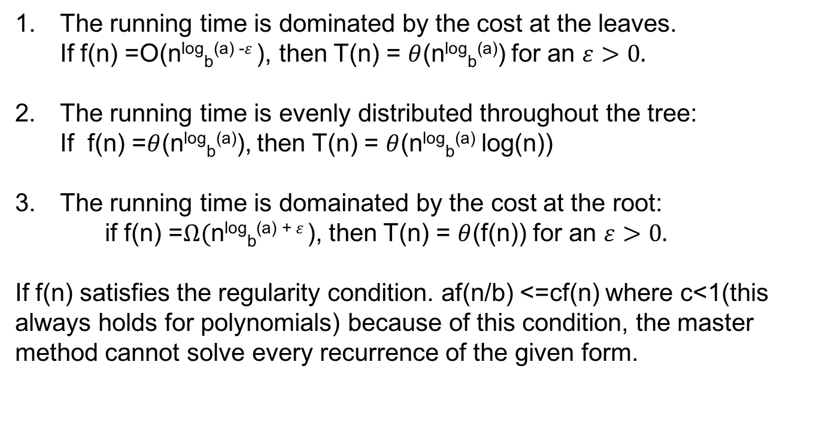
Master Theorem case

Slide 46
How to apply the master method(step by step)
Extract a,b and f(n) form a given recurrence
Determine n^{log}_{b}ª
Compare f(n) and n^{log}_{b}ª asymptotically.
Determine the appropriate Master method case and apply it

Slide 47
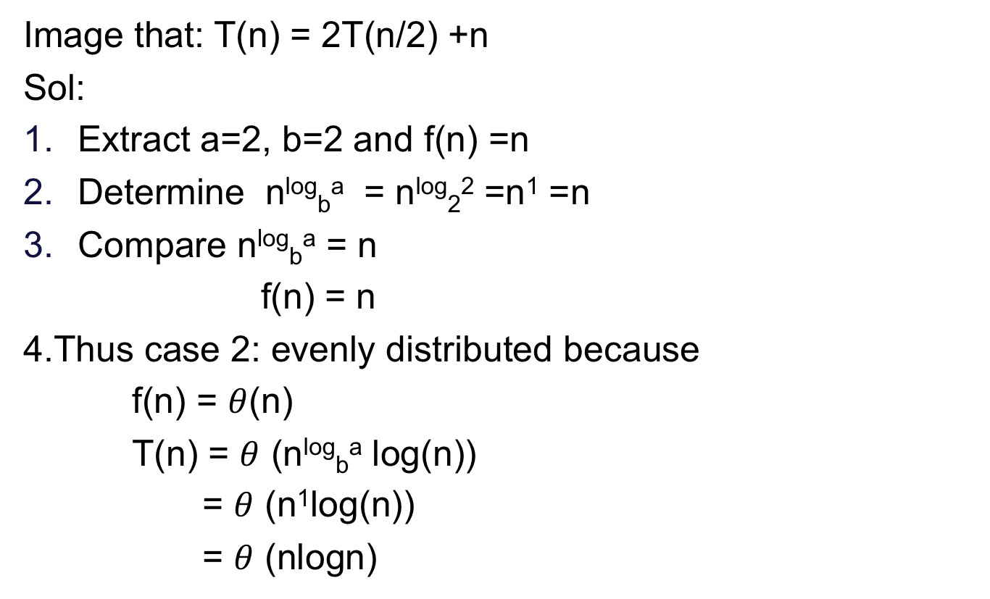
For each case an exercise[Ex:-1]

Slide 48
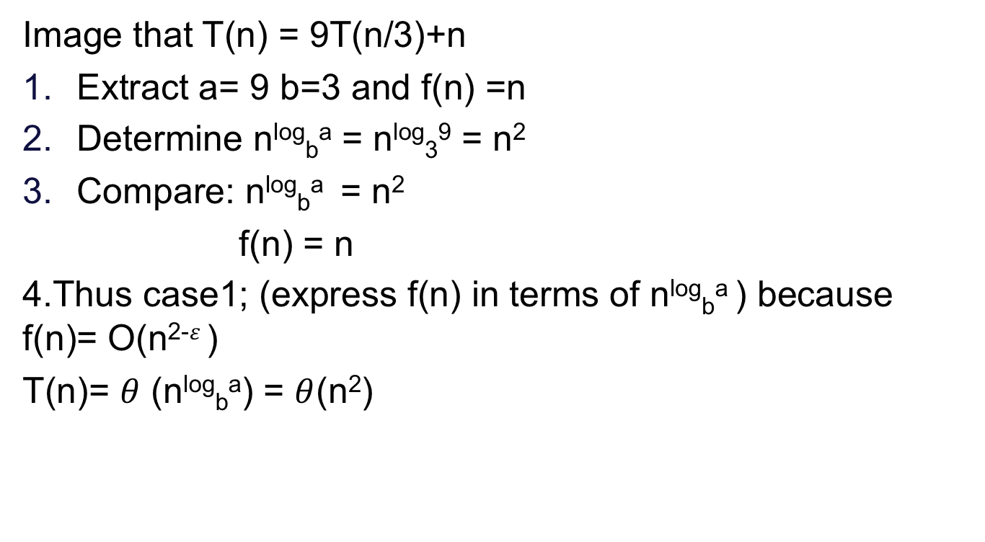
Example: 2

Slide 49
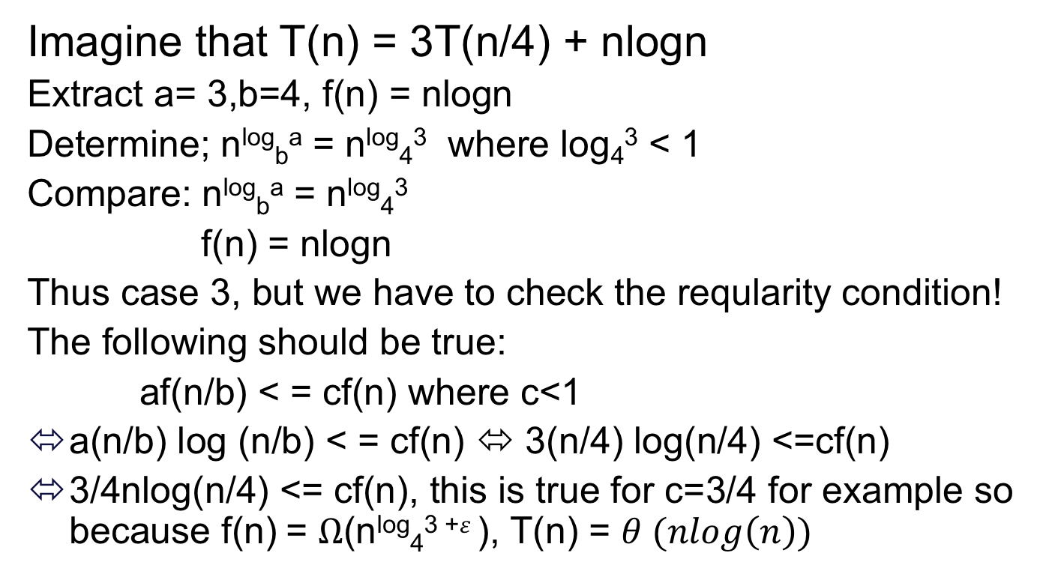
Example: 3

Slide 50
Method of solving recurrences
Substitution method
Recursion-tree method
Master method

Slide 51
Recurrence Relation
(Recursion –tree Method)
void test(int n)
{
if(n>0)
{
printf(“%d”,n);
test(n-1);
}
}
Test (3)
3
Test (2)
2
Test (1)
1
Test ()

Slide 52
Solving recurrences : Recursion tree
Solve T(n) = T(n/4) + T(n/2) + n²:
T(n)
11/5/2018
Data Structures and Algorithms Design
Page 20

Slide 53
Solving recurrences : Recursion tree
Solve T(n) = T(n/4) + T(n/2) + n²:
_{n}2
T(n/4)
T(n/2)
11/5/2018
Data Structures and Algorithms Design
Page 21

Slide 54
Solving recurrences : Recursion tree
Solve T(n) = T(n/4) + T(n/2) + n²:
_{n}2
(n/4)²
(n/2)²
T(n/16)
T(n/8)
T(n/8)
T(n/4)
11/5/2018
Data Structures and Algorithms Design
Page 22

Slide 55
Solving recurrences : Recursion tree
Solve T(n) = T(n/4) + T(n/2) + n²:
_{n}2
(n/4)²
(n/2)²
(n/16)²
(n/8)²
(n/8)²
(n/4)²
O(1)
11/5/2018
Data Structures and Algorithms Design
Page 23

Slide 56
Solving recurrences : Recursion tree
Solve T(n) = T(n/4) + T(n/2) + n²:
_{n}2
_{n}2
(n/4)²
(n/2)²
(n/16)²
(n/8)²
(n/8)²
(n/4)²
O(1)

Slide 57
Solving recurrences : Recursion tree
Solve T(n) = T(n/4) + T(n/2) + n²:
_{n}2
_{n}2
5 _{n2}
(n/4)²
(n/16)² (n/8)²
(n/2)²
(n/8)² (n/4)²
16
O(1)

Slide 58
Solving recurrences : Recursion tree
Solve T(n) = T(n/4) + T(n/2) + n²:
_{n}2
_{n}2
5 _{n2}
(n/4)²
(n/2)²
16
(n/16)²
(n/8)²
(n/8)²
(n/4)² ²⁵ n²
256
…
O(1)

Slide 59
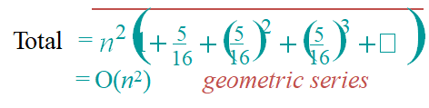
Solving recurrences : Recursion tree
Solve T(n) = T(n/4) + T(n/2) + n²:
_{n}2
_{n}2
5 _{n2}
(n/4)²
(n/2)²
16
(n/16)²
(n/8)²
(n/8)²
(n/4)² ²⁵ n²
256
…
O(1)

Slide 60
Thank You!!

