Slide 1
Data Structures and Algorithms Design DSECLZG519

Slide 2
Contact Session #3
DSECLZG519 – Abstract Data Types

Slide 3
Agenda for CS #3
1) Recap of CS#2
2) Abstract Data type
3) Stacks
Stack implementation using array
Stack applications
Expression Evaluation
Infix to postfix conversion
4) Queues
Queue implementation using array
Circular Queue
Applications of Queue
5) Linked List
Singly Linked list
Doubly Linked list – Insertion & Deletion
6) Stack & Queue implementation using linked list
7) Introduction to Amortized analysis

Slide 4
Abstract Data Type
The Data Type is basically a type of data that can be used in different computer program. It signifies the type like integer, float etc., the space like integer will take 4-bytes, character will take 1-byte of space etc.
The abstract datatype is special kind of datatype, whose behavior is defined by a set of values and set of operations. The keyword “Abstract” is used as we can use these datatypes, we can perform different operations. But how those operations are working that is totally hidden from the user. The ADT is made of with primitive datatypes, but operation logics are hidden.
Abstract Data Type :
In computer science, an abstract data type (ADT) is a mathematical model for a certain class of data structures that have similar behavior.
A method for achieving abstraction for data structures and algorithms
ADT = model + operations
Describes what each operation does, but not how it does it
An ADT is independent of its implementation

Slide 5
Operations on Data
Typical operations on data
Add data to a data collection (insert)
Remove data from a data collection (delete)
Ask questions about the data in a data collection (search, exists etc.)

Slide 6
Linear Data Structures
Data is organized in a linear fashion.
Simple ADTs, example :
Stack
Queue
Vector
Arrays and Lists
Sequences
All these are called Linear Data Structures

Slide 7
Non-linear Data Structures
Data is not organized in a linear fashion.
Relationship exists among data.
Examples :
Trees
Graphs

Slide 8
Arrays
Array is a finite set of homogeneous elements stored in adjacent/contiguous memory locations. It is represented by a single name.
Each location element is identified by a single name with its index. The first element is A[0], the second element is A[1] and so on ..
If there are N elements in the array, the last element will be
A[N-1].
A[0]
A[1]
…………………………….
A[N-1]

Slide 9
Stacks
A stack is a container of objects that are inserted and removed according to the last-in-first-out (LIFO) principle.
Objects can be inserted at any time, but only the last (the most-recently inserted) object can be removed.
Inserting an item is known as “pushing” onto the stack. “Popping” off the stack is synonymous with removing an item.
Pushing and popping happens only in one end called the top.

Slide 10
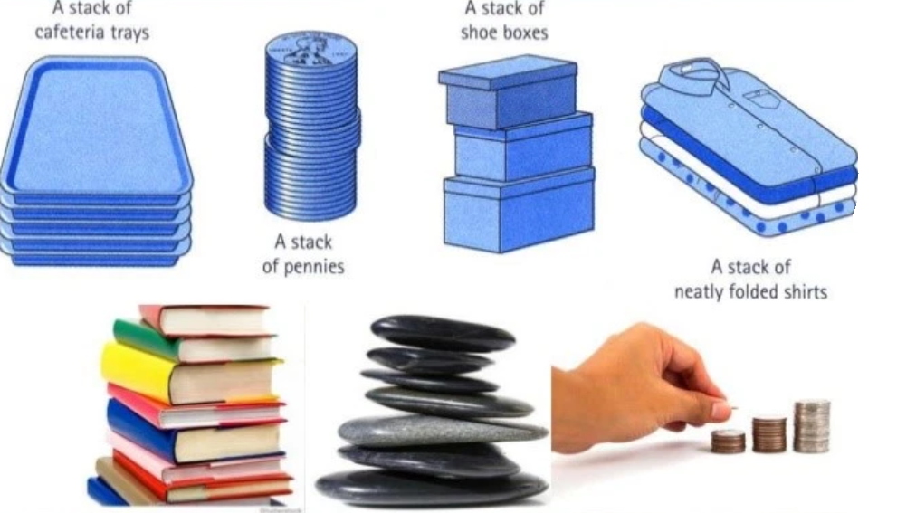


Stacks

Slide 11
Stacks: An Array Implementation
Create a stack S using an array by specifying a maximum size N for our stack.
The stack consists of an N-element array S and an integer variable t, the index of the top element in array S.
Array indices start at 0, so we initialize t to -1

Slide 12
Stacks: An Array Implementation
Pseudo code
Algorithm push(o) if size()==N then return Error/Overflow t=t+1 S[t]=o
Algorithm pop() if isEmpty() then return Error/Underflow e= S[t]
S[t] = null
t=t-1
return e
Algorithm size() return t+1
Algorithm isEmpty() if t == -1
return true
return false
Algorithm top() if isEmpty() then return Error return S[t]

Slide 13
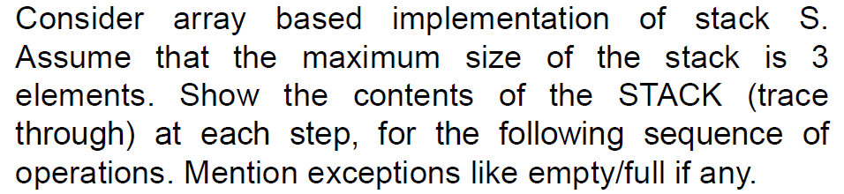
Operations on Stack Demo

Slide 14
Stacks: An Array Implementation
The array implementation is simple and efficient
(methods performed in O(1)).
Disadvantage
There is an upper bound, N, on the size of the stack.
The arbitrary value N may be too small for a given application OR a waste of memory.

Slide 15
Applications of Stack
Stacks can be used for expression evaluation.
Stacks can be used for Conversion from one form of expression to another.
Stacks can be used to check parenthesis matching in an expression.
Stack data structures are used in backtracking problems (recursion).

Slide 16
Forms of Expression
Arithmetic expressions can be written in 3 different forms or notations :
Infix Notation : Notation in which the operator symbol is placed in between its operands. Ex : A + B , C – D , A * D etc.
Pre-fix Notation : It is also called as Polish notation and refers to the notation in which the operator symbol is placed before its operands (when operator precedes the operands). Ex : +AB, -CD, *AD etc.
Post-fix Notation : It is also called as reverse polish notation and refers to the notation in which the operator symbol is placed after its operands (when operator follows the operands). Ex : AB+ , CD- , AD*

Slide 17
Forms of Expression
Examples :
The computer usually evaluates an arithmetic expression in infix notation in 2 steps. First, it converts the expression to postfix notation, and then it evaluates the postfix expression. In both these steps, the stack is used !! Let us examine how stack is used ☺
# | Infix | Prefix | Postfix
1 | (A+B) * C | *+ABC | AB+C*
2 | A + ( B * C ) | +A*BC | ABC*+
3 | A ^ B * C – D | - * ^ ABCD | AB ^ C * D -
4 | (A+B)/(C-D) | /+AB-CD | AB+CD-/

Slide 18
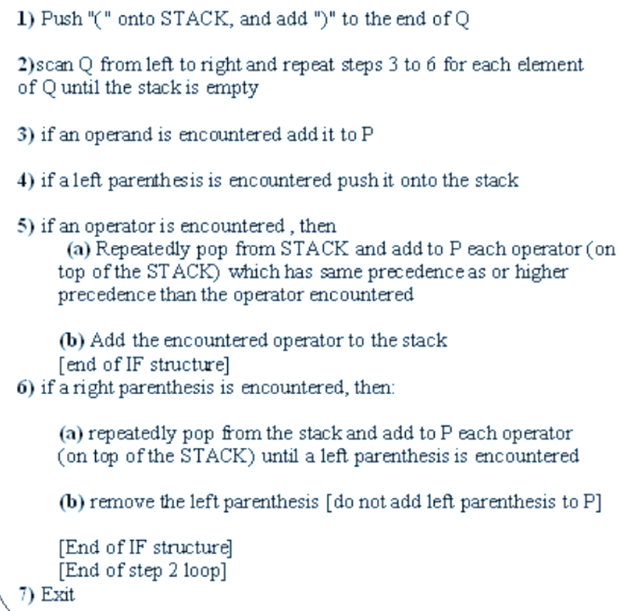
Algorithm: Infix to Postfix using Stack
The following algorithm transforms the infix expression Q into its equivalent postfix expression P.

Slide 19
Example : Converting Infix to Postfix using Stack
Consider the infix expression Q to be A + B * C → A+B*C)
Hence, the postfix expression P is ABC*+
# | Symbol Encountered | Postfix String P (Output) | STACK Contents
1 |  |  | (
2 | A | A | (
3 | + | A | (+
4 | B | AB | (+
5 | * | AB | (+*
6 | C | ABC | (+*
7 | ) | ABC* | (+
8 | - | ABC*+ | (
9 | - | ABC*+ | Empty

Slide 20
Example : Converting Infix to Postfix using Stack
Consider the infix expression Q to be (A+B) * C ➔ (A+B) * C )
Hence, the postfix expression P is AB+C*
# | Symbol Encountered | Postfix String P (Output) | STACK Contents
1 |  |  | (
2 | ( |  | ((
3 | A | A | ((
4 | + | A | ((+
5 | B | AB | ((+
6 | ) | AB+ | (
7 | * | AB+ | (*
8 | C | AB+C | (*
9 | ) | AB+C* | Empty
10 | - | AB+C* | Empty

Slide 21
Algorithm: Evaluation of Postfix expression using Stack
Algorithm:
1) Add a right parentheses “)” at the end of the arithmetic expression F
2) Scan F from left to right and repeat step 3 and step 4 for each element of F until the sentinel “)” is encountered.
3) If an operand is encountered, put it onto stack
4) If an operator is encountered, then :
a. Remove the 2 top elements from the stack, where n1 is the top element and n2 is the next-to-top element.
b. Evaluate n2 n1
c. Place the result of (b) back on stack.
Endif
End of step 2 loop
5) Set value equal to the top element of stack.
6) Exit
X
X

Slide 22
Example: Evaluation of Postfix expression using stack
Evaluate AB+C-BA+C^- where A=1,B=2 and C=3
➔ 1 2 + 3 – 2 1 + 3 ^ - )
Symbol Encountered | N1 (top) | N2(2nd top) | Value = N2 op N1 | STACK
1 |  |  |  | 1
2 |  |  |  | 1 2
+ | 2 | 1 | 1+2 = 3 | 3
3 |  |  |  | 3 3
- | 3 | 3 | 3 -3 = 0 | 0
2 |  |  |  | 0 2
1 |  |  |  | 0 2 1
+ | 1 | 2 | 2+1 = 3 | 0 3
3 |  |  |  | 0 3 3
^ | 3 | 3 | 3^3 = 27 | 0 27
- | 27 | 0 | 0 – 27 = -27 | -27
) | - | - | -27 | Empty
Hence, the evaluation of this expression leads to the answer -27

Slide 23
Exercises
1) Convert the following infix expressions into postfix
expressions using stack ( trace it as we did in class ) :
A+(B+C)*D
B+C-D/E*F
(A+B)+(C/D)*E
A+B*(C+D-E)*F
2) Evaluate the following postfix expressions :
ABC+*CBA-+* where A=1,B=2 and C=3
5 7 5 - * 12 4 * 24 / 6 + + )
After you solve it, verify your answer by putting the infix expression in this tool : https://www.mathblog.dk/tools/infix-postfix-converter/
After you solve it, verify your answer by putting the postfix expression in this tool https://www.free-online-calculator-use.com/postfix-evaluator.html

Slide 24
Queues
A queue differs from a stack in that its insertion and removal routines follows the first-in-first-out (FIFO) principle.
Elements may be inserted at any time, but only the element which has been in the queue the longest may be removed.
Elements are inserted at the rear (enqueued) and removed from the front (dequeued)
Front
Queue
Rear

Slide 25
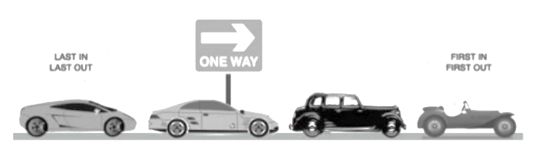

Queues

Slide 26
Queues
The queue supports three fundamental methods:
New():ADT – Creates an empty queue
Enqueue(S:ADT, o:element): - Inserts object o at the rear of the queue; an error occurs if the queue is full
Dequeue(S:ADT): - Removes the object from the front of the queue; an error occurs if the queue is empty
Front(S:ADT):element - Returns, but does not remove, the front element; an error occurs if the queue is empty

Slide 27
Queues: An Array Implementation
Create a queue using an array
A maximum size N is specified.
The queue consists of an N-element array Q and two integer variables:
f, index of the front element (head – for dequeue)
r, index of the element after the rear one (tail – for enqueue)
Initially, f=r=0 and the queue is empty if f=r

Slide 28
Queues
Disadvantage
Repeatedly enqueue and dequeue a single element N times.
Finally, f=r=N.
No more elements can be added to the queue, though there is space in the queue !!
Solution
Let f and r wraparound the end of queue (circular queue).

Slide 29
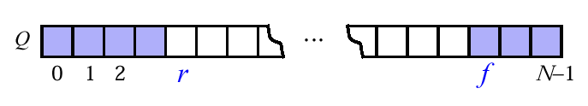
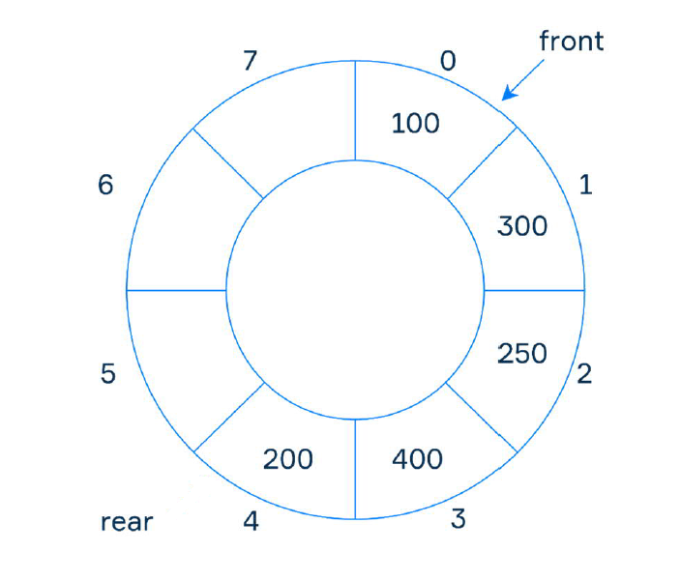
Queues: An Array Implementation
“wrapped around” configuration
Each time r or f is incremented, compute this increment as (r+1)modN or (f+1)modN

Slide 30
Queues: An Array Implementation
Pseudo code
Algorithm dequeue() if isEmpty() then return Error
o=Q[f]
Q[f]=null f=(f+1)mod N
return o
Algorithm enqueue(o) if size() = N - 1 then return Error Q[r]=o r=(r +1)mod N
Algorithm size() return (N-f+r) mod N
Algorithm isEmpty() return (f=r)
Algorithm front() if isEmpty() then return Error return Q[f]

Slide 31
Applications of Queue
Used in CPU scheduling
Used in Disk scheduling
Priority queue is used in heaps (We will learn about this later in the course)

Slide 32
Arrays: Pluses and minuses
+ Fast element access.
-- Impossible to resize.
Many applications require resizing!
Required size not always immediately available.

Slide 33
List ADT
A sequence of items where positional order matter
<a1, a2,…, an-1, an>
Lists are very general in computing
e.g. student list, list of events, list of appointments etc

Slide 34
List Operations
Supports the following methods for a list S:refer to relative positions in the list
first ( ):Return the position of the first element of S; an error occurs if S is empty.
last() :Return the position of the last element of S; an error occurs if S is empty.
isFirst(p ) :Return a Boolean value indicating whether the given position is the first one in the list.
islast (p ) : Return a Boolean value indicating whether the given position is the last one in the list.
before(p) :Return the position of the element of S preceding the one at position p; an error occurs if p is the first position.
after (p) ,size(),isEmpty(),insertAfter(), remove()

Slide 35
Singly Linked Lists
A singly linked list is a concrete data structure consisting of a sequence of nodes
Each node stores
element
link to the next node
next
elem
node
∅
A
B
C
D
35

Slide 36
Doubly Linked List
A doubly linked list is often more convenient!
Nodes store:
element
link to the previous node
link to the next node
Special trailer and header nodes
prev
next
elem
node
header
nodes/positions
trailer
elements

Slide 37
Insertion
We visualize operation insertAfter(p, X ) :
p
A
B
C
p
A
B
q
C
X
p
q
A
B
X
C

Slide 38
Insertion Algorithm
Algorithm insertAfter(p,e):
Create a new node v
v.setElement(e)
v.setPrev(p) {link v to its predecessor}
v.setNext(p.getNext()) {link v to its successor}
(p.getNext()).setPrev(v) {link p’s old successor to v}
p.setNext(v) {link p to its new successor, v}
return v {the position for the element e}
p
A
B
v
C
e

Slide 39
Deletion
We visualize remove(p)
p
A
B
C
D
A
B
C
p
D
A
B
C

Slide 40
Deletion Algorithm
Algorithm remove(p):
t = p.element {a temporary variable to hold the return value}
(p.getPrev()).setNext(p.getNext()) {linking out p}
(p.getNext()).setPrev(p.getPrev()) {linking out p}
p.setPrev(null) {invalidating the position p}
p.setNext(null)
return t
p
A
B
C
D

Slide 41
Worst-cast running time
In a doubly linked list
+ insertion at head or tail is in O(1)
+ deletion at either end is on O(1)
-- element access is still in O(n)

Slide 42
Stacks: Singly Linked List implementation
Nodes (data, pointer) connected in a chain by links
the head or the tail of the list could serve as the top of the stack

Slide 43
Queues: Linked List Implementation
Dequeue - advance head reference

Slide 44
Amortized Analysis
Some algorithms involve repeated calls to one or more data
structures
When analyzing the running time of the overall algorithm, need to sum up the time spent in all the calls to the data structure
When different calls take different times, how can we accurately calculate the total time?

Slide 45
Amortized Analysis-Dynamic table
The idea is to increase size of table whenever it becomes full.
Following are the steps to follow when table becomes full.
Allocate memory for a larger table of size, typically twice the old table.
Copy the contents of old table to new table.
Free the old table.
If the table has space available, we simply insert new item in
available space.

Slide 46
Amortized Analysis-Dynamic table
1
Insert item 1
Overflow
1 | 2
Insert item 2 Overflow
Insert item 3,Insert item 4 Overflow
Insert item 5,6 7, 8 Overflow
1 | 2 | 3 | 4
1 | 2 | 3 | 4 | 5 | 6 | 7 | 8
1 | 2 | 3 | 4 | 5 | 6 | 7 | 8 | 9

Slide 47
Amortized Analysis-Dynamic table
Analysis
The worst case cost of an insertion is O(n).
Worst case cost of n inserts is n * O(n) is O(n²).
This analysis gives an upper bound, but not a tight upper
bound for n insertions
BUT All insertions don’t take O(n) time!!!!

Slide 48
Amortized Analysis-Dynamic table
Analysis-Amortised cost (For inserting 9 elements)
= (1+2+3+1+5+1+1+1+9)/9
=((1+1+1+1+1+1+1+1+1) +( 1+2+4+8) )/9
=( n + (1+2+4+..+2^i))/n where 2^i <n
(if all operations are pushes then 2^i will be the largest power of 2 less than n, This sum is at most 2n − 1)
=(n + 2n − 1)/n
<=3n/n
<=3 is O(1)

Slide 49
Amortized Analysis
An amortized analysis is a strategy for analysing a sequence
of operations
To show that the average cost per operation is small, even though a single operation within the sequence might be expensive.
Even though we’re taking averages, however, probability is not involved!
An amortized analysis guarantees the average performance of
each operation in the worst case.

Slide 50
Amortized Analysis
An amortized analysis is a strategy for analysing a sequence
of operations
To show that the average cost per operation is small, even though a single operation within the sequence might be expensive.
Even though we’re taking averages, however, probability is not involved!
An amortized analysis guarantees the average performance of
each operation in the worst case.
Three different approaches:
Aggregate method: brute force
Accounting method: assign costs to each operation so that it is
easy to sum them up while still ensuring that result is accurate
Potential method: a more sophisticated version of the accounting method

Slide 51


Slide 52
Thank You for your time & attention !

