Slide 1
Data Structure and Algorithms

Slide 2
Agenda – session 5
Heaps - Insertion and deletion of elements
Heap implementation of priority queue, Heap sort

Slide 3
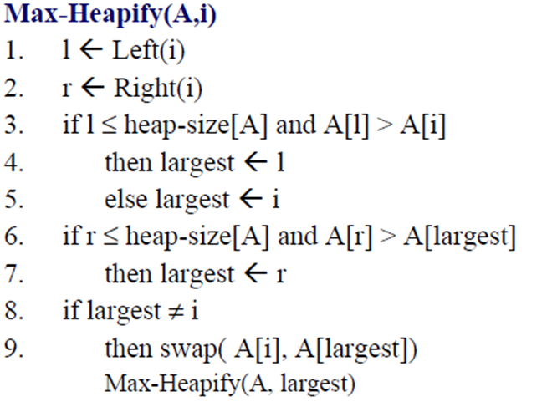
Heaps
Assume we are given a tree represented by a linear array A, and such that i ≤ length[A], and the trees rooted at Left(i) and Right(i) are heaps. Then, to create a heap rooted at A[i], use procedure Max-Heapify(A,i):
10
20
9
19
18
6
7
17
16 17
16
1

Slide 4
Heaps
If either child of A[i] is greater than A[i], the greatest child is exchanged with A[i]. So, A[i] moves down in the heap.
The move of A[i] may have caused a violation of the max- heap property at it’s new location.
So, we must recursively call Max-Heapify(A,i) at the location i where the node “lands”.
The above is the top-down approach of Max-Heapify(A,i)
10
20
9
19
18
6
7
17
16 17
16
1

Slide 5
Heaps
So, what must we do to build a heap?
We call Max-Heapify(A,i) for every i starting at last node and going to the root.
Why Bottom-up?
Because Max-Heapify() moves the larger node upward
into the root. If we start at the top and go to larger node indices, the highest a node can move is to the root of that sub-tree. But what if there is a violation between the sub-tree’s root and its parent?
So, we must start from the bottom and go towards the root to fix the problems caused by moving larger nodes into the root of sub-trees.

Slide 6
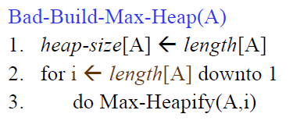
Heaps
2
3
4
5
6
7
8
9
10
11

Slide 7
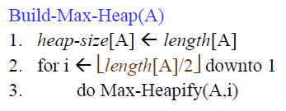










Heaps
Without going through a formal proof, notice that there is no need to call Max-Heapify() on leaf nodes. At most, the internal node with the largest index is at most equal to length[A]/2.
Since this may be odd, should we use the floor or the ceiling?
In the case below, it is clear that we really need the floor of length[A]/2 which is 5, and not the ceiling, which is 6.
1
2
3
4
5
6
7
8
9 10
11

Slide 8
Example: building a heap (1)
1 2 3 4 5 6 7 8 9 10
4 1 3 2 16 9 10 14 8 7
1
4
2
1
3
3
4
2
5
16
6
9
7
10
8 9
14 8
10
7

Slide 9
Example: building a heap (2)
1
4
2
1
3
3
4
2
5
16
6
9
7
10
8
14
9
8
10
7

Slide 10
Example: building a heap (4)
1
4
2
1
3
3
4
14
5
16
6
9
7
10
8
2
9
8
10
7

Slide 11
Example: building a heap (5)
1
4
2
1
3
10
4
14
5
16
6
9
7
3
8
2
9
8
10
7

Slide 12
Example: building a heap (6)
1
4
2
16
3
10
4
14
5
7
6
9
7
3
8
2
9
8
10
1

Slide 13
Example: building a heap (7)
1
16
2
14
3
10
4
8
5
7
6
9
7
3
8 9
2 4
10
1

Slide 14
Priority Queues
A priority queue is a data structure for maintaining a set S of elements, each with an associated value called a key.
We will only consider a max-priority queue.
If we give the key a meaning, such as priority, so that elements with the highest priority have the highest value of key, then we can use the heap structure to extract the element with the highest priority.

Slide 15
Priority Queues
Max priority queue supports the following operations:
Max-Heap-Insert(A,key): insert key into heap, maintaining heap property
Heap-Maximum(A): returns the heap element with the largest key
Heap-Extract-Max(A): returns and removes the heap element with the largest key, and maintains the heap property
Heap-Increase-Key(A,i,key): used (at least) by
Max-Heap-Insert() to set A[i] <− A[key], and then maintaining the heap property.

Slide 16
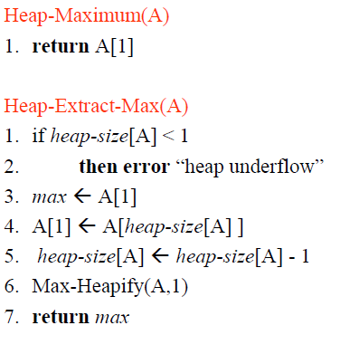
Priority Queues

Slide 17
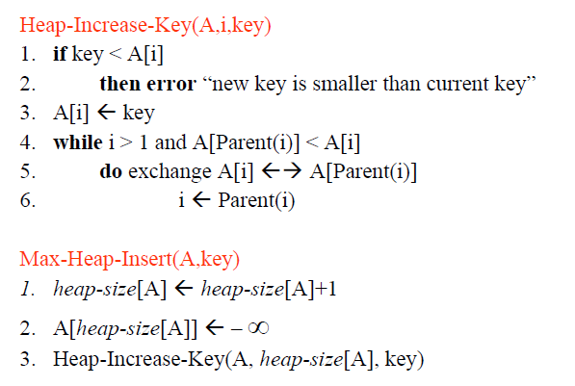
Priority Queues

Slide 18
Example: increase key (1)
1
16
2
14
3
10
4
8
5
7
6
9
7
3
8 9
2 4
10
1
increase 4 to 15

Slide 19
Example: increase key (2)
1
16
2
14
3
10
4
8
5
7
6
9
7
3
8
2
9
15
10
1

Slide 20
Example: increase key (3)
1
16
2
14
3
10
4
15
5
7
6
9
7
3
8
2
9
8
10
1

Slide 21
Example: increase key (4)
1
16
2
15
3
10
4
14
5
7
6
9
7
3
8
2
9
8
10
1

Slide 22
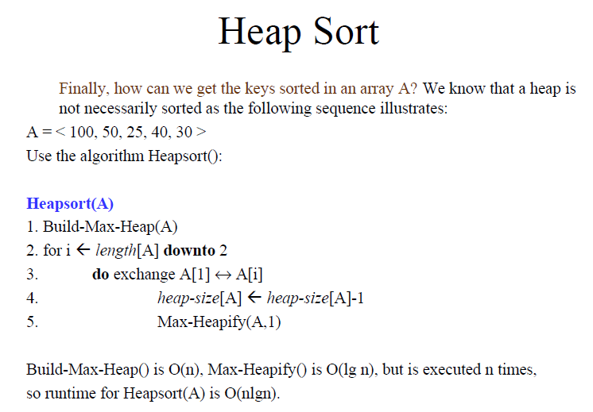

Slide 23
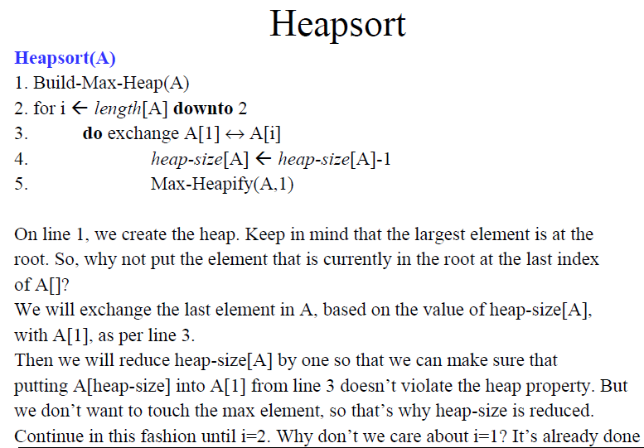

Slide 24
Example: Heap-Sort
1
16
3
10
2
14
4
8
5
7
6
9
7
3
8 9
2 4
10
1
16 14 10 8
7
9
3
2
4
1

Slide 25
Example: Heap-Sort (2)
1
14
2
8
3
10
4
4
5
7
6
9
7
3
8
2
9
1
10
16

Slide 26
Example: Heap-Sort (3)
1
10
2
8
3
9
4
4
5
7
6
1
7
3
8
2
9
14
10
16

Slide 27
Example: Heap-Sort (4)
1
9
2
8
3
3
4
4
5
7
6
1
7
2
8
10
9
14
10
16

Slide 28
Example: Heap-Sort (4)
1
8
2 3
7
3
4
4
5
2
6
1
7
9
8
10
9
14
10
16

Slide 29
Example: Heap-Sort (5)
1
7
2
4
3
3
4
1
5
2
6
8
7
9
8
10
9
14
10
16

Slide 30
Example: Heap-Sort (6)
1
4
2
2
3
3
4
1
5
7
6
8
7
9
8
10
9
14
10
16

Slide 31
Example: Heap-Sort (7)
1
3
2
2
3
1
4
4
5
7
6
8
7
9
8
10
9
14
10
16

Slide 32
Example: Heap-Sort (8)
1
2
2
1
3
3
4
4
5
7
6
8
7
9
8 9 ₁₀
10 14 16
1
2
3
4
7
8
9
10
14
16

Slide 33
Summary
We can perform the following operations on heaps:
MAX-HEAPIFY O(lgn)
BUILD-MAX-HEAP O(n)
HEAP-SORT O(nlgn)
MAX-HEAP-INSERT O(lgn)
HEAP-EXTRACT-MAX O(lgn)
HEAP-INCREASE-KEY O(lgn)
HEAP-MAXIMUM O(1)
Average
O(lgn)

Slide 34
Applications of the Priority Queue
Select print jobs in order of decreasing length
Forward packets on routers in order of urgency
Select most frequent symbols for compression
Sort numbers, picking minimum first
Anything greedy
Notes:
There are, of course, Jobs of applications for priority queues. Here are just a few.

