Slide 1
Data Structures Algorithm and Design DSECLZG519
Mr. Chennupati R Prasanna

Slide 2
Webinar 01

Slide 3
Time Complexity Analysis- Counting
Problem 1: what is the time complexity of the following code:
int a = 0, b = 0;
for (i = 0; i < N; i++) {
a = a + rand();
}
for (j = 0; j < M; j++) {
b = b + rand();
}

Slide 4
Problem 2: what is the time complexity of the following code:
int a = 0;
for (i = 0; i < N; i++) {
for (j = N; j > i; j--) {
a = a + i + j;
}
}

Slide 5
Problem 3: what is the time complexity of the following code:
int i, j, k = 0;
for (i = n / 2; i <= n; i++) {
for (j = 2; j <= n; j = j * 2) {
k = k + n / 2;
}
}

Slide 6
Analysis of while loop
Problem 4: what is the time complexity of the following code:
int i =0;
while (i<n)
{
stmt;
i++;
}

Slide 7
Recursion
Recursion when used in a programming or computer science context simply means when a part of your program calls itself.
Factorial Example
def recur_factorial(n):
if n == 1:
return n
else:
return n*recur_factorial(n-1)
There are mainly three ways for solving recurrences.
Substitution Method
Recurrence Tree Method
Master Method

Slide 8
Steps to solve the problem
We follow below steps to find the time complexity for a given program
Trace the Recursive function for the given Program
Apply any one of three ways to Recursive function to get the time complexity for a given program.

Slide 9
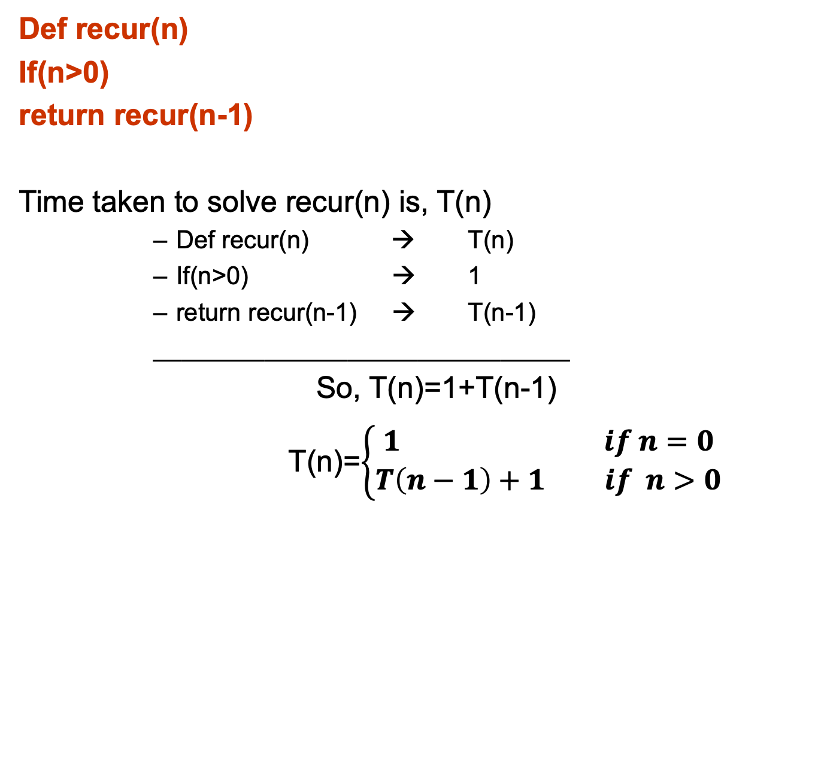
Recursive Function
Def recur(n)
If(n>0)
return recur(n-1)
Time taken to solve recur(n) is, T(n)
Def recur(n) → T(n)
If(n>0) → 1
return recur(n-1) → T(n-1)
______________________________
So, T(n)=1+T(n-1)
T(n)=$\left\{\begin{aligned}1 if n=0 \\ T\left(n−1\right)+1 if n>0\end{aligned}\right.$

Slide 10
Substitution Method
T(n)=$\left\{\begin{aligned}1 if n=0 \\ T\left(n−1\right)+1 if n>0\end{aligned}\right.$
T(n)=T(n-1)+1 → 1
T(n-1)=T((n-1)-1)+1
T(n-1)=T((n-2)+1 → 2
T(n-2)=T((n-3)+1 → 3
Substitute 2 in 1 ,
T(n)= (T((n-2)+1)+1
T(n)=T(n-2)+2
Substitute T(n-2),
T(n)=T(n-3)+3
……….for k times,
T(n)=T(n-k)+k

Slide 11
Substitution Method (cont..,)
As per base condition,
Assume n-k=0 => k=n
T(n)=T(n-k)+k
T(n)=T(n-n)+n
T(n)=T(0)+n
T(n)= 1+n
Time Complexity is O(n)

Slide 12
Recurrence relation
Void test (int n)
{
if(n>0)
{
for(i=0;i<n;i++)
{
printf(“%d’,n);
}
test(n-1);
}
}

Slide 13
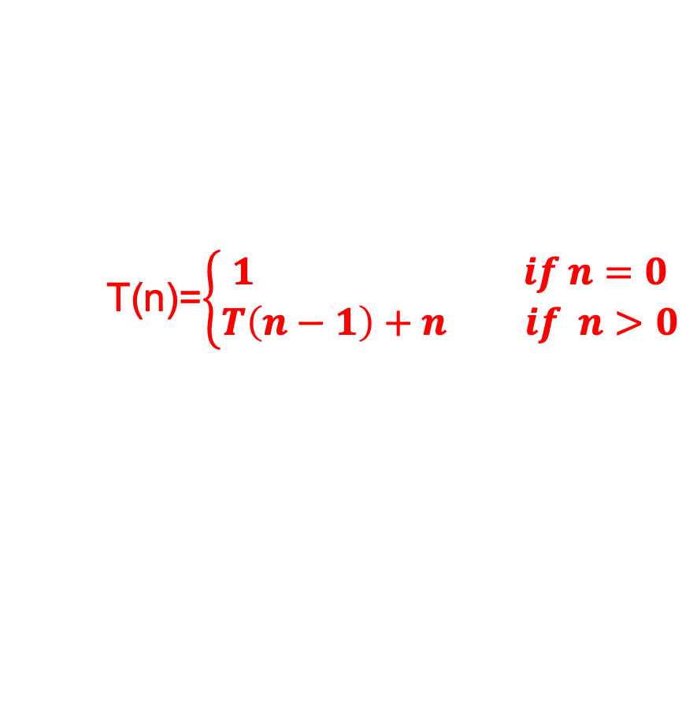
Recurrence Tree Method
T(n)=$\left\{\begin{aligned}1 if n=0 \\ T\left(n−1\right)+n if n>0\end{aligned}\right.$
T(n)=T(n-1)+n
Time Taken
T(n) n
n T(n-1) n-1
n-1 T(n-2) n-2
n-2 T(n-3) n-3
…… …..
T(2) 2
2 T(1) 1
1 T(0) 0 Stops Here
T(n)=0+1+2+3+……+(n-2)+(n-1)+n=n(n+1)/2
Time Complexity= O(n²)

Slide 14
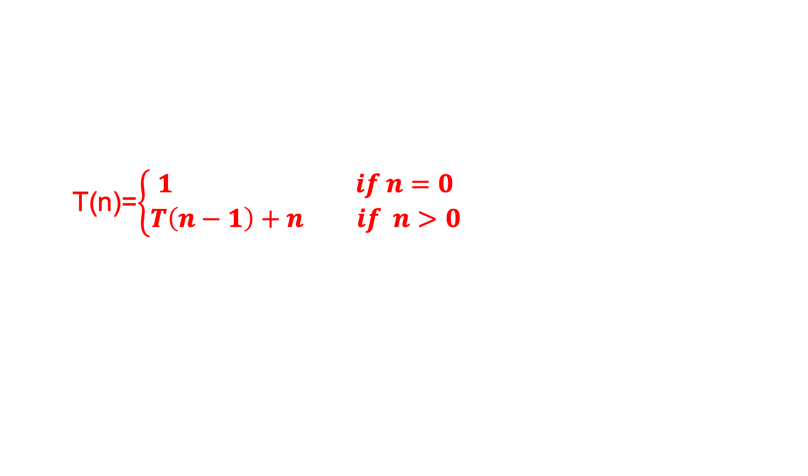
Substitution Method
T(n)=$\left\{\begin{aligned}1 if n=0 \\ T\left(n−1\right)+n if n>0\end{aligned}\right.$

Slide 15
Master Theorem
T(n) = aT(n/b) + θ(n^{k} log^{p}n)
where n = size of the problem a = number of sub-problems in the recursion and a >= 1 n/b = size of each sub-problem b > 1, k >= 0 and p is a real number.
Then,
Case 1:
if a > b^{k}, then T(n) = θ(n^{log}_{b}ª)
Case 2:
if a = b^{k}, then (a) if p > -1, then T(n) = θ(n^{log}_{b}ª log^{p+1}n) (b) if p = -1, then T(n) = θ(n^{log}_{b}ª loglogn) (c) if p < -1, then T(n) = θ(n^{log}_{b}ª)
Case 3:
if a < b^{k}, then (a) if p >= 0, then T(n) = θ(n^{k} log^{p}n) (b) if p < 0, then T(n) = θ(n^{k})

Slide 16
Master Theorem
Solve the following recurrence relation using Master’s theorem-
T(n) = √2T(n/2) + logn
Solution-
We compare the given recurrence relation with T(n) = aT(n/b) + θ (n^{k}log^{p}n).
Then,
a = √2
b = 2
k = 0
p = 1
Now, a = √2 = 1.414 and b^{k} = 2⁰ = 1.
Clearly, a > b^{k}.
we follow case-01
T(n) = θ (n^{log}_{b}ª)
T(n) = θ (n^{log}₂^{√2})
T(n) = θ (n^{1/2})
Thus,
T(n) = θ (√n)

Slide 17
Master Theorem
Solve the following recurrence relation using Master’s theorem-
T(n) = 2T(n/2) + nlogn
Solution-
We compare the given recurrence relation with T(n) = aT(n/b) + θ (n^{k}log^{p}n).
Then,
a = 2
b = 2
k = 1
p = 1
Now, a = 2 and b^{k} = 2¹ = 2.
Clearly, a = b^{k}.
we follow case-02
if a = b^{k}, then (a) if p > -1, then T(n) = θ(n^{log}_{b}ª log^{p+1}n)
T(n) = θ(n^{log}₂² log¹⁺¹n)
Thus,
T(n) = θ (nlog²n)

Slide 18
Master Theorem
Solve the following recurrence relation using Master’s theorem-
T(n) = 3T(n/2) + n²
Solution-
We compare the given recurrence relation with T(n) = aT(n/b) + θ (n^{k}log^{p}n).
Then,
a = 3
b = 2
k = 2
p = 0
Now, a = 3 and b^{k} = 2² = 4.
Clearly, a < b^{k}.
we follow case-03
if a < b^{k}, then (a) if p >= 0, then T(n) = θ(n^{k} log^{p}n) T(n) = θ(n² log⁰n)
Thus,
T(n) = θ (n²)

Slide 19
Master Theorem
Solve the following recurrence relation using Master’s theorem-
T(n) = 2T(n/4) + n^{0.51}
Solution-
We compare the given recurrence relation with T(n) = aT(n/b) + θ (n^{k}log^{p}n).
Then,
a = 2
b = 4
k = 0.51
p = 0
Now, a = 2 and b^{k} = 4^{0.51} = 2.03
Clearly, a < b^{k}.
we follow case-03
if a < b^{k}, then (a) if p >= 0, then T(n) = θ(n^{k} log^{p}n) T(n) = θ(n^{0.51} log⁰n)
Thus,
T(n) = θ (n^{0.51})

Slide 20

Master Theorem
Solve the following recurrence relation using Master’s theorem-
a is not a constant; the number of sub-problems should be fixed
T(n) = 8T(n/4) – n²lognf(n),
f(n) , which is the combination time, is not positive
a cannot have less than one sub problem
T(n) = 0.5T(n/2) + n²

Slide 21
Infix to postfix Conversion
Convert the following infix expression to postfix conversion :
(A+B/C*(D+E)-F)
Symbol | Stack | Postfix

Slide 22
Infix to prefix Conversion
Convert the following infix expression to postfix conversion :
(A+B)*C—D+F
Symbol | Stack | Expression

Slide 23
Thank You!!

