Slide 1

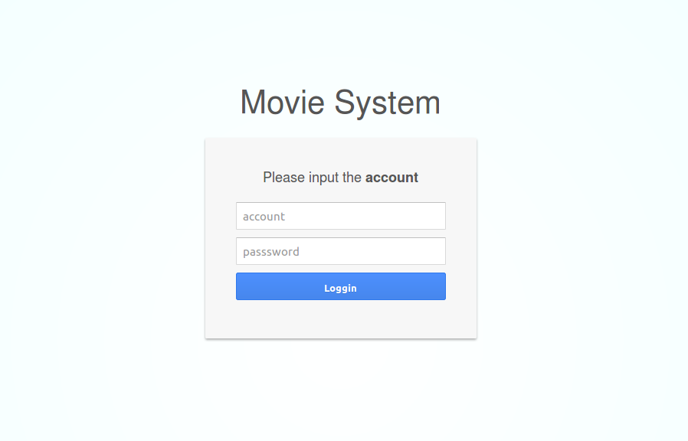
Movie management system
李止戈 侯嘉伟 吕呈恒

Slide 2

Problem Definition
People sometimes don’t know which movie to see
Recommend some good movies to users
Manage movies well
A strong and convenient movie management system.

Slide 3
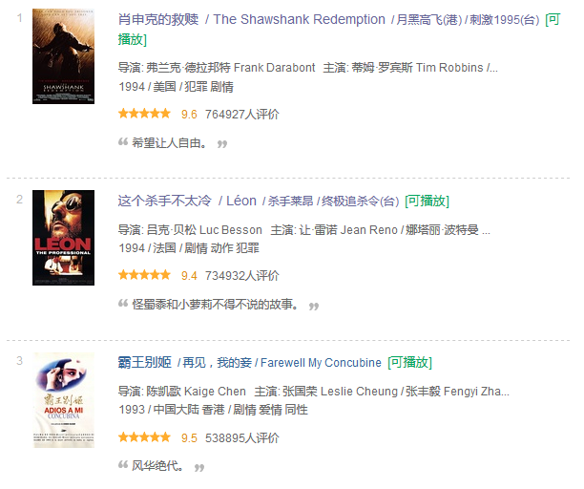
Existing Approach
Many websites that provide all kinds of information
Not easy to use and not convenient to manage
But we can crawl some data of movie from them.

Slide 4
Proposed Idea
First crawl some movie information from Douban.
Provide a convenient service for users, a strong back-end architecture.
To make the management more convenient, three roles and give them different authorities.

Slide 5
Proposed Idea
Users: see the basic information of all movies in the system, submit applications to ask for adding or modifying some movies.
Admins: have all rights users have, check and verify the applications
Super-admins: have all rights admins have, make big modification about the system.

Slide 6
Implementation Details
Use scrapy and python to crawl the data of 250 movies from Douban. Store them into MySQL and then transfer to Sqlite.
Use Django framework to build the back-end part. Construct the database by Sqlite,
mainly including two classes: Application and OfficialMovie. One to store the information of applications and another for movies.

Slide 7
Implementation Details
Build the front-end by bootstrap framework, and some javescript from jqeury.
The main method for communicating from front-end and back-end are ajax.
To achieve some functions like sorting, selecting, searching and linking by back-end.

Slide 8
Conclusion
A generally-completed system for movie management
Different levels of users.
See the recommend list and do searching, selecting and sorting.
Application’s submit and verify and modify the movie database
…

Slide 9
Future Work
Interface’s beautification
More powerful database
Make the system more intellectualized
Collect uses’ information and do bigdata-test for further application
…

Slide 10
Thank you

