Slide 1
FLEET OPERATIONS CONCEPT
EcoRoute
smarter logistics,
lower emissions
A fleet-operations concept that helps logistics teams plan efficient routes, monitor vehicles, and act on live sustainability signals.
PLANNING · MONITORING · IMPACT
Notes:
Introduce EcoRoute as one operating loop for logistics teams: plan better, see the fleet clearly, and act on sustainability signals while the work is happening.

Slide 2

02
THE OPERATING GAP
EXHIBIT 01
Logistics teams lack one shared operating picture
The decision is shared across teams, but the signals are not.
Drivers need practical routes
Leaders need evidence
Dispatchers balance competing constraints
Service, cost, and environmental performance should improve together.
A route must work on the road, not only look efficient in a planning tool.
Delivery commitments, vehicle availability, payload, traffic, and battery or fuel constraints all shape the route.
WHEN SIGNALS SIT APART, DISPATCH BECOMES SLOWER AND HARDER TO IMPROVE.
SO WHAT
EcoRoute gives every role the same operating picture, with a decision path attached.
Notes:
Describe the fragmentation clearly. Dispatchers optimize under pressure, drivers need routes they can execute, and leaders need proof that the choices are working. The shared picture is the missing layer.

Slide 3
03
THE ECO ROUTE LOOP
EXHIBIT 02
EcoRoute combines planning, monitoring, and impact
One workflow connects the choice before dispatch to the evidence after the trip.
Plan
Monitor
Improve
Unify fleet status, route planning, trip simulation, and carbon analytics.
See vehicles, payload, traffic, elevation, and EV preference signals in context.
Compare planned and completed trips, then feed the learning into the next decision.
SCENARIO TESTING
FEEDBACK LOOP
Try the route before dispatch and make trade-offs visible.
Use completed trips to improve the next plan.
SO WHAT
The product differentiates by closing the loop between planned efficiency and real-world performance.
Notes:
Frame EcoRoute as a loop rather than a dashboard. Planning creates a hypothesis, monitoring shows what happened, and impact analytics make the next plan better.

Slide 4

04
THE TECHNOLOGY STACK
EXHIBIT 03
Technology turns fleet data into decisions
Each layer answers a different operational question, then feeds the next one.
Routing context
Fleet inputs
Map and routing services for stops, distance, traffic, and route visualization.
Vehicle telemetry for status, battery, cargo, and trip records.
Decision analytics
Human interface
Emissions, fuel avoidance, energy efficiency, and operational KPIs.
Responsive dashboards for fleet managers and drivers.
DATA BECOMES USEFUL WHEN IT ARRIVES WITH CONTEXT, A CHOICE, AND A MEASURE OF CONSEQUENCE.
SO WHAT
The stack is valuable because it translates operational telemetry into a decision a person can act on.
Notes:
Walk from raw inputs to the human interface. Telemetry alone is not the product. Routing context and analytics turn it into a recommendation, and the dashboard makes that recommendation usable for managers and drivers.

Slide 5
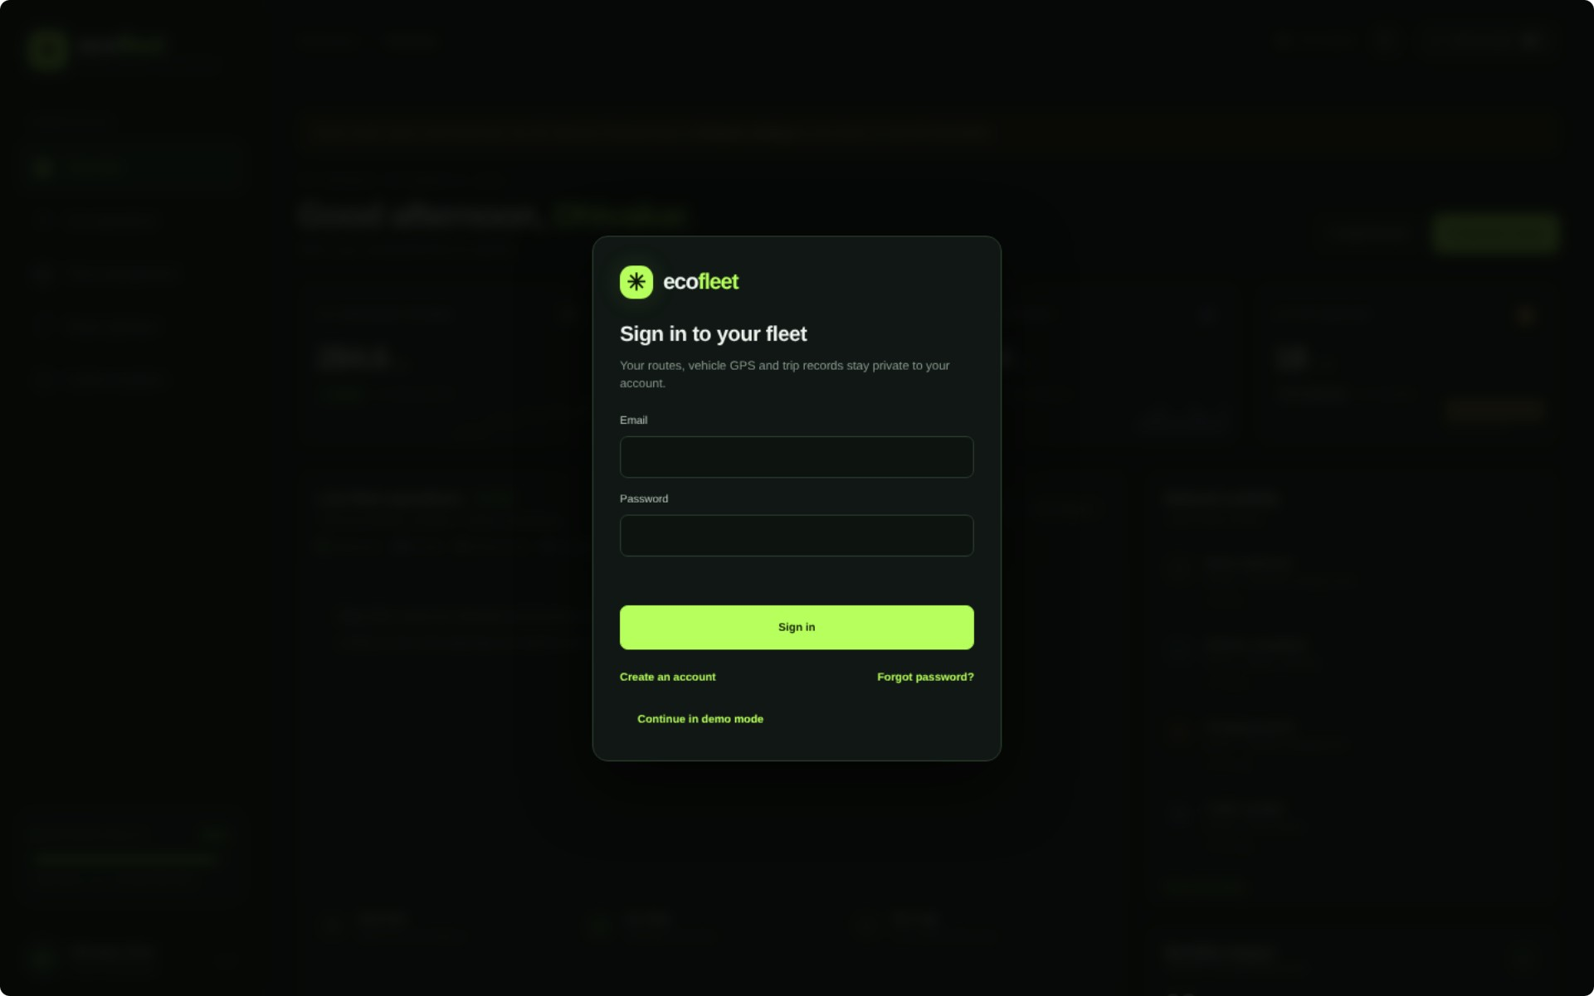
05
PROTOTYPE WORKFLOW
EXHIBIT 04
Prototype development begins with a manager workflow
The first journey is deliberately practical: move from sign-in to a dispatch decision.
Sign in to a role-based fleet workspace.
Review the fleet and select a vehicle or route.
Adjust optimization inputs and simulate the trip.
Compare operational and carbon outcomes before dispatch.
PROTOTYPE · ROLE-BASED FLEET WORKSPACE
SO WHAT
Design around the manager's decision, not around a collection of disconnected screens.
Notes:
Use the prototype screen as evidence that the journey starts with a role-based workspace. The workflow then follows the manager's actual job: select, adjust, simulate, and compare.

Slide 6
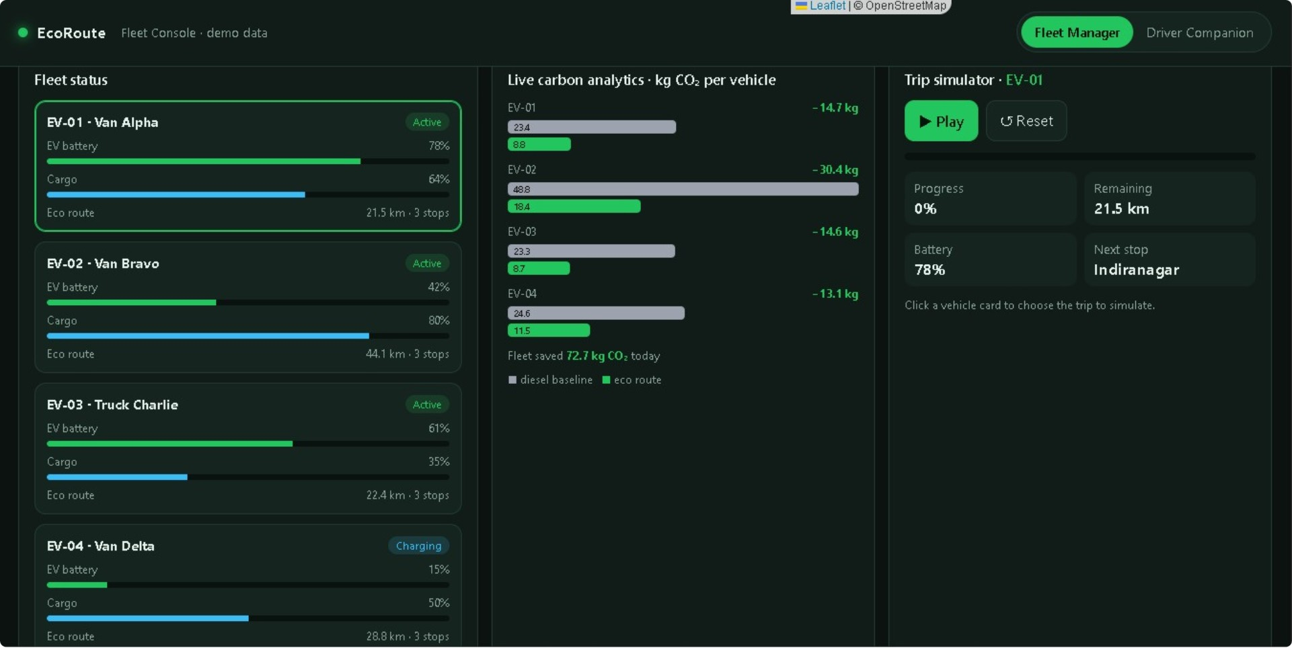
06
WORKING FUNCTIONALITY
EXHIBIT 05
Working functionality: monitor the fleet in real time
The prototype brings fleet activity, route context, and carbon outcomes into one operating view.
Fleet cards
PROTOTYPE · LIVE FLEET MONITORING
Vehicle activity, battery state, cargo utilization, and route distance are visible together.
Carbon analytics
Baseline and eco-route outcomes can be compared by vehicle.
Trip simulation
Operators can test decisions before dispatch rather than learn only after the trip.
SO WHAT
The prototype already demonstrates the core promise: see the fleet, test the choice, understand the impact.
Notes:
Point to the prototype as working functionality, not a concept sketch. Fleet cards, carbon comparisons, and trip simulation are already organized around the operator's decision before dispatch.

Slide 7
07
VALUE AND NEXT HORIZON
EXHIBIT 06
Benefits now, adaptive logistics next
Start with a clearer decision today, then let the operating loop become more adaptive over time.
NOW
NEXT
Make dispatch more deliberate
Make logistics adaptive
Dynamic rerouting as conditions change.
Predictive maintenance and charger planning.
More coordinated warehouse handoffs.
Faster decisions through one shared operating picture.
Better use of vehicle capacity and route context.
THE PRODUCT STARTS AS A DECISION SYSTEM AND GROWS INTO AN ADAPTIVE OPERATING LOOP.
SO WHAT
EcoRoute creates immediate operational value without closing off the path to more autonomous logistics.
Notes:
Separate the immediate value from the future scope. The first release improves the quality and speed of dispatch decisions. Later capabilities use the same data foundation to make the network more adaptive.

Slide 8




08
TEAM CONTRIBUTION
EXHIBIT 07
Team contribution: build one operating loop
Product
Experience
Map dispatcher, driver, and leadership needs.
Design the dashboard and interaction flow.
Engineering and data
Validation
Connect fleet inputs, routing, analytics, and simulation.
Test scenarios, document outcomes, and present the impact.
SO WHAT
Roles, data, and measurable action connect the work.
Notes:
Present the team in role-based language. Product defines the problem, experience makes it usable, engineering and data make it real, and validation proves whether the loop works.

Slide 9
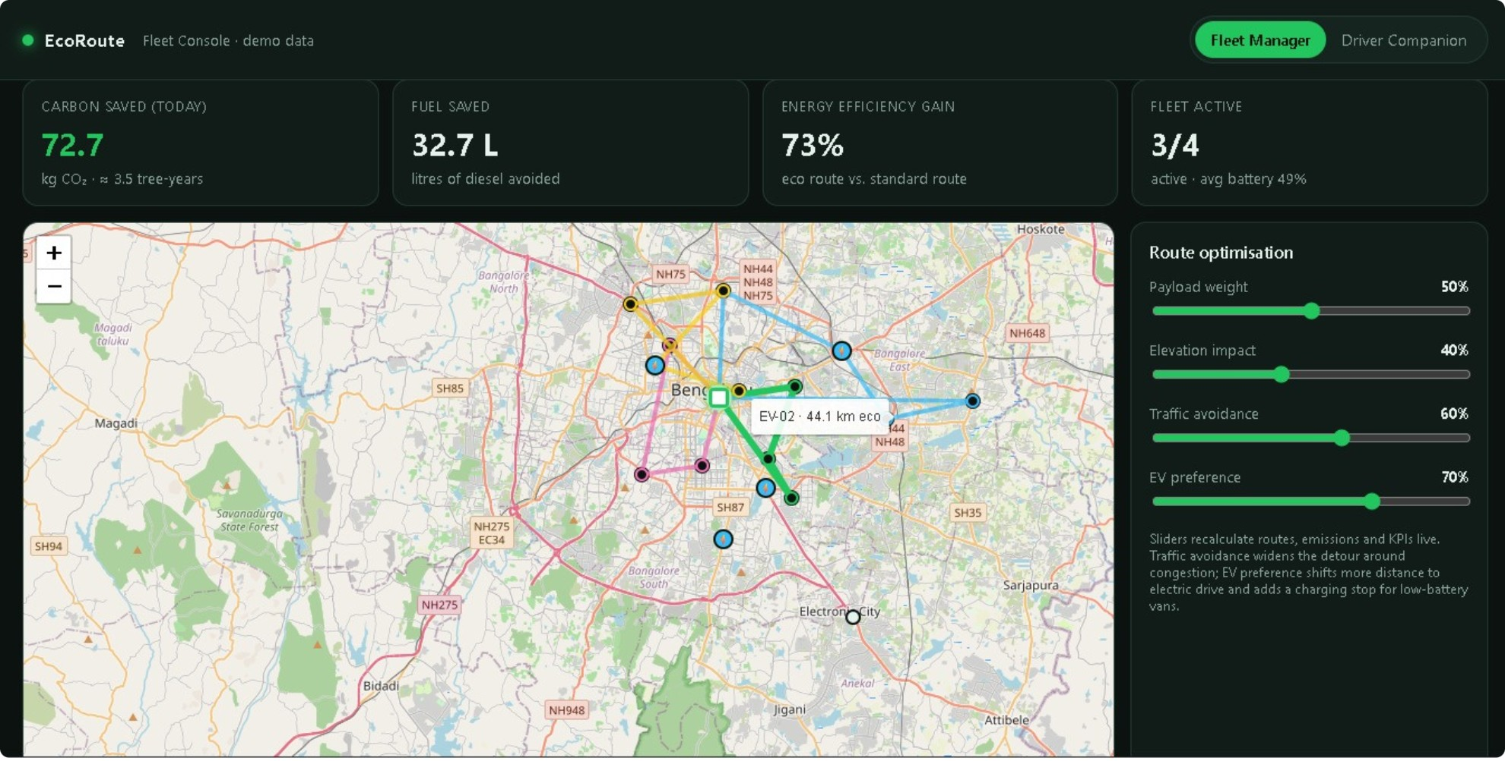
09
PRODUCT EVIDENCE
EXHIBIT 08
Prototype screen: route optimization in action
Adjust payload, elevation, traffic avoidance, and EV preference to see the route and KPI picture respond.
PROTOTYPE · ROUTE OPTIMIZATION
SO WHAT
The interface makes trade-offs inspectable before dispatch, where they are still easy to change.
Notes:
Use the screen to demonstrate the core interaction. The operator changes payload, elevation, traffic avoidance, and EV preference, then reads the route and KPI response before committing the trip.

Slide 10
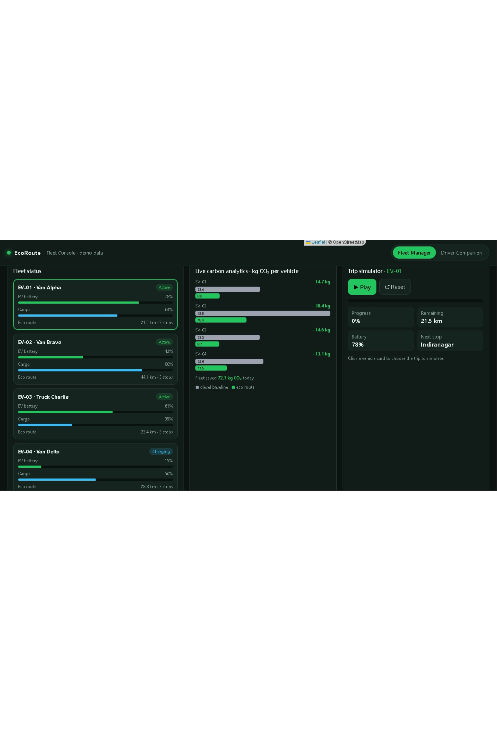
10
PRODUCT EVIDENCE
EXHIBIT 09
Prototype screen: measurable fleet outcomes
The prototype surfaces a shared scorecard for carbon saved, fuel saved, energy efficiency, and fleet activity.
72.7 kg
32.7 L
Carbon saved today · CO₂
Fuel saved
73%
3/4
Energy efficiency gain
Fleet active
PROTOTYPE · SHARED FLEET SCORECARD
Notes:
Close on measurable outcomes. The prototype surfaces carbon saved, fuel saved, energy efficiency, and active fleet status in one view, giving the team a common way to judge the effect of each route decision.

