Slide 1

RASJNA
Presented by:
N. Jahnavi Yadav
K. Mohan Naidu
G. Narendra
K. Deepak
M. Rajesh
J. Athreya

Slide 2


"Recipe Discovery to Plate Perfection"

Slide 3

In Sanskrit, "Rasa" refers to taste or flavor, and "jna" could be interpreted as "knowledge" or "knowing." Therefore, "Rasjna" could potentially be interpreted as "knowledge of taste" or "one who knows flavors."

Slide 4
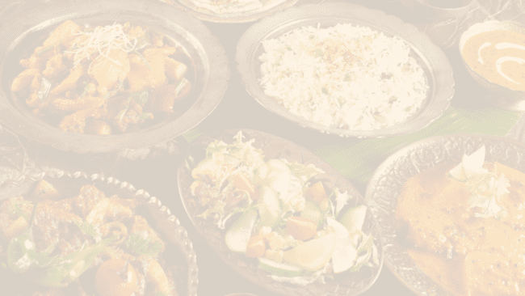
INTRODUCTION:
The Food Recipe App offers a comprehensive platform for users to explore a diverse array of culinary delights, providing functionalities such as easy recipe browsing, intuitive favorite-saving capabilities, and convenient shopping list creation. Beyond these fundamental features, the app distinguishes itself with a range of unique offerings. Leveraging advanced AI algorithms, it delivers personalized recipe recommendations tailored to individual tastes and dietary preferences. Moreover, fostering a sense of community, users can engage with fellow food enthusiasts by sharing their own recipes, leaving comments, and rating dishes they've sampled. This interactive aspect enhances user experience and fosters a vibrant culinary ecosystem. Market insights indicate a growing demand for such applications, with a significant surge observed during the COVID-19 pandemic, as more individuals turned to home cooking. With the rise of healthy eating trends and a desire for diverse meal options, the Food Recipe App stands poised to meet the evolving needs of today's culinary enthusiasts, offering both practical utility and a sense of culinary exploration.

Slide 5

SOLUTION :
The Food Recipe App stands as a culinary companion, guiding users on a journey of gastronomic delight. Its multifaceted functionalities empower users to seamlessly navigate through a treasure trove of recipes, curate personalized collections, and streamline their shopping experience with custom lists. What sets this app apart is its innovative approach, employing cutting-edge technology to deliver tailored recipe recommendations and foster a vibrant community of food enthusiasts. Positioned at the intersection of convenience and creativity, the Food Recipe App serves as a gateway to culinary exploration, offering a blend of practicality and inspiration for aspiring home chefs everywhere.

Slide 6

FEATURES:
In our food-making app project, we followed a structured development process to ensure efficiency, quality, and timely delivery. We adopted an Agile methodology, specifically Scrum, to manage the project effectively. This was followed by iterative development sprints, typically lasting two to four weeks, during which we focused on implementing specific features and functionalities. Regular sprint planning, review, and retrospective meetings were conducted to assess progress, address issues, and plan for the next sprint.
Throughout the development process, we utilized a range of tools and technologies to support collaboration, version control, and project management. Git was used for version control, allowing team members to collaborate on code changes and track revisions effectively. Additionally, project management was streamlined using Atlassian's Jira, which enabled us to create and track user stories, assign tasks, and monitor progress throughout the development lifecycle.
In response to these challenges, we implemented several solutions to mitigate risks and ensure project success. This included establishing clear communication channels, fostering collaboration between development teams and stakeholders, and adopting a test-driven development approach to identify and address issues early in the development lifecycle. Additionally, we conducted regular code reviews, automated testing, and continuous integration practices to maintain code quality and minimize regression errors.

Slide 7

PROPOSED WEBSITE:
The proposed website layout features a simple yet effective structure built using HTML and CSS. It begins with a header section displaying the title of the website. Beneath the header is a navigation bar, providing links to different pages such as Home, About, Services, and Contact. The main content area is situated below the navigation bar and contains a welcoming message along with some introductory text. This section is designed to showcase the primary content of the website. Lastly, at the bottom of the page is the footer, displaying copyright information and other relevant details. The layout is designed to be responsive, with content organized within a container to ensure readability and consistency across various screen sizes. Overall, this proposed website layout offers a clean and structured design that can be further customized and expanded to suit specific needs and preferences.

Slide 8

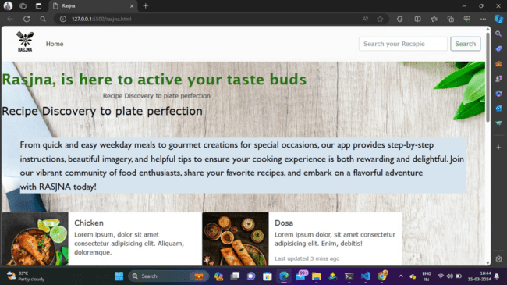

Slide 9

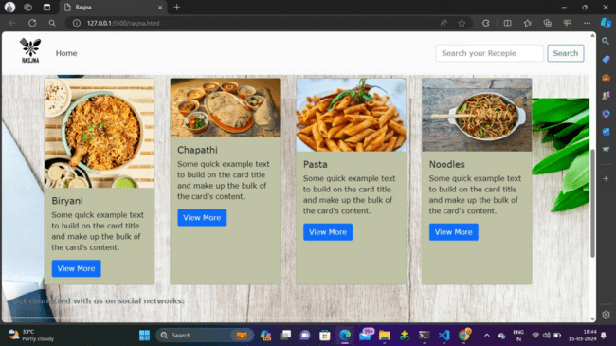

Slide 10
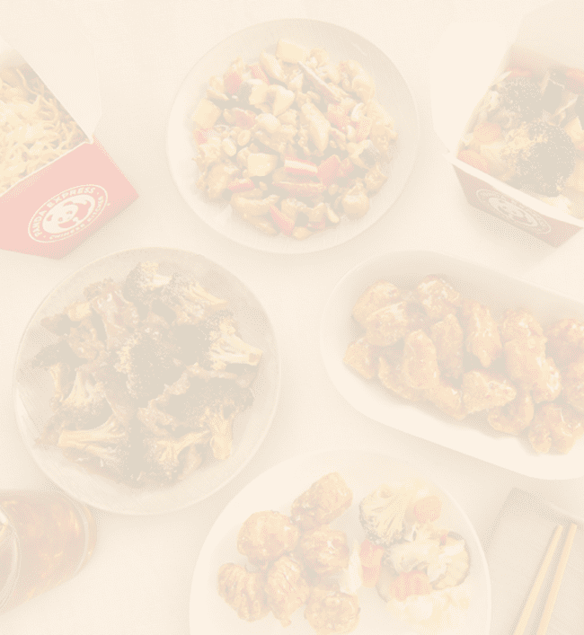
Architecture of a food-making website in detail:-
1. Homepage:
Featured recipes or blog posts
Navigation menu with categories (e.g., breakfast, lunch, dinner, desserts)
Search bar
Sign-up/login options
Social media links
2. Recipe Database:
Categorized database of recipes
Filter options (by cuisine, dietary preferences, difficulty level, etc.)
Individual recipe pages with:
Ingredients list
Preparation steps
Cooking time
Serving size
Nutritional information
User ratings and reviews
Option to print or save the recipe
3. User Accounts:
Registration/login functionality
User profile management
Favorite recipes list
Personalized recommendations based on user preferences
Ability to submit recipes, comments, and ratings

Slide 11
5.Blog:
Articles on cooking tips, techniques, and trends
Recipe roundups and collections
Interviews with chefs or food experts
User-generated content (e.g., guest posts)
6.Video Content:
Integration of cooking tutorial videos
Video galleries organized by recipe categories
Embedded videos on recipe pages
7.Social Media Integration:
Social sharing buttons on recipe pages
Embedded feeds from social media platforms
Integration with social login for user accounts
8.Responsive Design:
Optimized layout for desktop, tablet, and mobile devices
Fast loading times and smooth user experience across devices.

Slide 12

TECHNOLOGIES :
Front-end Development:
HTML/CSS/JavaScript: If you're considering a web-based front-end, you can use these technologies along with Java for the back-end.
React or Angular: If you prefer a modern web application approach, you can use React.js or Angular for building interactive user interfaces.
Back-end Development:
Java: As a Java Full Stack developer, you can use Java for the back-end logic of your application.
Spring Boot: A popular Java framework for building web applications, Spring Boot provides a robust and efficient way to create RESTful APIs and handle business logic.
Spring Data: For interacting with databases, you can use Spring Data to simplify data access and manipulation.
YouTube Data API: You'll need to integrate the YouTube Data API into your back-end to fetch videos from YouTube channels with the most views.
Database:
MySQL : These are popular relational database management systems that you can use to store user data, recipe information, and other relevant data.
Hibernate: As an ORM (Object-Relational Mapping) framework, Hibernate can be used to map Java objects to database tables and simplify database operations.
Deployment:
Docker: Docker containers provide a consistent environment for deploying your application across different platforms.
Amazon Web Services (AWS) or Google Cloud Platform (GCP): These cloud platforms offer various services for hosting and deploying your Java applications, including EC2 (Elastic Compute Cloud) or Google Compute Engine for virtual machines, and RDS (Relational Database Service) or Cloud SQL for managed databases.

Slide 13
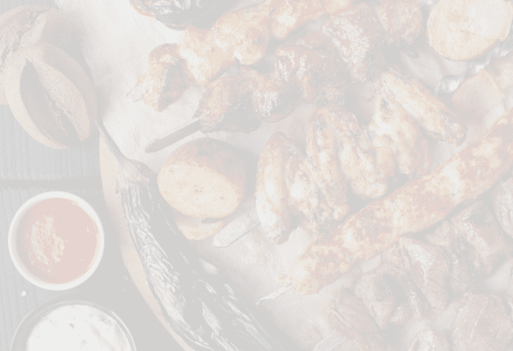
Development Process:
Overview of the Development Lifecycle:
Initiation: Defined project goals, user requirements, and scope.
Planning: Created a roadmap, defined sprints, and allocated resources.
Execution: Implemented features and functionalities in iterative sprints.
Monitoring and Control: Reviewed progress, addressed issues, and made adjustments as needed.
Closure: Conducted final testing, deployment, and project handoff.
Tools and Methodologies Used:
Agile (Scrum): Adopted an iterative and incremental approach to project management.
Git: Utilized for version control, enabling collaboration and tracking of code changes.
Slack: Facilitated real-time communication and collaboration among team members.
Zoom: Conducted virtual meetings and discussions to maintain team alignment.
Challenges Faced:
Changing Requirements: Managed evolving user feedback and requirements, requiring frequent adjustments to project scope.
Integration with Third-Party APIs: Faced technical challenges in integrating with APIs like the YouTube Data API for recipe retrieval.
Resource Allocation: Ensured optimal allocation of resources and team members to meet project deadlines and objectives.
Solutions Implemented:
Open Communication: Maintained regular communication with stakeholders to address changing requirements and priorities.
Flexibility and Adaptability: Prioritized flexibility in the development approach to accommodate changing project needs.
Test-Driven Development: Adopted a test-driven development approach to identify and address issues early in the development process.
Continuous Integration: Implemented continuous integration practices to ensure code quality and minimize regression errors.

Slide 14

ADVANTAGES:
Enhanced User Experience
Business Opportunities
Convenience and Accessibility
Diverse Recipe Selection
Trusted Quality Content
Social Engagement Features
Revenue Generation Potential
Scalable Architecture.

Slide 15
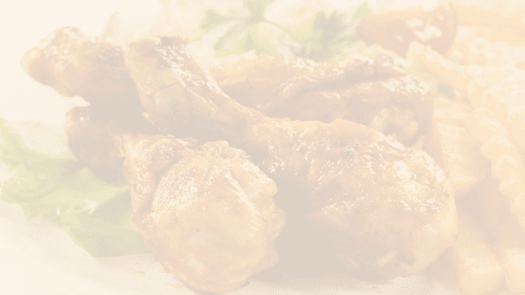
CONCLUSION:
Our recipe preparation instructor website provides a comprehensive platform for culinary enthusiasts of all skill levels to hone their craft and expand their culinary repertoire. Through our expertly curated collection of recipes, step-by-step instructional videos, and personalized guidance, we empower individuals to unleash their creativity in the kitchen and master the art of cooking with confidence. Whether you're a novice seeking to develop fundamental skills or a seasoned chef looking to explore new techniques and cuisines, our platform offers something for everyone. Join our community today and embark on a delicious journey of culinary discovery. With dedication and practice, you'll soon be impressing friends and family with your culinary creations. Cheers to cooking success!

Slide 16

THANK YOU

