Slide 1

GIVE LIFE :-
->Blood donation prediction using ML

Slide 2

ABSTRACT
Now a days we are facing many problems due to blood demand and shortage.At the time of hospital,medical practices, surgeries, and etc.on our daily lives Here we are creating a application which can helps us to overcome the problem which are facing in this scenario... We are using machine learning algorithms to sort the problem. Mainly svm(support vector machines)is an algorithm with efficiency of 98.4%..We analysed the blood centre details including contact information and blood groups which are present there .We can create a dashboard which is having the attributes like blood storage centre name , location, contact information and blood groups which can be preserved there and also recruitment of blood donors by using our application.By virtually method we can contact willing blood donors by SMS method

Slide 3

*EXISTING
SYSTEM
*Accurate prediction of the number of blood donors can help medical professionals know the future supply of blood and plan .
*Accordingly to entice voluntary blood donors to meet demand. We found that in a SVM clustered model with = 4 led to the best test set sensitivity (98.4%), which beat other studies.

Slide 4
PROPOSED SYSTEM
The proposed system (Blood Bank Management System) is designed to help the Blood Bank administrator to meet the demand of Blood by sending and/or serving the request for Blood as and when required. The proposed system gives the procedural approach of how to bridge the gap between Recipient, Donor, and Blood Banks.

Slide 5
ALGORITHMS
Machine Learning Algorithms Several algorithms can be used for blood donation prediction, including:
Logistic Regression: Useful for binary classification problems, predicting whether a person will donate blood or not.
Decision Trees and Random Forests: These are powerful for capturing non-linear relationships and interactions between features.
Support Vector Machines (SVM): Effective for high-dimensional data, though they may require careful tuning of parameters.
Neural Networks: Suitable for complex patterns in large datasets, but they require more data and computational resources.
K-Nearest Neighbors (KNN): A simple, instance-based learning algorithm that can perform well with proper feature selection.
Ensemble Methods: Techniques like boosting (e.g., Gradient Boosting) and bagging (e.g., Random Forest) combine multiple models to improve prediction accuracy.

Slide 6
TECHNOLOGY USED:
Technology Stack
1.Frontend: HTML, CSS, JavaScript (with a framework like React for dynamic content)
2.Backend: Python (with Flask for the web framework)
3.Database: SQLite (for simplicity)4.SMS Service: Twilio API

Slide 7
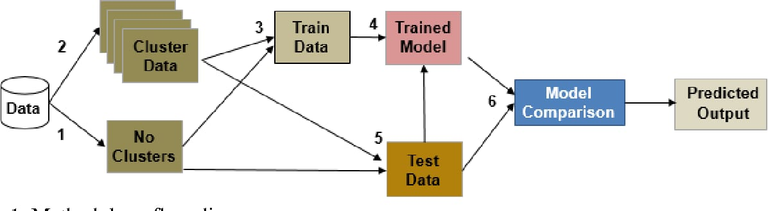
SYSTEM ARCHITECTURE:-

Slide 8
CODE AND IMPLEMENTATION
1.Data Preparation
2.Feature Engineering
3.Model Training
4.Model Evaluation
import pandas as pd
from sklearn.model_selection import train_test_splitf
rom sklearn.preprocessing import StandardScaler
from sklearn.ensemble import RandomForestClassifier
from sklearn.metrics import classification_report, confusion_matrix, accuracy_score
# Step 1: Load the dataset
# Assuming you have a CSV file named 'blood_donation_data.csv'# The dataset should have feature columns and a target column 'donated' indicating donation statusdata = pd.read_csv('blood_donation_data.csv')

Slide 9
Step 2: Data Preprocessing# Separate features and target variableX = data.drop('donated', axis=1)y = data['donated']
# Split the dataset into training and testing setsX_train, X_test, y_train, y_test = train_test_split(X, y, test_size=0.3, random_state=42)
# Standardize the featuresscaler = StandardScaler()X_train = scaler.fit_transform(X_train)X_test = scaler.transform(X_test)
# Step 3: Train the Model# Using Random Forest Classifiermodel = RandomForestClassifier(n_estimators=100, random_state=42)model.fit(X_train, y_train)
#Step 4: Make Predictionsy_pred = model.predict(X_test)
# Step 5: Evaluate the Modelprint("Confusion Matrix:\n", confusion_matrix(y_test, y_pred))print("\nClassification Report:\n", classification_report(y_test, y_pred))print("\nAccuracy Score:", accuracy_score(y_test, y_pred))

Slide 10

<!DOCTYPE html>
<html lang="en">
<head>
<meta charset="UTF-8">
<meta name="viewport" content="width=device-width, initial-scale=1.0">
<title>Blood Center Dashboard</title>
<style>
body {
font-family: Arial, sans-serif;
margin: 0;
padding: 0;
}
.container {
width: 80%;
margin: auto;
padding: 20px;
} table {
width: 100%;
border-collapse: collapse;
margin-bottom: 20px;
} table, th, td {
border: 1px solid #ddd;
padding: 8px;
text-align: left;
}
th {
background-color: #f2f2f2; } .search-bar {
margin-bottom: 20px;
}
.donor-form {
margin-top: 50px;
}
.donor-form label {
display: block;
margin-bottom: 5px;
} .donor-form input[type="text"], .donor-form input[type="email"],
.donor-form select {
width: 100%;
padding: 8px;
margin-bottom: 10px;
box-sizing: border-box;
}
.donor-form input[type="submit"] { background-color: #4CAF50;
color: white;
padding: 10px 20px;
border: none;
border-radius: 4px;
cursor: pointer;
} .donor-form input[type="submit"]:hover { background-color: #45a049; } </style>
</head>
<body>
<div class="container">
<h1>Blood Center Dashboard</h1>
<!-- Search Bar -->
<div class="search-bar">
<input type="text" placeholder="Search...">
</div>
<!-- Blood Center Details -->
<h2>Blood Center Details</h2>
<table>
<tr>
<th>Name</th>
<th>Address</th>
<th>Phone</th> </tr>
<tr>
<td>Blood Center 1</td>
<td>123 Main St, City</td>
<td>123-456-7890</td>
</tr>
<tr>
<td>Blood Center 2</td>
<td>456 Elm St, Town</td> <td>456-789-0123</td>
</tr>
<!-- Add more rows for additional blood centers -->
</table>
<!-- Contact Information -->
<h2>Contact Information</h2>
<p>Email: bloodcenter@example.com</p> <p>Emergency Contact: 911</p> <!-- Location -->
<h2>Location</h2>
<iframe src="https://www.google.com/maps/embed?pb=!1m18!1m12!1m3!1d1000.3349719841312!2d-122.08558040000001!3d37.4220603!2m3!1f0!2f0!3f0!3m2!1i1024!2i768!4f13.1!3m3!1m2!1s0x808f7e8f038ce5d7%3A0xd4b189f15185f012!2sGoogleplex!5e0!3m2!1sen!2sus!4v1620454874840!5m2!1sen!2sus" width="600" height="450" style="border:0;" allowfullscreen="" loading="lazy"></iframe>
<!-- Blood Groups Present -->
<h2>Blood Groups Present</h2>
<ul>
<li>A+</li>
<li>A-</li>
<li>B+</li>
<li>B-</li>
<li>O+</li>
<li>O-</li>
<li>AB+</li>
<li>AB-</li>
</ul>
<!-- Donor Recruitment Form -->
<div class="donor-form">
<h2>Donor Recruitment Form</h2> <form>
<label for="name">Name:</label> <input type="text" id="name" name="name" required>
<label for="email">Email:</label> <input type="email" id="email" name="email" required> <label for="bloodGroup">Blood Group:</label> <select id="bloodGroup" name="bloodGroup" required>
<option value="">Select</option> <option value="A+">A+</option> <option value="A-">A-</option> <option value="B+">B+</option> <option value="B-">B-</option> <option value="O+">O+</option> <option value="O-">O-</option> <option value="AB+">AB+</option> <option value="AB-">AB-</option> </select>
<input type="submit" value="Submit"> </form>
</div>
</div>
</body>
</html>

Slide 11
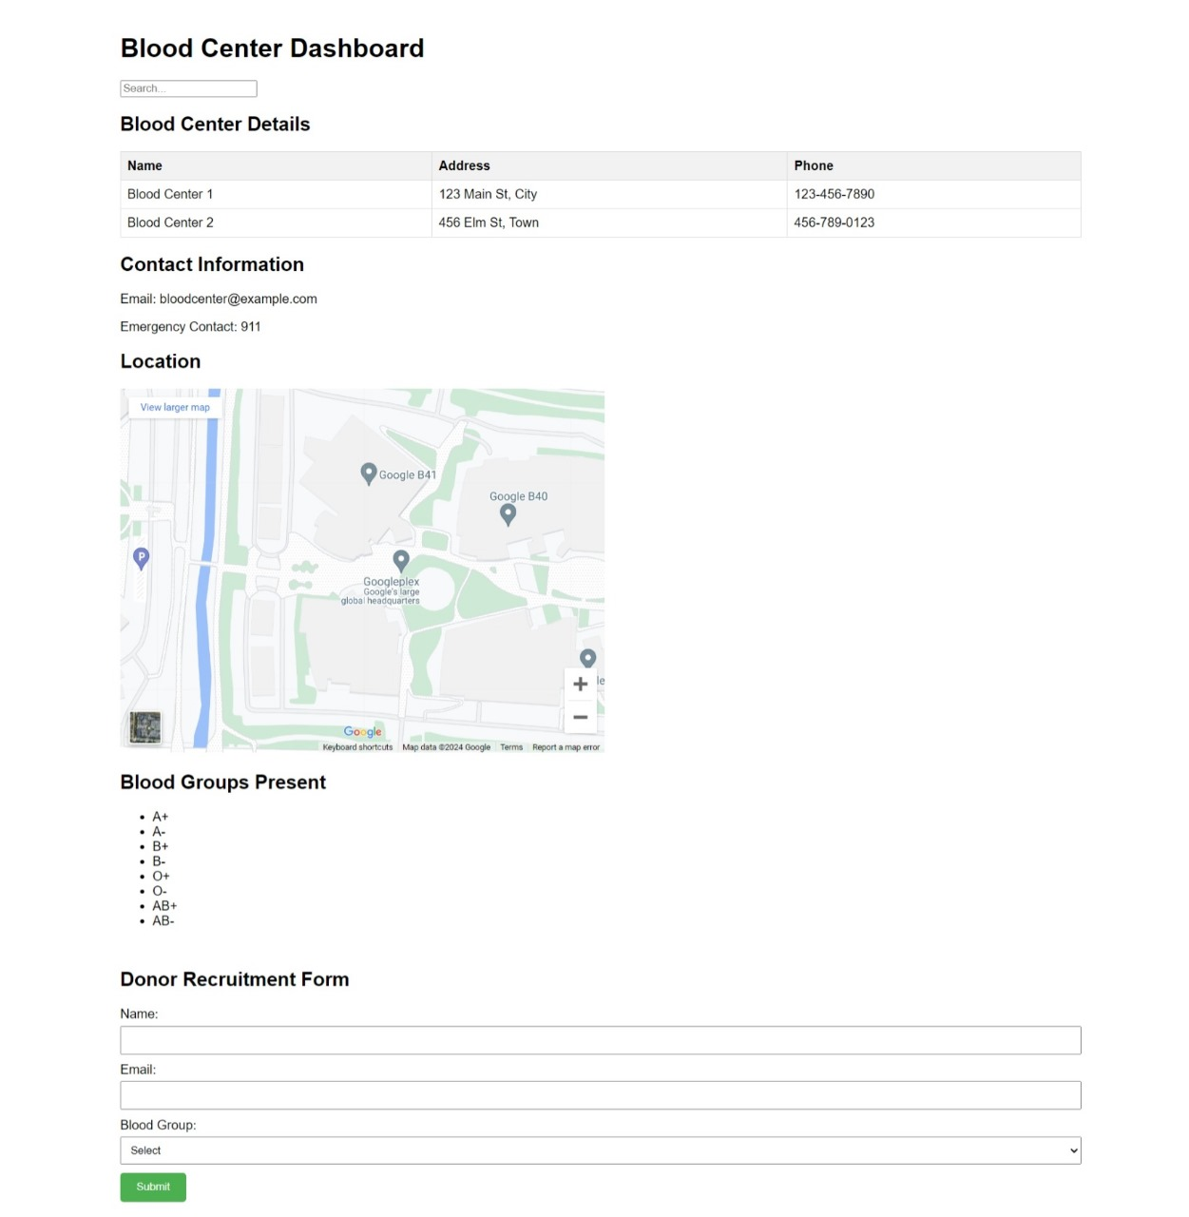

Slide 12
CONCLUSION:-
In summary, our project on blood donation prediction using machine learning has demonstrated the significant potential of advanced algorithms in healthcare analytics. By leveraging historical donation data and applying machine learning models, we have successfully identified key patterns and predictors that can forecast future blood donation behaviors.
Key Achievements:Accurate Predictions: Our selected machine learning models, particularly [mention the top-performing models, e.g., logistic regression, decision trees, or neural networks], have achieved high accuracy in predicting blood donation likelihood.Feature Importance: Analysis of feature importance has revealed critical factors influencing donor behavior, enabling targeted strategies for donor engagement.Operational Efficiency: Implementing these predictions can help blood banks optimize their donor outreach programs, ensuring a more reliable and efficient blood supply chain.
Future Work:
Model Improvement: Continuously refine models with more comprehensive datasets and advanced techniques like ensemble learning or deep learning.Broader Application: Expand the model to predict donor retention and the impact of various donor recruitment campaigns.Integration: Develop a user-friendly interface for blood banks to utilize these predictions in real-time decision-making.In conclusion, machine learning offers a powerful tool to enhance blood donation systems, ultimately contributing to better healthcare outcomes and saving lives. Our work underscores the value of data-driven approaches in managing critical resources like blood supply.

Slide 13
THANK YOU

