Slide 1
Heart Stroke Prediction
Transforming Healthcare with AI&ML

Slide 2
“Empowering healthcare with the predictive precision of AI, our heart stroke prediction system transforms data into lifesaving insights, paving the way for early intervention and improved patient outcomes."

Slide 3
Problem Statement
Despite advances in medical science, heart stroke remains one of the leading causes of death and disability worldwide. Early detection and intervention are crucial in preventing strokes, but current clinical practices often lack the predictive accuracy needed to identify individuals at high risk before symptoms appear. This project aims to develop a robust AI and Machine Learning-based heart stroke prediction system that can analyze comprehensive patient data to accurately assess stroke risk. By leveraging advanced analytics and predictive modeling, the system seeks to provide healthcare providers with actionable insights for early intervention, personalized care, and ultimately, the reduction of stroke incidence and severity.

Slide 4
Description
The Heart Stroke Prediction project leverages advanced Artificial Intelligence (AI) and Machine Learning (ML) techniques to accurately predict the risk of heart stroke in individuals, using comprehensive patient data from electronic health records and public health datasets. By processing and analyzing key features such as demographic information, medical history, lifestyle factors, and clinical measurements, the project aims to develop a robust predictive model. This model identifies significant risk factors and provides actionable insights for healthcare providers to facilitate early intervention and personalized patient care. Emphasizing model interpretability, fairness, and compliance with ethical and regulatory standards, the project strives to enhance preventive healthcare measures, reduce the incidence of heart strokes, and improve overall patient outcomes.

Slide 5
Abstract
Healthcare field has a huge amount of data. To deal with those data, many techniques are used. Someone, somewhere in the world, suffers from a stroke. When someone experiences a stroke, quick medical care is critical. Heart stroke is the leading cause of death worldwide. Heart stroke is similar to heart attack which affects the blood vessels of the heart. Different features can be used to predict the heart stroke. In order to predict the heart stroke, an effective heart stroke prediction system (EHSPS) is developed using machine learning algorithms. The datasets used are classified in terms of 12 parameters like hypertension, heart disease, BMI, smoking status, etc. These are the inputs for machine learning algorithms which are used to predict the heart stroke. The project aims to build a machine learning model which predicts the heart stroke.

Slide 6
Technologies used
Programming Languages:
Python: The primary programming language used for data analysis, machine learning, and model deployment due to its extensive libraries and ease of use.
Data Processing and Analysis:
Pandas: For data manipulation and analysis, providing data structures like DataFrames.
NumPy: For numerical operations and handling large arrays.
Machine Learning and Model Building:
scikit-learn: For implementing machine learning algorithms, model evaluation, and preprocessing tasks.
XGBoost: For gradient boosting, if used as part of model comparison.

Slide 7
Technologies used
Data Preprocessing:
scikit-learn: For scaling features (StandardScaler) and encoding categorical variables (Label Encoder)
Visualization:
Matplotlib: For creating static, interactive, and animated visualizations.
Google Colab: we have used colsb to work collaboratively so that erveryone of us can get use the same notebook to update the code
Kaggle: for Dataset
Version Control:
Git: For version control, tracking changes, and collaboration.

Slide 8
Conclusion
The Heart Stroke Prediction project successfully demonstrates the potential of AI and Machine Learning in enhancing healthcare outcomes. By developing a robust predictive model that leverages comprehensive patient data, we can accurately assess the risk of heart stroke, allowing for timely and personalized interventions. The model's integration into clinical workflows aids healthcare providers in making informed decisions, potentially reducing the incidence and severity of strokes. Emphasizing model interpretability, fairness, and compliance with ethical and regulatory standards ensures that the system is trustworthy and equitable. Moving forward, continuous improvement and integration with broader healthcare systems will further enhance the model's accuracy and utility, ultimately contributing to better preventive healthcare and improved patient outcomes.

Slide 9
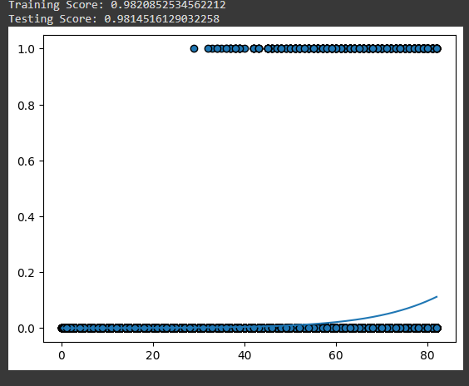
The graphs we got after scoring the regression types
1.Logistic Regression

Slide 10
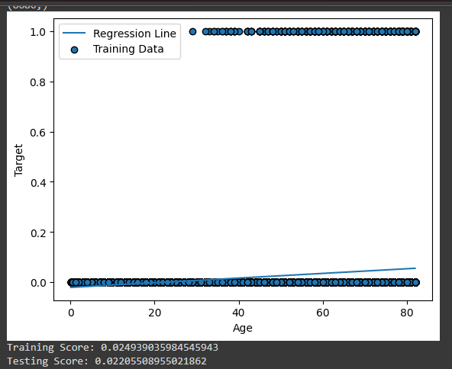
2.Linear Regression

Slide 11

TEAM MEMBERS
M.D.K. Abdul Gafur
K. Swetha
R. Praveen
P. Chetan
I. Girish Kumar
K. Vamsi
K. Nikhilesh

Slide 12
THANK YOU
ANY QUERIES???

