Slide 1

Stock price prediction
using ML model
By
K. Arvind Sai Teja
K. Srithesh varma
R. Alekhya
M. Giri Charan
B. Srinivas
Ch. Anish Raj
A. Nithin

Slide 2

Introduction to Stock Prediction Using ML
* Stock prediction using machine learning (ML) involves utilizing algorithms to analyze historical data and make future stock price predictions.
* ML models can analyze large datasets to identify patterns and trends that can help predict stock movements.
* The goal of stock prediction using ML is to assist investors in making informed decisions based on data-driven insights.

Slide 3
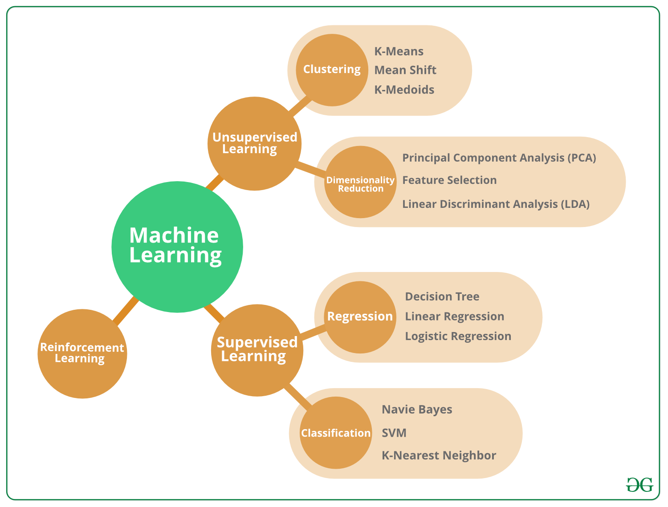
Importance of ML in Stock Prediction
* ML algorithms can handle vast amounts of data, enabling more accurate and timely predictions.
* ML models can adapt to changing market conditions and learn from past data to improve forecasting accuracy.
* By using ML for stock prediction, investors can potentially gain a competitive advantage in the market.

Slide 4
Real-World Applications of Stock Prediction Using ML
* ML-based stock prediction systems are widely used by financial institutions, hedge funds, and individual investors to make investment decisions.
* High-frequency trading firms leverage ML algorithms for real-time stock prediction and automated trading strategies.
* ML-powered stock prediction tools are continuously evolving to adapt to dynamic market conditions and enhance investment performance.

Slide 5
Technical analysis indicator
Technical analysis is a well method of forecasting future market trends by generating buy or sell signals based on specific information obtained from those prices.
A popular method for modeling and predicting the stock market is technical analysis, which is a method based on historical data from the market, primarily price and volume. Quantity. Technical analysis follows several assumptions:
(1) Prices are determined exclusively by supply and demand relationships.
(2) Prices change with the trend.
(3) Changes in supply and demand cause the trend to reverse.
(4) Changes in supply and demand can be identified on the chart.
(5) The patterns on the chart tend to repeat.

Slide 6
Stock Market Predictions Using LSTM(Long-Short Term Memory)
Due to the volatility of tick market prices, accurately estimating stock prices is challenging. Time series modeling, such as the use of LSTM neural network architecture, can aid in forecasting future values. A set of predictors, including fundamental market data and technical indicators, is used to represent stock market behavior. Single and multilayer LSTM models are created using the selected input variables, and their performance is compared using RMSE, MAPE, and Correlation Coefficient. Empirical findings indicate that the single-layer LSTM model outperforms the multilayer LSTM model in terms of fit and prediction accuracy.

Slide 7
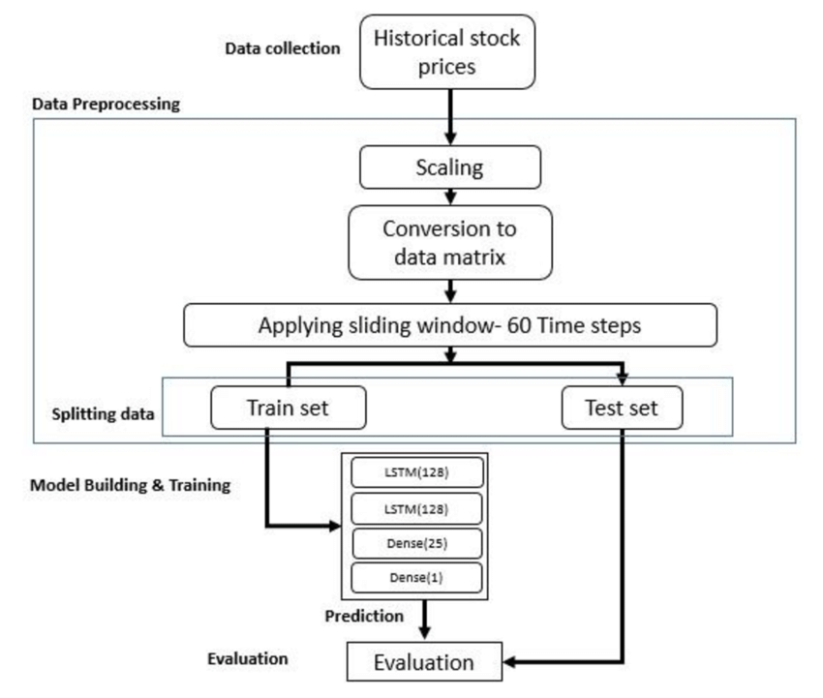
Block Diagram

Slide 8
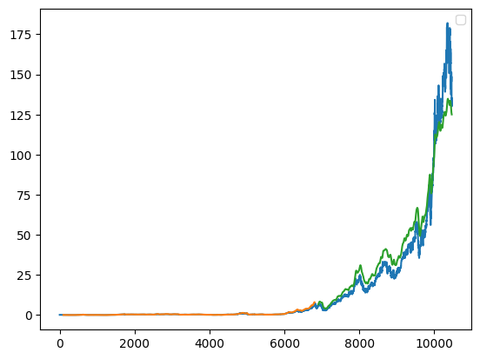
Predicted values graph

