Slide 1
Bulls&Bears website prototype

Slide 2
Welcome page

Slide 3
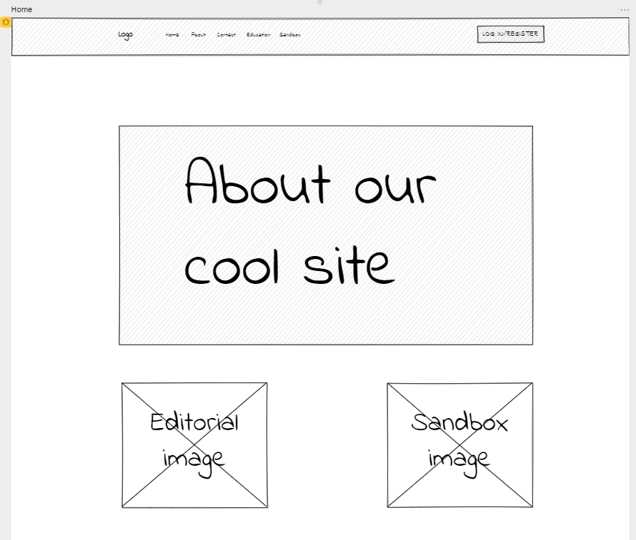

Slide 4
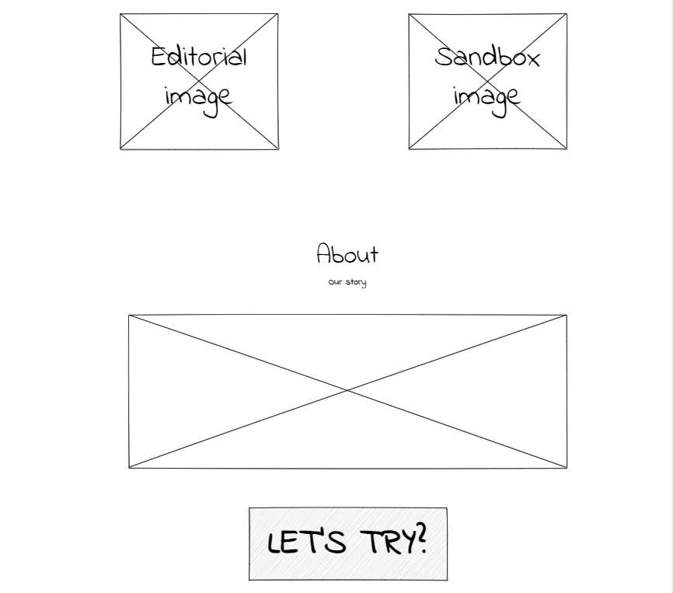

Slide 5
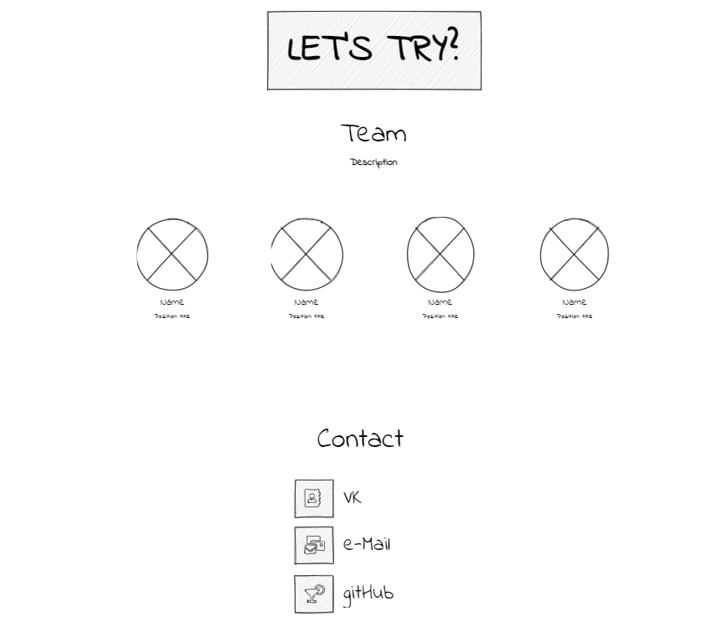

Slide 6
Log in page

Slide 7
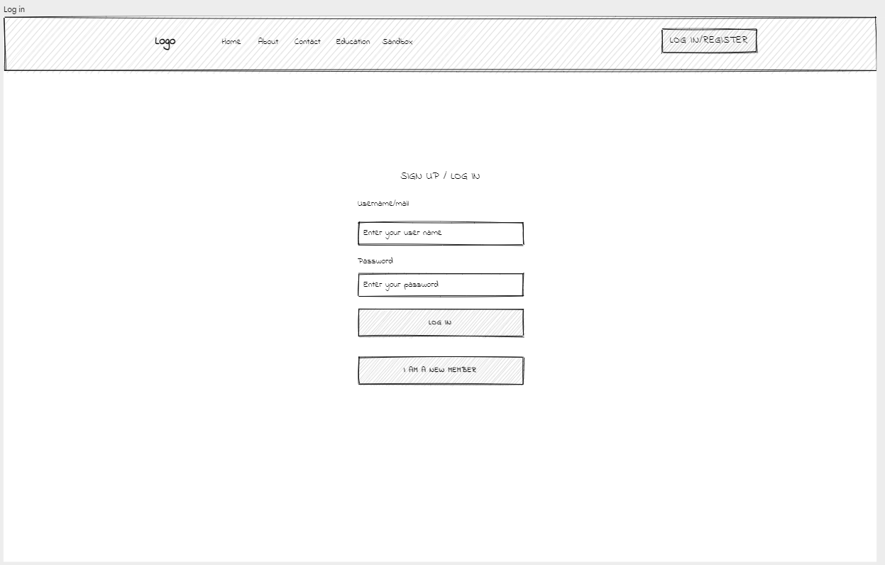

Slide 8
Registration page

Slide 9
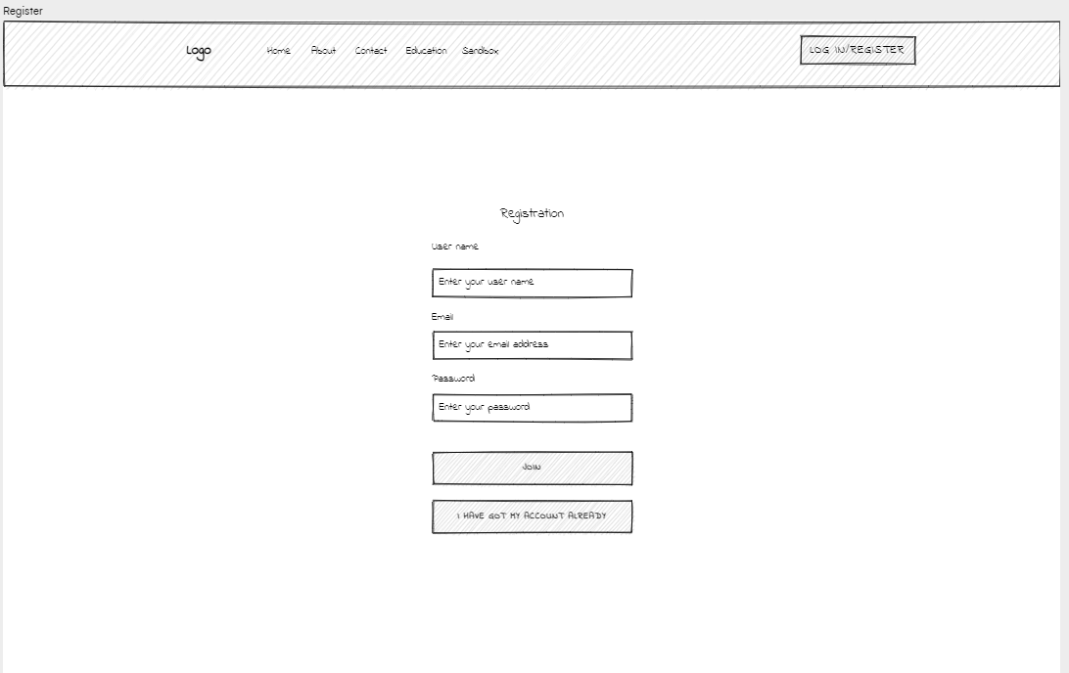

Slide 10
Account page

Slide 11
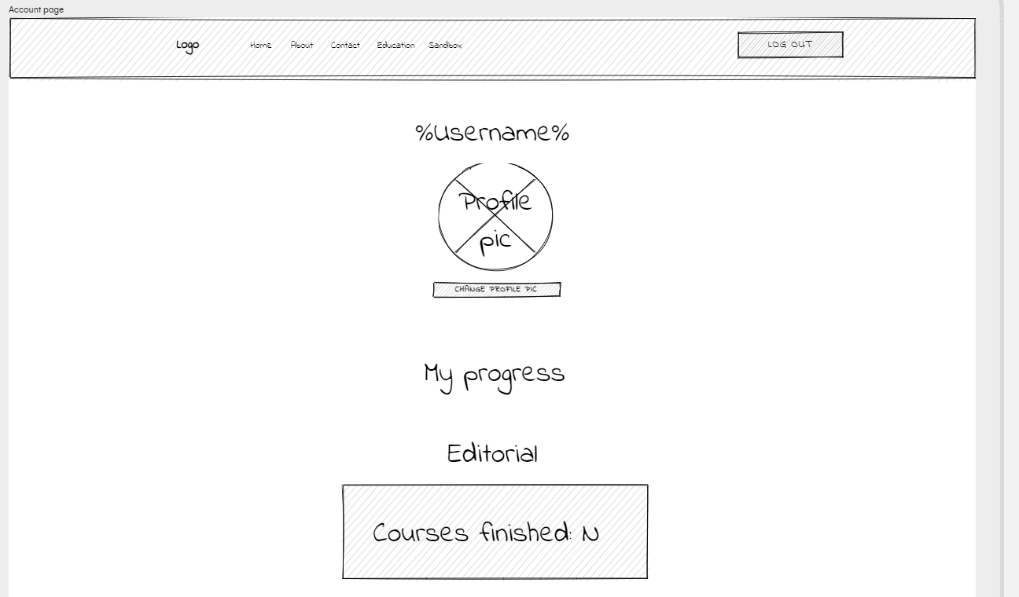

Slide 12
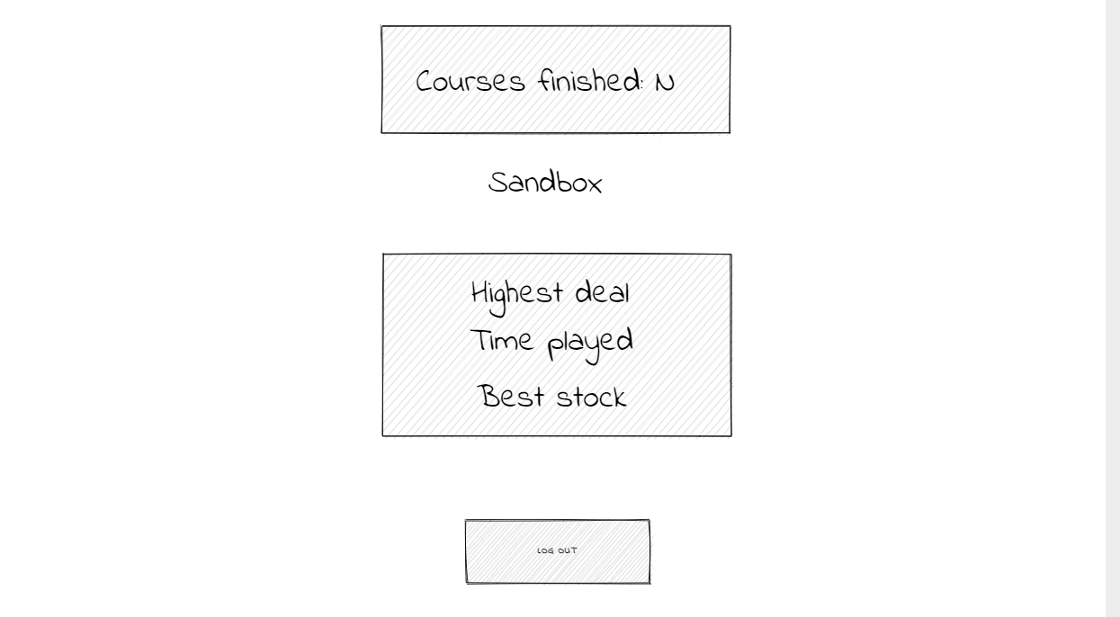

Slide 13
Editorial home page

Slide 14
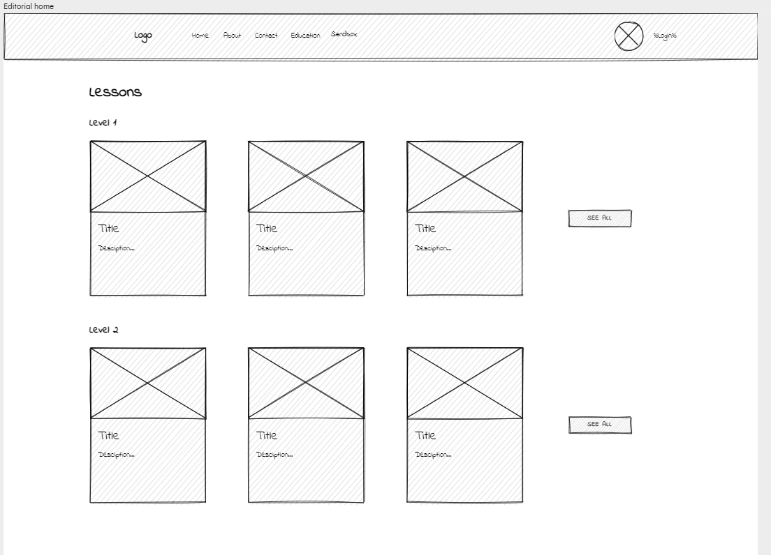

Slide 15
Course page

Slide 16
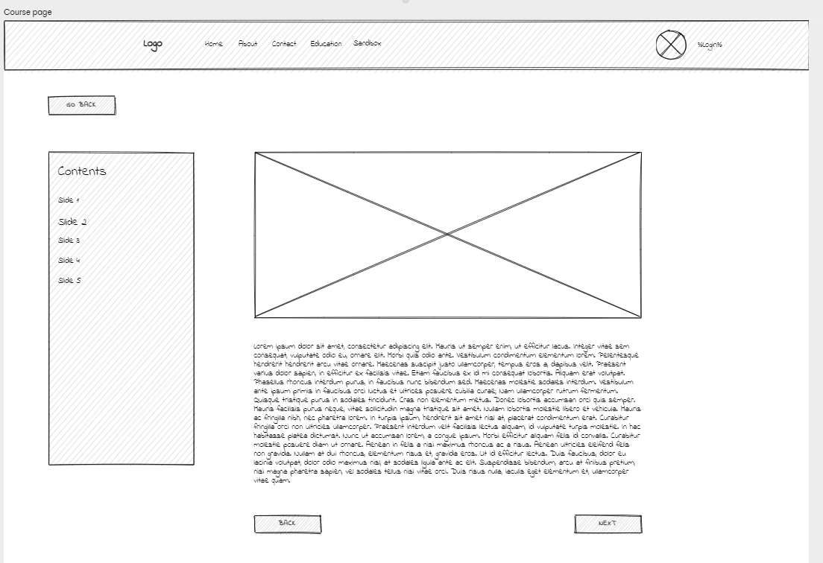

Slide 17
Sandbox page

Slide 18
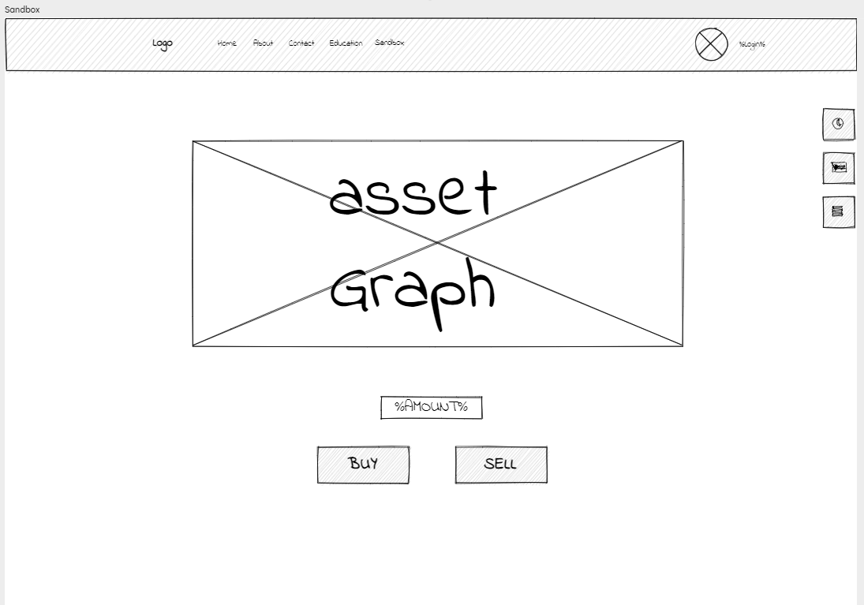

Slide 19
Sandbox transaction page

Slide 20
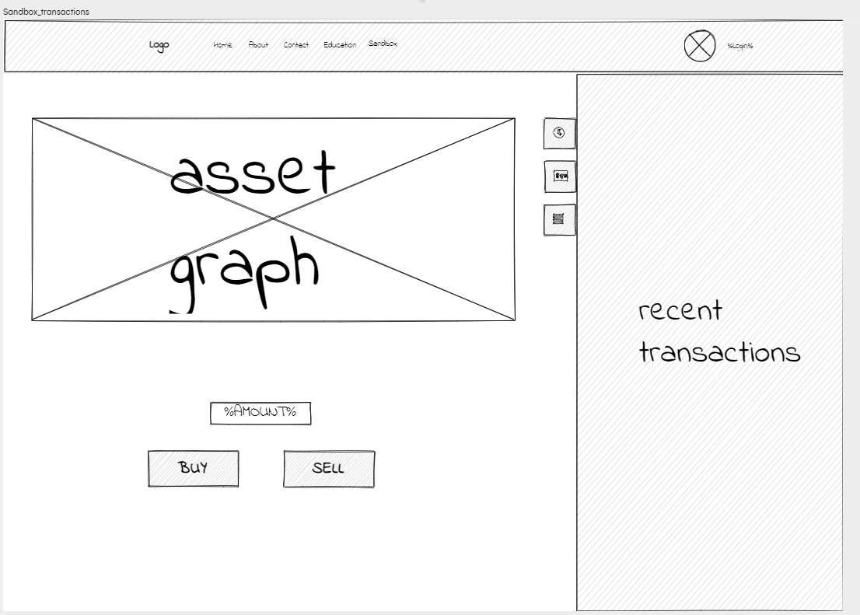

Slide 21
Sandbox your assets page

Slide 22
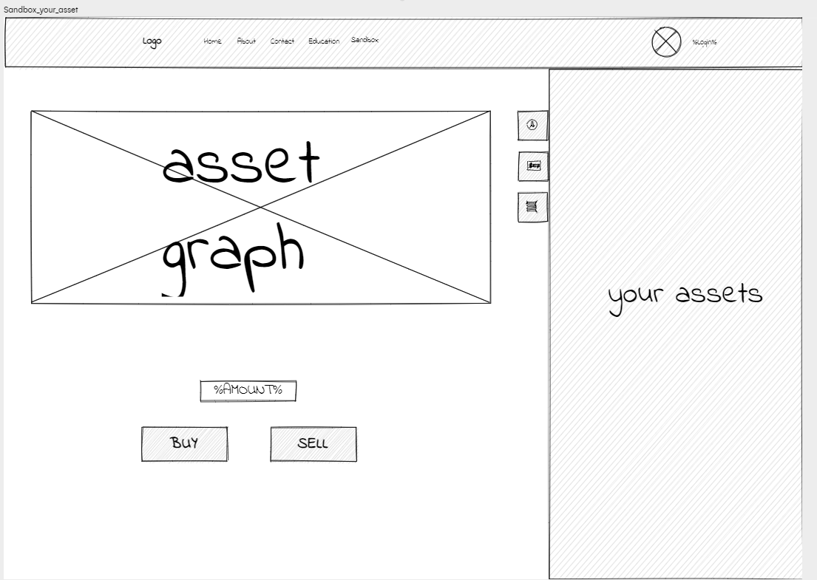

Slide 23
Sandbox all assets page

Slide 24
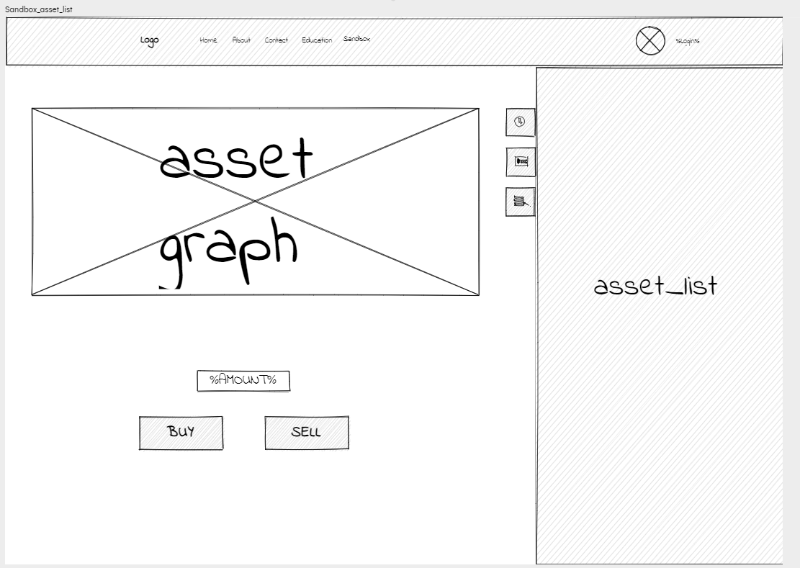

Slide 25
Feel free to visit interactive page
Link in interactive_link.txt

