Slide 1
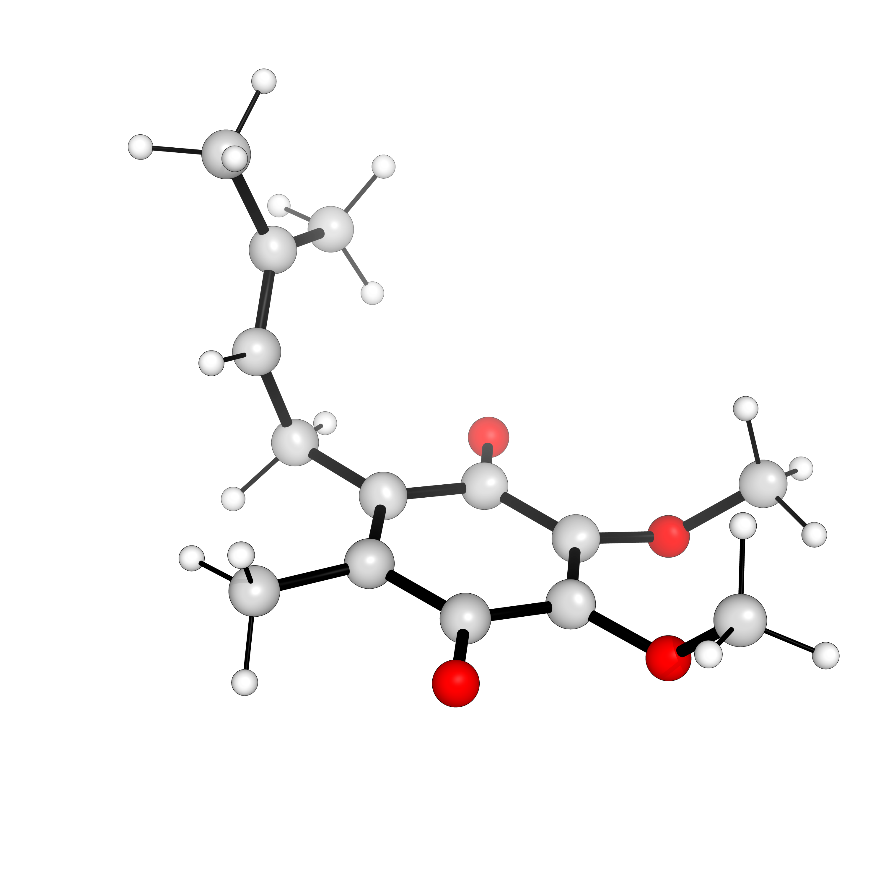
Exploring biologically relevant non-valence anions with the CC2 method
Mauro Gascón
Supervisor: Prof. Thomas Jagau

Slide 2
Non-Valence anions
In non-valence anions (NVAs) the excess electron resides in a diffuse orbital stabilized by long-range interactions.
Require large basis sets and accurate correlation treatment.
Relevant for electron scattering and transfer processes. Can act as a doorway for a valence state.

Slide 3
EOM-EA
Equation-of-motion electron-attachment coupled-cluster (EOM-EA-CC) methods are particularly well suited to study NVAs.
The description is based on the wavefunction of the parent neutral molecule.
The computational cost and memory requirements limit the EOM-EA-CCSD applications

Slide 4
CC2
Second-order approximate coupled-cluster singles and doubles (CC2) method is obtained from a perturbative analysis of the CCSD model.
Lowers computational scaling from CCSD
Allows treatment of “big” molecules: >25 heavy atoms.

Slide 5
Biological Quinones: Ubiquinone
Quinones are essential electron carriers in biological mechanisms.
Ubiquinone (coenzyme Q or CoQ) is a component of electron transport chains in bacterial photosynthesis and aerobic respiration.
It is capable of both a valence and dipole bound anion states.

Slide 6
Ubiquinone models
Quinone group is responsible for electron transfer.
Models are designed by varying the number of isoprenoid tail units: Q0, Q1,… Q10

Slide 7
Computational methods
Optimizations performed at TPSS+D3BJ/ma-def2-TZVP
EA calculated at the RI-EOM-EA-CC2 using the neutral ground state as CC reference state.
aug-cc-pVTZ basis further augmented by 3 s-shells on hydrogen atoms and 6 s- and 3 p-shells on all non-hydrogen atoms.

Slide 8
Q1 and Q0 models

Slide 9
Q0 dipole PES
The dipole of Q0 depends on the orientation of the methoxy chains

Slide 10
The simplest cluster model

Slide 11
Future steps
More realistic cluster model: polar residues might help “solvate” the electron.
Effect of different tail conformation.
Study other substituents: plastoquinone, vitamin K

