Slide 1



MATERIAL HANDLING EFFICIENCIES
FEBRUARY 2023

Slide 2

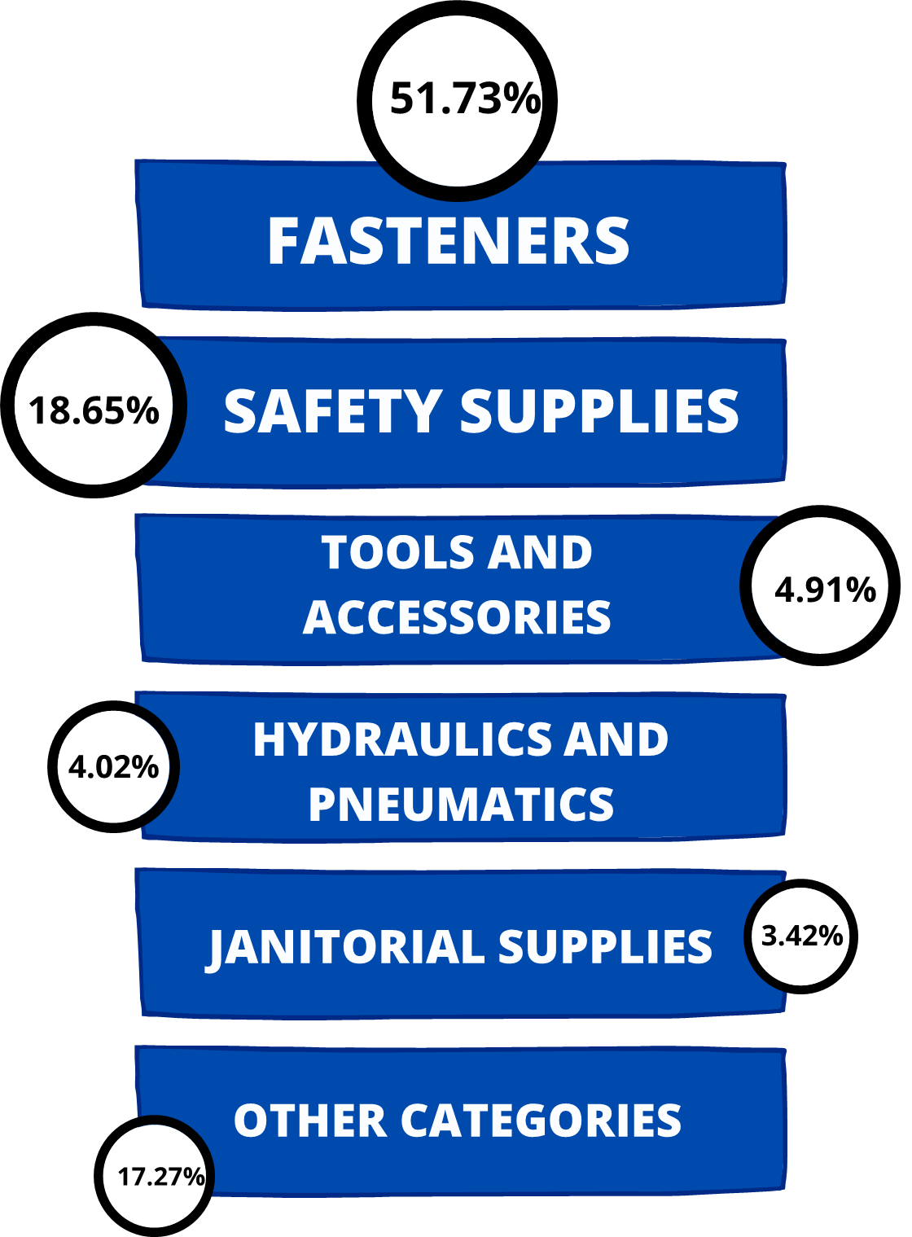
Storage Capacity
OTHER CATEGORIES
30%
FASTENERS
52%
SAFETY SUPPLIES
18%

Slide 3
Labor intensive
Labor Intensive
10
percentage reduction
88%
percentage reduction
82%
Class not slotted count
144

Slide 4
Min & MAx
Low Max
517
percentage reduction
62.12%
Insufficient Spread
618
percentage reduction
62.50%

