Slide 1
Multi-Cloud Oil & Gas Pipeline Monitoring Platform
Group 9 Capstone: an Azure field site sends sensor data to AWS over a private IPsec VPN
[Presenter names and roles]

Slide 2
The problem and what we set out to build
A remote field site produces pipeline readings (pressure, temperature, flow, vibration). HQ needs them live, over a private link, on a dashboard people can open from anywhere.
Private link
Containerised HQ
IPsec site-to-site VPN between Azure and AWS
EKS runs API, database and dashboard
Public HTTPS dashboard
Automated and repeatable
CloudFront in front of an ALB
GitHub Actions now, Terraform next

Slide 3
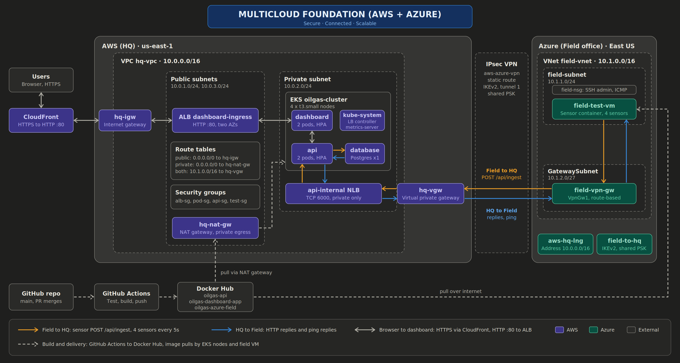
Architecture

Slide 4
Network foundation
AWS VPC hq-vpc 10.0.0.0/16: public subnets 10.0.1.0/24 and 10.0.3.0/24, private 10.0.2.0/24
Internet gateway, NAT gateway, public and private route tables
Azure VNet field-vnet 10.1.0.0/16: field-subnet 10.1.1.0/24, GatewaySubnet 10.1.2.0/27
Security groups (alb, pod, api, test) and field-nsg allow only needed ports and ICMP
Non-overlapping CIDRs, required for the VPN
Screenshot
aws-vpc-subnets.png
Screenshot
azure-vnet.png
Screenshot
sg-nsg-rules.png

Slide 5
IPsec site-to-site VPN
AWS: virtual private gateway, customer gateway, VPN connection (static routing, tunnel 1)
Azure: VpnGw1 gateway, local network gateway (10.0.0.0/16), connection field-to-hq (IKEv2)
Same pre-shared key on both sides
Route propagation enabled on both AWS route tables
Result: traffic between clouds never crosses the public internet
Screenshot
vpn-aws-tunnel-up.png
Screenshot
vpn-azure-connected.png

Slide 6
Kubernetes platform on EKS
EKS cluster oilgas-cluster, 4 x t3.small nodes in the private subnet
AWS Load Balancer Controller builds the ALB and the internal NLB
metrics-server feeds the HPA: api and dashboard scale 2 to 5 pods at 70% CPU
Pods pull images from Docker Hub through the NAT gateway
Controller uses its own IAM role (IRSA); app pods need none
Screenshot
eks-pods-running.png
Screenshot
hpa-targets.png

Slide 7
Application data flow
Sensor VM
Azure
VPN tunnel
IPsec
Internal NLB
TCP 6000
API
Flask
Postgres
readings
Dashboard
browser
4 sensors (PRESS-01, TEMP-02, FLOW-03, VIB-04) post a reading every 5 seconds
POST /api/ingest crosses the VPN to the internal NLB, then the API saves it
The dashboard asks the API for the latest readings
Replies return the same way, so both directions are proven
Screenshot
db-rows.png

Slide 8
Edge and CI/CD
Public edge
Screenshot
github-actions-run.png
Browser, HTTPS to CloudFront, HTTP :80 to the ALB, then the dashboard pods. CloudFront gives free HTTPS with no domain. Caching is off so readings stay live.
CI/CD pipeline
Screenshot
dockerhub-images.png
PR merged to main, GitHub Actions tests and builds three images, pushes them to Docker Hub. The cluster and the field VM pull from there. Deploys use kubectl.

Slide 9
Proof it works
Live dashboard over HTTPS
Ping HQ to Field
Screenshot
cloudfront-dashboard-live.png
Screenshot
ping-hq-to-field.png
Ping Field to HQ
Sensor stopped: data freezes, then resumes
Screenshot
ping-field-to-hq.png
Screenshot
sensor-stop-test.png

Slide 10
Problems we hit and how we solved them
Problem | Cause | Fix
Ping failed with the VPN up | No ICMP rule, no route propagation | Allowed ICMP in SG and NSG, enabled propagation
Pods stuck Pending | t3.small holds 11 pods per node | Scaled the node group to 4
ImagePullBackOff | Wrong image name in the manifest | Used oilgas-dashboard-app
Ingress had no ALB | Outdated controller IAM policy, one public subnet | Updated policy, tagged a second subnet
API returned 500 | readings table never created | Loaded db/schema.sql
HPA showed unknown | No CPU requests on pods | Added resource requests
Secret in the repo | db-secret.yaml was committed | Untracked it, added a placeholder example

Slide 11
Cost control, teardown and reproducibility
Teardown order
Cost control
CloudFront
Ingress and NLB service
EKS cluster
VPN connection, then gateways
NAT gateway and Elastic IP
Azure resource group
VPC
NAT gateway, EKS control plane, nodes and the Azure VPN gateway bill hourly. Everything was torn down after testing and verified empty.
Terraform (planned)
aws/, azure/ and vpn/ will rebuild the same design from code on a separate branch, proving it can be recreated.

Slide 12
Lessons learned and next steps
Lessons
Next steps and known limits
Plan pod capacity before choosing node sizes.
Firewall and route rules matter as much as the VPN itself.
Keep secrets out of Git from day one.
Check image names and IAM policies early.
Add a persistent volume for Postgres.
Load the schema automatically.
Add a second tunnel and NAT for failover.
Build the Terraform replica.
Move secrets to a managed store.
Team: [names and roles]

