Slide 1
Multi-Cloud Oil & Gas Pipeline Monitoring Platform
Group 9 Capstone Project:
Multi-cloud oil & gas pipeline monitoring platform. AWS (EKS, ALB, CloudFront) + Azure (VNet) connected via IPsec VPN. Flask microservices, PostgreSQL, Docker, GitHub Actions CI/CD.
Presented by Group 9:
Cpt. Adesanya Oluwaseun Michael
John Pamisi
Notes:
Good [morning/afternoon]. We are Group 9, and this is our capstone: a multi-cloud monitoring platform for oil and gas pipelines.
In short, a field site on Azure sends sensor data over a private VPN to AWS, where a Kubernetes application stores it and shows it on a live dashboard. I am [name], and with me are [names and roles].

Slide 2
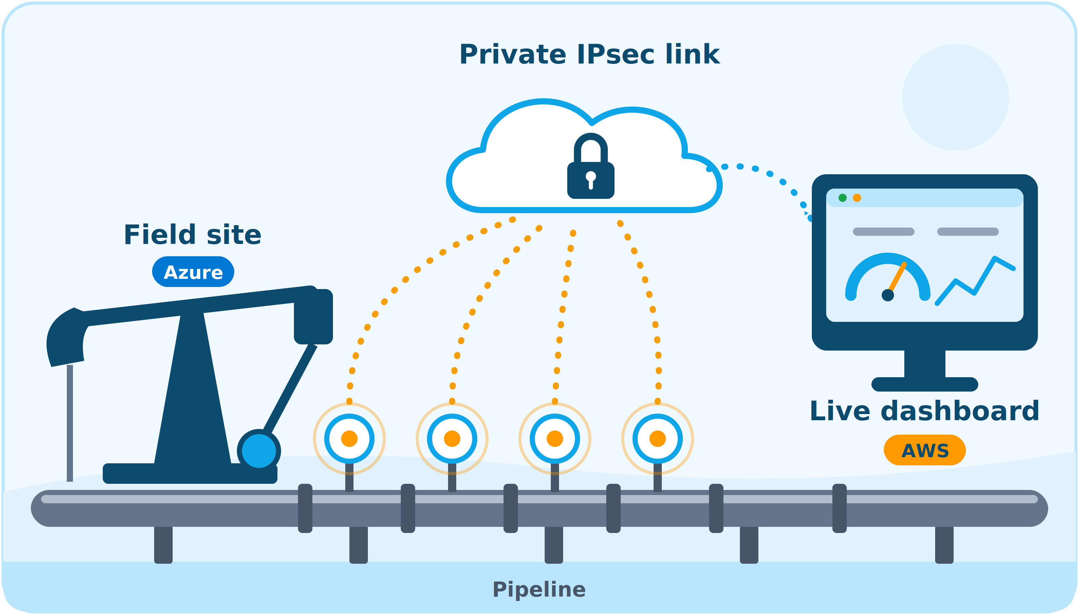
The problem and what we set out to build
A remote field site produces pipeline readings (pressure, temperature, flow, vibration). HQ needs them live, over a private link, on a dashboard people can open from anywhere.
Private link
Containerised HQ
IPsec site-to-site VPN between Azure and AWS
EKS runs API, database and dashboard
Public HTTPS dashboard
Automated and repeatable
CloudFront in front of an ALB
GitHub Actions now, Terraform next
Notes:
The problem is simple. A remote field site produces pipeline readings: pressure, temperature, flow and vibration. Headquarters needs those readings live, over a private link, on a dashboard that anyone can open.
We set four goals. First, a private link between Azure and AWS. Second, a containerised application at headquarters on Kubernetes. Third, a public dashboard with HTTPS. And fourth, a build that is automated and repeatable: GitHub Actions today, Terraform next.

Slide 3
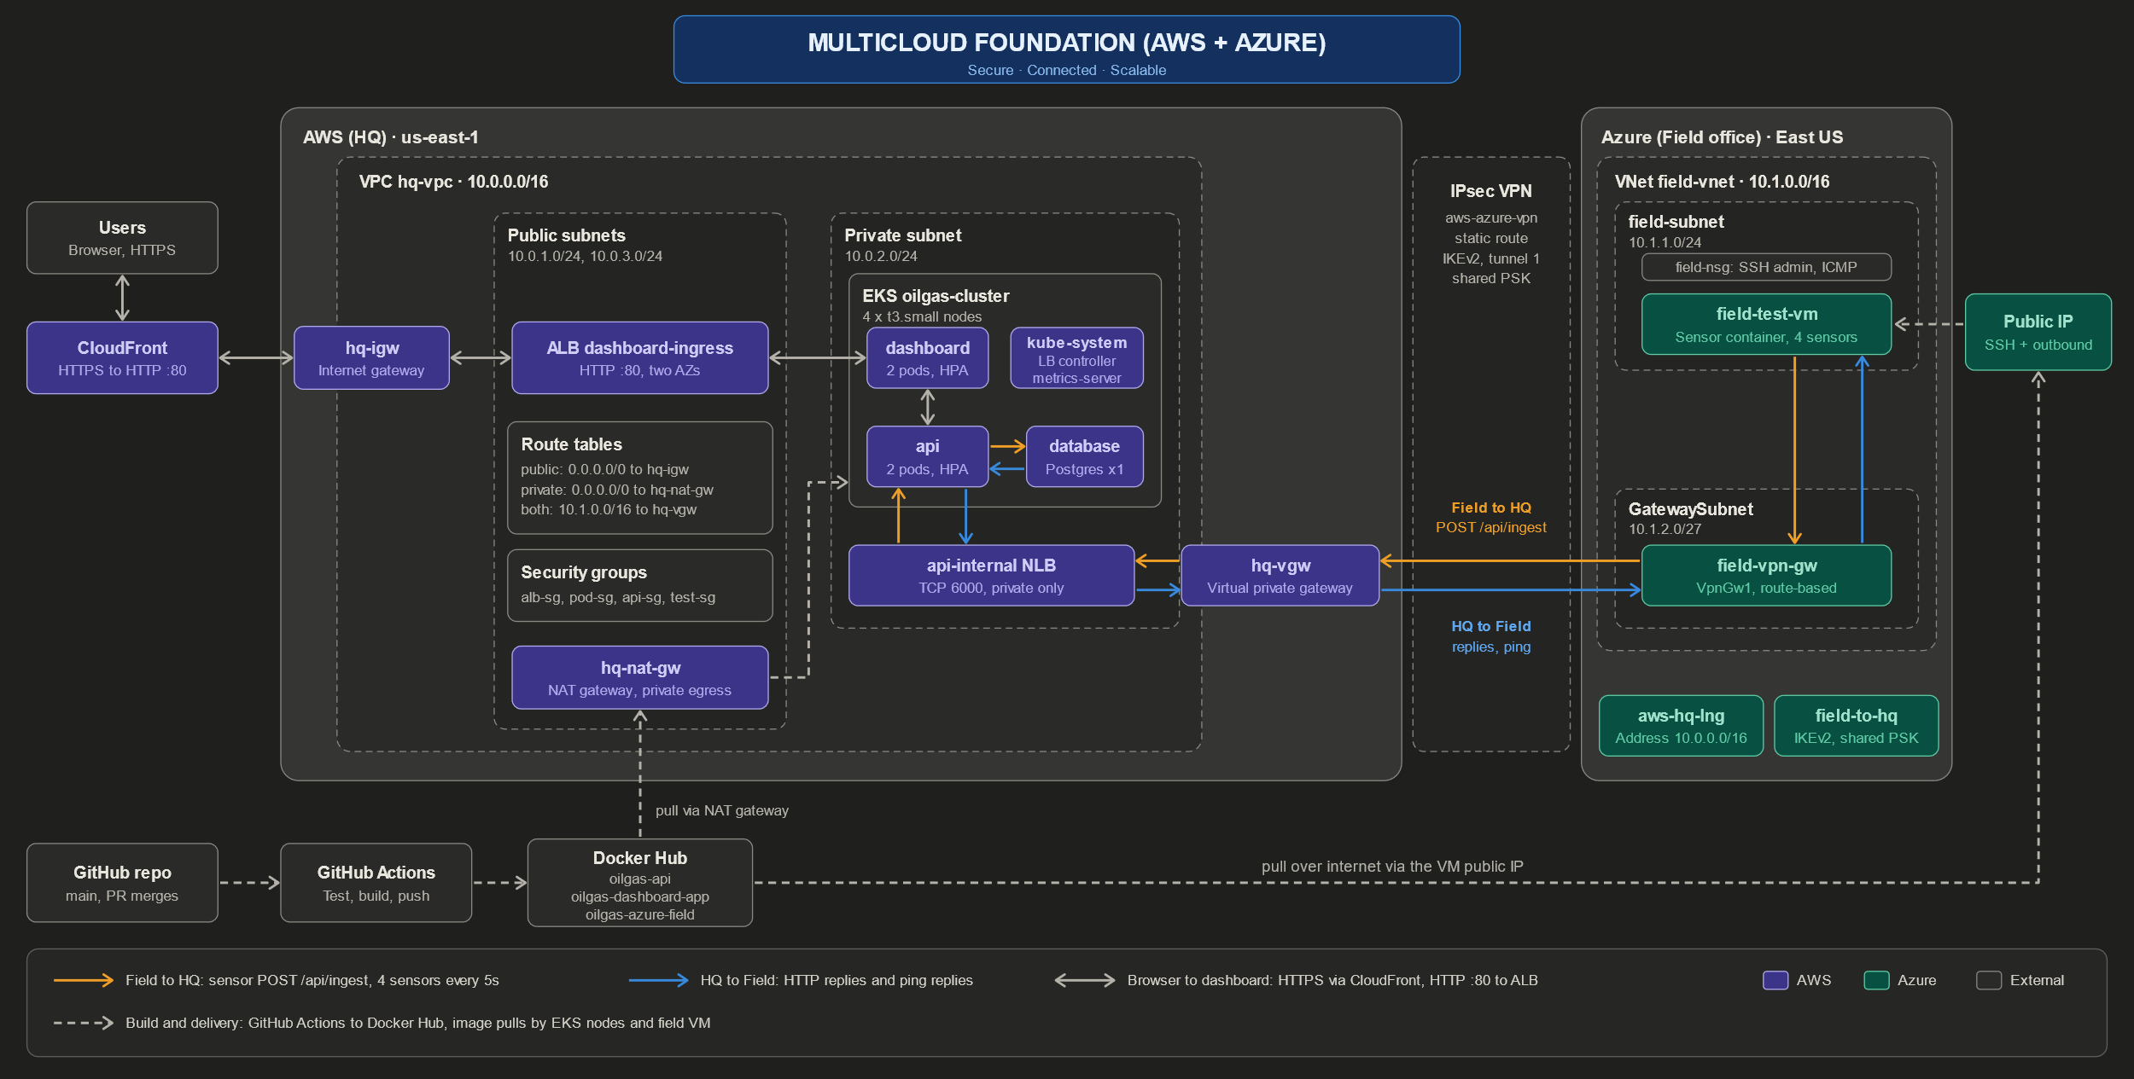
Architecture
Notes:
This is the whole design on one page. Start on the left. Users open the dashboard in a browser over HTTPS through CloudFront. CloudFront passes plain HTTP to an Application Load Balancer inside our AWS network. The load balancer sends traffic to the dashboard pods on our EKS cluster.
On the right is the field site on Azure: a virtual machine running a sensor container. It sends readings through the IPsec VPN tunnel to an internal load balancer, then to the API, which stores them in Postgres.
The orange arrows are sensor data going to headquarters. The blue arrows are replies coming back. The dashed line along the bottom is our delivery pipeline: GitHub, GitHub Actions and Docker Hub.

Slide 4
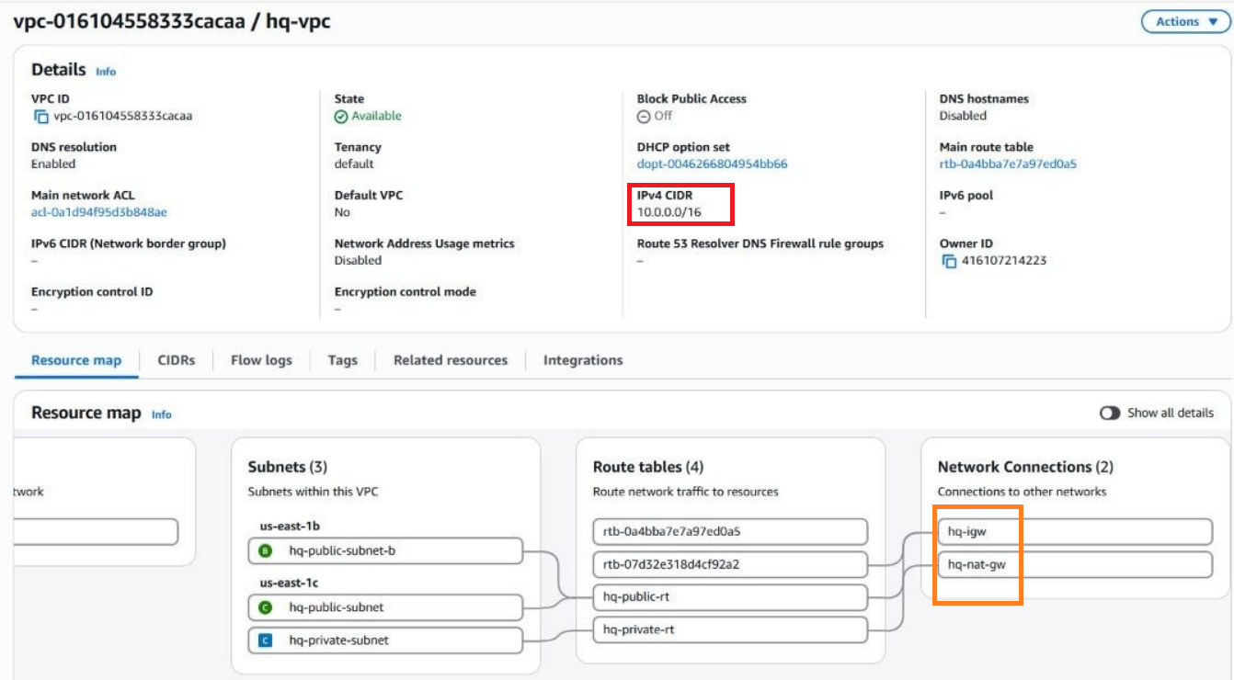
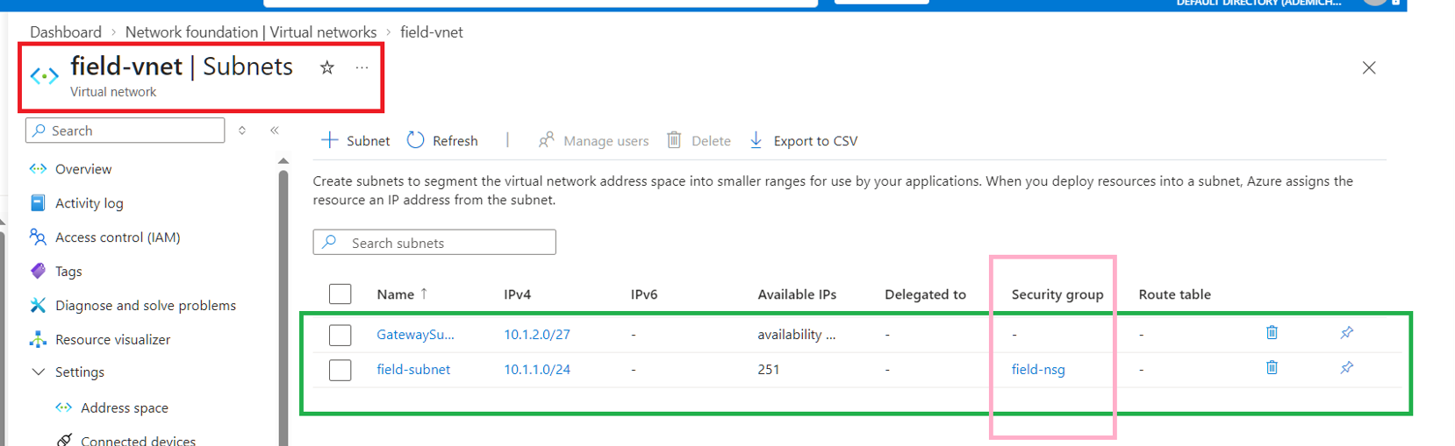
Network
foundation
AWS VPC hq-vpc 10.0.0.0/16: public subnets 10.0.1.0/24 and 10.0.3.0/24, private 10.0.2.0/24
Internet gateway, NAT gateway, public and private route tables
Azure VNet field-vnet 10.1.0.0/16: field-subnet 10.1.1.0/24, GatewaySubnet 10.1.2.0/27
Security groups (alb, pod, api, test) and field-nsg allow only needed ports and ICMP
Non-overlapping CIDRs, required for the VPN
Notes:
We started with the networks. On AWS we built a VPC with the range 10.0.0.0 slash 16: two public subnets in two zones, one private subnet, an internet gateway, a NAT gateway and route tables.
On Azure we built a virtual network, 10.1.0.0 slash 16, with a field subnet and a gateway subnet. The two ranges must not overlap, or the VPN cannot route between them.
We also set the firewalls: security groups on AWS and a network security group on Azure, allowing only the ports we need.

Slide 5
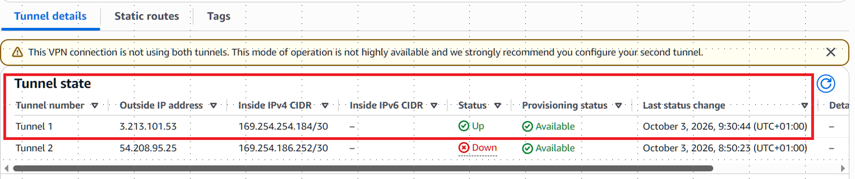
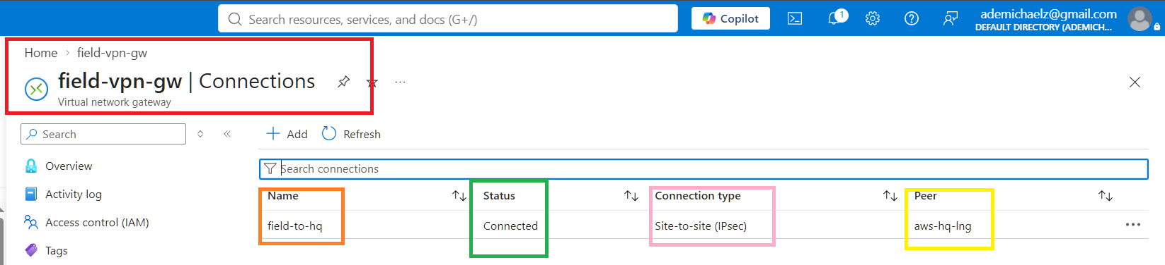
IPsec site-to-site VPN
AWS: virtual private gateway, customer gateway, VPN connection (static routing, tunnel 1)
Azure: VpnGw1 gateway, local network gateway (10.0.0.0/16), connection field-to-hq (IKEv2)
Same pre-shared key on both sides
Route propagation enabled on both AWS route tables
Result: traffic between clouds never crosses the public internet
Notes:
The VPN joins the two clouds. On AWS we created a virtual private gateway, a customer gateway and a VPN connection using static routing. On Azure we created a VPN gateway, a local network gateway that describes the AWS address range, and a connection using IKEv2. Both sides use the same pre-shared key.
We also enabled route propagation on the AWS route tables, so AWS knows to send Azure traffic into the tunnel.
These screenshots show the tunnel up on AWS and connected on Azure. The result is that traffic between the clouds never crosses the public internet.

Slide 6
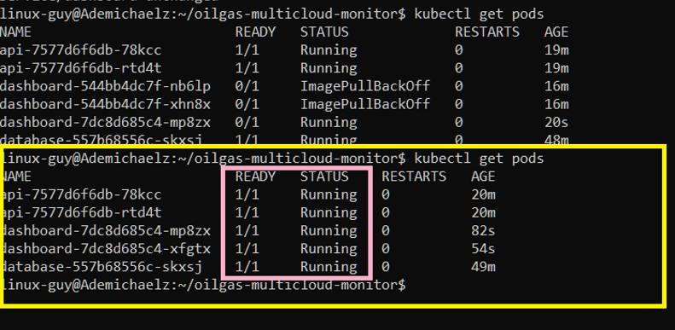
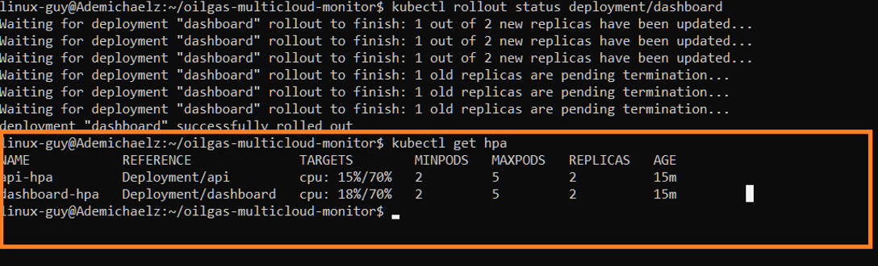
Kubernetes platform on EKS
EKS cluster oilgas-cluster, 4 x t3.small nodes in the private subnet
AWS Load Balancer Controller builds the ALB and the internal NLB
metrics-server feeds the HPA: api and dashboard scale 2 to 5 pods at 70% CPU
Pods pull images from Docker Hub through the NAT gateway
Controller uses its own IAM role (IRSA); app pods need none
Screenshot
kubectl-get-hpa.png
Notes:
At headquarters everything runs on Amazon EKS: a cluster with four small nodes in the private subnet. Three add-ons matter.
The AWS Load Balancer Controller creates the public and internal load balancers from our Kubernetes files. Metrics-server measures CPU. And the horizontal pod autoscaler adds pods, from two up to five, when CPU passes 70 percent.
Pods pull their images from Docker Hub through the NAT gateway. The controller has its own IAM role, and the application pods need none because they never call AWS.

Slide 7
Application data flow
W1 Sensor posts a reading (every 5 s)
Sensor VM
Azure
VPN tunnel
IPsec
Internal NLB
TCP 6000
API
Flask, the only door to the data
R1 Dashboard asks
Dashboard
browser
R4 API returns data
W4 API replies "received" along the same path
W2 API saves the reading
R2 API asks Postgres
Write (W1 to W4): the sensor posts, the API saves the reading in Postgres, Postgres confirms, the API replies "received"
Read (R1 to R4): the dashboard asks the API, the API asks Postgres, Postgres replies, the API returns the readings
The dashboard never connects to the database
W3 Postgres confirms
R3 Postgres replies
Postgres
readings table
Example reading
PRESS-01, 1612.5 psi, saved with a timestamp in the readings table
Write path
Read path
Notes:
This slide shows exactly how data moves, and the key point is that only the API talks to the database.
First, the write path, in orange. The sensor posts a reading every five seconds: W1. It crosses the VPN and the internal load balancer to the API. The API saves it in Postgres: W2. Postgres confirms: W3. And the API replies received, back along the same path: W4.
Now the read path, in blue. When someone opens the dashboard, the dashboard asks the API for the latest readings: R1. The API asks Postgres: R2. Postgres replies to the API: R3. And the API returns the data to the dashboard: R4.
The dashboard never connects to the database directly.

Slide 8
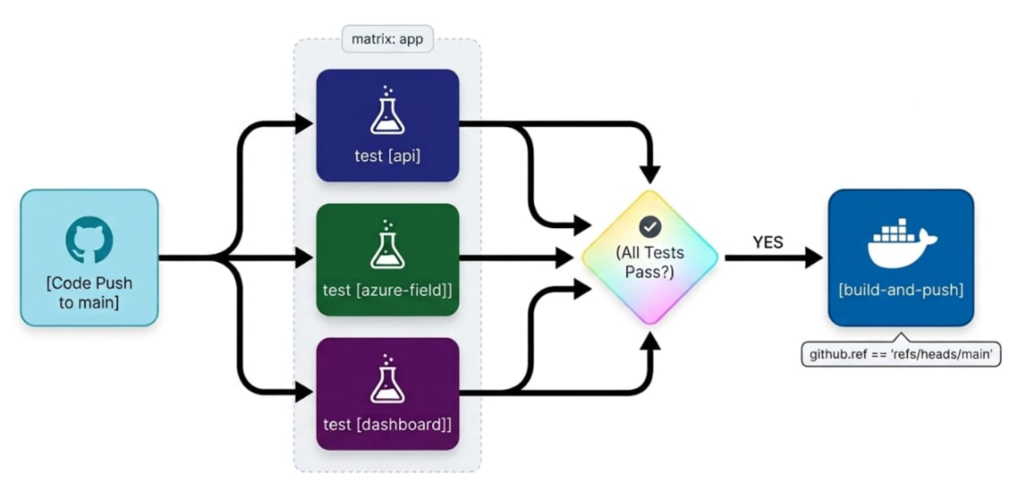
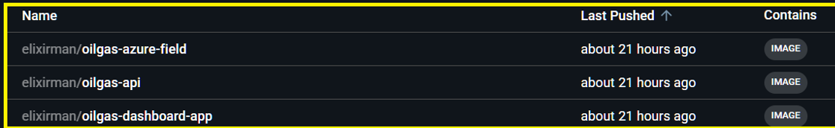
Edge and CI/CD
Public edge
CI/CD pipeline
Browser, HTTPS to CloudFront, HTTP :80 to the ALB, then the dashboard pods. CloudFront gives free HTTPS with no domain. Caching is off so readings stay live.
PR merged to main, GitHub Actions tests and builds three images, pushes them to Docker Hub. The cluster and the field VM pull from there. Deploys use kubectl.
Notes:
Two more pieces. First, the public edge. Browsers use HTTPS to CloudFront, which forwards HTTP on port 80 to the load balancer. CloudFront gives us free HTTPS without needing a domain, and we turned caching off so readings stay live.
Second, the pipeline. When a pull request merges to main, GitHub Actions runs the tests, builds three Docker images and pushes them to Docker Hub. The cluster and the field VM pull from there.
We then deploy the manifests with kubectl, so deployment is manual. The pipeline stops at the image push.

Slide 9
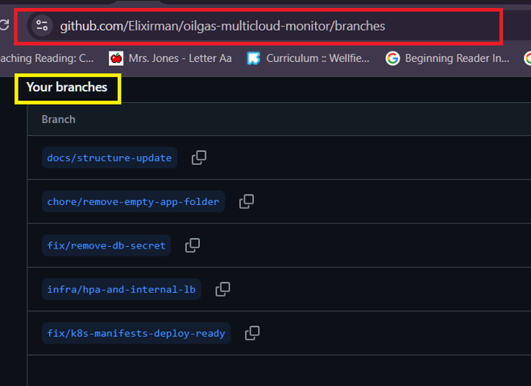
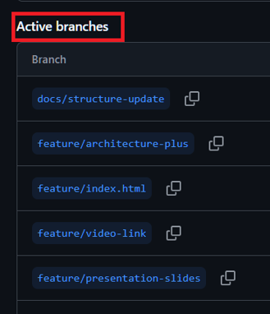
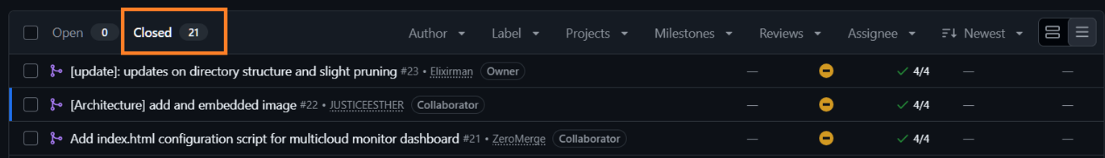
Source control
GitHub repository: Elixirman/oilgas-multicloud-monitor
Feature branches for each piece of work, named by task
Every change merged to main through a pull request
Commit messages tagged by phase, for example [k8s] or [docs]
Issues labelled by phase: network, vpn, app, k8s, edge
Notes:
For source control we used a GitHub repository, with a feature branch for each piece of work and pull requests merged into main.
Commit messages are tagged by phase, and issues are labelled by phase: network, VPN, app, Kubernetes and edge. These screenshots show the branches and the merged pull requests.

Slide 10
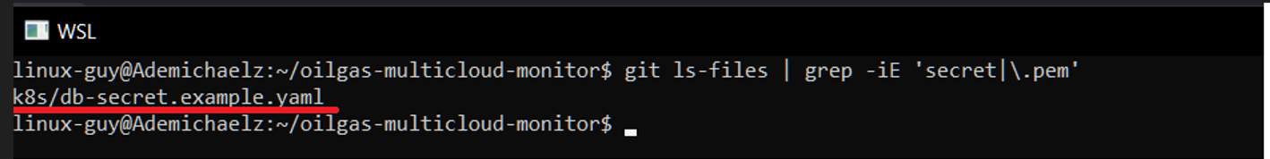
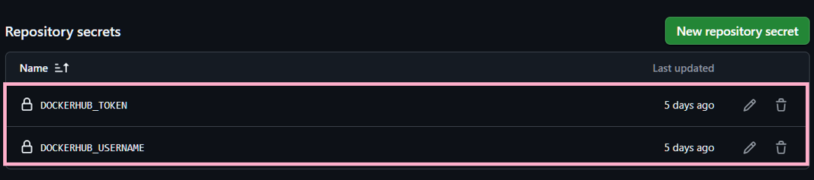
Security
Database credentials come from a Kubernetes Secret; the repo holds a placeholder example only
IAM: the load balancer controller has its own IRSA role, nodes have a node role, app pods have none
Network: security groups and the NSG allow only needed ports, SSH only from the admin IP, and the VPN encrypts cross-cloud traffic
No passwords or keys in GitHub: the real secret file and .pem keys are gitignored
Docker Hub login kept in GitHub Actions secrets
An early secret commit was found and removed from tracking
Notes:
On security: no passwords or keys are in GitHub. The real secret file and the SSH keys are gitignored. Docker Hub credentials sit in GitHub Actions secrets, and database credentials come from a Kubernetes Secret, with only a placeholder example in the repository.
We want to be open about one thing. An early commit contained the real database secret. We found it and removed it from tracking, and the database it protected no longer exists.
For permissions, the load balancer controller has its own role with a scoped policy, the nodes have a node role, and the application pods have none. On the network, the firewalls allow only needed ports, SSH is limited to the admin address, and the VPN encrypts traffic between the clouds.

Slide 11
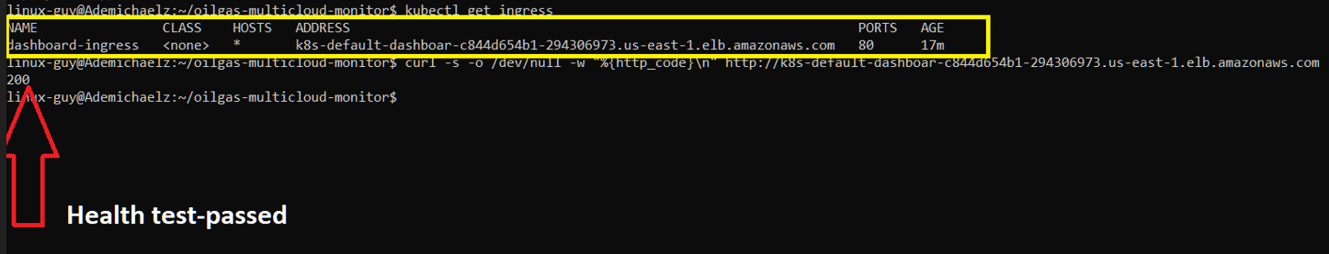
Monitoring and documentation
/health endpoint on the api (port 6000) and the dashboard (port 5000)
Kubernetes liveness and readiness probes call /health every 10 seconds
Container logs read with kubectl logs
metrics-server tracks CPU and the HPA scales pods from it
Documentation
README covers architecture, setup, deployment, environment variables and troubleshooting. Also docs/REQUIREMENTS.md and the interactive docs/index.html.
Notes:
For monitoring, both the API and the dashboard expose a health endpoint. Kubernetes liveness and readiness probes call it every ten seconds, and restart or hold back a pod that fails.
We read application logs with kubectl logs, and metrics-server feeds CPU numbers to the autoscaler.
Documentation lives in the README: architecture, setup, deployment, environment variables and troubleshooting. We also added a requirements checklist with screenshots and an interactive walkthrough.

Slide 12
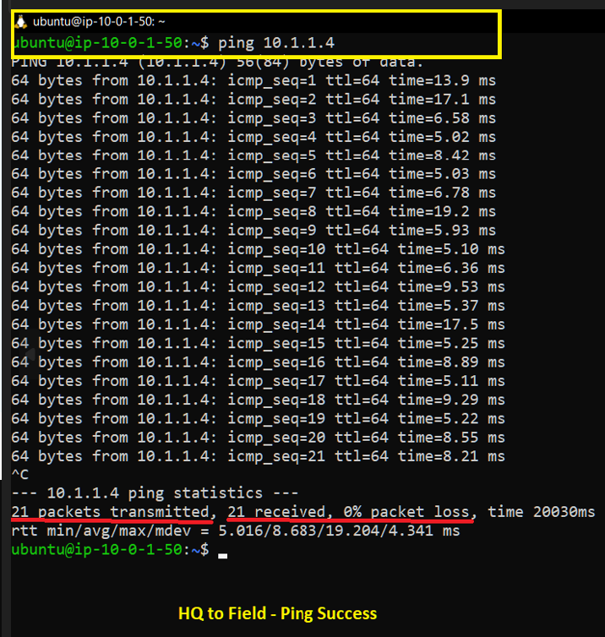
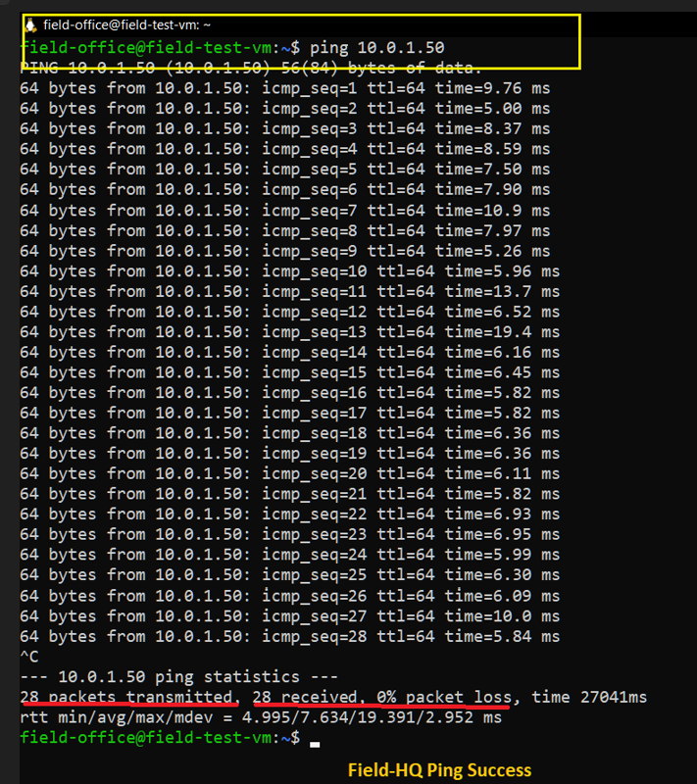
Proof it works
Ping HQ to Field
Ping Field to HQ
Notes:
Now the proof. These two screenshots show ping working in both directions between headquarters and the field VM. That proves the VPN, the routes and the firewall rules.

Slide 13
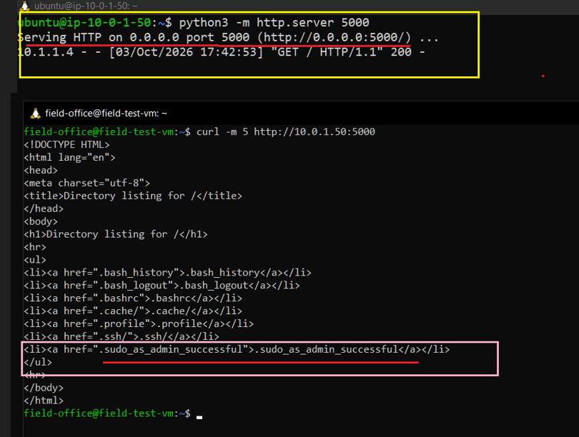
Proof it works 2
App data transmission test
Notes:
This is our application-level test. We started a simple web server on the HQ test instance, on port 5000. From the field VM in Azure we fetched it with curl, and the page came back. The server log shows the request arriving from the field VM's address. So real application traffic, not just ping, crosses the VPN.

Slide 14
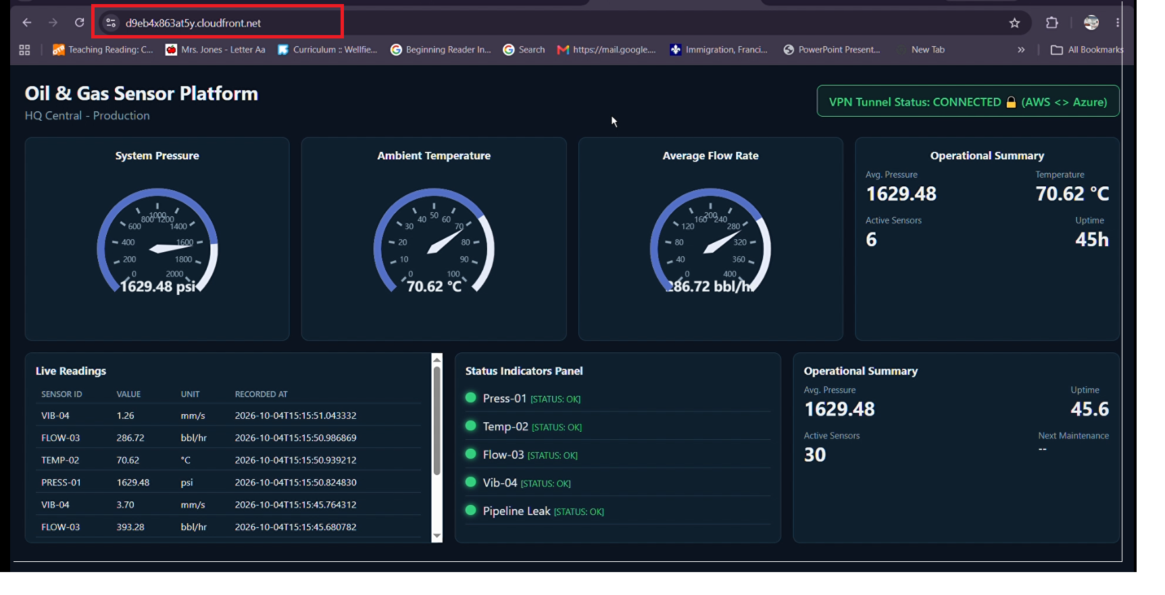
Proof it works 3
Live dashboard over HTTPS on AWS Cloudfront
Notes:
Finally, the live dashboard over HTTPS through CloudFront. The tunnel status shows connected, and the gauges and the live readings table are fed by the sensor readings from the field VM. This is the full chain working end to end.

Slide 15
Problems we hit and how we solved them
Problem | Cause | Fix
Ping failed with the VPN up | No ICMP rule, no route propagation | Allowed ICMP in SG and NSG, enabled propagation
Pods stuck Pending | t3.small holds 11 pods per node | Scaled the node group to 4
ImagePullBackOff | Wrong image name in the manifest | Used oilgas-dashboard-app
Ingress had no ALB | Outdated controller IAM policy, one public subnet | Updated policy, tagged a second subnet
API returned 500 | readings table never created | Loaded db/schema.sql
HPA showed unknown | No CPU requests on pods | Added resource requests
Secret in the repo | db-secret.yaml was committed | Untracked it, added a placeholder example
Notes:
We hit real problems and fixed each one.
Ping failed even with the VPN up. We were missing ICMP rules and route propagation. Pods got stuck pending, because small nodes hold only eleven pods each, so we scaled the node group. One pod showed image pull errors because the manifest used the wrong image name.
The ingress had no load balancer, because the controller's IAM policy was out of date and we needed a second public subnet. The API returned errors until we loaded the database schema. The autoscaler showed unknown until we added CPU requests to the pods. And we found a secret committed to the repository and removed it.

Slide 16
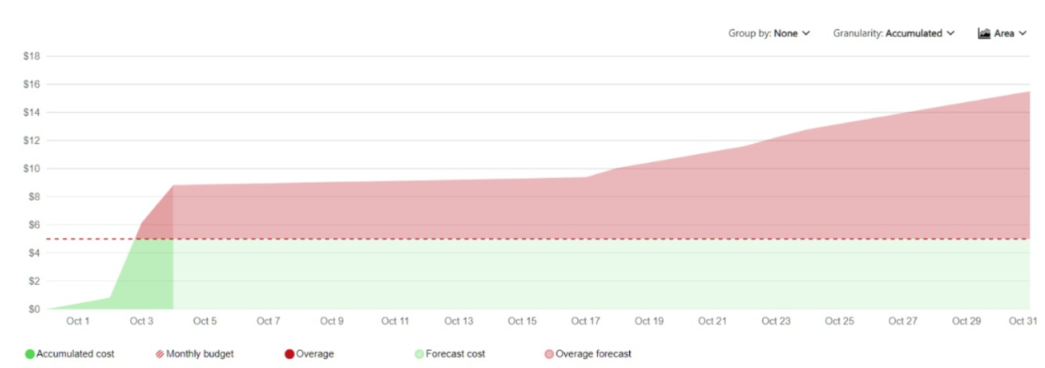
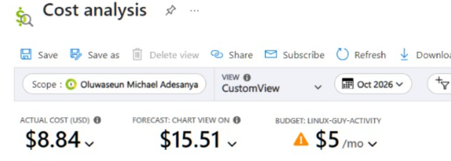
Cost control, teardown and reproducibility
Cost control
Teardown order
NAT gateway, EKS control plane, nodes and the Azure VPN gateway bill hourly. Everything was torn down after testing and verified empty.
CloudFront
Ingress and NLB service
EKS cluster
VPN connection, then gateways
NAT gateway and Elastic IP
Azure resource group
VPC
Terraform (planned)
aws/, azure/ and vpn/ will rebuild the same design from code on a separate branch, proving it can be recreated.
Notes:
Cost control. The NAT gateway, EKS, the nodes and the Azure VPN gateway all bill by the hour, so after testing we tore everything down in order: CloudFront, the load balancer services, the cluster, the VPN, the NAT gateway, the Azure resource group and finally the VPC. We verified that nothing was left running.
Terraform files for AWS and Azure are in progress, so the same design can be rebuilt from code on a separate branch.

Slide 17
Lessons learned and next steps
Lessons
Next steps and known limits
Plan pod capacity before choosing node sizes.
Firewall and route rules matter as much as the VPN itself.
Keep secrets out of Git from day one.
Check image names and IAM policies early.
Add a persistent volume for Postgres.
Load the schema automatically.
Add a second tunnel and NAT for failover.
Build the Terraform replica.
Move secrets to a managed store.
Team(Group-9)
Ayobami Akindolire | Olawale Idris Akinola-arch
Enyeneobong Nkwa | John Pamisi
Esther Sopuruchi Justice | Abundant Joel
Dr. Muhammad Bello Kusharki | Adesanya Oluwaseun Michael
Notes:
What we learned: plan pod capacity before choosing node sizes. Firewall and route rules matter as much as the VPN. Keep secrets out of Git from day one. And check image names and IAM policies early.
Our next steps are a persistent volume for Postgres, loading the schema automatically, a second tunnel and NAT gateway for failover, finishing the Terraform replica, and moving secrets to a managed store.
Thank you. We are happy to take questions.

Slide 18
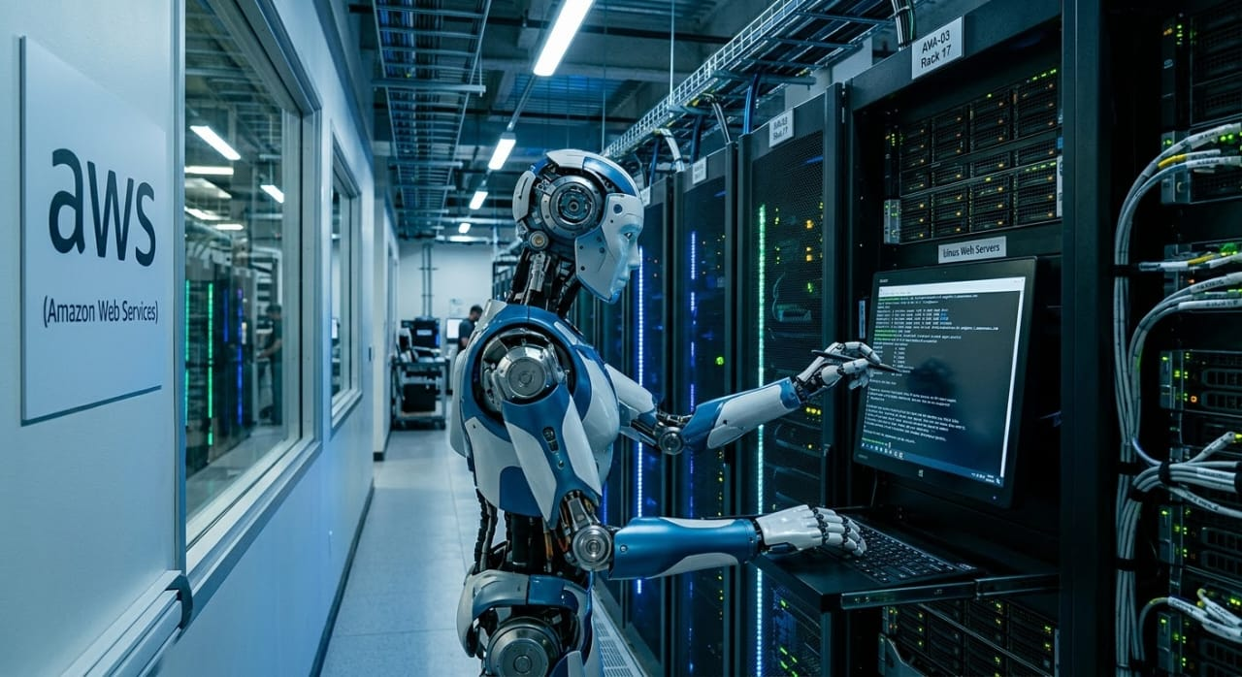
Thank You
Notes:
What we learned: plan pod capacity before choosing node sizes. Firewall and route rules matter as much as the VPN. Keep secrets out of Git from day one. And check image names and IAM policies early.
Our next steps are a persistent volume for Postgres, loading the schema automatically, a second tunnel and NAT gateway for failover, finishing the Terraform replica, and moving secrets to a managed store.
Thank you. We are happy to take questions.

