Slide 1
A+ Computer Science
LISTS

Slide 2
What is
a List?

Slide 3
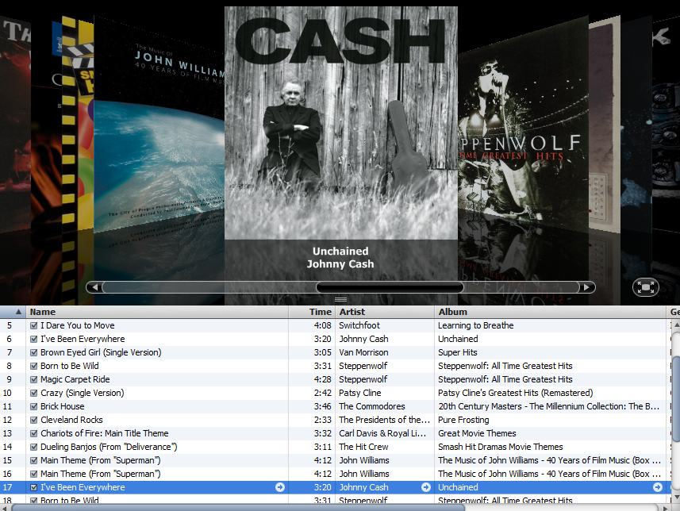


Slide 4
What is
a List?

Slide 5
ArrayList
Arraylist is a class that houses an
array. An ArrayList can store any type.
All ArrayLists store the first reference
at spot / index position 0.
Notes:
ArrayList can store a reference to any type of Object. ArrayList was built using an array[] of object references.

Slide 6
ArrayList
int[] nums = new int[10]; //Java int array
0 1 2 3 4 5 6 7 8 9
nums
0 | 0 | 0 | 0 | 0 | 0 | 0 | 0 | 0 | 0
An array is a group of items all of the same type which are accessed through a single identifier.

Slide 7
ArrayList
ArrayList aplus;
aplus
null
null
nothing
aplus is a reference to an ArrayList.
Notes:
A reference variable is used to store the location of an Object.
In most situations, a reference stores the actual memory address of an Object.
aplus stores the location / memory address of an ArrayList.

Slide 8
ArrayList
new ArrayList();
0x213
[]
ArrayLists are Objects.

Slide 9
ArrayList
ArrayList aplus = new ArrayList();
aplus
0x213
0x213
[]
aplus is a reference to an ArrayList.
Notes:
A reference variable is used to store the location of an Object.
In most situations, a reference stores the actual memory address of an Object.
aplus stores the location / memory address of an ArrayList.

Slide 10
Generics

Slide 11
ArrayList
ArrayList<String> words;
words = new ArrayList<String>();
List<Double> decNums;
decNums = new ArrayList<Double>();
Notes:
In the example above, words can only store String references. decNums can only store Double references.
Java knows the exact type of reference in both ArrayLists; thus, there is no need for casting when accessing class specific methods.
words.add("Hello");
out.println(words.get(0).charAt(0));

Slide 12
ArrayList
ArrayList<Long> bigStuff;
bigStuff = new ArrayList<Long>();
List<It> itList;
itList = new ArrayList<It>();
Notes:
In the example above, words can only store String references. decNums can only store Double references.
Java knows the exact type of reference in both ArrayLists; thus, there is no need for casting when accessing class specific methods.
itList.add(new It(34.21));
out.println(itList.get(0).getIt());

Slide 13
ArrayList
List<String> vals;
vals = new ArrayList<String>();
vals.add("aplus");
vals.add("compsci");
vals.add("contests");
out.println(vals.get(0).charAt(0));
out.println(vals.get(2).charAt(0));
OUTPUT a c
ray stores String references.
Notes:
In the example above, ray is an ArrayList that stores String references. Casting would not be required to call non-Object methods on ray.
ray.add(0,"hello");
ray.add(1,"chicken");
out.println(ray.get(0).charAt(0));
out.println(ray.get(1).charAt(5));

Slide 14
generics.java

Slide 15
ArrayList Methods

Slide 16
ArrayList frequently used methods
Name | Use
add(item) | adds item to the end of the list
add(spot,item) | adds item at spot – shifts items up->
set(spot,item) | put item at spot z[spot]=item
get(spot) | returns the item at spot return z[spot]
size() | returns the # of items in the list
remove( int spot ) | removes item at spot from the list
import java.util.ArrayList;

Slide 17
add( )
ArrayList<String> vals;
vals = new ArrayList<String>();
vals.add("aplus");
vals.add("rocks");
vals.add(0, "comp");
vals.add(1, "sci");
out.println(vals);
OUTPUT
[comp, sci, aplus, rocks]
Notes:
The add(item) method adds the new item to the end of the ArrayList.
The add(spot, item) method adds the new item at the spot specified. All other existing items are shifted toward the end of the ArrayList. The add method does not override existing values.

Slide 18
add( )
ArrayList<Integer> nums;
nums = new ArrayList<Integer>();
nums.add(34);
nums.add(0,99);
nums.add(21);
nums.add(1,7);
nums.add(3);
nums.add(11);
out.println(nums);
OUTPUT
[99, 7, 34, 21, 3, 11]
Notes:
The add(item) method adds the new item to the end of the ArrayList.
The add(spot, item) method adds the new item at the spot specified. All other existing items are shifted toward the end of the ArrayList. The add method does not override existing values.

Slide 19
addone.java addtwo.java

Slide 20
set( )
ArrayList<Integer> ray;
ray = new ArrayList<Integer>();
ray.add(23);
ray.add(11);
ray.set(1,5);
ray.add(4);
ray.set(0,7);
ray.add(53);
out.println(ray);
OUTPUT
[7, 5, 4, 53]
Notes:
The add(item) method adds the new item to the end of the ArrayList.
The set(spot, item) method replaces the reference at spot with the new item.
The location / address of item is placed in spot.
You cannot set a location to a value if the location does not already exist.
This will result in an index out of bounds exception.

Slide 21
set( )
ArrayList<Integer> ray;
ray = new ArrayList<Integer>();
ray.add(23);
ray.add(11);
ray.set(1,5);
ray.add(4);
ray.set(0,7);
ray.add(53);
out.println(ray.set(1,93) );
OUTPUT
5
Notes:
The add(item) method adds the new item to the end of the ArrayList.
The set(spot, item) method replaces the reference at spot with the new item.
The location / address of item is placed in spot.
The set method also returns a reference to the item that was previously in the position.

Slide 22
set( )
List<Integer> ray;
ray = new ArrayList<Integer>(); ray.add(23);
ray.add(0, 11);
ray.set(5,66);
out.println(ray);
OUTPUT
Runtime exception
Notes:
The add(item) method adds the new item to the end of the ArrayList.
The set(spot, item) method replaces the reference at spot with the new item.
The location / address of item is placed in spot.
You cannot set a location to a value if the location does not already exist.
This will result in an index out of bounds exception.

Slide 23
get( )
ArrayList<Integer> ray;
ray = new ArrayList<Integer>();
ray.add(23);
ray.add(11);
ray.add(12);
ray.add(65);
out.println(ray.get(0));
out.println(ray.get(1));
out.println(ray.get(2));
OUTPUT23 11 12
.get(spot) returns the reference stored at spot!
Notes:
The get(spot) method returns the reference stored at spot.

Slide 24
get( )
List<Integer> ray;
ray = new ArrayList<Integer>();
ray.add(23);
ray.add(11);
ray.add(12);
ray.add(65);
out.println(ray.get(3));
out.println(ray.get(4));
OUTPUT 65
Runtime exception
.get(spot) returns the reference stored at spot!
Notes:
The get(spot) method returns the reference stored at spot.

Slide 25
set.java get.java

Slide 26
Processing Lists with Loops

Slide 27
Standard For Loop
for (int i=0; i<ray.size(); i++)
{
out.println(ray.get(i));
}
.size( ) returns the number of elements/items/spots/boxes or whatever you want to call them.
Notes:
The size() method returns the number of items in the ArrayList. If the ArrayList is storing seven references, size() would return a 7.

Slide 28
Standard For Loop
List<Integer> ray;
ray = new ArrayList<Integer>();
ray.add(23);
ray.add(11);
for( int i = 0; i < ray.size(); i++){
out.println( ray.get( i ) );
}
OUTPUT
23 11
Notes:
The traditional for loop will iterate from 1 to size, failing when i equals size. Get is used in the traditional loop to access each item /reference in the list.

Slide 29
For Each Loop
for ( int item : bunchOfNums )
{
out.println( item );
}
The for each loop will access each reference in the list, starting with the first and ending with the last.
Notes:
The size() method returns the number of items in the ArrayList. If the ArrayList is storing seven references, size() would return a 7.

Slide 30
For Each Loop
for ( Integer num : primeList )
{
out.println( num );
}
The for each loop will access each reference in the list, starting with the first and ending with the last.
Notes:
The size() method returns the number of items in the ArrayList. If the ArrayList is storing seven references, size() would return a 7.

Slide 31
For Each Loop
List<Integer> ray;
ray = new ArrayList<Integer>();
ray.add(23);
ray.add(11);
ray.add(53);
for(int num : ray){
out.println(num);
}
OUTPUT
23 11 53
Notes:
The for each loop is great to print out Arrays and Collections. The for each loop extracts an item from ray each time it iterates. The for each loop is an iterator based loop. Once the loop reaches the end of ray, it stops iterating.

Slide 32
For Each Loop
List<Integer> ray;
ray = new ArrayList<Integer>();
ray.add(23);
ray.add(11);
ray.add(53);
for(Integer num : ray){
out.println(num);
}
OUTPUT
23 11 53
Notes:
The for each loop is great to print out Arrays and Collections. The for each loop extracts an item from ray each time it iterates. The for each loop is an iterator based loop. Once the loop reaches the end of ray, it stops iterating.

Slide 33
forloopone.java foreachloopone.java

Slide 34
Counting List
Values

Slide 35
Counting List Values
In order to count the number of occurrences of a particular value, you must use a loop to access all items in the list.
You must also include an if statement to check for the specified value and a variable with which to count each of the variable’s occurrences.
Notes:
Counting the number of occurrences of a particular item requires using a loop and a variable. The loop must iterate over all items in the list and the if statement must check each item. The variable will be used to count how many of a particular type exist.

Slide 36
Counting List Values
loop through all list items
if current item == search value
increase the count by 1
Notes:
Counting the number of occurrences of a particular item requires using a loop and a variable. The loop must iterate over all items in the list and the if statement must check each item. The variable will be used to count how many of a particular type exist.

Slide 37
Counting List Values
//assume nums is an list with values
int count = 0; for( int i = 0; i < nums.size(); i++ )
{
if ( num.get( i ) matches value )
count = count + 1;
}
//return or print count
Notes:
The standard for loop will work just fine here.
The for each loop requires less code and needs to be mastered as well.

Slide 38
Counting List Values
//assume nums is an list with values
int count = 0; for( int item : nums )
{
if ( item matches value )
count = count + 1;
}
//return or print count
Notes:
The for each loop is a great tool to use when accessing array values if a spot/index variable is not needed.
The for each loop above accesses all values in nums.
Each time the loop iterates, the next value from nums is pasted into item.
The for each loop will iterate as long as the structure it is connected to has values.
int[] nums = {1,2,3,4,5,6,7};
for(int item : nums)
{
out.print(item + " ");
}
//outs 1 2 3 4 5 6 7

Slide 39
listcount.java

Slide 40
Removing Items

Slide 41
remove( )
ArrayList<String> ray;
ray = new ArrayList<String>();
ray.add("a");
ray.add("b");
ray.remove(0);
ray.add("c");
ray.add("d");
ray.remove(0);
out.println(ray);
OUTPUT
[c, d]
Notes:
The remove method will remove the item at the specified spot / location or the specified value. When an item is removed, all items above the removed item are shifted down toward the front of the ArrayList. All items are shifted to the left towards zero.
[a, b] becomes [b]
[b, c, d] becomes [c, d]

Slide 42
remove( )
ArrayList<String> ray;
ray = new ArrayList<String>();
ray.add("a");
ray.add("b");
System.out.println( ray.remove(0) );
ray.add("c");
ray.add("d");
ray.remove(0);
System.out.println(ray);
OUTPUT
a [c, d]
Notes:
The remove method will remove the item at the specified spot / location or the specified value.
When an item is removed, all items above the removed item are shifted down toward the front of the ArrayList.
All items are shifted to the left towards zero.
[a, b] becomes [b]
[b, c, d] becomes [c, d]
The remove method returns the value being removed.

Slide 43
removeone.java

Slide 44
Basic Java Output

Slide 45
removing multiple values
spot = size – 1
while( spot is greater than or equal to 0 )
{
if ( this item is a match ) remove this item from the list
subtract 1 from spot
}
Notes:
In order to remove multiple values from an ArrayList, a loop must be used. The loop will need an if statement to identify the items to remove. Keep in mind that the ArrayList shrinks when items are removed. The items in the ArrayList shift down towards spot 0. The loop must start at size()-1 and go down in order to account for the shift.

Slide 46
removing multiple values
int spot = list.size() – 1;
while( spot >= 0 )
{
if ( list.get(spot).equals( value ) ) list.remove( spot );
spot = spot – 1;
}
Notes:
In order to remove multiple values from an ArrayList, a loop must be used. The loop will need an if statement to identify the items to remove. Keep in mind that the ArrayList shrinks when items are removed. The items in the ArrayList shift down towards spot 0. The loop must start at size()-1 and go down in order to account for the shift.

Slide 47
removeall.java

Slide 48
clear( )
ArrayList<String> ray;
ray = new ArrayList<String>();
ray.add("a");
ray.add("x");
ray.clear();
ray.add("t");
ray.add("w");
out.println(ray);
OUTPUT
[t, w]
Notes:
The clear() method removes all items from the ArrayList.
The ArrayList becomes an [] empty ArrayList with a size() of 0.
The clear() method essentially performs the same operation as instantiating a new ArrayList.

Slide 49
clear.java

Slide 50
Collections Class

Slide 51
Collections frequently used methods
Name | Use
sort(x) | puts all items in x in ascending order
binarySearch(x,y) | checks x for the location of y
fill(x,y) | fills all spots in x with value y
rotate(x,y) | shifts items in x left or right y locations
reverse(x) | reverses the order of the items in x
import java.util.Collections;

Slide 52
Collections
ArrayList<Integer> ray;
ray = new ArrayList<Integer>();
ray.add(23);
ray.add(11);
ray.add(66);
ray.add(53);
Collections.sort(ray);
out.println(ray);
out.println(Collections.binarySearch(ray,677));
out.println(Collections.binarySearch(ray,66));
OUTPUT
[11, 23, 53, 66]
-5
3
Notes:
Collections.sort() will put all items in natural ascending order.
Collectoins.binarySearch() will locate an item. If the item does not exist, binarySearch() will return -1+ -(where the value would be if it was there).
-3 is -1 + -2(2 is the spot where the item would be)

Slide 53
Collections
ArrayList<Integer> ray;
ray = ArrayList<Integer>();
ray.add(23);
ray.add(11);
ray.add(53);
out.println(ray);
rotate(ray,2);
out.println(ray);
rotate(ray,2);
reverse(ray);
out.println(ray);
OUTPUT
[23, 11, 53]
[11, 53, 23]
[11, 23, 53]
Notes:
Collections.rotate() rotates items to the right or to the left a specified number of spots / positions. A negative number rotates to the left and a positive number rotates to the right.
Collections. reverse() reverses the order of all items.

Slide 54
Collections
ArrayList<Integer> ray;
ray = new ArrayList<Integer>();
ray.add(0);
ray.add(0);
ray.add(0);
out.println(ray);
Collections.fill(ray,33);
out.println(ray);
OUTPUT
[0, 0, 0]
[33, 33, 33]
Notes:
Collections.fill() will fill in all spots with a specified value.

Slide 55
binarysearch.java
rotate.java fill.java

Slide 56
Search Methods

Slide 57
ArrayList frequently used methods
Name | Use
contains(x) | checks if the list contains x
indexOf(x) | checks the list for the location of x

Slide 58
ArrayList<Integer> ray;
ray = new ArrayList<Integer>();
ray.add(23);
ray.add(11);
ray.add(66);
ray.add(53);
out.println(ray);
out.println(ray.indexOf(21));
out.println(ray.indexOf(66));
out.println(ray);
out.println(ray.contains(21));
out.println(ray.contains(66));
OUTPUT
[23, 11, 66, 53]
-1
2
[23, 11, 66, 53]
false
true

Slide 59
search.java

Slide 60
Work on Programs!
Crank
Some Code!

Slide 61
A+ Computer Science
LISTS

