Slide 1


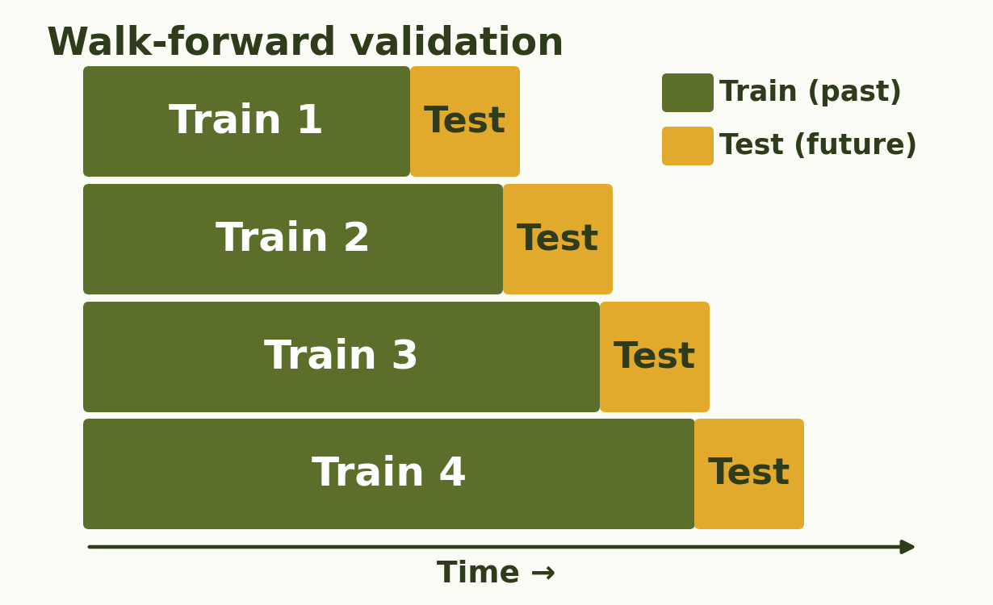
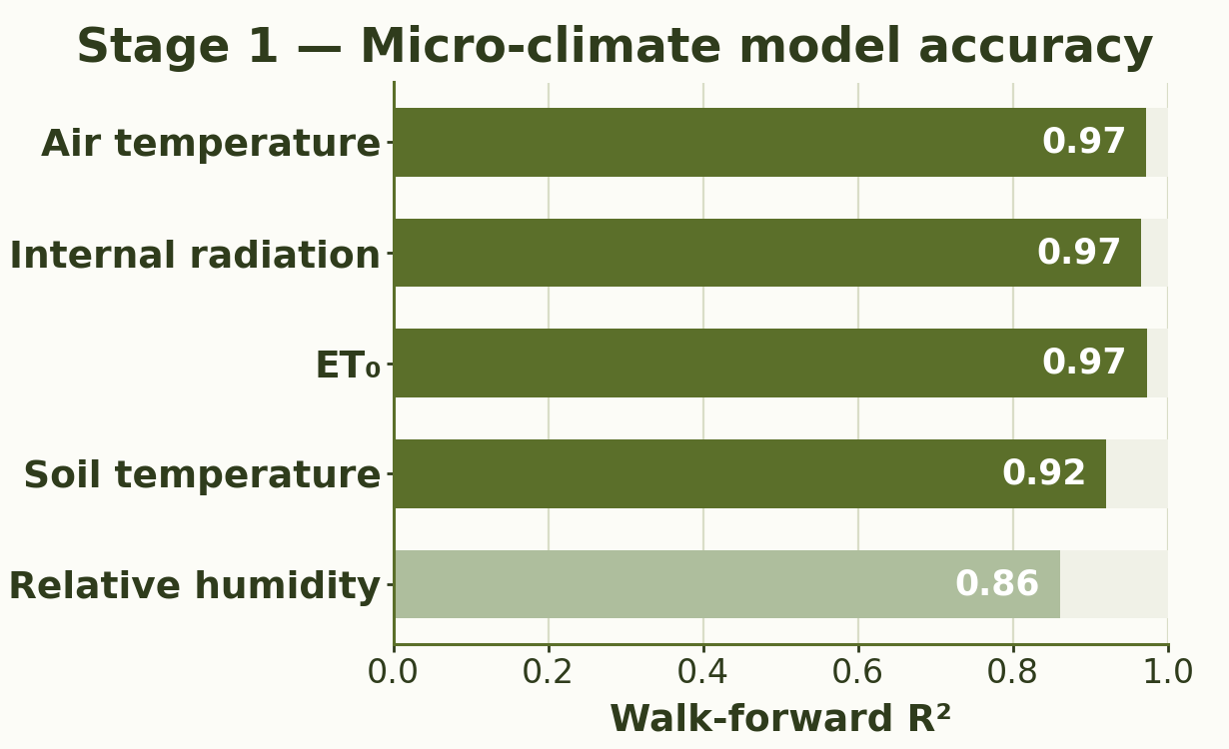
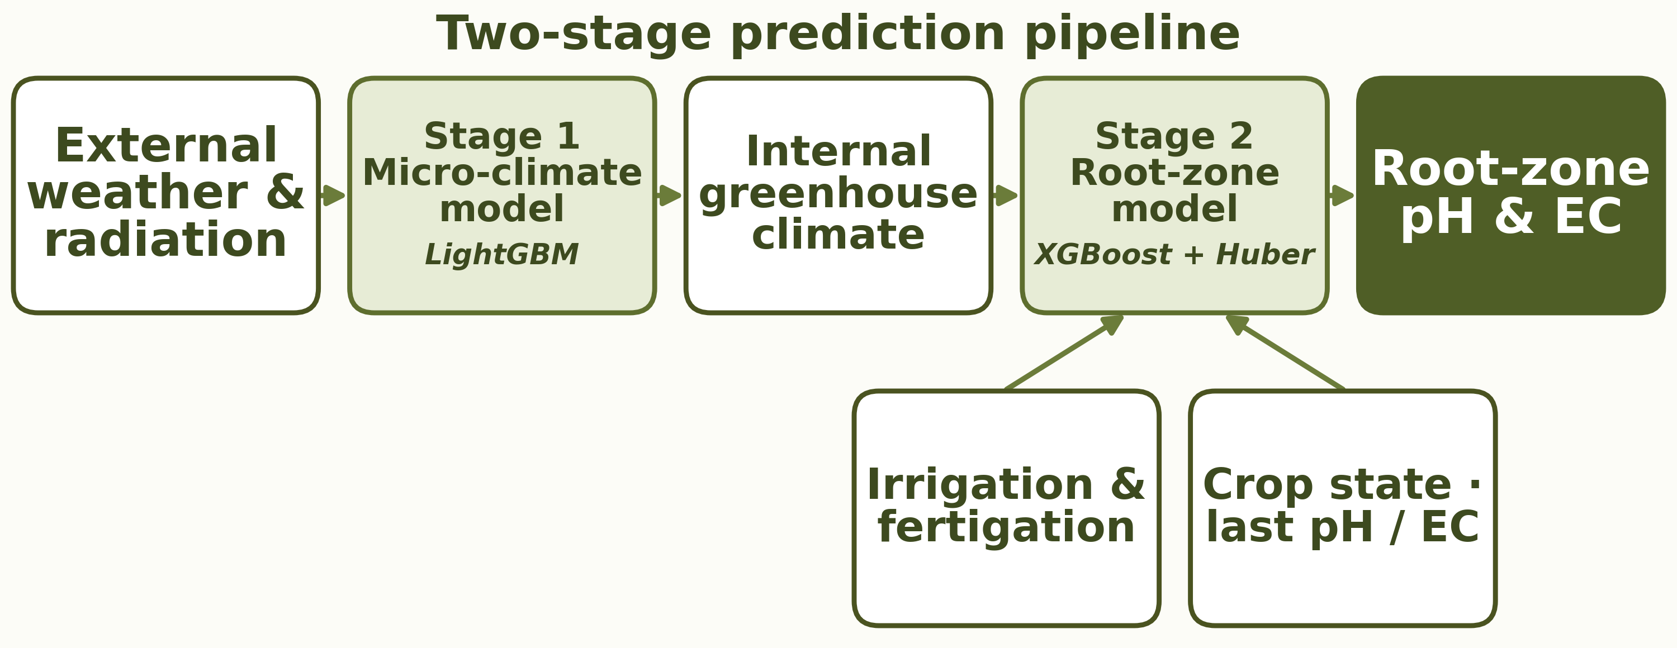
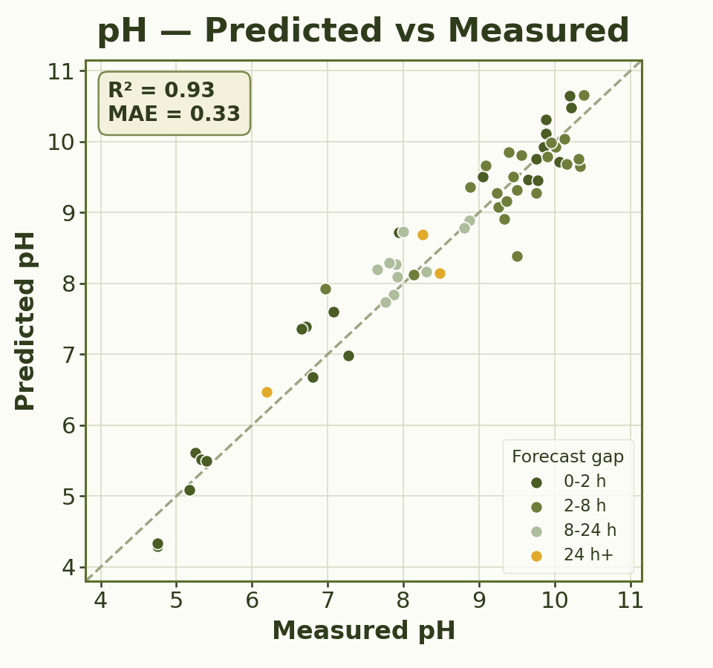
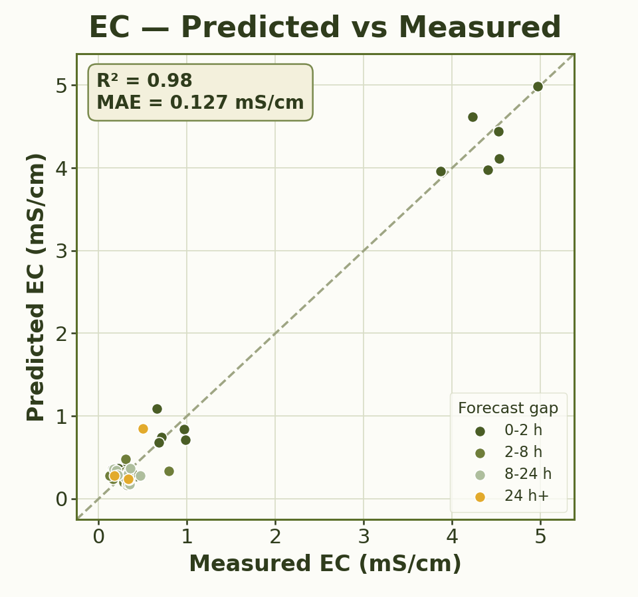
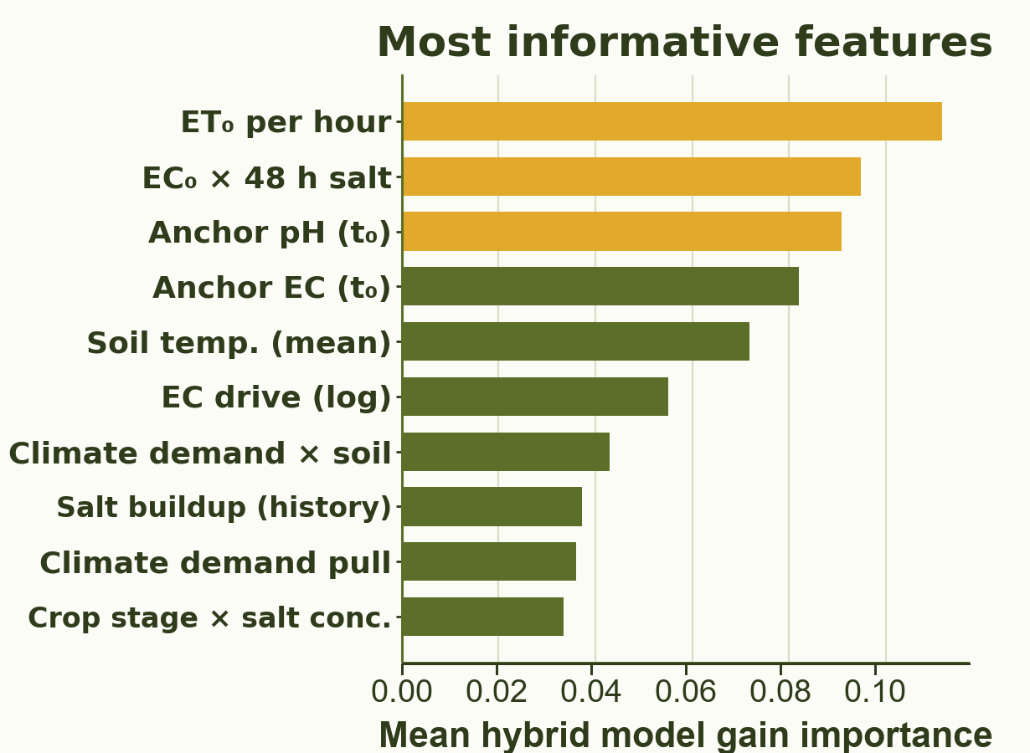
RUPPIN ACADEMIC CENTER · DEPARTMENT OF COMPUTER SCIENCE · AI & DATA SCIENCE SPECIALIZATION
Predictive Modeling of Root-Zone Variables Using Greenhouse Data
Students: Eden Eliyahu, Oren Chaushu
Supervisors: Dr. Avner Priel, Dr. Alaa Jamal
01
Motivation
06
Validation Strategy
Root-zone pH and EC affect nutrient availability, salinity stress, and fertilizer efficiency. In greenhouses, they are typically monitored through accurate but infrequent manual samples, leaving gaps where changes from irrigation, fertigation, climate, and plant uptake may be missed. Predicting pH and EC from greenhouse data can give growers earlier insight, support faster corrections, and improve crop management.
▪ Walk-forward validation matches deployment: future pH/EC is predicted from past labels, forecasted climate and planned irrigation/fertigation.
▪ Future pH/EC labels are never used for training until after that sample becomes available.
02
Project Goal
▪ Develop a soft sensor that predicts future root-zone pH and EC from the latest measurement, forecasted climate, planned irrigation/fertigation and crop-state data.
▪ Estimate the t₀ → t₁ change so growers can test a planned irrigation/fertigation strategy, see expected future pH/EC values, and adjust before conditions drift.
07
Micro-Climate Model
03
Data
▪ Predicts internal greenhouse climate from external weather and radiation.
▪ Generates continuous climate inputs - temperature, RH, radiation, ET₀ and soil temperature - for the root-zone model.
16,682
10-min rows
109
pH/EC labels
+20
input features
Unified 10-minute master dataset, May 29 – Sep 21, 2025: ▪ External weather & solar radiation — weather station / solar sensor
▪ Greenhouse micro-climate — internal sensors ▪ Irrigation & fertigation — management schedule ▪ Crop-state features — canopy-cover observations ▪ Manual pH & EC measurements — lab samples
04
Method
Two-stage prediction pipeline:
1. Forecast internal greenhouse micro-climate from external weather and radiation.
2. Predict t₀ → t₁ root-zone pH/EC change using climate, crop state and planned events.
08
Root-zone Model Results - Walk-forward Test
0.33 pH MAE
0.93 pH R²
+62% pH MAE reduction
0.127 EC MAE
0.98 EC R²
+35% EC MAE reduction
MAE reduction is relative to a last-value baseline
05
Algorithms & Model Choice
Hybrid model choice: nonlinear learning + robust modeling of rare extreme intervals.
Gradient Boosting
Main model for nonlinear tabular greenhouse data.
Captures interactions between climate, irrigation, fertigation, crop state, and baseline pH/EC.
Huber Regressor
Robust companion model for sharp pH/EC shifts. Reduces sensitivity to extreme intervals linked to acid injection, fertigation, or salinity changes.
09
Conclusions
▪ Prediction value → The model improved over the last-measurement baseline (+62% pH, +35% EC) and supports earlier pH/EC drift detection.
▪ Decision-support prototype → built a user platform where growers can test planned irrigation/fertigation actions before applying them.
▪ Soft-sensor feasibility → sparse samples can support useful forecasts when combined with dense operational data.
10
Challenges & Limitations
▪ Sparse EC/pH labels → modeled ΔpH/ΔEC between measured samples
▪ Missing climate data → filled greenhouse gaps with micro-climate predictions
▪ Irregular sampling → used time-gap and window aggregation features
▪ Small EC changes → applied log-EC change and MAE-based evaluation
▪ Limited generalization → requires testing on more seasons, crops, and greenhouses

