Slide 1
BitMingle
Reid bixler and CARTER HALL

Slide 2
Background
Unlinkability – Input and Output must be unlinkable
Verifiability – Attacker must not be able to steal honest coins
Robustness – Protocol should succeed in presence of malicious participants
Compatibility – Must work on top of Bitcoin network
Incentivized Fees – Introduce fees for incentivizing lenders to join
Efficiency – Users with restricted resources should be able to run it

Slide 3
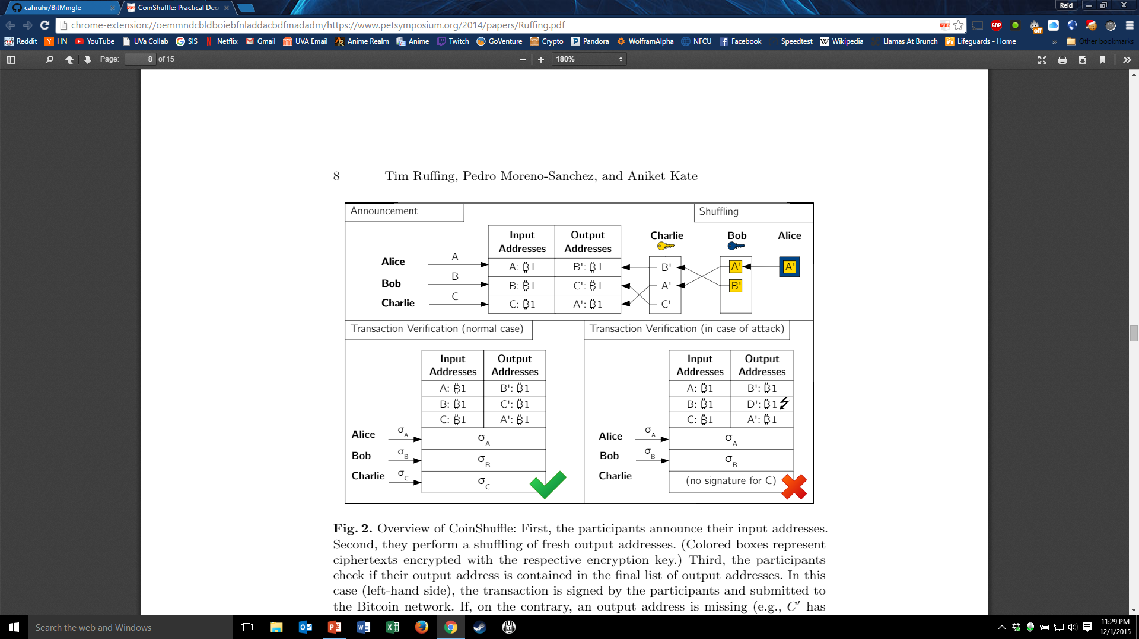
COINSHUFFLE
Protocol:
Announcement
Shuffling
Transaction Verification

Slide 4
Bitmingle!
I_{A}
10 BTC
9 BTC
L_{A}
MINGLE
9 BTC
L_{E1}
I_{E1}
10 BTC
9 BTC
L_{E2}
9 BTC
L_{E3}
I_{E2}
10 BTC
9 BTC
L_{E4}
F_{E1}
I_{E3}
10 BTC
1.25 BTC
F_{E2}
1.25 BTC
F_{E3}
I_{E4}
10 BTC
1.25 BTC
F_{E4}
TX
1.25 BTC

Slide 5
How to mingle
Create a network available to all Bitcoin users
Become one of two ‘minglers’
Launderer (M_{A})
Lender (M_{E})
Ability to broadcast intent/availability

Slide 6
Launderer (M_{A}) CREAtes a mingle
Set by Launderer
Mingle Size (S) – Required number of participants to start the mingle (includes M_{A})
Expiration (E) – Amount of time the launderer is willing to wait for S participants
Will cancel broadcast if expiration is reached
Required Input (RI) – Specific amount of Bitcoin M_{A} wants to launder
Fee (F) – Percentage of RI that M_{A} is willing to pay to create the mingle
# Output Addresses (O) – Number of output addresses required per participant
Broadcasts Mingle to network seeking Lenders to achieve Mingle Size
Once Mingle Size is reached, automatically create Mingle Transaction

Slide 7

Lenders (M_{E}) search for mingles
Search across network for criteria
Required Input – How much the lender must have to join in the mingle
Lender Gain – How much the lender will get for participating in the mingle
Equal to $\frac{Fee}{MingleSize −1}$ (The launderer will not gain and is included in MingleSize)
Current Mingle Size – How many participants are currently waiting for the mingle
# Output Addresses – How many output addresses the lender must have available
Must not be the same as input address
If found appropriate Mingle, join until completion or expiration

Slide 8

Requirements of a mingle transaction
Inputs must all be equal in size (N total)
Outputs per participant will be broken into 2 categories
Launder Outputs – Equal to $RequiredInput −Fee$ (N × #OutputAddr total)
Fee Outputs – Equal to $\frac{Fee}{MingleSize −1}+Fee$ (N-1 total)

Slide 9

Mingle transaction visualization
Required Input = 10 BTC
Fee = 10%
Mingle Size = 5
# Output Address = 1
I_{A}
10 BTC
9 BTC
L_{A}
Launder Outputs = $RequiredInput −Fee∗RI$
Fee Outputs = $\frac{Fee∗RI}{MingleSize −1}+Fee∗RI$
$$LO = 10BTC – (10BTC ∗ 10\%) = 9BTC$$
$$FO= \frac{10\% ∗10BTC}{5−1}+10\%∗10BTC=1.25BTC$$
#LO = MingleSIze * #OutputAddr = 5
#FO = MingleSize – 1 = 4
MINGLE
9 BTC
L_{E1}
I_{E1}
10 BTC
9 BTC
L_{E2}
9 BTC
L_{E3}
I_{E2}
10 BTC
9 BTC
L_{E4}
F_{E1}
I_{E3}
10 BTC
1.25 BTC
F_{E2}
1.25 BTC
F_{E3}
I_{X} = Input Address of X
L_{X} = Launder Address of X
F_{X} = Fee Address of X
A = Launderer
E₁₋₄ = Lenders 1-4
I_{E4}
10 BTC
1.25 BTC
F_{E4}
TX
1.25 BTC

Slide 10
Launderer Incentives
In charge of mingle characteristics
Sets size, fee, expiration, output addresses
Decentralized
No central authority controlling the details of the mixing
Maximized anonymity
Increased size = More inputs/outputs
Variable fee = Difficult to compare
Increase output addresses = More outputs, difficult to track
No trackable lender fee
Speed of Transaction
Small Required Input = Many Lenders
Small Mingle Size = Minimize Wait Time
Increased Fee = Quicker Accepts

Slide 11
Lender incentives
$$$ MAKIN DAT MONAY $$$
Also mixes most of your Bitcoin
Lender addresses are ‘easier’ to track because always will be least/smallest outputs
Quick transactions -> More Mingles -> More Money

Slide 12

Restrictions/requirements
All inputs must be the same (Anonymity)
All related outputs must be the same (including if multiple outputs) (Anonymity)
E.G. If RI = 10BTC and M_{A} wants 3 OA each getting 2, 3, and 4BTC, then all participants must also get exactly 2, 3, and 4BTC in their Launder Addresses (including fee outputs)
Minimum Lender Gain (To prevent attacks)
$LenderGain=\frac{Fee}{\#Lenders}$ (where # Lenders = Mingle Size – 1)
At the moment, 0.001 or 0.1% Lender Gain
Could change to maximize usage of BitMingle
(i.e. too low = not enough lenders, too high = not enough launderers)
Minimum Fee/Required Input (To prevent attacks)
Must be larger than transaction fee

Slide 13
Things to work on before report
Calculate better values for Minimum Lender Gain
Formalize into a paper
Prove keeps to wanted traits
Prove anonymity
Compare to current protocols
Create a working implementation???
(Sell to Google for 1,000,000BTC)

Slide 14
Questions?

