Slide 1

Chinese Geopolitical Strategy and Bitcoin
Eashan Kaw

Slide 2
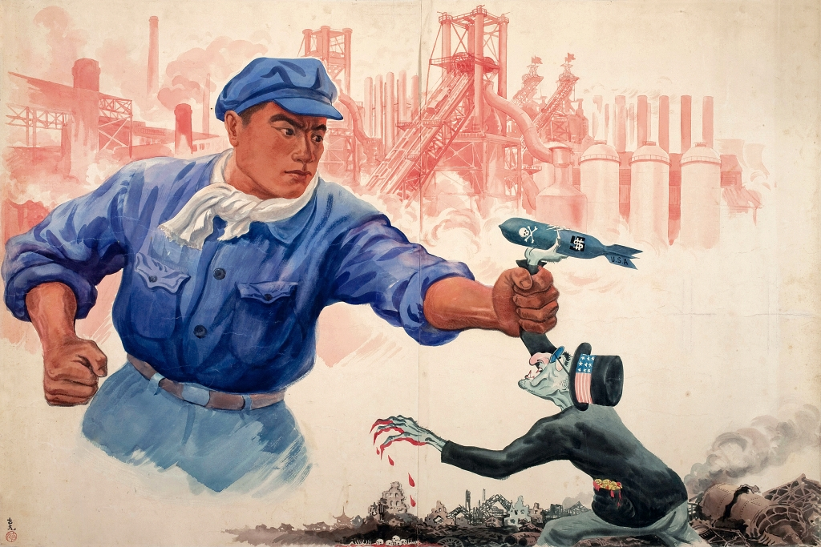

Slide 3

Roadmap
Why manipulate a currency?
Approximated Cost of Attack
Historical examples of manipulation
Historical willingness to pay for manipulation

Slide 4
Why bother?
Currency manipulation is one of the most efficient ways to disrupt a target economy during wartime.
Fewer substitutes than disrupting trade routes

Slide 5
Is it possible?
Currency manipulation would be pointless if currency markets were self-correcting.
For example, if you dump treasury bonds to trigger a fire sale, all that will happen is you
Milton Freidman believed floating rates would be relatively stable after Bretton Woods

Slide 6
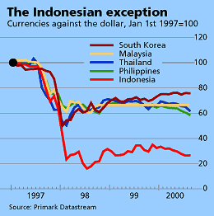
Baht Stability

Slide 7
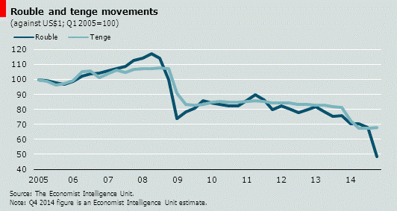
Ruble Stability

Slide 8
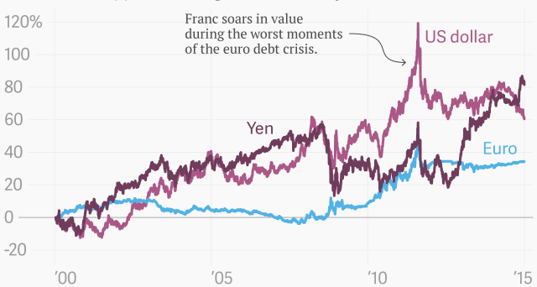
Swiss Franc Stability

Slide 9
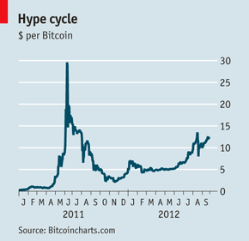
Bitcoin Stability

Slide 10
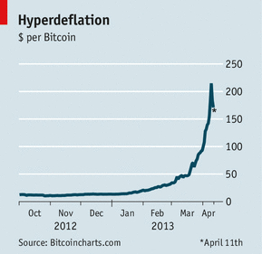
More Bitcoin Stability

Slide 11
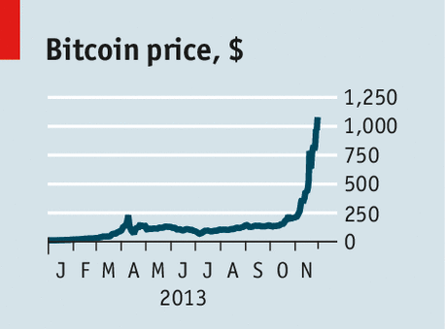
Hyper Deflation Indeed

Slide 12
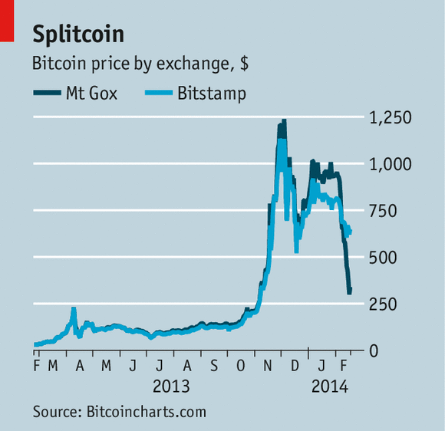
Oops

Slide 13
Floating Volatility
“The history of the pound sterling/U.S. dollar rate is instructive. From 1949 to 1966, that rate did not change at all. In 1967 the devaluation of the pound by 14 percent was regarded as a major economic policy decision. Since the end of fixed rates in 1973 and 1991, however, the pound, on average, either appreciated or depreciated by 14 percent every two years.” –”Paul Krugman”

Slide 14
Historical Uses of Currency Manipulation
Imperial Japan against China in WWII
Nazi Germany against Britain in WWII
US against Great Britain in the Suez Crisis
Nigerian Civil War
France under DeGaulle against the US

Slide 15
Current Costs of 51% Attack
Approximately $120 Million Dollars + $8,000 per hour in electricity costs
Difficulty: 5.6e10
Threshold hashing power: 4.0e17 Hashes/sec
52,000 Antminer S5+, $2,3000 each
BTC Market Cap at ~$5B
.01% of Chinese GDP
Chinese GDP (2015) is $11.3T

Slide 16
Estimation of Future Cost
Assumption: BTC grows to a $20T Market Cap by 2030
Projected cost of attack: $480B
Projected Chinese GDP in 2030: $56T
Attack is .85% of 2030 Chinese GDP

Slide 17
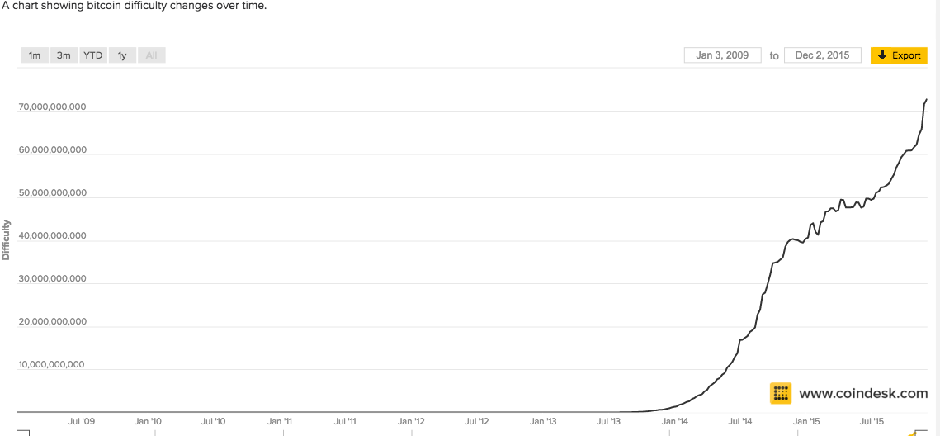
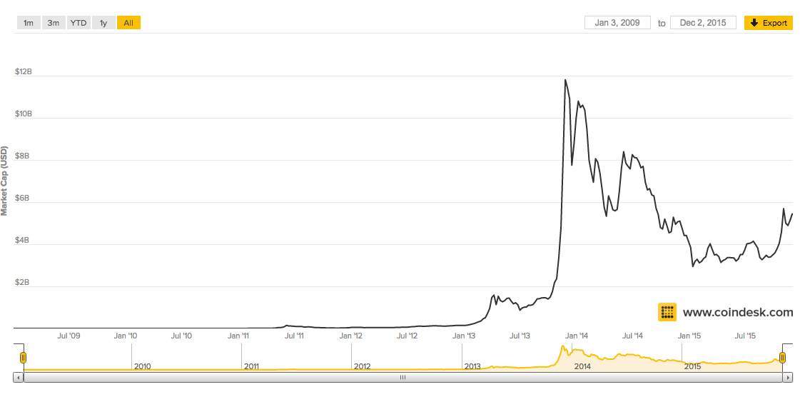
Assumptions behind projections

Slide 18
Coercion
Japan attempted to replace Chinese currency with Yen
Japan may have invested 1% of GDP into acquiring Chinese national currency to replace it with Yen

Slide 19
Anti-money Laundering
The US invests $7B per year to Anti-money laundering efforts
US GDP in ~$18T in 2015
.03% of GDP is invested in AML efforts

Slide 20
Preliminary Conclusions
Increased capital flight and anti-money laundering efforts are most likely reasons for currency
Undermining the protocol for geo-strategic purposes has much more unclear costs and benefits, it likely is not cost effective

