Slide 1
An Analysis and Breakdown of SHA Hashing in Bitcoin
By: Jeremy Gabalski
Cryptocurrency - Spring 2015

Slide 2

SHA-2 Analysis
SHA-2 is an entire family. Includes SHA-224, SHA-256, SHA-384, SHA-512, SHA-512/224, SHA-512/256
Same algorithmic structure, with different initial values, rounds, and digest lengths
Emphasis on SHA-256, the type of hashing that Bitcoin relies on

Slide 3
SHA256 Basics
Takes in 512 bits and returns 256 bits of encrypted text
Published in 2001 by the NSA
64 identical rounds of data obfuscation
Notes:
Each round takes the data, works on it a little bit, and then shifts it. As a whole, the 64 rounds do a very good job with data obfuscation.

Slide 4
Algorithm Prep: Constant Explanation
6a09e667 bb67ae85 3c6ef372 a54ff53a 510e527f 9b05688c 1f83d9ab 5be0cd19
Initial bit string that all instances oh SHA256 start with
First 32 bits of the fractional part of the square root of the first eight primes
Each round, a constant is drawn from a constant table filled in similar fashion
constant values are arbitrary, irrational, and independant
Notes:
The key point here is that these are not easy numbers to work with.
Nothing is suspicious about these numbers (arbitrary).

Slide 5

Algorithm Prep: Input Manipulation
-SHA256 takes in input strings 512 bits long. The preprocessing stage ensures the string length is a multiple of 512
-Each SHA round draws a value from the ‘word table’
Notes:
SHA takes the message, appends a 1 onto it, adds the minimum amount of zeros such that the length of the message divided by 512 is a multiple of 448,
and then with 64 bits presents the length of the message. This ensures a multiple of 512 bits after the preprocessing stage.
words table[0,15] are filled with 32 bit chunks of the 512 bit input. Then those are manipulated in some way with right shifts, right rotates, and XOR operations

Slide 6
The Round
A B C D E F G H
K(i)
+
W(i)
Examine bit position for all three. Output the majority of the bit values at each position
For every place, examine the E bit. If 1, take the corresponding F bit, else, take the corresponding G bit
Take A and rotate it right by 2, 13, and 22 bits. Sum these new values and take that sum modulo 2
Rotate the bits of E to the right by 6,11, and 25 bits. Sum these new values.
Notes:
The higher star the the new E value.
The start in the bottom right corner is the new A value.
Only two values are mathematically changed.
A shift of value occurs by one position.
A is calculated, the old A is the new B, old b is new C, old C is new D, E is calculated, old E is new F, old F is new G, old G is new H.
All nonlinear operations mixed up the data in different ways. That is part of what makes SHA so strong.

Slide 7
How Good is SHA256?
Pre-Image Attack | Collision Attack
Brute force. Given a digest, you try every possible input to attempt to find the one that produces the correct hashed value | Find any two arbitrary inputs x and y such that SHA256(x) = SHA256(y)

Slide 8
How Good is SHA256- Continued
Searching through 2^256 input combinations (pre-image) is impractical
Best known collision attack worked with 52 rounds
Collisions gets interesting - pigeonhole principle
SHA256 is not a provably hard algorithm
Notes:
Academics, in attempts to solve very hard problems, usually attempt to solve a similar but slightly easier problem, such as making the assumption that SHA256 only used 52 rounds of data gumbling.

Slide 9
Technology and Energy Analysis

Slide 10
ASIC Chips - Application Specific Integrated Circuit
CPU→ GPU → FPGA → ASIC→ ???
Technological developments developed solely based on how quickly each version of hardware could calculate a SHA256 hash
Notes:
FPGA = Field Programmable Gate Array. A chip that can be configured by the customers after it has been produced and sold.

Slide 11
What Makes These Chips Better?
No Magic
SHA256 is composed of simple mathematical calculations
100% chip dedication
Loop unrolling (of the 64 SHA256 rounds)
Pipelining - doing whatever can be done in parallel appropriately
Notes:
Loops are tough on circuits and memory, and are fairly expensive computationally. You have to manage the jumps, were to go to on each iteration, and manage the pointers necessary to do so.

Slide 12
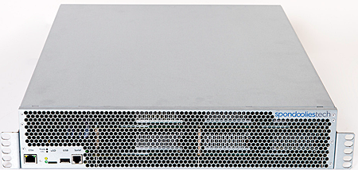
The King of the Castle (For Now)
SP35 Yukon
5.5 TH/s
Pre-installed mining software

Slide 13
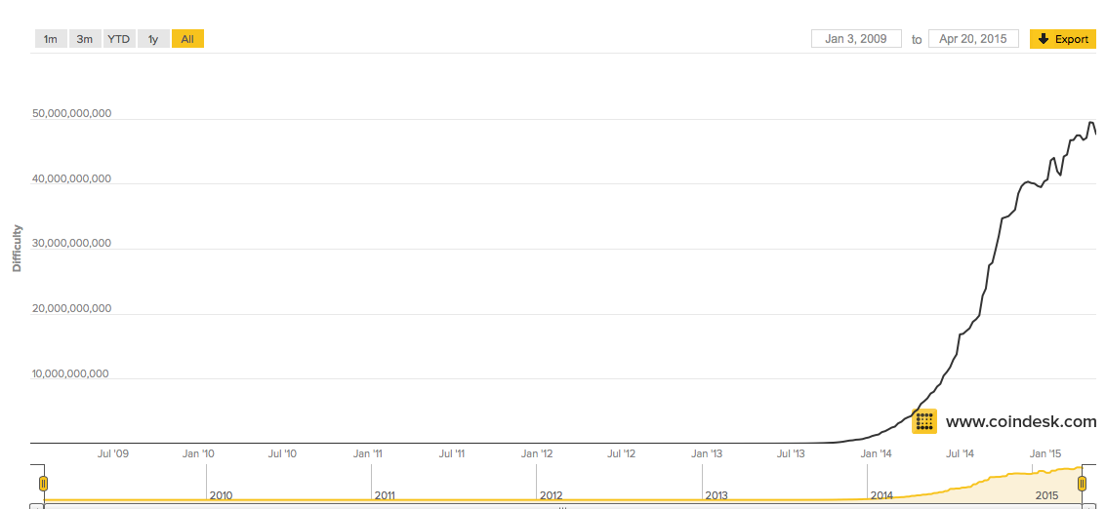
Effects and Consequences of ASIC

Slide 14
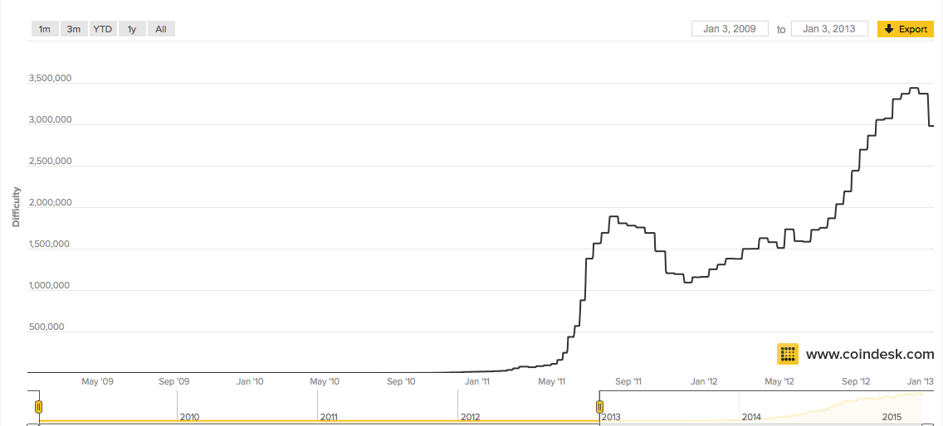
Pre- 2013

Slide 15
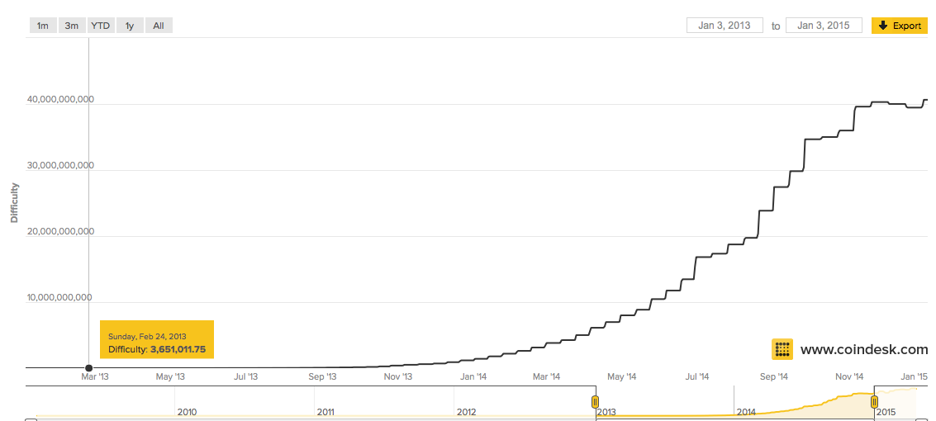
2013 - 2015

Slide 16
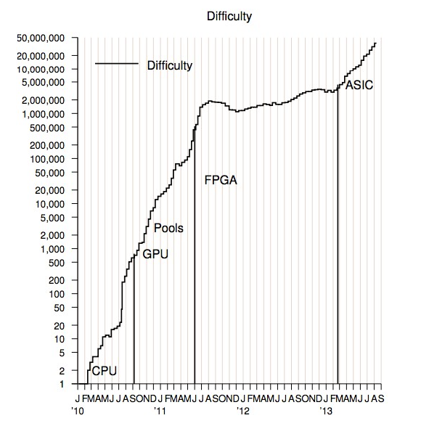
2013 - The Year of the ASIC
June 2012: Butterfly Labs Announced Its First ASIC Product
Early models saw production delays (Melting cases, trouble meeting power specifications, production trouble to meet demand).

Slide 17
You Want Moore? Technical Considerations
Moore’s Law - Number of transistors per square inch doubles every ~ 2 years
** Rate of advancement with ASIC chips cannot persist
More (smaller and denser chips), transistors, and HEAT
Eventually cooling becomes hard, and even impractical (due to electricity costs).
We will reach a point where advancements in cooling and maintaining peak performance will take precedence

Slide 18
ASICS - Fundamental Considerations
Ultrafast hashing equipment renders more and more hardware obsolete
When mining is impractical, you ‘shut the lights off’
Results: increased centralization, less investment incentives
**In order to realistically speculate, you need to factor in energy costs, hashing equipment price, hash/s limits, and bitcoin’s macro level of popularity

Slide 19
Future Speculations
-SHA256, is algorithmically strong (For now).
- **Bitcoin can continue to grow in popularity (as the pool grows so can the difficulty)
- Number of hashes each person is willing to pay for and contribute has more effect than the single person
- **Increased hashing rates will still occur for some time, but not at significant magnitudes (Possibly a 10TH/s cutoff).

Slide 20
Sources
http://bitcoin.stackexchange.com/questions/17132/is-bitcoin-mining-itself-compromising-the-security-of-sha256
http://gizmodo.com/mining-bitcoin-with-pencil-and-paper-1640353309
http://crypto.stackexchange.com/questions/5338/why-are-these-specific-values-used-to-initialise-the-hash-buffer-in-sha-512
http://web.cs.ucdavis.edu/~rogaway/papers/relates.pdf
http://www.coindesk.com/bitcoin-mining-can-longer-ignore-moores-law/
http://www.topbitcoinmininghardware.com/the-sp300-yukon-review-by-spondoolies-mining-enhanced/
http://bitcoin.stackexchange.com/questions/1293/how-many-integer-operations-on-a-gpu-are-necessary-for-one-hash
http://www.coindesk.com/data/bitcoin-mining-difficulty-time/
https://www.dom.com/library/domcom/pdfs/virginia-power/rates/residential-rates/schedule-1.pdf
https://bitcointalk.org/index.php?topic=85758.20

