Slide 1
Loans and Credit Default Swap in Bitcoin
By: Trisha Hajela and Merlin Zhang

Slide 2
Our Project
Is there a way to apply a CDS to Bitcoin?
Intermediary
Is there a modified, ideal cryptocurrency that a CDS would work with?
What are the implications of implementing a CDS into a cryptocurrency?
Are there any other financial instruments that we can consider?

Slide 3
Bitcoin Lending vs. Common Currency Lending
Bitcoin lending → universal currency
No real concept of credit scores with Bitcoin lending
Bitcoin lending has higher default rates (because of higher interest rates)
Bitcoin lending is fairly new, while common currency lending is established

Slide 4
Bitcoin Lending Platforms: BTCJam
Largest p2p lending platform
Allows you to sell a portion of your loan on the platform (no need for third party)
Net-arb: loan collection mechanism

Slide 5
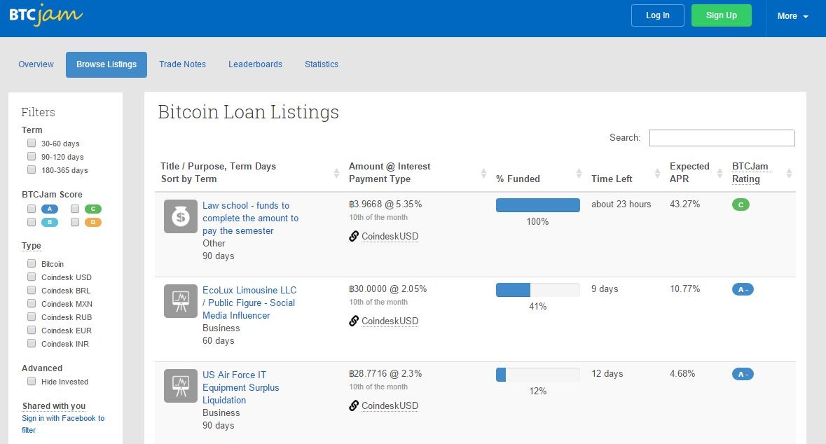

Slide 6
Bitcoin Lending Platforms: BitLendingClub
Reverse Auction System: you choose to bid the amount and the rate
Amortization schedule for loan is shown
Borrowers with less than 100 reputation cannot automatically withdraw their coin borrowed
Must have a legitimate
Research and disclose to investors when there is suspicious activity (i.e. multiple IP addresses, multiple accounts)
Loan collection: releases personal information of the lender

Slide 7
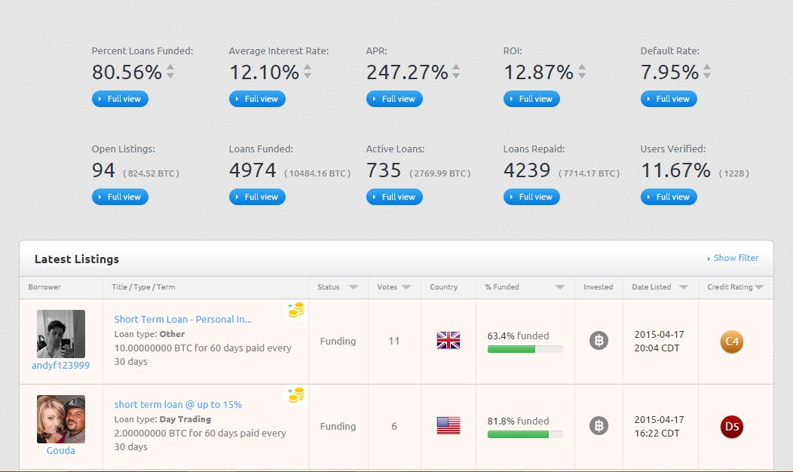

Slide 8
Bitcoin Lending Platforms: Bitbond
Blind identifiers
Has lowest origination fees (~0.5-1%)
intermediary payment (processing)
Offers long-term loans
Loan collection: releases personal information of the lendee or sells the claim to a collection agency

Slide 9
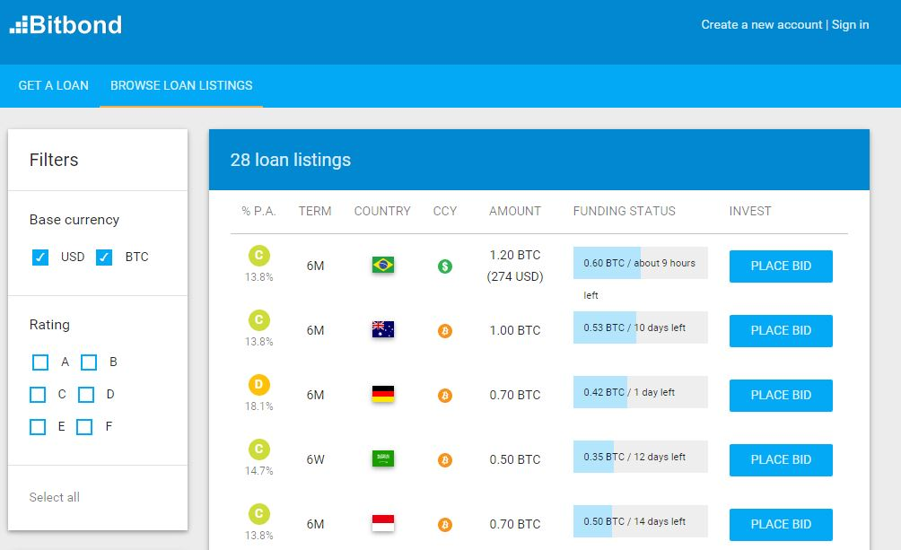

Slide 10
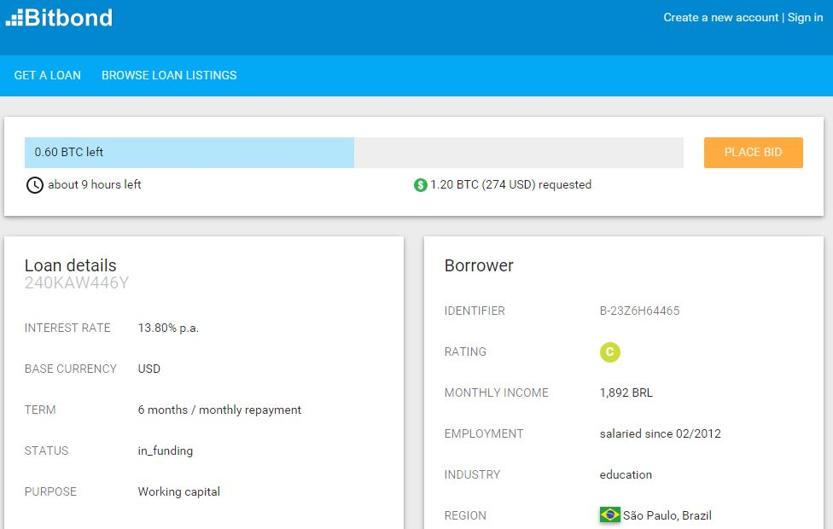

Slide 11
Our Solution
Create a loaning system with an intermediary, which also acts as the third party
Fixed fee to use service
Fee acts as a sort of down payment: a portion is returned after a loan is repaid
For sufficiently high loans, a borrower must provide some initial deposit that will be returned once they have generated a sufficient credit score

Slide 12
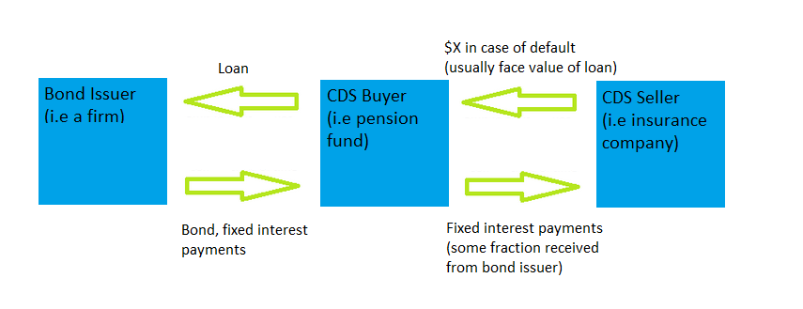
Credit Default Swap

Slide 13
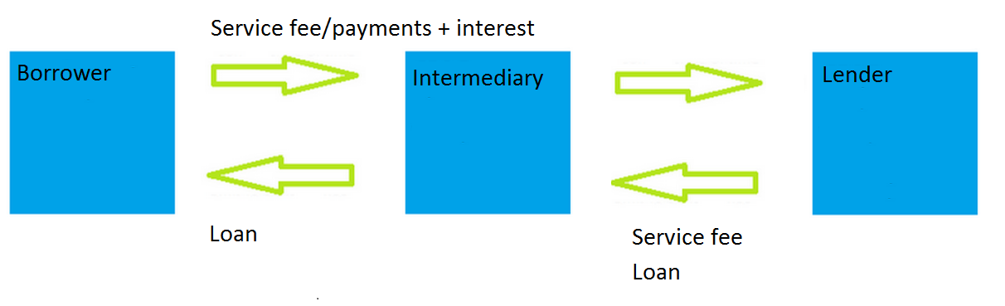
Simple Loaning System

Slide 14
Default Rate
Default rate on Bitcoin loans: ~10%
Expected return without interest
E[x] = .9*[x₁+x₂+ … + x_{n}]
Need to recuperate losses
Interest rate: > 1.11%

Slide 15
Credit System
How can we more accurately predict default rates?
Build a credit system
Better ratings associated with lower default rates
Create tiers

Slide 16
Example
Credit Score Default Rate
A
A+: .01
A: .02
A-: .05
B
B+: .1
B: .15
B-: .2
C
C+: .25
C: .3
C-: .4
Using such a system, it would be possible to more accurately assign risk.
Also need to account for the total number of loans taken out.
Assign each user a unique ID based on their wallet address.
In the case of default in some time frame, publish the address.

Slide 17
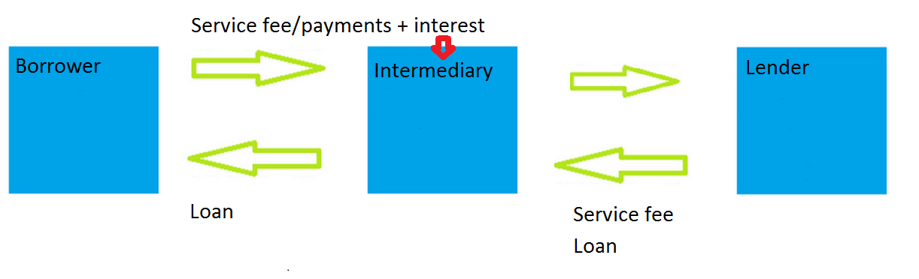
Modified CDS
F = face value of loan
d = default rate
P = amount repaid
In order to reduce risk for the intermediary in the case of default, the intermediary pays the lender an amount = F-d*P

