Slide 1
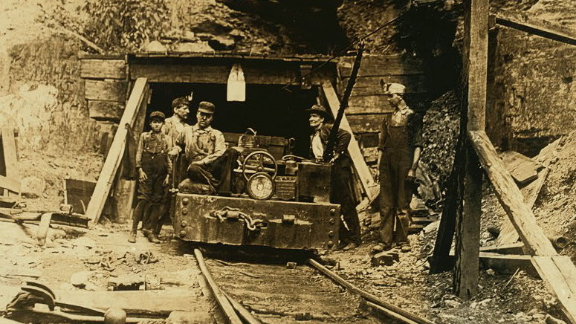
Class 9:
Mining
Cryptocurrency Café
UVa cs4501 Spring 2015
David Evans

Slide 5
Plan for Today
Quiz
Bitcoin (PointCoin) Mining
Cost of Computing
Mining

Slide 6
Analyzing Cost
int gaussSum (int m) {
int sum = 0;
for (int i = 1; i <= m; i++) {
sum = sum + i;
}
return sum;
}
cs2110/cs2150
What is the cost of this function?

Slide 7
Analyzing Cost
int gaussSum (int m) {
int sum = 0;
for (int i = 1; i <= m; i++) {
sum = sum + i;
}
return sum;
}
cs2110/cs2150
What is the cost of this function?

Slide 8
Analyzing Cost
int gaussSum (int m) {
int sum = 0;
for (int i = 1; i <= m; i++) {
sum = sum + i;
}
return sum;
}
In Reality:
What is the “cost” of this function?

Slide 9
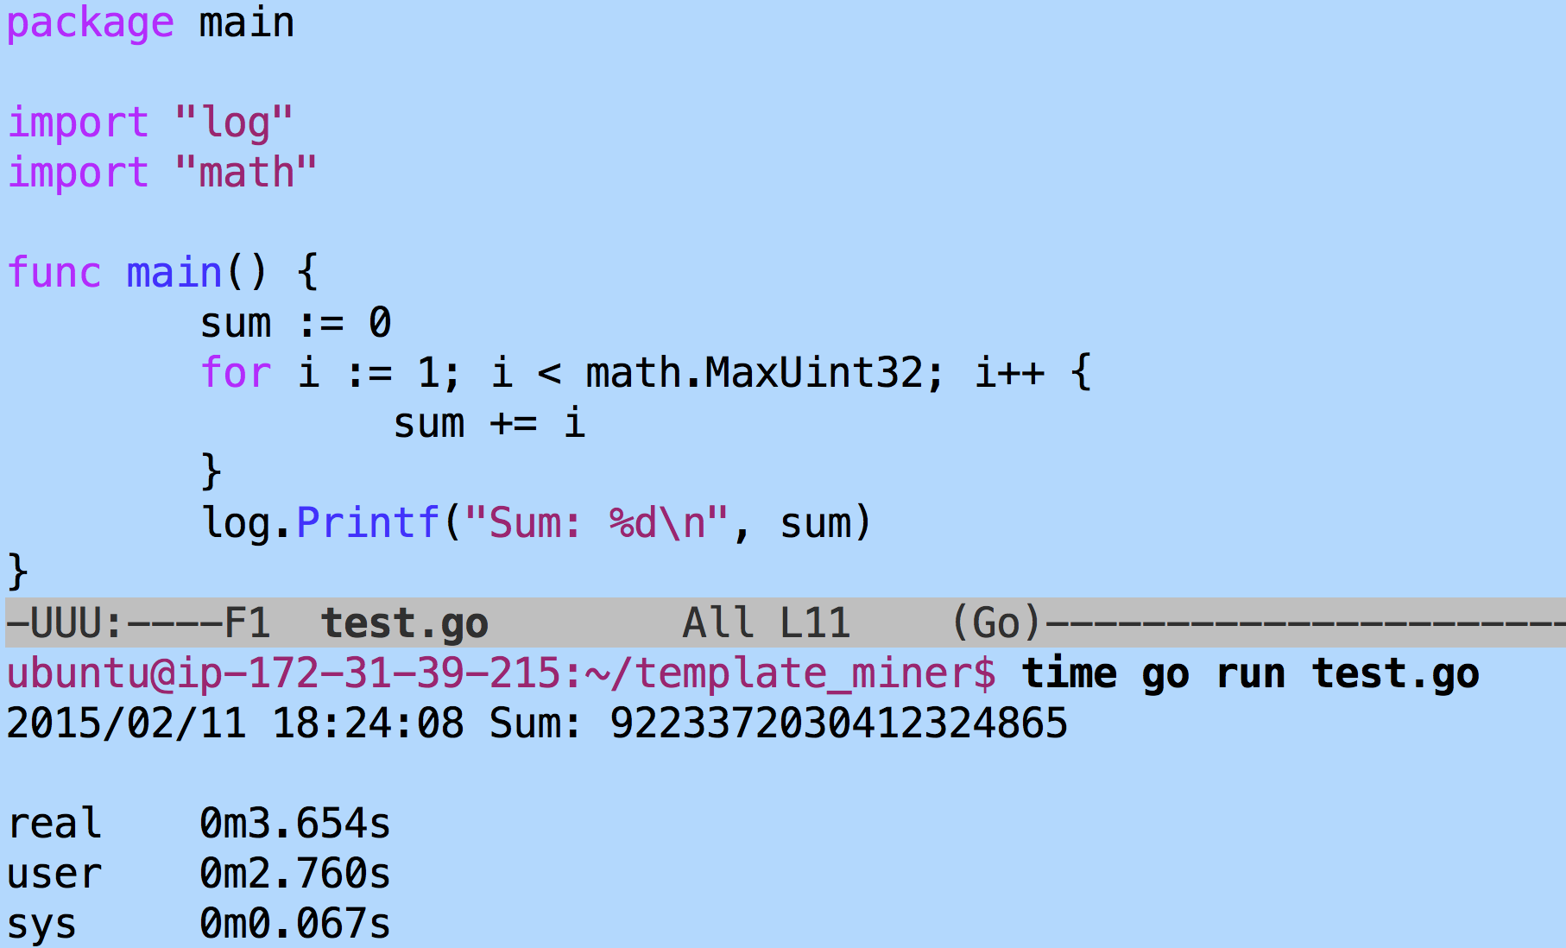
> !javac
javac gaussSum.java
> time java gaussSum
2147483647
4294967295

Slide 10
Charge
Project 2: starting code and hints for your miners will be posted tonight
Read: Chapter 8: Mining and Consensus
Next week:
Start thinking about your projects
Attacks on bitcoin
Later:
Anyway to make a cryptocurrency without wasting all that energy?

