Slide 1
Inside Bitcoin Exchanges
Corrigan Blanchfield, Alex Coffin,
Ankit Gupta, Tara Raj

Slide 2
Motivation
Opportunity to invest in Bitcoin like a commodity or foreign currency
Public transaction records may reveal information about Bitcoin exchanges

Slide 3
Since Last Time...
Taint Analysis
Coinbase vs. Circle Order Processing
Visualization of Results
Comparison/Applicability to Mt. Gox

Slide 4
Taint Analysis
Level of anonymity between two addresses involved in a transaction (“the link”)
High taint %
More easily traceable
Low taint %
Hard to trace back
Mixing service

Slide 5
Coinbase vs. Circle “Taint”
Taint analysis on our exchanges:
Coinbase - 20% taint; 70% taint
Circle - 0.8% taint; 8% taint
(Our address vs. major exchange address)

Slide 6
Fulfillment Practices
Coinbase is peer-to-peer fulfillment
Circle uses a reserve system
Reflected in taint

Slide 7
Coinbase Visuals

Slide 8
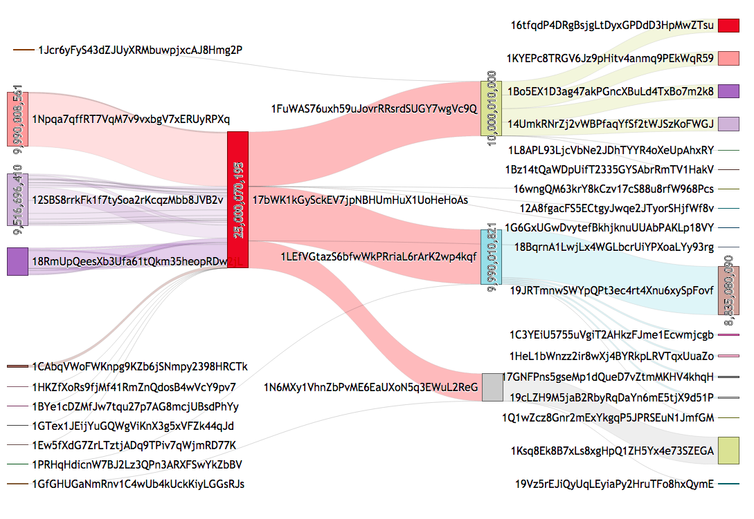
Coinbase Visualization

Slide 9
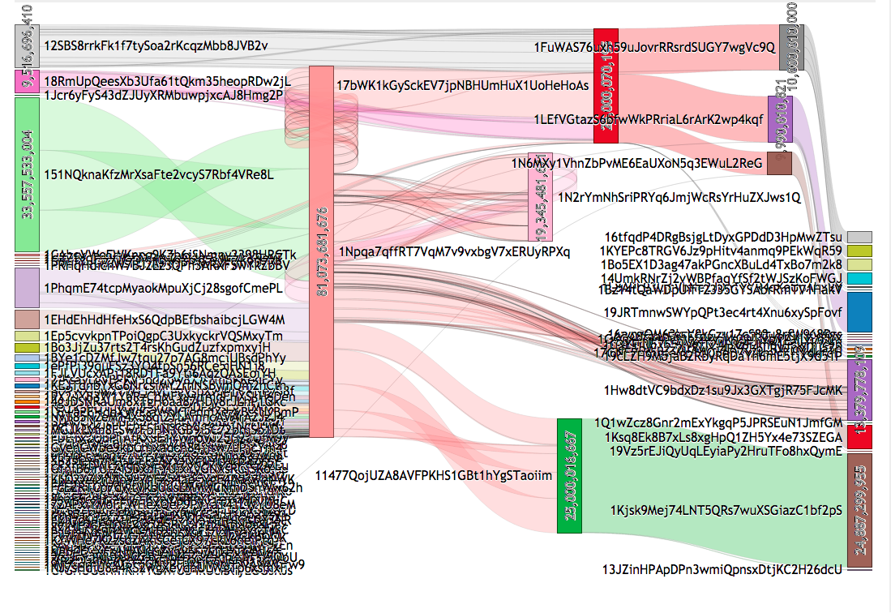

Slide 10
Circle Visuals

Slide 11
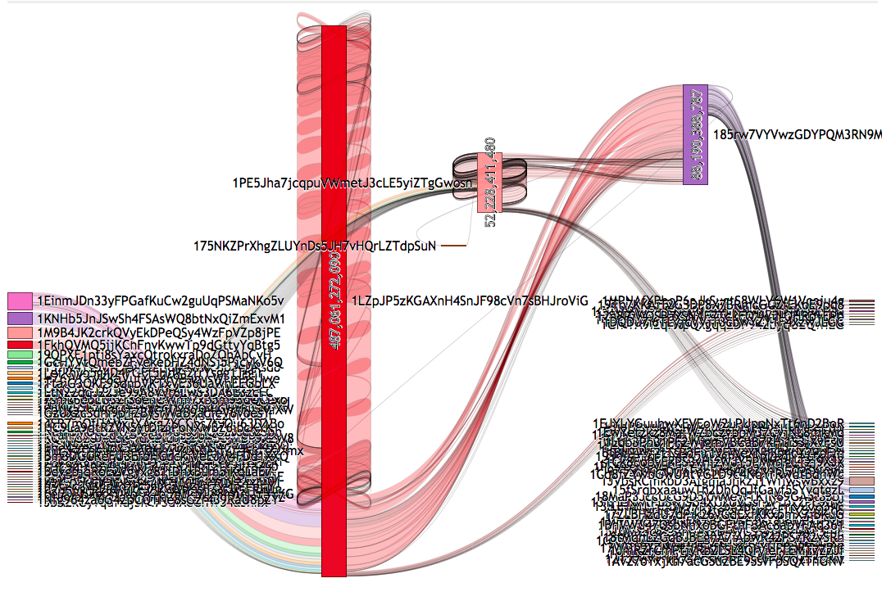

Slide 12
Importance
Taint analysis, visualization not currently the vital metrics by which Bitcoin exchanges are evaluated
Somewhat beyond the scope of a new user’s market research
We believe that the assurance of privacy in Bitcoin use is of paramount importance
Coinbase and Circle the obvious choices based on ease of sign-up
Meaningless if your account is tied to your identity
Desire for privacy != surreptitious motives

Slide 13
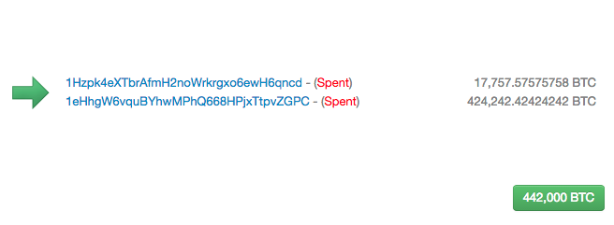
Case study: Mt. Gox
June 2011 Mt. Gox attacked and hacker sent $$$ to himself for a cent a coin
Over $8 Million worth of Bitcoin affected
Mt. Gox responds by showing their cold storage

Slide 14
Accountability in Aftermath?
Gox suspended withdrawals in US dollars on June 20, 2013
Started a years worth of intermittent fulfillment
Regardless of press releases withdrawals not being filled
Shutdown by February of 2014
The company said “lost almost 750,000 of its customers' bitcoins, and around 100,000 of its own bitcoins, totaling around 7% of all bitcoins, and worth around $473 million near the time of the filing”.
Mt. Gox released a statement saying "The company believes there is a high possibility that the Bitcoins were stolen”

Slide 15
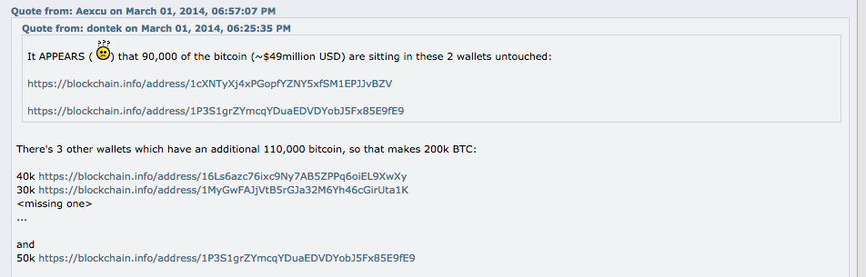
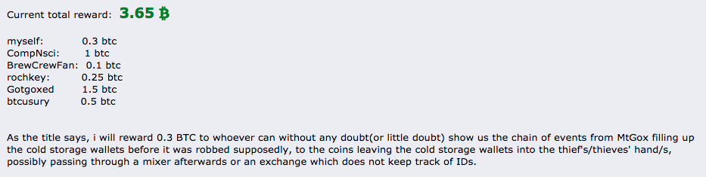

Witch Hunt to find Cold Wallets

Slide 16
Questions?

