Slide 1
More Mining
David Evans and Samee Zahur CS4501, Fall 2015 University of Virginia

Slide 2
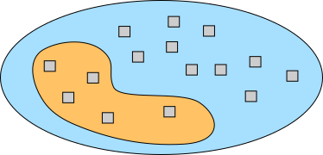
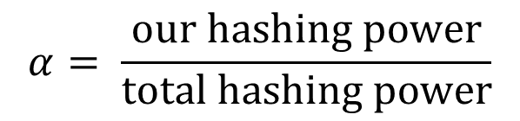
Selfish mining – back with math!
$$α= \frac{\text{our} \text{hashing} \text{power}}{\text{total} \text{hashing} \text{power}}$$

Slide 3
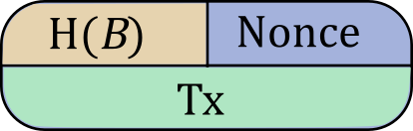








$$α$$
$$α$$
$$α$$
$$α$$
2
3
4
$$1−α$$
$$1−α$$
$$1−α$$
$$1−α$$

Slide 4









State diagram
$$α$$
$$α$$
$$α$$
$$α$$
0
1
2
3
$$1−α$$
$$1−α$$
$$1−α$$
$$1−α$$
$$1−α$$

Slide 5
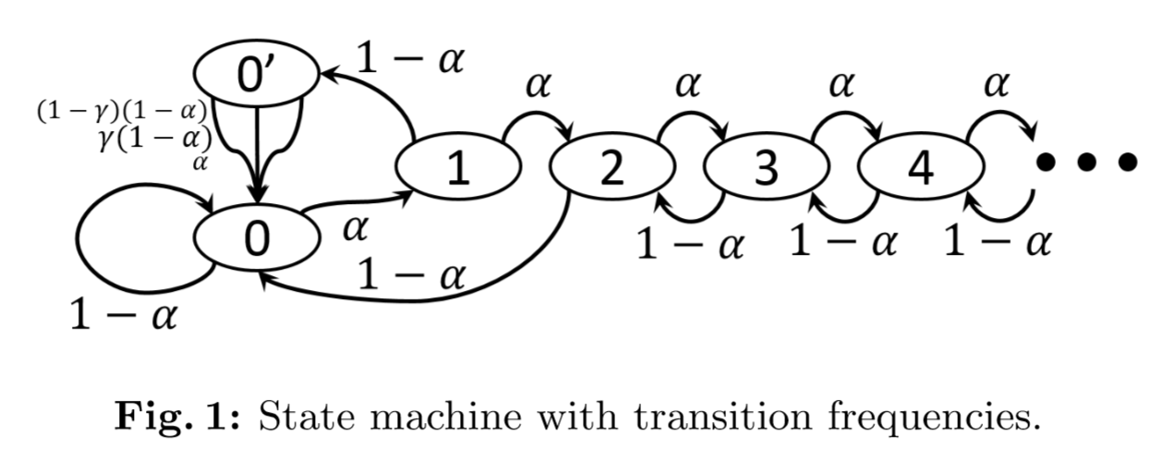
[Ittay Eyal and Emin Gün Sirer, 2013]

Slide 6
State diagram
$$α$$
$$α$$
$$α$$
$$α$$
0
1
2
3
$$1−α$$
$$1−α$$
$$1−α$$
$$1−α$$
$$1−α$$
Blocks won = number of forward advances

Slide 7






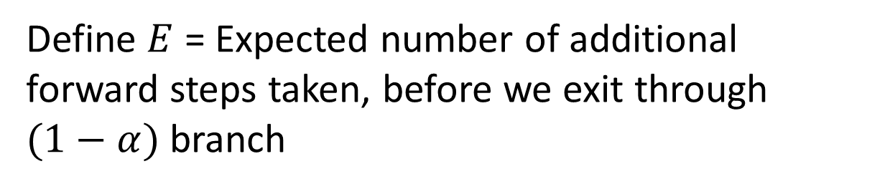


Expected advances
$$α$$
$$α$$
$$α$$
$$α$$
2
3
4
$$1−α$$
$$1−α$$
$$1−α$$
$$1−α$$
Define $E$ = Expected number of additional forward steps taken, before we exit through $(1−α)$ branch

Slide 8
Expected advances
$$α$$
$$α$$
$$α$$
$$α$$
2
3
4
$$1−α$$
$$1−α$$
$$1−α$$
$$1−α$$
$$E=\left(1−α\right)×0+ …$$

Slide 9
Expected advances
$$α$$
$$α$$
$$α$$
$$α$$
2
3
4
$$1−α$$
$$1−α$$
$$1−α$$
$$1−α$$
$$E=\left(1−α\right)×0+α×(1+…)$$

Slide 10
Expected advances
$$α$$
$$α$$
$$α$$
$$α$$
2
3
4
$$1−α$$
$$1−α$$
$$1−α$$
$$1−α$$
$$E=\left(1−α\right)×0+α×(1+E+E)$$

Slide 11

Expected advances
$$α$$
$$α$$
$$α$$
$$α$$
2
3
4
$$1−α$$
$$1−α$$
$$1−α$$
$$1−α$$
$$E=α×(1+2E)$$
$$∴E=\frac{α}{1−2α}, \text{assuming} α<\frac{1}{2}$$

Slide 12












$$α$$
$$α$$
$$α$$
$$α$$
0
1
2
3
$$1−α$$
$$1−α$$
$$1−α$$
$$1−α$$
$$1−α$$
Selfish
Others
$$α^{2}×\left(2+E\right)$$
$$\left(1−α\right)×1$$
$$α\left(1−α\right)×1$$

Slide 13
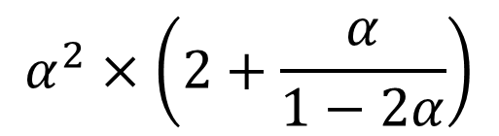


$$α$$
$$α$$
$$α$$
$$α$$
0
1
2
3
$$1−α$$
$$1−α$$
$$1−α$$
$$1−α$$
$$1−α$$
Selfish
Others
$$α^{2}×\left(2+\frac{α}{1−2α}\right)$$
$$\left(1−α\right)×1$$
$$+ α\left(1−α\right)×1$$
$$=1−α^{2}$$

Slide 14

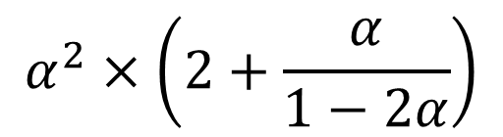


Selfish
Others
$$α^{2}×\left(2+\frac{α}{1−2α}\right)$$
$$1−α^{2}$$
At $α=0.40$,
Selfish reward = 0.64 blocks/cycle
Honest reward = 0.84 blocks/cycle
$\frac{\text{Selfish}}{\text{Total}}$= $\frac{0.64}{0.84+0.64}≈0.432$

Slide 15
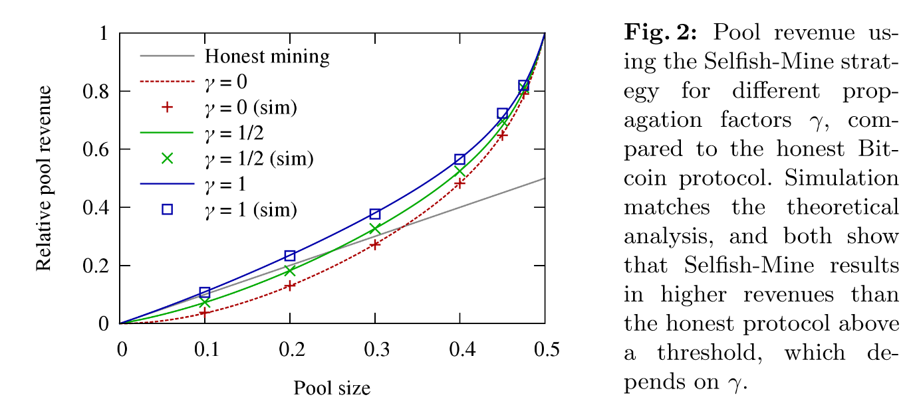

Slide 16
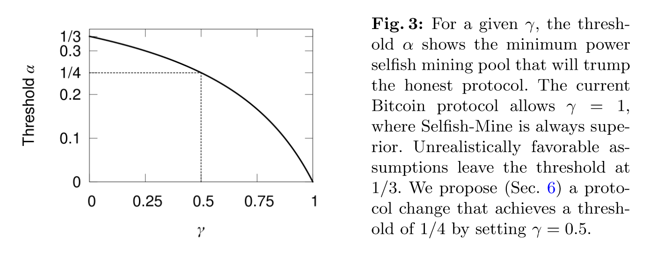

Slide 17
Mining cooperatively – in pools!

Slide 18
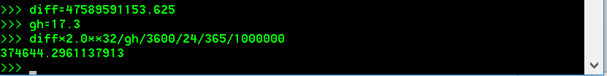
Mining profit
Intel Core i5 2600K
Quad core
Speed: total 17.3 M hashes per second
Power: 75 Watts
At last night’s difficulty, we would need over 374,000 years.

Slide 19
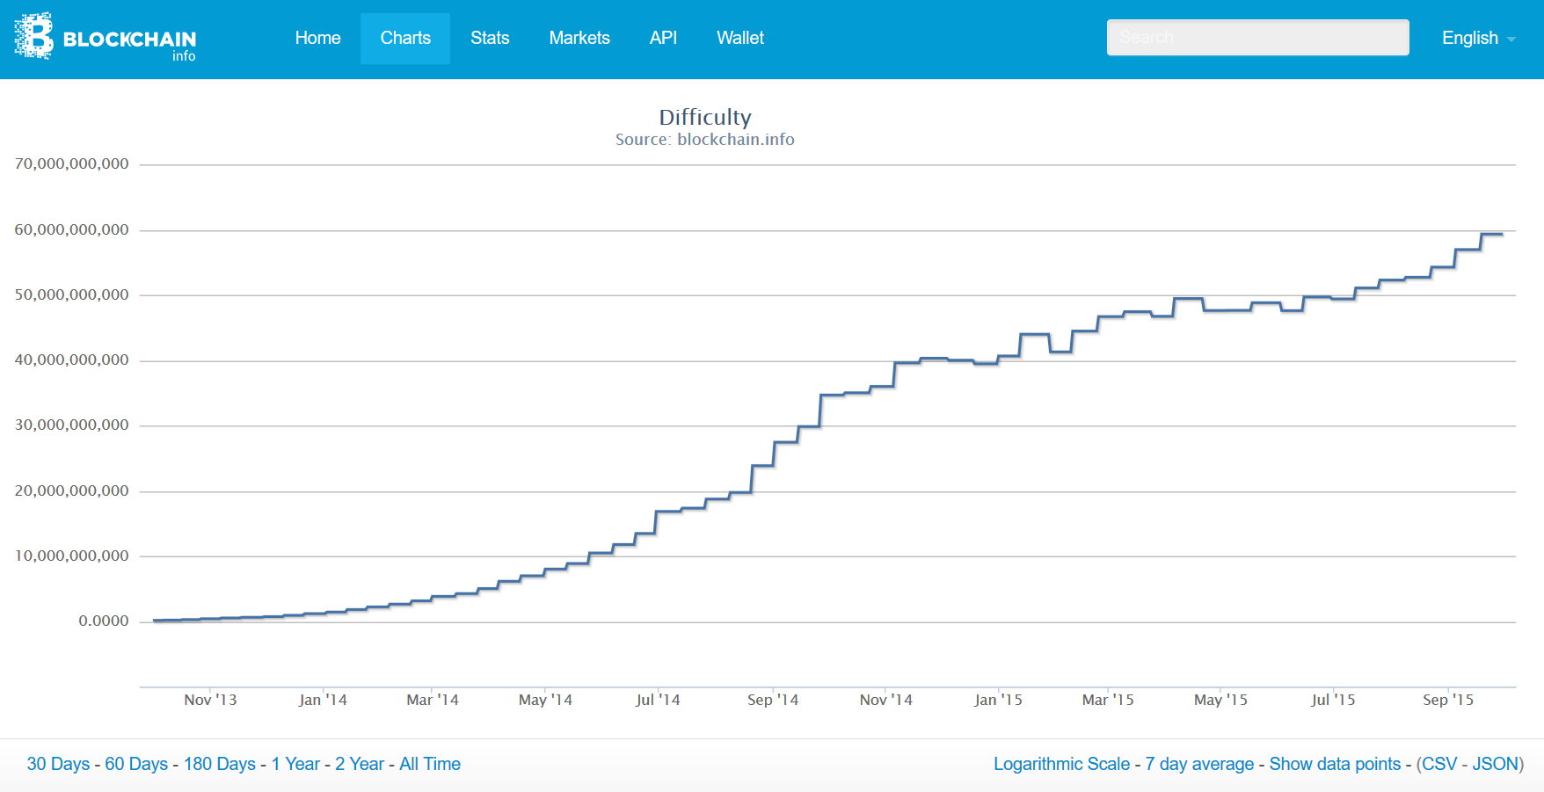

Slide 20
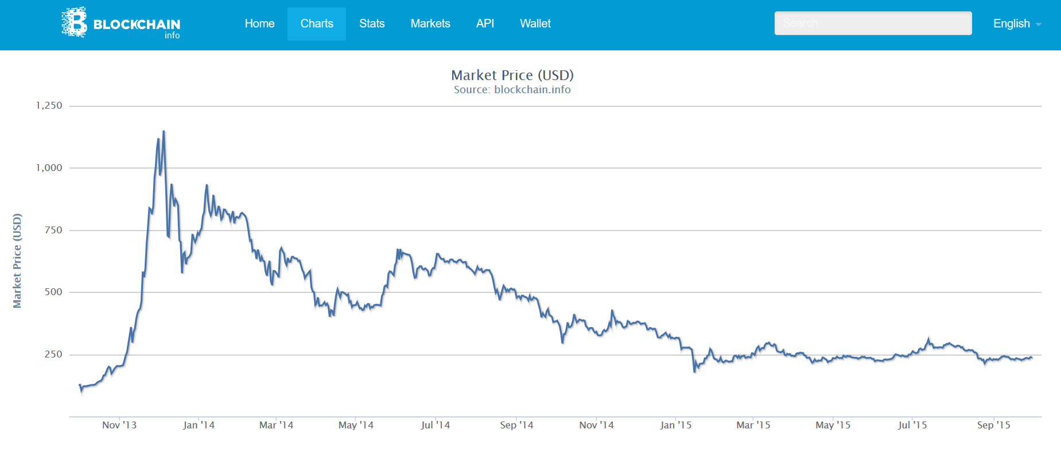

Slide 21
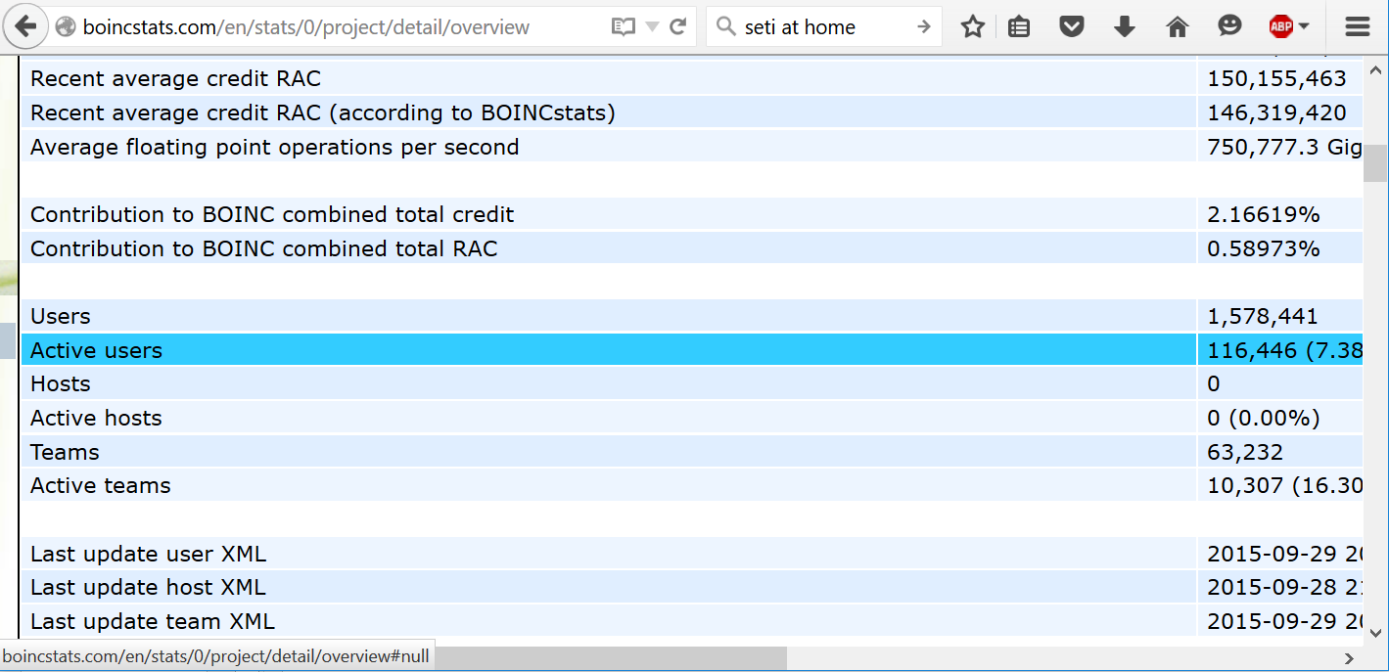
Distributed computing: SETI@home

Slide 22
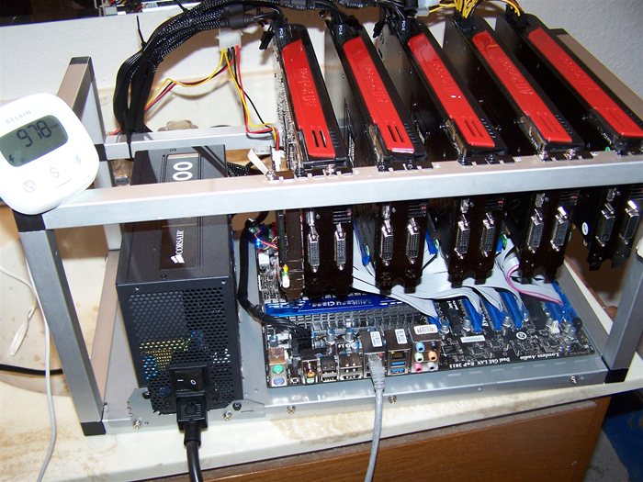
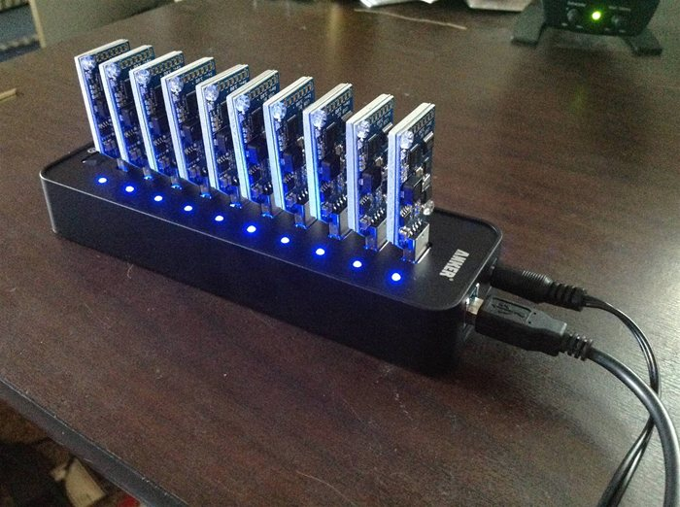
Engaging small miners … again
GPUs @ 30-100 MH/sec
ASICs @ 11 GH/sec

Slide 23
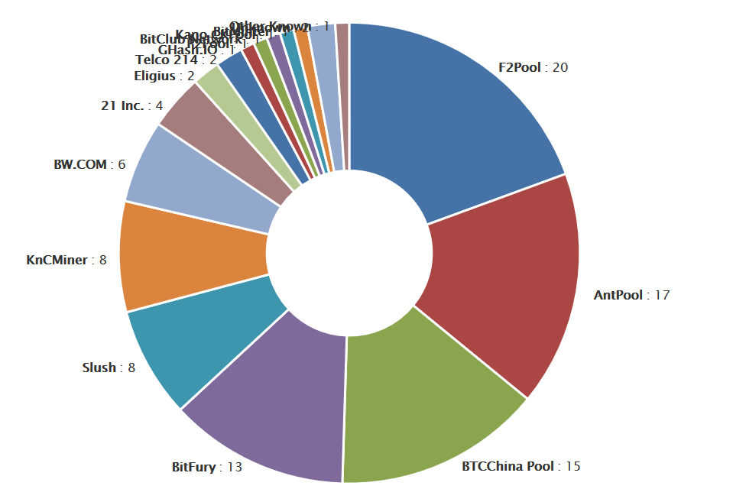
blockchain.info/pools

Slide 24
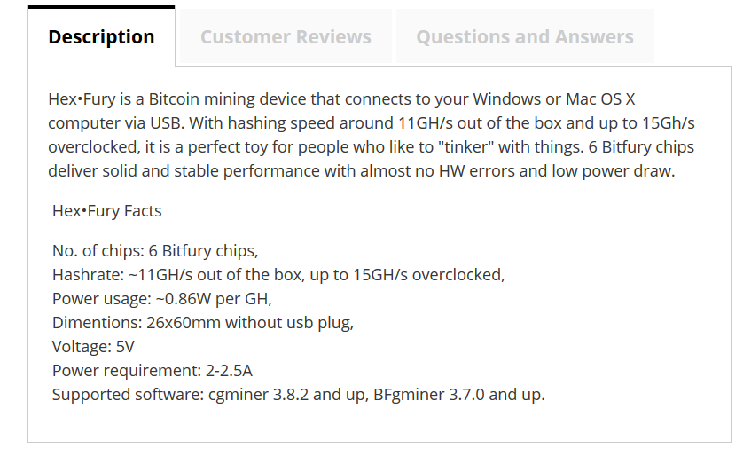
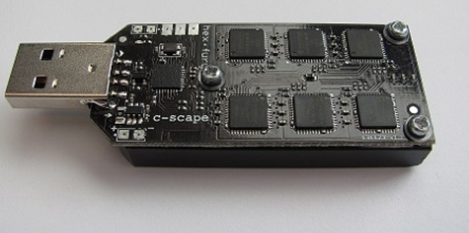
Calculate at: http://www.alcula.com/calculators/finance/bitcoin-mining/

Slide 25
Pool manager
Hey, I found a block!
Worker
Worker
Worker
Yay!
Yay!
Yay!

Slide 26
Puzzle “shares”
Pool manager
Lower difficulty:
Hash(B₁) = 0x00000002dd43…
Hash(B₂) = 0x0000000076a5…
Hash(B₃) = 0x0000000f270b…
Hash(B₄) = 0x0000000f3f5b…
Purpose of “shares”:
Proof of work
Measures hash rate
Worker

Slide 27
Proportional rewards
When block is found:
yourShares = shares you submitted since last block
totalShares = shares submitted by the pool since last block
yourReward = 25 BTC * yourShares/totalShares

Slide 28

Reward variation
You get more reward if this block is found is found early. I.e. early shares are worth more in expectation. Exploit by:
Send shares only early in search
Hop to a different pool if they found a block recently

Slide 29
Expected share reward

Slide 30
Combating pool hopping
Ineffective methods:
Detect and punish/ban
Delaying pool block statistics
De-incentivize by changing scoring system:
Reward miners who stay longer
Make rewards independent of “block found” time

Slide 31
Encouraging small miners … again
Can we use “GPU/ASIC resistant” cryptocurrencies?

Slide 32
Password Databases
Insecure
Better
Username | Password
Jack.Clough | 12password
Betty.Smith | 8c2odkw
Username | “Salt” | Scrypt(password+salt)
Jack.Clough | 150FE5Btiq… | PaR6mPwHBj…
Betty.Smith | t1Y1B67ulN… | QrUaLRqFvc…

Slide 33
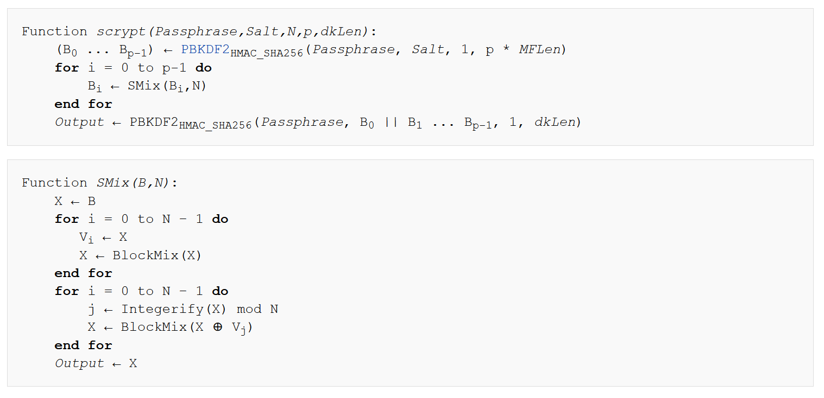

Slide 34
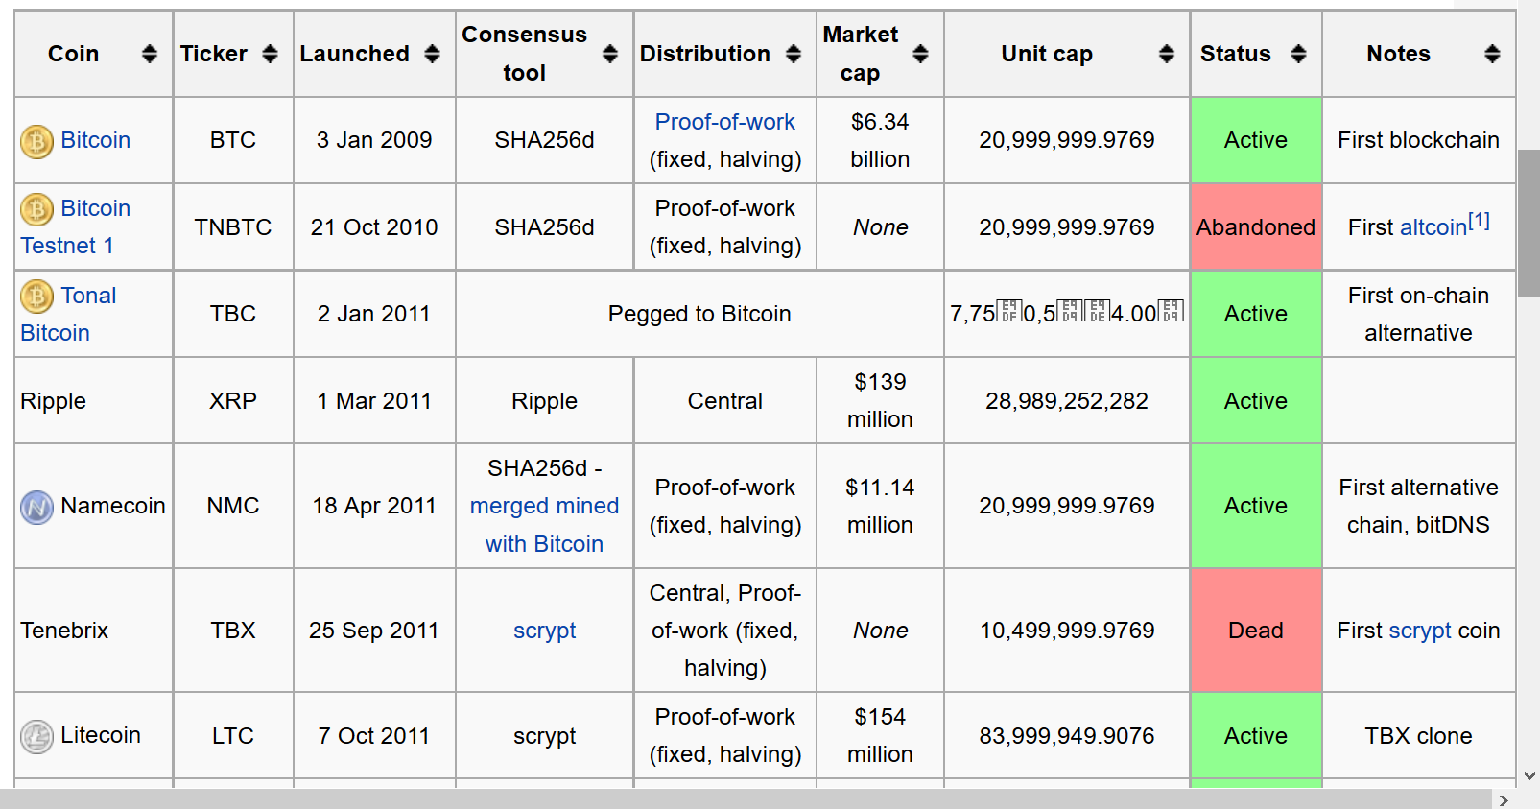
Comparison of cryptocurrencies

Slide 35
Logistics
No class on Monday, Oct 5th
Next class on Wednesday, Oct 7th
Problemset 2 is out: due Oct 9th
Midterm: Oct 19th

