Slide 1
Cryptocurrency Survival: An Analysis of the Price and Future of Bitcoin
Avinash Ramesh

Slide 2

Overview
Price History
Volatility Analysis
Price Drivers
Short-term Predictive Techniques
Projections for 2015
Long-term Survival and Projections

Slide 3
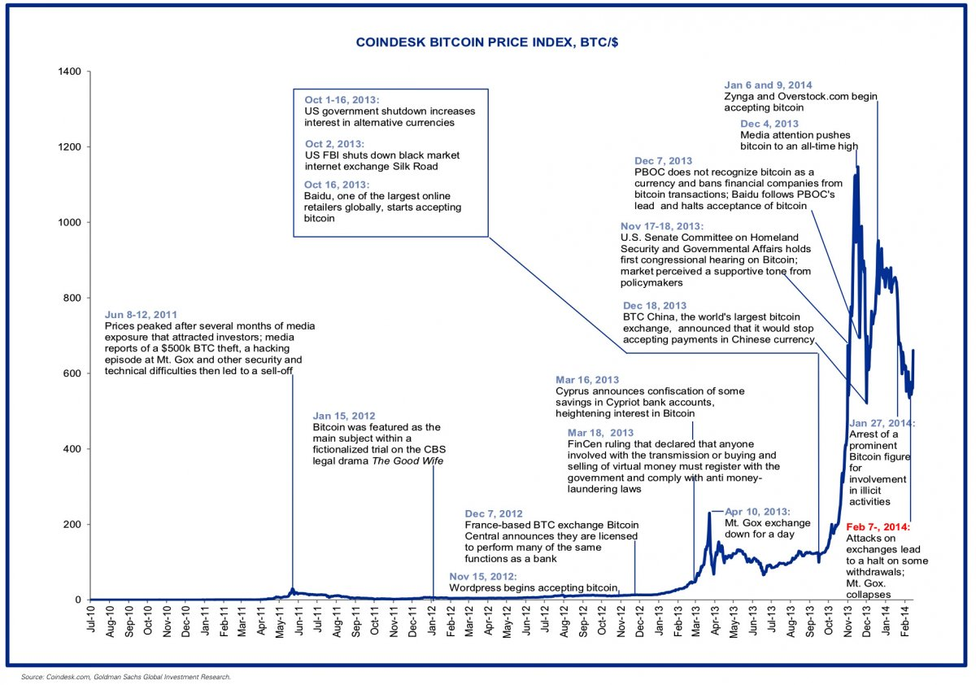
Price History – General Overview

Slide 4
Price History 2014 – A Year in Review
Price went from $763.97/BTC to $313.92/BTC
Ross Ulbricht on trial for running Silk Road marketplace
January 9th – Overstock.com announced it would accept bitcoin
February 18th – First bitcoin ATM opened in the US
February 25th – Mt. Gox shutdown
February – Slovenian Exchange BitStamp experiences DDOS attack
December 19th – Charlie Shrem sentenced to two years jail for helping Silk Road customers illegally launder money through BitInstant

Slide 5
Price Drivers
Transaction Volume
The amount of bitcoin moved around the system
Supply
Lower than 13 million due to lost bitcoin
Expectations of Future Value
Uncertainty of Future Value
Leads to volatility
High uncertainty/volatility bad because bitcoin should be a store of value
“While the eMail pointing to a $50,000 bitcoin is imprecise to say the least, It’s a starting point. A more rigorous mathematical model integrating demand projections with probabilities of certain make-or-break contingencies isn’t just possible – it already exists, in various versions, across various investors’ hard drives.”

Slide 6
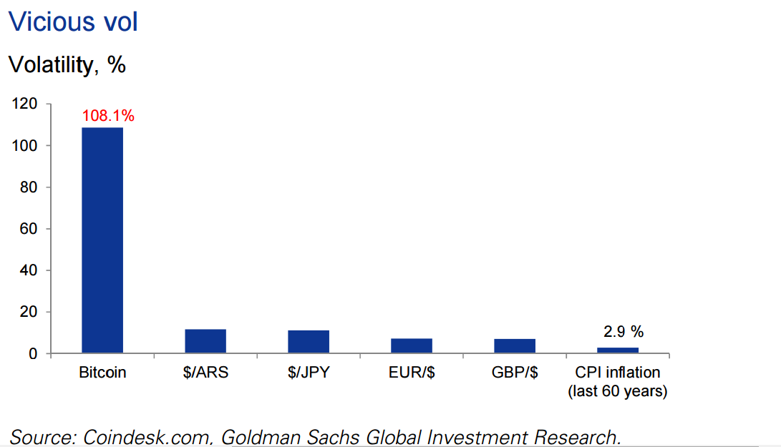
Volatility Analysis

Slide 7
Volatility Analysis (cont.)

Slide 8
Volatility Analysis (Cont.)

Slide 9
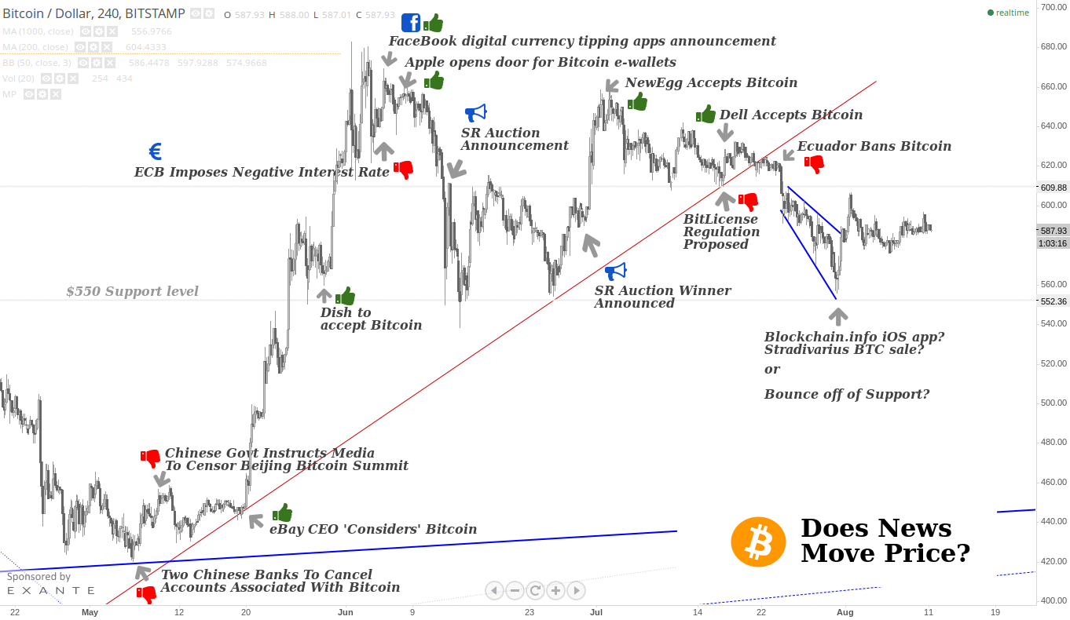
Price Drivers - News

Slide 10
Price Drivers (cont.)
Velocity
Number of times a unit of currency is used in a fixed period of time
Low velocity -> higher price
Liquidity
Hoarders’ coins are illiquid
Human Emotion
Can’t Model
Lower bound – mining reward must be greater than mining costs

Slide 11
Short-term Predictive Techniques - Overview
Spot Price
Bayesian Regression
Paper by Shah and Zhang
Assumes technical methods can be used to predict future price
Uses nonparametric regression
Trial period in paper returned 89% under model
Artificial Neural Networks
Commonly used for pattern recognition and nonlinear curve fitting

Slide 12
Short-Term Predictive Techniques - Problems
Bayesian Regression
Trial period was only 60 days
Did not take into account transaction fees
Gain was over a timespan in which bitcoin price rose dramatically
Appears inconclusive
Artificial Neural Networks
Too many hidden-layers leads to overfitting, too few leads to underfitting

Slide 13
Projections for 2015 – The Good
Boston Retail Partners believe 8% of retailers will accept Bitcoin
This year to see integration of BitLicense, which sets rules and regulations for BTC merchants
CoinBase announced the release of an insured exchange in February
Major companies such as Microsoft, Overstock.com, and Dell now take Bitcoin

Slide 14
Projections for 2015 – The Bad
According to “The Guardian”, 65% of general public still doesn’t understand Bitcoin
Of those with awareness of Bitcoin, 85% have never used it
Juniper Research predicts transactions for cryptocurrencies to fall as much as 50%
Transactions from 2014 artificially inflated due to advent of altcoins like Dogecoin

Slide 15
Long-Term Survival Critics and Responses
Gold cannot be compared to Bitcoin due to intrinsic value of gold
Response: gold’s intrinsic value is quite low, both Bitcoin and gold are general stores of value
Adoption of near-perfect substitute AltCoins creates a potentially unlimited amount of BitCoin
Response: Network Effects
Lack of government control
Governments can impose taxes in fiat currencies which prevents full adoption of Bitcoin
Response A: Government control will play a larger factor in Bitcoin’s future
Response B: Bitcoin is meant to be decentralized

Slide 16
Long-Term Survival Critiques and Responses
Most people holding it are speculating
True, but move from 95%/5% to 80%/20% speculation to payment ratio.
Several illegal transactions
According to Fred Ehrsam, cofounder of CoinBase, SilkRoad transactions account for <1% of total

Slide 17
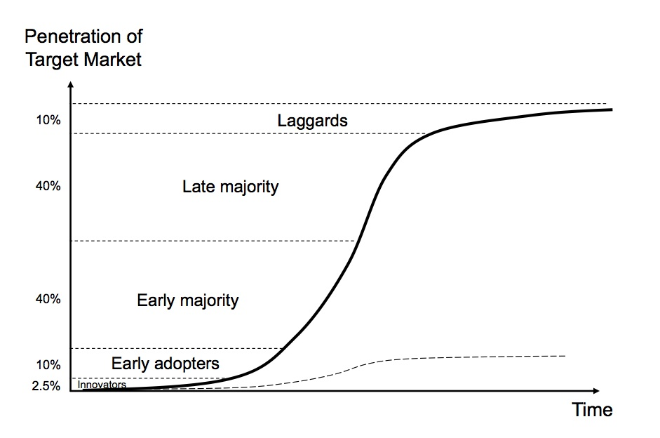
Long-Term Survival Projection: S-Curve
Current Problem of Chicken or Egg
Waiting for critical mass of merchants and consumers

Slide 18
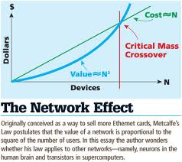
Long-Term Survival Projections: Network Effects
Bitcoin will reach a critical mass before altcoins, after which its network effect will keep it as the dominant cryptocurrency
Comparison of Bitcoin to Internet

Slide 19
Bitcoin Price Simulator
Price = (TransactionVol / Velocity) * (1 / Supply)
http://worldbitcoinnetwork.com/BitcoinPriceModel-Alpha.html

Slide 20
Conclusion
2014 was a rough year for Bitcoin in terms of price, but also showed long-term potential
Analysis of Bitcoin’s volatility shows that it has been steadily decreasing
Bitcoin is still in the early adoption phase of the S curve, and has yet to reach a critical mass of people
Bitcoin’s price is complex and affected by several factors; however, there exist models to try to account for these factors

Slide 21
Sources
http://arxiv.org/pdf/1410.1231v1.pdf
https://willyreport.wordpress.com/2014/05/25/the-willy-report-proof-of-massive-fraudulent-trading-activity-at-mt-gox-and-how-it-has-affected-the-price-of-bitcoin/
http://www.paymentlawadvisor.com/files/2014/01/GoldmanSachs-Bit-Coin.pdf
http://www.newsbtc.com/2015/02/13/juniper-predicts-future-bitcoin-will-two-years/
http://www.btcpredictions.com/index.html
http://www.theguardian.com/technology/2015/feb/03/bitcoin-2015-make-or-break-year
http://www.newsbtc.com/2015/02/05/report-predicts-50-drop-cryptocurrency-transactions-year/
http://www.coindesk.com/juniper-research-bitcoin-transactions-double-2017/
http://www.newsbtc.com/2014/12/31/microsoft-experimenting-bitcoin/
https://www.cryptocoinsnews.com/predicting-bitcoin-value-50000/
https://www.youtube.com/watch?v=g2nXgK34HIM&feature=share
http://insidebitcoins.com/news/bitcoin-2014-growing-adoption-high-profile-arrests-and-a-bewildering-price/28060
http://www.cnbc.com/id/102301308
https://www.cryptocoinsnews.com/affects-bitcoin-price/
https://jmarcedwards.files.wordpress.com/2011/01/networkeffect1.jpg

