Slide 1
Class 17:
Permacoin/Ethereum
Cryptocurrency Café
UVa cs4501 Spring 2015
David Evans

Slide 2
Plan
Final Project
Proposals due Thursday
Useful proofs of work?
More powerful scripts

Slide 3
Proofs-of-Work
Bitcoin: SHA-256
Compute intensive
No value, motivates investment in SHA ASICs
Litecoin, Dogecoin: scrypt
Memory-access intensive
No value, motivates investment in general- purpose computing (?)
Can we have a proof-of-work that also produces something useful?

Slide 4


Challenge of Useful Proofs-of-Work
Need to embed previous block and transactions in problem
Need random problem instances to be useful
Need partially-selected problem instances to be hard
Must be easy to verify winning results
Want adjustable difficulty

Slide 5
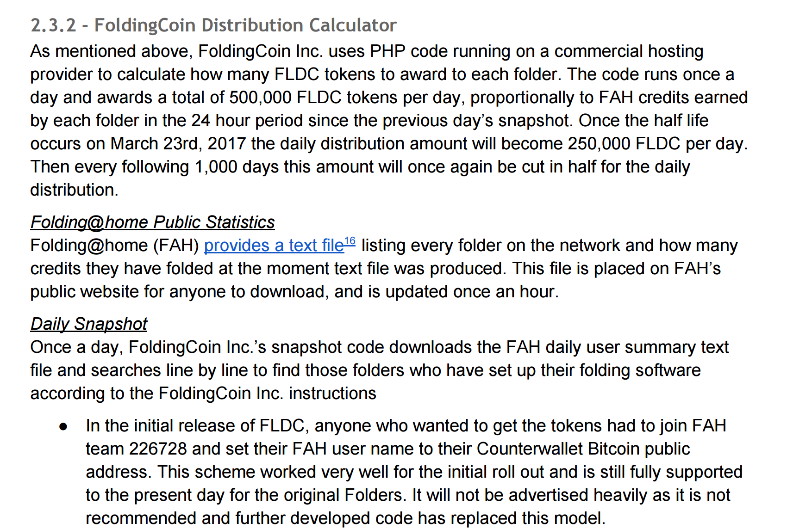
http://foldingcoin.net/wp/wp-content/uploads/2015/02/FoldingCoin-White-Paper-v1.0.pdf

Slide 6
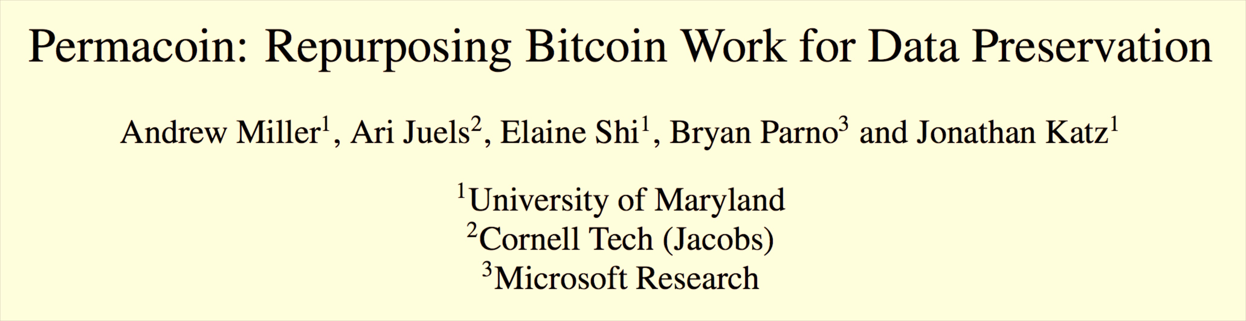
IEEE Security and Privacy (“Oakland”), 2014
Proof-of-Retrievability: node is storing what it should
Ensure local storage: block access depend on private key, which is also owner of coin value.

Slide 7
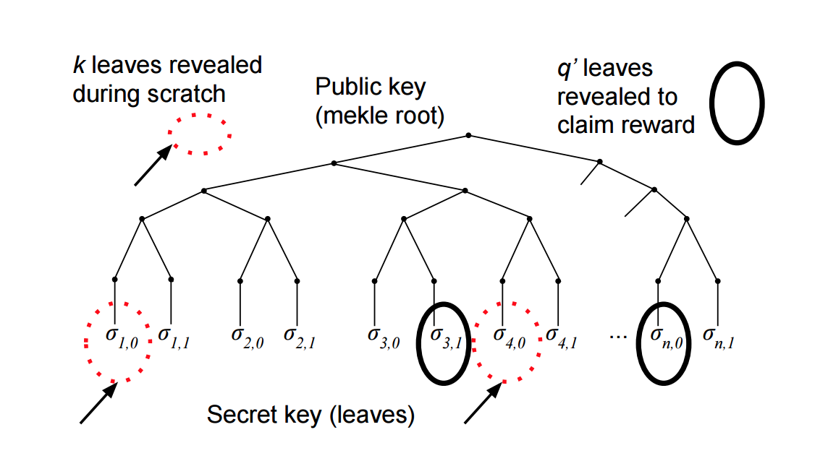
Permacoin: Merkle Tree

Slide 8
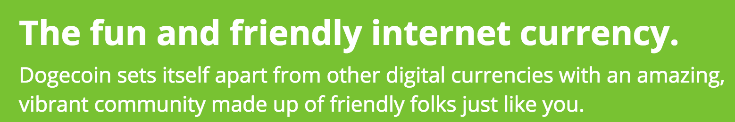

Bitcoin-like decentralized currencies:
it is about the community!

Slide 9
Charge
Project Proposals due Thursday (11:59pm)
If you don’t already have an idea or are looking for teammates, come to office hours! (right now)

