Slide 1
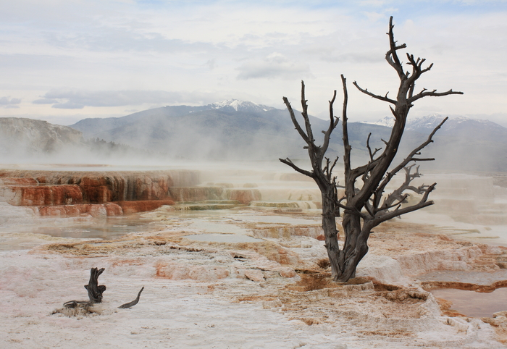
Class 13:
Selfish Mining (Supersized)
Cryptocurrency Café
UVa cs4501 Spring 2015
David Evans

Slide 2
Plan for Today
Quiz 2 [Spurlock Video]
Quiz 2 Discussion
Selfish Mining
Talk tomorrow:
Lana Swartz
“Social Transactions: The Meaning and Management of New Payment Infrastructures”
3:30pm Tomorrow (Feb 26)
New Cabell Hall 229a

Slide 3

http://youtu.be/uLxhI81Flvk?t=18m43s

Slide 4
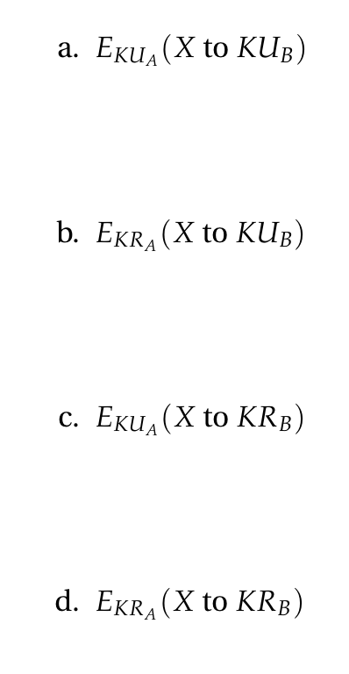

Slide 5
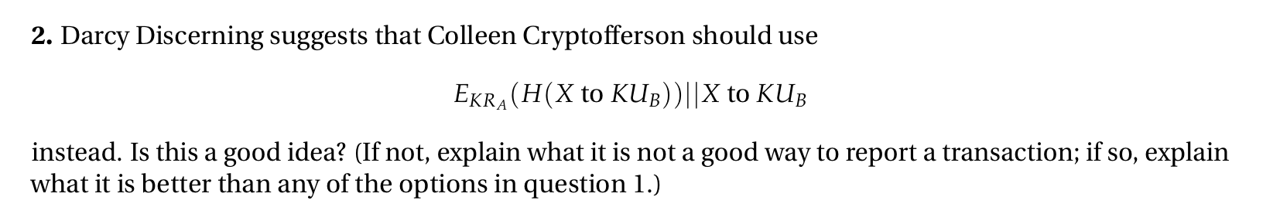

Slide 6
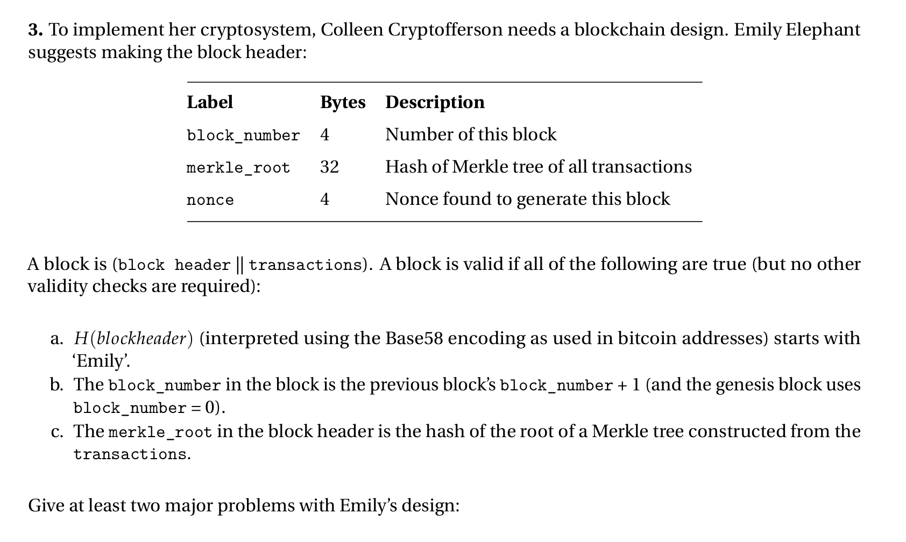

Slide 8
http://youtu.be/uLxhI81Flvk?t=18m43s

Slide 9
Charge
Project 2 Part 2:
Due Thursday 5 March

