Slide 1
Asymmetric Key Signatures
David Evans and Samee Zahur
CS4501, Fall 2015

Slide 2




You have money!
Please pay $1000 to my employee --TheBoss

Slide 3
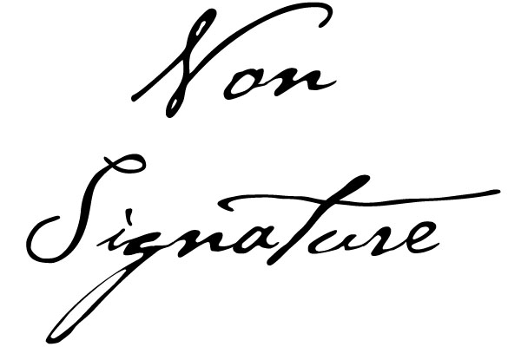
Real-life Signatures
Easy to verify
Bank has your signature
Forging unlikely
Legal consequences of forging
Checkbooks are well-guarded
Copying it requires physical access
Hard to repudiate
Bank keeps a copy for few months

Slide 4
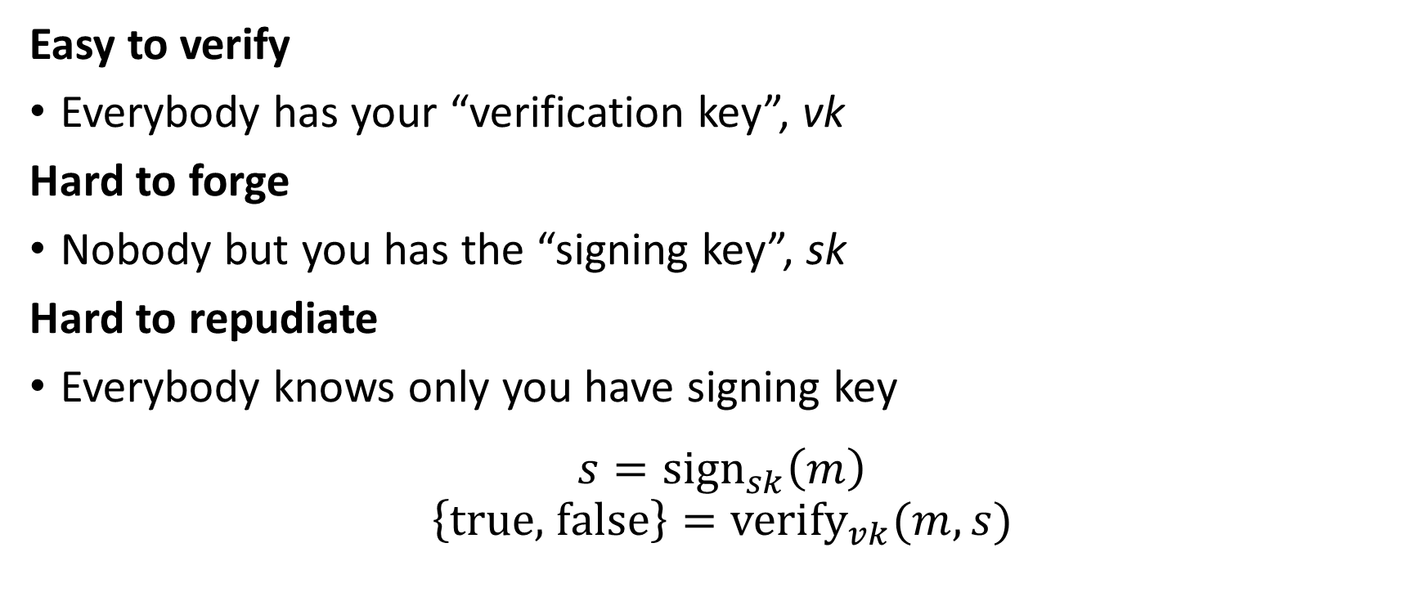
Digital Signatures
Easy to verify
Everybody has your “verification key”, vk
Hard to forge
Nobody but you has the “signing key”, sk
Hard to repudiate
Everybody knows only you have signing key
$$s={\text{sign}}_{sk}\left(m\right) \\ \left\{\text{true}\text{, }\text{false}\right\}={\text{verify}}_{vk}(m,s)$$

Slide 5
Topics
Asymmetric cryptography
Digital signatures
Elliptic curve cryptography
Implementation pitfalls

Slide 6



Ordinary (or symmetric) crypto
Message
key
key

Slide 7
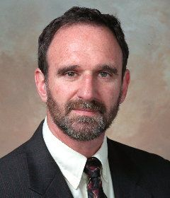
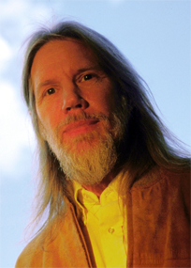
New Directions in Cryptography, 1976
Martin Hellman
Whitfield Diffie

Slide 8


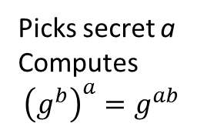
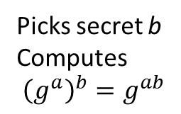

Diffie-Hellman Key Exchange
$$g^{a} \text{mod} p$$
$$g^{b} \text{mod} p$$
Picks secret a
Computes $${\left(g^{b}\right)}^{a}=g^{ab}$$
Picks secret b
Computes $${\left(g^{a}\right)}^{b}=g^{ab}$$
Public values: $g, p, g^{a}, g^{b}$
Shared secret: $g^{ab}$

Slide 9
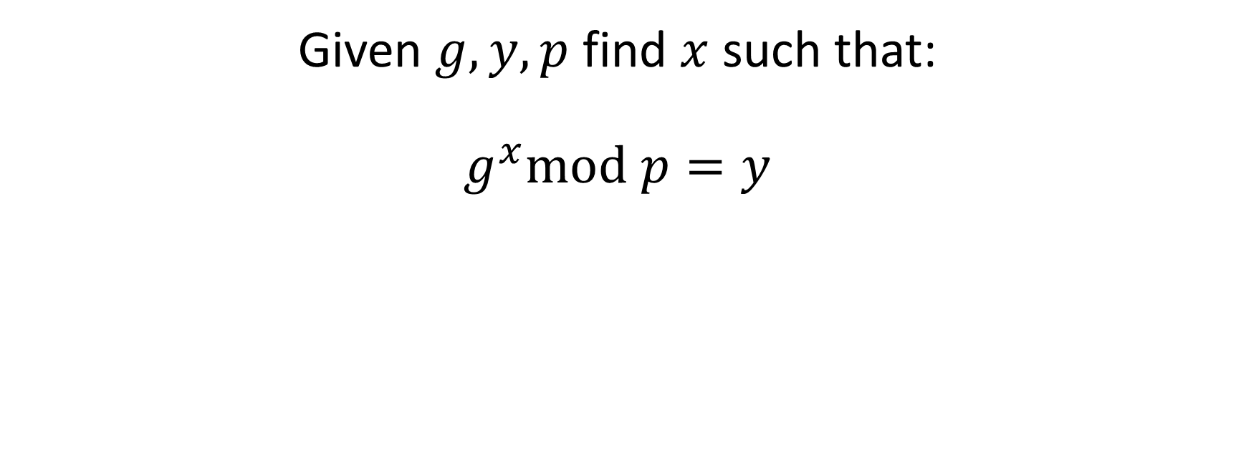
Discrete Logarithm Problem
Given $g,y,p$ find $x$ such that:
$$g^{x}\text{mod} p=y$$

Slide 10
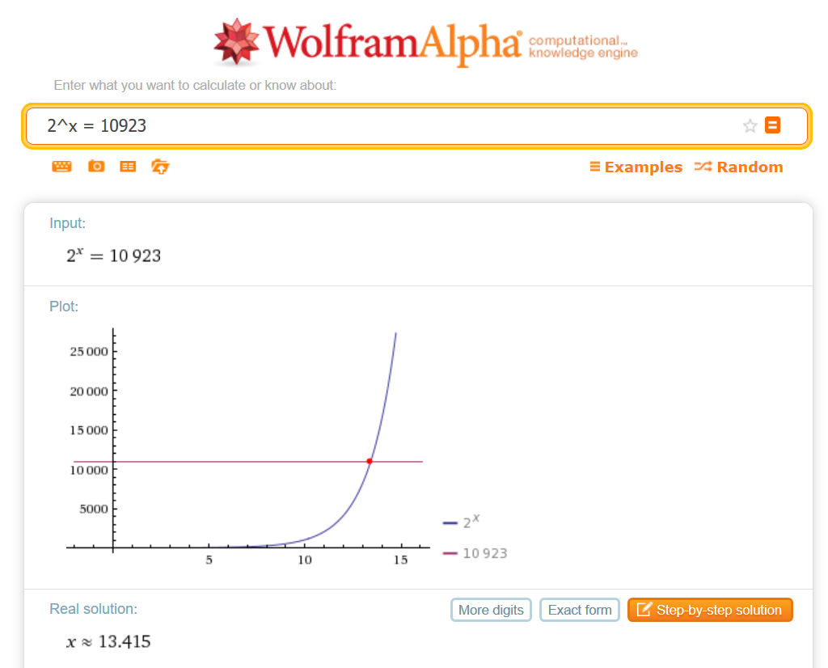
Discrete Logarithm Problem

Slide 11
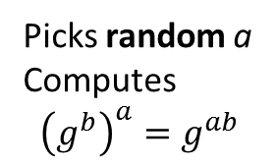
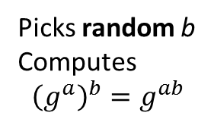
Random element out of …?
$$g^{a} \text{mod} p$$
$$g^{b} \text{mod} p$$
Picks random a
Computes $${\left(g^{b}\right)}^{a}=g^{ab}$$
Picks random b
Computes $${\left(g^{a}\right)}^{b}=g^{ab}$$

Slide 12
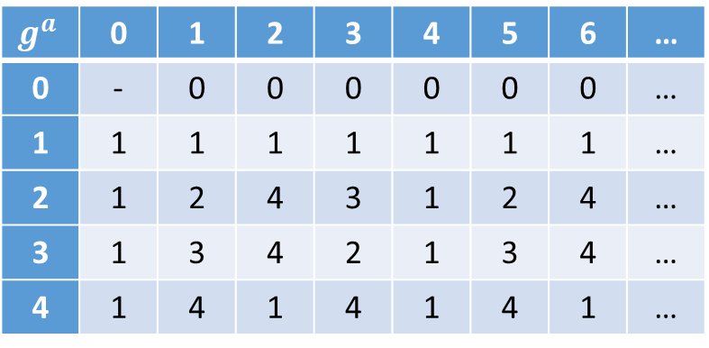
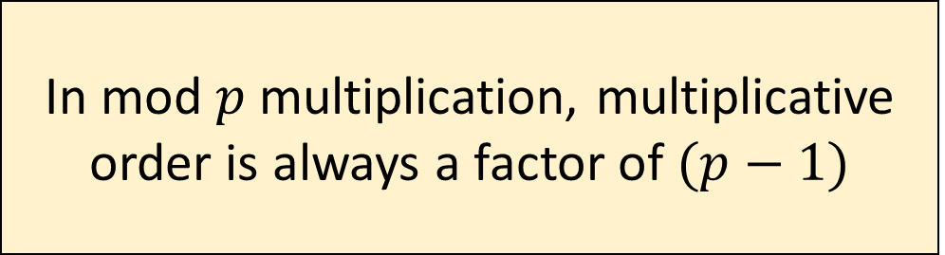
Mod 5 Exponentiation
 | 0 | 1 | 2 | 3 | 4 | 5 | 6 | …
0 | - | 0 | 0 | 0 | 0 | 0 | 0 | …
1 | 1 | 1 | 1 | 1 | 1 | 1 | 1 | …
2 | 1 | 2 | 4 | 3 | 1 | 2 | 4 | …
3 | 1 | 3 | 4 | 2 | 1 | 3 | 4 | …
4 | 1 | 4 | 1 | 4 | 1 | 4 | 1 | …
Order 1
Order 2
In mod $p$ multiplication, multiplicative order is always a factor of $(p−1)$

Slide 13

Exponent Modulus
Multiplicative order $n$ is at most $p−1$
Pick random $x$ such that $0≤ x < p−1$
$g^{a}g^{b}\operatorname{mod}{p}=g^{a+b}\operatorname{mod}{p}=g^{\left(a+b\right)\operatorname{mod}{n}}\operatorname{mod}{p}$

Slide 14
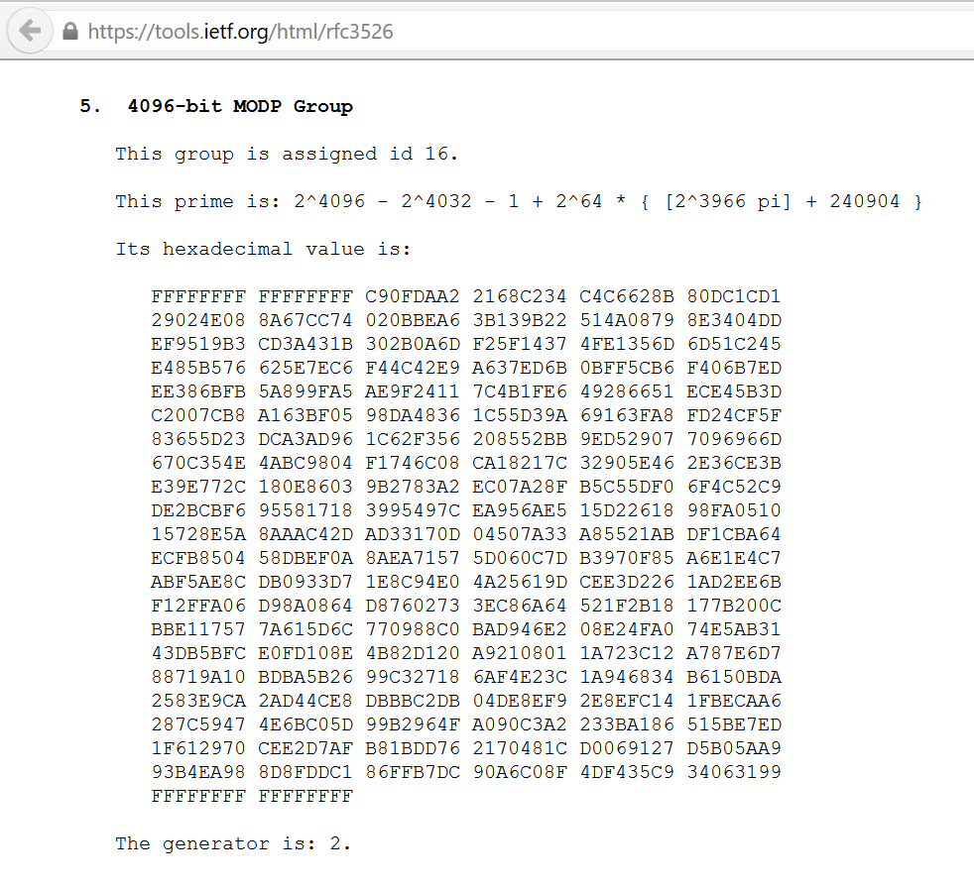

Slide 16



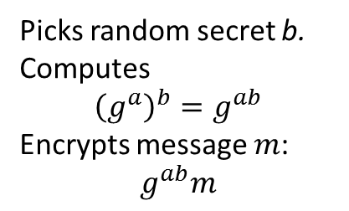

Public-key Cryptography
Publicly announces $g^{a}$
$g^{b}$, $g^{ab}m$
Picks secret a
Computes $${\left(g^{b}\right)}^{a}=g^{ab}$$
Picks random secret b. Computes $${\left(g^{a}\right)}^{b}=g^{ab}$$
Encrypts message $m$:
$$g^{ab}m$$
Public values: $g, p, g^{a}, g^{b}$
Shared secret: $g^{ab}$

Slide 17



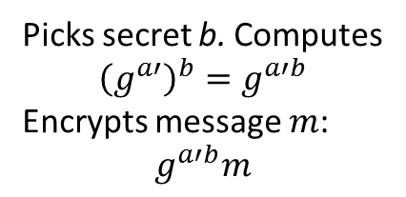


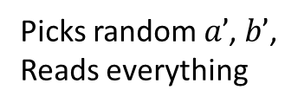
Man-in-the-Middle (MITM)
$$g^{a}$$
$$g^{a′}$$
$g^{b′}$, $g^{ab′}m$
$g^{b}$, $g^{a′b}m$
Picks secret a
Computes $${\left(g^{b}\right)}^{a}=g^{ab}$$
Picks secret b. Computes $${\left(g^{a′}\right)}^{b}=g^{a′b}$$
Encrypts message $m$:
$$g^{a′b}m$$
Picks random $a’$, $b’$,
Reads everything

Slide 18
Digital Signature

Slide 19
Recall
Easy to verify
Everybody has your “verification key”, vk
Hard to forge
Nobody but you has the “signing key”, sk
Hard to repudiate
Everybody knows only you have signing key
$$s={\text{sign}}_{sk}\left(m\right) \\ \left\{\text{true}\text{, }\text{false}\right\}={\text{verify}}_{vk}(m,s)$$

Slide 20
Discrete-log based signature

Slide 21


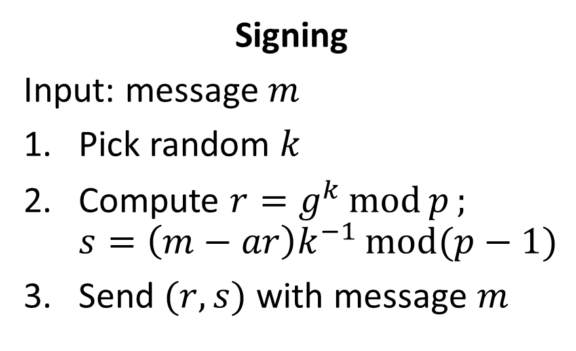
ElGamal Signature Scheme
Fixed global parameters: $g, p$
Private key: $a$
Public key: $g^{a} \operatorname{mod}{p}$
Signing
Input: message $m$
Pick random $k$
Compute $r=g^{k}\operatorname{mod}{p};$ $s=\left(m−ar\right)k^{−1}\operatorname{mod}{(p−1)}$
Send $(r,s)$ with message $m$
Verification
Input: message $m, \left(r,s\right)$
Check if $r^{s}{\left(g^{a}\right)}^{r}=g^{m}(\operatorname{mod}{p})$

Slide 22
Bitcoin Payment
Sign it like a check!

Slide 23
Recap
We want to sign transactions digitally on the bitcoin network, such that they are:
Easy to verify
Hard to forge
Hard to repudiate
Discrete exponentiation is easy, logarithm is hard
We used it to make asymmetric (aka. public) key crypto
Same principle used for digital signatures

Slide 24
Avoiding (overly) long numbers

Slide 26
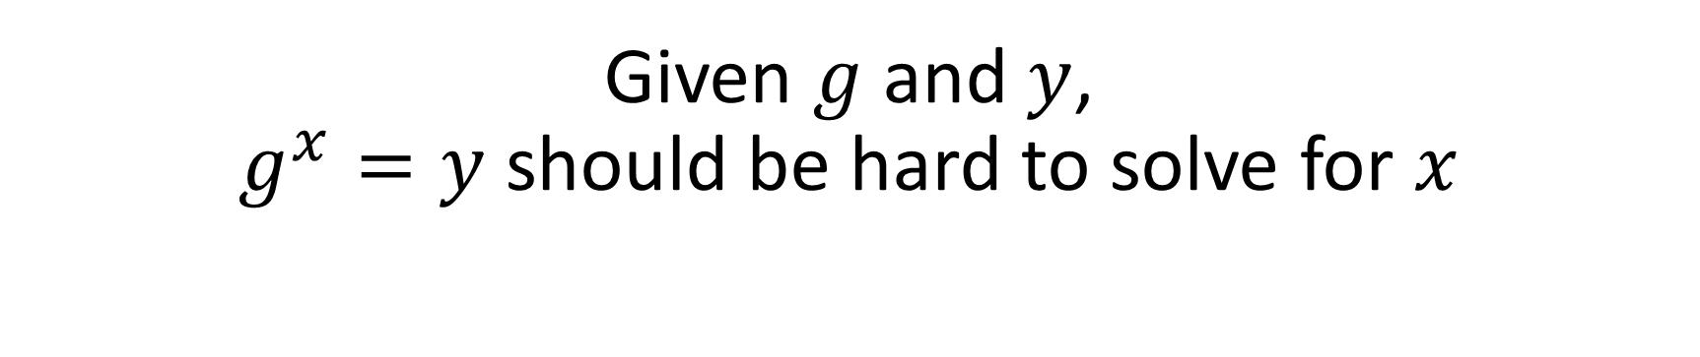
Informal Requirements
Given $g$ and $y$, $g^{x}=y$ should be hard to solve for $x$

Slide 27
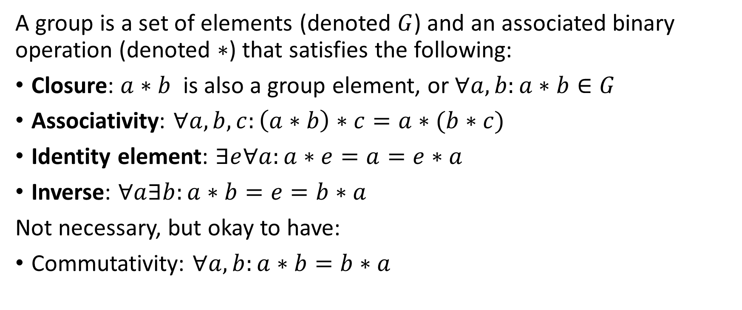
Group
A group is a set of elements (denoted $G$) and an associated binary operation (denoted $∗$) that satisfies the following:
Closure: $a∗b$ is also a group element, or $∀a,b:a∗b∈G$
Associativity: $∀a,b,c:\left(a∗b\right)∗c=a∗(b∗c)$
Identity element: $∃e∀a:a∗e=a=e∗a$
Inverse: $∀a∃b:a∗b=e=b∗a$
Not necessary, but okay to have:
Commutativity: $∀a,b:a∗b=b∗a$

Slide 28
Additional Cryptographic Properties
Discrete logarithm should be hard
Group operation should be efficient
Implies small key sizes

Slide 29
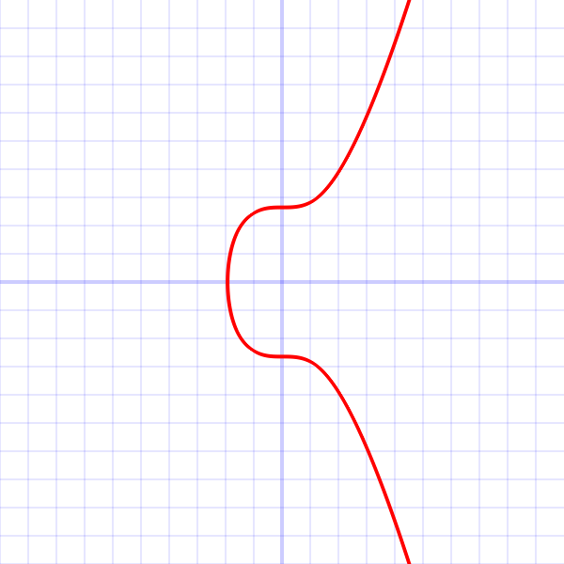

Elliptic Curve Cryptography (ECC)
Group elements: points on the curve, P, Q, and R
Point “addition”: using “geometry”. P+Q=R
Q
P
R
$$y^{2}=x^{3}+7$$

Slide 30
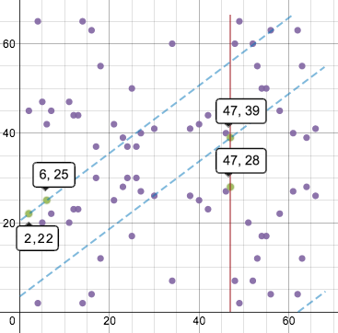
Elliptic “Curve”
Image from: http://www.coindesk.com/math-behind-bitcoin/

Slide 31
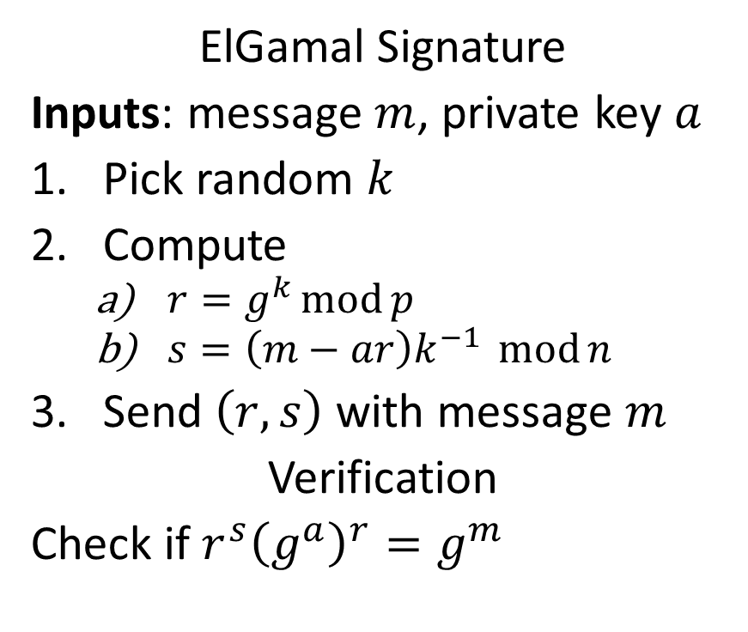
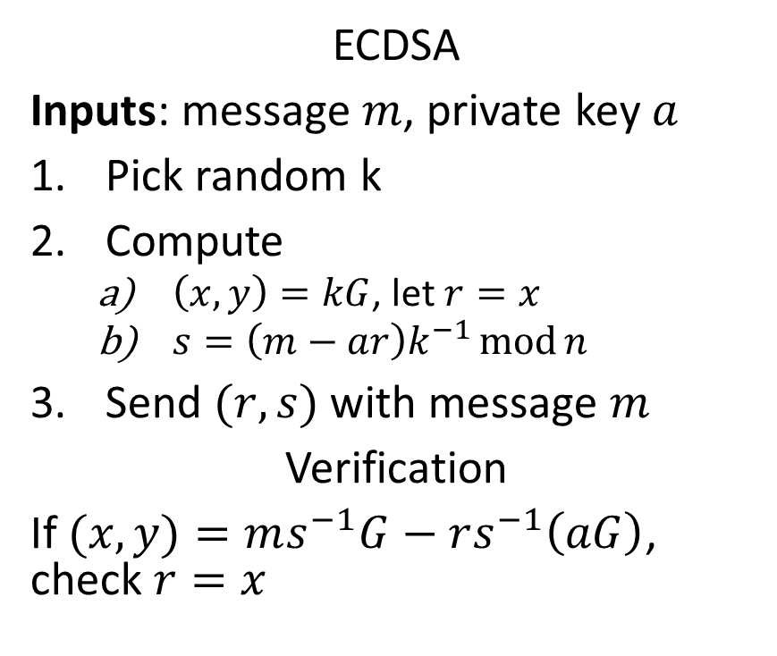
Elliptic Curve Digital Signature Algorithm (ECDSA)
ElGamal Signature
Inputs: message $m$, private key $a$
Pick random $k$
Compute
$r=g^{k}\operatorname{mod}{p}$
$s=\left(m−ar\right)k^{−1} \operatorname{mod}{n}$
Send $\left(r,s\right)$ with message $m$
Verification
Check if $r^{s}{\left(g^{a}\right)}^{r}=g^{m}$
ECDSA
Inputs: message , private key
Pick random k
Compute
, let
Send with message
Verification
If , check

Slide 32
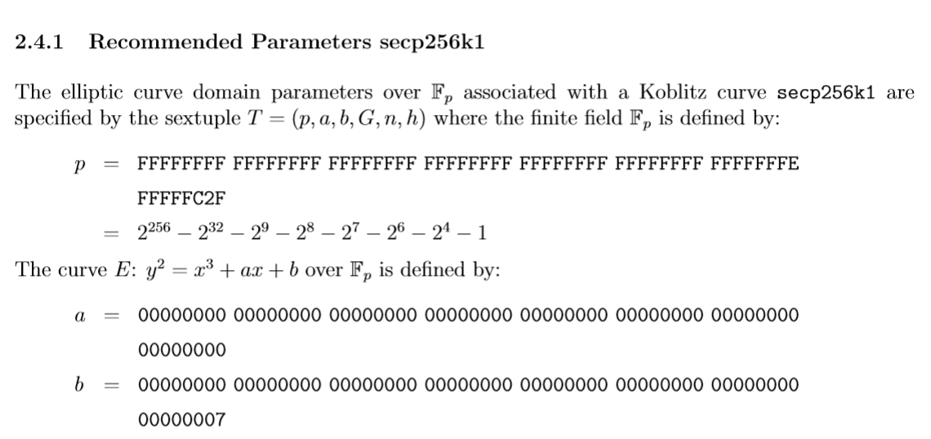
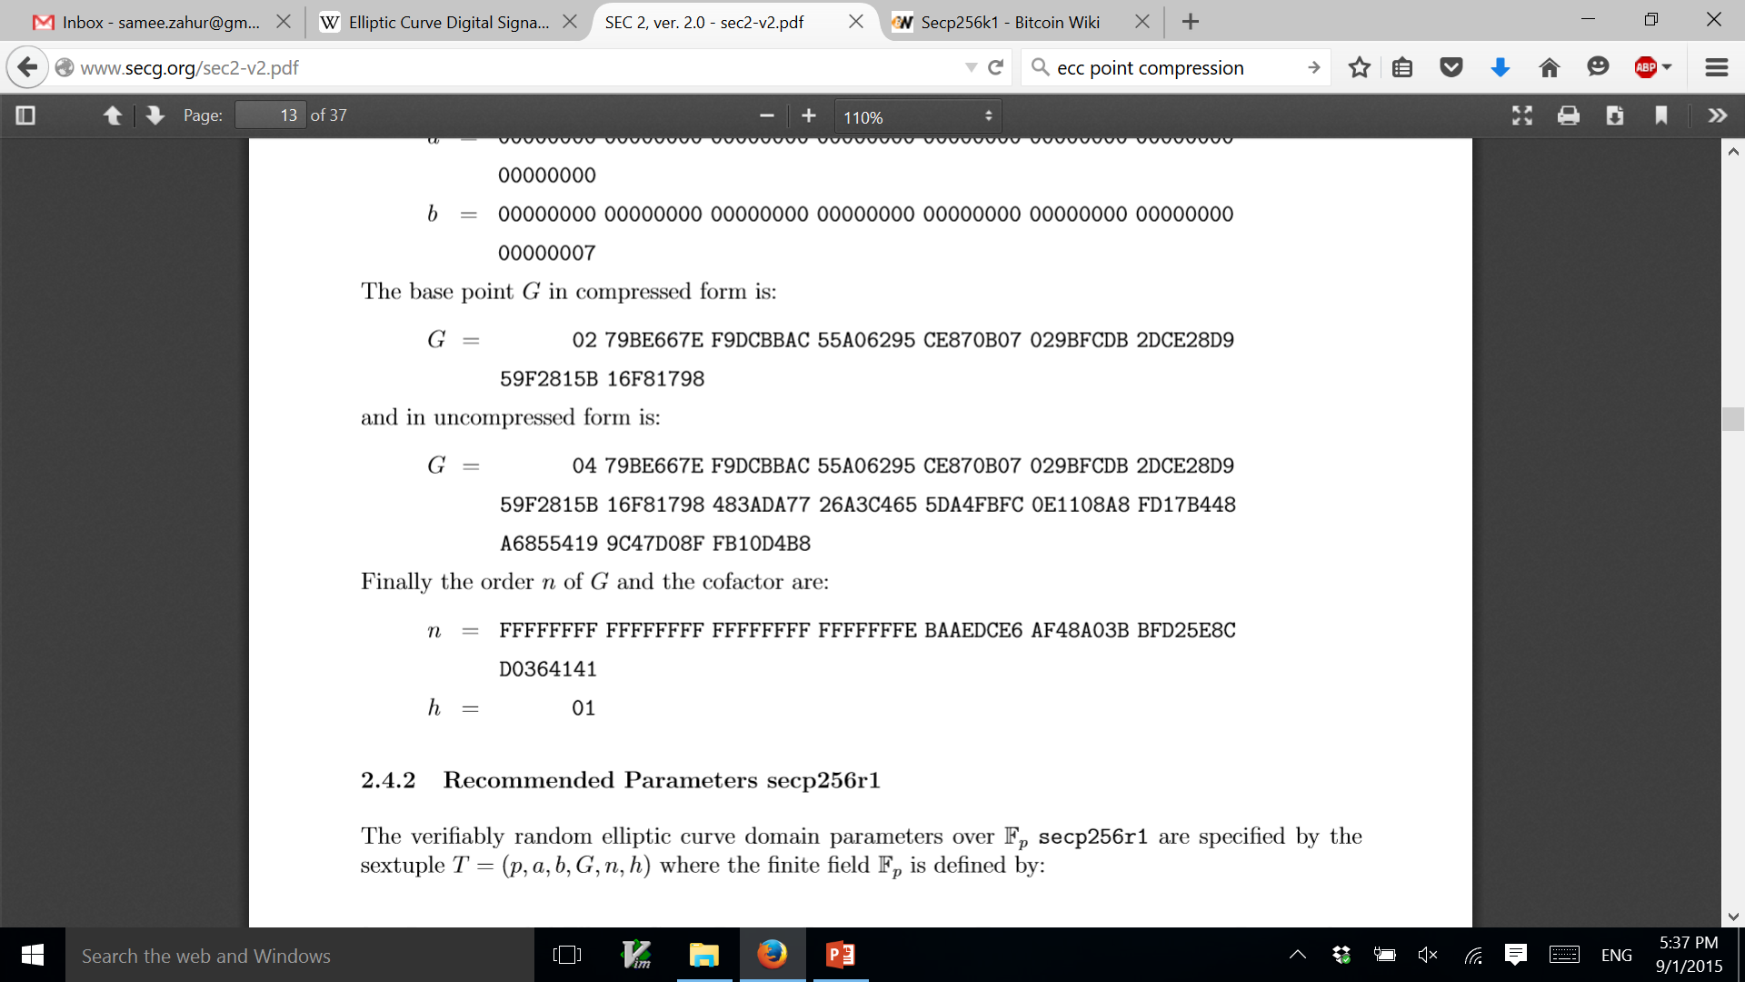

Slide 34
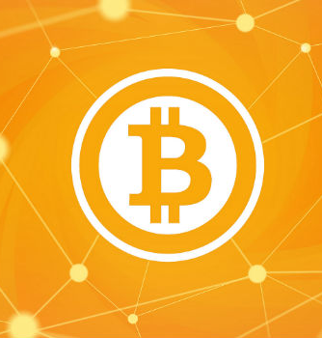
You have money!
Please pay $1000 to my employee --TheBoss
Jason Benjamin

Slide 35
Logistics
Next class: hash functions and Bitcoin consensus
Checkup 1 on Monday. Includes everything till today

