Slide 1
Subverting Bitcoin
David Evans and Samee Zahur

Slide 2
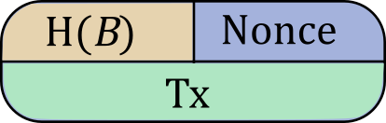
Mining
Why do we need miners?

Slide 3
Conflicting Blocks

Slide 4
Consensus
Majority of hashing power has voted for transactions on longest chain.
It is costly to increase voting power
Players are not motivated to cheat

Slide 5
The 51% attack!
If any party controls majority of hashing power, they can:
Undo the past
Deny mining rewards
Undermine the currency

Slide 6
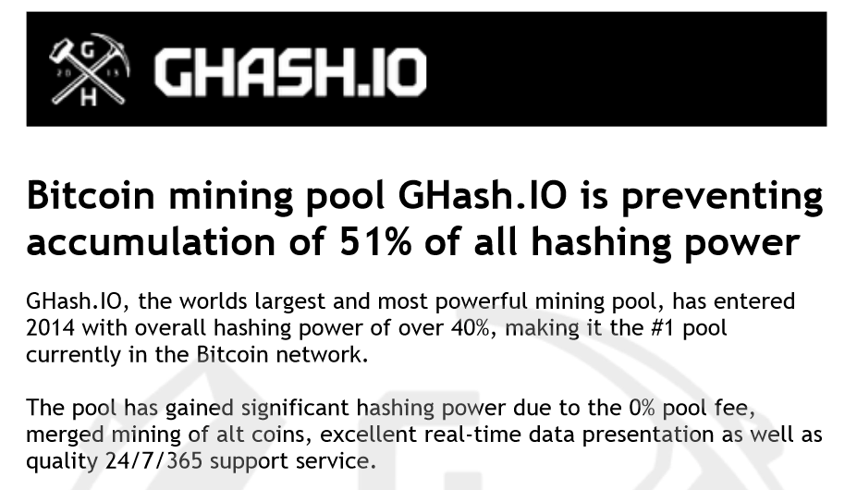
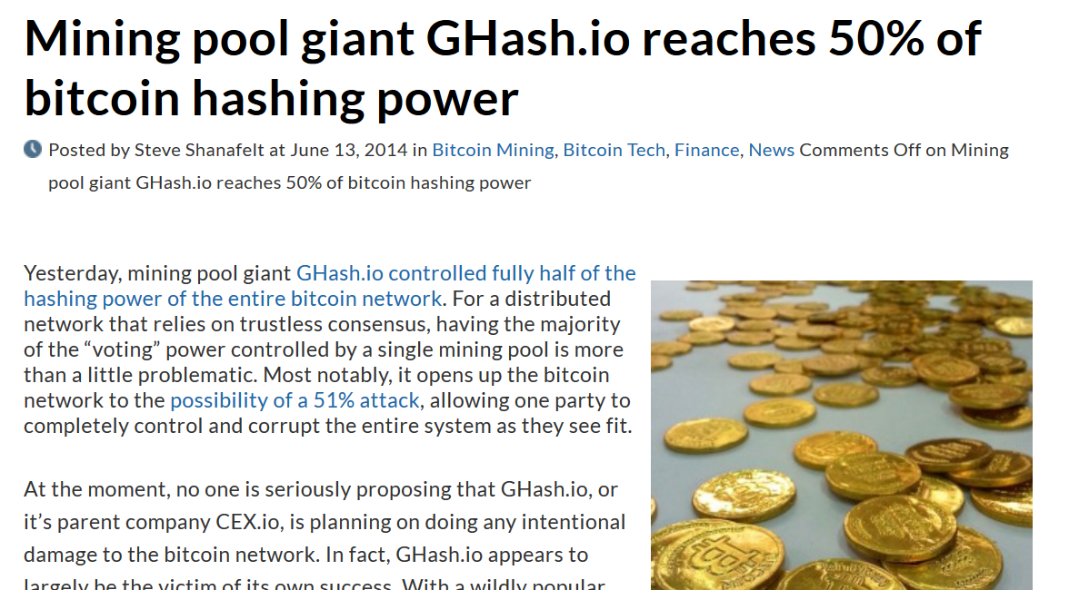
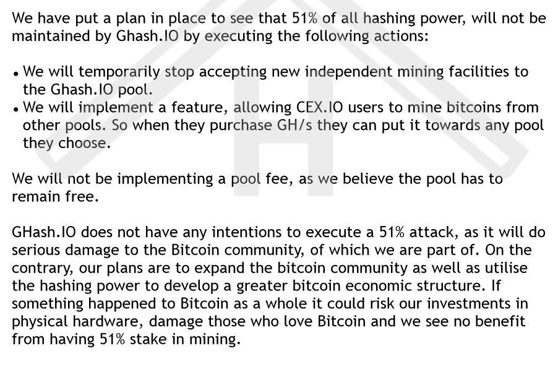

Slide 7
Nash Equilibrium
Or, can selfish miners keep Bitcoin stable?

Slide 8
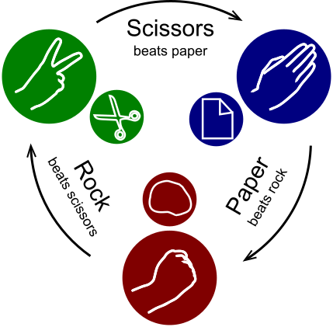

Slide 9


Slide 10
Nash equilibrium
It is a configuration of strategies such that no participant can do better by unilaterally changing their own strategy.

Slide 11
Prisoner’s Dilemma
 | B stays loyal | B defects
A stays loyal | 1,1 | 3,0
A defects | 0,3 | 2,2

Slide 12
Bitcoin mining … equilibrium?

Slide 13
Selfish mining

Slide 14
I’ll keep these blocks for myself!

Slide 15
I’ll keep these blocks for myself!

Slide 16
if we gain a lead:
withhold blocks mine on private chain
else if lead shrinks, but is still at least 2:
reveal blocks to keep abreast with public chain
else if lead drops below 2:
reveal all blocks mine on public chain

Slide 17
Worries
“Rational miners will prefer to join the selfish miners, and the colluding group will increase in size until it becomes a majority. At this point, the Bitcoin system ceases to be a decentralized currency.”
Majority is not Enough: Bitcoin Mining is Vulnerable
Ittay Eyal, and Emin Gün Sirer

Slide 18
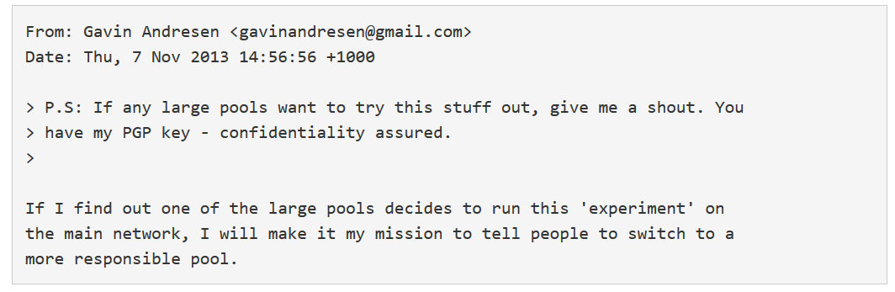
Reaction

Slide 19
Detecting selfishness
Orphaned blocks
Timing hints
More at: “How to detect selfish miners” by Ittay Eyal, and Emin Gün Sirer, http://hackingdistributed.com/2014/01/15/detecting-selfish-mining/

Slide 20
Next up…
Revised checkup 2 answers
Next class: mining pools

