Slide 1
Customer Repurchase
Prediction for E-commerce data
Eliza Bai

Slide 2
Summary
Problem description
Classification with multiple features
Feature engineering
Creating different kinds of features from raw data
Model training
Models from machine learning and ensemble technique
Performance study
Accuracy, AUC and cross-validation and feature importance study
Conclusion and future work

Slide 3
1 Problem description
Data provided:
Train.csv (a)
Test.csv (b)
Transansactions.csv (c)
User_pofiles.csv (d)
Task:
To predict the class labels (‘used?’ and ‘repurchase?’)
of the ‘test.csv’

Slide 4
Raw data:
a
b
c
d

Slide 5
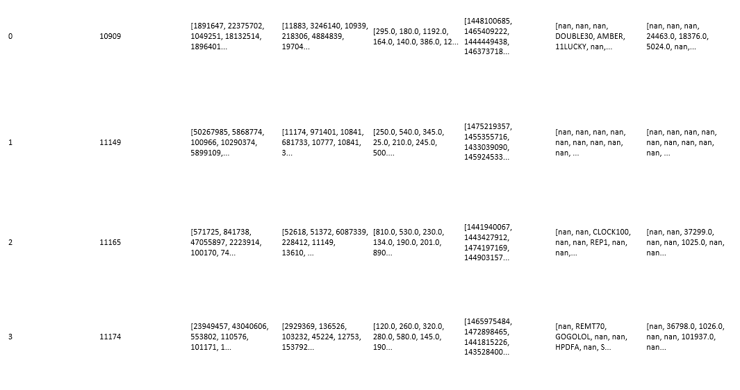
Expanded train data:
userid | Orderid | Shopid | total_price | order_time | voucher_code_used | promotionid_used

Slide 6
2 Feature engineering
Count or ratio features
Shop diversity
Day counts
Over all order number
Aggregation features
Max repeating order from same shop
Spent trend feature across time span
Recent activity features
Last order time-now
The time difference from last order and promotion sent time
Age and gender related features
Age value and divided age ranges

Slide 7
1 Shop diversity
2 Day counts
3 Over all order number
4 Promotion used number
5 Max repeating order from same shop
6 spent trend feature across time span(middle time point split)
7 Last order time - today
8 The time difference from last order and promotion sent time
9 Age
10 gender
11 email verified
12 registered year
13 is seller

Slide 8
3 Model training
Single classification models:
Logistic Regression
Random Forest
Gradient boosting
Ensemble techniques

Slide 9
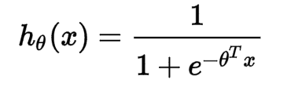
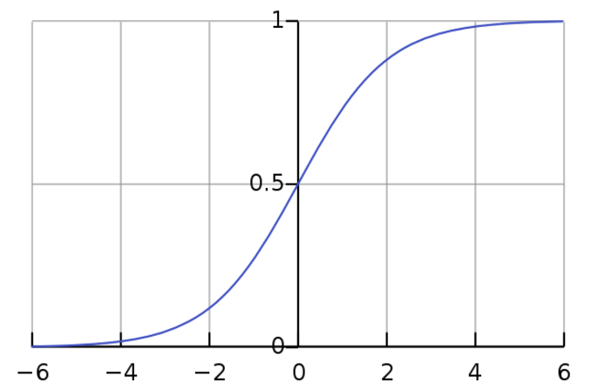
Logistic Regression:
N_jobs: 4 (parallel)

Slide 10
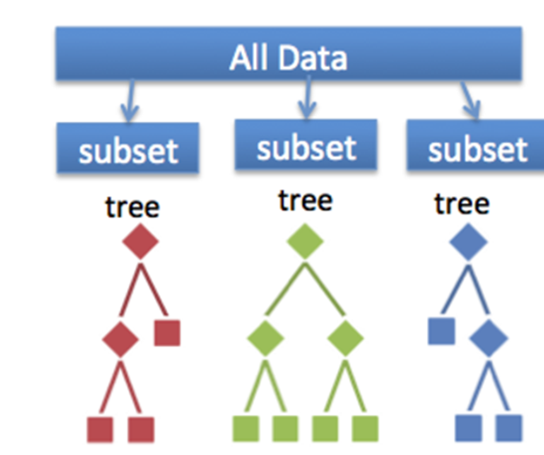
Random Forests:
Sample drawn with replacement randomly (bootstrap) from train set and features are chosen from small subset of variables at random as well
find a variable (and a value for that variable ) which optimizes the split

Slide 11
n_estimators: 20 (computing time, correlation)
Max_features: 3 (↓variance ↓ bias ↑, sqrt())
Max_depth: 7
Min_samples_split: 25 (full developing)
N_jobs: 4 (parallel)

Slide 12
Gradient Boosting
An ensemble of weak prediction models. It builds the model in a stage-wise fashion, optimization of an arbitrary differentiable loss function.

Slide 13
Voting Classifier
Averaging methods:
build several estimators independently → average their predictions (variance↓). eg. Bagging method, forests of randomized trees, …
Boosting methods:
base estimators sequentially → combine weak models (bias ↓). eg. Gradient Tree Boosting, …
Soft voting

Slide 14
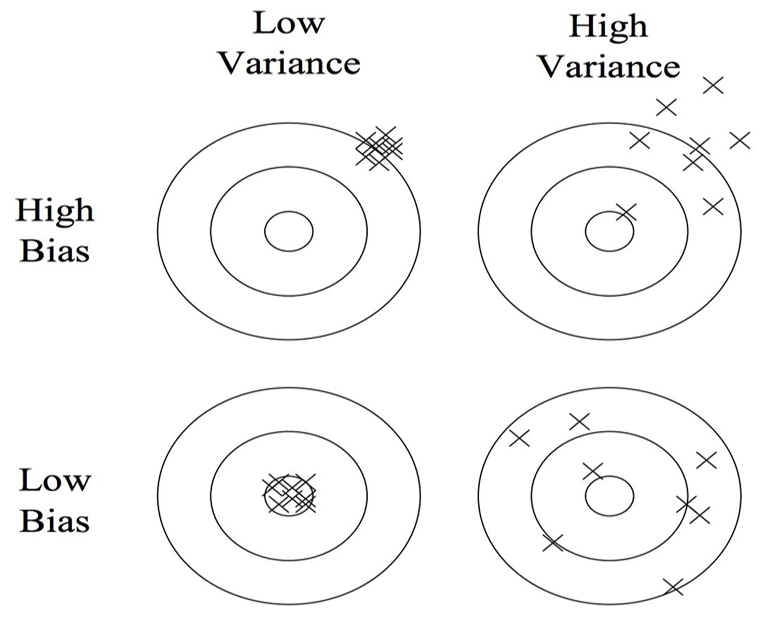

Slide 15
4 Performance study
Accuracy of train dataset based on different models
Repurchase? Label:
 | Logistic Regression | Random Forest | Gradient boostig | Ensemble
Accuracy | 83.646% | 86.153% | 86.204% | 86.270%
Cross-validation | 83.637% | 85.867% | 86.021% | 86.058%
Importance of features based on different models

Slide 16
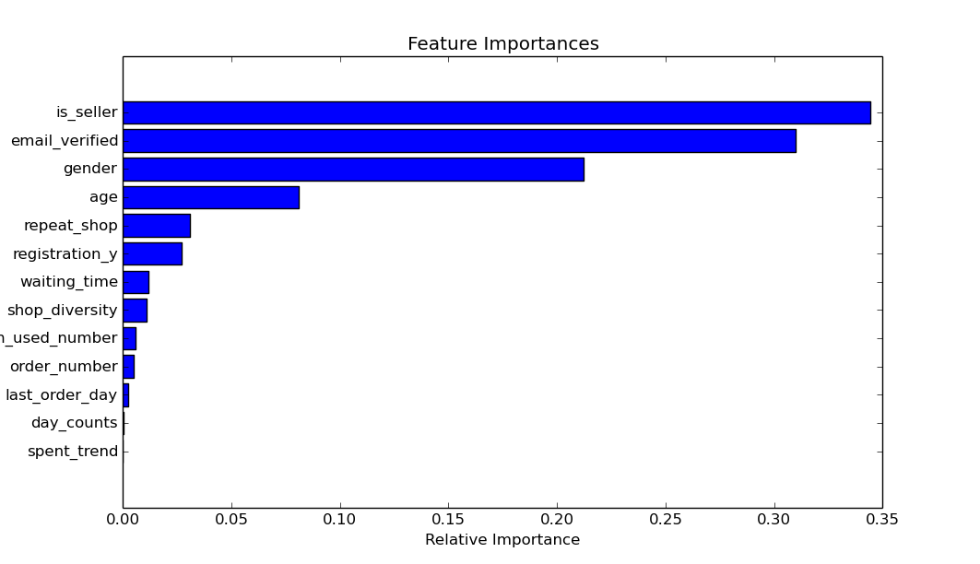
Accuracy: 83%
10 fold cross validation: 83%
Logistic Regression

Slide 17
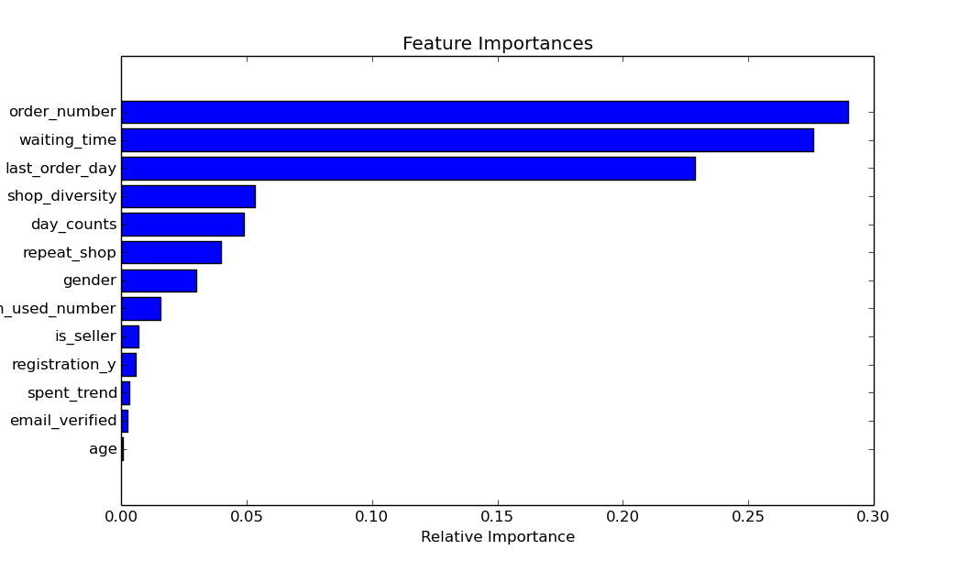
Accuracy: 86.1%
10 fold cross validation: 85.8%
Random Forest

Slide 18
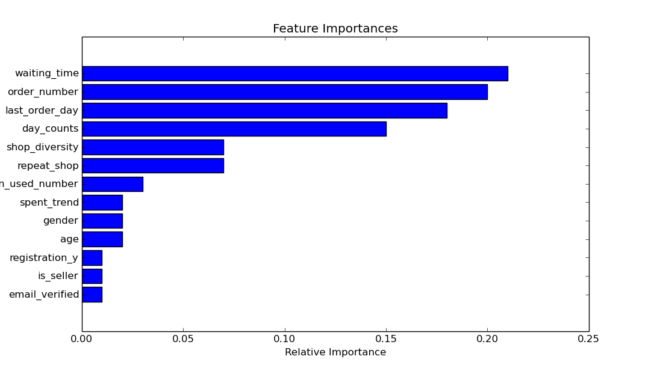
Accuracy: 86.2%
10 fold cross validation: 85.9%
Gradient boosting

Slide 19
Imbalanced data
used? Label: >96%
Used?
0 72891
2738
Repurchase?
1 62107
0 13522
Downsamping

Slide 20
Prediction after downsampling data
Repurchase?
 | Logistic Regression | Random Forest | Gradient Boosting | Ensemble
accuracy | 74.48% | 75.97% | 73.19% | 76.36%
AUROC | 79.16% | 88.47% | 88.38% | 88.53%
Cross-validation | 83.63% | 85.77% | 85.97% | 86.02%
used?
 | Logistic Regression | Random Forest | Gradient Boosting | Ensemble
accuracy | 83.04% | 88.47% | 86.58% | 87.69%
AUROC | 80.74% | 84.35% | 83.73% | 85.72%
Cross-validation | 96.34% | 96.39% | 96.49% | 96.43%

Slide 21
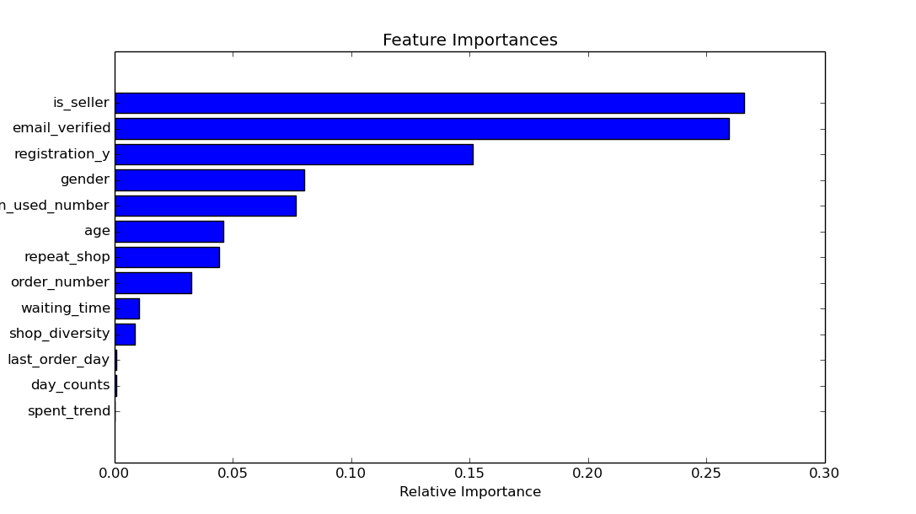
Used? logistics regression

Slide 22
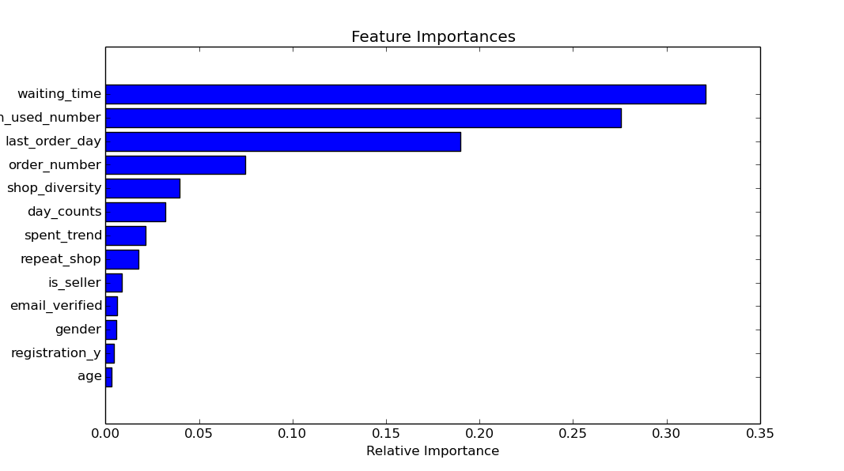
Used? random forest regression

Slide 23
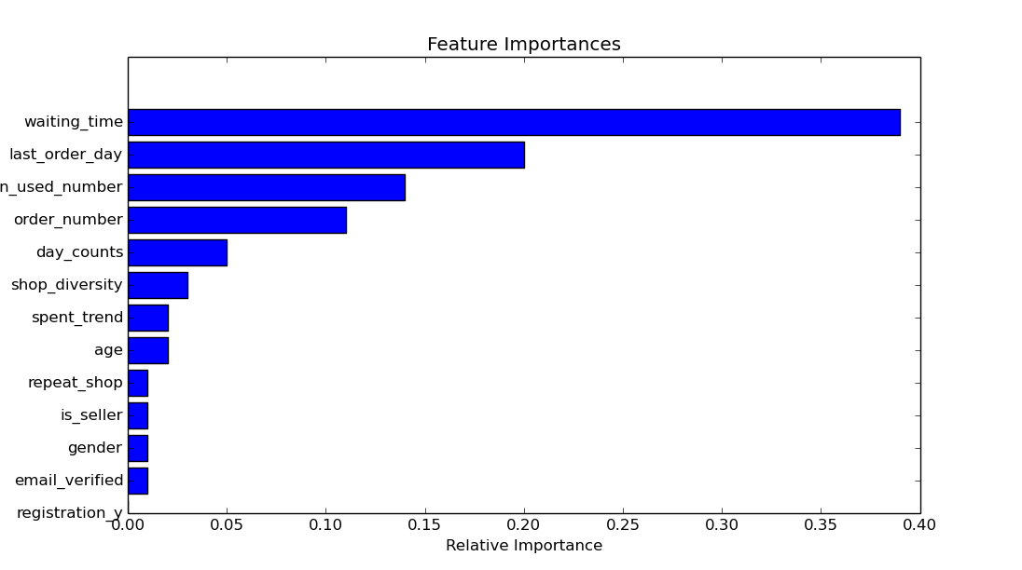
Used? gradient boosting regression

Slide 24
5 Conclusion and future work
Summary:
Features analysed and created in e-commerce data
Different kind of Models trained with features
Performance study illustrated and test data predicted

Slide 25
5 Conclusion and future work
Future work:
1 Expand features:
similarity scores, trends, PCA, LDA features, monthly features, trend features
2 Tune model parameters
e.g. Grid search
3 Explore other models
e.g. XGBoost model
4 Adjust imbalanced data
5 Convert consecutive numbers in to bins
Wrapper method

